Slide 1
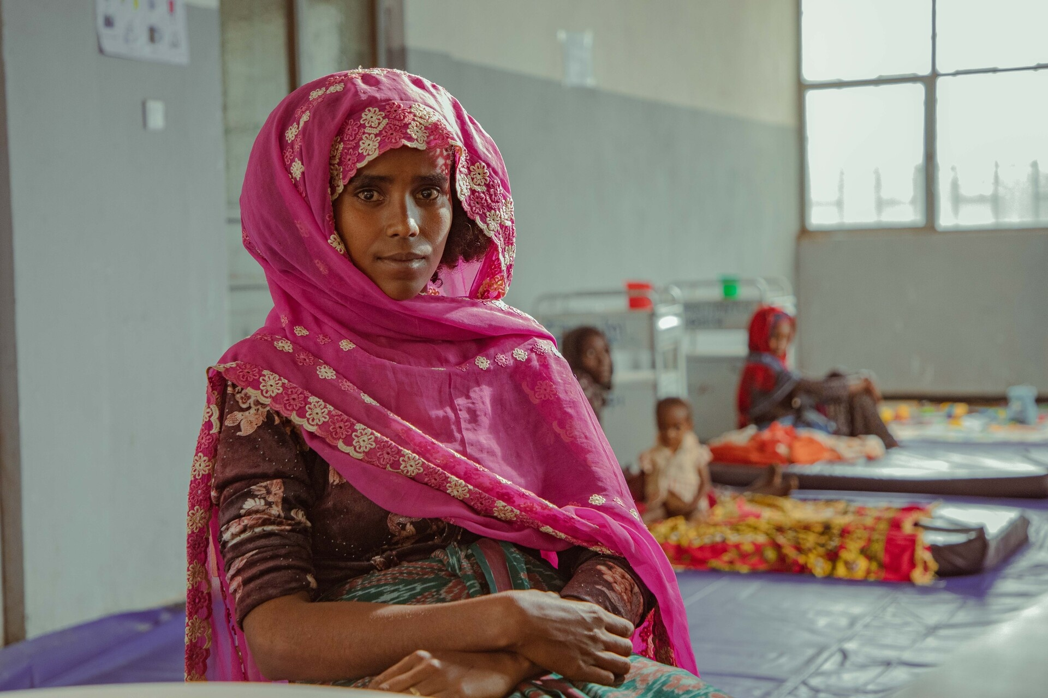
Polio Transition Progress
Monitoring & Evaluation Update
Quarter-3, 2024

Slide 2

Polio Transition Strategy
Global Vision
A world in which Polio Investments are sustained and used to bring strong. Resilient and equitable health systems
Impact Goals
Strategic Outcomes
Milestones
All countries remain Polio free
All people reached and immunized with Polio and other vaccines
Intermediate transition
Poliovirus and other diseases rapidly detected and reported
Governance
All countries minimize the burden and eliminate VPDs
Polio and other disease outbreaks prepared for and responded to
Performance
All countries rapidly detect and control disease outbreaks
Poliovirus materials safely and securely contained
Finance

Slide 3
Updated List of Countries
Previous list of Priority Countries (20)
New List of Priority Countries (21)
Watch List Countries
AFR (7 Countries)
Angola
Cameroon
Chad
DR Congo
Ethiopia
Nigeria
South Sudan
EMR (8 Countries)
Afghanistan
Iraq
Libya
Pakistan
Somalia
Sudan
Syria
Yemen
SEAR (5 Countries)
Bangladesh
India
Indonesia
Myanmar
Nepal
AFR (14 Countries)
Angola
Burkina Faso
Cameroon
Central African Rep
Chad
DR Congo
Ethiopia
Guinea
Madagascar
Mali
Mozambique
Niger
Nigeria
South Sudan
EMR (6 Countries)
Afghanistan
Pakistan
Somalia
Sudan
Syria
Yemen
SEAR (1 country)
Myanmar
EMR (2 Countries)
Iraq
Libya
SEAR (4 Countries)
Bangladesh
India
Indonesia
Nepal
AFR (1 country)
Kenya

Slide 4
Data Sources and Limitations
Two Distinct Sets of Indicators
Strategic Outcomes
Baseline data collected covers the following years:
Immunization indicators (SO 1.1 - 1.3): year 2023, Jan – Dec 2023
Surveillance indicators – Acute Flaccid Paralysis, environmental surveillance for Polio and Measles / Rubella surveillance (SO 2.1 - 2.4): year 2024 (Quarter 3), 12 months rolling: Oct 2023 – Sept 2024
Surveillance indicators – IHR capacity (SO 2.5): year 2023, Jan – Dec 2023
Health emergency – polio outbreak indicators (SO 3.1 - 3.3): years 2021-2024 (Quarter 3), Jan 2021 – Sept 2024
Health emergency – measles outbreak and IHR indicators (SO 3.4 – 3.5): year 2023, Jan – Dec 2023
Containment indicator (SO 4.1): year 2024 (Quarter 3), Jan – Sept 2024
Biomedical facilities with Poliovirus Infectious Material Indicator4.2): year 2023
Milestone Indicators (M1 – M4): year 2023
Milestone indicator – external health expenditure (M4.2): 2021 or latest available year.
Indicators integrated with existing monitoring frameworks and reporting systems
Such as GPEI 2022-2026 strategy KPIs, Immunization Agenda 2030 scorecard and e-SPAR
Milestones
Data Limitations
Collected at the country level using a dedicated web tool and validated at the regional level
The overall data availability stood at 85%, with 267 of the 315 required data points available across the 21 Polio transition countries.
Most recent available data used due to lags in reporting
Extracted data not further scrutinized for quality checks
Proxy indicators used to assess broader health systems performance
For milestones, self reported data is used

Slide 5
Polio transition Goals
Goal 1: All countries remain Polio free
Goal 2: Minimize the burden of and eliminate vaccine-preventable diseases (VPDs)
Goal 3: Rapidly detect and control disease outbreaks
  Pakistan and Afghanistan remain endemic
  Among 26 countries that reported cVDPV outbreaks, 11 are Polio Transition priority countries
  20 priority countries (out of 21) reported less than 90% IPV1 coverage
  17 priority countries (out of 21) reported less than 90% coverage of DTP3
  6 countries (out of 21) report IHR capacity score related to health emergency management lower than regional averages

Slide 6
Strategic Outcome 1
National Immunization Programmes
Systematically reach and immunize everyone with polio and other vaccines
1.1
National coverage of IPV1 provided through routine service
1.2
National coverage of DPT3 provided through routine services
1.3
Percentage of districts with DPT3 coverage greater than or equal to 80%

Slide 7
Strategic Outcome 1 – 2023
In African region, the highest number of countries (8) are Off Track for IPV coverage
EMR has the highest proportion of countries Off Track across the SO1 indicators, with 4 out of 6 countries off track for both IPV and DTP3 coverage
Myanmar is not on track for any indicator
Only Burkina Faso reported more than 90% IPV1 coverage
Four countries reported more than 90% coverage of DTP3
Nine countries reported equal to or more than 80% districts with DTP3 coverage ≥ 80%
AFR
EMR
SEAR
AFR + EMR+SEAR
Number of Countries On Track
SO 1.1
National coverage of IPV1 provided through routine service
Number of Countries At Risk
SO 1.2
National coverage of DPT3 provided through routine services
Number of Countries Off Track
SO 1.3
Percentage of districts with DTP3 coverage greater than or equal to 80%

Slide 8
Strategic Outcome 1: Status by Countries - 2023
SO – 1.1
9/21 countries are not on track for any indicator (they are either At Risk or Off Track)
2 out of these 9 countries are Off Track for all indicators
National coverage of IPV1 provided through routine service
Countries At risk/Off Track for any Indicator
SO – 1.2
Countries Off Track for All Indicators
AFR | Nigeria
AFR | Cameroon
AFR | Mali
AFR | Ethiopia
EMR | Afghanistan
EMR | Syria
SEAR | Myanmar
National coverage of DPT3 provided through routine services
AFR | Angola
EMR | Yemen
SO – 1.3
Percentage of districts with DTP3 coverage greater than or equal to 80%
AFRO
EMRO
SEAR

Slide 9
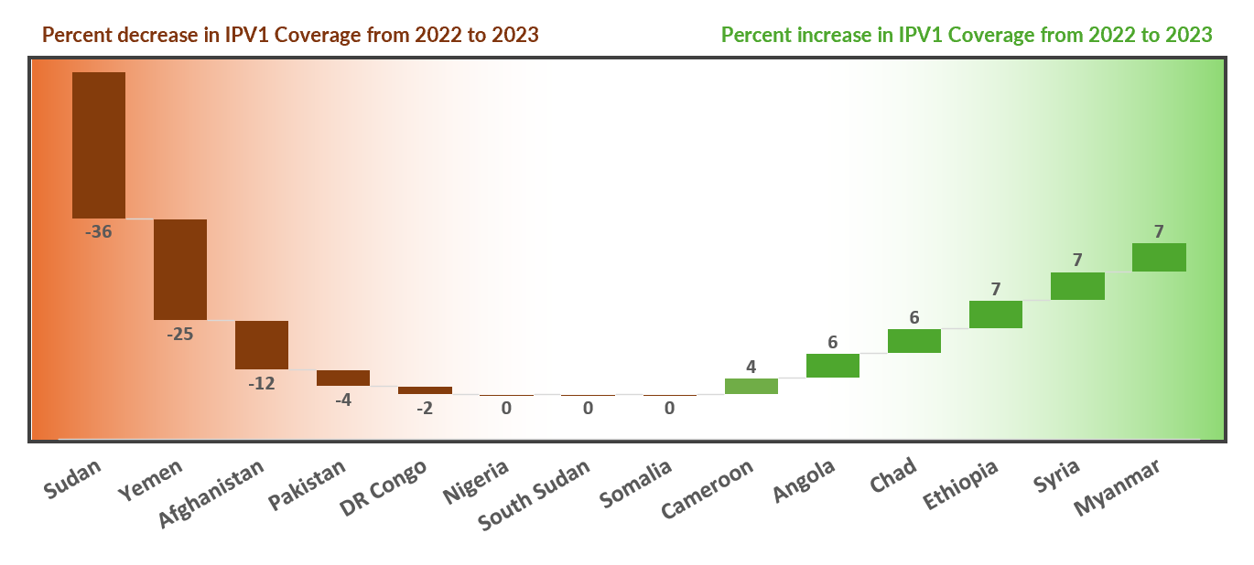
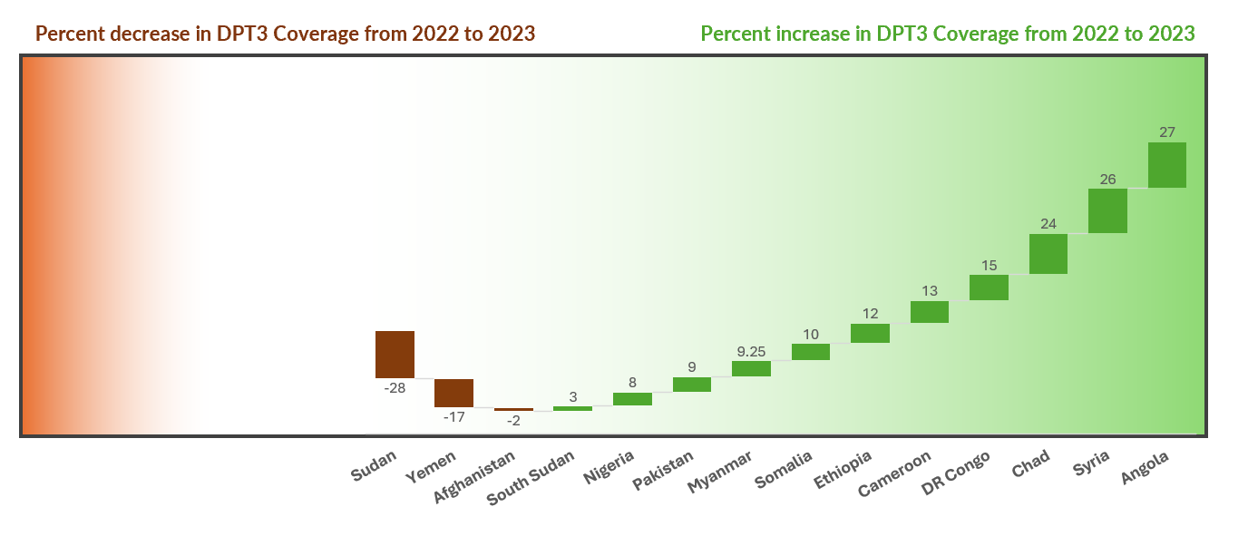
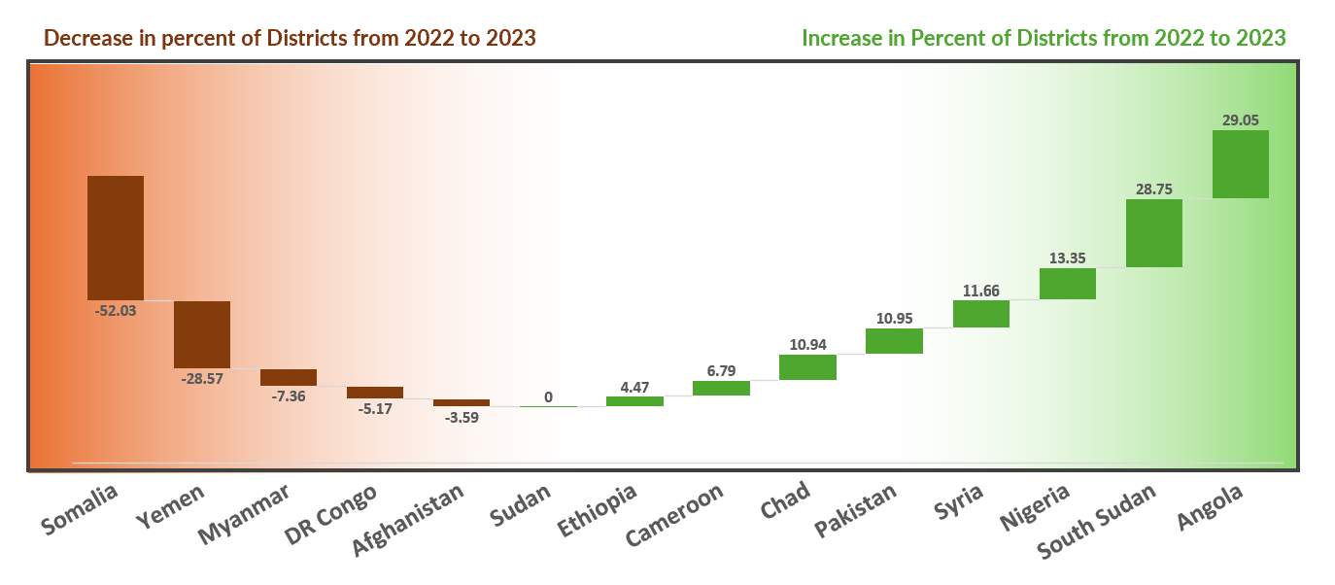
SO1: 2022 to 2023 Change (Country Level Analysis)
SO 1.1
SO 1.2
Overall DTP3% coverage is increasing compared to IPV% coverage in countries
Sudan, Yemen and Afghanistan had a decline in immunization coverage compared to 2022
DR Congo and Myanmar – National DTP3 coverage is increasing, while % districts with DTP3 coverage benchmark is decreasing
SO 1.3

Slide 10
Strategic Outcome 2
National Surveillance Systems
rapidly detect and report poliovirus and other diseases
2.1
Percentage of districts with rate of non-polio AFP detected annually ≥ 2 per 100 000 population aged less than 15 years.
2.2
Percentage of reporting AFP cases and ES sample final results within 35 days of onset of AFP cases or ES sample
2.3
Percentage of active ES sites meeting sensitivity threshold of at least 50% samples positive for enterovirus
2.4
Rate of discarded non-measles non-rubella cases annually per 100,000 population (provisional data)
2.5
Country average IHR capacity score related to laboratory compared to regional average

Slide 11
Strategic Outcome 2: Status by Regions – Quarter 3 2024
AFR has the highest proportion of countries Off Track and At Risk for SO 2 Indicators
All six EMR countries are Off Track for IHR capacity score lower than regional averages
71% (15/21) countries achieved benchmark for AFP detection rate
42% (9/21) countries reported on track for timeliness of reporting.
19% (4/21) countries on track for sensitivity
28% (6/21) countries on track for IHR capacity score lower than regional averages
AFR
EMR
SEAR
AFR + EMR+SEAR
Number of Countries On Track
SO 2.1
Percentage of districts with rate of non-polio AFP detected annually ≥ 2 per 100 000 population aged less than 15 years.
Number of Countries At Risk
SO 2.2
Percentage of reporting AFP cases and ES sample final results within 35 days of onset of AFP cases or ES sample
Number of Countries Off Track
SO 2.3
Percentage of active ES sites meeting sensitivity threshold of at least 50% samples positive for enterovirus
SO 2.4
Rate of discarded non-measles non-rubella cases annually per 100,000 population (provisional data)
SO 2.5
Country average IHR capacity score related to laboratory compared to regional average
(n = number of countries)

Slide 12
Strategic Outcome 2: Status by Countries – Quarter 3 2024
SO – 2.1
Percentage of districts with rate of non-polio AFP detected annually ≥ 2 per 100 000 population aged less than 15 years.
SO – 2.2
Percentage of reporting AFP cases and ES sample final results within 35 days of onset of AFP cases or ES sample
SO – 2.3
Percentage of active ES sites meeting sensitivity threshold of at least 50% samples positive for enterovirus
AFR
EMR
SEAR

Slide 13
Strategic Outcome 2: Status by Countries – Q3 2024
SO – 2.4
Rate of discarded non-measles non-rubella cases annually per 100,000 population (provisional data)
SO – 2.5
Country average IHR capacity score related to laboratory compared to regional average
SEAR
EMR
Regional Average = 57
Regional Average = 72
AFR
5/21 countries are not on track for four or more indicators
Sudan is Off Track for all indicators
Countries Off Track for All Indicators
Countries Not On Track for 4 or more indicators
EMR | Sudan
AFR | Angola
AFR | South Sudan
AFR | Mali
AFR | Mozambique
SEAR | Myanmar

Slide 14
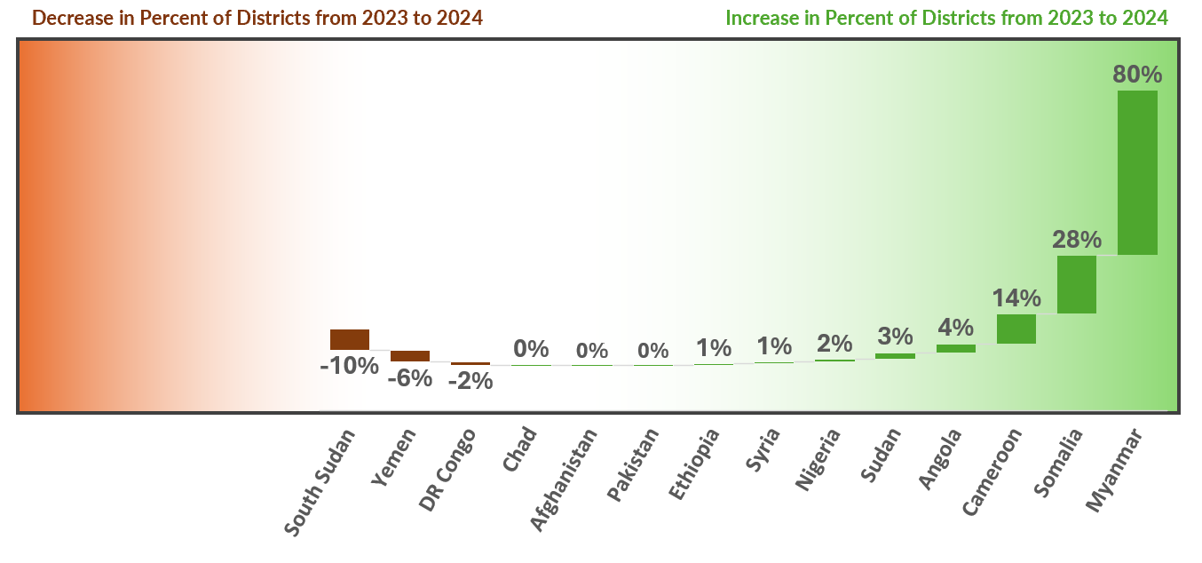
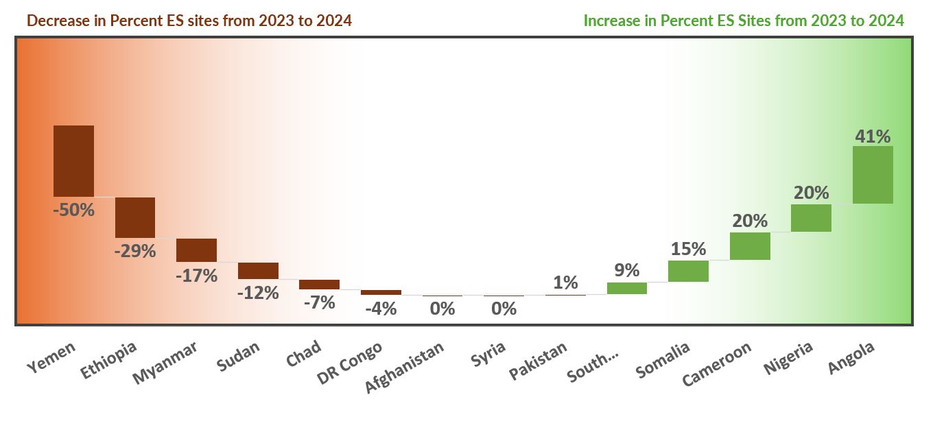
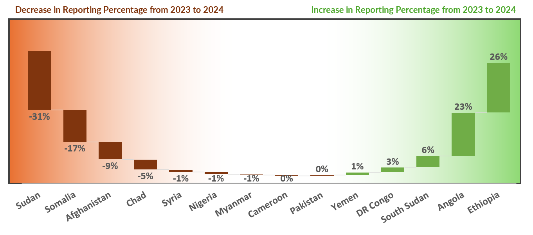
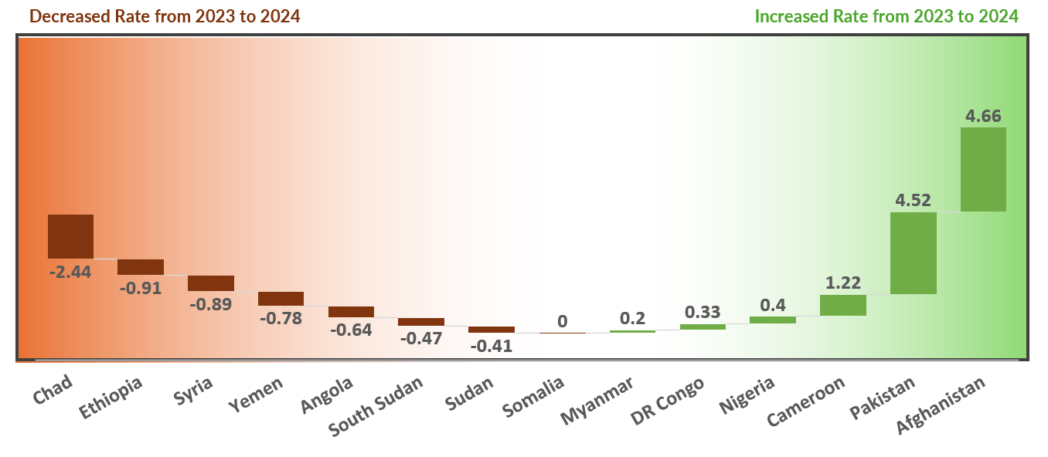
SO2: 2023 to 2024 Change (Country Level Analysis)
SO 2.1
SO 2.3
% of districts with rate of non-polio AFP detected annually ≥ 2 per 100 000 population aged less than 15 years.
% of active ES sites meeting sensitivity threshold of at least 50% samples positive for enterovirus
SO 2.2
SO 2.4
% of reporting AFP cases and ES sample final results within 35 days of onset of AFP cases or ES sample
Rate of discarded non-measles non-rubella cases annually per 100,000 population (provisional data)

Slide 15
Strategic Outcome 3
National Health Emergency Systems
Prepare for and respond to polio and other disease outbreaks
3.1
Percentage of polio (WPV and cVDPV) outbreaks stopped within 120 days of outbreak confirmation
3.2
Percentage of the first large-scale campaign (R1) implemented within 28 days of outbreak confirmation
3.3
Percentage of polio (WPV and cVDPV) of outbreak response SIAs delayed or cancelled due to ruptures of vaccine supply
3.4
Percentage of Measles outbreaks with timely detection and response - provisional data
3.5
Country average IHR capacity score related to Health Emergency management

Slide 16
Strategic Outcome 3: Status by Regions (2021 – Q3 2024)
All six EMR countries On Track for SO 3.1 but majority are Off Track or At Risk for remaining SO3 indicators
75% (12/16 among reported) countries are on track for timely outbreak control
29% (5/17 among reported) countries reported on track for timely implementation of first large campaign
65% (13/20 among reported) countries off track for SIAs delayed or cancelled due to ruptures of vaccine supply
2 countries are off track on timely detection and response of measles outbreak
28% (6/21) countries are on track for IHR capacity score
AFR
EMR
SEAR
AFR+EMR+SEAR
SO 3.1
Percentage of polio (WPV and cVDPV) outbreaks stopped within 120 days of outbreak confirmation
Number of Countries On Track
SO 3.2
Percentage of the first large-scale campaign (R1) implemented within 28 days of outbreak confirmation
Number of Countries At Risk
Number of Countries Off Track
SO 3.3
Percentage of polio (WPV and cVDPV) of outbreak response SIAs delayed or cancelled due to ruptures of vaccine supply
SO 3.4
Percentage of Measles outbreaks with timely detection and response - provisional data
n = number of countries)
SO 3.5
Country average IHR capacity score related to Health Emergency management

Slide 17
Strategic Outcome 3: Status by Countries
SO – 3.1
Percentage of polio (WPV and cVDPV) outbreaks stopped within 120 days of outbreak confirmation
SO – 3.2
Percentage of the first large-scale campaign (R1) implemented within 28 days of outbreak confirmation
SO – 3.3
Percentage of polio (WPV and cVDPV) of outbreak response SIAs delayed or cancelled due to ruptures of vaccine supply
AFR
EMR
SEAR

Slide 18
Strategic Outcome 3: Status by Countries
SO – 3.4
Percentage of Measles outbreaks with timely detection and response - provisional data
SO – 3.5
Country average IHR capacity score related to Health Emergency management
Regional Average = 57
EMR
SEAR
AFR
Regional Average = 71
Nigeria is on track for all indicators in this Strategic Outcome
Madagascar is not on track for any indicators

Slide 19
Strategic Outcome 4
Poliovirus Infectious Materials
Are either destroyed or safely and securely contained in line with the established bio-risk management standard
4.1
Percentage of nOPV2 vials that are received by the country and are opened, used during SIAs, and unusable vials that are subsequently destroyed
4.2
Number of biomedical facilities retaining poliovirus infectious material (PV IM)

Slide 20
Seven countries this indicator is applicable to are On track
Strategic Outcome 4 – Current Situation
SO 4.2
Number of biomedical facilities retaining poliovirus infectious material (PV IM)
SO 4.1
Percentage of nOPV2 vials that are received by the country and are opened, used during SIAs, and unusable vials that are subsequently destroyed
Countries with Number of medical facilities retaining long term polio virus:
EMR | Pakistan | 1
AFR
EMR
SEAR

Slide 21
Regional Summary – African region
7 countries from the African region have been included in the Polio Transition Priority countries
Improved performance – On track for most indicators
Nigeria: Improved performance in surveillance and outbreak preparedness and response. Improvement in immunization performance compared to last year, yet remains off track
Cameroon – Overall improvement from last year - high performance except for immunization (remains off track)
Burkina Faso
Central African Rep
Guinea
Madagascar
Mali
Mozambique
Niger
Low Performance in several indicators
Burkina Faso and Mozambique – Weak surveillance
Ethiopia – Immunization and surveillance with low coverages
Guinea and Madagascar – Strong surveillance, but weak performance in immunization and outbreak control and response
Niger – Weak performance in surveillance and outbreak control

Slide 22
Regional Summary
AFRO
EMRO
SEARO
Low Performance in all SOs
Angola and Chad – poor performance and remain off track overall – Though improvement from last year.
Mali remains off track overall except for one indicator.
South Sudan – overall poor performance across all indicators except two.
DR Congo – overall a mix of decline and slight improvement compared to last year – remains off track for 85% of performance indicators
Central African Rep – Low performance in immunization and outbreak preparedness and response and 60% of surveillance indicators
Somalia and Sudan – Poor performance across indicators
Pakistan – Overall on track especially Strong surveillance
Afghanistan – Poor immunization – On track surveillance except for decline in surveillance timeliness indicator
Yemen – Decline in immunization and surveillance performance compared to last year – Poor performance
Syria – Strong surveillance – immunization performance improved compared to last year but remains at risk.
Myanmar – Not on track for any immunization indicators
Off track for all surveillance indicators except timeliness of reporting

Slide 23
Watchlist Countries

Slide 24
Strategic Outcome 1
National Immunization Programmes
Systematically reach and immunize everyone with polio and other vaccines
1.1
National coverage of IPV1 provided through routine service
1.2
National coverage of DPT3 provided through routine services
1.3
Percentage of districts with DPT3 coverage greater than or equal to 80%

Slide 25
Strategic Outcome 1 – Current Situation
43% (3/7) countries reported more than 90% IPV1 coverage
71% (5/7) countries reported more than 90% coverage of DTP3
43% (3/7) of the countries reported equal to or more than 80% districts with DTP3 coverage
AFR
EMR
SEAR
OVERALL
SO 1.1
National coverage of IPV1 provided through routine service
SO 1.2
National coverage of DPT3 provided through routine services
SO 1.3
Percentage of districts with DTP3 coverage greater than or equal to 80%
Number of Countries On Track
Number of Countries At Risk
Number of Countries Off Track

Slide 26
Strategic Outcome 1: Status by Countries
SO – 1.1
National coverage of IPV1 provided through routine service
Indonesia is at risk on all three indicators
SO – 1.2
National coverage of DPT3 provided through routine services
SO – 1.3
Percentage of districts with DTP3 coverage greater than or equal to 80%
AFR
EMR
SEAR

Slide 27
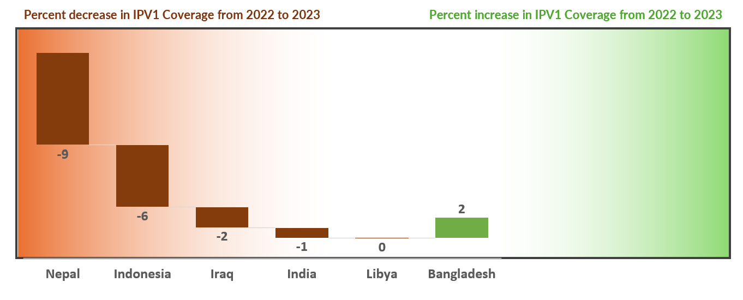
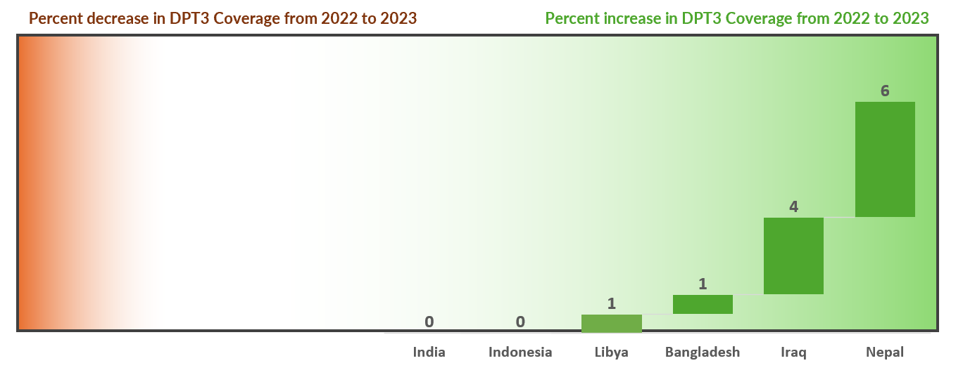
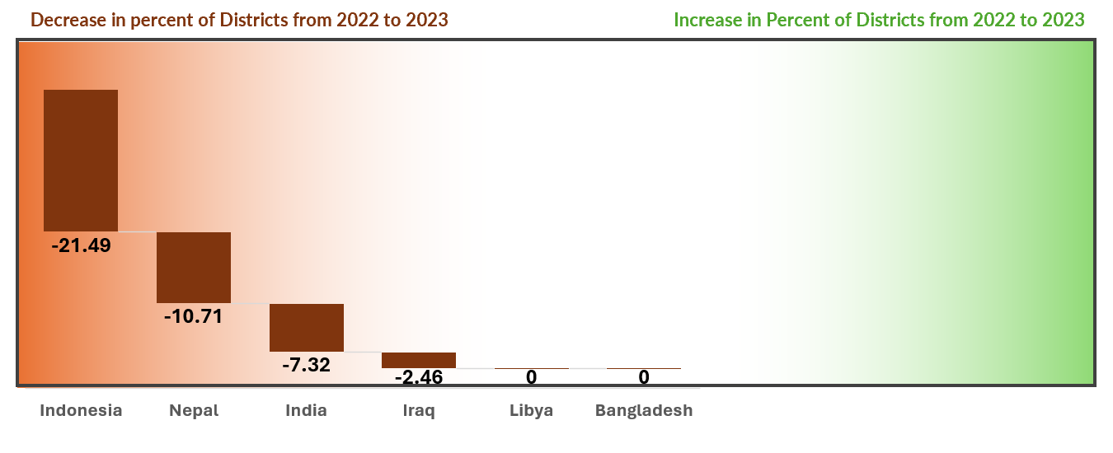
SO1: 2022 to 2023 Change (Country Level Analysis)
SO 1.1
SO 1.2
Overall DTP3 % coverage is increasing compared to IPV% coverage in countries
Nepal, Indonesia, Iraq and India have declining IPV coverage compared to last year
SO 1.3

Slide 28
Strategic Outcome 2
National Surveillance Systems
rapidly detect and report poliovirus and other diseases
2.1
Percentage of districts with rate of non-polio AFP detected annually ≥ 2 per 100 000 population aged less than 15 years.
2.2
Percentage of reporting AFP cases and ES sample final results within 35 days of onset of AFP cases or ES sample
2.3
Percentage of active ES sites meeting sensitivity threshold of at least 50% samples positive for enterovirus
2.4
Rate of discarded non-measles non-rubella cases annually per 100,000 population (provisional data)
2.5
Country average IHR capacity score related to laboratory compared to regional average

Slide 29
Strategic Outcome 2: Status by Regions
Both EMR countries Off Track for IHR capacity score
28% (2/7) countries achieved benchmark for AFP detection rate
14% (1/7) countries reported on track for timeliness of reporting.
57% (4/6 among reported) countries on track for sensitivity
100% (7/7) countries on track rate of discarded non-measles non-rubella cases indicator
42% (3/7) countries on track for IHR capacity score for laboratories
AFR
EMR
SEAR
OVERALL
SO 2.1
Percentage of districts with rate of non-polio AFP detected annually ≥ 2 per 100 000 population aged less than 15 years.
Number of Countries On Track
SO 2.2
Percentage of reporting AFP cases and ES sample final results within 35 days of onset of AFP cases or ES sample
Number of Countries At Risk
SO 2.3
Percentage of active ES sites meeting sensitivity threshold of at least 50% samples positive for enterovirus
Number of Countries Off Track
SO 2.4
Rate of discarded non-measles non-rubella cases annually per 100,000 population (provisional data)
SO 2.5
Country average IHR capacity score related to laboratory compared to regional average
n = number of countries)

Slide 30
Strategic Outcome 2: Status by Countries
SO – 2.1
SO – 2.4
Percentage of districts with rate of non-polio AFP detected annually ≥ 2 per 100 000 population aged less than 15 years.
Rate of discarded non-measles non-rubella cases annually per 100,000 population (provisional data)
SO – 2.2
SO – 2.5
Percentage of reporting AFP cases and ES sample final results within 35 days of onset of AFP cases or ES sample
Country average IHR capacity score related to laboratory compared to regional average
AFR
EMR
SEAR
SO – 2.3
Percentage of active ES sites meeting sensitivity threshold of at least 50% samples positive for enterovirus
AFR
EMR
SEAR

Slide 31
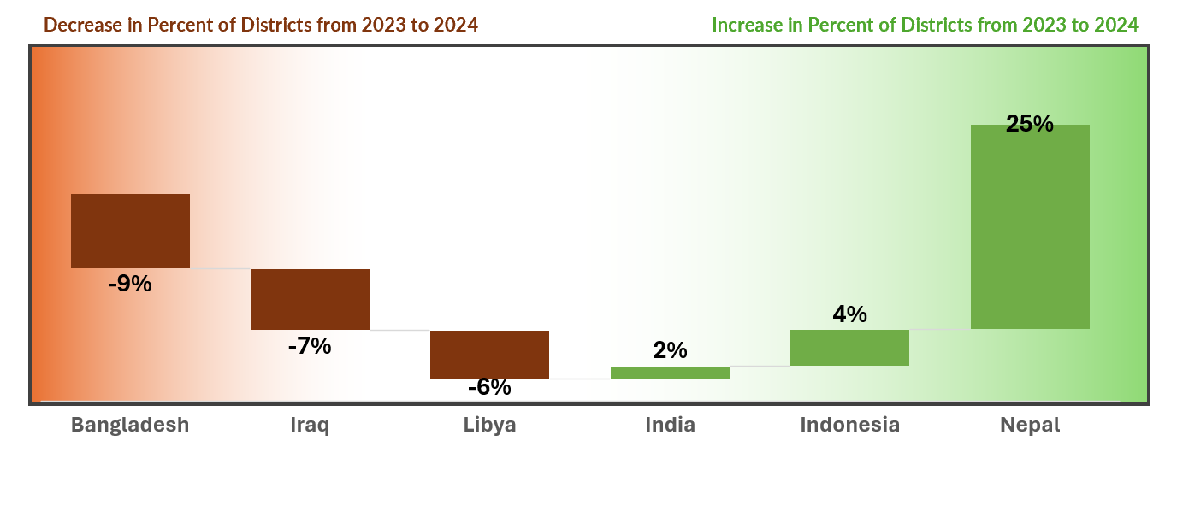
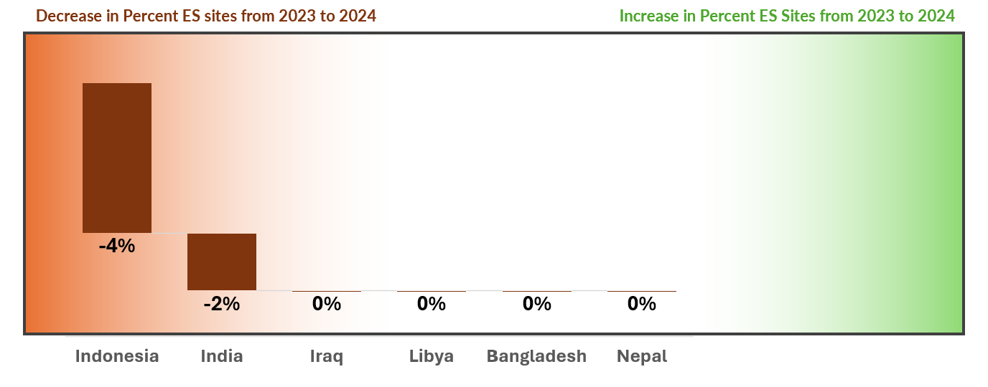
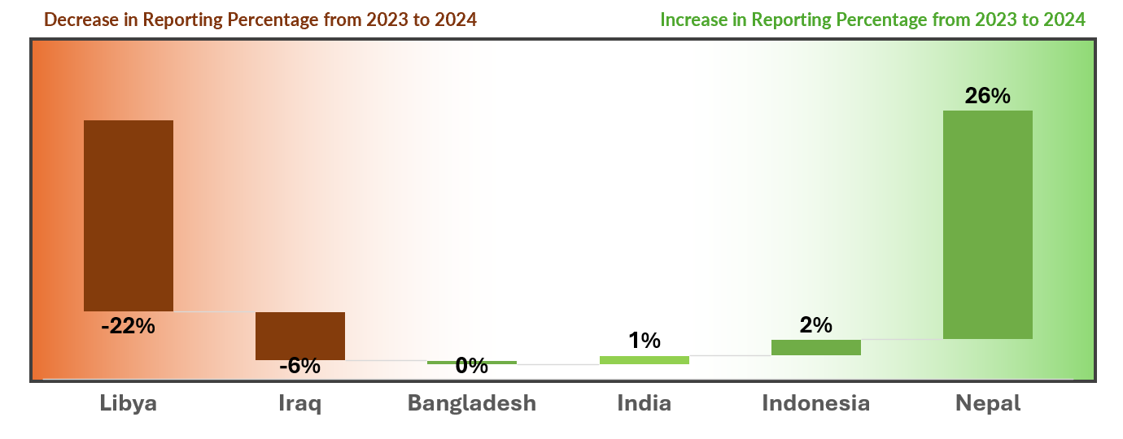
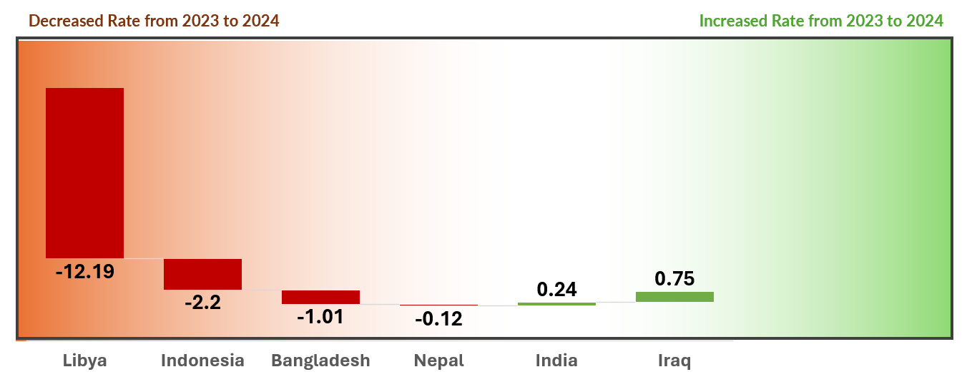
SO2: 2023 to 2024 Change (Country Level Analysis)
SO 2.1
SO 2.3
% of active ES sites meeting sensitivity threshold of at least 50% samples positive for enterovirus
% of districts with rate of non-polio AFP detected annually ≥ 2 per 100 000 population aged less than 15 years.
SO 2.2
SO 2.4
% of reporting AFP cases and ES sample final results within 35 days of onset of AFP cases or ES sample
Rate of discarded non-measles non-rubella cases annually per 100,000 population (provisional data)
Myanmar shows 17% decrease in sensitivity from last year.
Libya is showing decline in performance in three indicators compared to last year.

Slide 32
Strategic Outcome 3
National Health Emergency Systems
Prepare for and respond to polio and other disease outbreaks
3.1
Percentage of polio (WPV and cVDPV) outbreaks stopped within 120 days of outbreak confirmation
3.2
Percentage of the first large-scale campaign (R1) implemented within 28 days of outbreak confirmation
3.3
Percentage of polio (WPV and cVDPV) of outbreak response SIAs delayed or cancelled due to ruptures of vaccine supply
3.4
Percentage of Measles outbreaks with timely detection and response - provisional data
3.5
Country average IHR capacity score related to Health Emergency management

Slide 33
Strategic Outcome 3: Status by Regions
100% (8/8) countries remained on track for timely outbreak control
Kenya is off track for SIAs delayed or cancelled due to ruptures of vaccine supply
Nepal is off track on timely detection and response of measles outbreak
37% (3/8) – On track for IHR capacity score
AFR
EMR
SEAR
OVERALL
SO 3.1
Percentage of polio (WPV and cVDPV) outbreaks stopped within 120 days of outbreak confirmation
Number of Countries On Track
SO 3.2
Percentage of the first large-scale campaign (R1) implemented within 28 days of outbreak confirmation
Number of Countries At Risk
SO 3.3
Percentage of polio (WPV and cVDPV) of outbreak response SIAs delayed or cancelled due to ruptures of vaccine supply
Number of Countries Off Track
SO 3.4
Percentage of Measles outbreaks with timely detection and response - provisional data
SO 3.5
Country average IHR capacity score related to Health Emergency management
n = number of countries)

Slide 34
Strategic Outcome 3: Status by Countries
SO – 3.1
SO – 3.4
Percentage of polio (WPV and cVDPV) outbreaks stopped within 120 days of outbreak confirmation
Percentage of Measles outbreaks with timely detection and response - provisional data
SO – 3.2
SO – 3.5
Country average IHR capacity score related to Health Emergency management
Percentage of the first large-scale campaign (R1) implemented within 28 days of outbreak confirmation
SO – 3.3
Regional Average = 57
Regional Average = 71
Percentage of polio (WPV and cVDPV) of outbreak response SIAs delayed or cancelled due to ruptures of vaccine supply
AFR
EMR
SEAR
AFR
EMR
SEAR

Slide 35
Strategic Outcome 4
Poliovirus Infectious Materials
Are either destroyed or safely and securely contained in line with the established bio-risk management standard
4.1
Percentage of nOPV2 vials that are received by the country and are opened, used during SIAs, and unusable vials that are subsequently destroyed
4.2
Number of biomedical facilities retaining poliovirus infectious material (PV IM)

Slide 36
Strategic Outcome 4 – Current Situation
Indonesia is off track on this indicator
SO 4.2
Number of biomedical facilities retaining poliovirus infectious material (PV IM)
Countries with Number of medical facilities retaining long term polio virus:
SEAR | Indonesia | 3
SEAR | India | 2
AFR
EMR
SEAR
Percentage of nOPV2 vials that are received by the country and are opened, used during SIAs, and unusable vials that are subsequently destroyed
Number of Countries On Track
SO 4.1
Number of Countries At Risk
Number of Countries Off Track

Slide 37
Regional Summary – Watchlist Countries
AFRO
SEARO
Kenya is showing weak performance in surveillance and Outbreak indicators.
Four countries from the South-east Asia region moved to watchlist category
Bangladesh and India showing high performance– Not Off track for any indicator
Indonesia has sub-optimal performance all immunization and surveillance.
Nepal is at risk in several performance indicators. Special focus on immunization and Surveillance is required.
EMRO
Libya shows sub-optimal immunization performance, and a significant decrease in the surveillance performance indicators compared to the last year and remains in the risk zone.
Overall Iraq is performing well; however, a slight decline is observed in half of surveillance performance indicators compared to last year

Slide 38
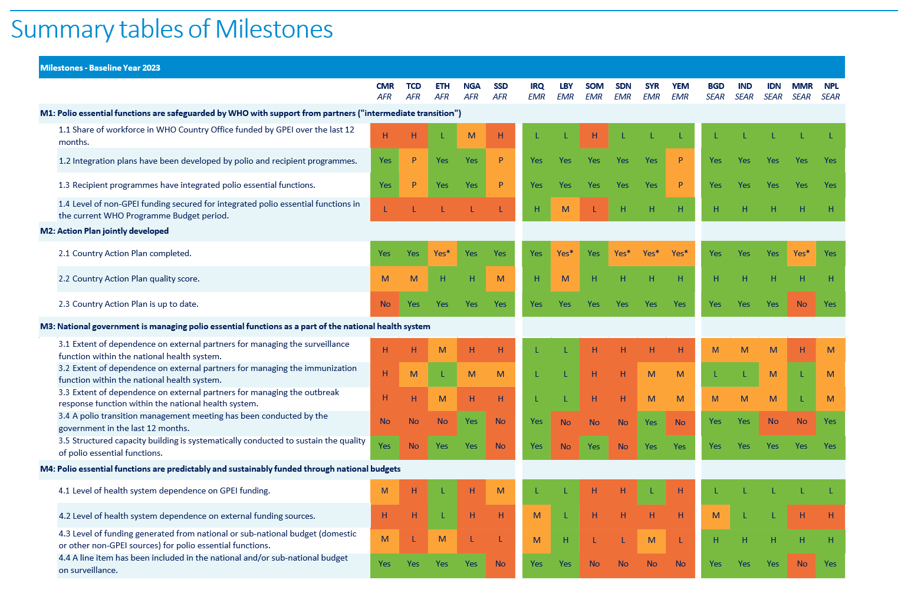

Slide 39
Polio Transition Countries – Strategic Outcome Indicators Summary

Slide 40
Watchlist Countries – Strategic Outcome Indicators Summary

Slide 42
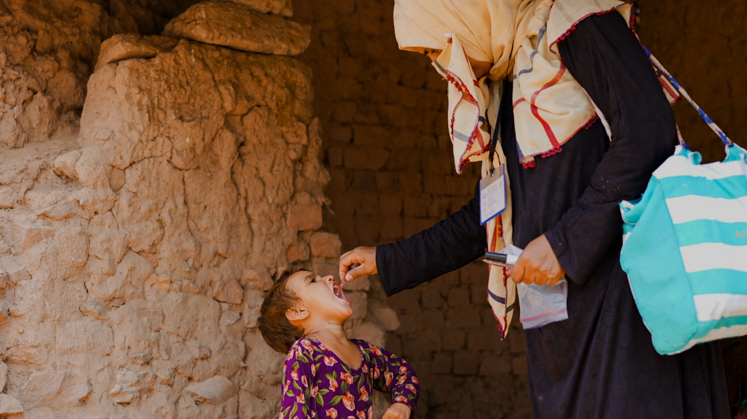
Thank You

