Slide 1

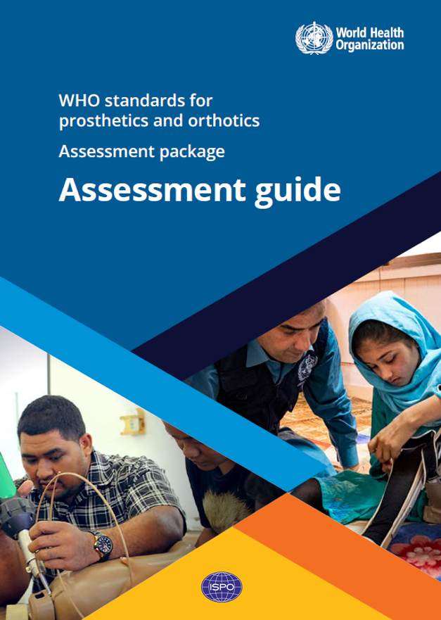
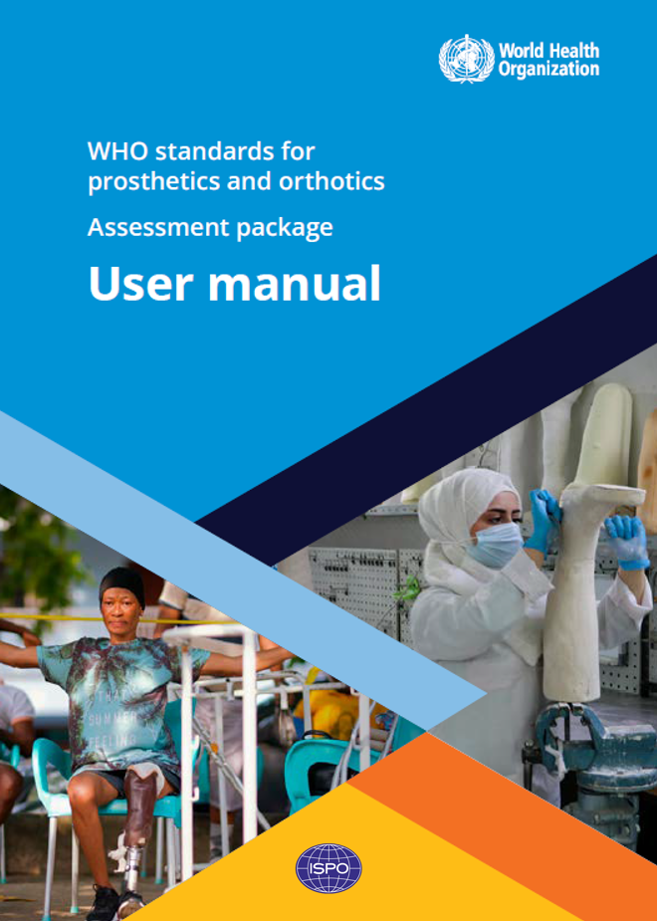
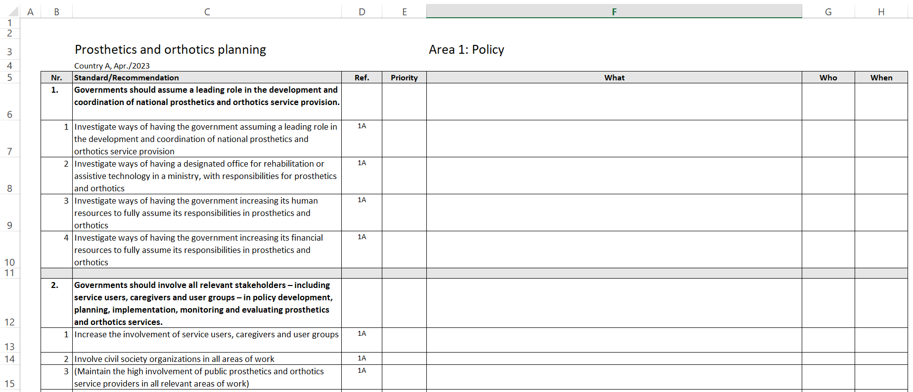
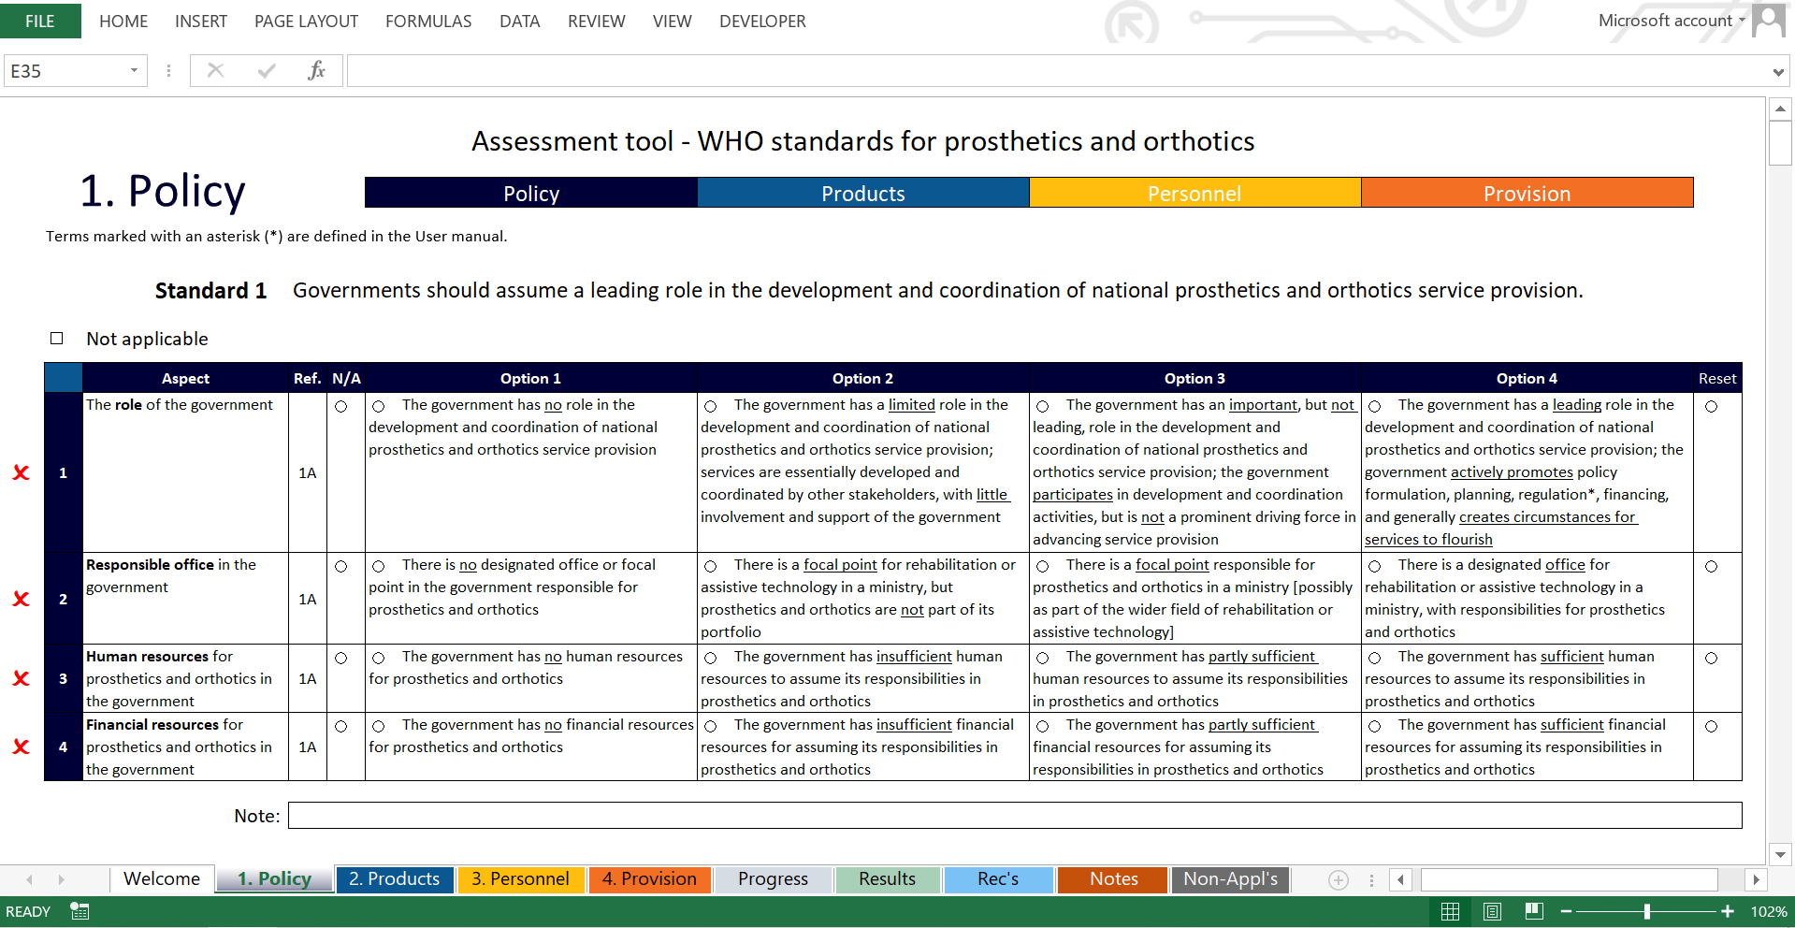
WHO standards for prosthetics and orthotics
Assessment package

Slide 2
Aim of package
To support countries in assessing the implementation of the standards
To help identifying strengths and weaknesses in countries and at the global level
To stimulate strategic planning with the use of the assessment results
To promote the use of the WHO standards

Slide 3
Package components
Assessment guide (“The Guide”)
Assessment tool (“The Tool”)
User manual (“The Manual”)
Planning document
+ this PowerPoint presentation and a video

Slide 4
The Guide
presents the aims of assessment and planning sessions
outlines assessment and planning processes
suggests types of stakeholders to be involved
proposes possible schedules
presents expected outcomes

Slide 5
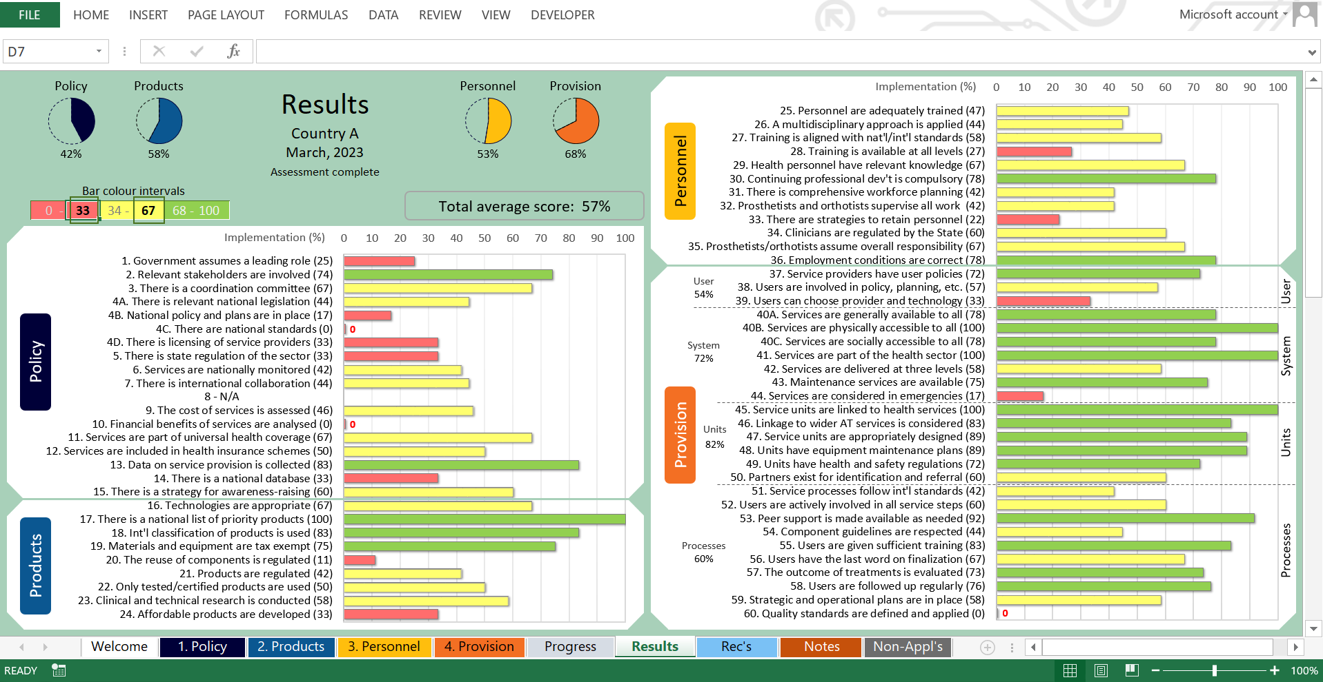
The Tool
Excel file that:
guides users through the assessment process
measures the degree of implementation
presents results
provides recommendations on actions that can improve standards implementation

Slide 6
The Manual
explains how the Assessment tool is used
presents functions and features of the different worksheets
explains the scoring system
provides definitions of selected key terms

Slide 7
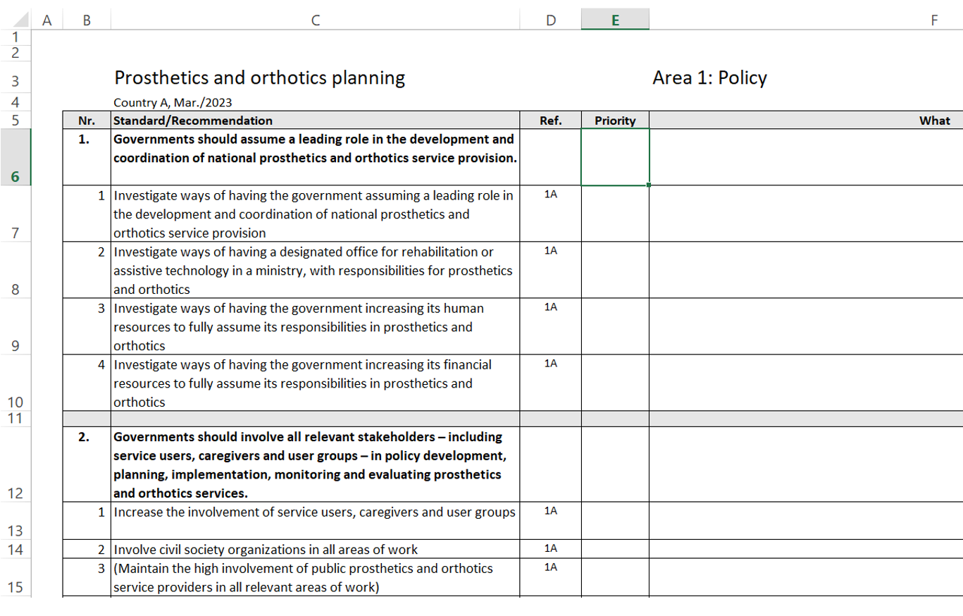
The Planning document
Excel file that:
lists all recommendations copied from the Tool
provides a format for planning (can be changed to suite local needs)

Slide 8
Process
Assessment Evaluate the implementation status of the standards
Planning Outline steps to improve standards implementation
Implementation Implement the plan

Slide 9
Assessment

Slide 10
Assessment steps
1. Identify an Organizing Body
- for example a P&O committee; professional association; educational institution; or a government body responsible for health and rehabilitation.
2. Establish a Standards Assessment Group with a broad range of stakeholders:
- service users, caregivers and user groups; the government; P&O service providers; other health and rehabilitation services; training and academic institutions; professional associations; and NGOs (including international organizations if present).

Slide 11
Assessment steps
3. Make all needed preparations, such as:
study the Standards, Guide, Tool and Manual;
appoint assessment facilitators;
collect readily available core data (if possible, conduct surveys);
prepare a meeting programme;
organize a short preparation session for the Standards Assessment Group.
4. Carry out the assessment:
face-to-face (2 days); or
online (possibly using several short sessions, as appropriate for the group).

Slide 12
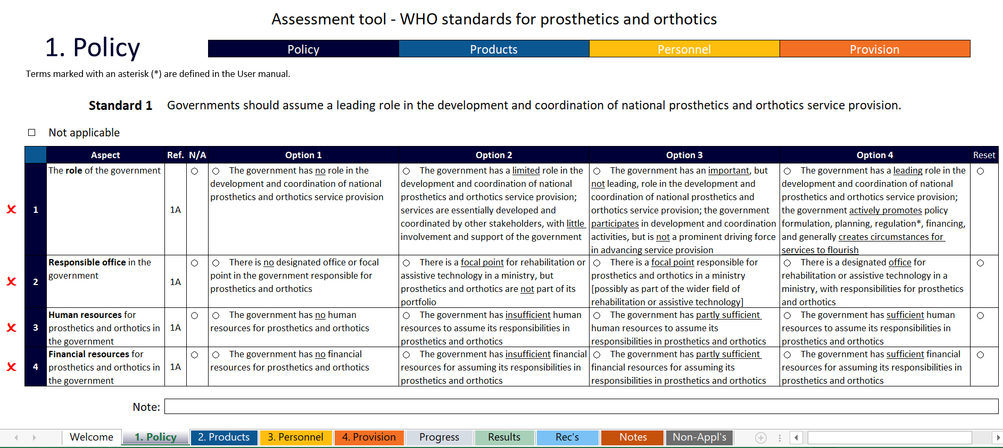
Assessment steps
Apply the Assessment tool

Slide 13
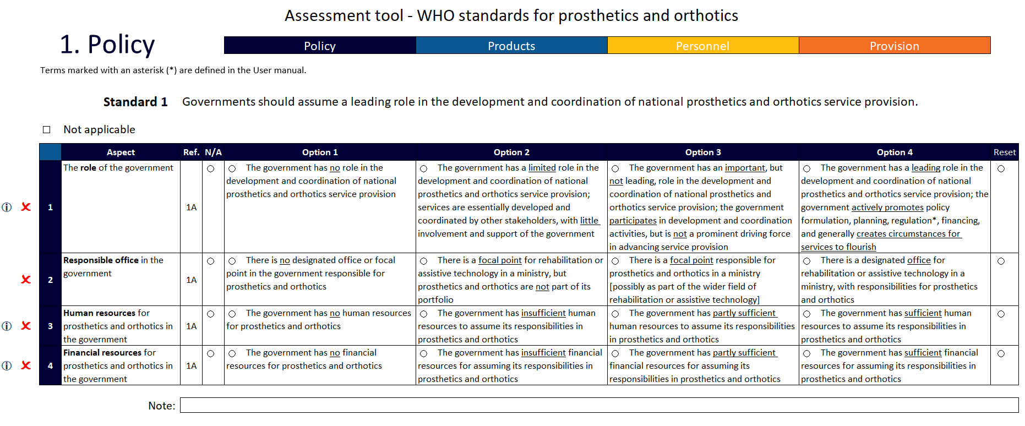

Slide 14
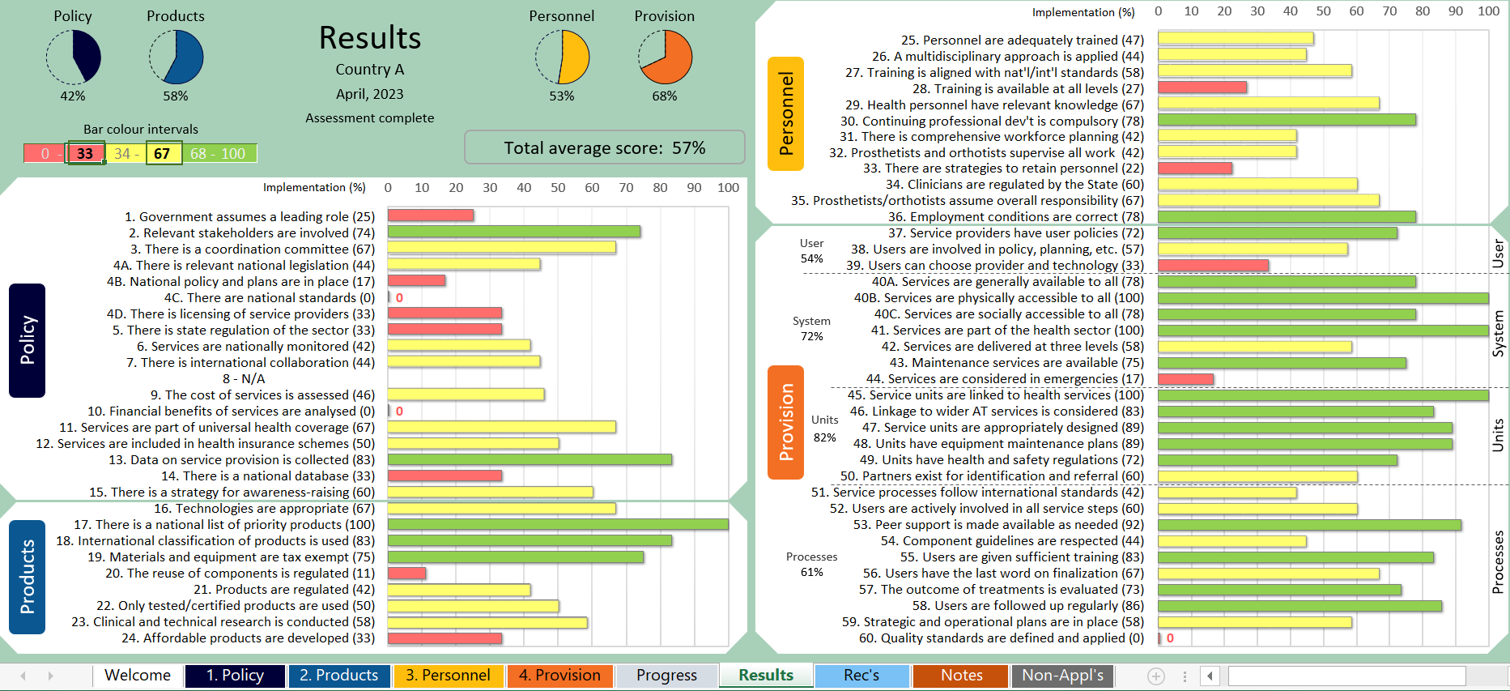
Assessment steps
5. Analyse and report on results

Slide 15
Planning

Slide 16
Planning steps
1. Identify an Organizing Body
- preferably the same as for the assessment
2. Establish a Planning Group
- similar or the same as the Standards Assessment Group
3. Copy recommendations from the Assessment tool to the Planning document
4. Use the Planning document and other resources to carry out the planning (following normal procedures for similar work)

Slide 17
Planning document

Slide 18
Implementation of the plan
(following the country’s usual practices)

Slide 19
Dissemination and sharing of results

Slide 20
For more information, please contact:
World Health Organization
Access to Assistive Technology and Medical Devices
E-mail: assistivetechnology@who.int
Website: https://www.who.int/health-topics/assistive-technology
WHO standards: https://www.who.int/publications/i/item/9789241512480
Assessment package: https://www.who.int/teams/health-product-policy-and-standards/assistive-and-medical-technology/assistive-technology/prosthetics-and-orthotics-services

