Slide 1


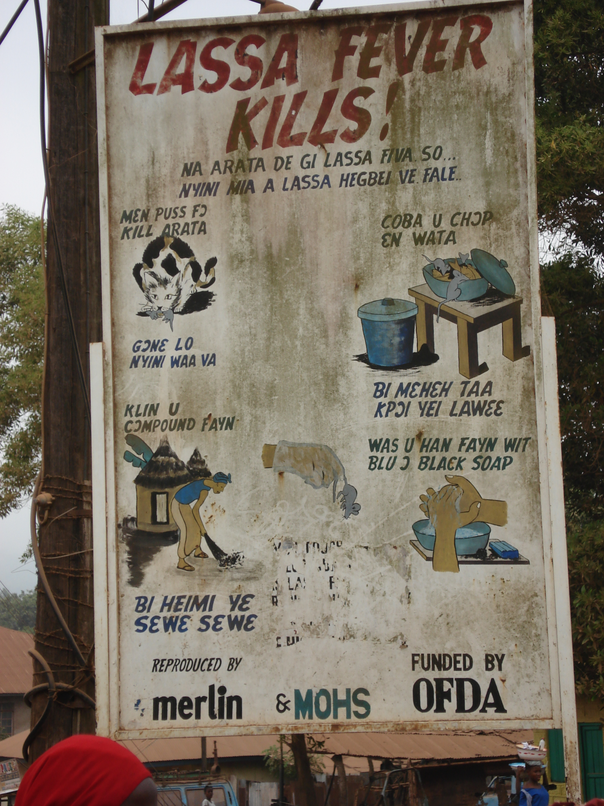
Other Lassa fever research priorities relevant for vaccine evaluation
Accelerating the licensure of Lassa Vaccines
Robert F. Garry, PhD
Tulane University
26October22

Slide 2
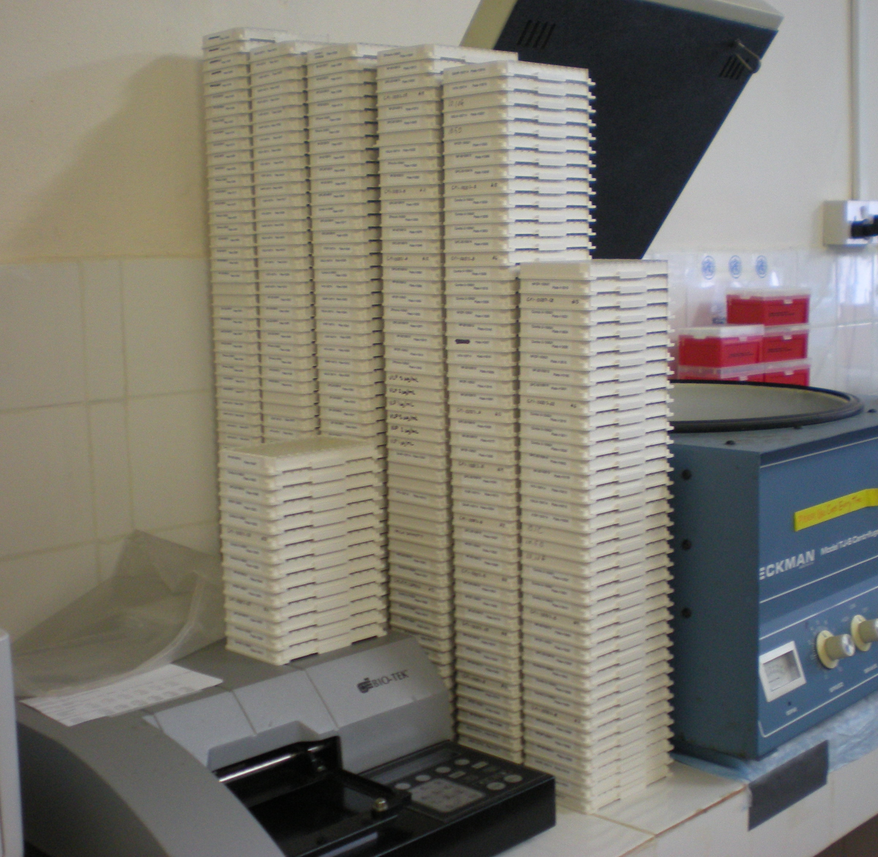
Can seroepidemiology guide vaccine trials and [LATER] vaccine deployment?
Do available immune based assays have sufficient sensitivity and specificity?
Can assays be successfully deployed in West Africa?

Slide 3
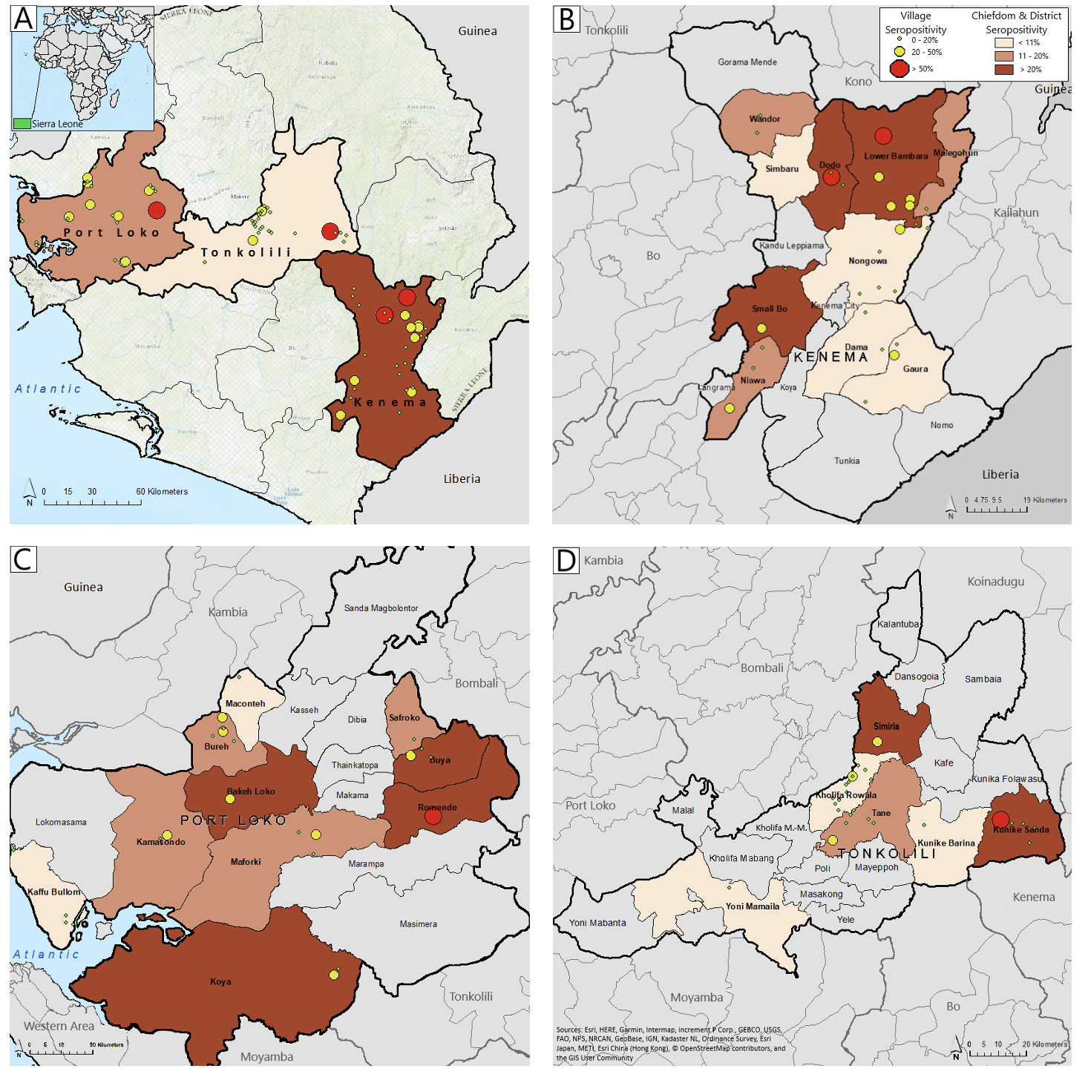
The large ENABLE Study by CEPI and other prior epidemiological studies indicate that the proper tools exist to do the baseline epidemiology.
Incidence?
Prevalence?
N = 10,062

Slide 4
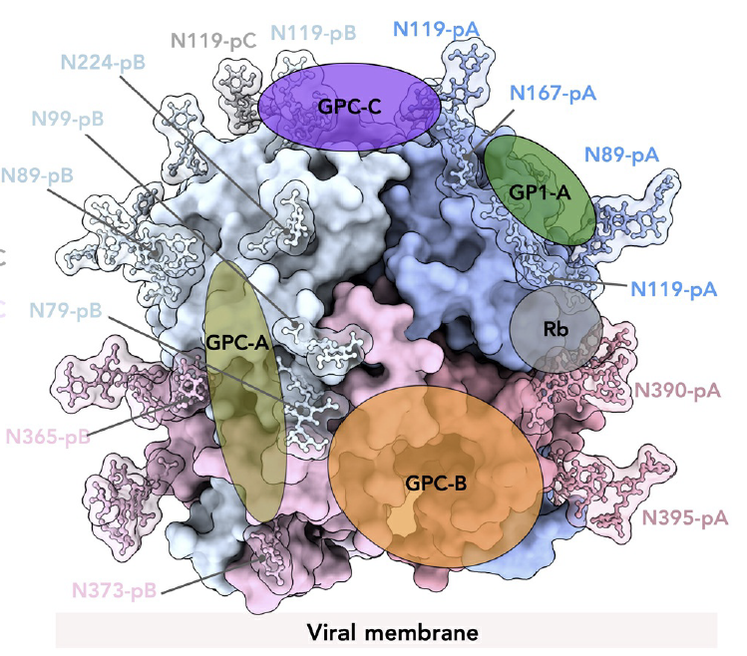
Do we have an adequate understanding of immune correlates of protection?
What are the roles of neutralizing and non-neutralizing antibodies in vaccine-induced protection?
Will cellular immunity be the dominant arm?
What is the role of pre-existing immunity?
How long does protection last?
Are there differences across the lifespan or in different countries?
Li et al., Science Translational Medicine 26Oct22, in press…

Slide 5
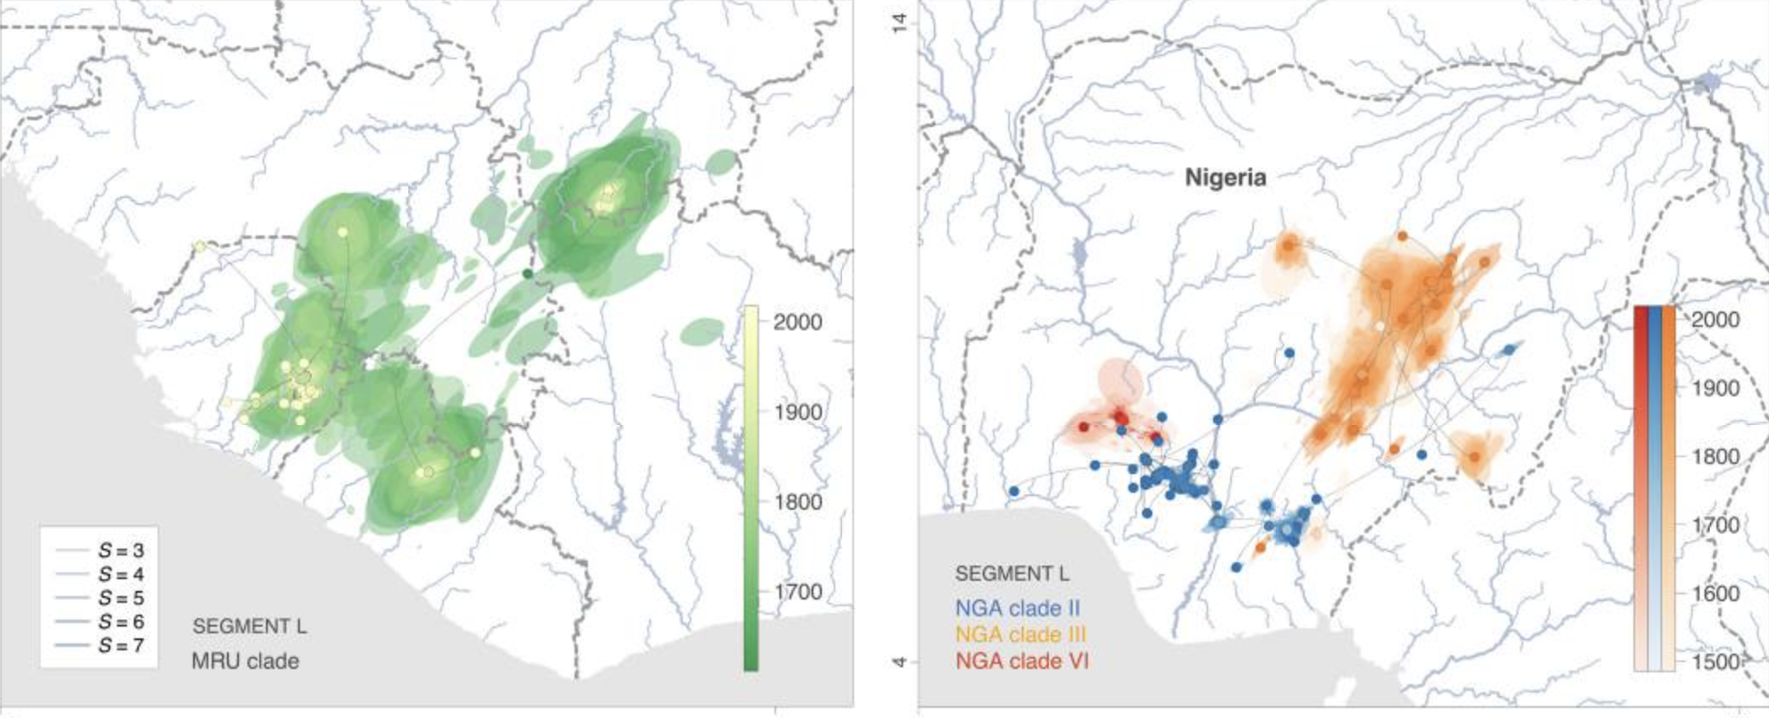
Lassa virus is genetically diverse: Can vaccines provide cross-lineage protection?
Guinea
Nigeria
Sierra
Leone
IV
III
VI
IIA
Liberia
IIB
Siddle et al N Engl J Med 2018 Nov 1;379(18):1745-1753.

Slide 6
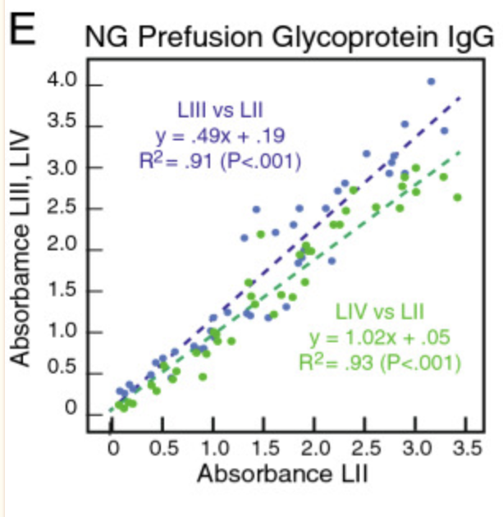
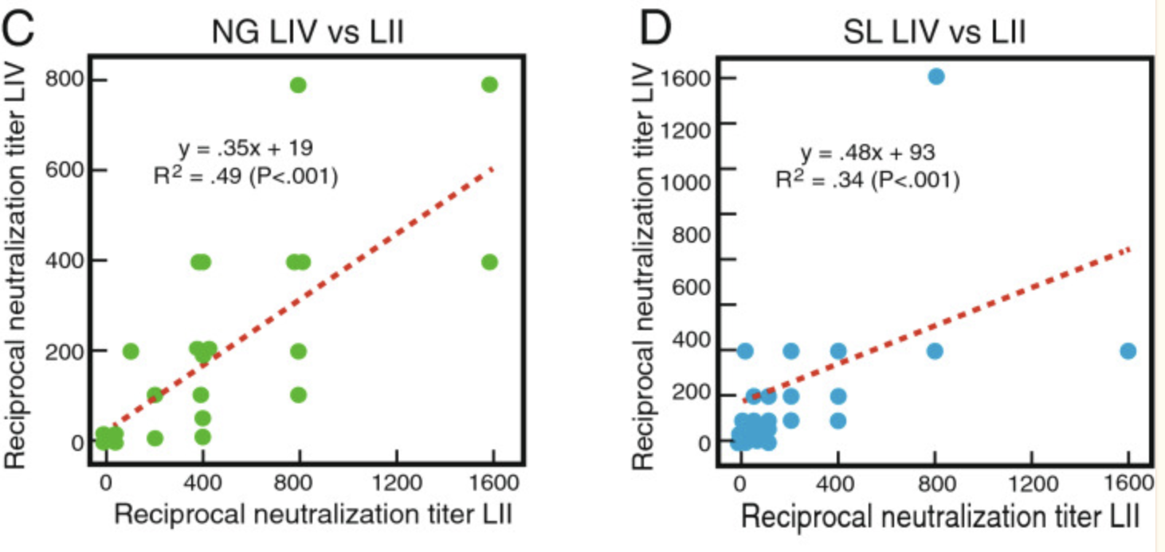
Probably YES -Lassa virus infection induces strongly cross-reactive binding and neutralizing antibodies.
NEUTRALIZING
BINDING
Caveat – Lineage VI might be
an outlier - To Be determined
Heinrich et al., Sci Rep. 2020; 10: 16030.

Slide 7
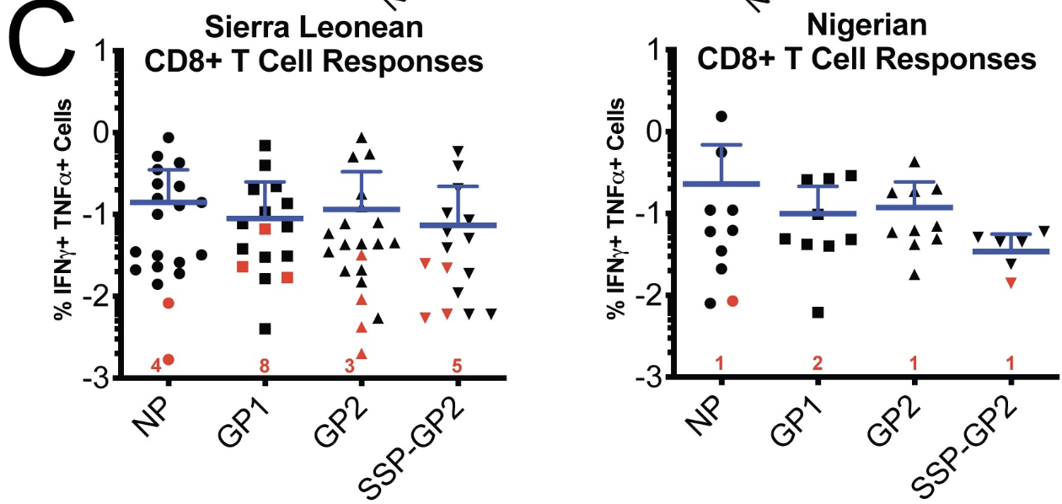
Also, CD4+ and CD8+ T cell responses appear cross-reactive
Sullivan et al., 2020 https://doi.org/10.1371/journal.ppat.1008352

Slide 8
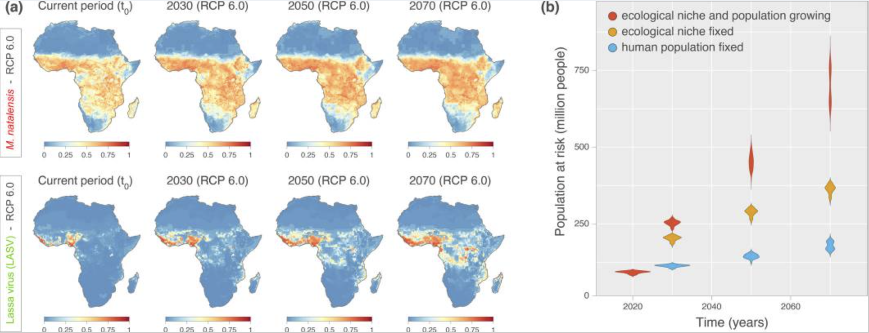
The human population at risk for Lassa fever will expand. How and where should vaccines be deployed?
Klittinget al., Nat Commun. 2022; 13: 5596

Slide 9
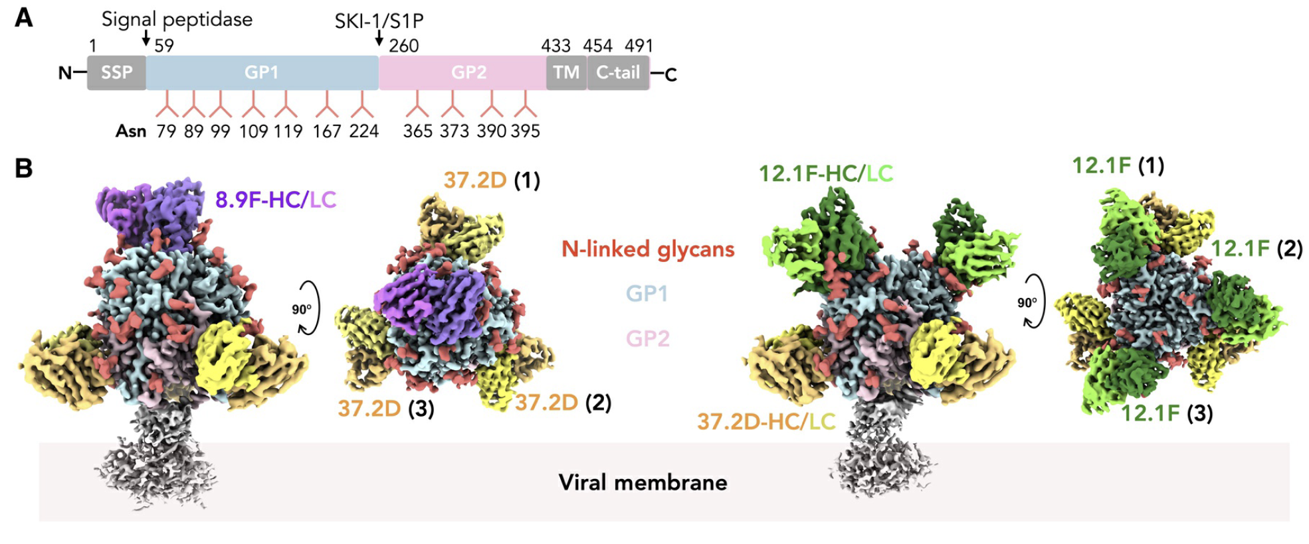
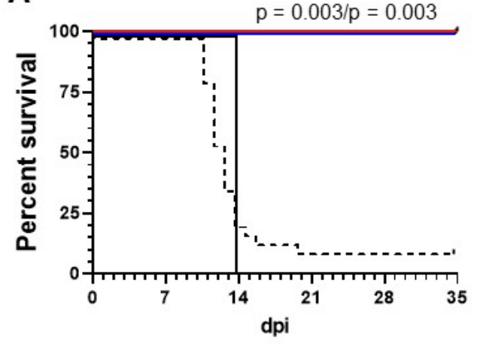
How can Lassa vaccines and [new] therapeutics best be deployed in concert ?
Li et al., Science Translational Medicine 26Oct22, in press…
Cross et al., submitted

