Slide 1


Infant and young child feeding counselling: an integrated course
2nd edition
Module 2
Counselling skills
WHO/HEP/NFS/21.17
© World Health Organization 2021. Some rights reserved. This work is available under the CC BY-NC-SA 3.0 IGO licence.

Slide 2
Session 5: Listening and learning – objectives
5/1
After completing this session, participants will be able to:
list the six Listening and learning skills
give an example of each skill
demonstrate the appropriate use of the skills when counselling on infant and young child feeding

Slide 3
Session 8: Building confidence and giving support – objectives
8/1
After completing this session, participants will be able to:
list the six Skills for building confidence and giving support
give an example of each skill
demonstrate the appropriate use of the skills when counselling on infant and young child feeding

Slide 4
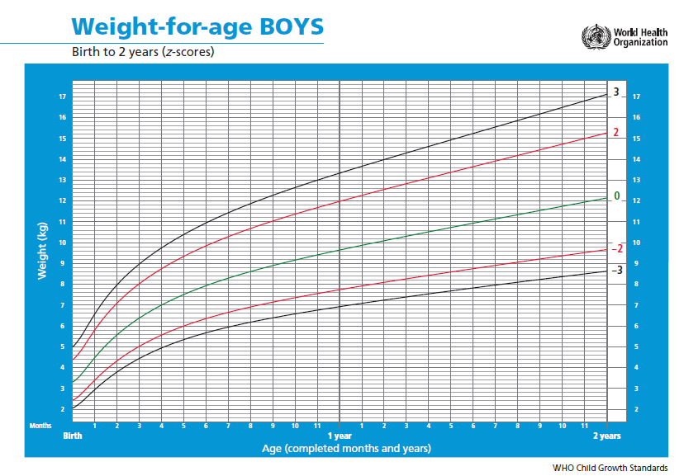
8/2

Slide 5
Which of these remarks will help to build the mother’s confidence?
8/3
“Your baby’s growth line is going up too slowly.”
“I don’t think your baby is gaining enough weight.”
“Your baby gained weight last month just on your breast milk.”

Slide 6
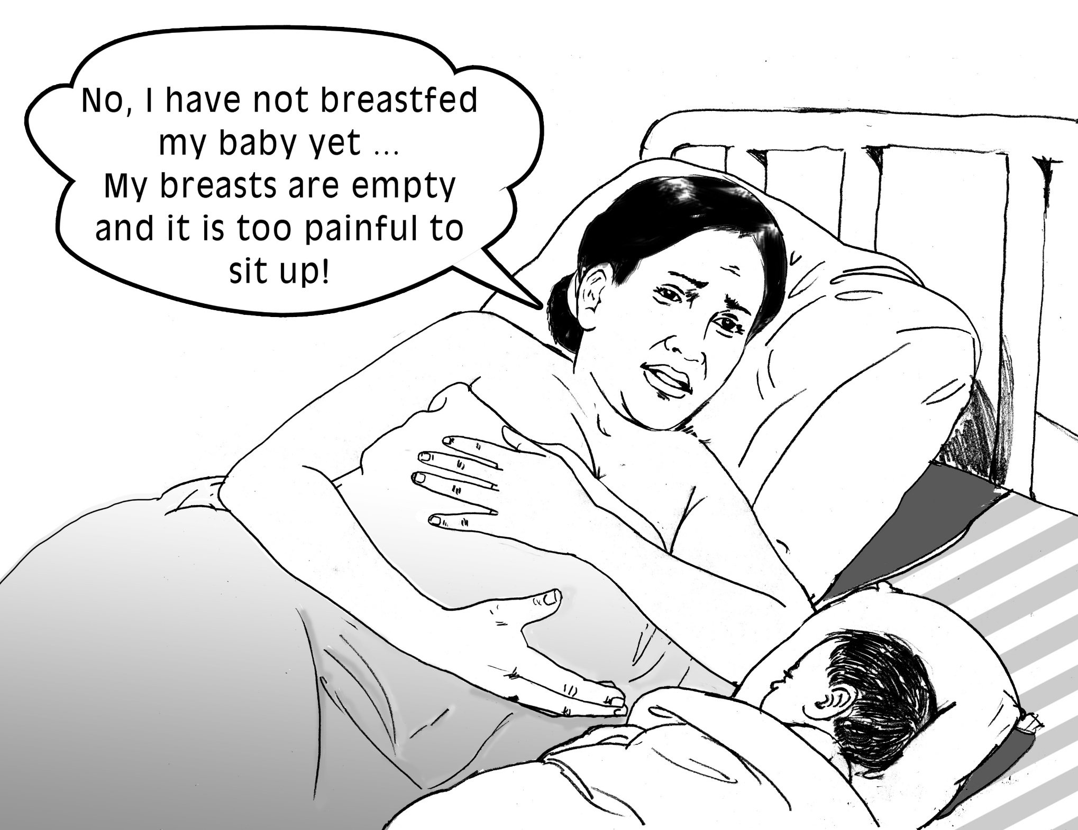
8/4

Slide 7
Which response is more appropriate?
8/5
“You should let your baby suckle now to help your breast milk to come in.”
“Let me try to make you more comfortable, and then I’ll bring you a drink.”

Slide 8
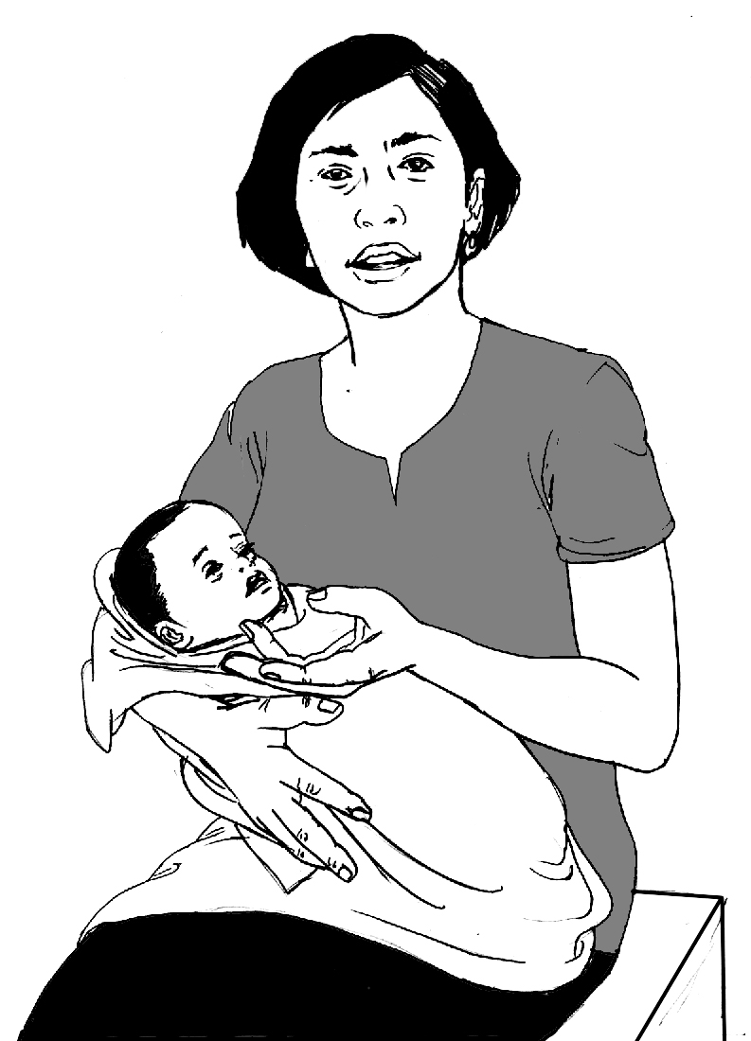
8/6
He has started to have loose stools.
Should I stop breastfeeding?

Slide 9
Which response gives positive information?
8/7
“It is good that you asked before deciding. Diarrhoea usually stops sooner if you continue to breastfeed.”
“Oh no, don’t stop breastfeeding. He may get worse if you do that.”

Slide 10
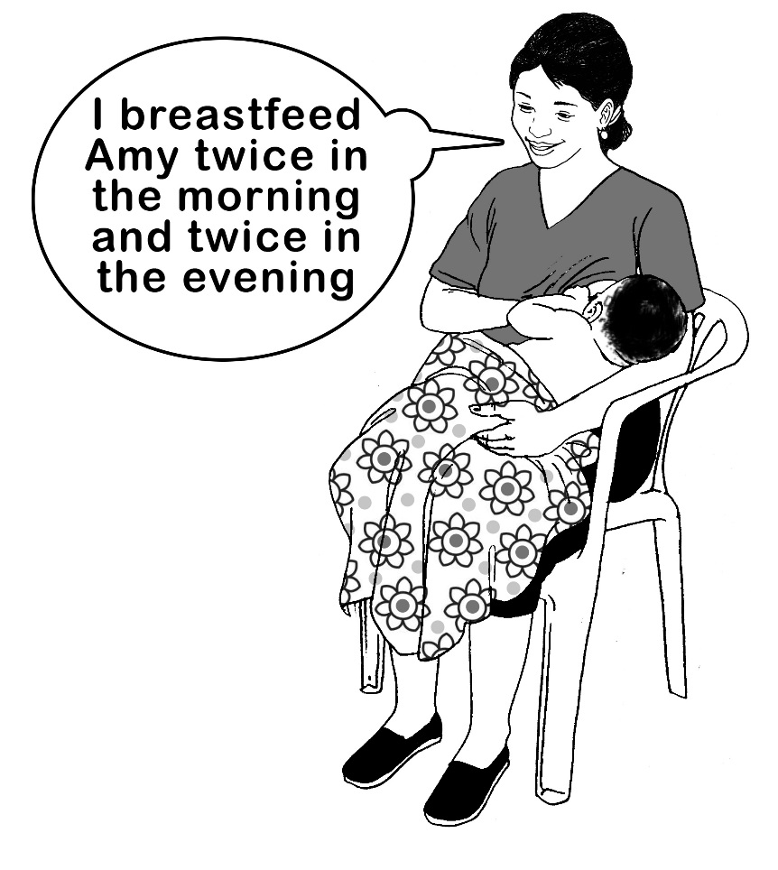
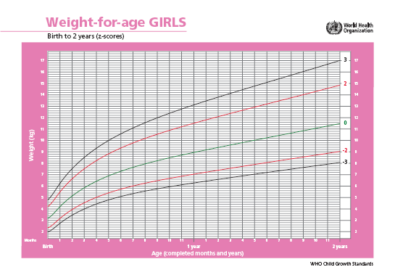
8/8
I breastfeed Amy twice in the morning and twice in the evening

Slide 11
Which of these responses is a command, and which is a suggestion?
8/9
“You must feed Amy at least 10 times a day.”
“It might help if you feed Amy more often.”

