Slide 1


Infant and young child feeding counselling: an integrated course
2nd edition
Module 3: Sessions 11–15
Breastfeeding
WHO/HEP/NFS/21.18
© World Health Organization 2021. Some rights reserved. This work is available under the CC BY-NC-SA 3.0 IGO licence.

Slide 2
Session 11: Why breastfeeding is important 1
– objectives
11/1
After completing this session, participants will be able to:
state the advantages of optimal breastfeeding
list the risks of artificial feeding
describe the main differences between breast milk and artificial milks

Slide 3
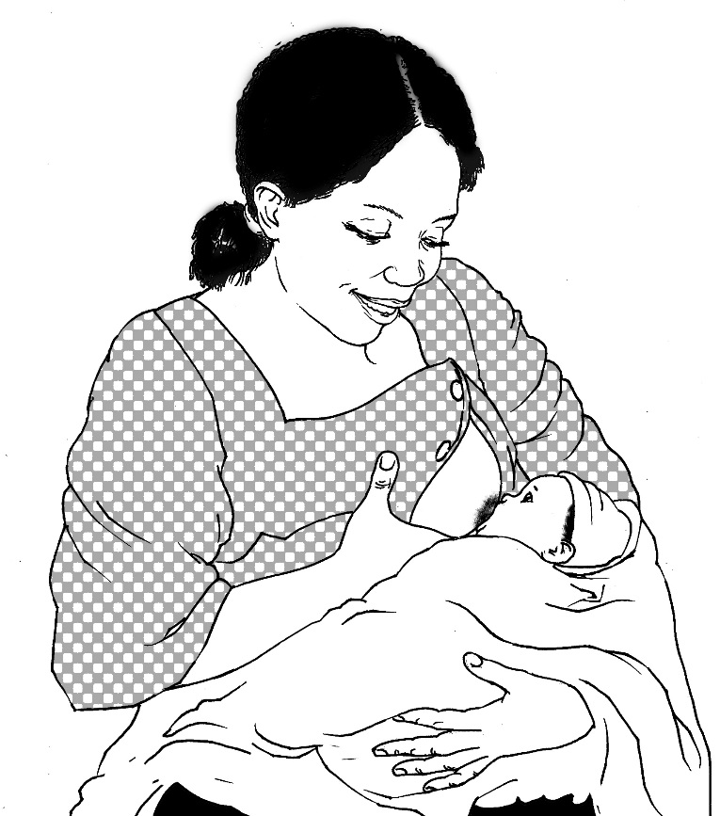
Advantages of breastfeeding
11/2
Breast milk
Perfect nutrients
Easily digested;
efficiently used
Protects against infection
Protects against long-term noncommunicable diseases
Breastfeeding
Helps bonding and development
Helps delay a new pregnancy
Protects mothers’ health
Costs less than artificial feeding

Slide 4
Nutrients in human and animal milks
11/3a
Fat
Protein
Lactose

Slide 5
Nutrients in human and animal milks
11/3b
Human
Cow’s
Goat’s
Fat
Protein
Lactose

Slide 6
Quality of proteins in different milks
11/4

Slide 7
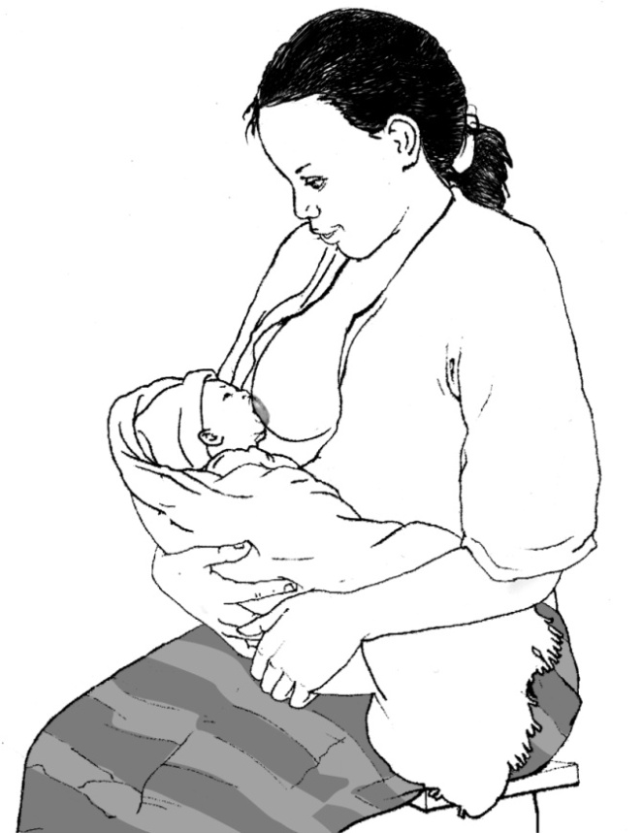
Protection against infection
11/5
1. Mother infected
2. White cells in the mother’s body make antibodies to protect her
4. Antibodies to the mother’s infection secreted in milk to protect her baby
3. Some white cells go to her breasts and make antibodies there

Slide 8



Differences between colostrum and mature milk
11/6
Foremilk
Hindmilk
Fat
Protein
Lactose
Colostrum
Mature milk

Slide 9
Colostrum
11/7
Property Importance
Antibody rich - protects against allergy & infection
Many white cells - protects against infection
Purgative - clears meconium
- helps to prevent jaundice
Growth factors - helps intestine to mature
- prevents allergy, intolerance
Rich in vitamin A - reduces severity of infection
- prevents eye disease

Slide 10
Risk of diarrhoea by feeding method
Philippines, infants aged 0–2 months
11/8
Source: Popkin BM, Adair L, Akin JS, Black R, Briscoe J, Flieger W. Breast-feeding and diarrheal morbidity. Pediatrics. 1990;86:874–82.

Slide 11
Psychological benefits of breastfeeding
11/9
Emotional bonding
Close, loving relationship between mother and baby
Mother more emotionally satisfied
Baby cries less
Baby may be more emotionally secure
Development
Children perform better on intelligence tests

Slide 12
Risks of artificial feeding
11/10
Interferes with bonding
More diarrhoea and persistent diarrhoea
More frequent respiratory infections
Malnutrition; vitamin A deficiency
More allergy and milk intolerance
Increased risk of some chronic diseases
Obesity
Lower scores on intelligence tests
Mother may become pregnant sooner
Increased risk of anaemia, ovarian cancer and breast cancer in the mother

Slide 13

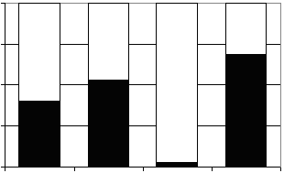
Breast milk in the second year of life
11/11
100%
Gap
75%
50%
Percentage of daily needs
Provided by 550 mL breast milk
25%
0%
Energy
Protein
Iron
Vitamin A
Nutrient

Slide 14
Session 12: How breastfeeding works 1
– objectives
12/1
After completing this session, participants will be able to:
name the main parts of the breast and describe their function
describe the hormonal control of production and ejection of breast milk
describe the difference between good and poor attachment of a baby at the breast
describe the difference between effective and ineffective suckling

Slide 15
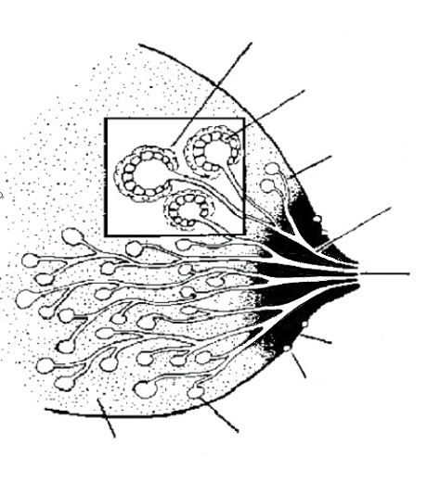
Anatomy of the breast
12/2
Oxytocin makes them contract
Muscle cells
Milk-secreting cells
Prolactin makes them secrete milk
Ducts
Large ducts
Nipple
Areola
Montgomery’s glands
Alveoli
Supporting tissue and fat

Slide 16
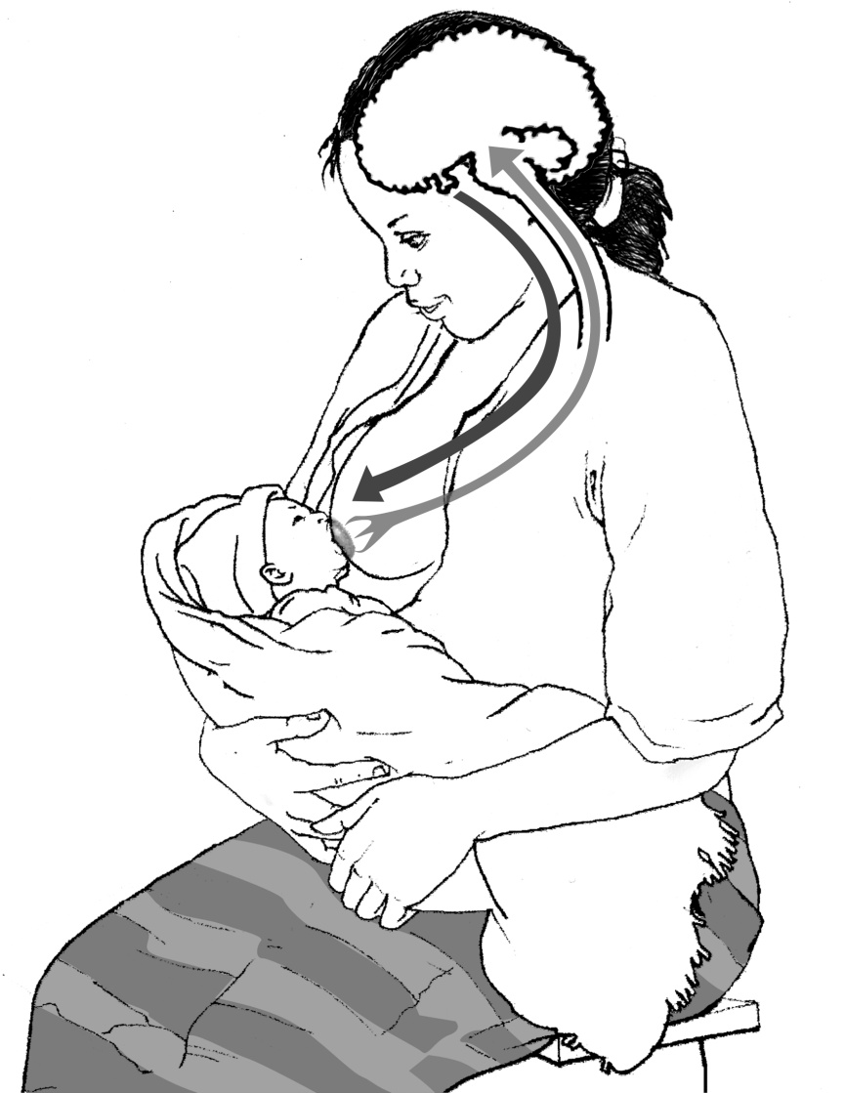
Prolactin
12/3
Secreted during and after feed to produce next feed
Sensory impulses
from nipples
Prolactin in blood
Baby suckling
More prolactin secreted at night
Suppresses ovulation

Slide 17

Oxytocin reflex
12/4
Works before or during feed to make milk flow
Sensory impulses from nipples
Oxytocin in blood
Baby suckling
Makes uterus contract

Slide 18


Helping and hindering the oxytocin reflex
12/5
These help the reflex
These hinder the reflex
Worry
Stress
Pain
Doubt
Thinks lovingly of baby
Sounds of baby
Sight of baby
Touches baby
Confidence

Slide 19
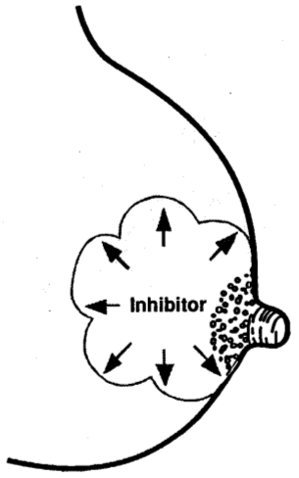
Inhibitor in breast milk
12/6
If breast remains full of milk, secretion stops

Slide 20
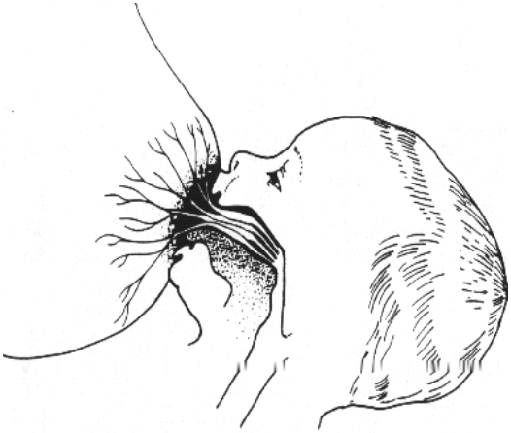
Attachment to the breast
12/7

Slide 21
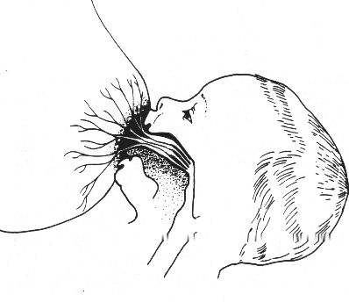
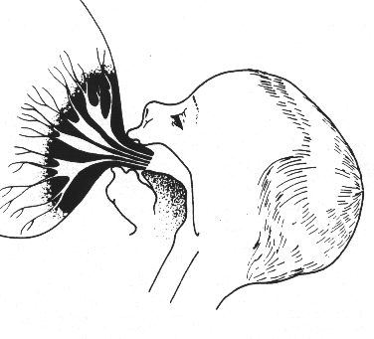
Good and poor attachment
12/8
What differences do you see?
1
2

Slide 22
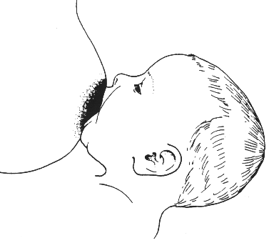
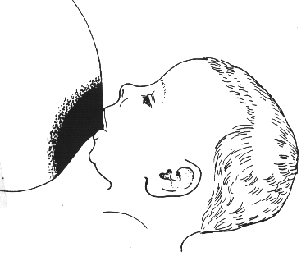
Attachment (outside appearance)
12/9
What differences do you see?
1
2

Slide 23
Results of poor attachment
12/10
Painful nipples
Damaged nipples
Engorgement
Baby unsatisfied and cries a lot
Baby feeds frequently and for a long time
Decreased milk production
Baby fails to gain weight

Slide 24
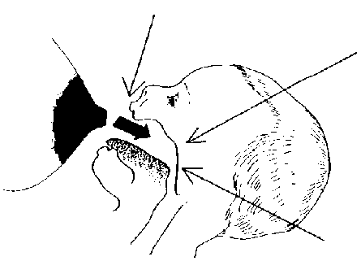
Reflexes in the baby
12/11
Rooting reflex
When something touches the lips, the baby opens the mouth and puts the tongue down and forward
Sucking reflex
When something touches the palate, the baby sucks
Skill
The mother learns to position the baby
The baby learns to take the breast
Swallowing reflex
When the mouth fills with milk, the baby swallows

Slide 25
Session 13: Assessing a breastfeed 1 – objectives
13/1
After completing this session, participants will be able to:
explain The four key signs of good attachment
assess a breastfeed by observing a mother and baby
identify a mother who may need help
recognize signs of good and poor attachment and positioning
explain the contents and arrangement of the Job aid: Breastfeed observation

Slide 26
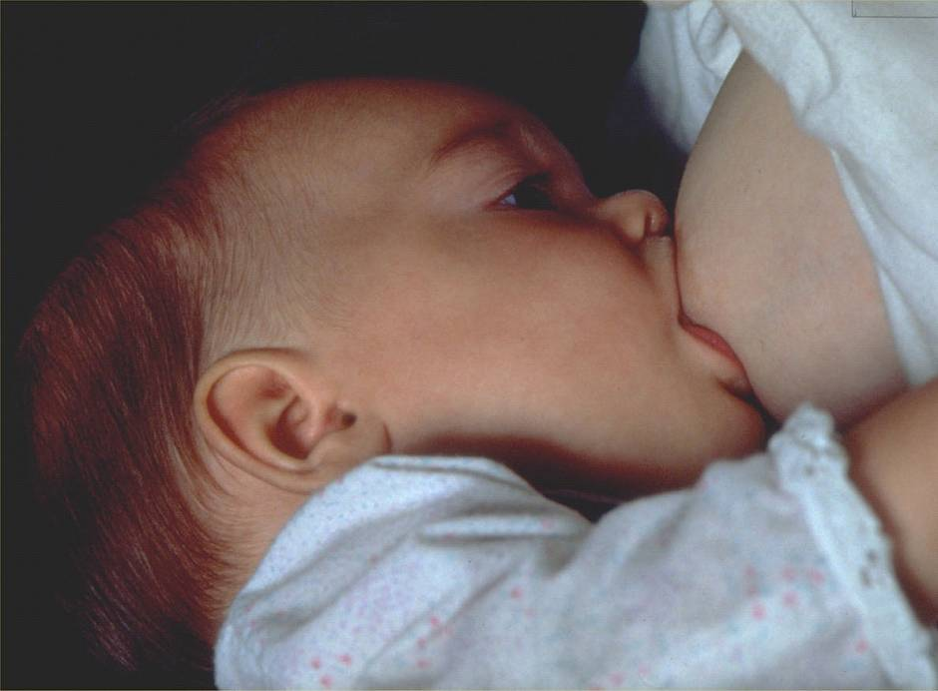
13/2

Slide 27
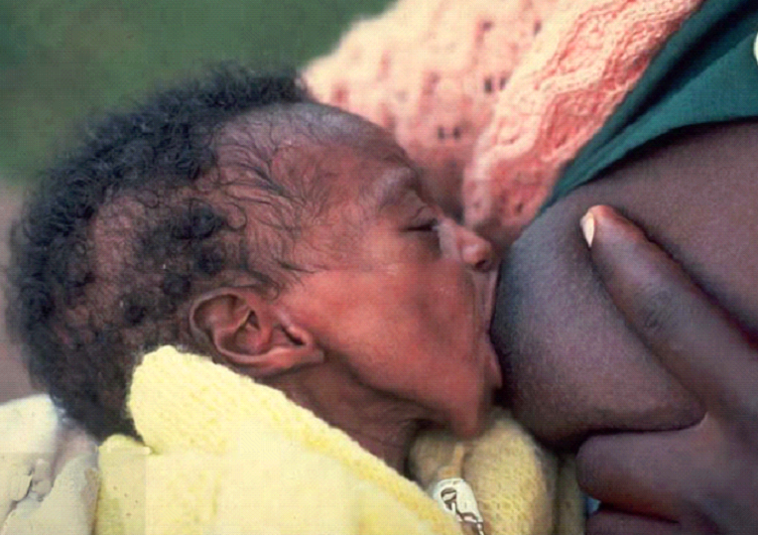
13/3

Slide 28
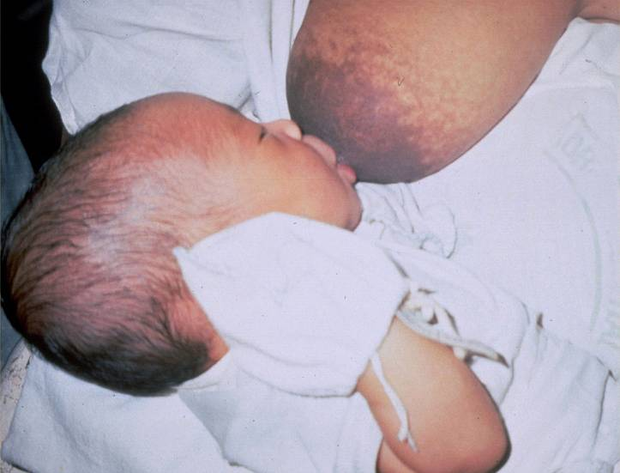
13/4

Slide 29
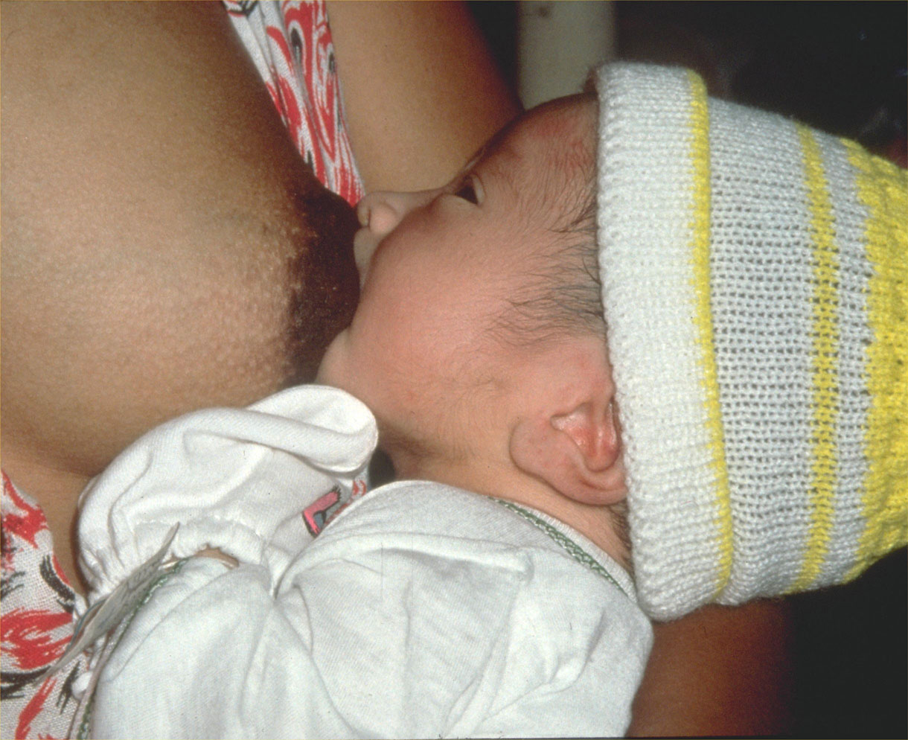
13/5

Slide 30
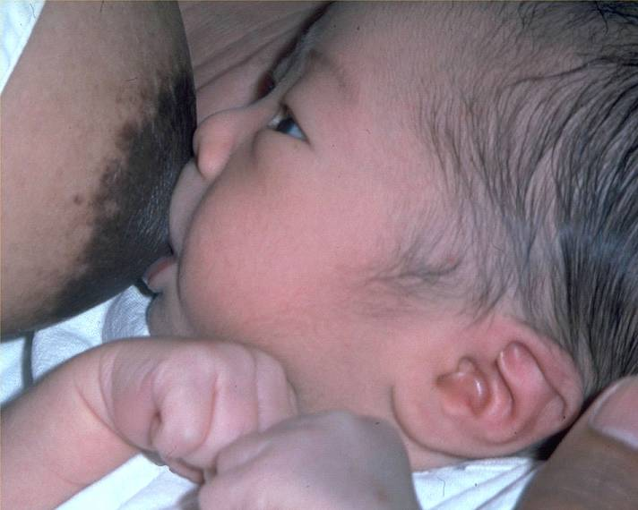
13/6

Slide 31
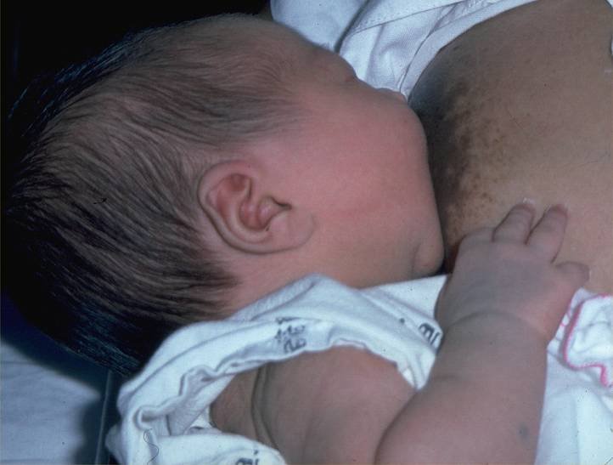
13/7

Slide 32
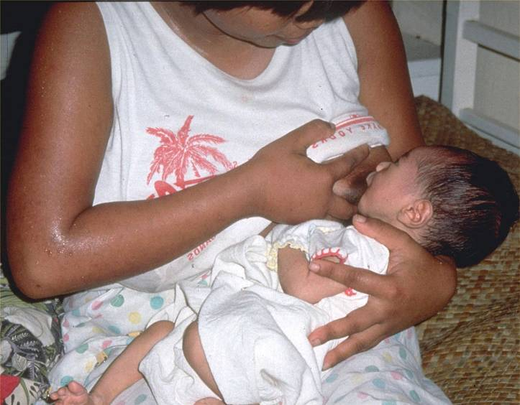
13/8

Slide 33
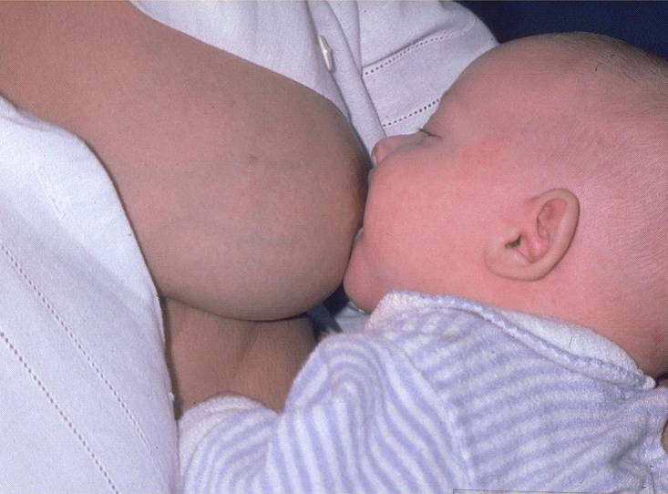
13/9

Slide 34
Session 14: Positioning a baby at the breast 1 – objectives
14/1
After completing this session, participants will be able to:
explain The four key signs of good positioning
describe how a mother should support her breast for feeding
demonstrate the main positions – sitting, lying, underarm and across
help a mother to position her baby at the breast, using The four key signs of good positioning in different positions

Slide 35
Session 15: Taking a feeding history –
0 up to 6 months of age 1 – objectives
15/1
After completing this session, participants will be able to:
take a feeding history of an infant aged 0 up to 6 months
demonstrate appropriate use of the Job aid: Feeding history – 0 up to 6 months

Slide 36
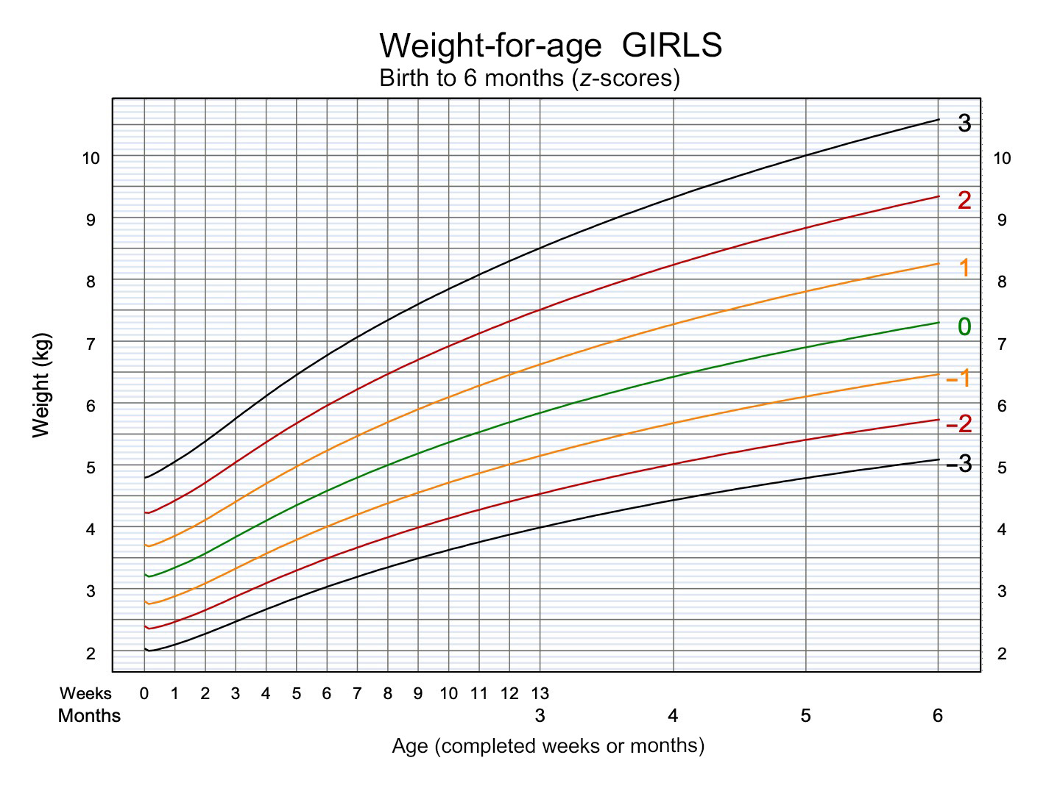
15/2

Slide 37
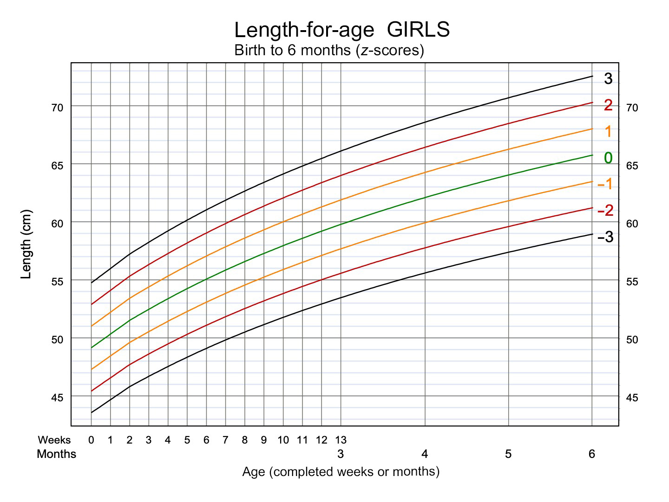
15/3

