Slide 1


Infant and young child feeding counselling: an integrated course
2nd edition
Module 4: Sessions 23–25
Breastfeeding (advanced sessions)
WHO/HEP/NFS/21.19
© World Health Organization 2021. Some rights reserved. This work is available under the CC BY-NC-SA 3.0 IGO licence.

Slide 2
Session 23: Why breastfeeding is important 2 – objectives
23/1
After completing this session, participants will be able to:
state the advantages of exclusive breastfeeding for 6 months
describe the main differences between breast milk, animal milk and infant formula milk
list the advantages of continued breastfeeding with complementary feeding for up to 2 years or beyond
list the risks of artificial feeding
define the terms used to describe infant feeding
explain the recommendations for optimal infant and young child feeding

Slide 3
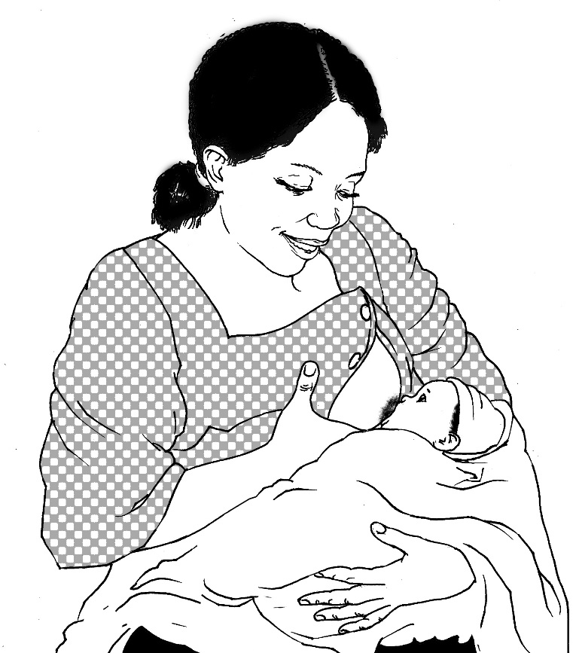
Advantages of breastfeeding
23/2
Breast milk
Perfect nutrients
Easily digested;
efficiently used
Protects against infection
Protects against long-term noncommunicable diseases
Breastfeeding
Helps bonding and development
Helps delay a new pregnancy
Protects mothers’ health
Costs less than artificial feeding

Slide 4
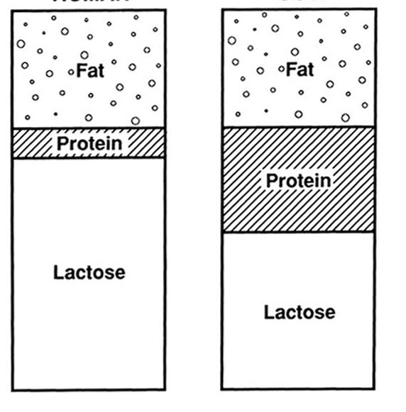
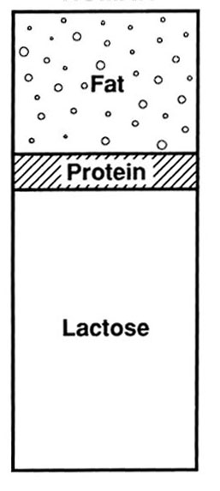
What are the differences between these milks?
23/3
Human
Cow’s
Formula
Varies
0.9%
constant
1.5%
+
sucrose
+ oligosaccharides
70 kcal/100 mL
66 kcal/100 mL
68 kcal/100 mL

Slide 5
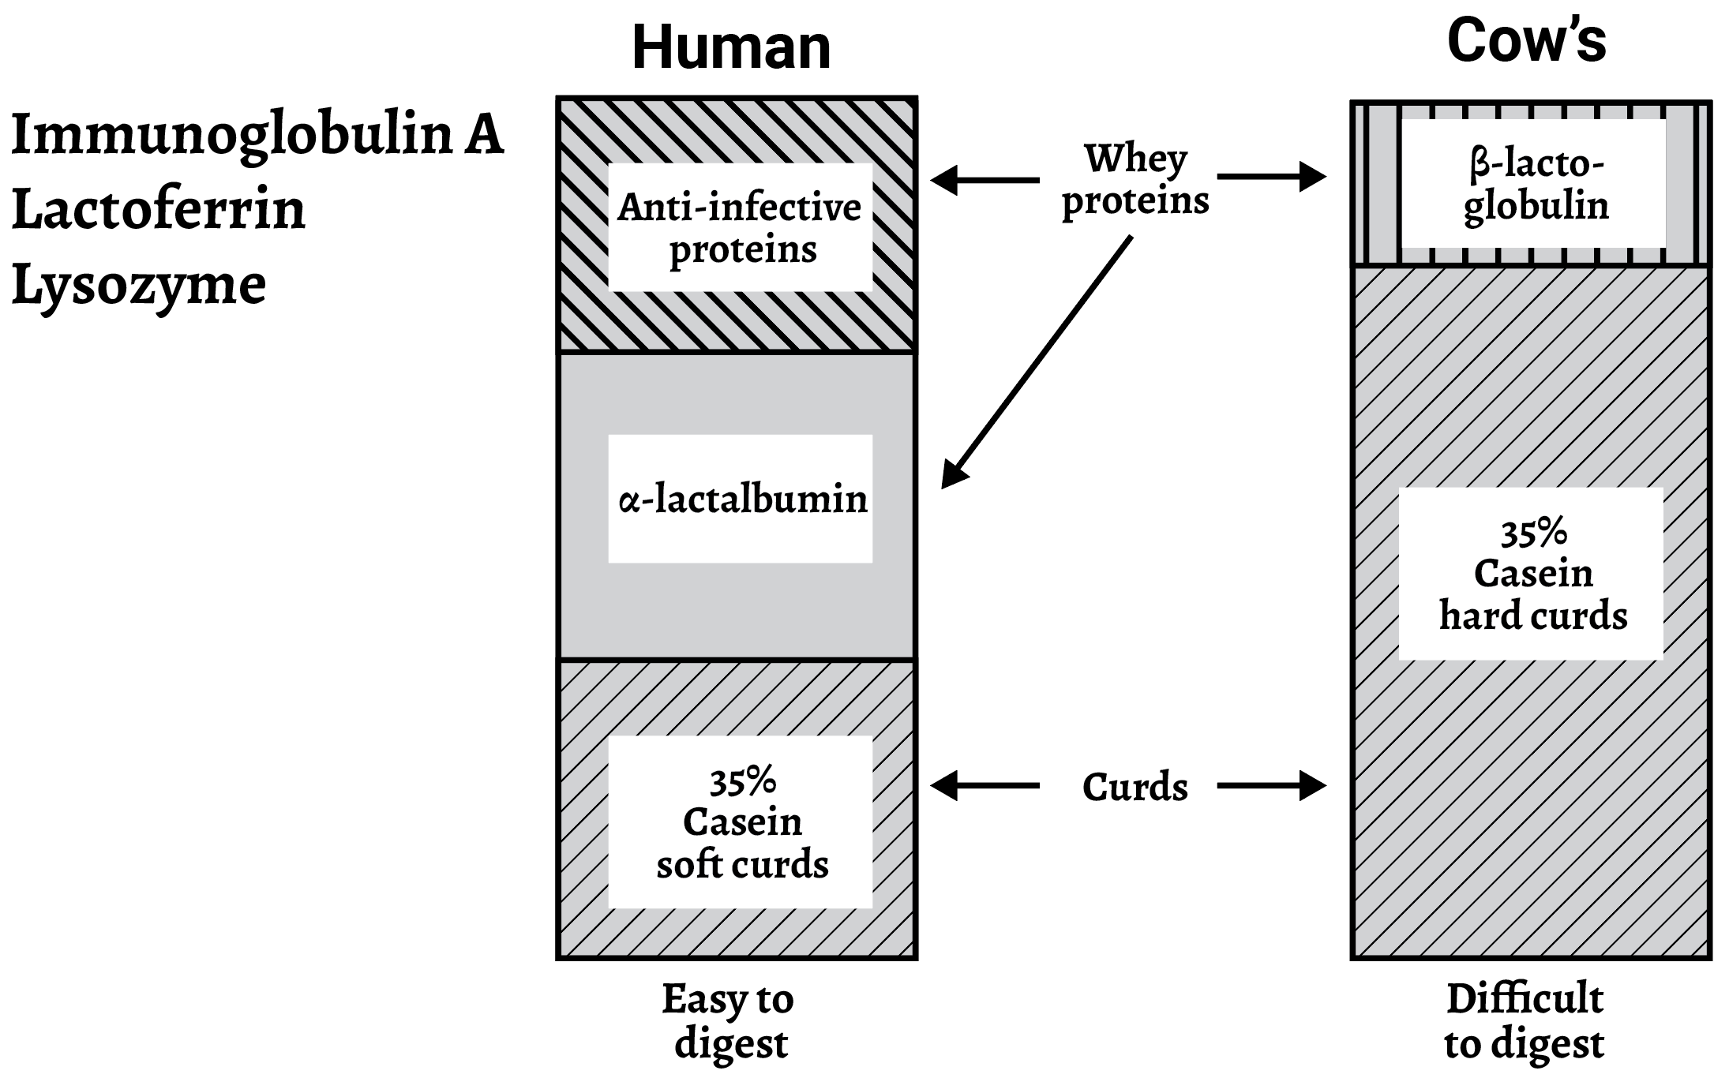
Differences in the quality of proteins in different milks
23/4
Human
Cow’s

Slide 6
Differences in the fats of different milks
23/5

Slide 7
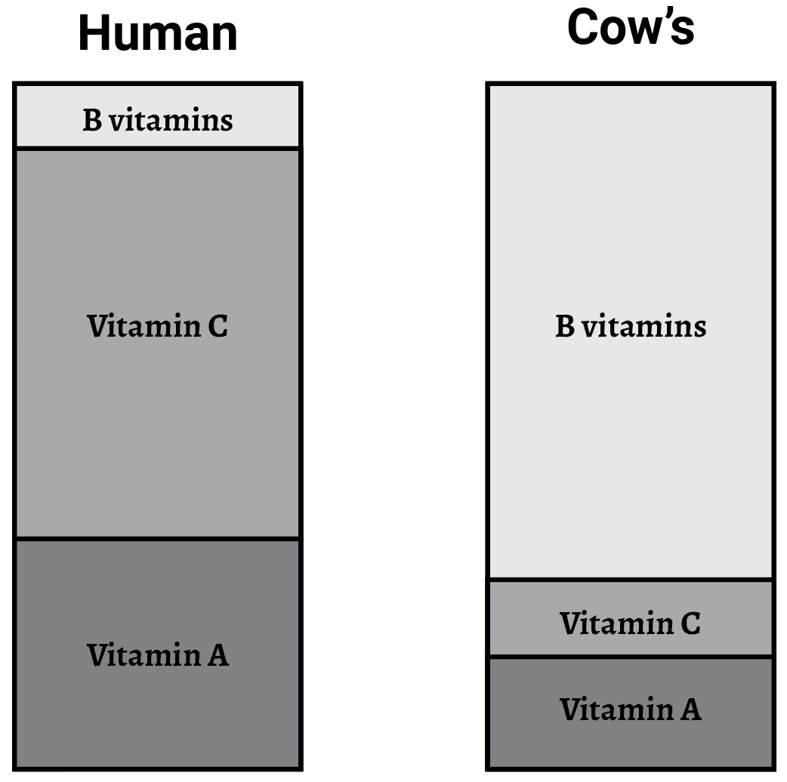
Vitamins in different milks
23/6
Human
Cow’s

Slide 8
Iron in milk
23/7

Slide 9
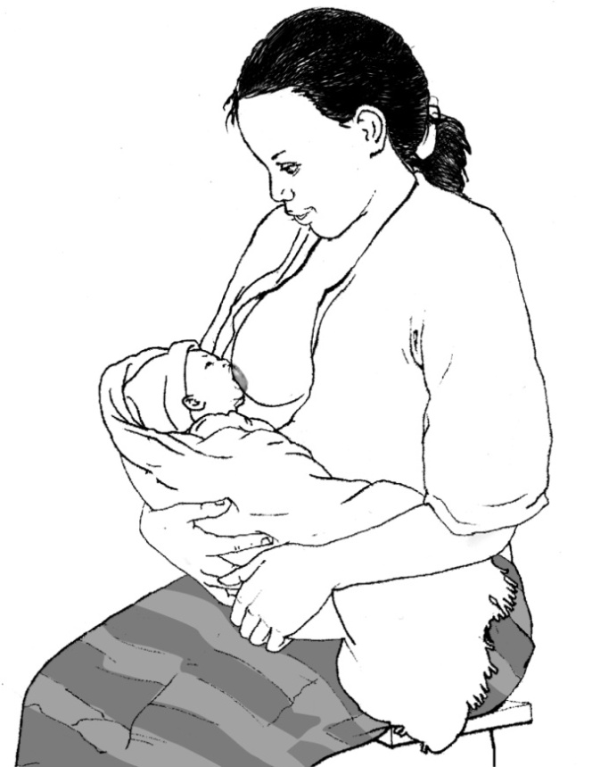
Protection against infection
23/8
1. Mother infected
2. White cells in the mother’s body make antibodies to protect her
4. Antibodies to mother’s infection secreted in milk to protect her baby
3. Some white cells go to her breasts and make antibodies there

Slide 10
Summary of differences between milks
23/9
Component | Human milk | Cow’s milk | Formula milk
Protein | Right amount Easy to digest | Too much Difficult to digest | Quantity reduced Quality as cow’s
Fats | EFAs present Lipase to digest | No EFAs No lipase | Some EFA added No lipase
Carbohydrate | Lactose – plenty Oligosaccharides (anti-infective) | Lactose – less Oligosaccharides not suitable | Lactose + sucrose Lacks oligosaccharides
Vitamins and minerals | Adequate if mother has enough | Low vitamin A and C and iron | Vitamins/minerals added usually enough
Anti-infective factors | IgA, lactoferrin, lysozyme, cells | None | None
Growth factors | Present | None | None
EFA: essential fatty acid; IgA: immunoglobulin A.

Slide 11



Differences between colostrum and mature milk
23/10
Foremilk
Hindmilk
Fat
Protein
Lactose
Colostrum
Mature milk

Slide 12
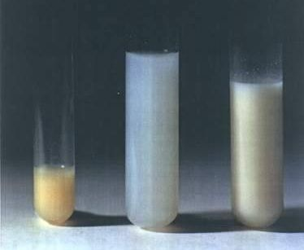
23/11

Slide 13
Colostrum
23/12
Property Importance
Antibody rich - protects against allergy & infection
Many white cells - protects against infection
Purgative - clears meconium
- helps to prevent jaundice
Growth factors - helps intestine to mature
- prevents allergy, intolerance
Rich in vitamin A - reduces severity of infection
- prevents eye disease

Slide 14
Psychological benefits of breastfeeding
23/13
Emotional bonding
Close, loving relationship between mother and baby
Mother more emotionally satisfied
Baby cries less and more emotionally secure
Mother behaves more affectionately
Mother less likely to abandon or abuse baby
Development
Children perform better on intelligence tests later on
Fewer behavioural problems

Slide 15
Risk of diarrhoea by feeding method
Philippines, infants aged 0–2 months
23/14
Source: Popkin BM, Adair L, Akin JS, Black R, Briscoe J, Flieger W. Breast-feeding and diarrheal morbidity. Pediatrics. 1990;86:874–82.

Slide 16
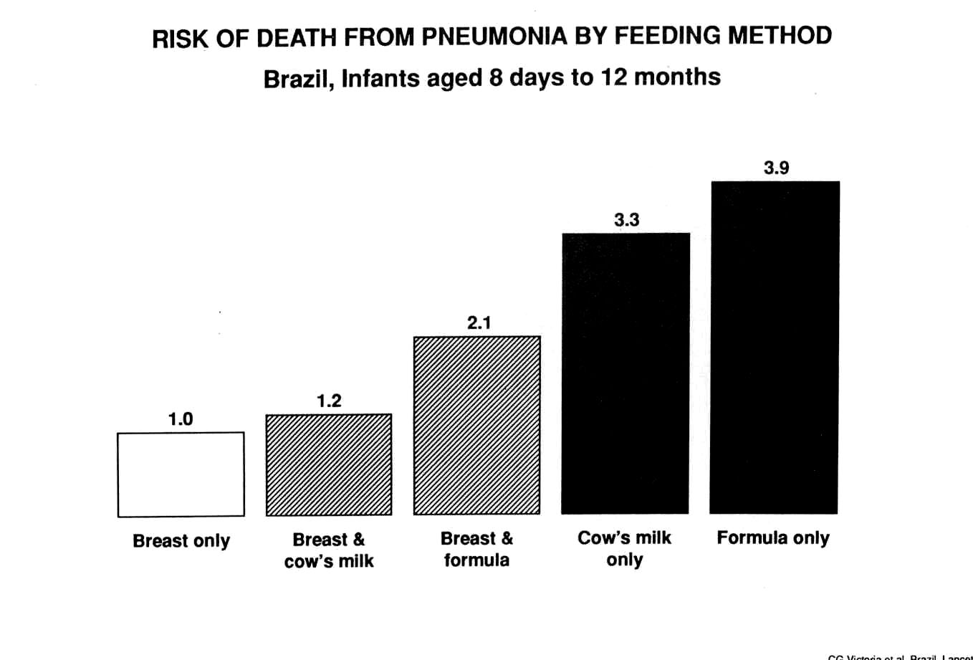
Protection against respiratory infection
Risk of death from pneumonia by feeding method
Brazil, infants aged 8 days to 12 months
23/15
Breast milk only Breast and Breast and Cow’s milk Formula milk
cow’s milk formula milk only only

Slide 17

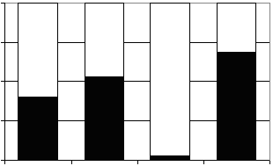
Breast milk in the second year of life
23/16
100%
Gap
75%
50%
Percentage of daily needs
Provided by 550 mL breast milk
25%
0%
Energy
Protein
Iron
Vitamin A
Nutrient

Slide 18
Risks of artificial feeding
23/17
Interferes with bonding
More diarrhoea and persistent diarrhoea
More frequent respiratory infections
Malnutrition; vitamin A deficiency
More allergy and milk intolerance
Increased risk of some chronic diseases
Obesity
Lower scores on intelligence tests
Mother may become pregnant sooner
Increased risk of anaemia, ovarian cancer and breast cancer in the mother

Slide 19
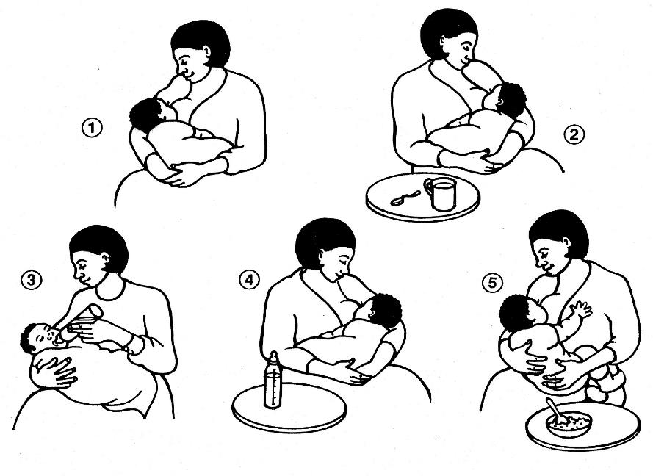
Terms for infant feeding
23/18

Slide 20
Recommendations
23/19
Start breastfeeding within 1 hour after birth
Breastfeed exclusively to 6 months of age
Give complementary foods to all children from 6 months of age
Continue breastfeeding up to 2 years of age or beyond

Slide 21
Session 24: How breastfeeding works 2 – objectives
24/1
After completing this session, participants will be able to describe:
the relevant anatomy of the breast
the physiology of the lactation hormones
the physiology of breast-milk production and flow
the suckling action of the baby when well attached and
when poorly attached
the causes and effects of poor attachment
reflexes in the baby related to breastfeeding

Slide 22
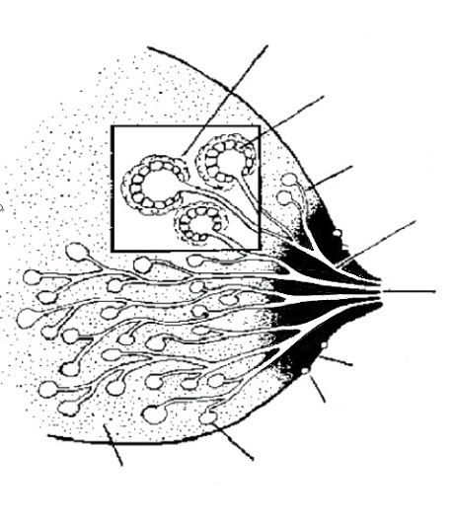
Anatomy of the breast
24/2
Oxytocin makes them contract
Muscle cells
Milk-secreting cells
Prolactin makes them secrete milk
Ducts
Large ducts
Nipple
Areola
Montgomery’s glands
Alveoli
Supporting tissue and fat

Slide 23
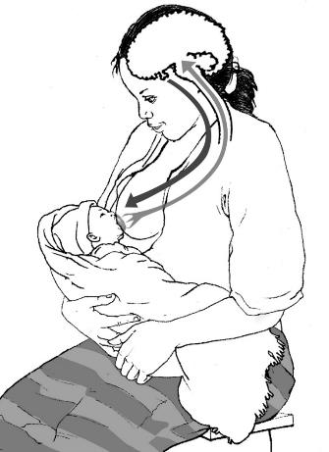
Prolactin
24/3
Secreted during and after feed to produce next feed
Sensory impulses from nipples
Prolactin in blood
Baby suckling
More prolactin secreted at night
Suppresses ovulation

Slide 24
Oxytocin reflex
24/4
Works before or during feed to make milk flow
Sensory impulses from nipples
Oxytocin in blood
Makes uterus contract
Baby suckling

Slide 25

Helping and hindering the oxytocin reflex
24/5
These help the reflex
These hinder the reflex
Thinks lovingly of baby
Sounds of baby
Sight of baby
Touches baby
Confidence
Worry
Stress
Pain
Doubt

Slide 26
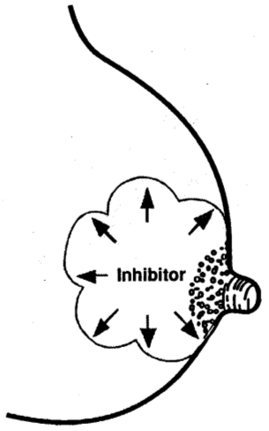
Inhibitor in breast milk
24/6
If breast remains full of milk, secretion stops

Slide 27
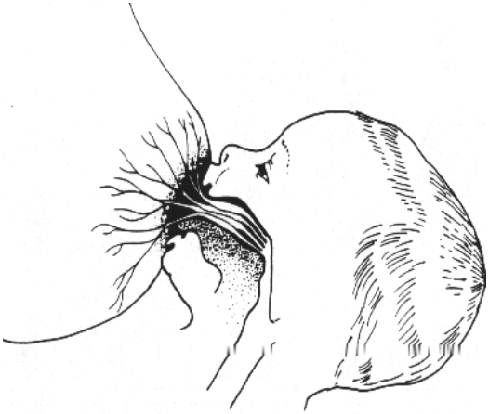
Attachment to the breast
24/7

Slide 28
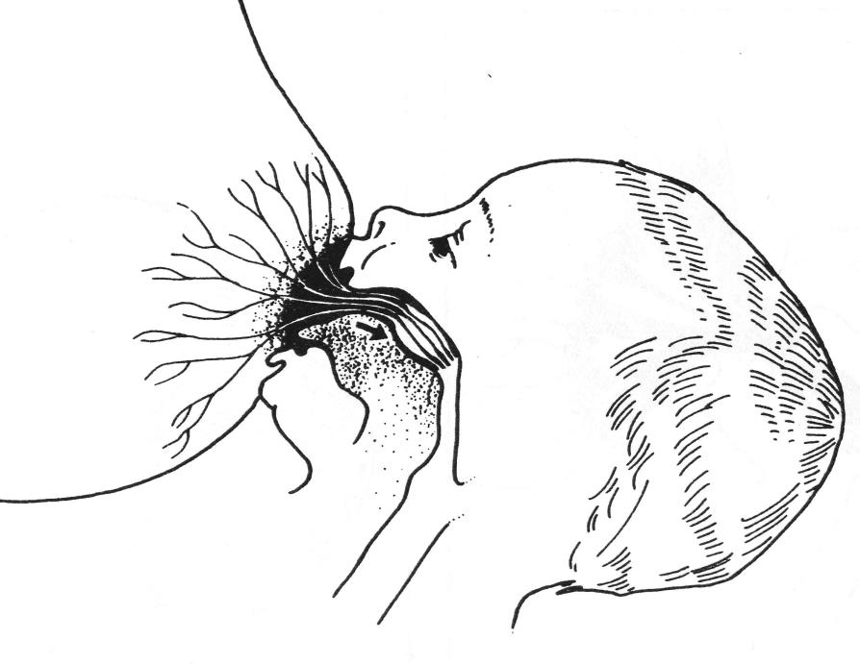
24/8

Slide 29
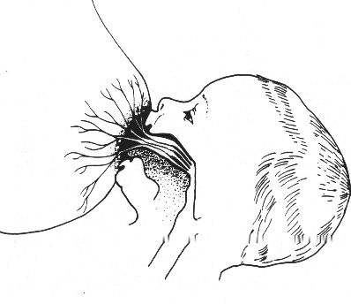
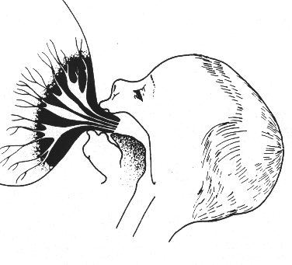
Good and poor attachment
24/9
What differences do you see?
1
2

Slide 30
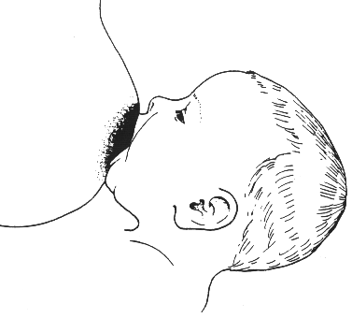
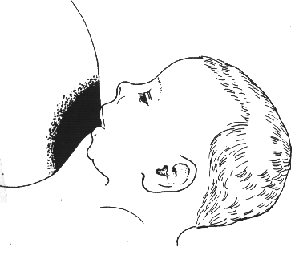
Attachment (outside appearance)
24/10
What differences do you see?
1
2

Slide 31
Results of poor attachment
24/11
Pain and damage to nipples
Breast milk not removed effectively
Apparent poor milk supply
Milk production decreases
Sore nipples and fissures
Engorgement
Mastitis
Baby unsatisfied and wants to feed a lot
Baby frustrated and refuses to suckle
Baby’s weight gain slows

Slide 32
Causes of poor attachment
24/12
Use of feeding bottle before breastfeeding established
for later supplements
Inexperienced mother first baby
previous bottle feeder
Functional difficulty delayed start to breastfeeding
small or weak baby
breast poorly protractile
engorgement
Lack of skilled support less traditional help and community support doctors, midwives, nurses
not trained to help

Slide 33
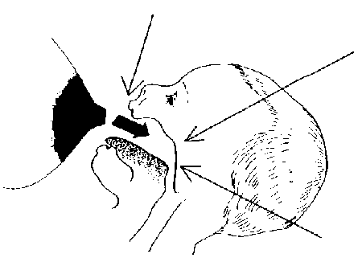
Reflexes in the baby
24/13
Rooting reflex
When something touches the lips, the baby opens the mouth and puts the tongue down and forward
Sucking reflex
When something touches the palate, the baby sucks
Skill
The mother learns to position the baby
The baby learns to take the breast
Swallowing reflex
When the mouth fills with milk, the baby swallows

Slide 34
Session 25: Assessing a breastfeed 2 – objectives
25/1
After completing this session, participants will be able to:
explain the contents and arrangement of the Job aid: Breastfeed observation
describe how to assess a breastfeed using the Job aid: Breastfeed observation
describe how to recognize a mother who needs help

