Slide 1


Infant and young child feeding counselling: an integrated course
2nd edition
Module 4: Sessions 26–27
Breastfeeding (advanced sessions)
WHO/HEP/NFS/21.19
© World Health Organization 2021. Some rights reserved. This work is available under the CC BY-NC-SA 3.0 IGO licence.

Slide 2
Session 26: Observing a breastfeed –objectives
26/1
After completing this session, participants will be able to:
recognize The four key signs of good attachment
recognize good and poor positioning of the baby according
to The four key signs of good positioning
assess a breastfeed using the Job aid: Breastfeed observation
recognize a mother who needs help, using the Job aid: Breastfeed observation

Slide 3
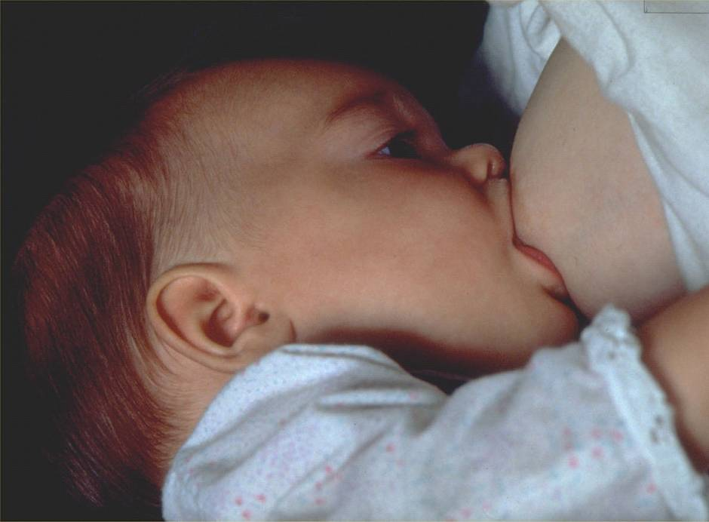
26/2

Slide 4
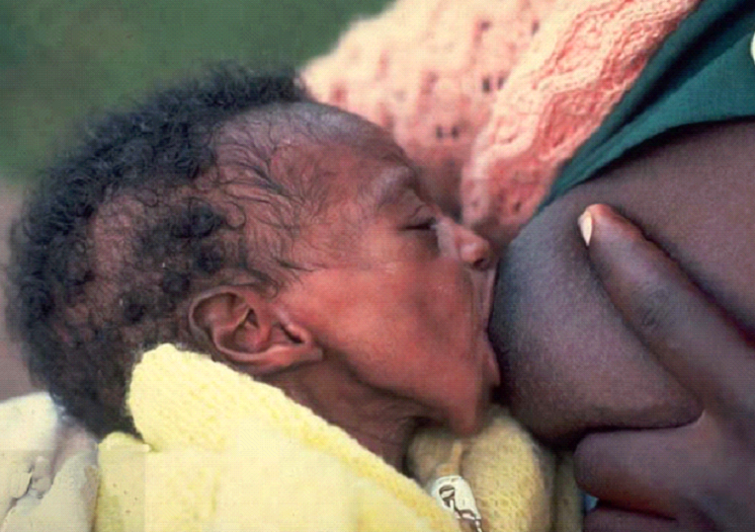
26/3

Slide 5
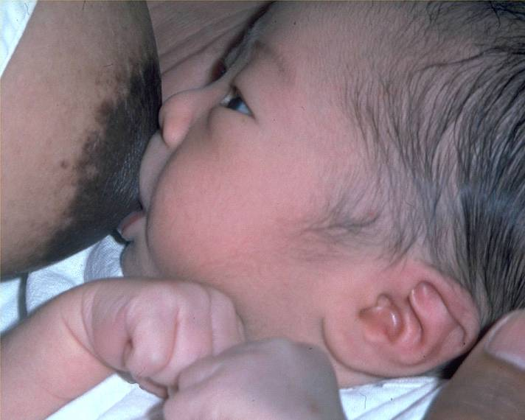
26/4

Slide 6
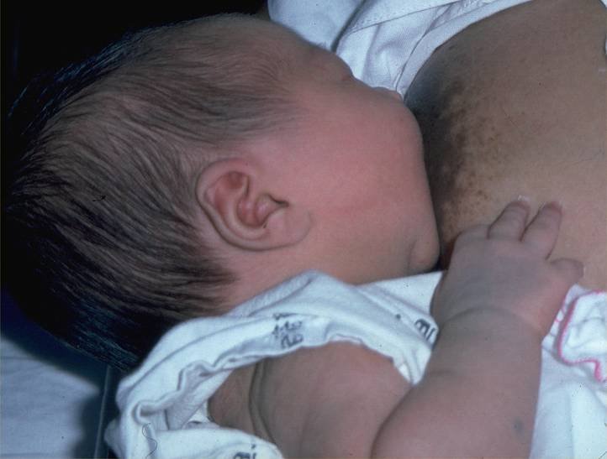
26/5

Slide 7
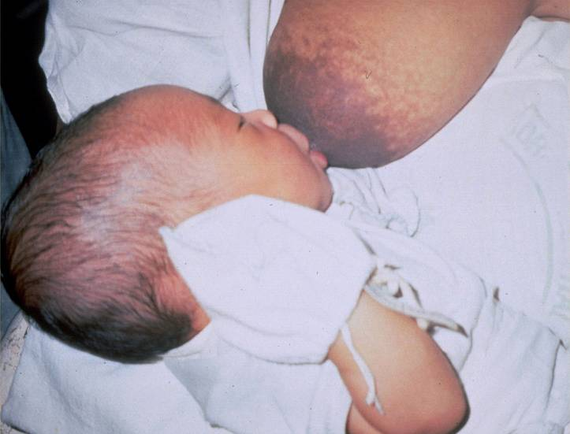
26/6

Slide 8
26/7

Slide 9
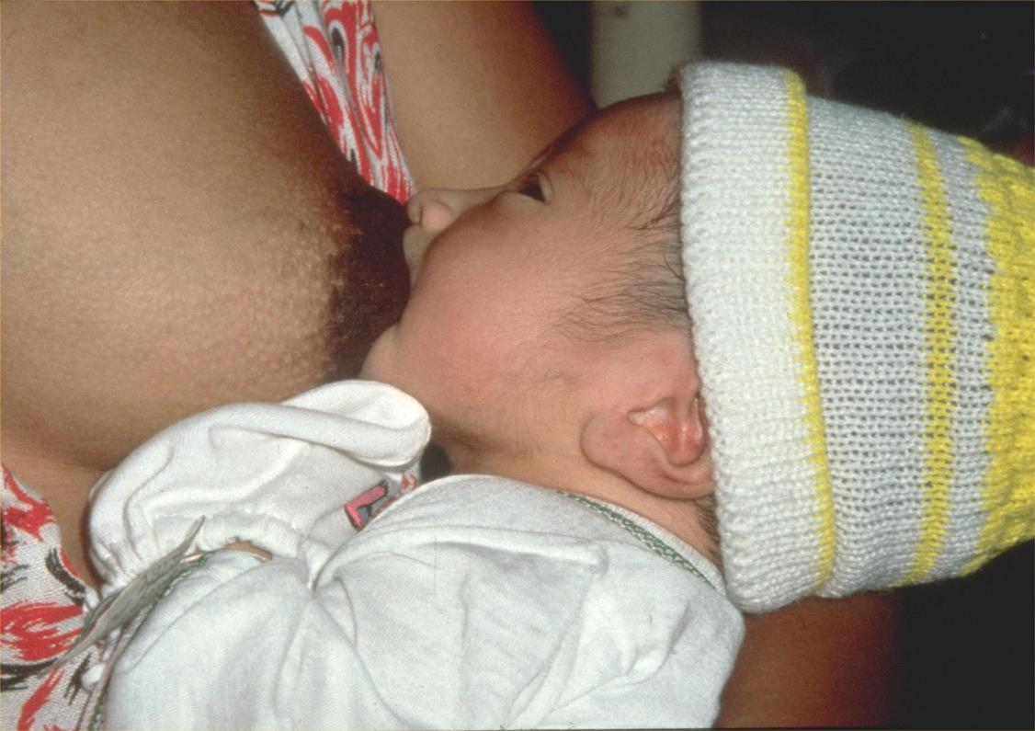
26/8

Slide 10
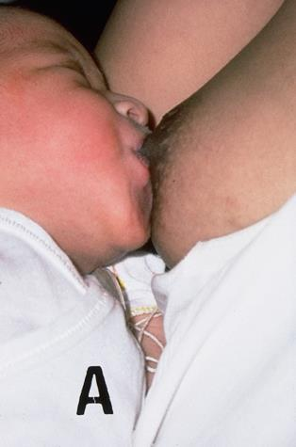
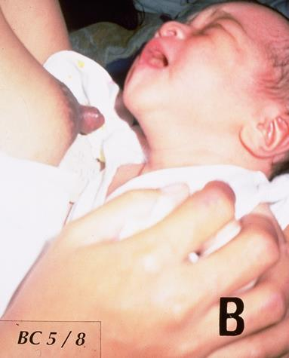
26/9

Slide 11
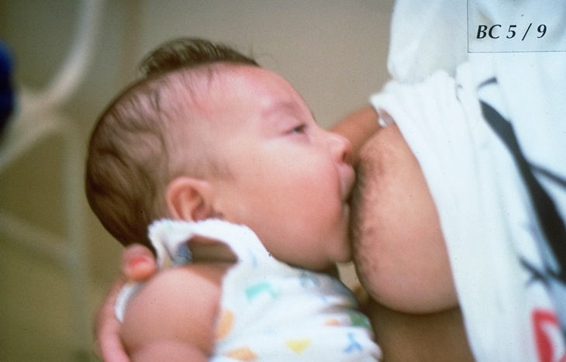
26/10

Slide 12
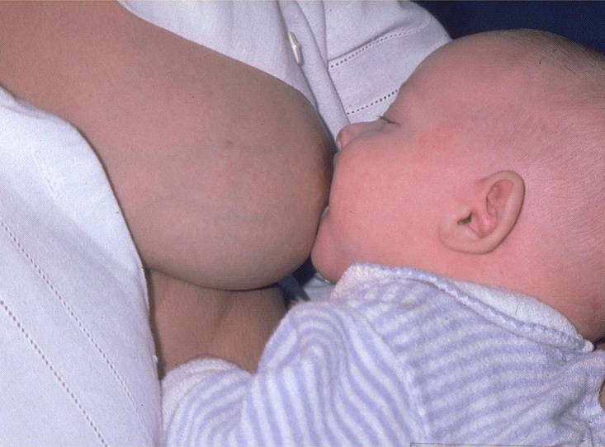
26/11

Slide 13
26/12

Slide 14
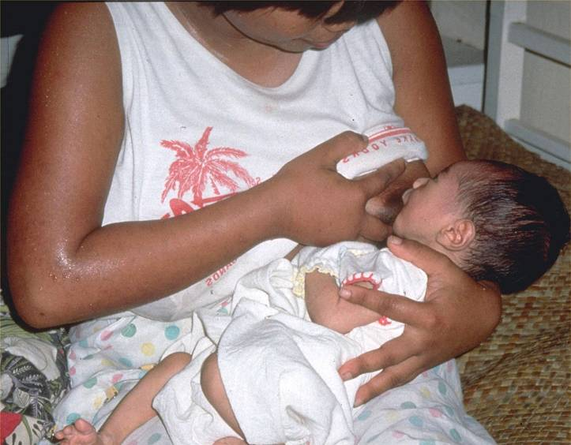
26/13

Slide 15
26/14

Slide 16
26/15

Slide 17
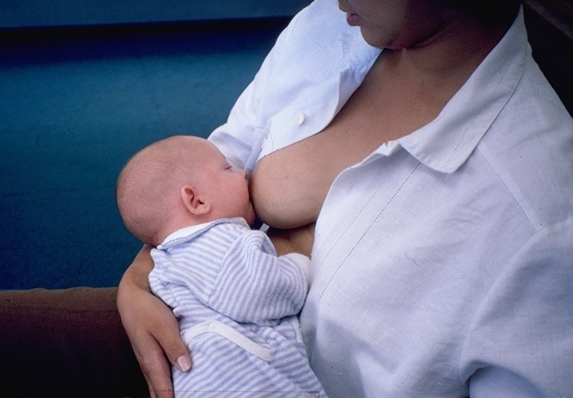
26/16

Slide 18
Session 27: Positioning a baby at the breast 2 – objectives
27/1
After completing this session, participants will be able to:
explain The four key signs of good positioning
explain the different positions for a mother to breastfeed
explain different ways to hold a baby
describe how a mother should support her breast
for feeding
explain the common mistakes of positioning a baby
help a mother to hold and position her baby at the breast, by demonstrating with a doll

