Slide 1


Infant and young child feeding counselling: an integrated course
2nd edition
Module 4: Sessions 31–40
Breastfeeding (advanced sessions)
WHO/HEP/NFS/21.19
© World Health Organization 2021. Some rights reserved. This work is available under the CC BY-NC-SA 3.0 IGO licence.

Slide 2
Session 31: Taking a feeding history –
0 up to 6 months 2 – objectives
31/1
After completing this session, participants will be able to:
describe how to take a feeding history of an infant aged
0 up to 6 months
describe the content and arrangement of the Job aid: Feeding history – 0 up to 6 months
describe how to use of the Job aid: Feeding history –
0 up to 6 months

Slide 3
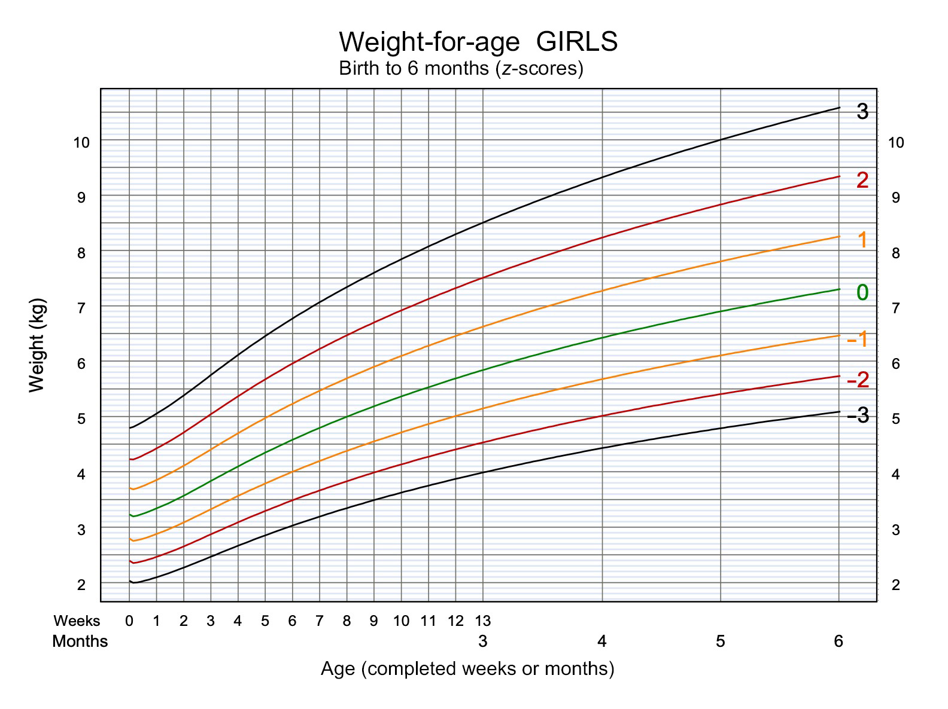
31/2
Demonstration 31.A
Lucy

Slide 4
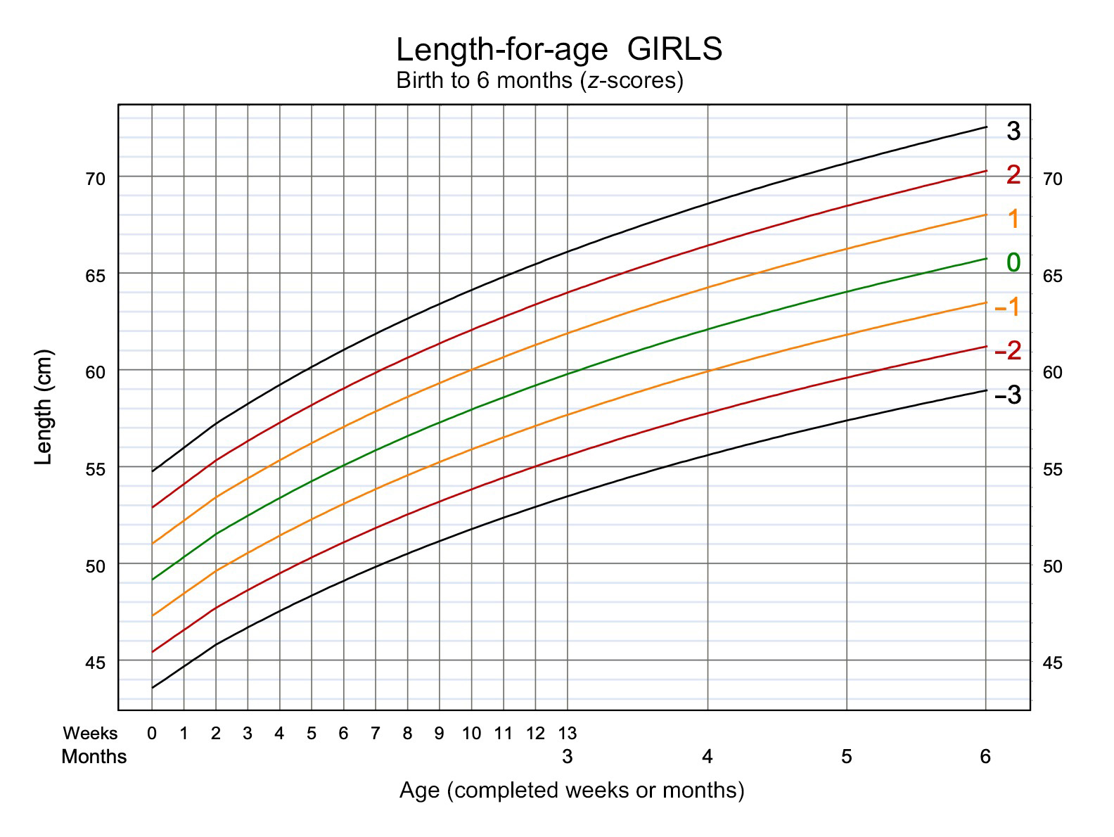
31/3
Demonstration 31.A
Lucy

Slide 5
Session 33: Expressing breast milk 2 – objectives
33/1
After completing this session, participants will be able to:
list the situations when expressing breast milk is useful
explain how to stimulate the oxytocin reflex
rub a mother’s back to stimulate the oxytocin reflex
demonstrate how to select and prepare a container for expressed breast milk
describe how to store breast milk
explain to a mother the steps of expressing breast milk
by hand

Slide 6
Session 34: “Not enough milk” –objectives
34/1
After completing this session, participants will be able to:
list the reliable and possible signs that a baby is not getting enough milk
decide whether a baby is getting enough breast milk
describe the common reasons why a baby may have a low intake of breast milk in the first 2 weeks of life
list the common reasons why a baby may have a low intake of breast milk intake after 2 weeks of age
describe the common reasons for apparent insufficiency of milk
decide the cause of the difficulty
explain the management of real or apparent low milk supply

Slide 7
Session 35: Crying – objectives
35/1
After completing this session, participants will be able to:
list different reasons why babies may cry
help families with babies who cry a lot to continue exclusive breastfeeding and not to start unnecessary complementary feeds or supplements

Slide 8
Session 38: Feeding low-birth-weight and sick babies – objectives
38/1
After completing this session, participants will be able to:
describe why breast milk is the best food for low-birth-weight babies
describe why it is important to continue breastfeeding or giving breast milk when an infant is sick or jaundiced
help a mother of a low-birth-weight or sick baby to give her baby breast milk
help a mother to feed her baby by cup

Slide 9
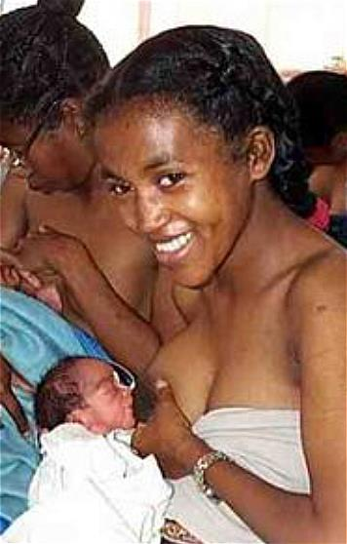
Advantages of breastfeeding for low-birth-weight babies
38/2
Lower risk of septicaemia and other infections
Less necrotizing enterocolitis
Lower mortality
Better mental development

Slide 10
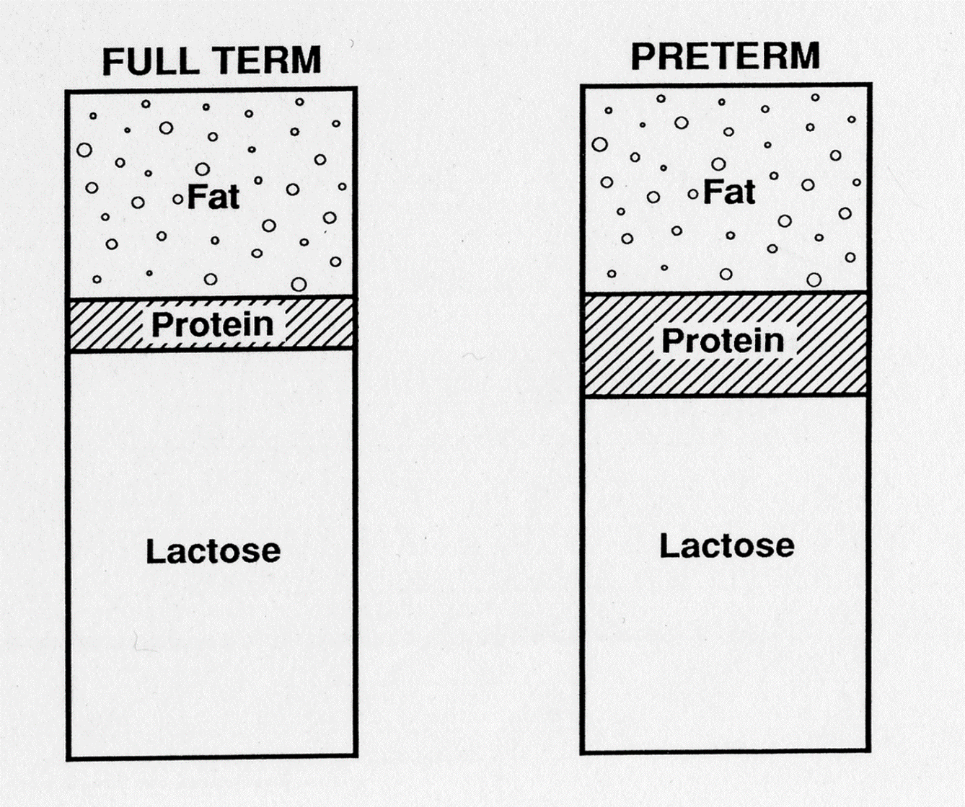
What is the difference between these breast milks?
38/3

Slide 11
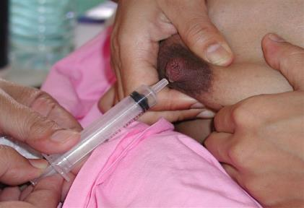
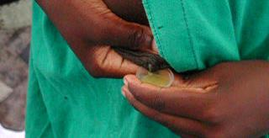
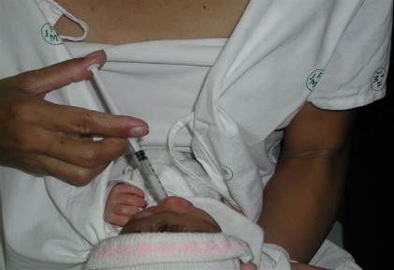
Expressing breast milk on the day of birth
Start expressing within 6 hours after delivery – collect small amounts in a syringe
38/4

Slide 12
Methods of feeding low-birth-weight babies
38/5
Gestational age, weeks | Approximate weights, g | Oral feeding method
Before 32 | 1000–1500 | Intragastric feeding
32–34 | 1300–1800 | Cup for most feeds Try breastfeeding
33–35 | 1600–2000 | Breastfeeding for part of feed Feed by cup or tube to ensure enough
34–36 | 1800–2200 | Coordinated breastfeeding May need some supplements

Slide 13
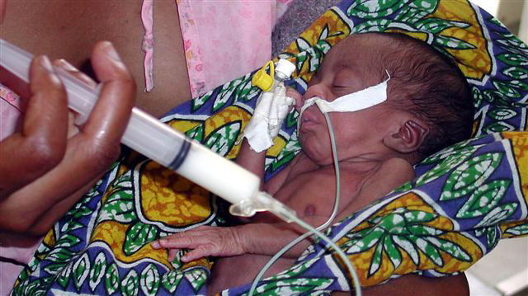
Intragastric tube feeding before 32 weeks
38/6

Slide 14
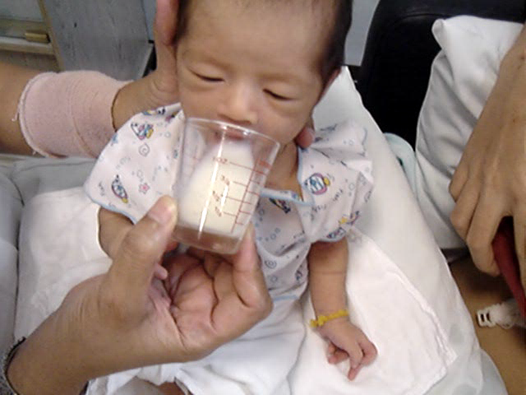
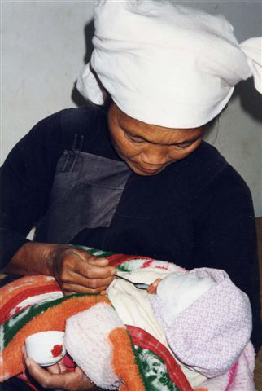
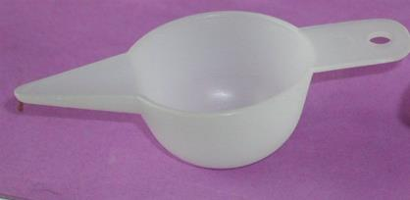
Cup-feeding, spoon-feeding, paladai
38/7

Slide 15
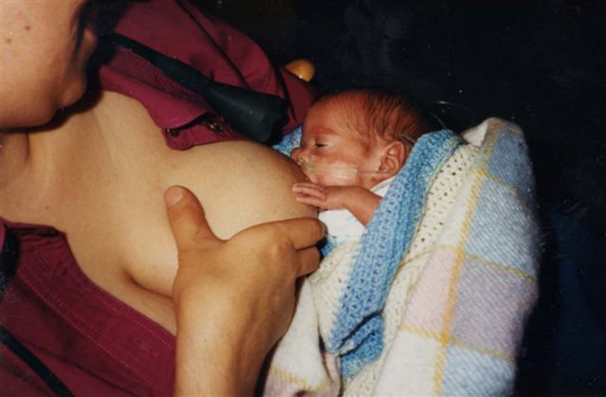
Partial breastfeeding: 33–35 weeks
38/8

Slide 16
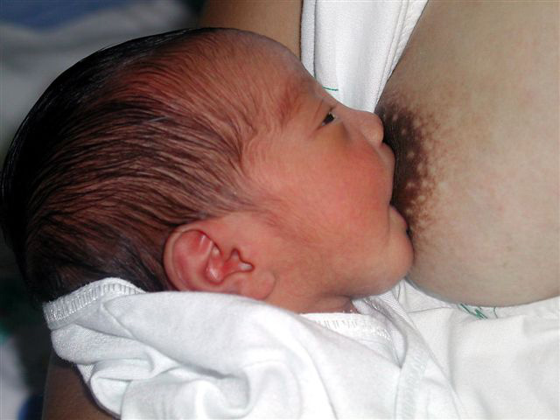
Ensure good attachment
38/9

Slide 17
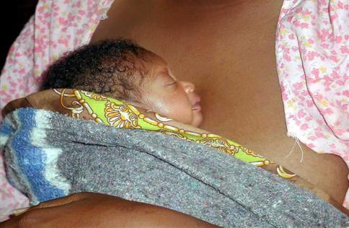
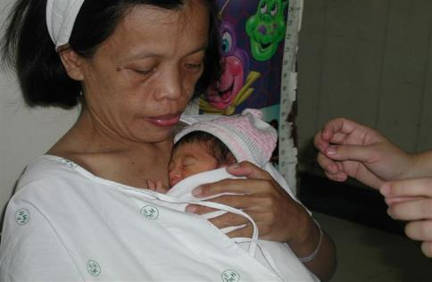
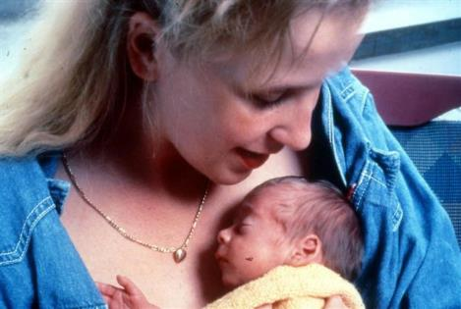
Skin-to-skin contact
38/10

Slide 18
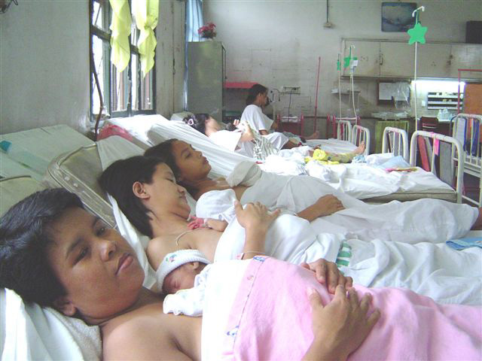
Kangaroo mother care
38/11

Slide 19
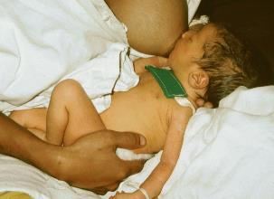
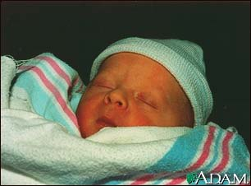
Early jaundice and hypoglycaemia: 2–10 days
38/12
These do NOT help
Glucose feeds
Extra water
Infrequent or restricted breastfeeds
These help:
Breastfeed early
Frequent unrestricted breastfeeds
20% extra if given expressed breast milk

Slide 20
Why do babies stop breastfeeding when they are ill?
38/13
Difficulty with breastfeeding
Difficulty suckling (e.g. respiratory infection)
Loss of appetite (e.g. severe infections)
Oral feeds not possible (e.g. some surgery)
Misinformation
Someone says breastfeeding caused the illness
Health worker advises mother to stop

Slide 21
Breastfeeding of sick babies
38/14
If breastfeeding stops:
Baby - gets less nourishment
- loses more weight
- takes longer to recover
- lacks the comfort of suckling
Breast milk decreases – baby may refuse to start again
If breastfeeding continues:
Baby - gets best nourishment
- loses less weight
- recovers more quickly
- is comforted by suckling
Production of breast milk continues

Slide 22
How to help breastfeeding if a baby is sick
38/15
If the baby:
Is in hospital
Can suckle well
Suckles less than before
Is not able to suckle or refuses
Cannot take oral feeds
Is recovering
Help the mother to:
Stay in hospital with her baby
Breastfeed more often
Give more frequent, shorter feeds
Express her breast milk and give it by cup or tube
Express 3-hourly to keep up the milk supply
Start breastfeeding again.
Breastfeed more often to build up the milk supply

Slide 23
Session 39: Increasing breast milk and relactation – objectives
39/1
After completing this session, participants will be able to:
describe the main requirements for increasing the supply of breast milk
explain the procedure for increasing the supply of breast milk if the baby is willing to suckle
describe the use of the breastfeeding supplementer

Slide 24
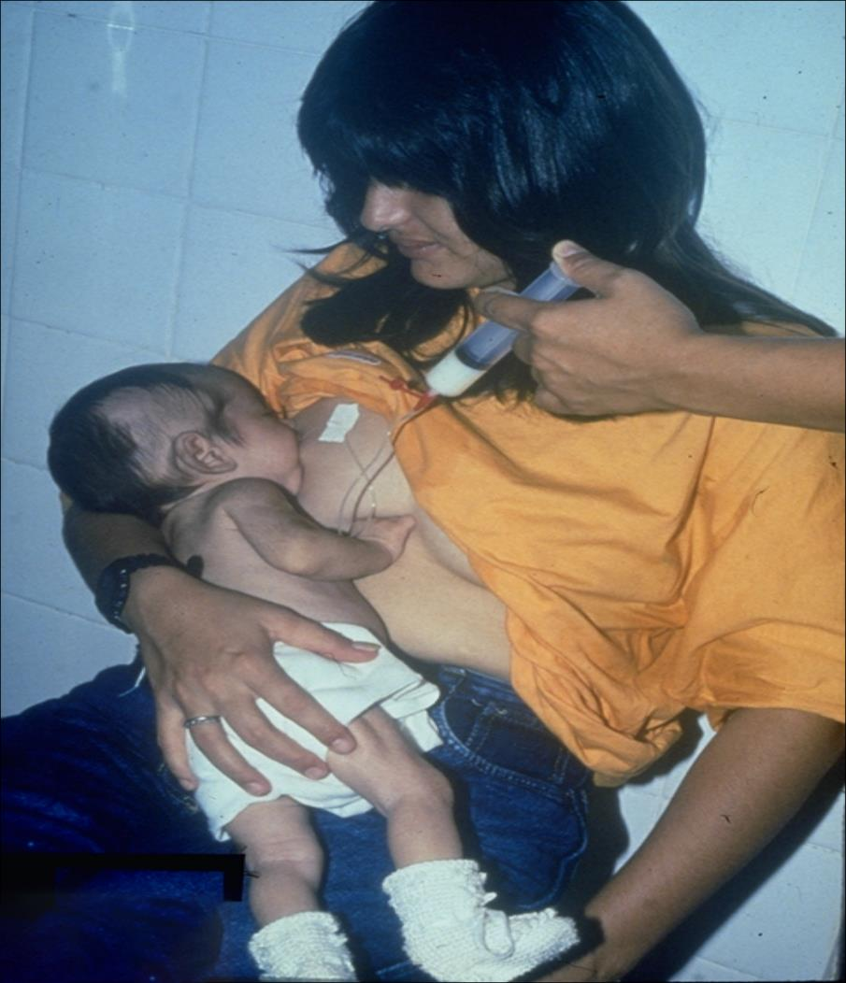
39/2

Slide 25
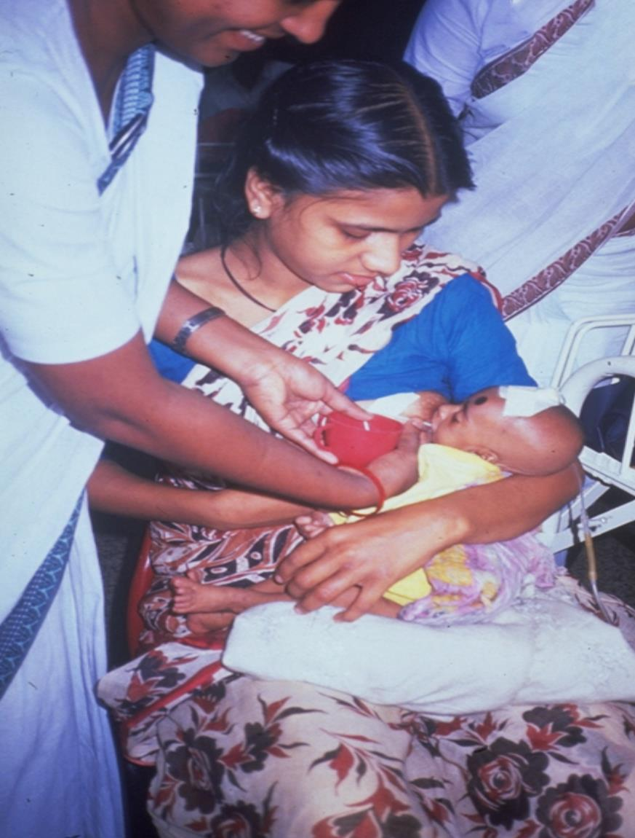
39/3

Slide 26
Session 40: Sustaining breastfeeding – objectives
40/1
After completing this session, participants will be able to:
help mothers to continue to breastfeed for up to 2 years or beyond
support breastfeeding when they see mothers and babies for other reasons

Slide 27
40/2a

Slide 28
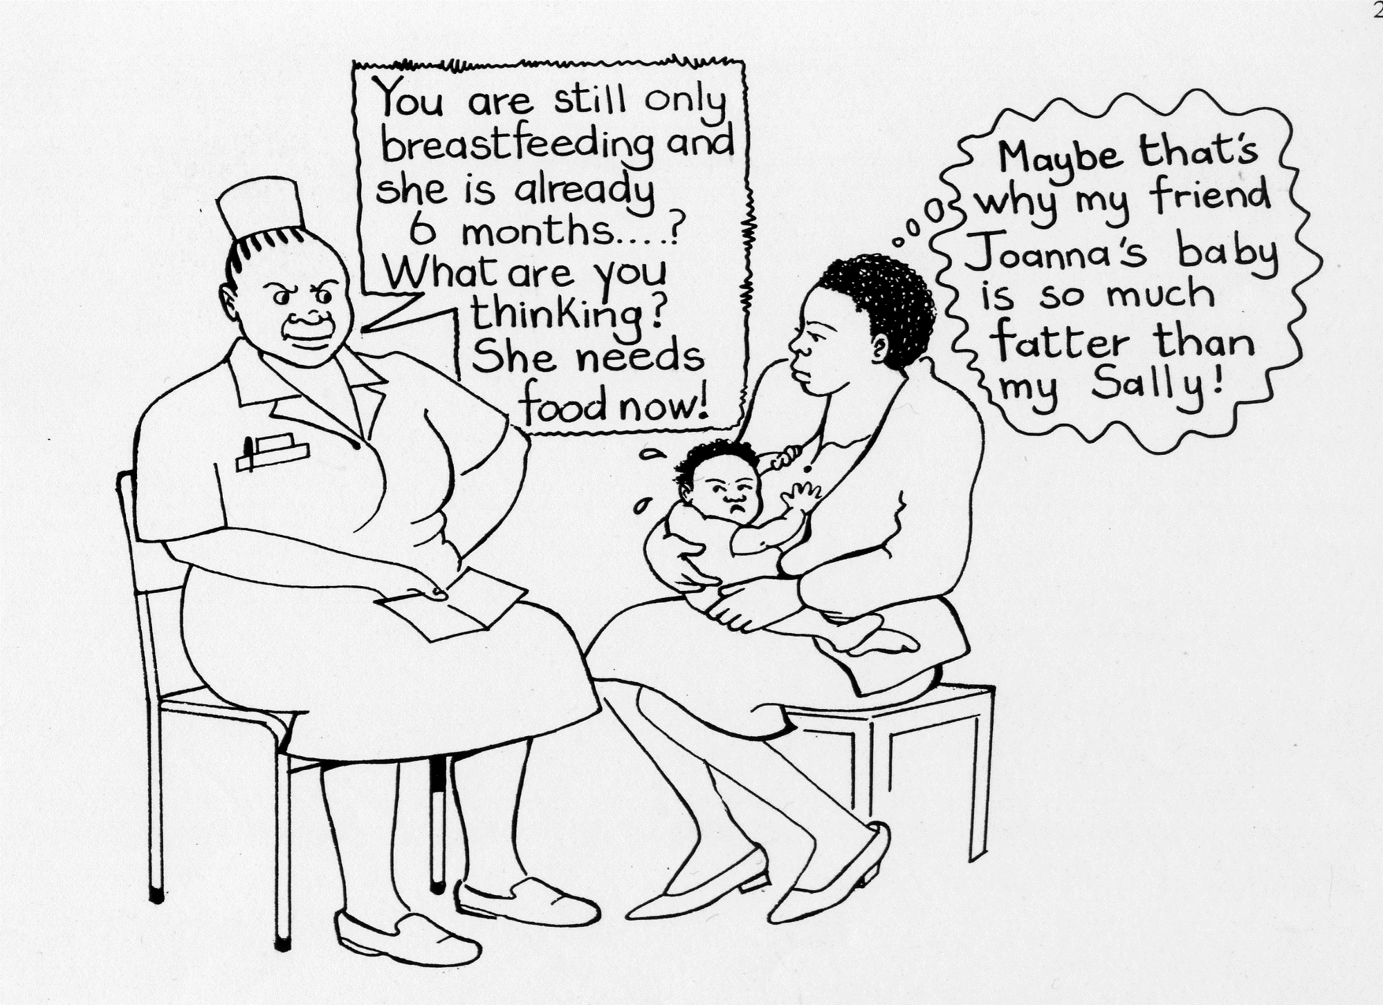
40/2b

Slide 29
40/3a

Slide 30
40/3b

