Slide 1


Infant and young child feeding counselling: an integrated course
2nd edition
Module 6: Sessions 56–60
Growth assessment
WHO/HEP/NFS/21.21
© World Health Organization 2021. Some rights reserved. This work is available under the CC BY-NC-SA 3.0 IGO licence.

Slide 2
Session 56: Introducing child growth assessment – objectives
56/1
After completing this session, participants will be able to:
start a Growth record for a child and select pages to use at a given visit
determine a child’s age on the visit day
identify the correct charts to use (age and sex) on a given visit, and where these charts are in the Growth record

Slide 3
Child growth assessment 1
56/2
Basic growth assessment involves measuring a child’s weight and length/height
Measurements are then compared to growth standards
Why? To determine whether the child is growing normally or has a growth problem or trend towards a problem
Steps: measure, plot, interpret, take action to address or prevent growth problems
Correct measurement, plotting and interpretation is essential to identify problems correctly

Slide 4
Child growth assessment 2
56/3
If there is a growth problem, determine the causes
Take action to address the causes of poor growth; without appropriate action, programmes are ineffective in improving child health
In extreme poverty or emergencies, growth assessment aims to identify children who need urgent intervention, (therapeutic or supplementary feeding), to prevent death
In health-facility settings, children with severe forms of undernutrition should be referred for specialized care
Obese children need medical assessment and specialized management; non-severe problems can be managed through counselling, including age-appropriate advice on feeding and physical activity

Slide 5
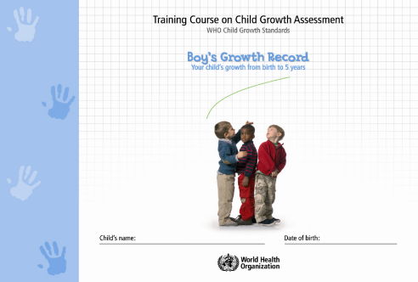
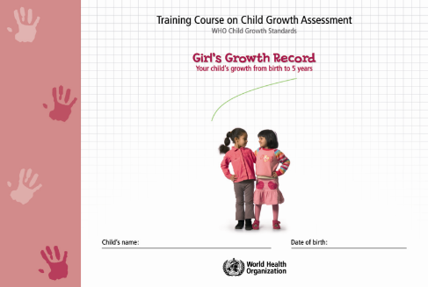
The Child growth record
56/4
Contains all of the charts needed to record and assess the growth of a child from birth up to 5 years of age
A different Growth record is needed for boys and girls because boys and girls have different weights and lengths from birth

Slide 6
Growth record contents
56/5
Personal data (page 1)
Visit notes (pages 6–11)
Special care (page 12)
Feeding recommendations (pages 13–18)
Food safety and hygiene (page 20)
Care for development (pages 21–26)
Growth charts (length/height-for-age; weight-for-age; weight-for-length/height)
  – 0–6 months (pages 29–31)
  – 6–24 months (pages 33–35)
  – 2–5 years (pages 37–39)
Gross motor milestones (page 41)

Slide 7
Start a new Growth record
56/6
Select a boy's or girl's record as appropriate
Ensure the date of birth is correct
Record measurements at birth (weight, length, head circumference)
Later growth assessment depends on the correctness of the birth date and measurements
Other information will be entered later (birth of the next child, feeding history, any adverse events)

Slide 8
The Child age calculator
56/7
Important to know the precise child's age today, in order to assess certain growth indicators
Study the Child age calculator
– Circular 12-month calendar
– Rotating disk
– Age in completed weeks for the first 3 months
– Age in completed months for 3–12 months
To calculate age:
– Work out completed years
– Bold arrow points to the child's birthday
– Locate today's date on stationary calendar
– Count on rotating disk completed weeks/months since last birthday

Slide 9
Session 57: Measuring weight, length and height – objectives
57/1
After completing this session, participants will be able to:
use the available weighing and measuring equipment
weigh a child
measure a child’s length
measure a child’s height

Slide 10
58/1
Session 58: Measuring: it’s not so easy – objectives
After completing this session, participants will be able to:
identify common errors in measuring weight, length and height

Slide 11
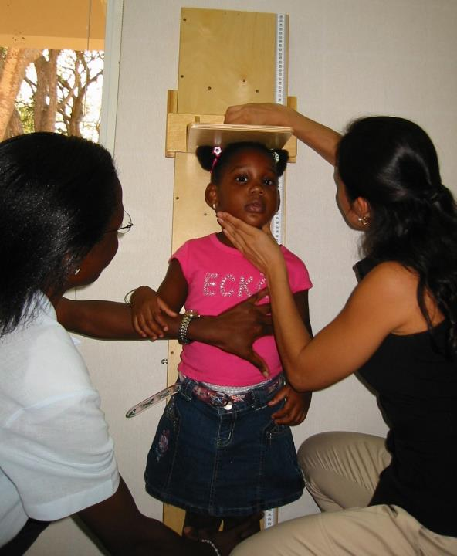
58/2
Notes:
Height--Child held in position at knees and tummy, measurer in good position

Slide 12
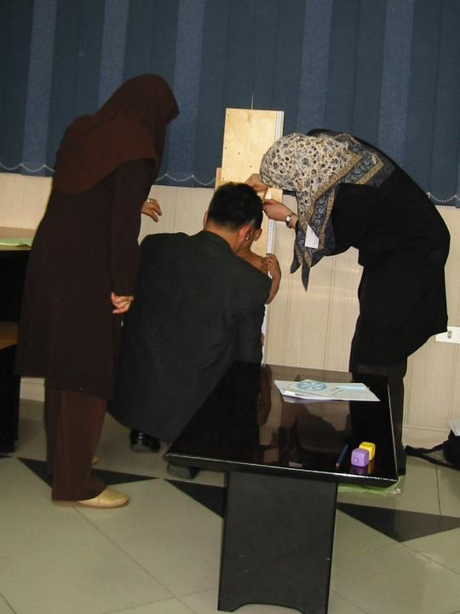
58/3
Notes:
Height--Measurer on right leaning over to read tape. Assistant should be over to left, so that measurer can take position in front of child.

Slide 13
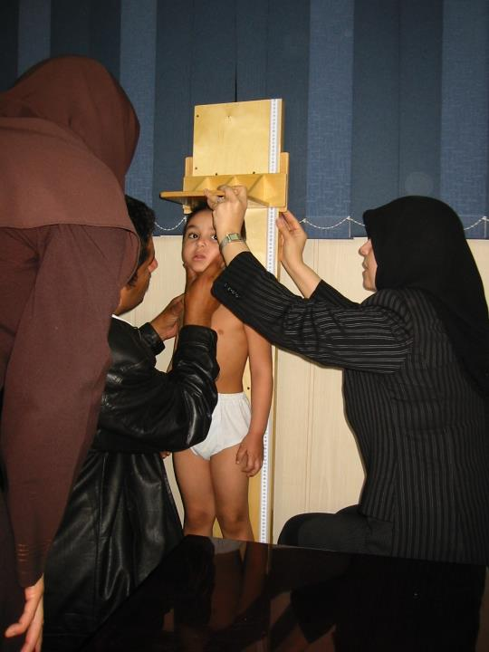
58/4
Notes:
Height--Measurer well down on the level of the child. She should hold the head board at its top centre. Assistant should be over to left of board, so that measurer can be in front of tape to read it.

Slide 14
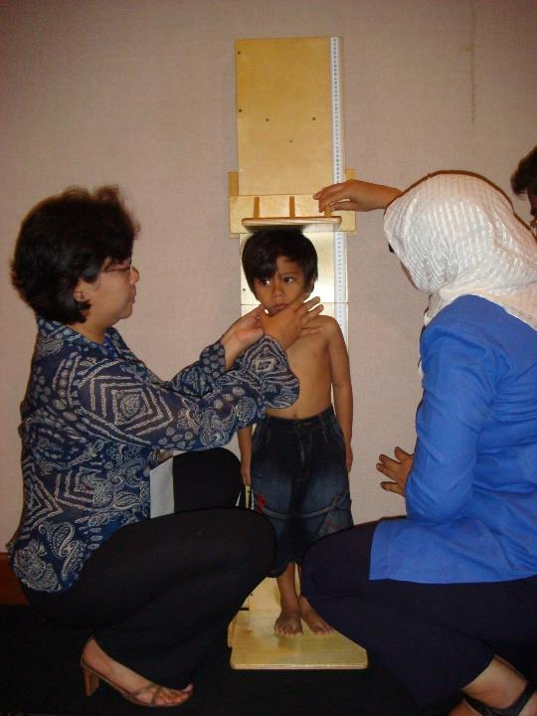
58/5
Notes:
Assistant should be down. Measurer should be holding child’s head, not the assistant. Measurer should hold the board at its top centre. Assistant should check feet and hold knees. Child seems to be leaning toward assistant with weight not balanced equally on both feet.

Slide 15
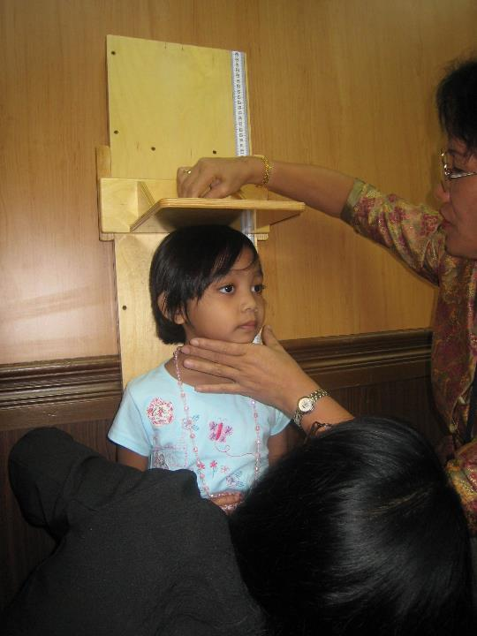
58/6
Notes:
Good position of child and measurer.

Slide 16
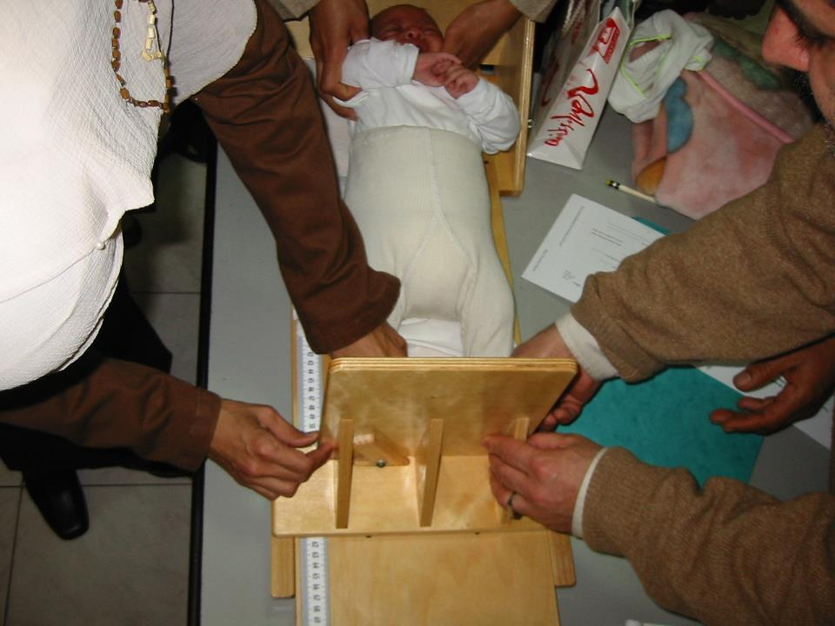
58/7
Notes:
Length--Diaper interferes with straightening of legs. Assistant is holding one shoulder, instead of holding both sides of head, so baby’s torso is twisted.

Slide 17
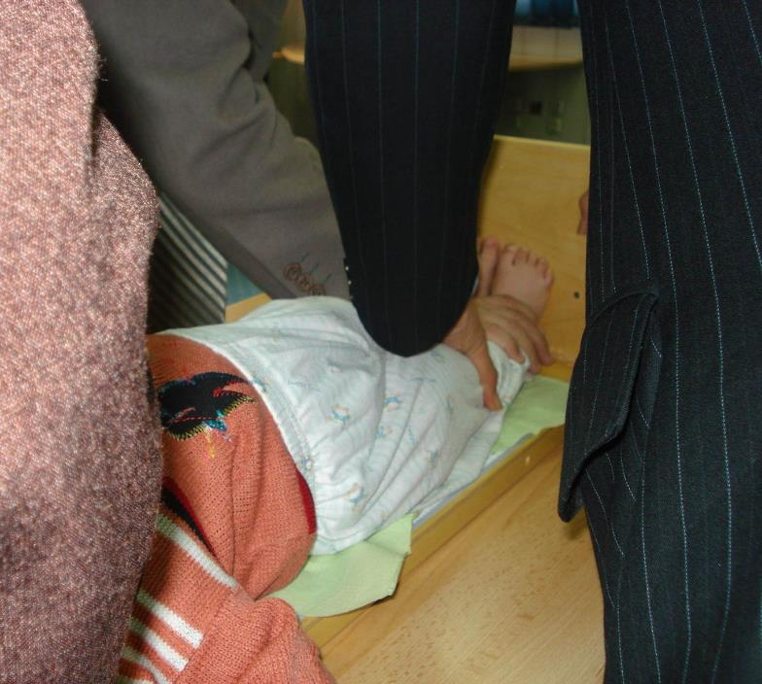
58/8
Notes:
Length--feet flat on board. Child is wearing a lot of clothes.

Slide 18
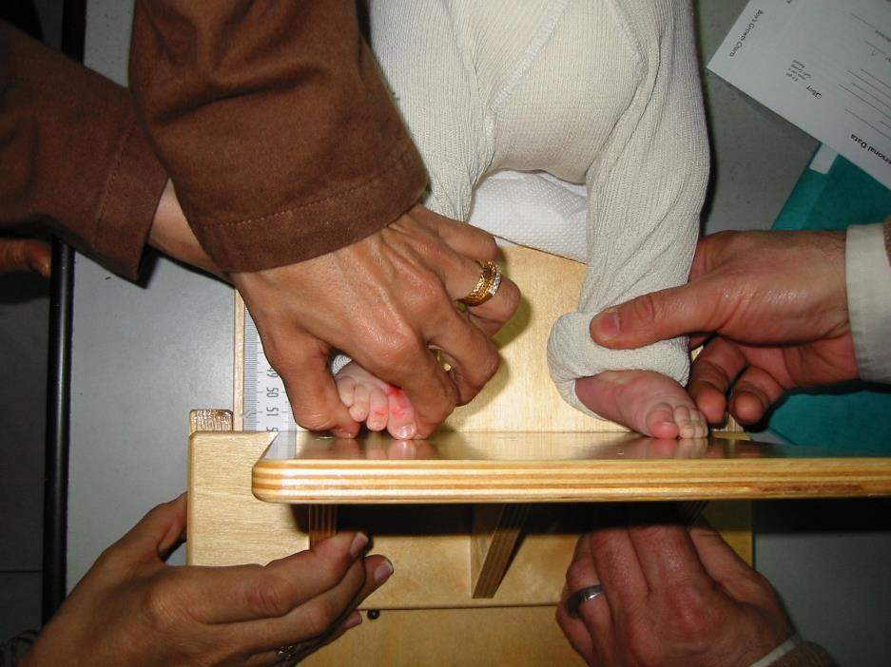
58/9
Notes:
Length--Feet not flat

Slide 19
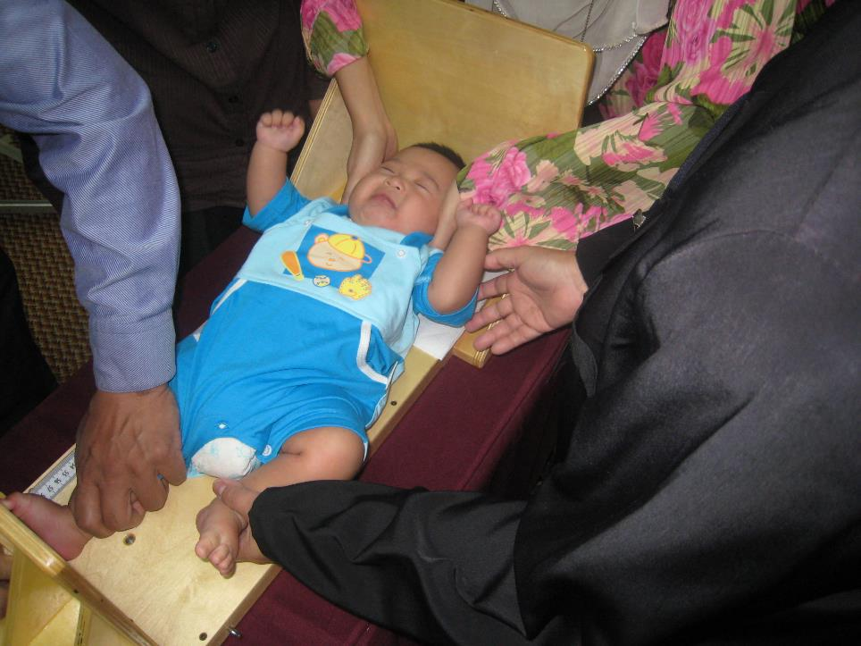
58/10
Notes:
Measurement taken with one leg only. Head held in good position. Important to be certain torso is straight.

Slide 20
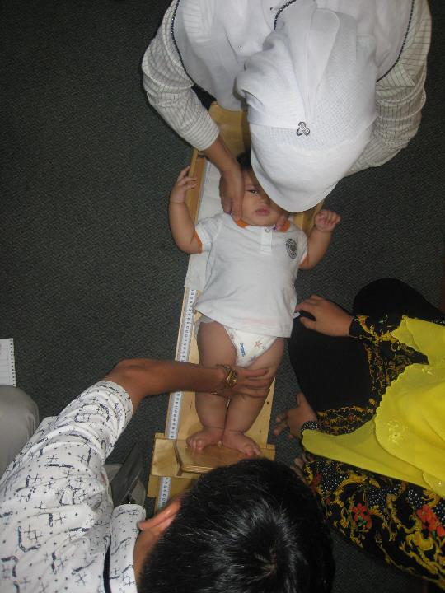
58/11
Notes:
Head held in good position, knees controlled well. Difficult child measured well.

Slide 21
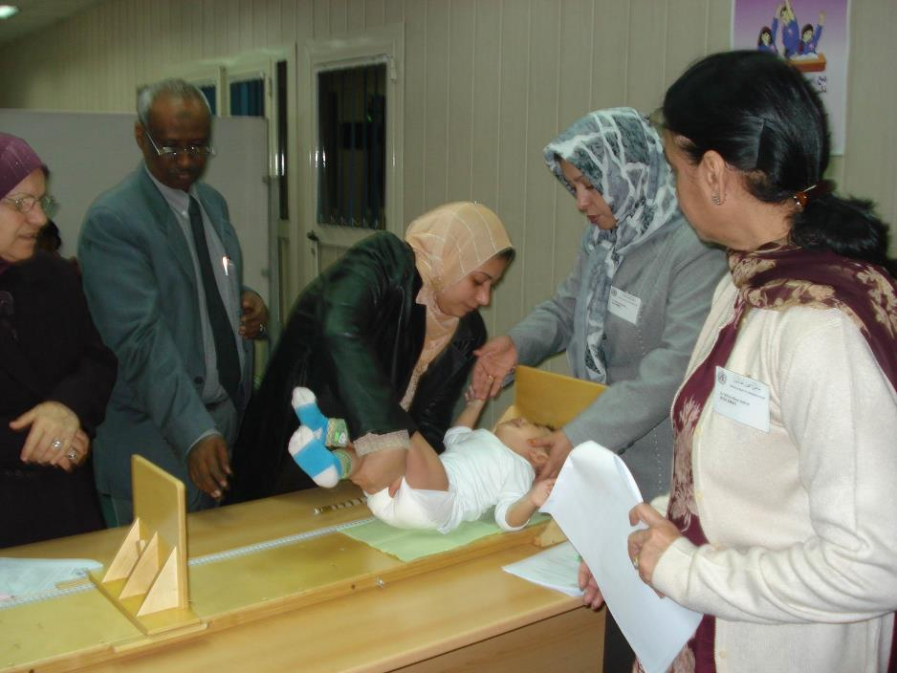
58/12
Notes:
Length--Going into position—most children get upset at this point, so measurer should be closer and ready to move quickly. Board should be closer to edge of table.

Slide 22
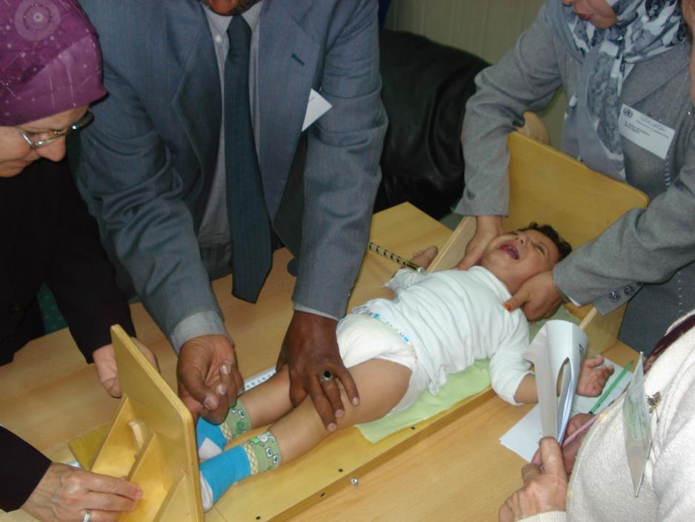
58/13
Notes:
Length—Knees held in good position by measurer. Torso is straight. Assistant is holding head in good position by holding hands over ears with thumbs on shoulders. Feet do not look flat yet, and measurer should be working the footboard.

Slide 23
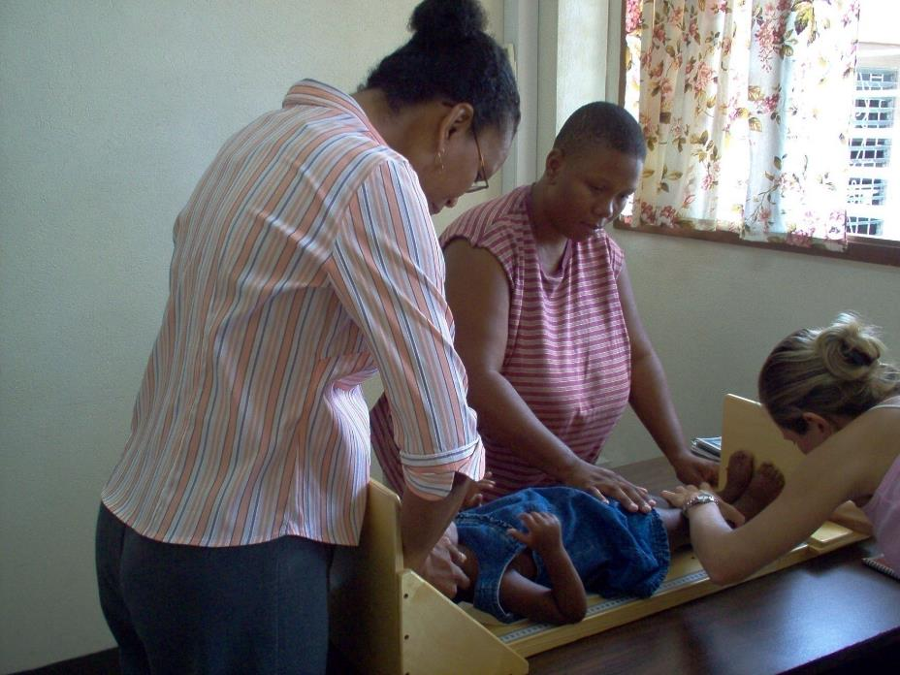
58/14
Notes:
Length--Good position of knees and feet. Measurer bends close to check feet and read tape accurately. Assistant in good position.

Slide 24
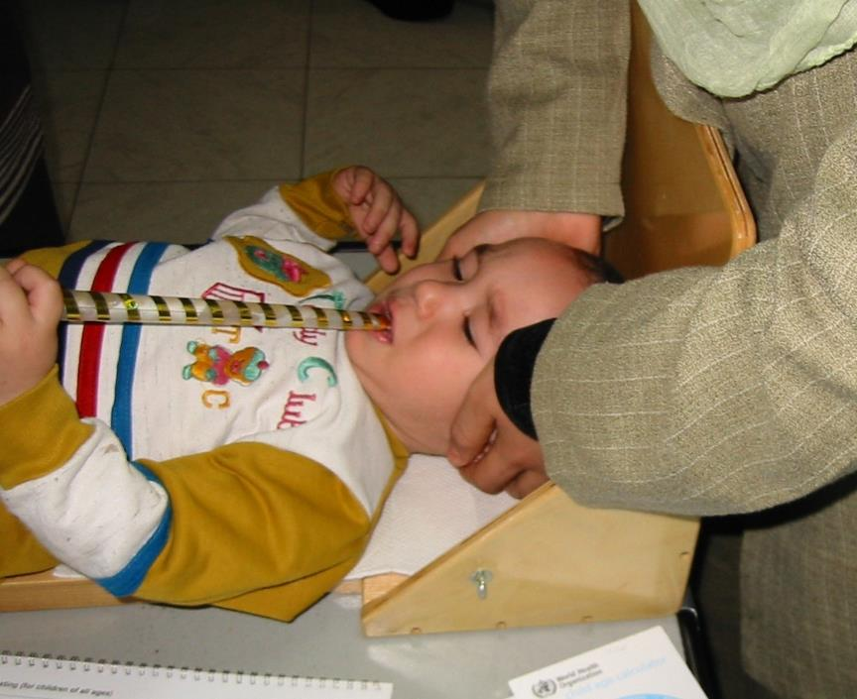
58/15
Notes:
Length--Poor head position. Dangerous to have toy in mouth.

Slide 25
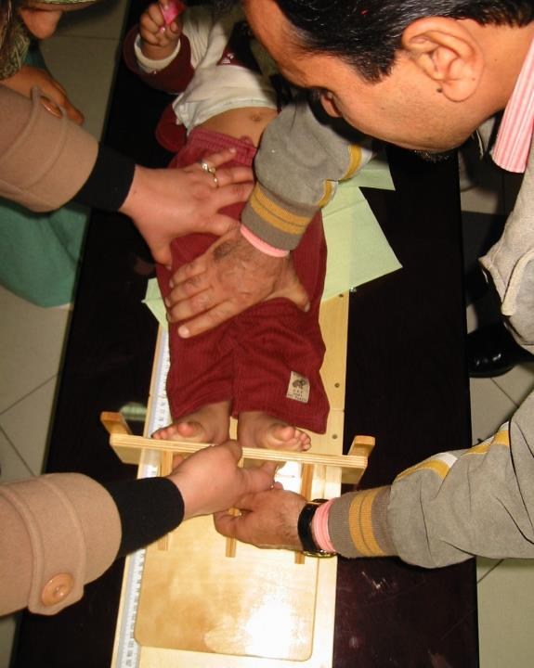
58/16
Notes:
Torso not straight. Person other than the measurer is holding the knees. (Too many helpers often do more harm than good.) Measurer could see child’s body position better if child was undressed.

Slide 26
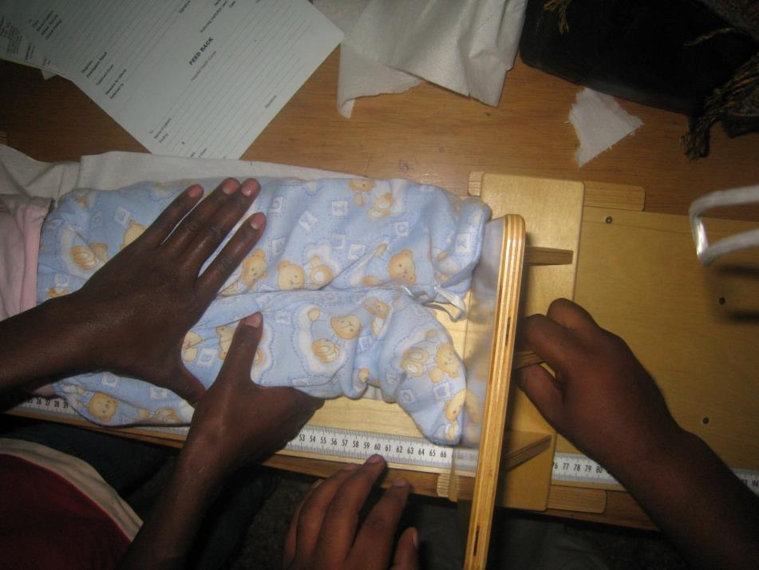
58/17
Notes:
Cannot see this child’s feet!

Slide 27
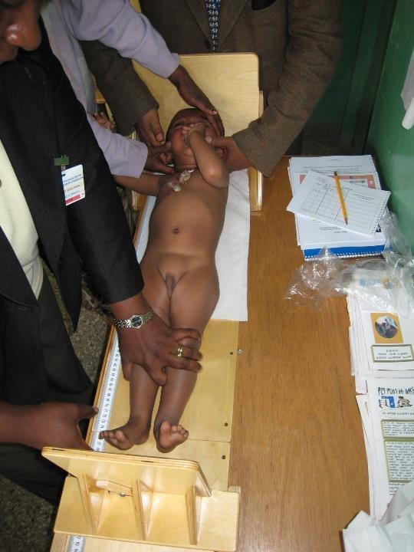
58/18
Notes:
Child in good position, as we can see without clothes. Knees held well, legs and torso are straight. Too many helpers around the head.

Slide 28
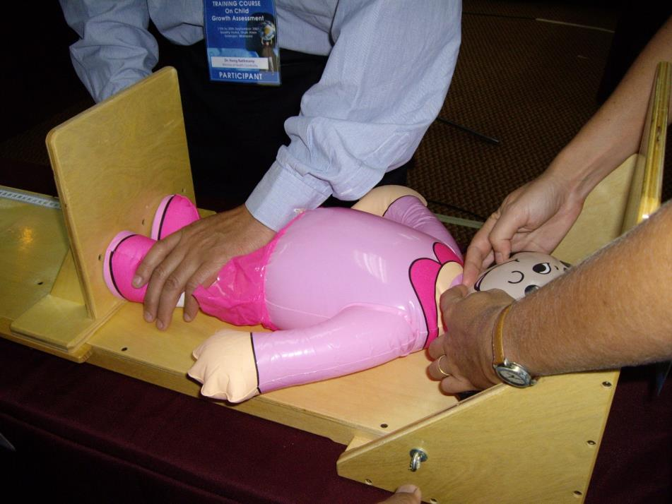
58/19

Slide 29
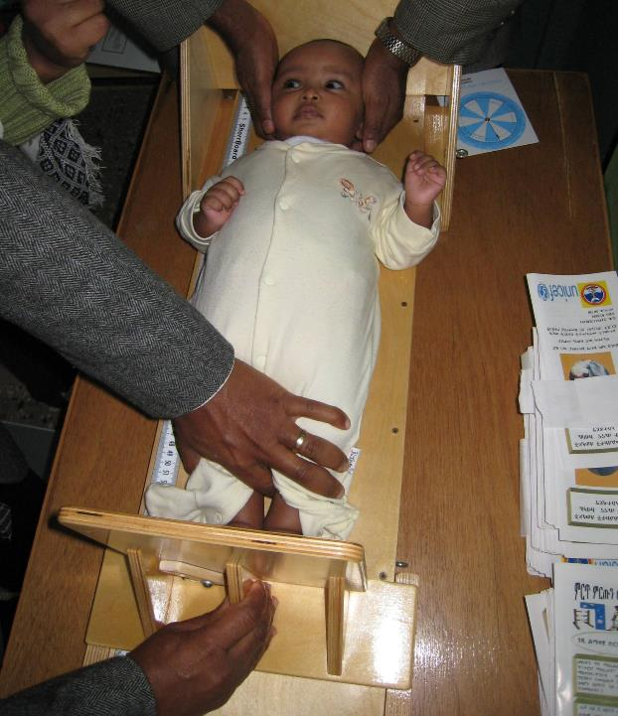
58/20
Notes:
Measurer took child’s feet out of clothes so could see them. Measurer is holding knees and footboard correctly. Assistant holding head correctly. Would be better if child were undressed.

Slide 30
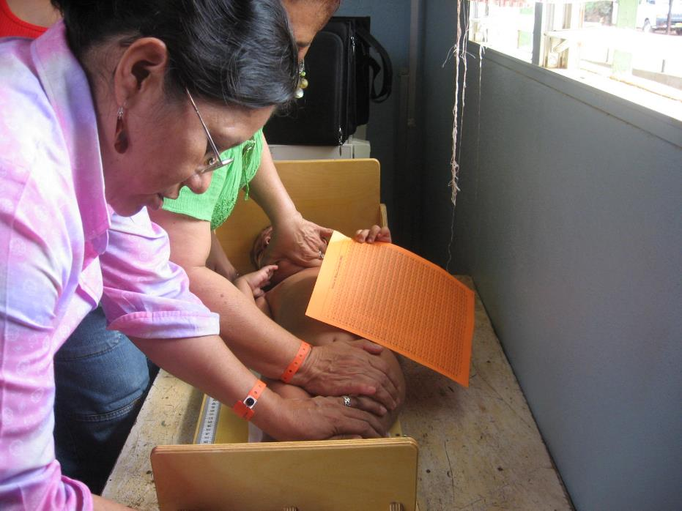
58/21
Notes:
Child’s body is very crooked. Head not in position. Assistant should be standing behind head board.

Slide 31
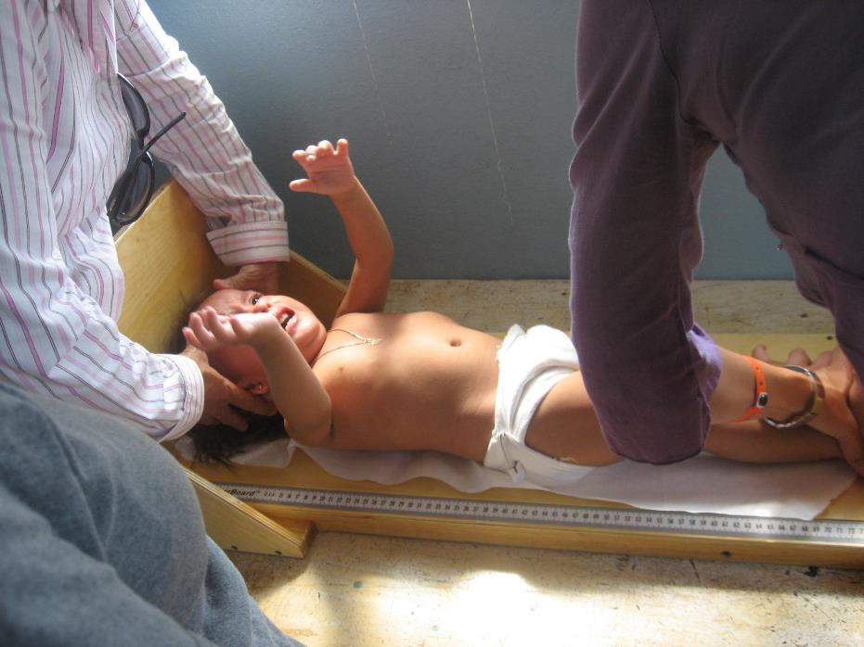
58/22
Notes:
Child in good position. Torso straight. Measurer and assistant in good position.

Slide 32
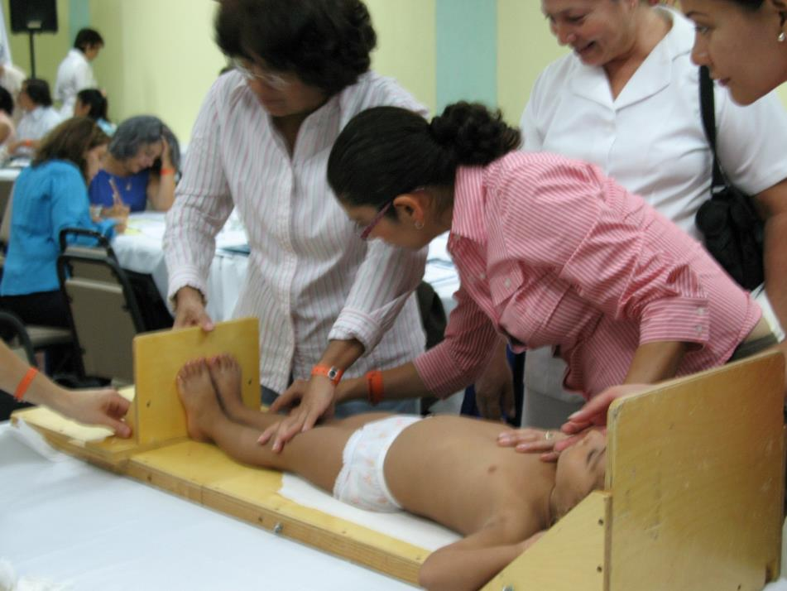
58/23
Notes:
Assistant should stand at head of child—no one is holding or checking head position. Measurer should hold foot board by its centre support.

Slide 33
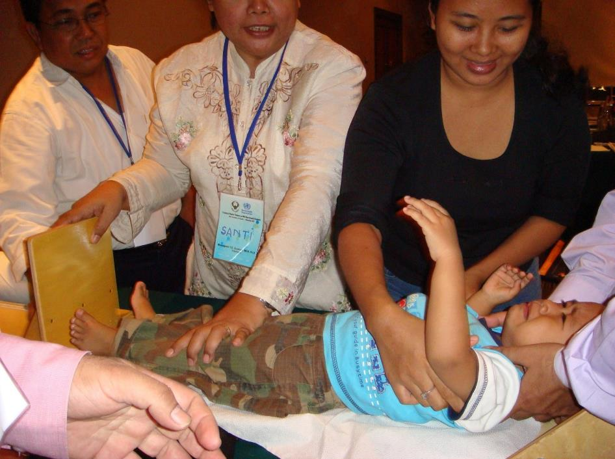
58/24
Notes:
Clothes make it difficult to see the knees. Feet are not yet flat against footboard with toes facing up. Mother should be on opposite side so that the measurer has more space. Assistant seems to have good control of the head.

Slide 34
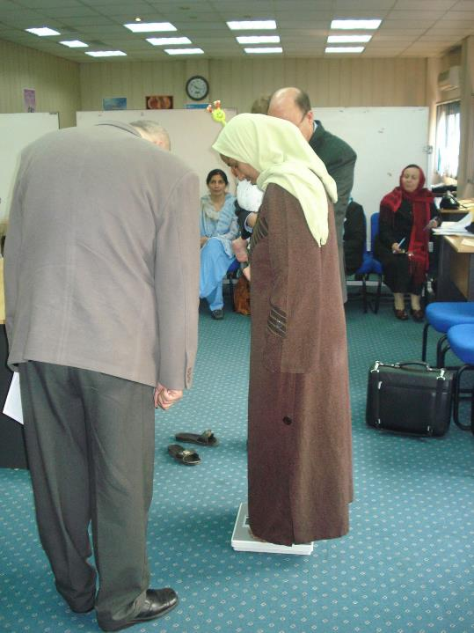
58/25
Notes:
Weight—Scale gives error message when robe swings, covering and uncovering solar panel.

Slide 35
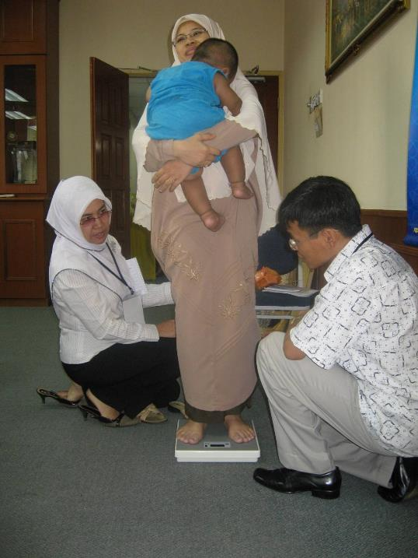
58/26
Notes:
Weight—Notice person on left is holding back robe to keep it out of the way.

Slide 36
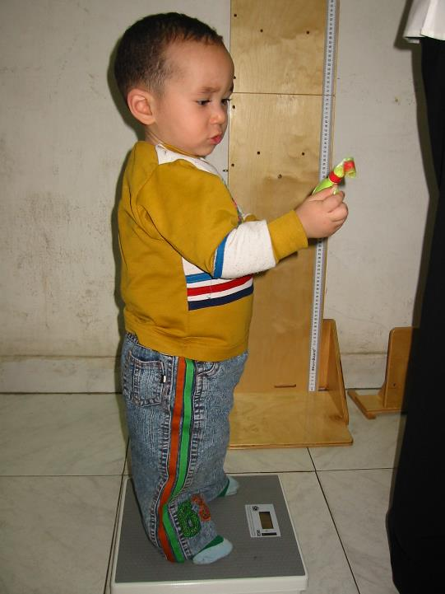
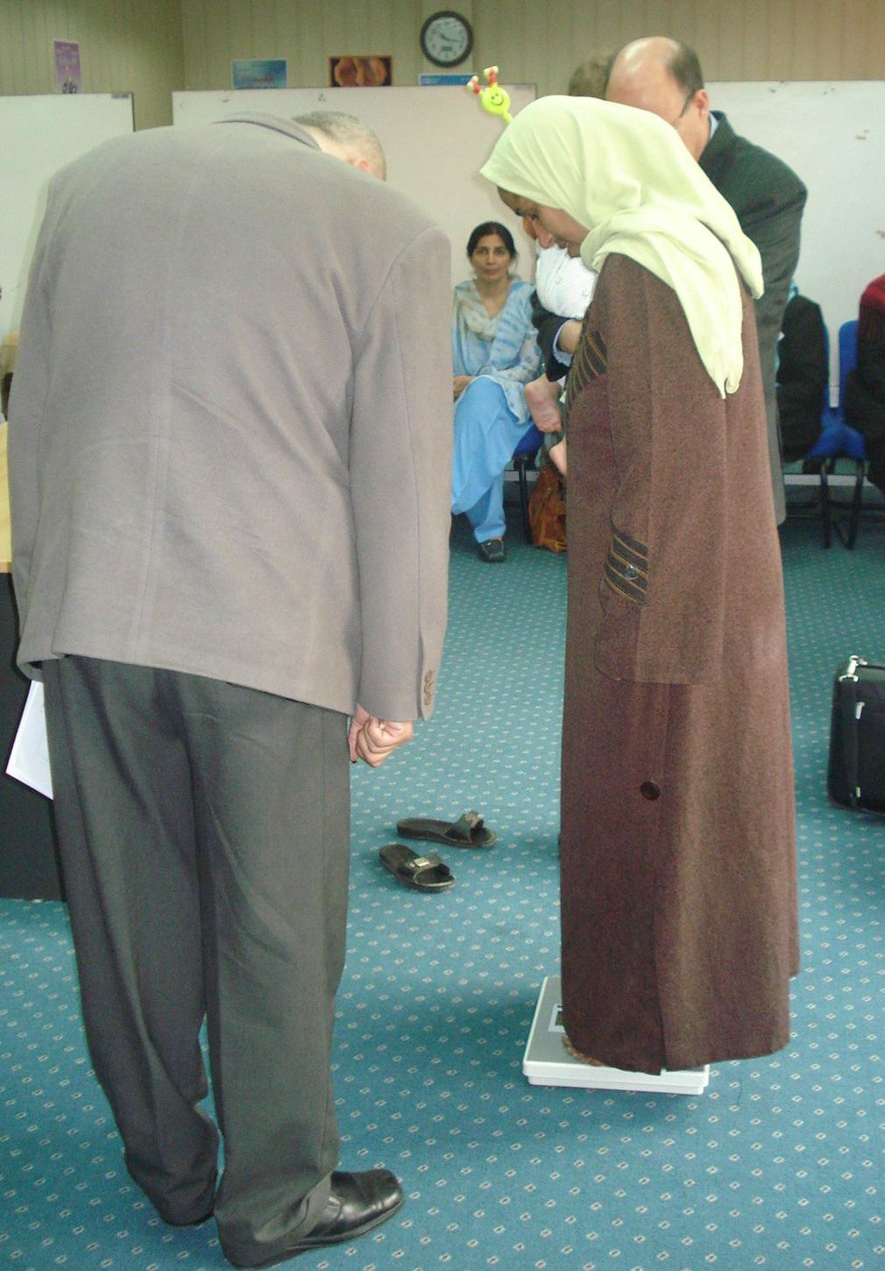
58/27
Notes:
Too many clothes! Jeans, diaper and shirt can weigh a kilogram and more!

Slide 37
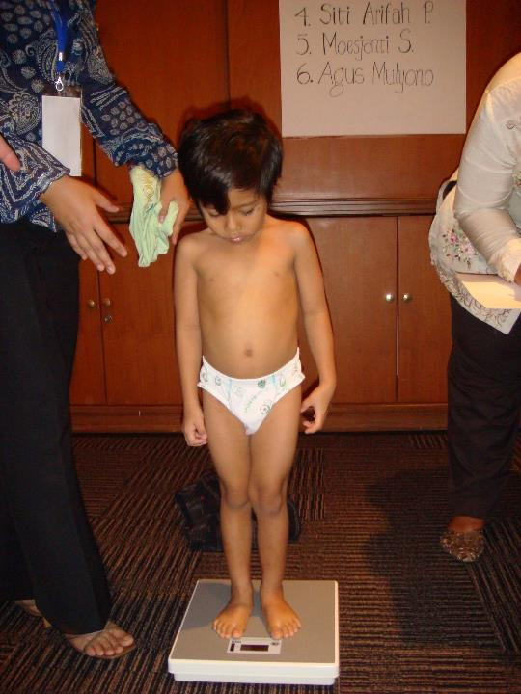
58/28
Notes:
Child undressed so that this weight measurement will be accurate.

Slide 38
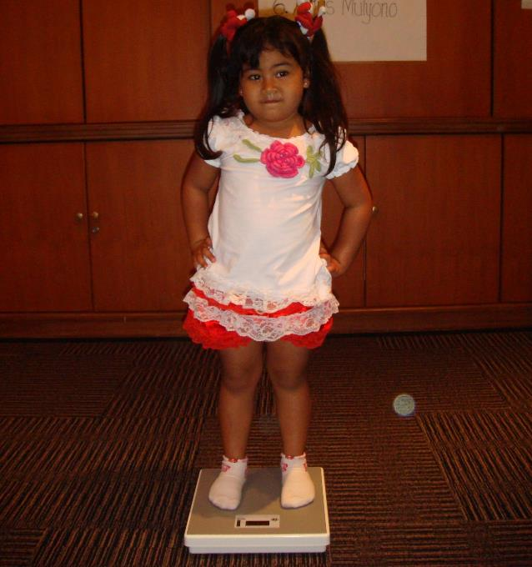
58/29

Slide 39
59/1
Session 59: Plotting points for growth indicators – objectives
After completing this session, participants will be able to:
identify axes on growth-indicator charts
plot single points on height-for-age, weight-for-age and weight-for-height charts

Slide 40
59/2
Plot points for growth indicators
Select charts in the Growth record, based on the child's age at this visit
Is the child growing normally?
Note the plotting convention in this course
The x-axis (horizontal)
The y-axis (vertical)
Plotted point

Slide 41
59/3
Example: plotted weight-for-age point
The boy is
6 weeks old and weighs 5 kg
•
Age (completed weeks or months)

Slide 42
59/4
Plot length/height-for-age
Indicator of stunting or excess height
Length from 0 to 23 months and height from 2 years
Age on x-axis and length/height on y-axis
Plot age on vertical line showing completed weeks, months, or years and months, not in the middle
Plot length/height on or between horizontal lines to the closest estimated measurement
Connect points from several visits to see trend
Do the plotted points make sense?

Slide 43
59/5
Plot weight-for-age
Indicator of underweight owing to thinness or shortness
Not used to classify overweight
Not valid in the case of oedema
Age on x-axis and weight on y-axis
Plot age on vertical line showing completed weeks, months, or years and months, not in the middle
Plot weight on or between horizontal lines, to the closest estimated measurement
Connect points from several visits to see trend

Slide 44
59/6
Plot weight-for-length/height
Measure of weight in proportion to length/height
Wasting – result of acute illness or food shortage that leads to severe weight loss
Wight-for-length/height is also an indicator of overweight/obesity
Not valid in the case of oedema
Length/height on x-axis and weight on y-axis
Plot length/height on a vertical line rounded up or down to the nearest whole cm
Plot weight on or between horizontal lines to the closest estimated measurement
Connect points from several visits to see trend

Slide 45
59/7
Weight-for-age BOYS
6 months to 2 years (z-scores)
Overhead 1
●
●
Age (completed months and years)

Slide 46
59/8
Height-for-age BOYS
2 to 5 years (z-scores)
Overhead 2
●
●
Age (completed months and years)

Slide 47
59/9
Weight-for-length GIRLS
Birth to 2 years (z-scores)
Overhead 3
●
●

Slide 48
59/10
Length-for-age BOYS
Birth to 6 months (z-scores)
Overhead 5
Age (completed weeks or months)

Slide 49
59/11
Weight-for-age GIRLS
Birth to 6 months (z-scores)
Overhead 6
Age (completed weeks or months)

Slide 50
59/12
Weight-for-age BOYS
6 months to 2 years (z-scores)
Overhead 7
Age (completed weeks or months)

Slide 51
60/1
Session 60: Interpreting plotted points
for growth indicators – objectives
After completing this session, participants will be able to:
identify growth problems from plotted points on a single indicator chart
define a growth problem using several indicator charts and observations

Slide 52
60/2
Interpret plotted points for growth indicators
Growth curves to help you interpret plotted points
Median and z-score (standard deviation = SD) lines
Positive and negative z-scores
The farther from the median, the more likely that there is a growth problem
Consider other facts when interpreting points (health condition, parent size, etc.)

Slide 53
60/3
Identify growth problems from plotted points
Review list of problems in each indicator chart:
stunted, severely stunted (length/height-for-age)
– pages 29, 33, 37
underweight, severely underweight (weight-for-age)
– pages 30, 34, 38
wasted, severely wasted (weight-for-length/height)
– pages 31, 35, 39
possible risk of overweight, overweight, obese
(weight-for-length/height) – pages 31, 35, 39

Slide 54
60/4
Consider all growth charts and observations
Consider all growth charts together: there may be a problem with one but not the others
Low weight-for-age could be due to wasting or shortness: look at weight-for length/height and length-for-age when there is a problem with weight-for-age
A stunted child may have a normal weight-for-height,
but have low weight-for-age
Weight-for-length/height is usable even when age is not known
Looking at the growth charts all together is useful to determine the nature of growth problems

Slide 55
60/5
Measurements for two girls
 | Age | Height | Weight | BMI
Girl X | 2 years 2 months | 86 cm | 12 kg | 16.2 kg/m²
Girl ● | 4 years 4 months | 86 cm | 12 kg | 16.2 kg/m²

Slide 56
60/6
Height-for-age GIRLS
2 to 5 years (z-scores)
X
●
Age (completed months and years)

Slide 57
60/7
Weight-for-age GIRLS
2 to 5 years (z-scores)
Weight (kg)
X
●
Age (completed months and years)

Slide 58
60/8
Weight (kg)
X
●

