Slide 1


Infant and young child feeding counselling: an integrated course
2nd edition
Module 6: Sessions 61–70
Growth assessment
WHO/HEP/NFS/21.21
© World Health Organization 2021. Some rights reserved. This work is available under the CC BY-NC-SA 3.0 IGO licence.

Slide 2
61/1
Session 61: Interpreting trends on growth charts – objectives
After completing this session, participants will be able to:
interpret trends on growth charts
determine whether a child is growing normally, has a growth problem or is at risk of a growth problem

Slide 3
61/2
Interpreting trends on growth charts
Points from several visits show trends of normal growth,
an existing problem or risk of a problem
"Normal" growth generally runs parallel to the z-score lines (tracking)
Look out when a growth lines crosses z-score lines, inclines/declines sharply or remains flat
Risk depends on where the line originates
Consider the child's whole situation when interpreting trends

Slide 4
61/3
Crossing z-score lines
Growth lines that cross z-score lines (not just those that are labelled on the chart) indicate possible risk
Children who are growing and developing normally will generally be on or between –2 and 2 z-scores of a given indicator
The growth of an individual child plotted over time is expected to track fairly close to the same z-score

Slide 5
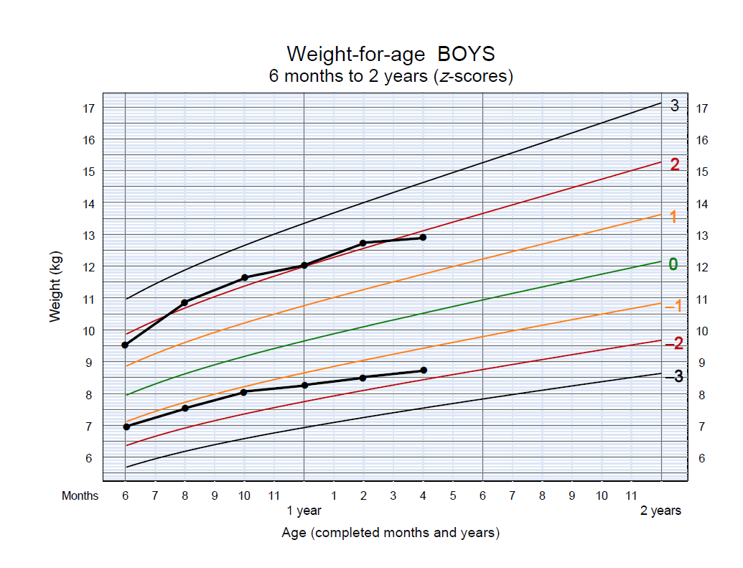
61/4
Example: crossing z-score lines

Slide 6
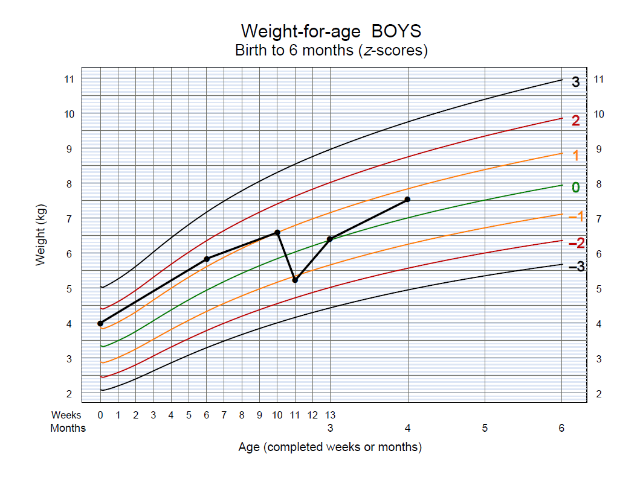
61/5
Sharp incline or decline

Slide 7
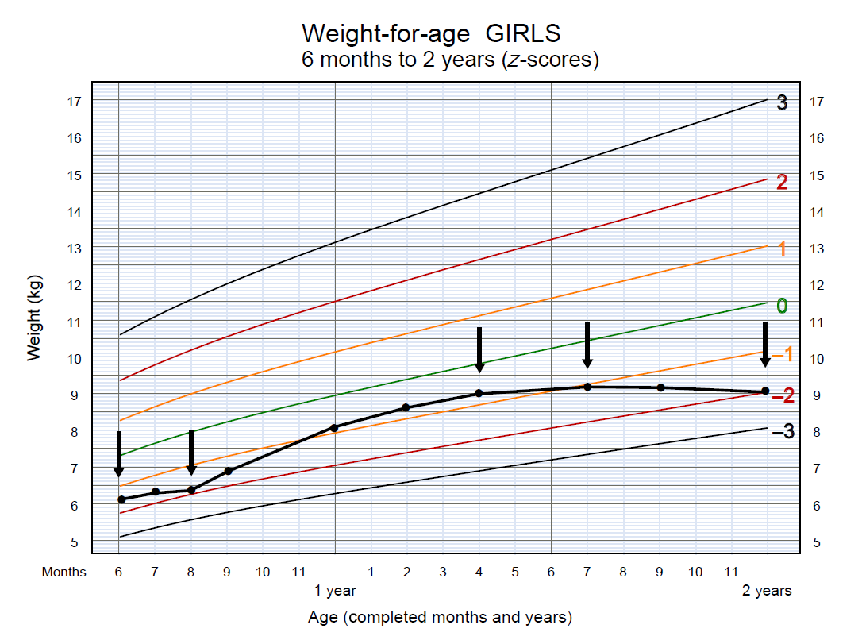
61/6
Flat growth line (stagnation)

Slide 8
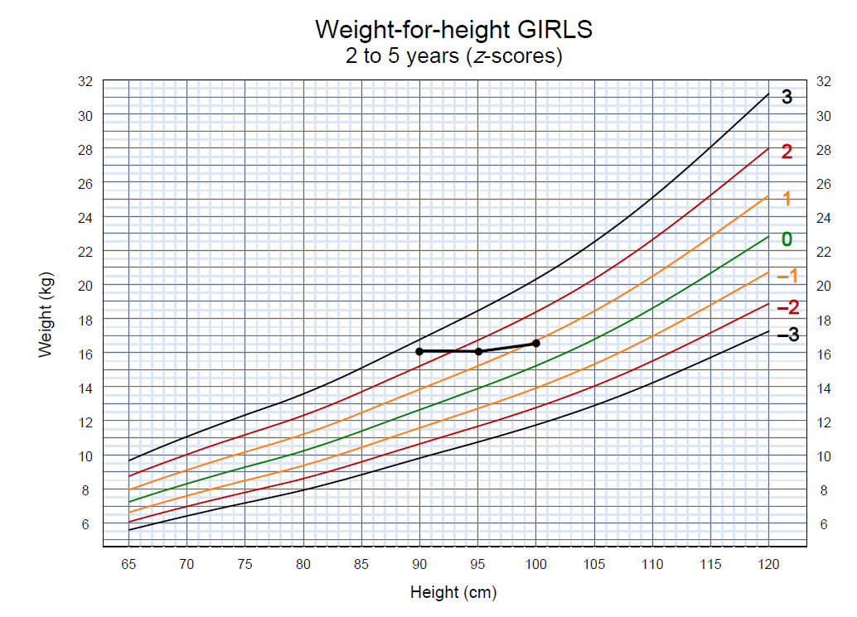
61/7
Flat growth line (catch-down)

Slide 9
61/8

Slide 10
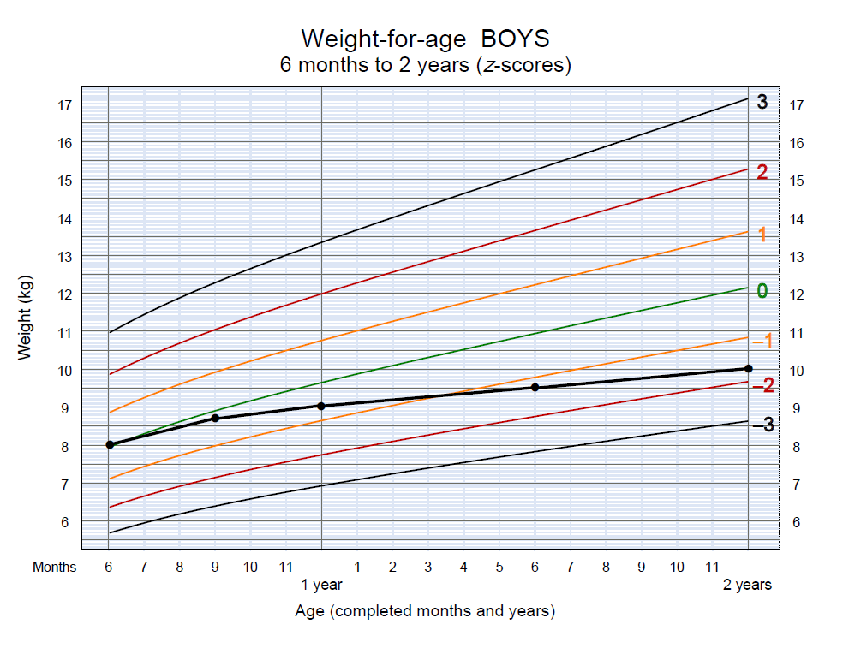
61/9

Slide 11
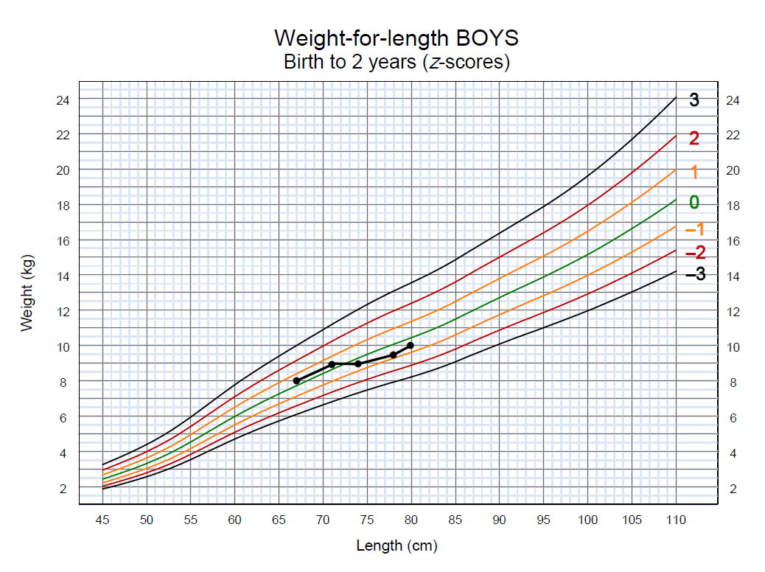
61/10
Overhead 15
Ben

Slide 12
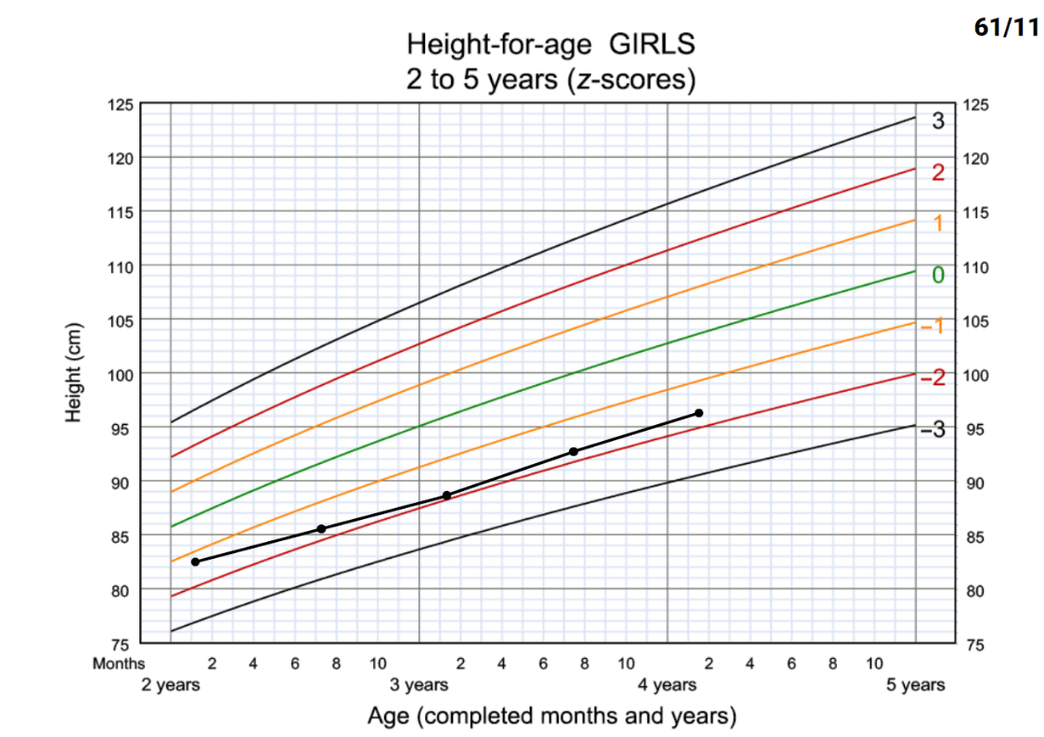
Overhead 17
Delia

Slide 13
61/12
Overhead 18
Delia
Weight (kg)

Slide 14
61/13
Overhead 19
Delia
Weight (kg)

Slide 15
62/1
Session 62: Growth assessment results and feeding counselling when the child is growing well – objectives
explain to a mother or caregiver the results of their
child's growth assessment
explain how to deal with a child who has severe
growth problems
gather information on feeding practices using the
Job aid: Food intake – 6 up to 24 months

Slide 16
62/2
Causes of undernutrition
Malnutrition
and death
Manifestations
Inadequate dietary intake
Immediate causes
Disease
Insufficient
household food security
Insufficient health services and unhealthy environment
Underlying causes
Inadequate maternal and child care

Slide 17
62/3
Refer children with severe growth problems
Children with any of the following severe undernutrition problems should be referred urgently for specialized care:
severely wasted (below −3 z-scores for weight-for-length/height)
clinical signs of marasmus (e.g. appears severely wasted, like “skin and bones”)
clinical signs of kwashiorkor (e.g. generalized oedema; thin, sparse hair; dark or cracking/peeling patches of skin)
oedema of both feet

Slide 18
63/1
Session 63: Investigating causes of undernutrition – objectives
After completing this session, participants will be able to:
explain when to investigate causes of undernutrition
identify the key sections of the Job aid: Investigating causes of undernutrition
explain how to use the Job aid
identify the eight steps involved in investigating causes of and counselling for undernutrition

Slide 19
63/2
Investigate undernutrition if a child:
is wasted
is underweight
is stunted but not overweight or at risk of overweight
shows a growth trend towards one of these problems

Slide 20
63/3
Job aid: Investigating causes of undernutrition
Two columns – questions and feeding recommendations
Take note of age-specific questions
Complete investigation of causes before giving any advice
How:
  Ask all relevant questions for child's age
  Listen carefully to what the caregiver says
  Ask follow-up questions to obtain complete information
  Note all likely causes
  With the caregiver, identify important causes

Slide 21
63/4
Investigating causes of undernutrition
Illness: speak about how to feed a child during illness
Trauma: consider whether the interview should be done at another time
Scope: breastfeeding, appetite, complementary feeding food types, frequency, quantities, family meal habits
What possible causes does the mother/caregiver recognize?
Take time with the caregiver (dedicated staff for counselling in busy facilities)

Slide 22
63/5
Job aid: Investigating causes of undernutrition
Step 1: Find out whether the child is currently ill
Step 2: If not ill, initiate investigation of causes
Step 3: Ask about any recent changes in eating and/or breastfeeding
Step 4: Discuss age-specific questions about the child’s feeding
Step 5: Ask about recurrent illnesses
Step 6: Assess possible underlying social and environmental causes
Step 7: Jointly with the mother/caregiver, identify causes
Step 8: Counsel

Slide 23
63/6
Possible causes of undernutrition
Make a note of possible causes as the caregiver speaks with you
Poor sanitation, >2 children aged under 5 years, mother/father absent (separation/death) or in poor health, family does not have enough to eat
Note what you think are most important likely causes but find out what causes the caregiver recognizes
Example: interview with Nalah's mother

Slide 24
64/1
Session 64: Counselling a mother or caregiver whose child has undernutrition – objectives
After completing this session, participants will be able to:
involve the mother or caregiver in identifying possible causes of undernutrition
find age-appropriate advice for the problem identified
set goals for improving the growth of an undernourished child
provide examples of checking questions to use when counselling

Slide 25
64/2
Provide counselling related to the causes of undernutrition
What does the mother think she can do to help her child?
Discuss what is feasible, encourage the mother to take action, praise her efforts
Find feeding advice appropriate for the child's age in the right column of the Job aid: Investigating causes of undernutrition
Stunted child: improve linear growth without excessive weight gain (increase amount and bioavailability of micronutrients – consumption of animal-source foods, fortified foods, sprinkles or supplements)

Slide 26
64/3
Set a goal for improving the growth of an undernourished child
Propose doable actions (2 or 3 , no more) for the mother to try; write them down in the Growth record
Possible goals:
  Return to normal growth following illness
  Stop trend towards undernutrition and reverse it
  No specific weight-gain targets especially if stunted
Express goals in terms of improving growth, so that length and weight increase proportionally
Set appointment for follow-up visit

Slide 27
65/1
Session 65: Investigating causes and counselling a mother or caregiver whose child is overweight – objectives
After completing this session, participants will be able to:
explain when to investigate causes of overweight
identify the key sections of the Job aid: Investigating causes of undernutrition
identify the five steps involved in investigating causes of and counselling for overweight
involve the mother in identifying possible causes of overweight
set goals for improving the growth of a child who is overweight

Slide 28
65/2
Investigate causes of overweight if a child:
is overweight (above 2 z-scores weight-for-length/height)
shows a growth trend towards overweight
is stunted and overweight or at risk of overweight
is obese (where there is no referral system for the specialized management of obesity)

Slide 29
65/3
Job aid: Investigating causes of overweight
Two columns – questions and feeding recommendations
Take note of age-specific questions
Complete investigation of causes before giving any advice
For older children ask about physical activity
If one or both parents are overweight, this increases child's risk
Focus on child's eating/activity patterns, not parents'
  Ask all relevant questions for child's age
  Listen carefully to what the caregiver says
  Ask follow-up questions to obtain complete information
  Note all likely causes
  With the caregiver, identify important causes

Slide 30
65/4
Job aid: Investigating causes of overweight
Step 1: Initiate investigation of causes
Step 2: Discuss age-specific questions about the child's feeding
Step 3: Ask about physical activity (children aged over 6 months)
Step 4: Jointly with the caregiver, identify causes
Step 5: Counsel

Slide 31
65/5
Counselling related to causes of overweight
What does the mother think she can do to help her child?
Discuss what is feasible, encourage the mother to take action, praise her efforts,
Find feeding advice appropriate for the child's age in the right-hand column of the Job aid: Investigating causes of undernutrition
If a feeding practice differs from what is recommended, explain what is recommended
Mention local examples of high-energy snacks/foods to be avoided and nutritious foods to offer
Describe how to reduce the energy density of food
(less fat and added sugar)

Slide 32
65/6
Set a goal for improving the growth of an overweight child
Propose doable actions (two or three, no more) for the mother to try, write them down in the Growth record
Do not recommend weight loss
The goal is to slow down weight gain with continued growth in height, to normalize weight-for-height
Express goals in terms of improving growth, so that length and weight increase proportionally
Set an appointment for a follow-up visit

Slide 33
66/1
Session 66: Checking understanding and arranging follow-up 2 – objectives
After completing this session, participants will be able to:
demonstrate how to ensure that a caregiver understands information provided, by using checking questions
arrange referral or follow-up of a child

Slide 34
66/2
Give your child only breast milk from birth to
6 months of age

Slide 35
66/3
Breastfeed as often as your child wants, at least 8 times in 24 hours

Slide 36
66/4
Breastfeed whenever your child shows signs of hunger, such as fussing, sucking their fingers or moving their lips

Slide 37
66/5
Now that your baby is
6 months old, start giving 2–3 tablespoons of thick porridge or well-mashed foods
2–3 times a day

Slide 38
66/6
Feed your child a staple food, such as rice or wheat cereal

Slide 39
66/7
You need to give your child some animal-source foods, such as meat, chicken, fish, eggs, milk, cheese, yogurt and curds

Slide 40
66/8
Peas and beans are another good source of protein

Slide 41
66/9
Also give a variety of other foods, such as leafy green and yellow-coloured vegetables and fruits

Slide 42
66/10
At 9–11 months of age, give your baby
3–4 meals per day plus 1–2 snacks

Slide 43
66/11
At each meal, your baby (age 9 months) needs about ½ cup of finely chopped or mashed foods

Slide 44
66/12
Feed your child from their own plate or bowl so you will know when they have eaten their entire serving

Slide 45
66/13
Patiently help your baby eat; talk to them, look into their eyes and encourage them

Slide 46
66/14
Now that your child is 2 years old, they should eat family foods at three meals each day

Slide 47
66/15
Twice daily between meals, give nutritious snacks such as yogurt or fruit

Slide 48
66/16
Constructing checking questions
Identify the key words or phrases in the recommendation that the caregiver should know
Construct the checking question using some key words/phrases; start the question with the words:
  How • What
  Why • Please show me . . . ?
  When

Slide 49
66/17
Checking questions . . .
Avoid questions that can be answered by yes/no, such as those starting with:
Do you?
Will you? (e.g. Will you breastfeed your child until 6 months?)
Are you?

Slide 50
67/1
Session 67: Gathering information and counselling on complementary feeding practices and growth: role-plays – objectives
After completing this session, participants will be able to gather information and provide counselling on complementary feeding practices and growth, by:
demonstrating appropriate use of counselling skills
investigating causes of growth problems
providing appropriate counselling on the identified problem
setting a target for growth, to be reviewed at a follow-up visit
using the Job aid: Investigating causes of undernutrition and the Job aid: Investigating causes of overweight
using the Job aid: Food intake – 6 up to 24 months

Slide 51
70/1
Session 70: Growth charts – objectives
After completing this session, participants will be able to:
explain the meaning of the standard curves
plot a child’s weight on a growth chart
interpret individual growth curves and define whether a child is growing well or has malnutrition

Slide 52
70/2

Slide 53
70/3
Length-for-age BOYS
6 months to 2 years (z-scores)
Age (completed months and years)

Slide 54
70/4

Slide 55
70/5

Slide 56
70/6

