Slide 1
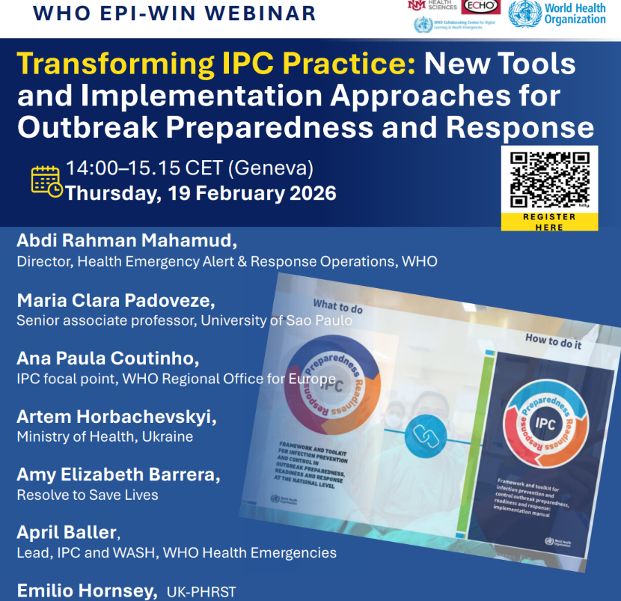
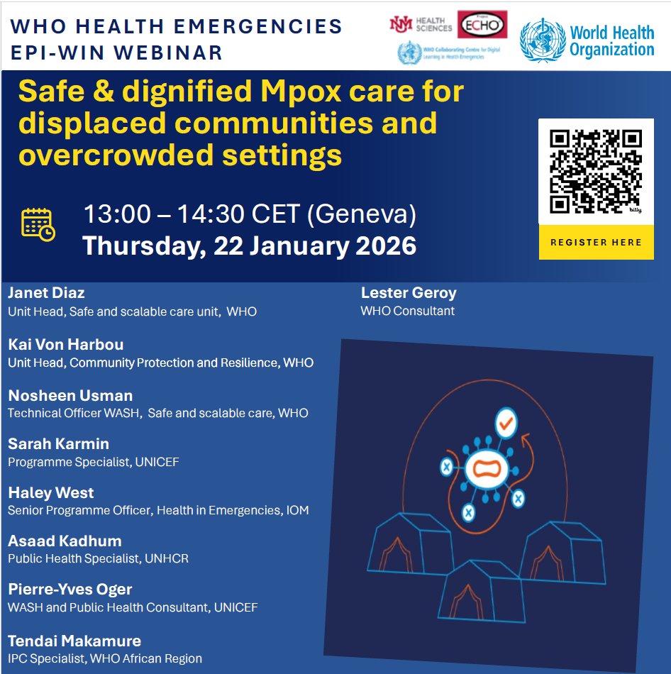
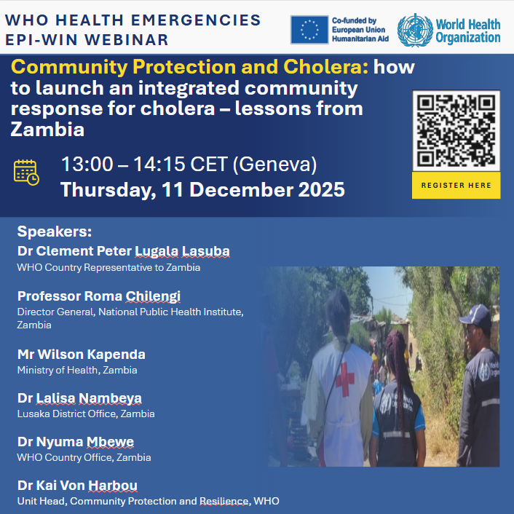

Slide 2

WHO Information Network for Epidemics (EPI-WIN) Webinar
Transforming IPC Practice: New Tools and Implementation Approaches for
Outbreak Preparedness and Response
Time (CEST) | Topic | Speaker
14.00 - 14.05 | Introduction of EPI-WIN, housekeeping | Supriya Bezbaruah, EPI-WIN Science and Knowledge Translation, WHO
14.05 - 14.10 | Welcome remarks | Abdi Rahman Mahamud, Director, Health Emergency Alert & Response Operations, WHO
14:10 – 14:25 | Overview of the Framework and toolkit for IPC outbreak implementation manual | Maria Clara Padoveze, Senior associate professor, University of Sao Paulo
14:25 – 14:35 | Regional perspective | Ana Paula Coutinho, IPC focal point, WHO Regional Office for Europe
14:35 – 14:50 | Ukraine Country Experience | Artem Horbachevskyi , Ministry of Health, Ukraine
14:50 – 15:00 | IPC Framework for Outbreak Response at Primary Health Care | Amy Elizabeth Barrera, Resolve to Save Lives
15:00 – 15:10 | Q&A | April Baller, Lead, IPC and WASH, WHO Health Emergencies Emilio Hornsey, UK-PHRST
15:10 - 15.15 | Closing | Supriya Bezbaruah, EPI-WIN Science and Knowledge Translation, WHO

Slide 3
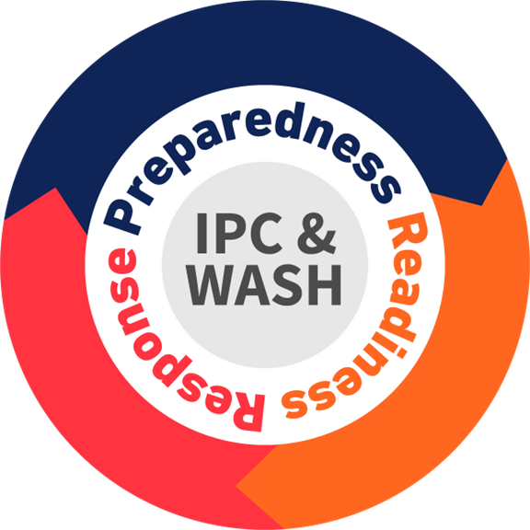
The framework and toolkit for IPC outbreak preparedness, readiness and response: implementation Manual
Prof. Dr. Maria Clara Padoveze
on behalf IPC & WASH Team
WHO Health Emergencies Programme
Geneva, Switzerland
19th February 2026
https://www.who.int/publications/i/item/9789240105614
Notes:
Thanks for the invitation to participate in this webinar, which has the objective to present The implementation manual for Framework and toolkit for IPC outbreak preparedeness, readiness and response, which was recently published.

Slide 4
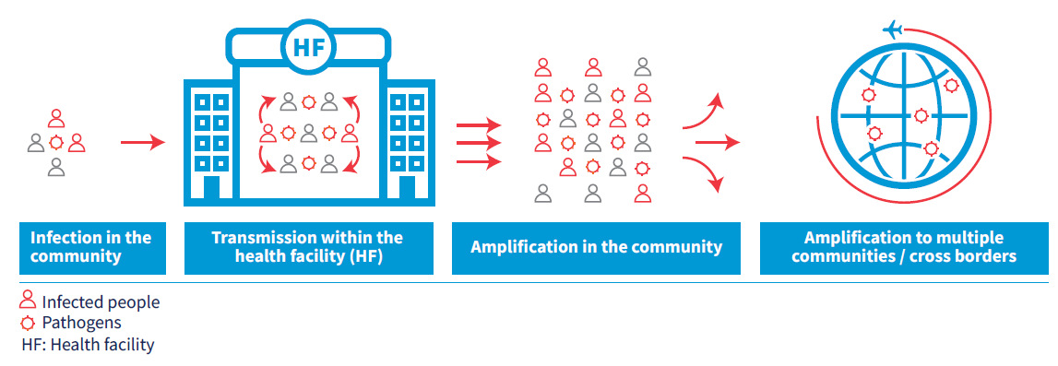
How Outbreaks Amplify in Health Facilities - and Beyond
Notes:
Why this document is important? - Infections occurring during outbreaks can spread within health care facilities, resulting in healthcare associated infections. This leads to a pathway of amplification of infections to multiple communities, eventually spreading across borders to other countries.
Notably, large recent outbreaks such as COVID-19 and Ebola have exposed the gaps in infection prevention and control (IPC) programmes that exist in all countries.

Slide 5
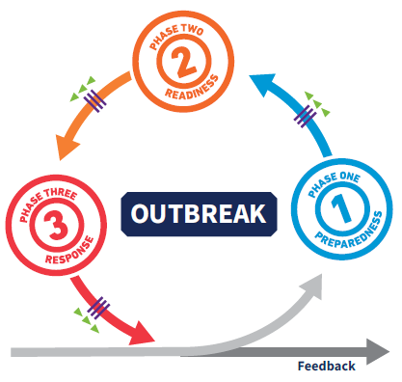
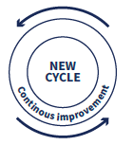
Turn learning Into Actions
Strengthening IPC preparedness and operational readiness are pivotal for effective outbreak response
Policymakers and health care workers must turn lessons from every outbreak and pandemic into actions
The "Framework and toolkit for infection prevention and control outbreak preparedness, readiness and response at the national level (IPC-OFT): implementation manual" provides resources for national and subnational authorities
Notes:
Therefore, strengthening IPC preparedness and operational readiness are pivotal for effective outbreak response. To achieve better results it is essential that policymakers and health care workers turn lessons learned from every outbreak and pandemic into actions aiming at to improve the response capacity. That considered, this implementation manual provides resources for national and subnational authorities to support the implementation process.

Slide 6
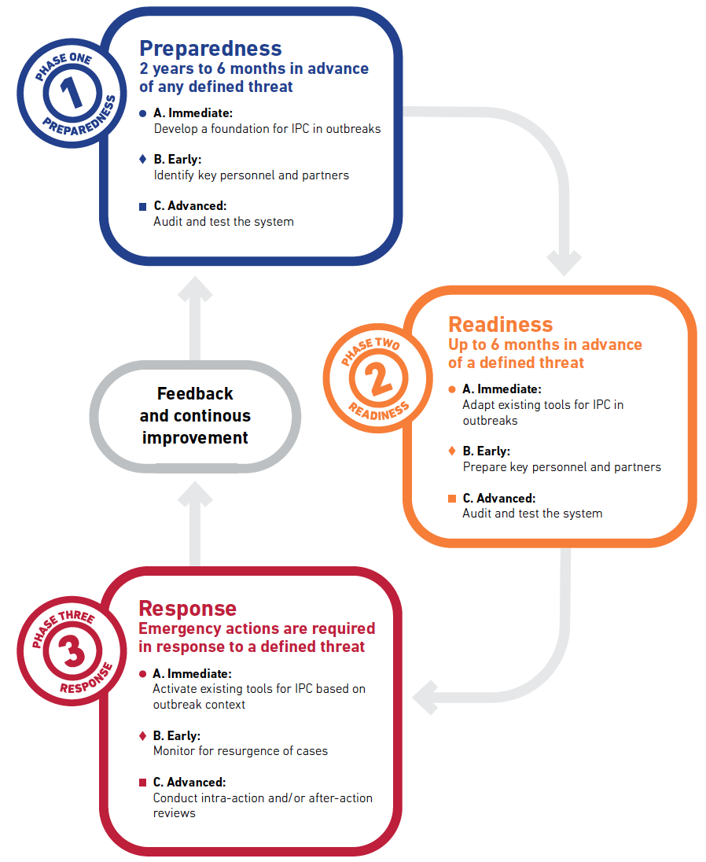
When to act:
Emergency Phases and Activities prioritization
Develop, plan, risks mapping
Adapt to
disease-specific focus
Activate, execute the plan
Notes:
When do we need to act? - The previously published Framework has the key concept of time – In relation to threats in public health emergencies. So, during the preparedness phase we should build the basics, mapping risks and planning the actions. During the readiness, it is time to adapt all the plans to disease-specific focus. And finally, during the response these plans are activate. In this framework is described as the priority of actions within each phases as immediate, early and advanced. As mentioned before, these phases represent a continuous cycle that includes a feedback element.
Two Dimensions of readiness:
Ongoing readiness capabilities: “Always ready for assessed risks”
Activation with prioritization & mobilization of threat-specific actions

Slide 7
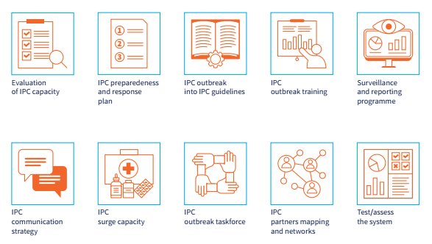
Ten key IPC Actions at National and Facility level
Notes:
What do we need to do? The IPC framework have key IPC actions that are indicated to implemented at both national and facility levels, with their respectives specificities. Systematic approach for evaluation of IPC capacity, preparedness and response plan, guidelines development, surveillance and reporting programme, communication strategies, surge capacity, outbreak task force, partners and network mapping and assessing the system should be implemented.

Slide 8
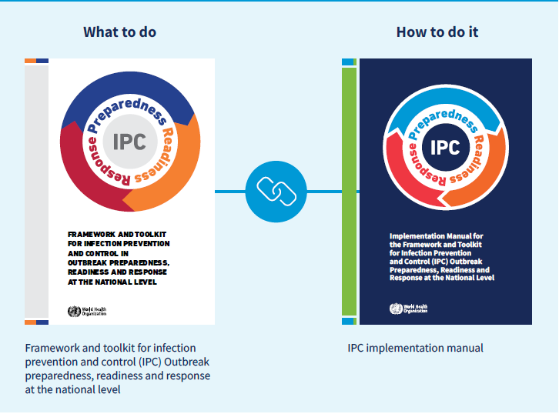
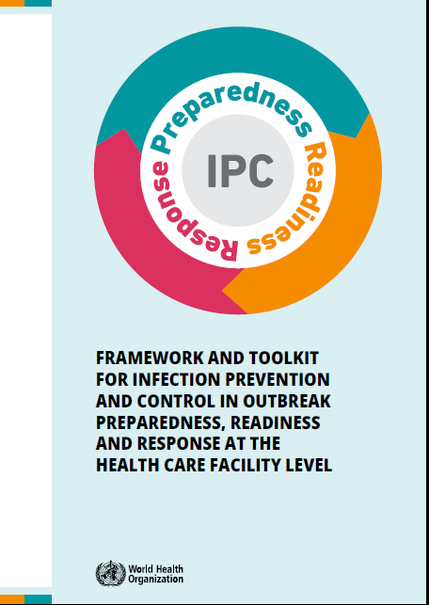
Framework & Toolkit for IPC in outbreak: Implementation manual
Key actions step by step
Barriers & how to overcome them
Country examples & case studies
Practical and adaptable tools
Links to resources
Notes:
How to do it? Then we came with the objective of this implementation manual, which is to provide national and subnational authorities with step-by-step directions and tools to implement the WHO Framework and Toolkit for Infection Prevention and Control Outbreak Preparedness, Readiness and Response at the National level (IPC-OFT). This "what to do" is comprehensive described in the framework and toolkit publications and now we have the implementation manual with this step-by-step approach. The implementatio manual contains the key actions and respective step-by-step, examples of main barriers and how to overcome them, inspirational country examples and a comprehensive list of adaptable tools and resources

Slide 9
Step-by-Step process
Identify
Identify the emergency phase
Select
Select key action
Follow
Follow the step and how to perform it
Search
Search for corresponding tools and resources
Notes:
This slide give an overview of the structure of the implementation manual. First, the identification of the emergency phase, then select key actions according to the priorities, them follow the steps and how to perform it and search for the corresponding tools as needed. I will give more details in the following slides.

Slide 10
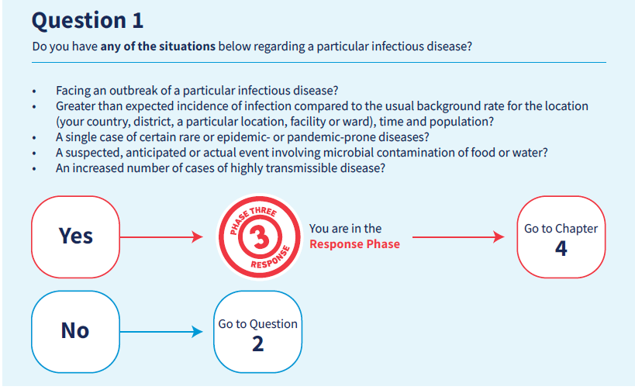
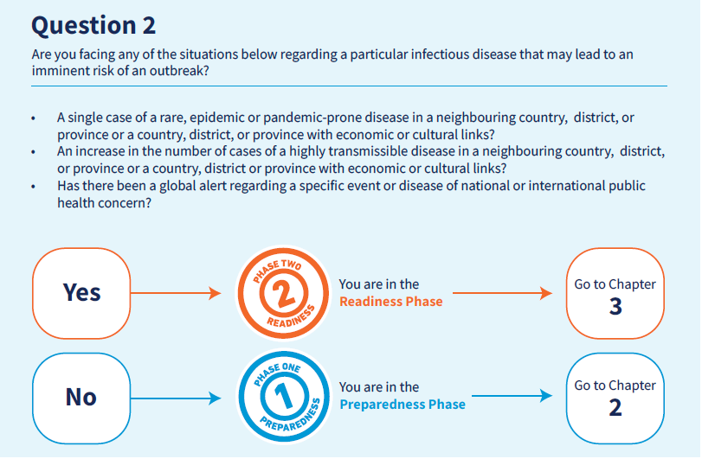
Event Emergencies Phase Identification
Notes:
Sometimes, there might be difficulties to identify which a given public emergency phase is. This is an event relate condition and for instance one country can be in a preparedness phase for one disease (ex: ebola) and readiness phase to another (ex: measles). In this implementation manual, you can find a logical algorithm of question to facilitate. By answering these 2 questions with a list of situations it is possible to easily define the phase and go to the corresponding chapter of the Manual.

Slide 11
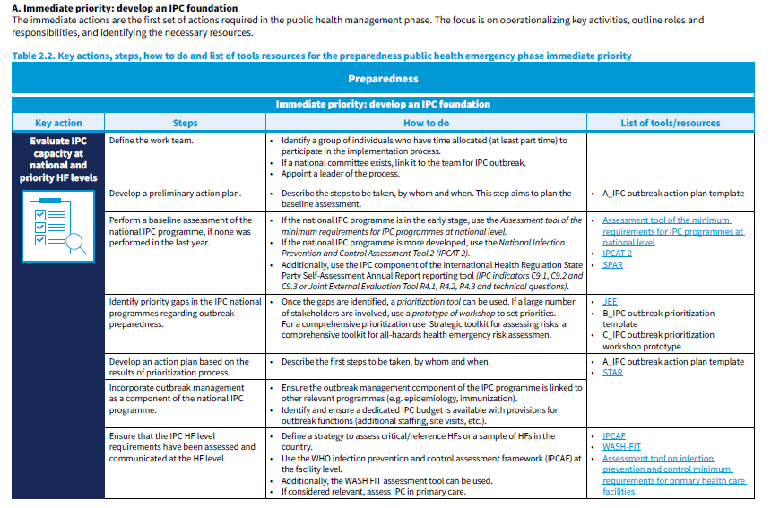
Step-by-Step: From Actions to Tools
For each key actions, follow the steps and how to do
Tools A to T
(developed for this manual
Links to available resources
Notes:
Folowing the emergency phase identification, we are going from key actions to tools and multiple steps. For each key actions, the user of the manual should follow the steps and how to do it. In the first column, we show the key actions. Second and third column have the detailed steps. And the last column have the information about the suggested tools and resources to support and facilitate the implementation of that key action. And this structure goes in the same way along the manual chapters for preparedness, readiness and response. Of note, for the preparedness phase, many activities and tools are related to basics in the IPC programmes, and refers to well know tools such as IPCAT, WASH FIT, and others.

Slide 12
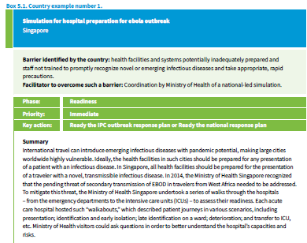

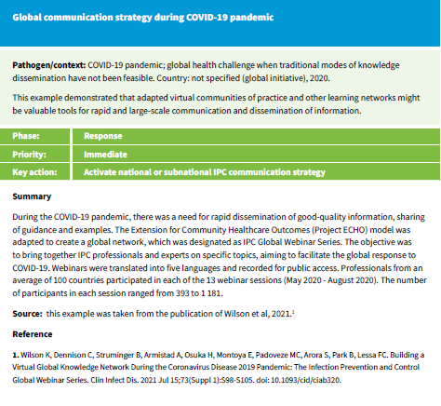


Practical Examples
Country examples
Actual examples of barriers and strategies, facilitators identified by countries
Case studies
Examples from the literature
Notes:
One chapter of this implementation manual brings inspirational practical examples from countries. Country examples were collected from interviews with relevant stakeholders in some countries to present actual situations of barriers and strategies adopted to overcome them. Here in this slide you can see an example of simulation exercises in Singapore. As case studies there ae some examples collected during the literature review that ilustrates key actions and steps for implementation.

Slide 13
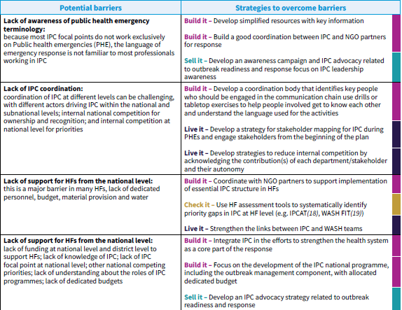
Potential barriers and how to overcome them
Identify or anticipate potential barriers in your context
Look for potential strategies to overcome them
Notes:
During the development of this material, interviews and focus groups were performed. This results in a list of potential barriers that can be antecipated in a given context. As examples, the lack of IPC awareness and coordination. For those barriers, suggestion of strategies to overcome them are presented. For examples, the partners mapping and stakeholder analysis

Slide 14
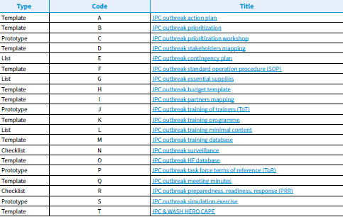

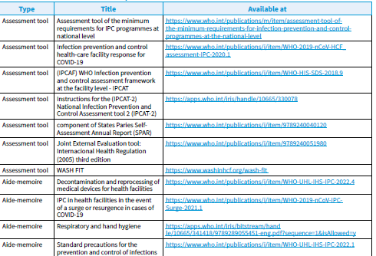


Tools
Templates, prototypes, check lists that can be downloaded and filled in.
Additional resources (assessment tools, aide-mémoires, forecast tools, guides)
Notes:
Finally, this implementation manual has a wide range of the tools. We developed around 20 tools, which includes assessment tools, templates, check list, and prototypes. These tools can be downloaded and filled in or adapted. Additionaly, a detailed list of resources is provide according to the type of resources.

Slide 15
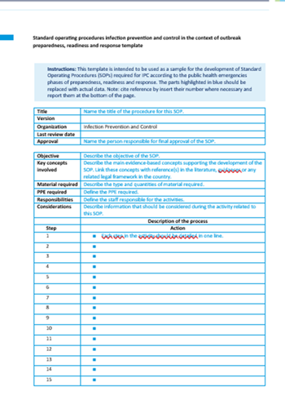
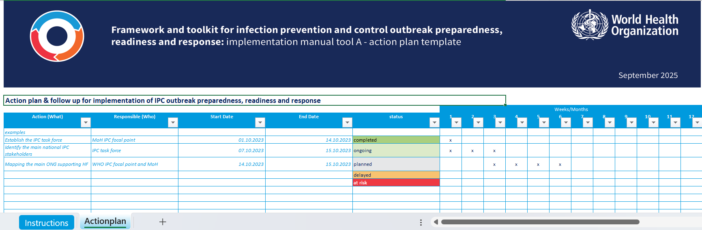
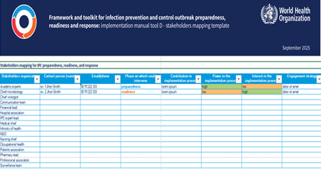
Tools examples
Notes:
Many of tools developed for the purpose of this implementation manual were based on feedback and learning from outbreaks. For example, we know that many countries want to quickly stablish their task force but lack examples of terms of reference, so it is possible to download one and adapt it. As other examples, there are templates for standard operational procedures for IPC, prototypes for programmes of training of trainers, excel spreadsheets for action plans, partners mapping, and stakeholder mapping. Also there are prototypes for contingency plans and a simulation booklet specific for IPC. The HERO CAPE is part of these package of tools which you may be aware because there was months ago an specific webinar about the HERO CAPE.

Slide 16
Conclusion
The IPC framework, toolkit, and this implementation manual help countries build stronger preparedness, readiness, and response capacities at both national and subnational levels
The tools provided in the implementation manual are adaptable and can be tailored to each country’s context, priorities, and health system needs.
Together, these resources support sustained improvements in IPC systems, helping prevent outbreak amplification and strengthening national health security.
Notes:
In conclusion...

Slide 17
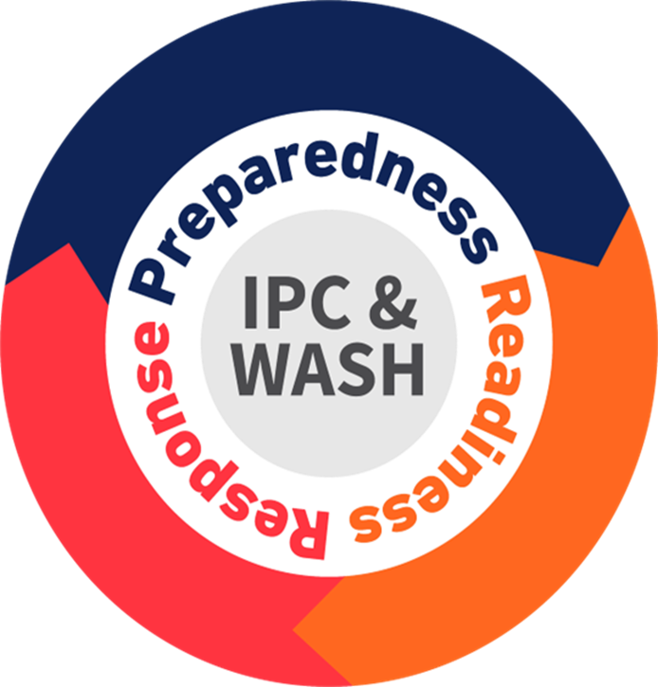
Thank You
Any Questions ?
https://www.who.int/emergencies/operations/ipc-wash

Slide 18
Regional perspective:
Ana Paula Coutinho Rehse
Technical Officer – Infection Prevention & Control
Pandemic Threats, Communicable Diseases, and AMR (PCT)
Health Security Division
WHO Regional Office for Europe

Slide 19
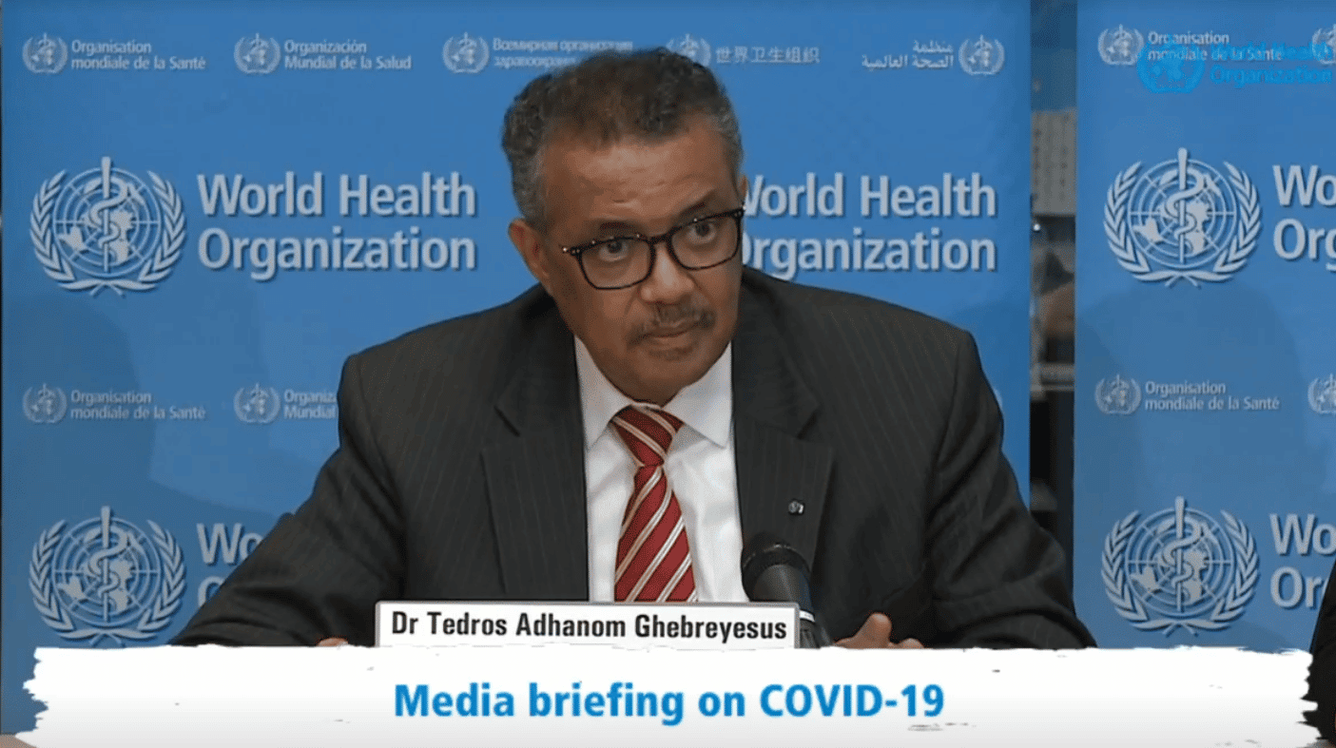
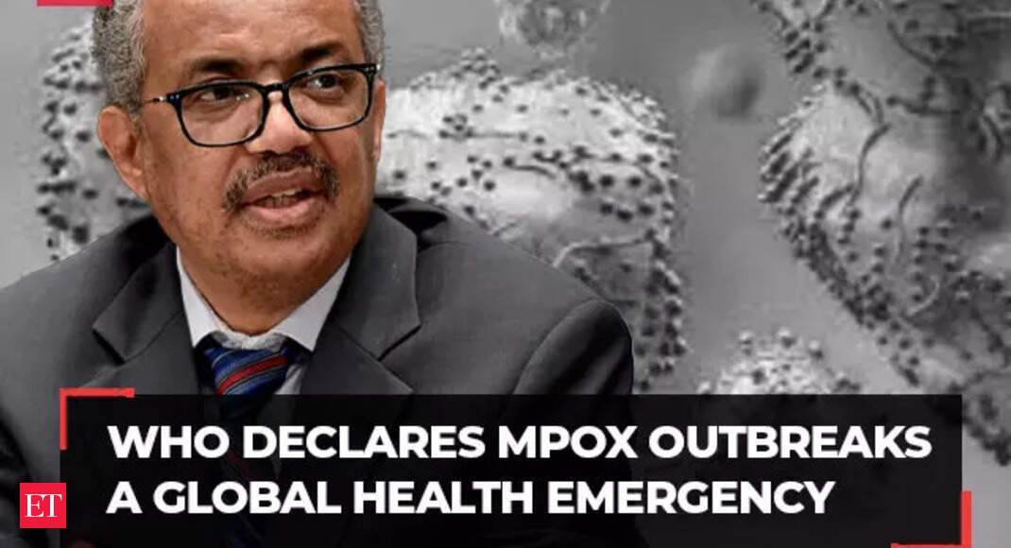
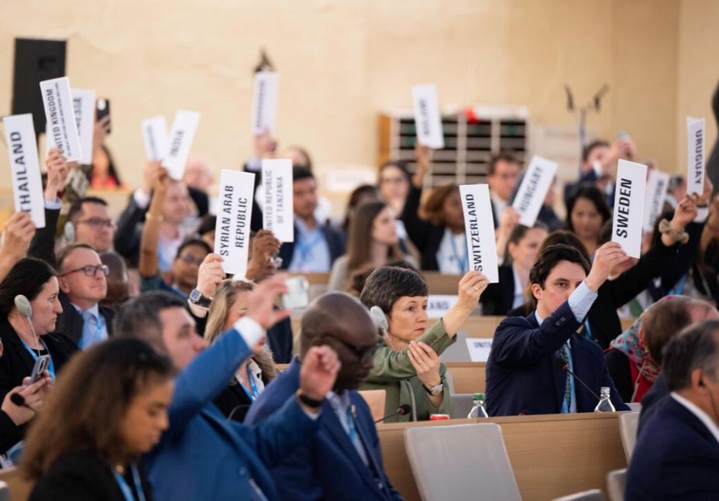
Once upon a time
“A global pandemic requires a world effort to end it – none of us will be safe until everyone is safe”
Ursula von der Leyen, President of the European Commission

Slide 20
IHR States Parties Self-Assessment Annual Reporting
Core Capacity – Infection Prevention and Control
WHO European Region

Slide 21
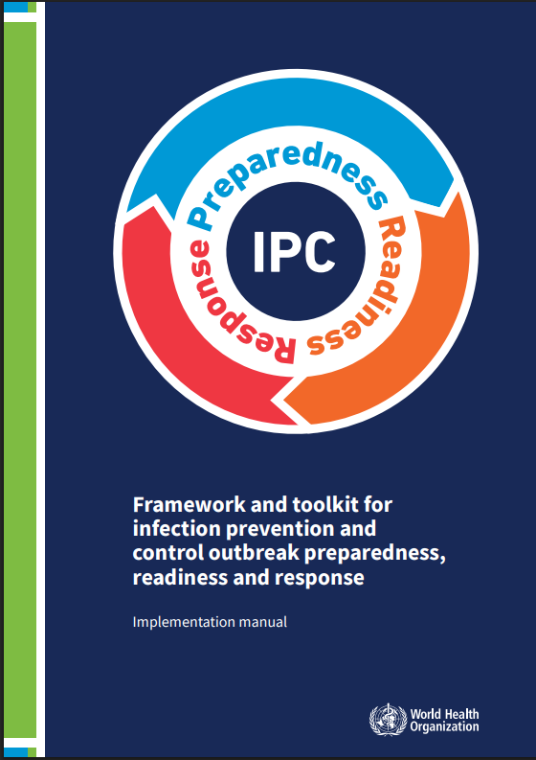
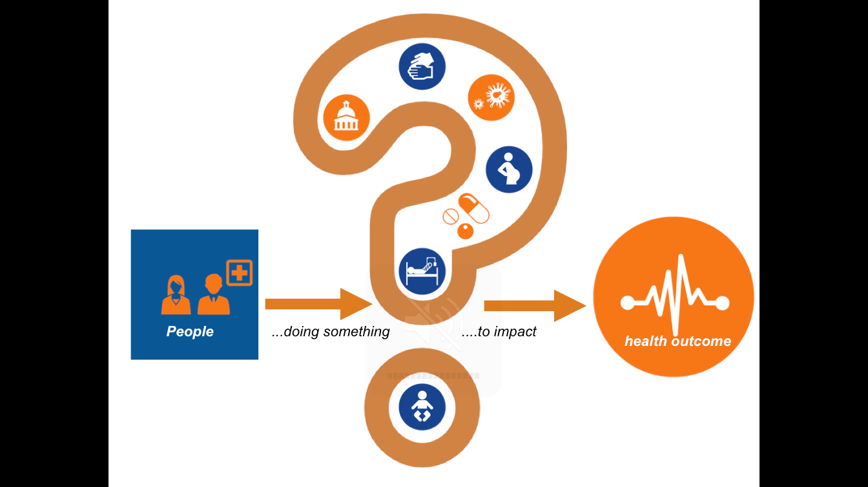
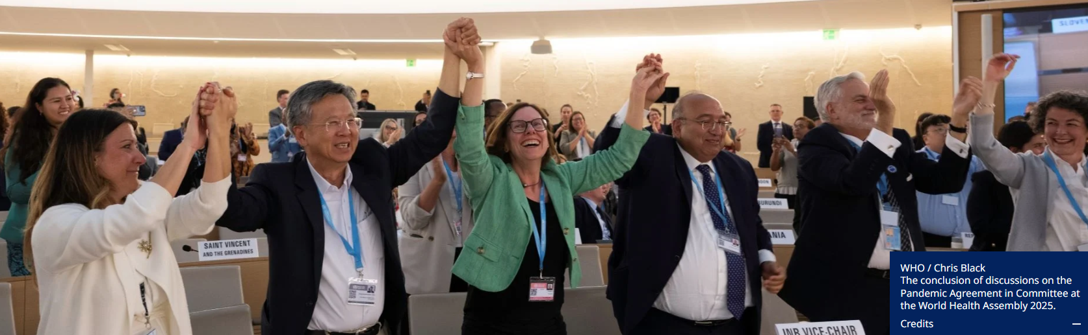

Slide 22

Please reach out coutinhoa@who.int if you want to implement the framework
Thank you!

Slide 23



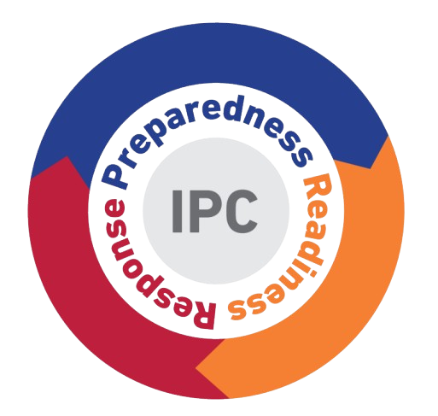
Ukraine’s Pilot Implementation of the IPC-OFT Manual:
Lessons and Deliverables
Pilot testing mission
Nov 2024, Kyiv
Measles and cholera selected as use-cases
Artem Horbachevskii
Head of AMR and IPC department
Public Health Center of the MOH of Ukraine

Slide 24




Field visits in Kyiv
full healthcare system coverage
Nov 2024
Ukraine pilot of the IPC-OFT
implementation manual:
Measles and cholera selected use-cases
Ukraine piloted the IPC-OFT implementation manual through a structured, collaborative mission approach to strengthen outbreak IPC capacities.
Two currently relevant outbreak threats with fundamentally different transmission pathways and response requirements.
Cholera: tests WASH capacity—safe water, sanitation, hand hygiene, environmental cleaning, and waste/wastewater management.
Measles: tests rapid triage, patient-flow separation, airborne precautions, and vaccination response.

Slide 25
Ukraine pilot of the IPC-OFT
implementation manual:
Measles and cholera selected use-cases
Two currently relevant outbreak threats with fundamentally different transmission pathways and response requirements.
Ukraine piloted the IPC-OFT implementation manual through a structured, collaborative mission approach to strengthen outbreak IPC capacities.
Field visits in Kyiv
full healthcare system coverage
Nov 2024
Tertiary Health Care facility
Secondary Health Care facility
Regional CDC
Emergency Medical Services Station
Primary Health Care facility
Measles: tests rapid triage, patient-flow separation, airborne precautions, and vaccination response.
Cholera: tests WASH capacity—safe water, sanitation, hand hygiene, environmental cleaning, and waste/wastewater management.

Slide 26

Field visits in Kyiv
full healthcare system coverage
Nov 2024
Tertiary Health Care facility
Key insights
Cholera
An outdated cholera guideline caused confusion around PPE use, leading to inconsistent practices. This will be addressed by updating the national cholera guidelines. Additionally, HERO-CAP assessments will be conducted at both regional and national levels as a separate solution to enhance preparedness and response capacities for outbreaks.
Measles
A communication gap between primary healthcare facilities and regional CDCs delayed contact tracing and follow-up. However, two measles outbreaks in healthcare settings last year highlighted the need for improvement. As a result, a new tool for assessing healthcare facility readiness for measles outbreaks was developedwith methodological input from Ana Paula Coutinho and Mahmoud Aly Zeenelabdin Hamouda.
Outbreak Preparedness Is Multi-Institutional and Complex
Outbreak preparedness, readiness and response span multiple sectors (HCF`s, emergency services, police). Aligning one unified algorithm across these sectors is inherently complex.
IPC receives limited attention at all stages, even though it is crucial to prevent the spread of outbreaks
Undervaluation of IPC
IPC is underprioritized in outbreak response, despite strong focus on surveillance, treatment, and logistics. In Ukraine, WHO Minimum Requirements for IPC, mandated in 2024, are obligatory for all healthcare facilities. However, their uneven implementation, partly due to the war, limits the effectiveness of IPC measures. Without adequate IPC, outbreaks cannot be fully controlled, even with strong surveillance and treatment efforts.
Primary Health Care facility
Artem Horbachevskii
a.horbachevskyi@phc.org.ua
Secondary Health Care facility
Emergency Medical Services Station
Regional CDC

Slide 27
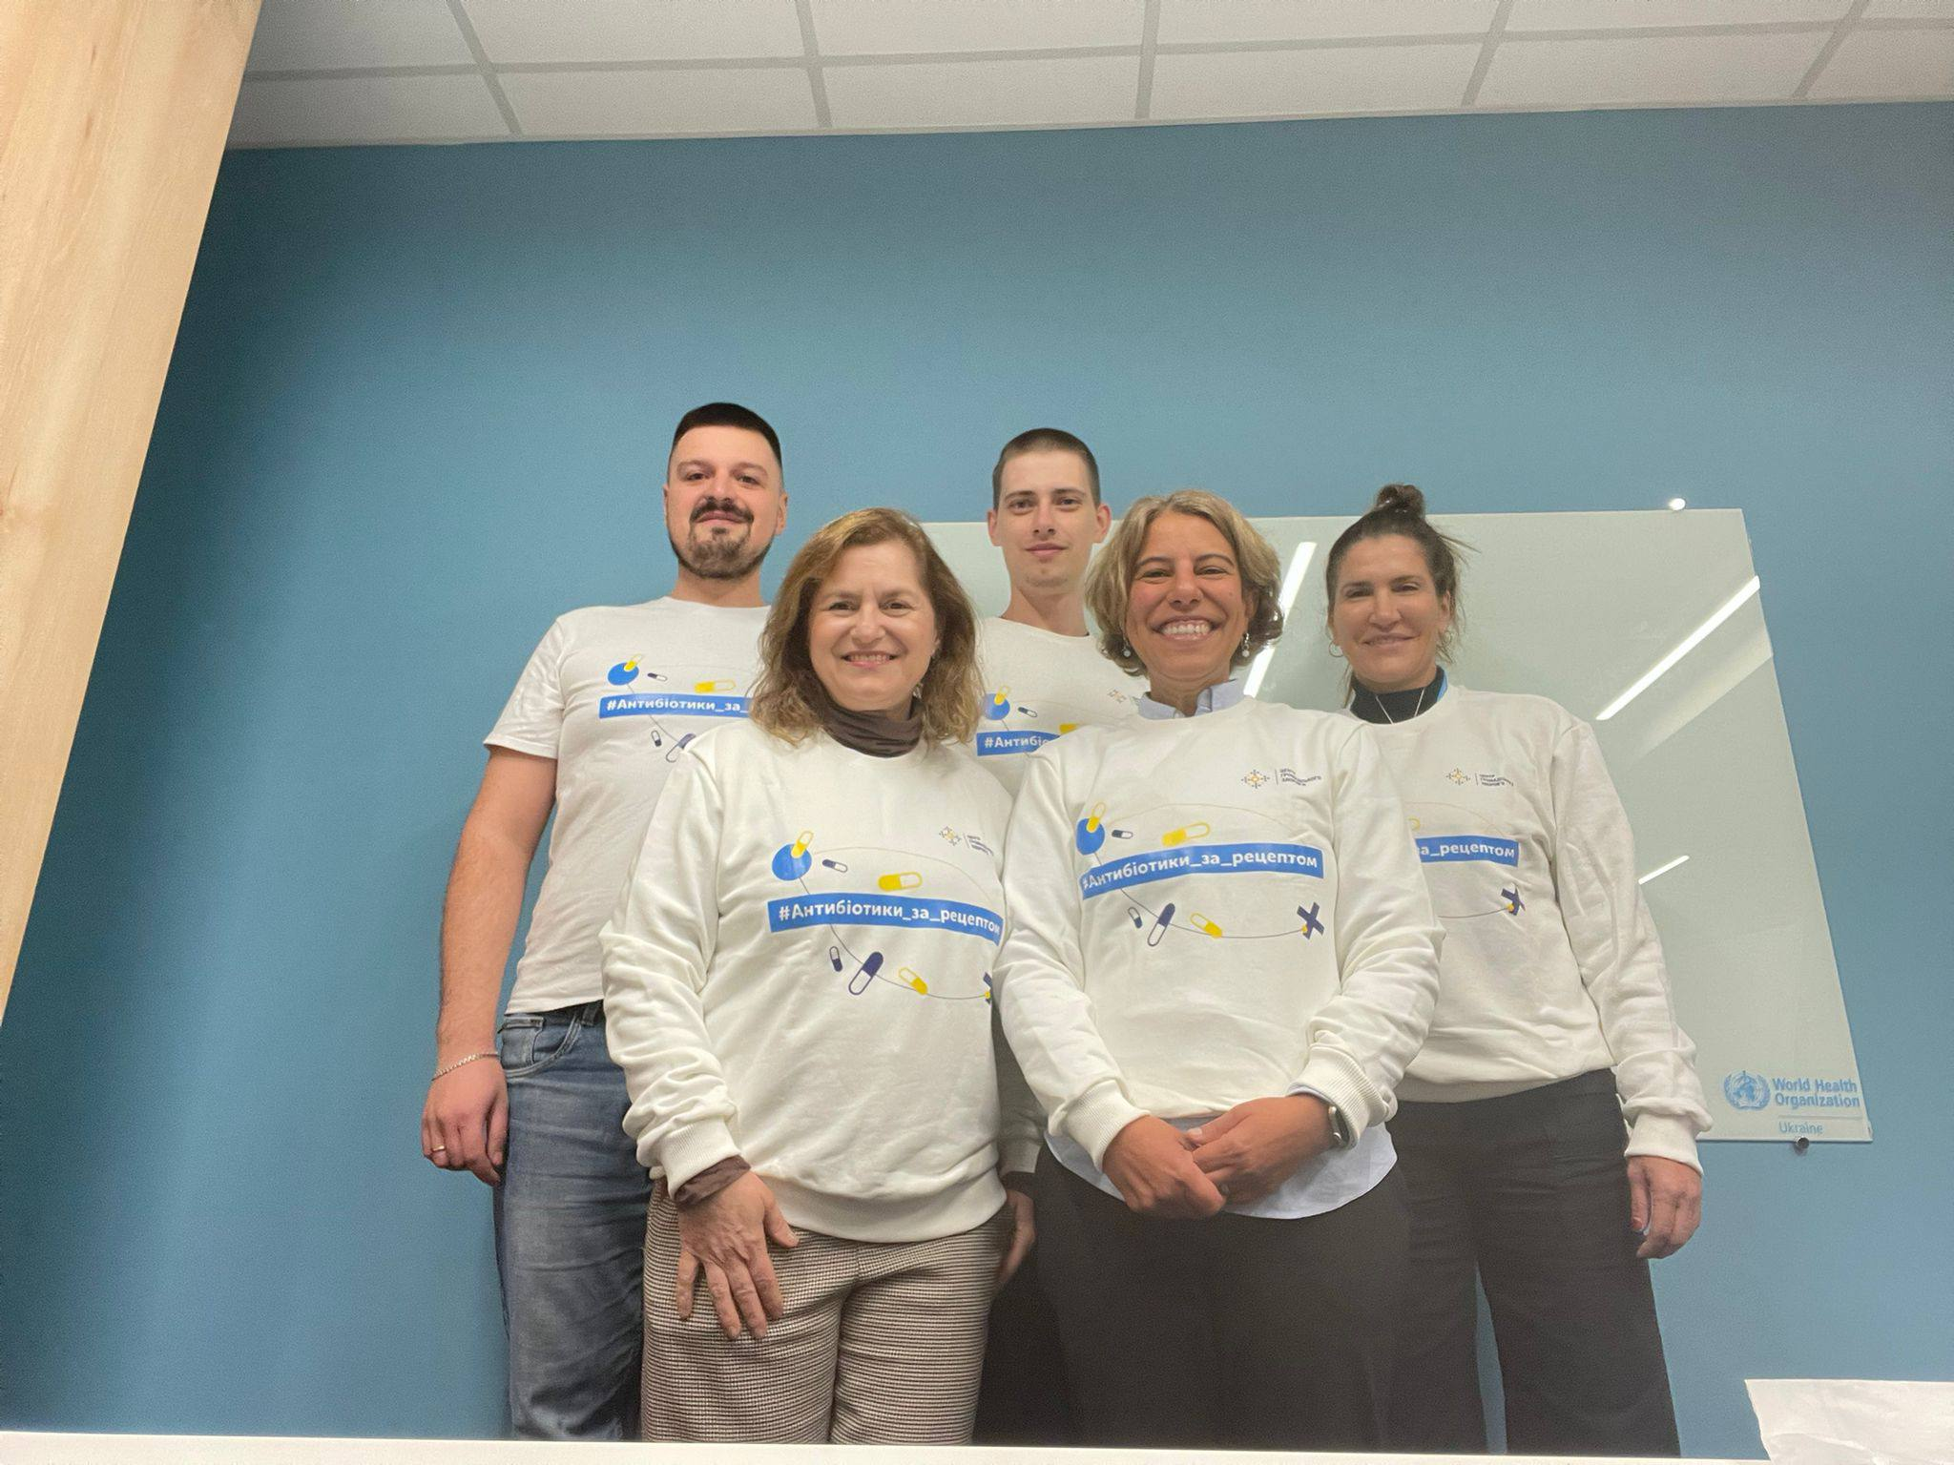
Outbreak Preparedness Is Multi-Institutional and Complex
Outbreak preparedness, readiness and response span multiple sectors (HCF`s, emergency services, police). Aligning one unified algorithm across these sectors is inherently complex.
IPC receives limited attention at all stages, even though it is crucial to prevent the spread of outbreaks
Key insights
Measles
A communication gap between primary healthcare facilities and regional CDCs delayed contact tracing and follow-up. However, two measles outbreaks in healthcare settings last year highlighted the need for improvement. As a result, a new tool for assessing healthcare facility readiness for measles outbreaks was developedwith methodological input from Ana Paula Coutinho and Mahmoud Aly Zeenelabdin Hamouda.
Cholera
An outdated cholera guideline caused confusion around PPE use, leading to inconsistent practices. This will be addressed by updating the national cholera guidelines. Additionally, HERO-CAP assessments will be conducted at both regional and national levels as a separate solution to enhance preparedness and response capacities for outbreaks.
Thank you for your attention
Special thanks:
Ana Paula Coutinho
Mahmoud Hamouda
Maria Clara Padoveze
April Baller
Arkadii Vodianyk
Artem Horbachevskii
a.horbachevskyi@phc.org.ua
Undervaluation of IPC
IPC is underprioritized in outbreak response, despite strong focus on surveillance, treatment, and logistics. In Ukraine, WHO Minimum Requirements for IPC, mandated in 2024, are obligatory for all healthcare facilities. However, their uneven implementation, partly due to the war, limits the effectiveness of IPC measures. Without adequate IPC, outbreaks cannot be fully controlled, even with strong surveillance and treatment efforts.

Slide 28
Utilizing the IPC framework, toolkit and implementation manual for preparedness, readiness, and response in Primary Healthcare(PHC) Facilities
Amy Elizbeth (E-beth) Barrera-Cancedda, PhD, MPH, RN
February 19, 2026

Slide 29
Why focus on IPC preparedness, readiness, and response at the PHC level?
Health emergencies are increasing—WHO estimates most countries will face a major event every 5 years
PHC serves as the health system’s first line in emergencies—maintaining services, supporting countermeasures, and anchoring responses in communities
Yet PHC remains underfunded, understaffed, and often overlooked in response planning. IPC suffers the same fate when implemented at the PHC level.
Is there a way to elevate the critical importance of both to better prepare and respond to outbreaks?

Slide 30

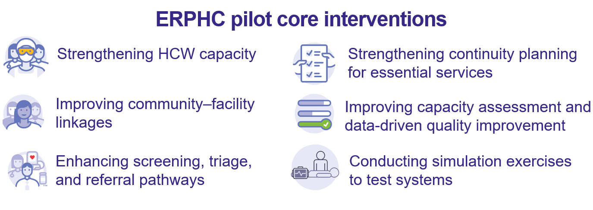
What is EPIDEMIC Ready Primary Health care?
An approach that strengthens PHC to prevent, detect and respond to outbreaks while ensuring the continuity of essential health services
ERPHC Pilot
Ethiopia, Nigeria, Sierra Leone, Uganda
766 PHC facilities

Slide 31
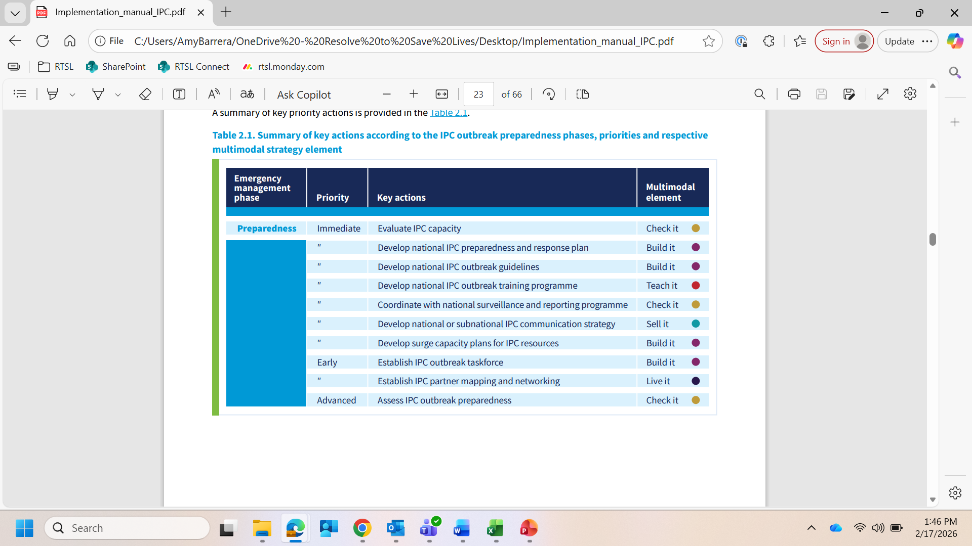
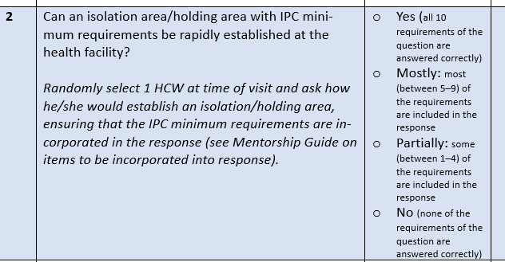
How did we PREPARE PHCs for outbreaks:
ERPHC activities:
Evaluated IPC capacity
    Used Assessment tool on IPC minimum requirements for PHC, and
    Developed ‘mentorship tool’ which assessed functional IPC capacities:

Slide 32
How did we PREPARE PHCs for outbreaks
ERPHC activities:
2. Develop PHC preparedness and response plans
    Focused on specific actions, with accountable parties pre-identified
        Identifying a holding area
        Who would make changes to the built environment (i.e., uni-directional flow or identifying more space in case of surge)

Slide 33
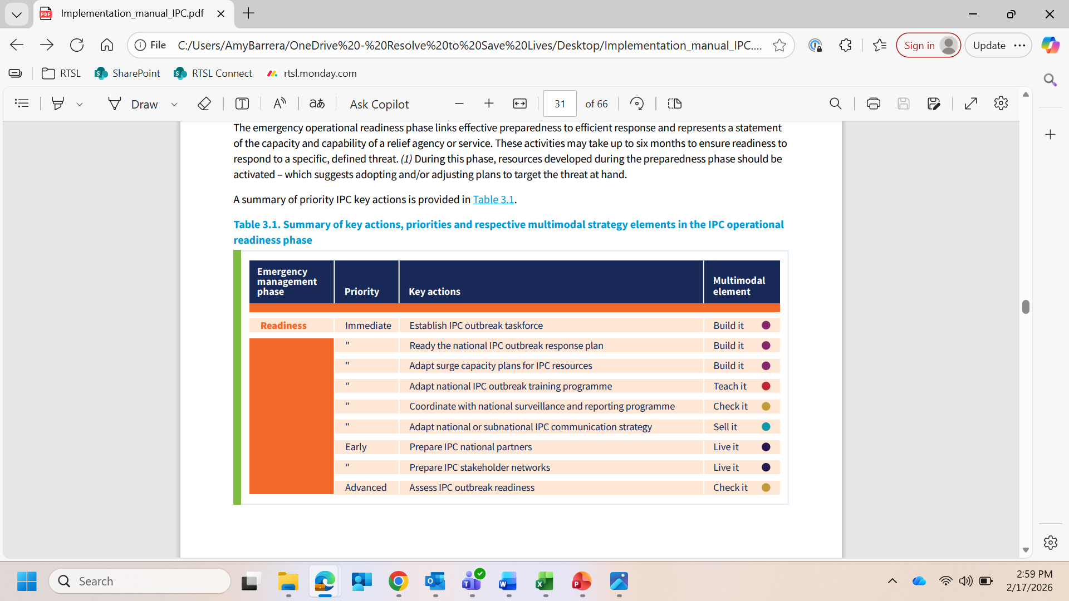
How did we ‘READY’ PHCs for outbreaks:
ERPHC activities:
3. Prepare IPC stakeholder networks
Developed and implemented communication plans, including devices were available
Engaged in real-time, “mystery patient” simulation exercises to assess functional performance

Slide 34
What did we LEARN:
The innovation is in the integration
Nigeria: ERPHC facilities scored significantly higher than non-ERPHC sites 95% v 71% (p = 0.01)

Slide 35
Stronger IPC, safer health care workers
Hand hygiene knowledge and practice improved from 43% at baseline to 98%
Availability of PPE for emergency use improved, with 80% of facilities maintaining a stock, up from 59% at baseline
“We were scared to open during COVID - we didn’t think we could manage. When Ebola came, the staff were really scared, but the mentors guided us, helped us set up triage and isolation, and gave us confidence. Then anthrax came. This time we felt ready - we no longer needed to run.”
(Sister Hilda, Wanda Health Centre, Uganda)

Slide 36
THESE TOOLS AND RESOURCES ARE JUST AS RELEVANT AT THE HEALTH FACILITY LEVEL

