Slide 1
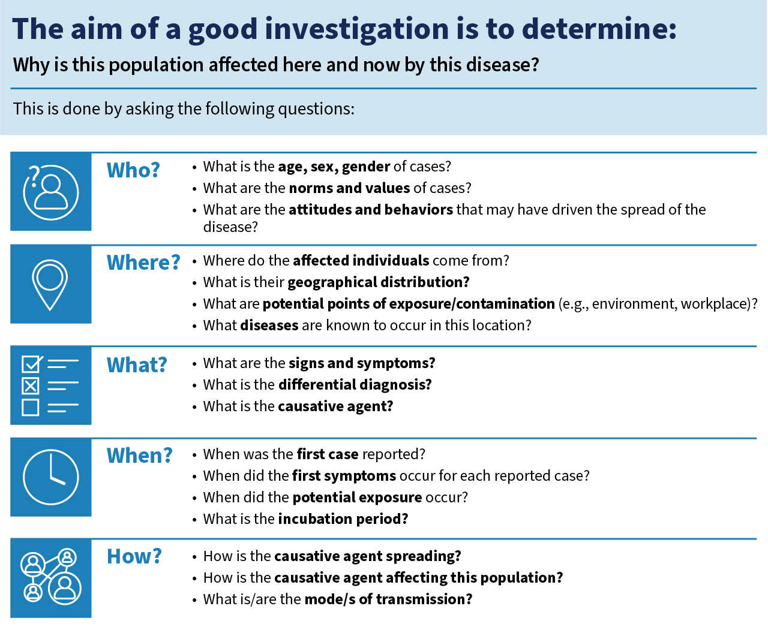
WHO Outbreak toolkit (OTK)
One stop shop of WHO existing guidance and tools for outbreak investigation
OTK Project Team
Leshan Koyie
Stacie Dunkle
Marie-Amélie Degail

Slide 2
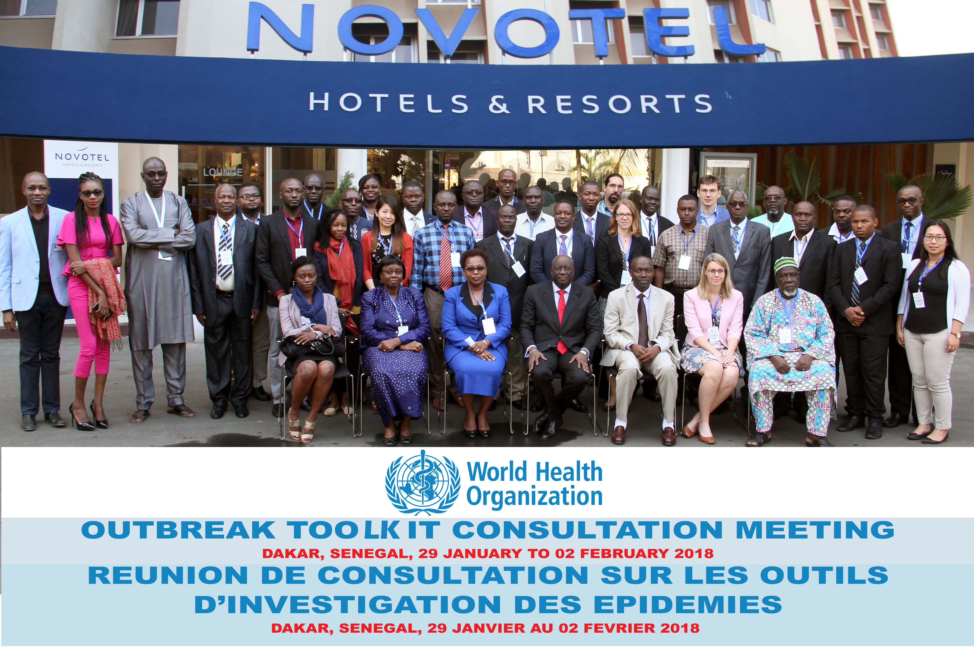
Background
Lessons learned from Ebola in West Africa
(2013-2017)
          Initial field investigations were delayed and did not meet required quality standards
          Data was collected for too long, with no clear standards, and much of it was never analyzed.
          WHO guidance was spread across many different webpages, making it hard to find.
          Response quality depended heavily on good early analysis — which required reliable data collected from the start.

Slide 3
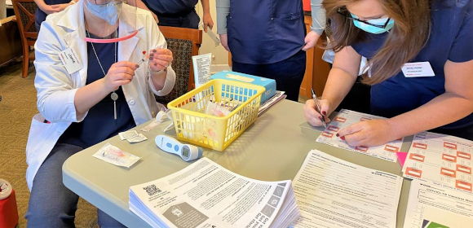
Background
Recent events and observations during field missions have highlighted several recurring, action-limiting issues such as:
          Time lost in gathering and adapting various technical resources
          Extensive and poorly formatted data
          Poor linkage of epidemiological, clinical and laboratory data and limited tools to guide investigations of outbreaks of unknown origin.

Slide 4
Goal
Objective
To limit the impact of outbreaks by improving the quality, timeliness, and use of data during outbreak investigations.
    To provide technical support to primary respondent facing an outbreak in remote place with limited resources.
    To improve quality, comparability and timeliness of outbreak investigations reinforcing epidemiological principles and good practices.
    To limit mortality, morbidity and economic impact of outbreak by supporting rapid identification of the cause of any outbreak including public health event of unknown origin.

Slide 5
Approach
A repository of WHO resources for outbreak investigation and response organised by disease, and regularly updated
A set of generic outbreak investigation packages that can be adaptable to various contexts
Developed collaboratively by a multidisciplinary team working collectively across WHO and in collaboration with partners
Designed to Support field investigators and frontline responders
Prioritizes on essential description, analysis, and interpretation of epidemiological data, not research, focusing on the utilization of data for informed decision-making and reporting

Slide 6
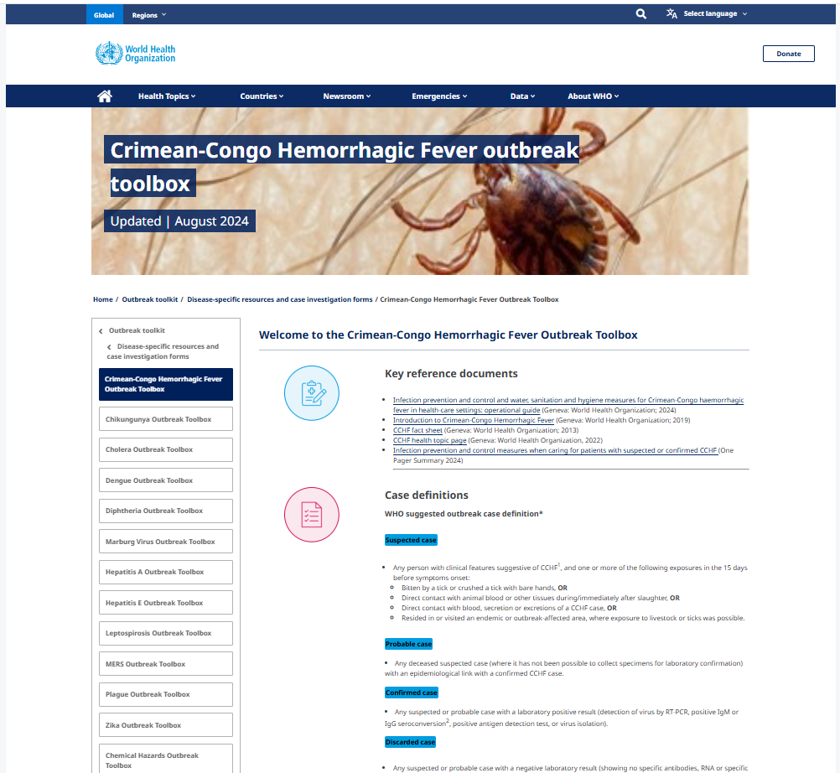
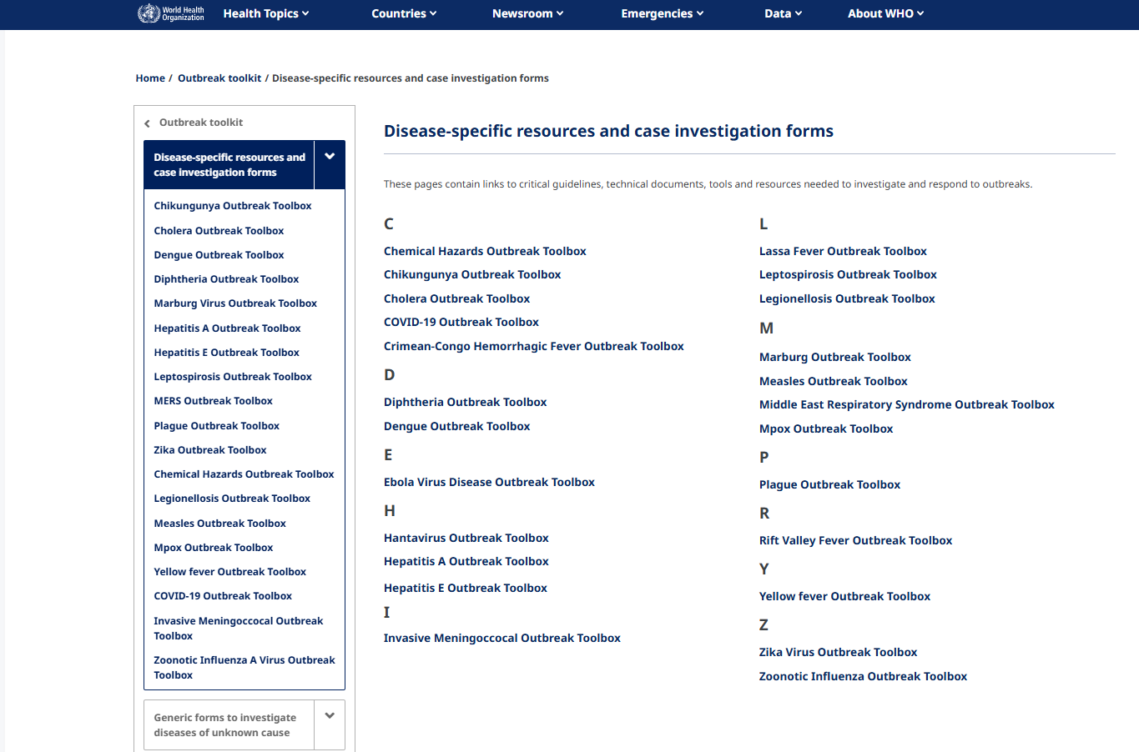
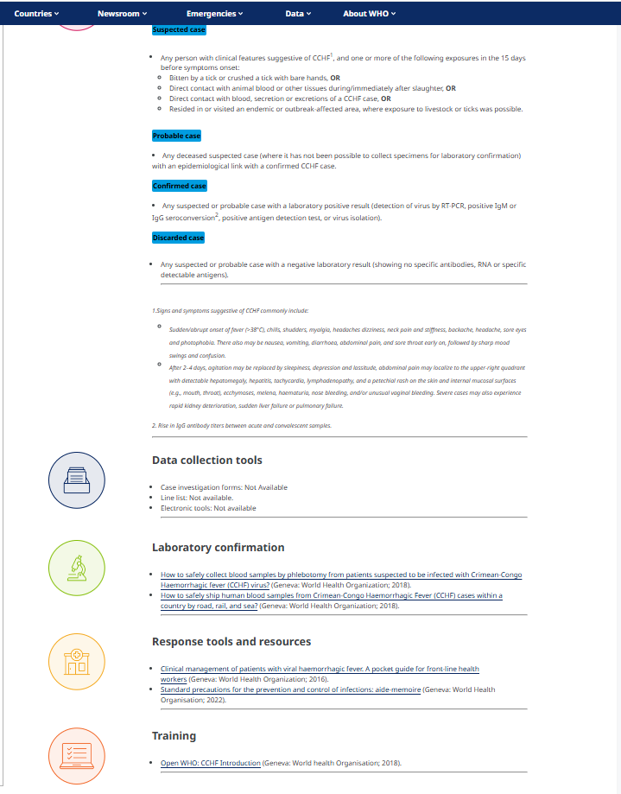
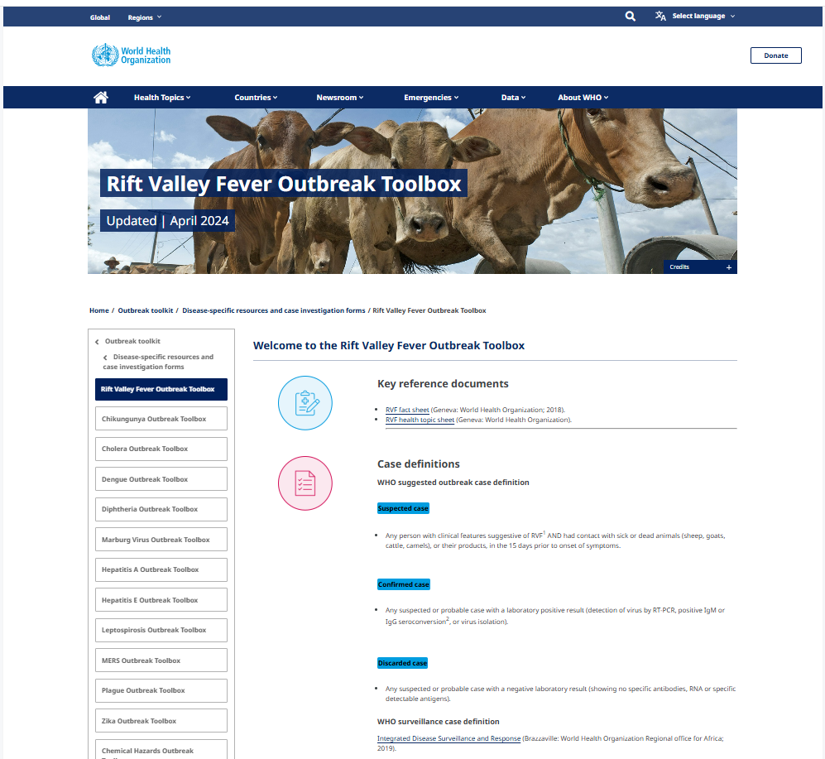
A dedicated set of webpages on WHO website
Disease specific guidance for 23 diseases and conditions
Key reference documents including guidelines
Case definitions
Laboratory sampling and testing methods
Response tools and resources (including digital data collection tools)
Other resources

Slide 7
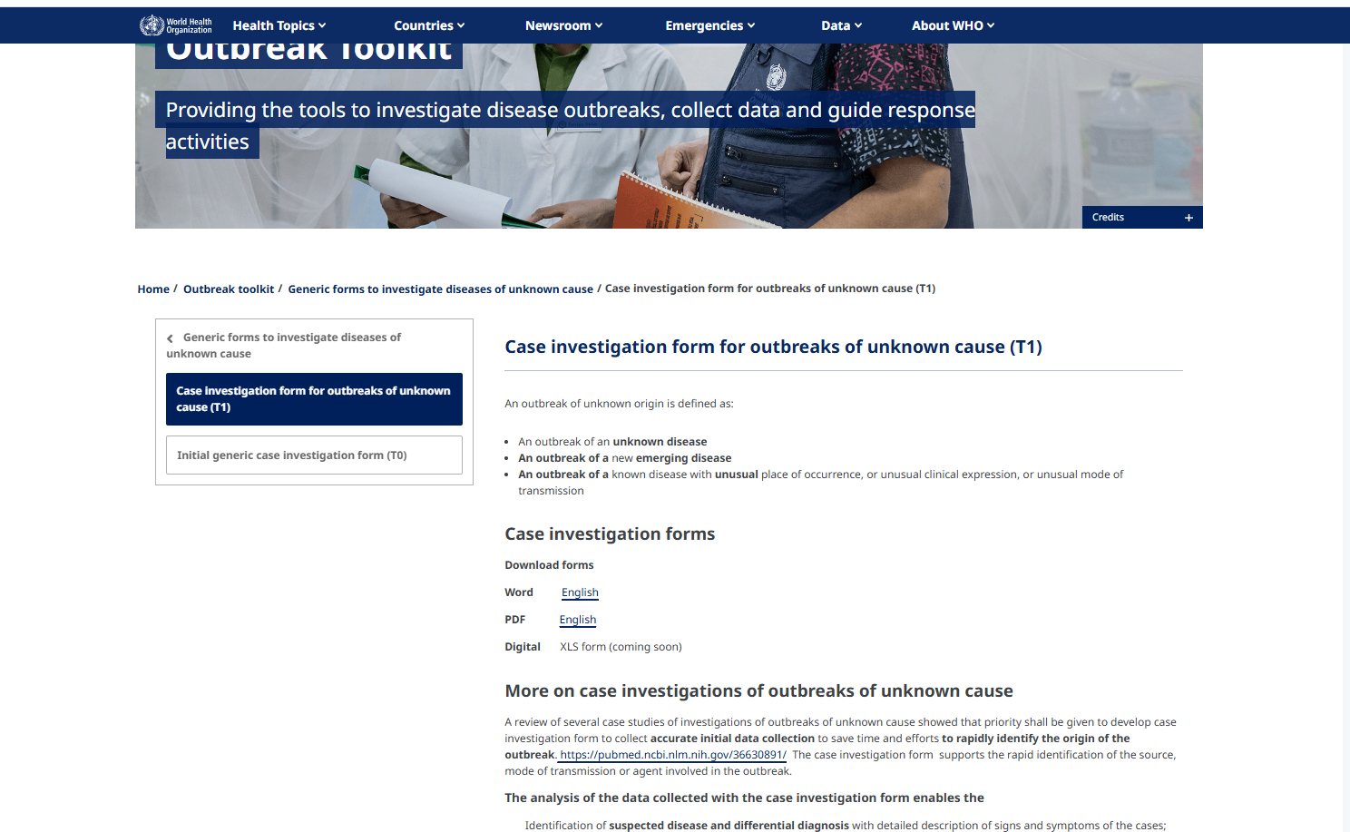
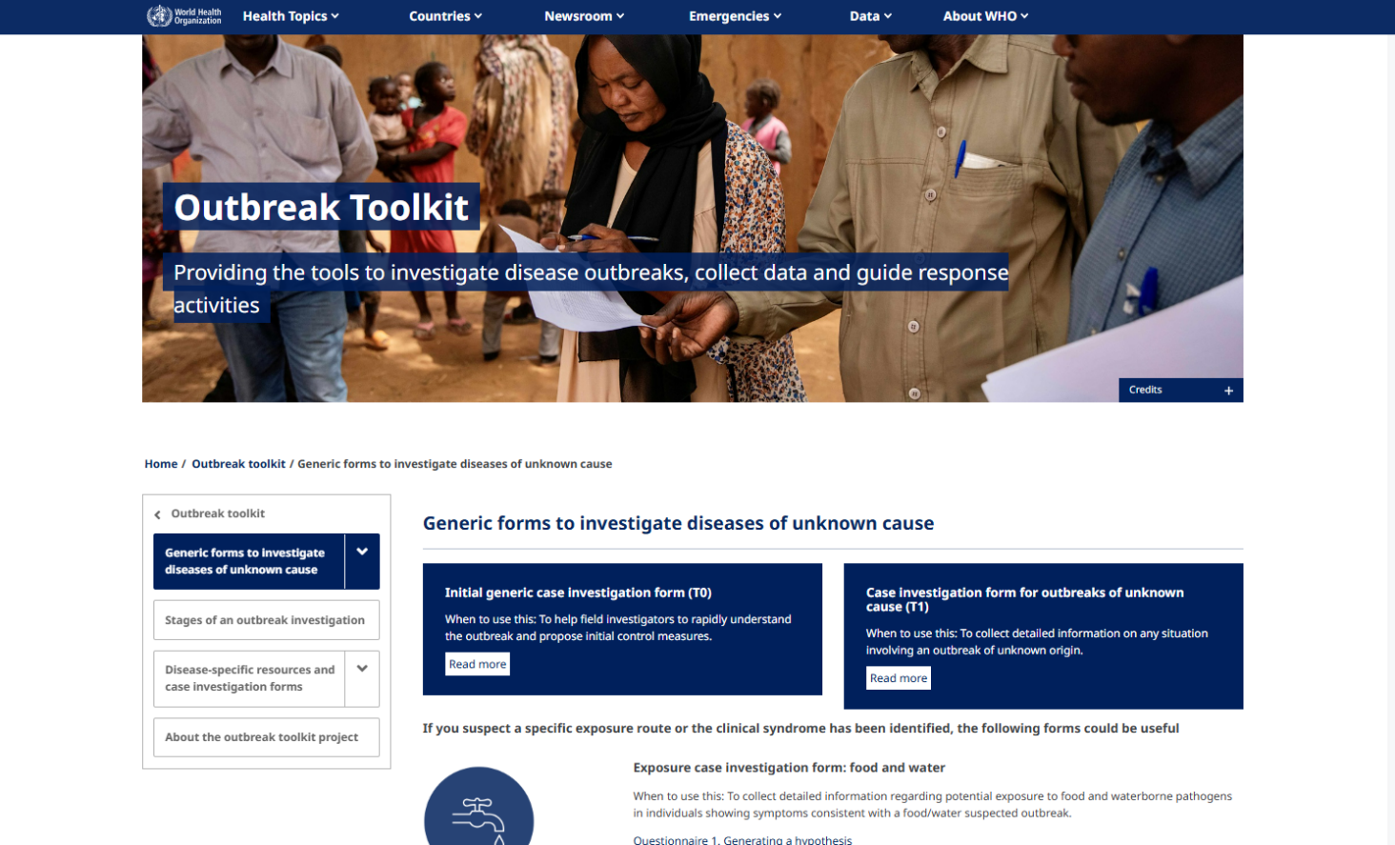
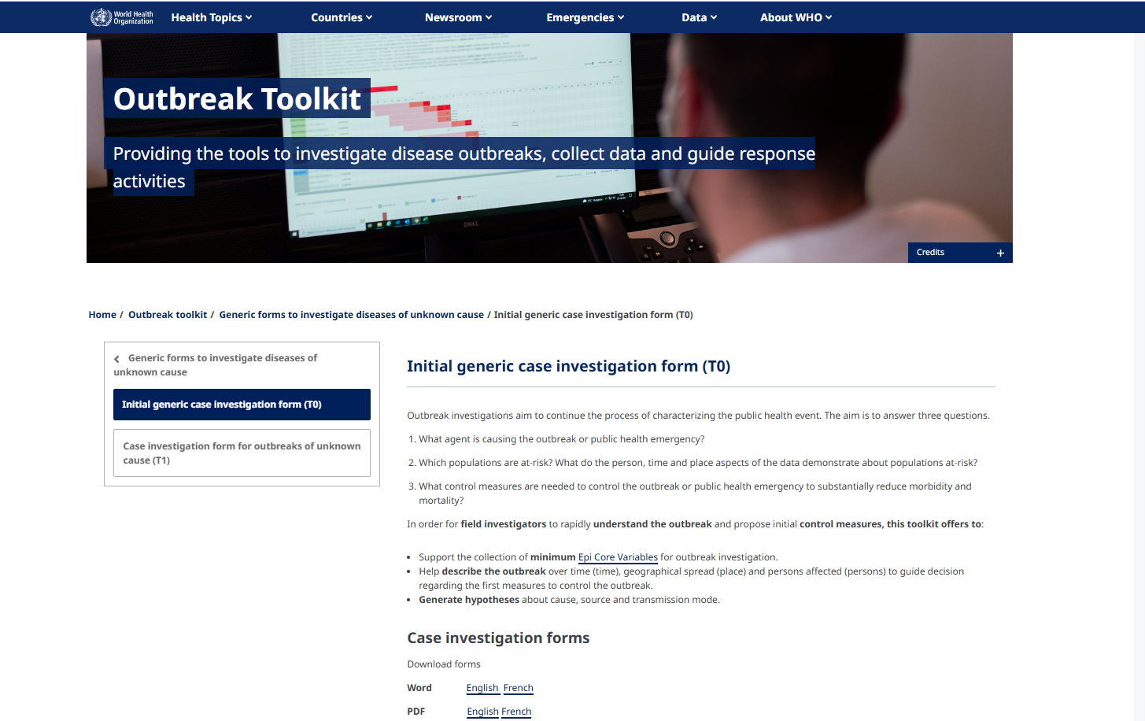
A dedicated set of webpages on WHO website
Standardized generic data collection tools and packages
Initial generic case investigation form (T0) – core set of data for the investigation of an outbreak
Case investigation form for outbreaks of unknown cause (T1)
One Health page and RCCE resources

Slide 8
What Next?
Explore the Toolkit – Visit the WHO Outbreak Toolkit and familiarize yourself with its key resources. https://www.who.int/emergencies/outbreak-toolkit.
Adopt the Tools in Field response – T0/T1 forms, Disease specific CIFs.
Share with Your Teams – Disseminate the toolkit across national, subnational, and frontline response teams to harmonize practices.
Provide Feedback – Contribute suggestions to help refine, update, and localize the toolkit for your context.
Stay Updated – Follow the periodic updates and new language additions to ensure your teams are using the latest versions.

