Slide 1
Avian Influenza H5: An update
20 July 2024

Slide 2
Background
Since the 2003-2004 emergence of Avian Influenza H5N1, the global surveillance, preparedness and response of zoonotic influenza has never stopped, even during the Covid-19 pandemic.
In 6 May 2024, we reported a highly pathogenic avian influenza (HPAI) A(H5N1) clade of viruses which arose in 2020 from previously circulating influenza A(H5Nx) viruses.
It led to unprecedented numbers of deaths in wild birds and in domestic poultry. It spread globally and has been reported in non-avian species including, and most recently in dairy cattle.
Since then, more human infections of avian influenza H5 have been reported, including those from Australia, China, and USA. Meanwhile the H5N1 virus continues to be detected in more cattle in the USA.
The succeeding slides show some updates in humans and birds. The EPI-WIN webinar provides more detail on human influence genetic sequence found in humans, cattle and birds.

Slide 3
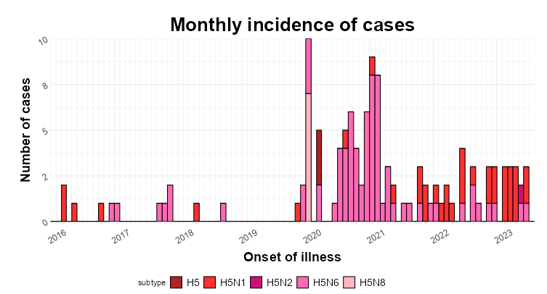
Influenza A(H5) infections reported in humans, 2018-2024

Slide 4
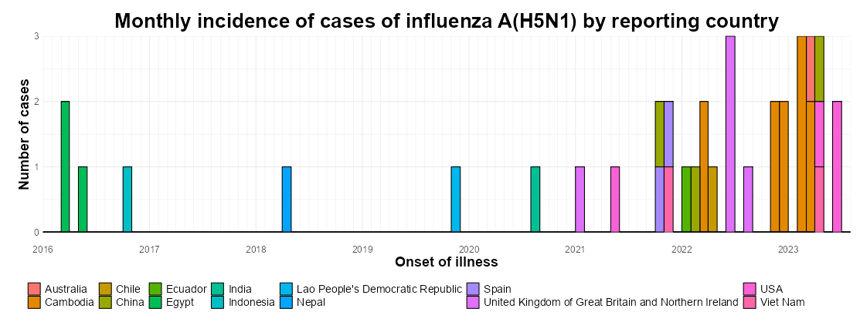
Influenza A(H5N1) infections reported in humans, 2018-2024
Notes:
11 H5N1 in 2024

Slide 5
Human cases of A(H5N1), USA, 2024 (3)
  First case in Texas in a person with direct contact (without eye or respiratory protection) with cattle presumed to be infected; onset of symptoms March; conjunctivitis
  Second case in Michigan in a person under monitoring due to contact with A(H5N1)-infected dairy cattle; onset of symptoms in May; also had conjunctivitis
  Third case in Michigan in a person with direct exposure to infected dairy cattle; onset of symptoms in May; this person had primarily respiratory symptoms
https://www.cdc.gov/flu/avianflu/avian-flu-summary.htm

Slide 6
Human cases of A(H5N1), 2024 (8)
Cambodia: 5 human cases in January and February, from 4 provinces; all had exposure to sick or dead chickens; one was asymptomatic and tested as part of contact tracing
Viet Nam: a fatal case in an adult from Khanh Hoa province; onset in March; treated in the intensive care unit for pneumonia; exposure to wild birds
Australia: a child with a travel history to India prior to onset of illness in February; treated in the intensive care unit; source of exposure unknown but similar A(H5N1) viruses known to circulate in birds in the area in India
China: detected A(H5N1) in a person who had traveled from Viet Nam and was sampled at a port of entry; this person had mild illness and exposure to chicken from a market in Viet Nam
https://www.who.int/emergencies/disease-outbreak-news/item/2024-DON501
https://www.who.int/emergencies/disease-outbreak-news/item/2024-DON511

Slide 7
Summary of zoonotic infections in humans
Sporadic cases with direct or indirect exposure to infected animals or contaminated environments as the likely source of exposure to the virus.
Infections can be severe and even fatal.
According to available evidence, no further spread of the virus to close contacts and no cases detected in the community among those without links to the cases.
Where available, sequences of the virus isolates from the human cases are similar to those from local animals.
Prompt and thorough investigations are critical and should include early identification of any unusual events that could signal person-to-person transmission of the virus.

Slide 8
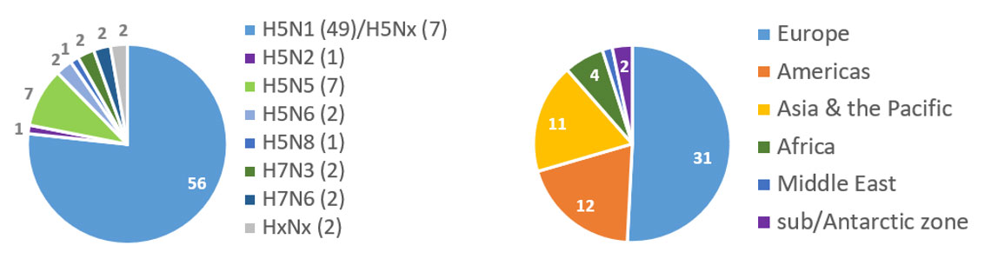

Global Avian Influenza Viruses situation
Countries reporting HPAI since 01 October 2023 by subtype (left) and by region (right) as of 22 May 2024
Source, FAO https://www.fao.org/animal-health/situation-updates/global-aiv-with-zoonotic-potential/en

Slide 9
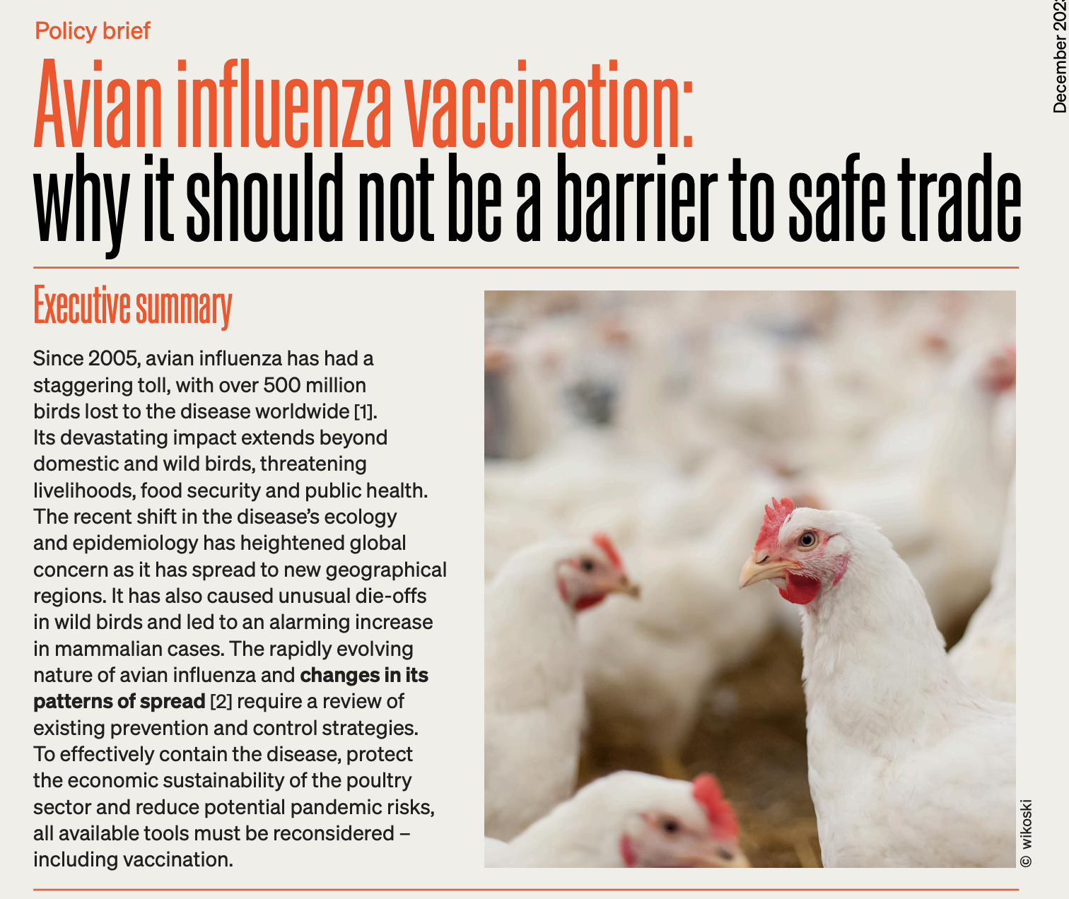
Prevention measures in animal health sector
Vaccination in poultry against A (H5)
Surveillance in wild and domestic birds including whole genome sequencing where economically feasible
Viral monitoring
Development of guidelines
Biosecurity to reduce spillover or spillback of AI into poultry, livestock value chains and mammals including humans
Awareness and training of stakeholders to understand the risks associated with HPAI
Emergency preparedness and contingency planning for HPAI including capacity building and fitness for purpose of diagnostic testing
Monitor HPAI events in animals and report to WOAH. Include HPAI in differential diagnosis in non-avian species, including cattle and other livestock populations with high risk of exposure to HPAI viruses.
Ian Brown, Chairman of WOAH-FAO joint network of expertise on animal influenza (OFFLU)

Slide 10
Useful links
Genetic and antigenic characteristics of clade 2.3.4.4b A(H5N1) viruses identified in dairy cattle in the United States of America
Technical Report: June 2024 Highly Pathogenic Avian Influenza A(H5N1) Viruses
The OFFLU website www.offlu.org
OFFLU landing page on HPAI detections in livestock: https://www.offlu.org/index.php/4437-2/
Updated OFFLU Statement on high pathogenicity avian influenza in dairy cows: https://www.offlu.org/wp-content/uploads/2024/05/2024_05_10_HPAI_Dairy-cattle.pdf
Diagnostic guidance: HPAI dairy cattle: https://www.offlu.org/wp-content/uploads/2024/05/2024_05_10_Diagnostic-guidance_HPAI_Cattle.pdf

Slide 11
EPI-WIN webinar
Listen to “Avian Influenza H5 Update”, 6 June 2024
Check out the prequel webinar “Public health risk of avian influenza A(H5N1) detected recently in dairy cattle”, 6 May 2024
Speakers
  Maria Van Kerkhove, Director a.i., Epidemic and Pandemic Prevention and Preparedness, WHO
  Wenqing Zhang, Head, Global Influenza Preparedness (GIP), WHO
  Aspen Hammond, Technical officer, GIP, WHO
  Charles (Todd) Davis, WHO Collaborating Centre, GISRS, US Centres for Diseases Control (CDC)
  Ian Brown, Chairman of WOAH-FAO joint network of expertise on animal influenza (OFFLU)

