Slide 1
Dengue: Overview of the current situation and response
13 June 2024

Slide 2
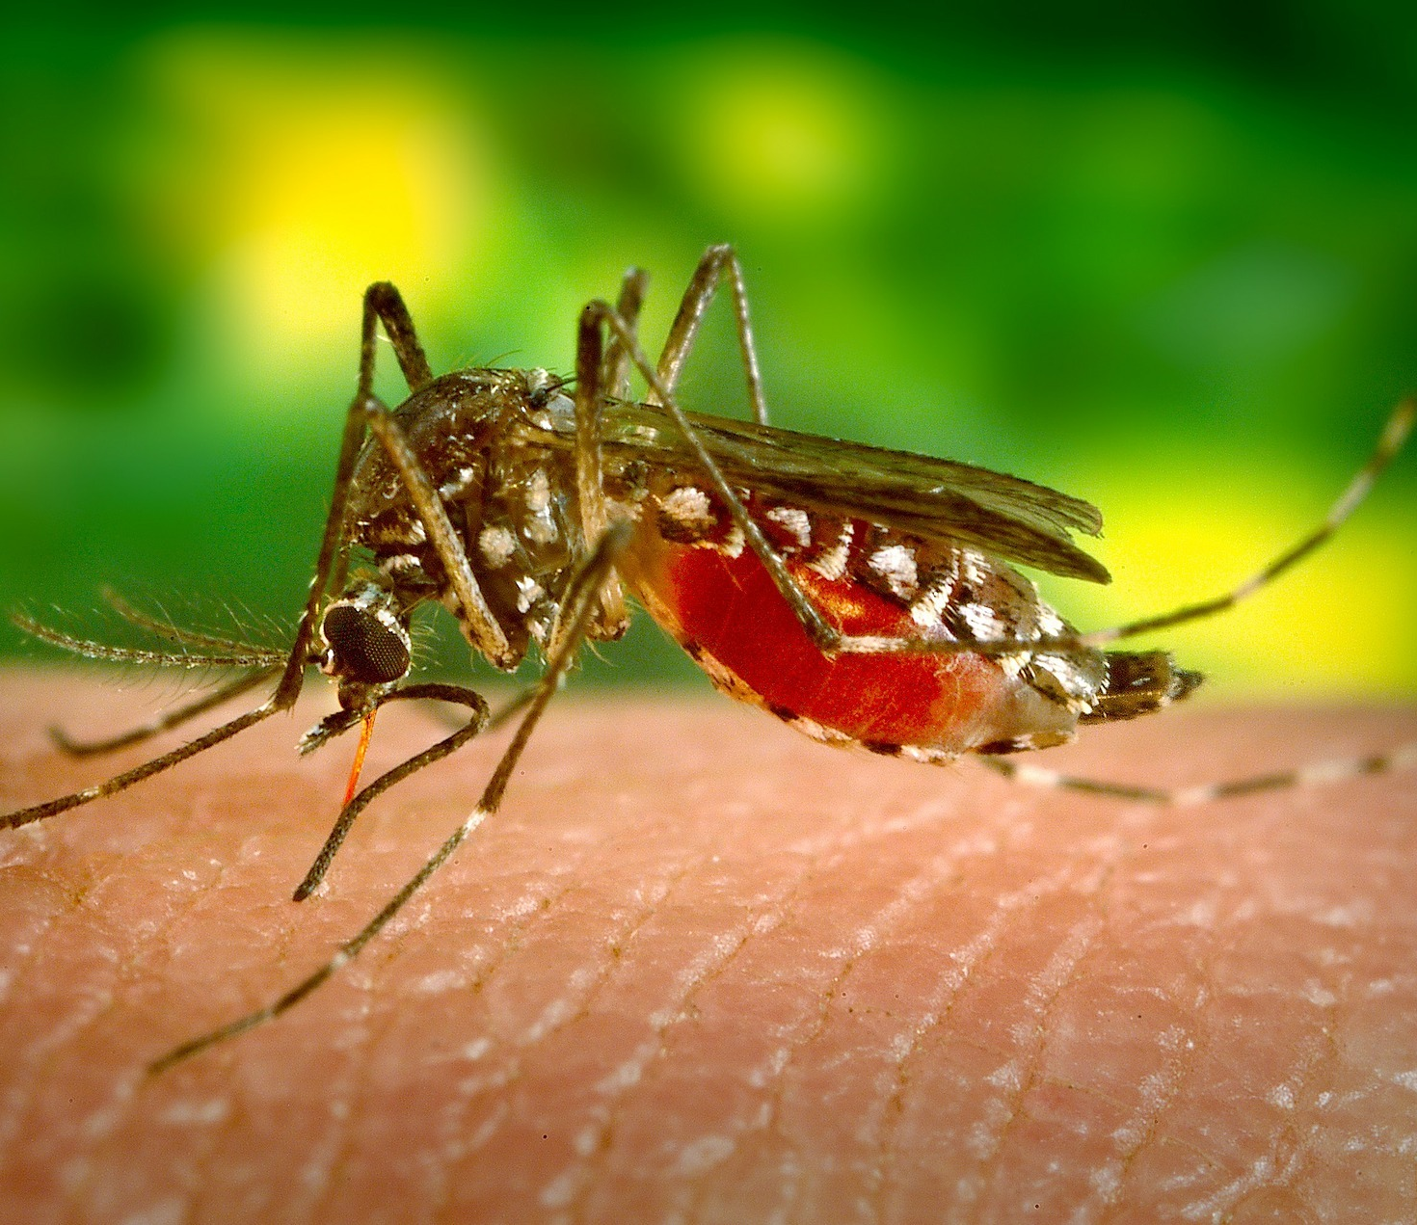
Introduction to dengue
Dengue (break-bone fever) is a viral infection that spreads from mosquitoes to people. It is more common in tropical and subtropical climates.
Most people who get dengue will not have symptoms. But for those who do, the most common symptoms are high fever, headache, body aches, nausea, and rash. Most will get better in 1–2 weeks. Some people develop severe dengue and need care in a hospital.
Dengue was declared a global Grade 3 emergency in early December 2023.
Changes in dengue disease patterns are observed as influenced by climate change: Outbreaks happen 1-2 months earlier; and moving further north and further south as temperate areas become warmer.
Requires multisectoral approach to response e.g. One Health Approaches

Slide 3
Global overview
January to April 2024
Cases
7,890,546
Severe cases
16,554
7,890,546 cases and 4,000 deaths reported to WHO from 79 countries by end of April 2024
161 countries or territories captured in the surveillance system, 82 of which are zero reporting for 2024
The surveillance system in regions outside of the Americas is still under development so comparisons should not be made
Other countries will be added as data become available
Confirmed cases
3,801,753
Deaths
4,000
WHO region | Cases | Deaths
African Region | 32,895 | 49
Eastern Mediterranean Region | 3,060 | 2
European Region | 0 | 0
Region of the Americas | 7,713,869 | 3,829
South-East Asia Region | 54,713 | 58
Western Pacific Region | 86,009 | 62
WHO Global Dengue Surveillance Dashboard:
https://worldhealthorg.shinyapps.io/dengue_global/

Slide 4
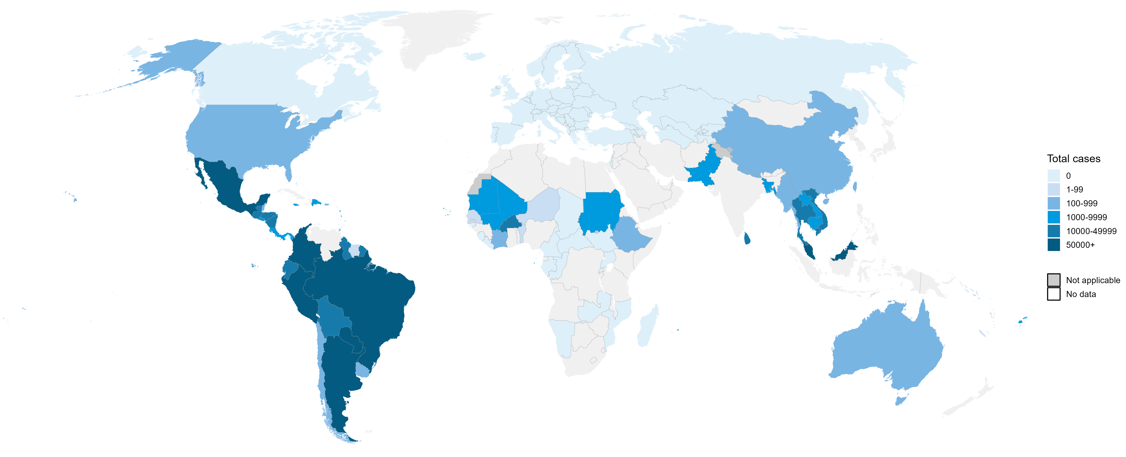
Geographical spread of reported cases
January to April 2024
Note: Case definitions, case ascertainment and reporting requirements vary by country, so data are not directly comparable between countries
Data Source: WHO
Map production: World Health Emergencies Programme
© WHO 2024. All rights reserved.
The designations employed and the presentation of the material in this publication do not imply the expression of any opinion whatsoever on the part of WHO concerning the legal status of any country, territory, city or area or of its authorities, or concerning the delimitation of its frontiers or boundaries. Dotted and dashed lines on maps represent approximate border lines for which there may not yet be full agreement.

Slide 5
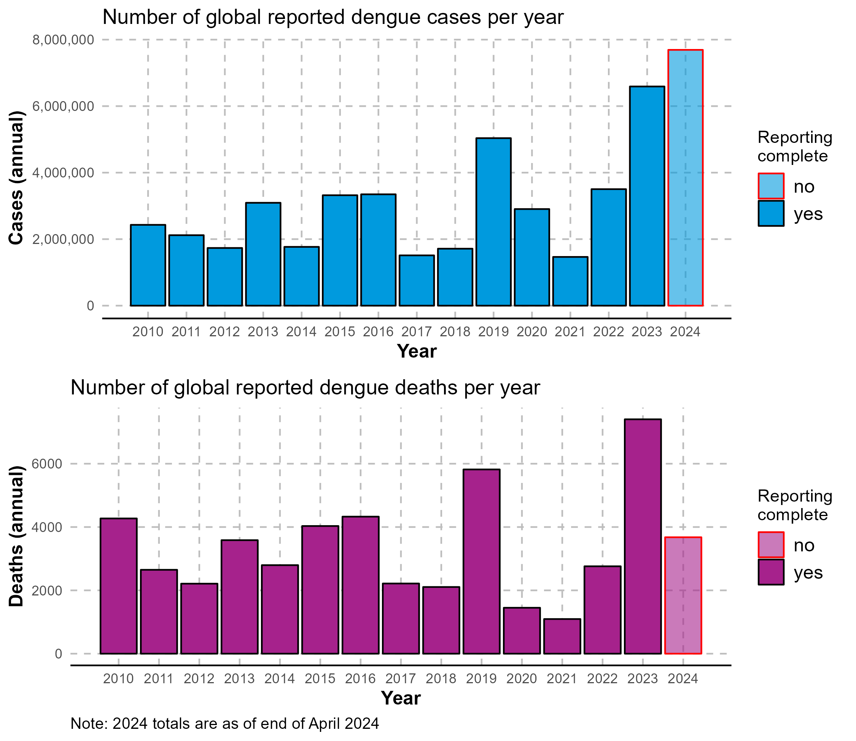
Reasons for increasing cases of Dengue
Climate change. Warmer conditions favour the mosquito. Warm climate allows mosquitos and the virus to multiply faster.
Changing distribution in the mosquito vector. The Aedes mosquito is silently spreading to the south parts of Europe.
Weakening health system. After the pandemic, there is a need to rebuild capacity and strengthen surveillance systems.
Large movement of people after the Covid-19 restrictions.
Reported cases and deaths have been increasing since 2021, with 2023 previously recording the highest number

Slide 6





Climate-sensitive disease outbreaks, the new health crisis
1
Scale of dengue outbreaks and geographic expansion
2
Climate change and social factors
DENGUE
3
Challenges in clinical diagnosis and laboratory testing
4
Insufficient capacities to respond at national level
5
Lack of funds to prevent and control dengue and other NTDs
Dengue and cholera outbreaks we now see are part of climate-sensitive disease outbreaks. The slide shows the challenges in prevention and responding to these.

Slide 7
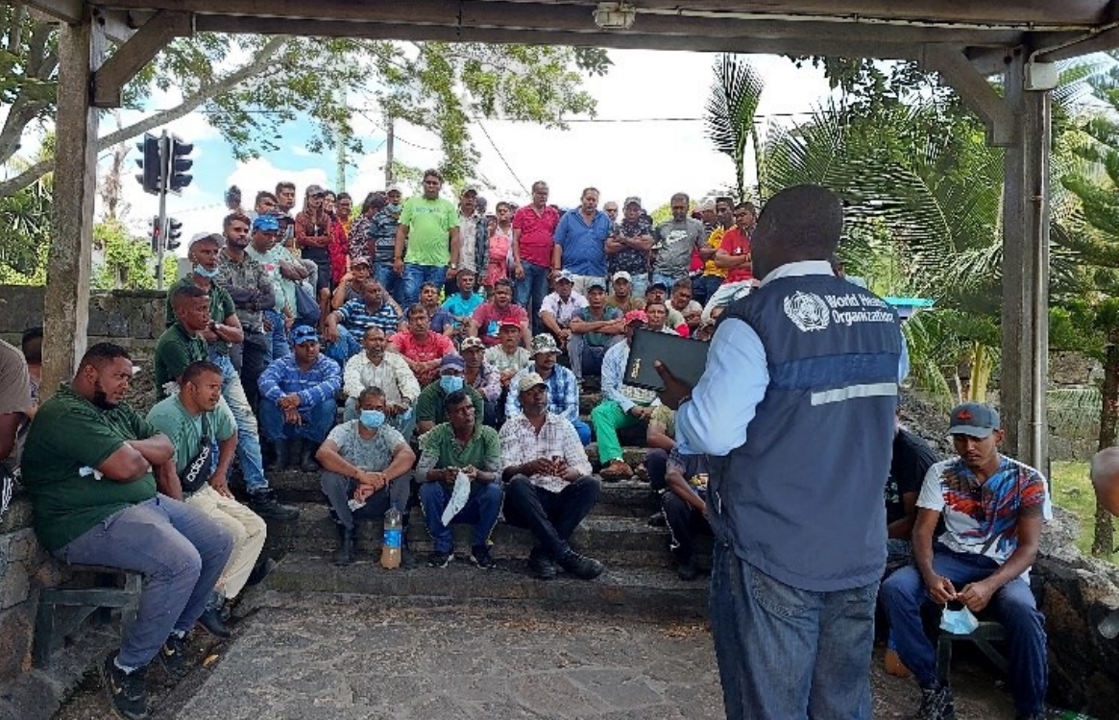
Country case study: Mauritius
Dengue was eliminated from Mauritius before an outbreak in 2009, but the country experienced ungraded minor outbreaks every few years
Challenges
  Overburdened and overstretched vector control teams.
  Community sensitisation for vector management in private residences.
  Management and testing for insecticide resistance at national level.
  Availability of weekly surveillance data for the entire republic
  Insufficient HR with vector control expertise
  There is no specific treatment nor efficient vaccine against dengue
  Budget constraints and procedural delays
Dr Abha Jodheea Jutton, Emergency Preparedness and Response Officer, WHO Country Office Mauritius

Slide 8
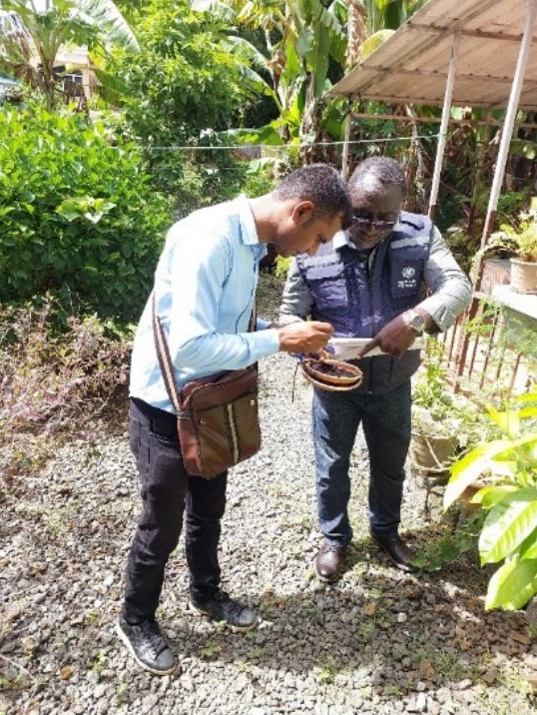
Country case study: Mauritius
Reflections
  Mauritius is experiencing the worst dengue outbreak.
  The outbreak posed a significant threat to the tourism industry, a key economic sector for Mauritius
  The problem of insecticide resistance underscored the importance of reinforcing vector control efforts and strengthening entomological expertise.
  Preparedness and multi-sectoral approach to combat dengue
Next steps
  Review of the dengue response
  Effective data sharing
  Building institutional and human resource capacities
  Enhance the arboviruses surveillance system
  Development of an emergency workforce strategy
Dr Abha Jodheea Jutton, Emergency Preparedness and Response Officer, WHO Country Office Mauritius

Slide 9
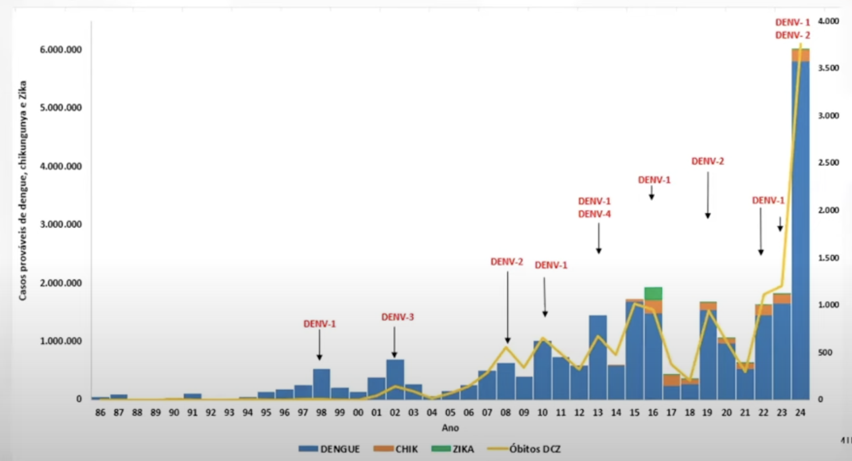
Country case study: Brazil
Recent developments
  National guidelines published
  Modelling data for 2024
  Preparedness meetings for endemic areas to develop contingency plan, risk stratification, etc.
  Activation of operations center for dengue emergency
  Risk communication and webinars
  Behavioural science efforts
2024 has seen the highest number of cases, higher than 2021-2023 combined.
Dr. Livia Carla Vinhal Frutoso. Head of the national surveillance of arboviruses, Ministry of Health of Brazil

Slide 10
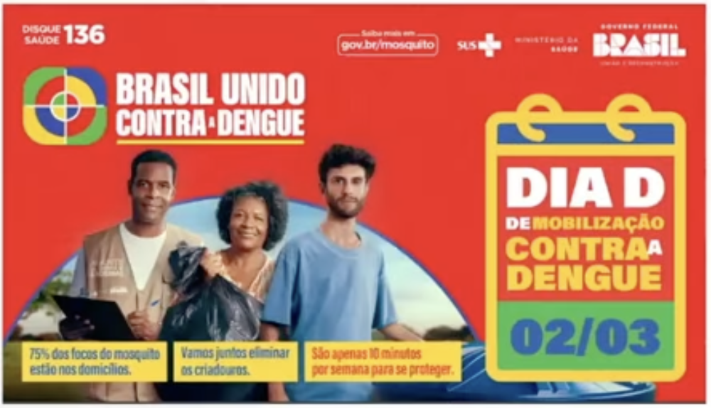
Country case study: Brazil
Challenges
  Laboratory diagnostics
  Vector resistance
  Case definitions
  Robust and timely information systems
  Epidemic response capacity
  New vector control technologies
  Public policy structure
  Need permanent investment in research
Dr. Livia Carla Vinhal Frutoso. Head of the national surveillance of arboviruses, Ministry of Health of Brazil

Slide 11
WHO’ response to dengue outbreaks- priority areas
Reinforce global and regional surveillance system of dengue and other arboviruses.
Provide technical support and guidance:
Clinical management, diagnostics
Laboratory testing
RCCE
….
1
2
4
Increase donors' interest and foster resource mobilization to fund the SPRP for dengue and other arboviruses
3
Improve vector control management (surveillance, PoE, travel, WASH) and national capacities to prevent and respond to dengue

Slide 12
Summary and next steps
7.9 million cases and 4,000 deaths recorded globally from 79 countries between January and April 2024
Cases recorded by end of April have already exceeded the total of 6.6 million cases reported globally in 2023, with several regions and subregions due to experience typically transmission season in the second half of the year
Global monthly surveillance for dengue has been established with 161 countries so far incorporated, 82 of which have recorded no cases January-April 2024
Work is underway to expand WHO global dengue surveillance system to include other arboviruses, namely Zika and chikungunya given the cocirculation of these, and possible misdiagnosis, in many countries
Historical data is not routinely available across all regions however where it is, in South-East Asia and the Region of the Americas, there is some evidence of longer and higher incidence seasons in recent years in endemic countries however this varies substantially by country and subregion
WHO Global Dengue Surveillance Dashboard: https://worldhealthorg.shinyapps.io/dengue_global/

Slide 13
EPI-WIN webinar
WHO Fact sheets – Dengue and severe dengue
Listen to “Dengue: Overview of the current situation and response”, 13 June 2024
Presentations
  Dr Raman Velayudhan, Unit Head Veterinary Public Health, Vector Control and Environment unit. Global Neglected Tropical Diseases Programme, WHO HQ
  Dr Maria Van Kerkhov, Director, Epidemic and Pandemic Preparedness and Prevention (EPP) department, WHO HQ
  Diana Rojas, Team Lead Arboviruses, Epidemic and Pandemic Preparedness and Prevention Department, WHO Health Emergencies Programme
  Martina McMenamin, Epi Lead G3-dengue emergency, WHO Health Emergencies Programme
  Dr Awa Ndir, WHO HQ Dengue IMST
  Dr Abha Jodheea Jutton, Emergency Preparedness and Response Officer, WHO Country Office Mauritius
  Dr. Livia Carla Vinhal Frutoso. Head of the national surveillance of arboviruses, Ministry of Health of Brazil

