Slide 1
Integrated Sentinel Surveillance for Influenza and other Respiratory Viruses: standards and implementation
5 December 2024

Slide 2
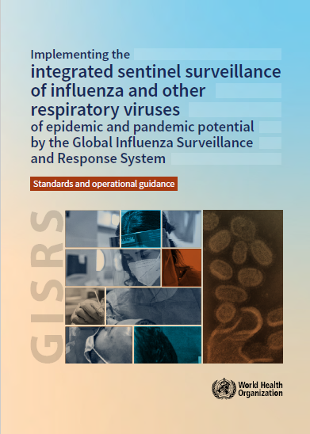
What is integrated surveillance?
Integrated surveillance are approaches to public health surveillance that combine various systems and data sources to monitor multiple diseases, conditions and events. It allows efficient, effective and coordinated responses to public health threats.
Primary objectives
  Monitor epidemiologic and clinical characteristics of acute respiratory infections
  Monitor virologic patterns and characteristics of circulating viruses causing acute respiratory infections
  Generate evidence to guide public health action
  Support early warning and event-based surveillance
Secondary objectives
  Monitor clinical severity and high-risk groups/settings
  Provide platform for special studies or specialized investigations (e.g., vaccine/treatment effectiveness, antiviral susceptibility, disease outcomes, disease burden, etc.)
JUST PUBLISHED
This updated guidance stands in as the new guidance and standards, superseding prior guidance.
https://iris.who.int/handle/10665/379678

Slide 3
Updates on the new guidelines
Based on shared primary objectives of sentinel surveillance for respiratory viruses
  Acknowledge additional objectives that sentinel surveillance, and eGISRS support
Allow size and approach to be guided by each country’s surveillance objectives
Maintain the core surveillance standards for influenza
Maintain SARS-CoV-2 testing from sentinel sites for representative and year-round awareness
Integrate RSV
Case definitions and sample size requirements based on evidence and national operational feasibility and priorities
Considerations in the selection of sentinel sites based on the number of patients
Strategic shift towards the reporting of case-based and age-disaggregated data to WHO regional office and global reporting platforms
The succeeding slides provide an overview of essential contents.

Slide 4
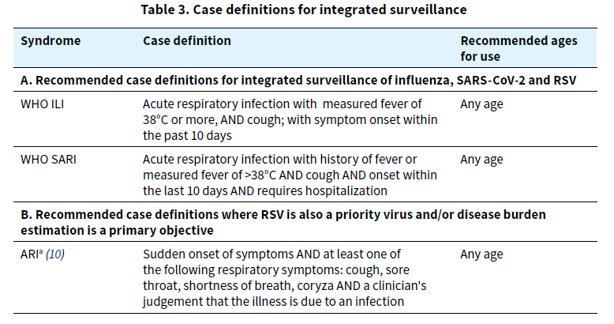
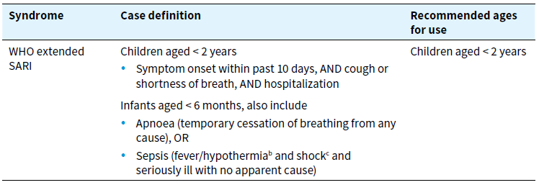
Which case definitions to use?

Slide 5

How many specimens to test?
Year-round testing for influenza and SARS-CoV-2
Aim to test at least 50 specimens from ILI/ARI patients per week at national level
Aim to test at least 50 specimens from SARI patients per week at national level
At a minimum,
  Aim to test at least 50 specimens per week at national level.
  --> Specimens can be from a mix of ILI/ARI or SARI patients
If prioritizing RSV testing, aim to test 20 specimens per week at national level year-round
  Ideally from hospitalized children aged <2 years
  May be a sub-sample of 50 SARI specimens

Slide 6
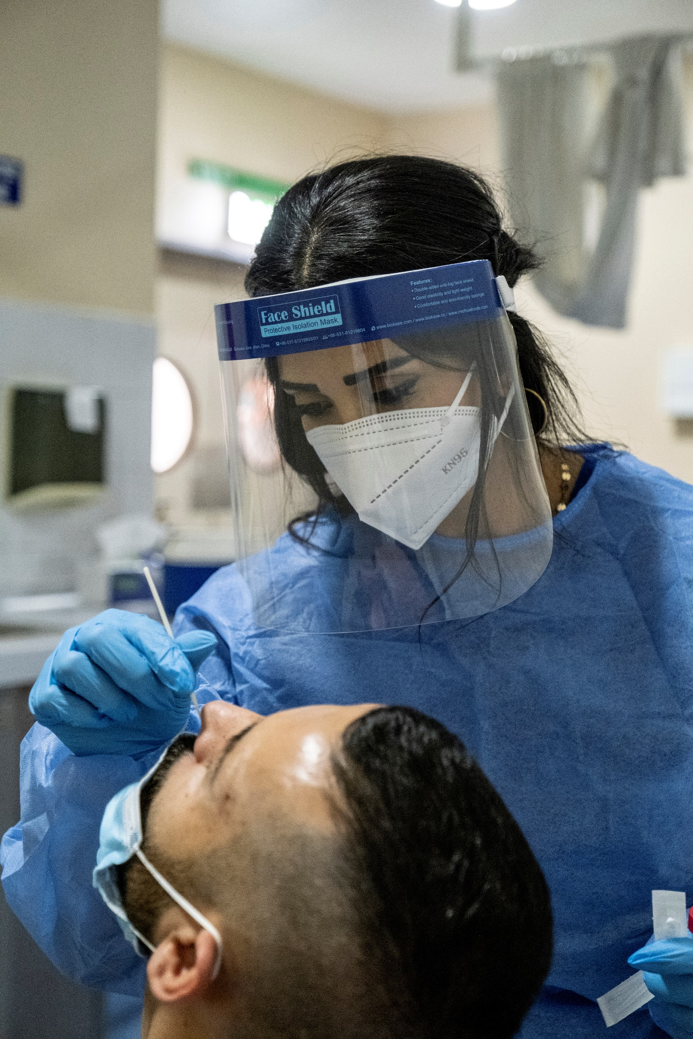
Which patients to choose for testing?
It is often not feasible to test all patients with ILI/ARI or SARI
Random sampling is ideal but impractical
A pre-defined sampling scheme, for which patients are sampled for surveillance testing, can minimize bias
  Key point: sampling scheme should be systematically applied to reduce bias
  Sample every n^{th} patient (e.g., every 10th, 20th, etc.)
  Sample all patients on every other day
  Sample the first n patients each day

Slide 7

How many sentinel sites?
There is not a recommended target number of sites
A few sentinel sites providing good quality data are better than larger systems with poor quality data
Choose enough sites so that at least 1000 patients a week at national level are evaluated for the case definitions.
    > 1000 patients will likely enroll enough patients to meet testing goals and reach primary objectives
When choosing sites, prioritize sites that are:
    Representative of the population
    Provide good quality and timely data
    Can sustainably perform surveillance

Slide 8
Data collection
Public health surveillance involves systematic collection of data and analysis
From each sentinel site
From patients with specimen collected
From laboratory testing
Number of patients evaluated for each case definition
Number of patients with ILI/ARI/SARI
Number of patients with specimens
Number of specimens shipped to lab
Number of patients with specimens
Minimum data:
  Sentinel site
  Age, sex
  Onset date
  Case definition/symptoms
  Hospitalized (Y/N)?
  Specimen collection date
Test results
Number of specimens received
Number of specimens tested
Number of specimens positive
  Influenza
  SARS-CoV-2
  RSV
Lab data links with the patient data

Slide 9
Data reporting to WHO
Global Respiratory Virus Activity Weekly Updates
Report to WHO (regional or global) by Thursday the week following the end of an epi-week
Syndromic data should be reported in aggregate for each week for each age group and case definition
  Number of patients evaluated in each age group for each ILI/ARI and SARI that week
  Number of patients in each age group with ILI/ARI and SARI that week
Virologic data should be reported in aggregate for each age group and case definition
  Number of ILI/ARI patients in each age group that had specimens collected
    Number tested for each virus in each age group
    Number tested positive for each virus in each age group
  Number of SARI patients in each age group that had specimens collected
    Number tested for each virus in each age group
    Number tested positive for each virus in each age group
Case-based reporting is also possible

Slide 10
Monitoring and Evaluation
Continuous monitoring
  Data quality and completeness
  Timely data collection, laboratory testing and reporting to national, regional, global level
Periodic evaluation
  Of part or all of the system
  1-2 years after implementation (then every 5-10 years)
  When considering changes to system
  After changes to system

Slide 11
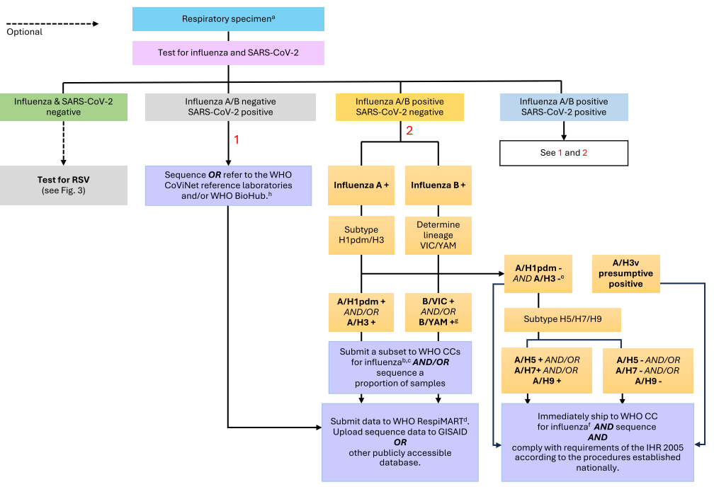
Other contents of the guidance
Clinical specimens – Type, collection, storage and transport
Laboratory testing algorithms
Genomic sequencing
Laboratory workflow
Sample testing algorithm for influenza viruses and SARS-CoV-2

Slide 12
Key points for NICs on integrated surveillance
Focus on Quality not quantity
  Representativeness, timeliness, standardized, systematic and continuous collection
Sampling
  Weekly minimum 50-100 specimens (from ILI/ARI, SARI case definitions)
Testing
  multiplex reagents kits from International Reagent Resource (IRR) with ancillary reagents support from IRR and WHO
  Timeliness of surveillance data reporting - weekly reporting
Quality Programme
  SARS-CoV-2 integrated into GISRS External Quality Assessment Programme (EQAP) panel since April 2020
  Influenza PCR EQAP since 2007
Sequencing
  Weekly sequencing minimum 15 sentinel viruses
  SARS-CoV-2 Spike and Influenza A full genome nanopore sequencing methods and reagents available through IRR
  Submit GSD timely and regularly (e.g. weekly or fortnightly) to GISAID or other publicly accessible database
    Tick "GISRS" under the “Network” field and "Sentinel Surveillance" under the “Sampling Strategy” field in GISAID.

Slide 13
EPI-WIN webinar
View webinar “Integrated sentinel surveillance for influenza and other respiratory viruses: standards and implementation”
Speakers
  Dr. Wenqing Zhang, WHO
  Dr. Aspen Hammond, WHO
  Dr. Dmitriy Pereyaslov, WHO
  Dr. Melissa Rolfes, WHO
  Dr. Siddhi Hirve, WHO
Reference: Integrated sentinel surveillance guidance
For more information: www.who.int/teams/global-influenza-programme

