Slide 1
Pathogen Genomics in Health Emergencies: Spotlight Cholera
12 December 2024

Slide 2
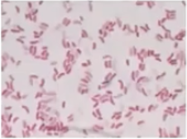
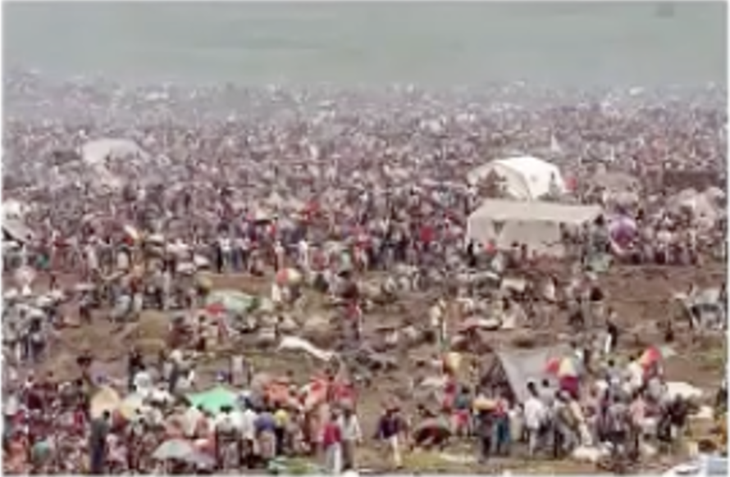
Review of cholera
Bacterial infection caused by Vibrio cholerae (serogroup O1/O139, toxigenic)
Clinical sign: Acute watery diarrhea that rapidly leads to severe dehydration (case fatality rate 30-50% within hours if left untreated).
Managed through rehydration by oral rehydration solution and often antibiotics.
Transmitted among humans through direct or indirect contacts.
  Direct e.g. body fluids, hands, mortuary toilet
  Indirect e.g. water, food, flies
Causes explosive outbreaks in context of wars, civil conflicts and refugee camps without clean water, decent sanitation and good hygiene.
Vibrio cholerae
Cholera outbreak in Goma, 1994

Slide 3
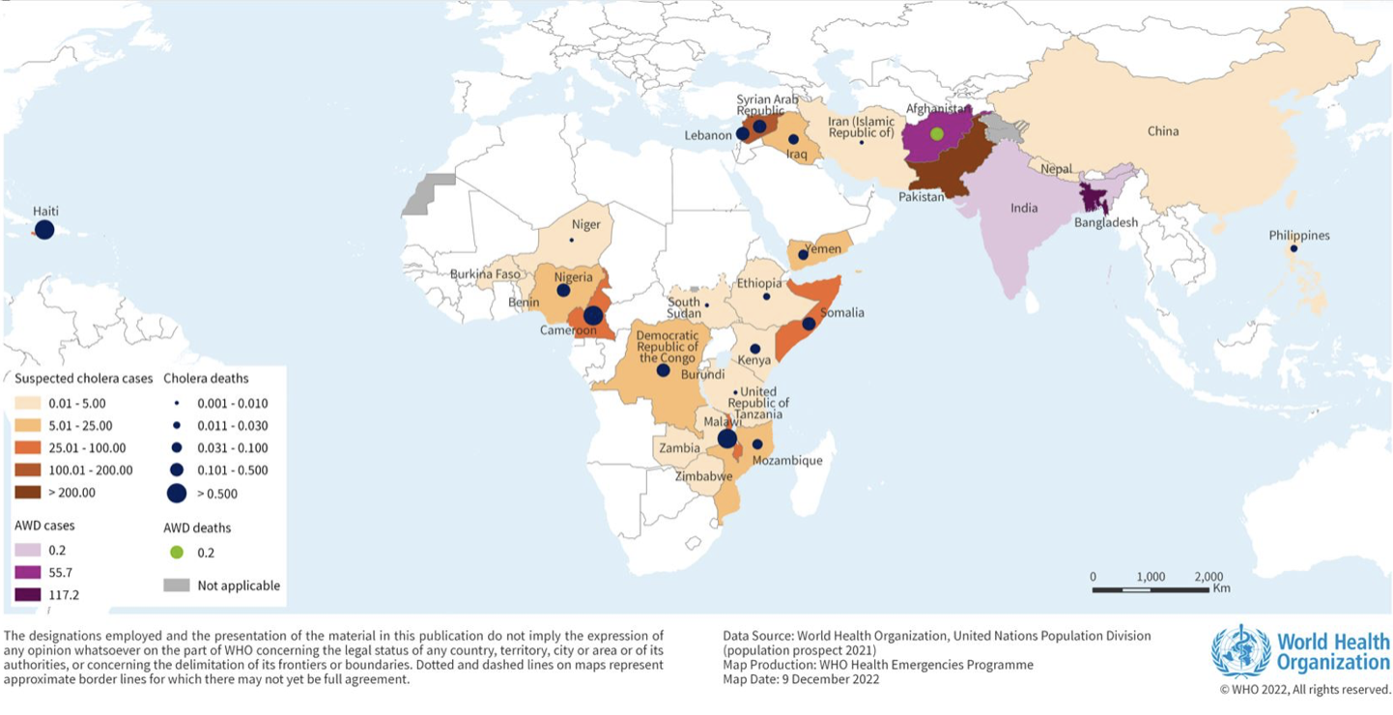
Cholera pandemics
Past cholera outbreaks:
In 2022, the global resurgence of cholera was classified as a grade 3 emergency by WHO.
  New countries affected: Lebanon (6000 cases), Syria (>70,000 cases)
  Large outbreaks (>10,000 cases) in Afghanistan, Cameroon, Malawi, Nigeria, Democratic Republic of the Congo and Somalia
  Resurgence of the outbreak in Haiti and Yemen
Incidence of cholera cases^{iii}(including estimated cases of acute watery diarrhoea (AWD)^{iv}) per 100,000 population reported to WHO from 1 January to 30 November 2022v. https://www.who.int/emergencies/disease-outbreak-news/item/2022-DON426

Slide 4
Pathogen genomic surveillance
Pathogen genomic surveillance is the monitoring and analysis of the genetic material (the genome) of pathogens, such as viruses, bacteria, fungi, and parasites.
This surveillance involves the collection, sequencing, and analysis of genomic information of pathogens to understand their genetic makeup, evolution, and how they spread.
Pathogen genomic surveillance was used widely during the COVID-19 pandemic to track and predict the evolution of the virus itself and can be used across diseases to inform public health outcomes and prepare for future pandemics and epidemics.
For more information: https://www.who.int/initiatives/international-pathogen-surveillance-network

Slide 5
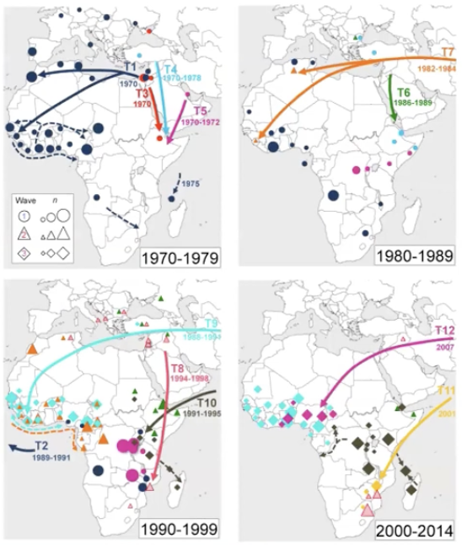
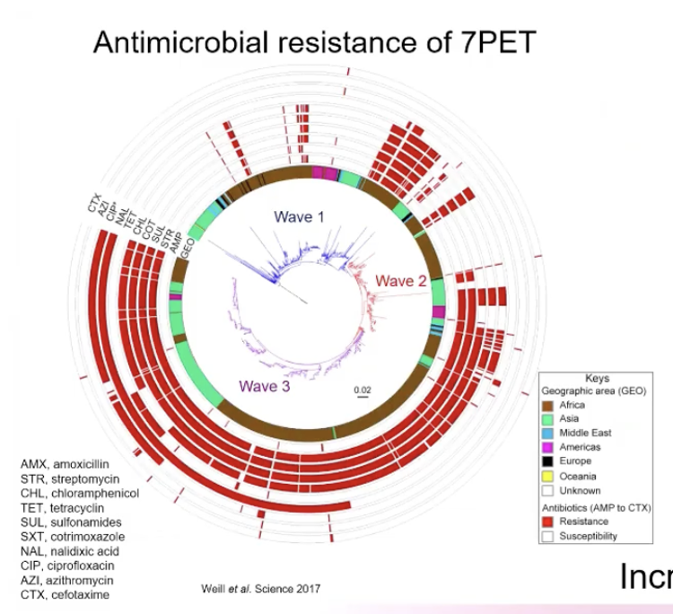
Typing of cholera
Typing of Vibrio cholerae developed from classical laboratory methods in the 1990s to genomics in the 2000s.
Uses of genomics
  Identification of the cholera pandemic agent
  Detection of spread of the cholera agent
  Detection of antimicrobial resistance of the cholera agent
Circular genome map showing AMR in cholera. Genomics can detect specific mechanisms of AMR in Vibrio genome.
Spread of cholera from Middle East to Africa

Slide 6
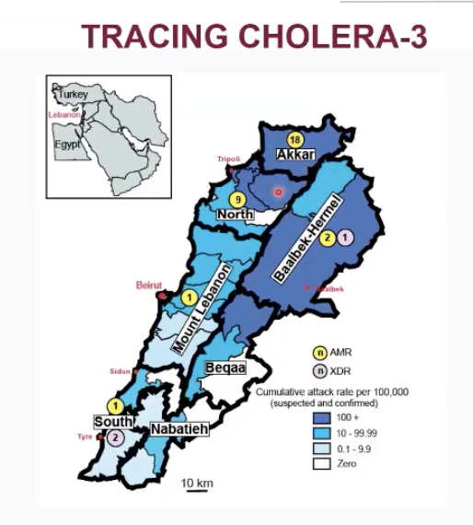
Application of genomics: An unusual cholera outbreak in Lebanon, 2022-23
Laboratory response actions during the outbreak
A total of 671 Vibrio cholerae O1 isolates were recovered during the outbreak.
AST was performed on all 671 isolates.
636 isolates (94.7%) had the AMR profile.
35 isolates (5.6%) had the XDR profile.
XDR profile was exclusive to two areas in the country: Tyr (south) and the Beqaa Valley.
PCR confirmed the presence of the toxin gene ctx.
34 isolates were chosen for WGS based on their AMR profile.
Lesson: Sequencing gives more information than needed, but did not change outbreak response
Map showing AMR and XDR cholera in Lebanon.

Slide 7
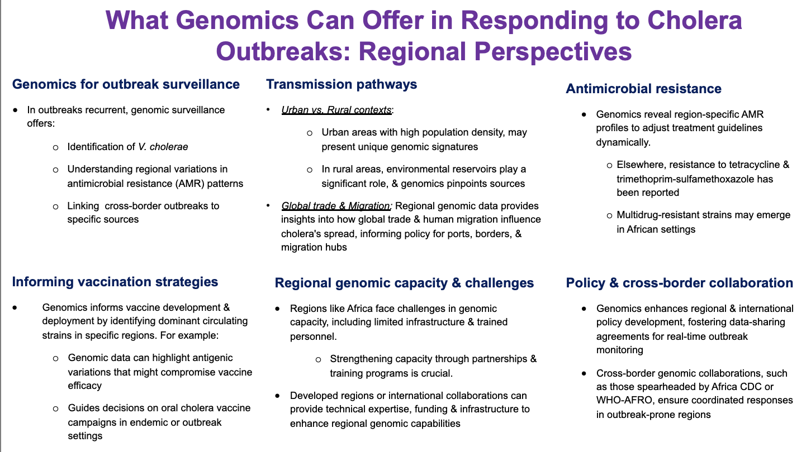
Enhanced Cholera Genomic Surveillance in Africa

Slide 8
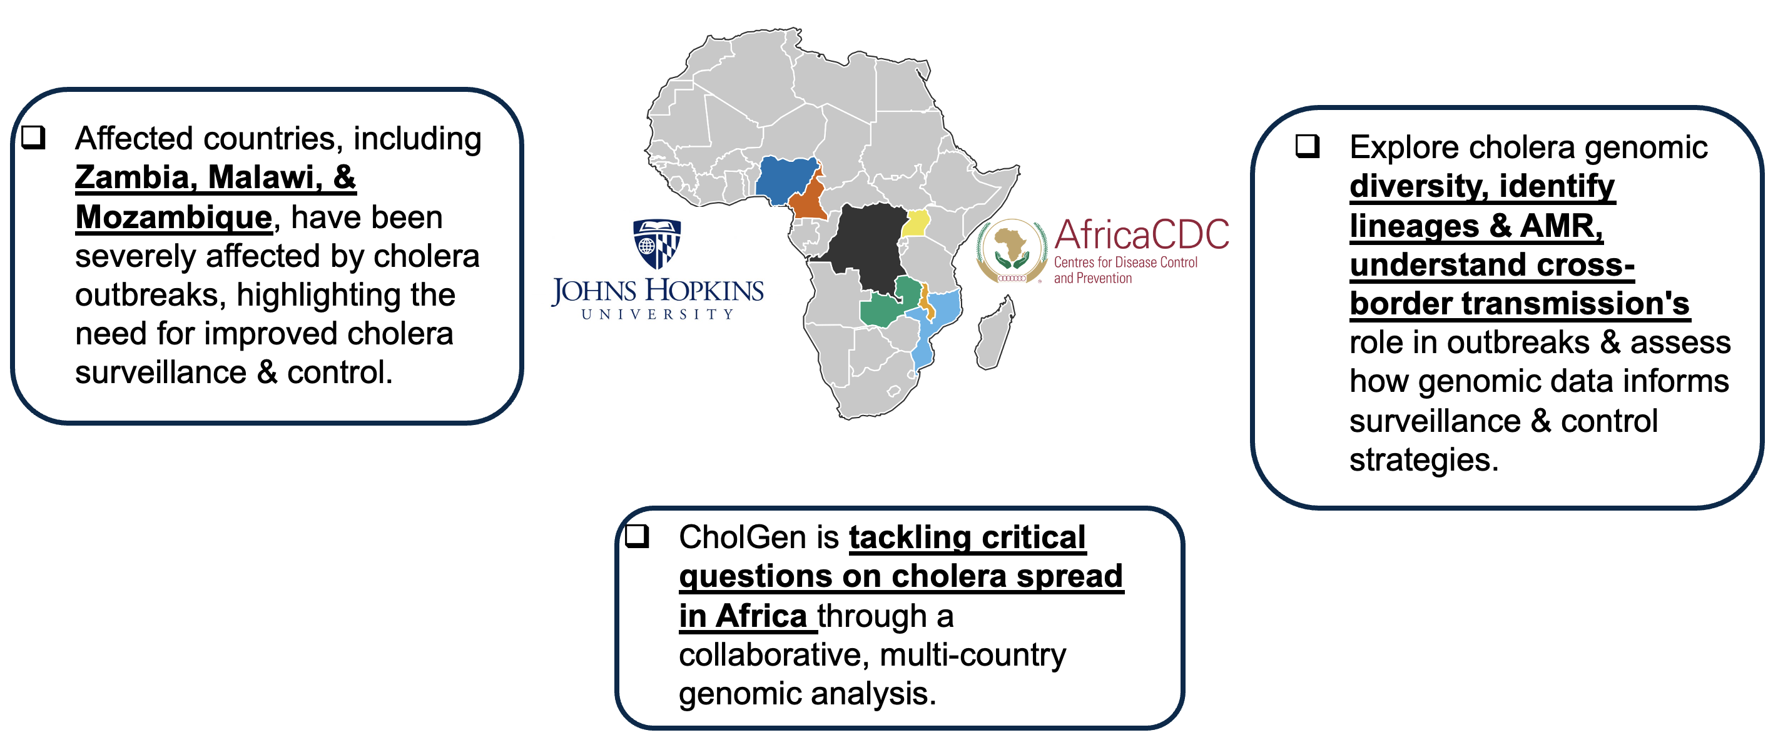
Establishing capacity for cholera surveillance in Africa

Slide 9
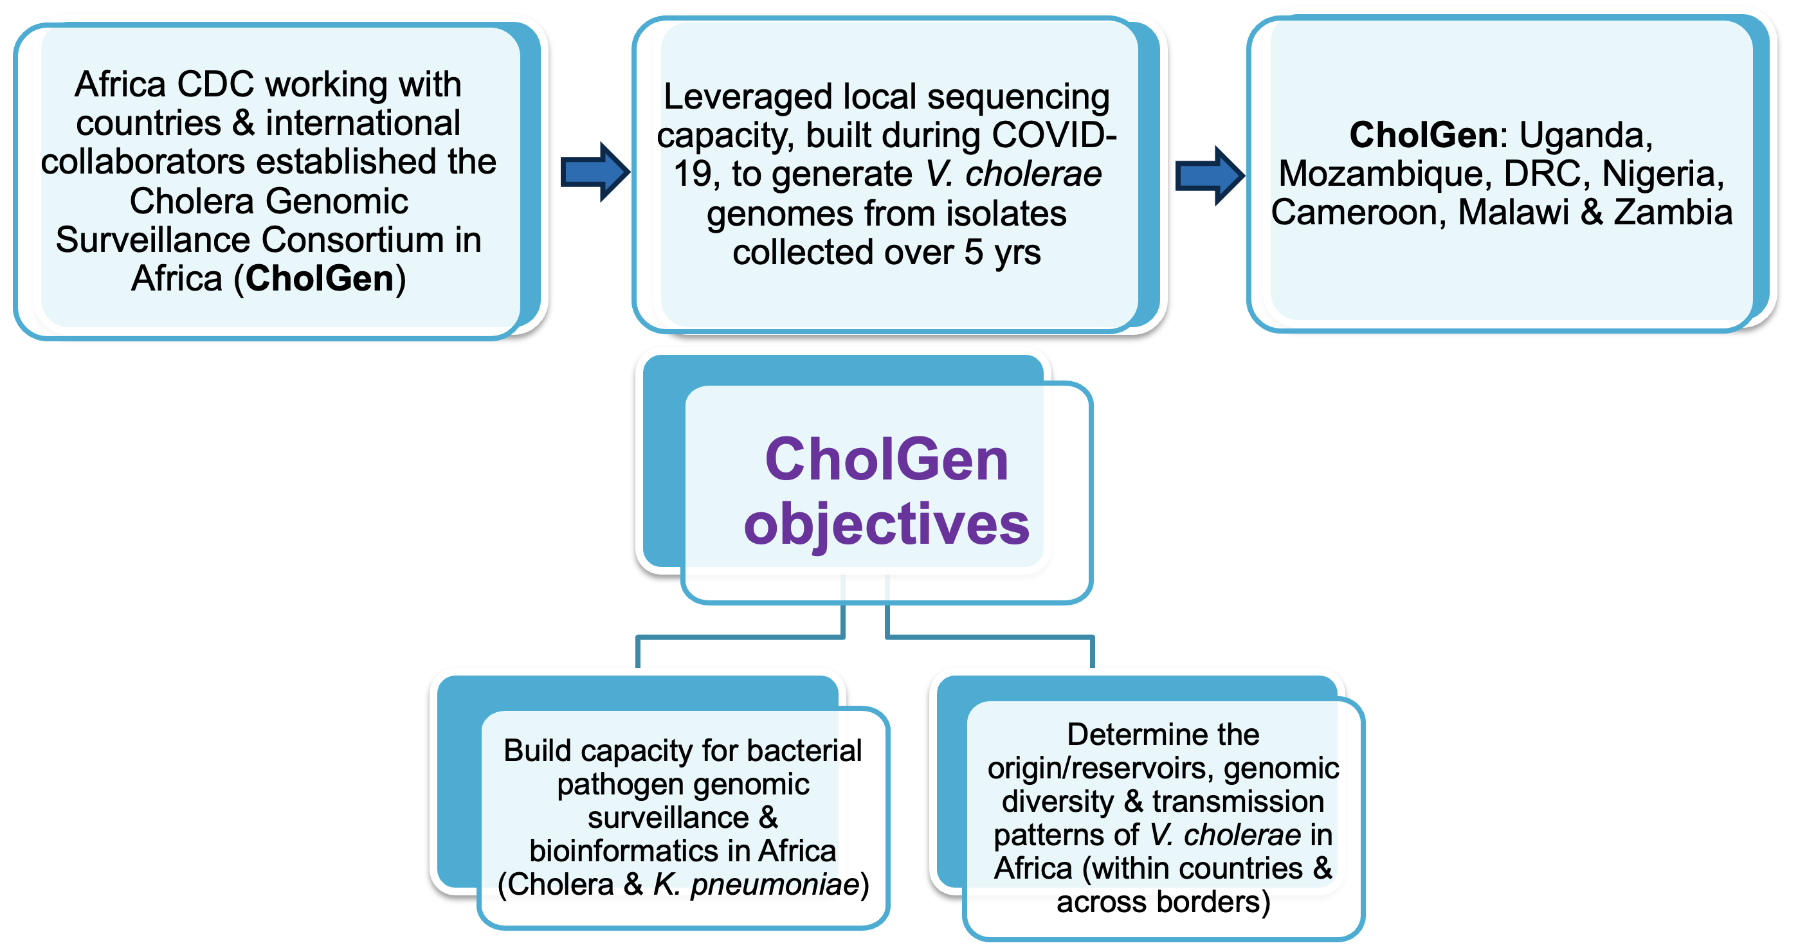
Enhanced Cholera Genomic Surveillance in Africa: CholGen Consortium

Slide 10

International Pathogen Surveillance Network (IPSN)
The International Pathogen Surveillance Network (IPSN) is a global network of pathogen genomic actors, brought together by the WHO Hub for Pandemic and Epidemic Intelligence, to accelerate progress in pathogen genomics, and improve public health decision-making.
The IPSN brings together organizations from across sectors, income levels and geographies with a commitment to international cooperation and equity, and deep expertise in genomics data and technologies or scale-up of surveillance systems.
It sets out to create a mutually supportive global network of genomic surveillance actors that amplifies and accelerates the work of its members to improve access and equity.
For more information: https://www.who.int/initiatives/international-pathogen-surveillance-network

Slide 11
EPI-WIN webinar
View webinar “Pathogen Genomics in Health Emergencies: Spotlight Cholera”
Speakers
  Dr Timothy Dallman, WHO Genomics and Analytics
  Prof. François-Xavier Weill, Institut Pasteur, France
  Dr Antoine Abou Fayad, American University of Beirut, Lebanon
  Dr Gerlad Mboowa, Broad Institute, USA
  Dr Nadia Wauquier, WHO Cholera Team
For more information: https://www.who.int/initiatives/international-pathogen-surveillance-network

