Slide 1
Engaging communities in early outbreak detection and response action through community-based surveillance
14 November 2024

Slide 2
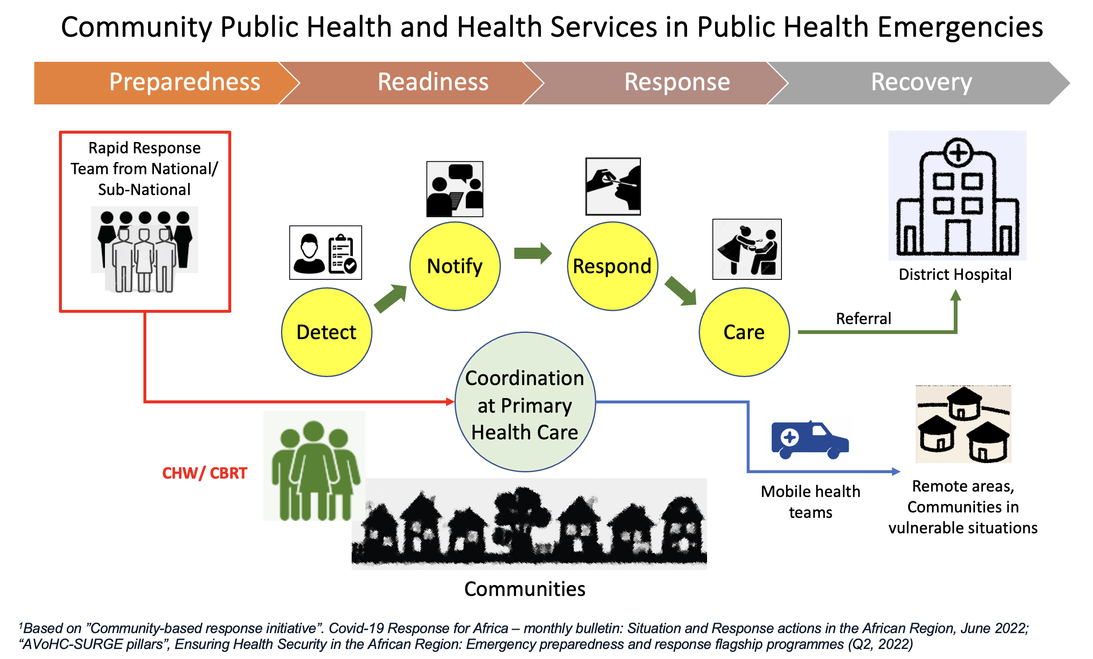
Community capacities, services and coordination
Leveraging community structures
and networks
Community based early detection and notification
Community based public health interventions and services integrated with PHCs, local public health systems
Capacity building of community health workforce

Slide 3
Example of national surveillance structure
National Surveillance Systems
(EWARS/IDSR. IBS/EBS, VPD, Influenza (ILI/SARI), Arbovirus, TB, etc,)
Sub-National and District Health
Primary Health Care & Community Facing PH System
Link with vertical programmes
Community-Based Surveillance
Preparedness phase
CBS Activities
Detection, Notification, Verification, Investigation, Contact tracing, Response, Case management, Referral
Response phase
CB-First Responders, CHWs, CBS Volunteers, Community Volunteers

Slide 4
The theory of integrated environmental-animal-humans surveillance - response systems: The example of the Adadle woreda in Ethiopia
One Statement about OH
Project: Integrated Surveillance-Response System in
the Somali Regional State of Ethiopia (SDC funding)
Collaboration between Swiss TPH, Swiss Agency for Development and Cooperation SDC, Jigjiga University and AHRI Alert Armauer Hansen Research Institute
Added value of Integrated Surveillance-Response Systems
  Reduce time to detection
  Delay time to first emergence
  Reduce exposure and burden
  Are ultimately less costly than sectorial surveillance – response systems

Slide 5
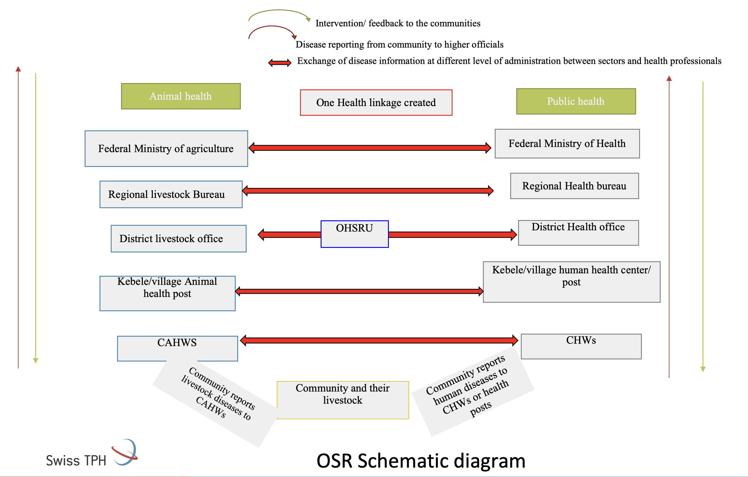
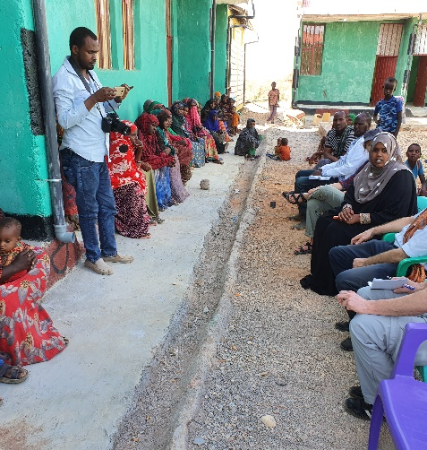
Integrated Surveillance-Response System in
the Somali Regional State of Ethiopia (SDC funding)

Slide 6
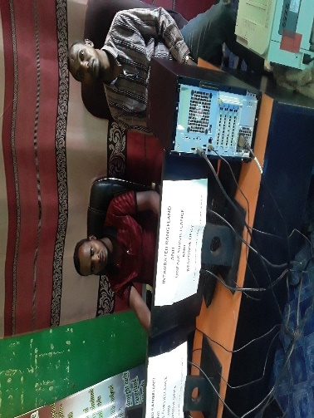
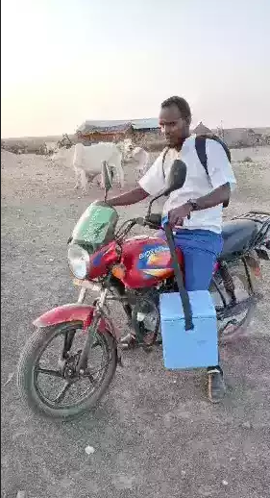
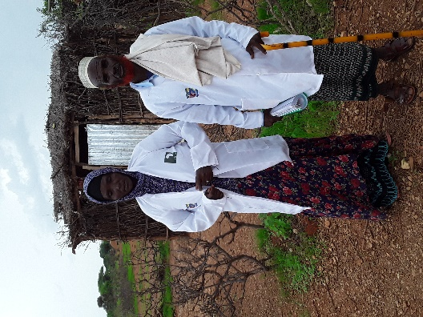
Community based iSRS
One health unit established
Office furniture's and communication materials.
Two staff (Livestock and animal health assigned).
Surveillance team at village level established (CAHWS,CHW, human & animal health staff.
Interdisciplinary training and inception workshop.
Stakeholder workshop or meeting.
OSHCU
CHAWS & CHWS

Slide 7
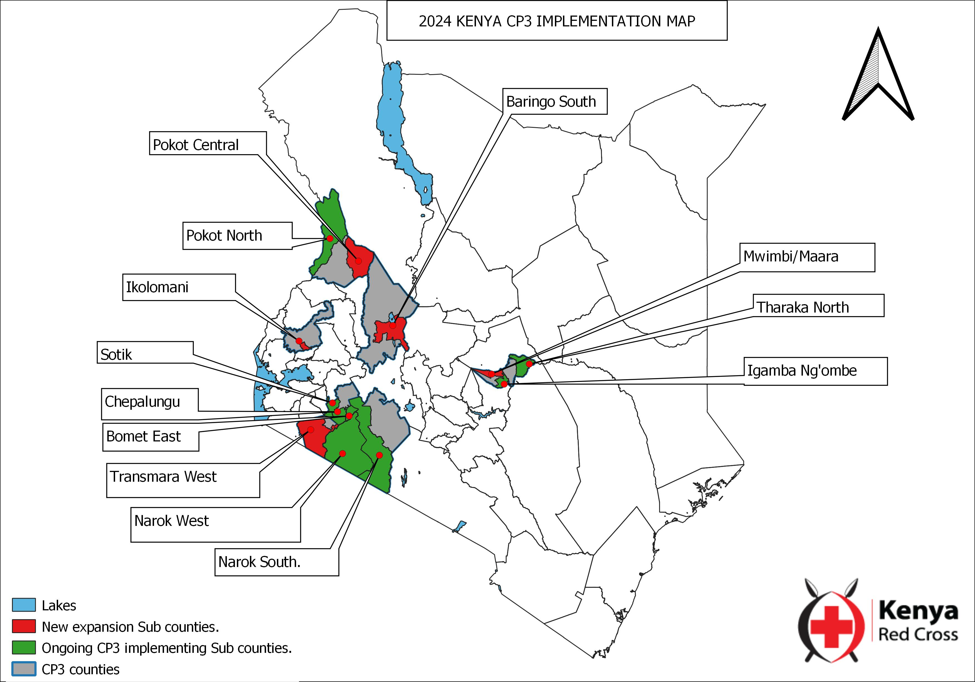
Engaging communities in outbreak preparedness: Early detection, warning and local response
The approach:
Kenya RC implements a community epidemic and pandemic preparedness programming (CP3) in 6 counties in Kenya.
The program adopts a community-led approach to outbreak detection and response through the engagement of community health promoters, community members, community leaders and community based key stakeholders.
CP3 aims to strengthen the ability of communities, KRCS, implementing counties, and other partners to prevent, detect and respond to disease threats and prepare for future risks.

Slide 8
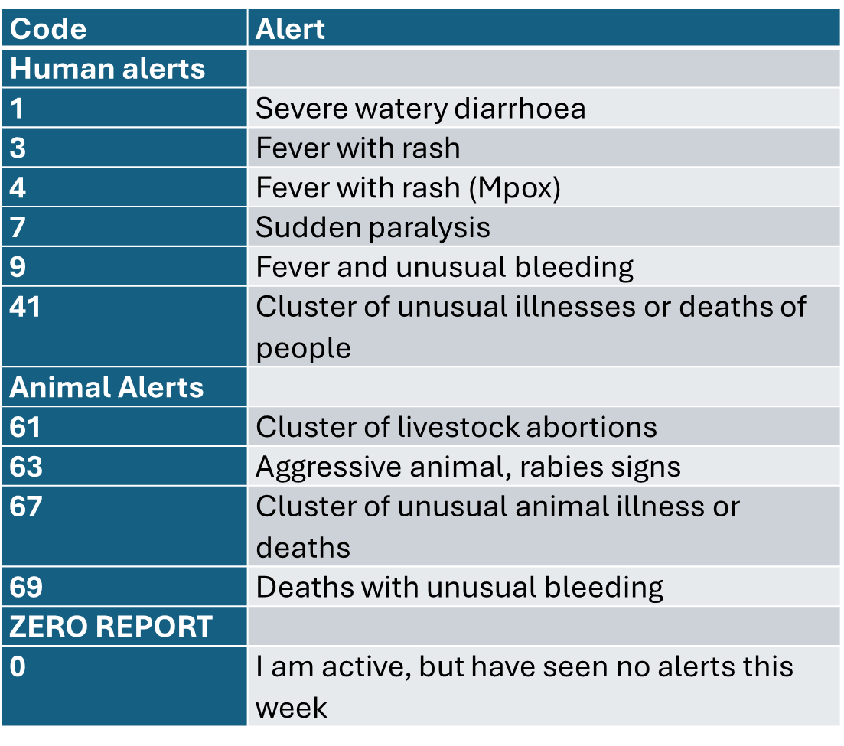
The strategy:
Use of a One Health approach in Risk Communication and Community Engagement (RCCE).
Use of a One Health approach in Community-based Surveillance (CBS)
Training of 2,042 Community Health Promoters (CHPs) in Epidemic Preparedness in Communities (EPiC) and CBS
Training of 261 Community Health Assistants (CHAs) and 126 Animal Health Assistants (AHAs) in EPiC and CBS
Coordination meetings
  County and sub county one health units.
  Community health units
Adoption of Kenya’s community health strategy (CHS) for sustainability
CBS alerts
Notes:
The approach rely majorly on community health structures instituted by the governments (CHPs, AHAs, CHAs, CHEW and CHCs)
RCCE- risk communication and community engagement
CBS- community based surveillance
CHP- community health promoter
EPiC- epidemic preparedness and response in communities
CBS- Community Based Surveillance
CHA- Community Health Assistant (supervises CHPs from ministry of health)
AHA- Animal Health Assistant (supervises CHPs from ministry of agriculture and animal development)

Slide 9
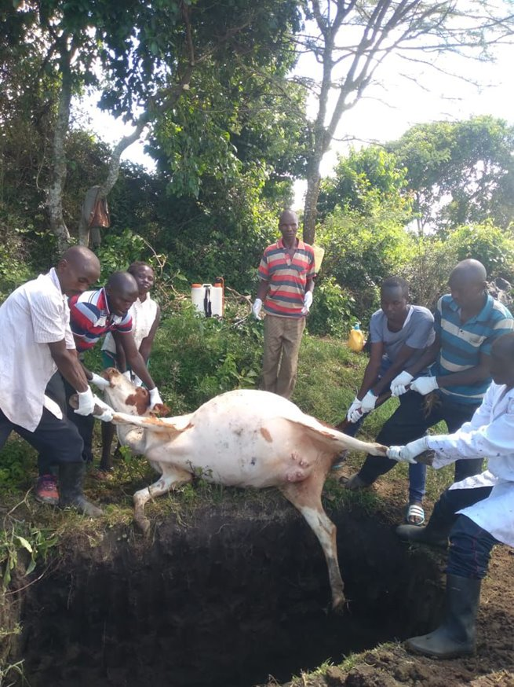
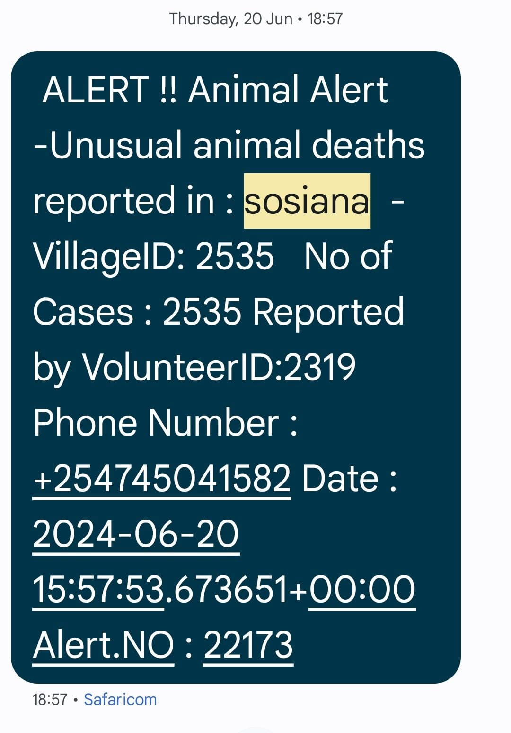
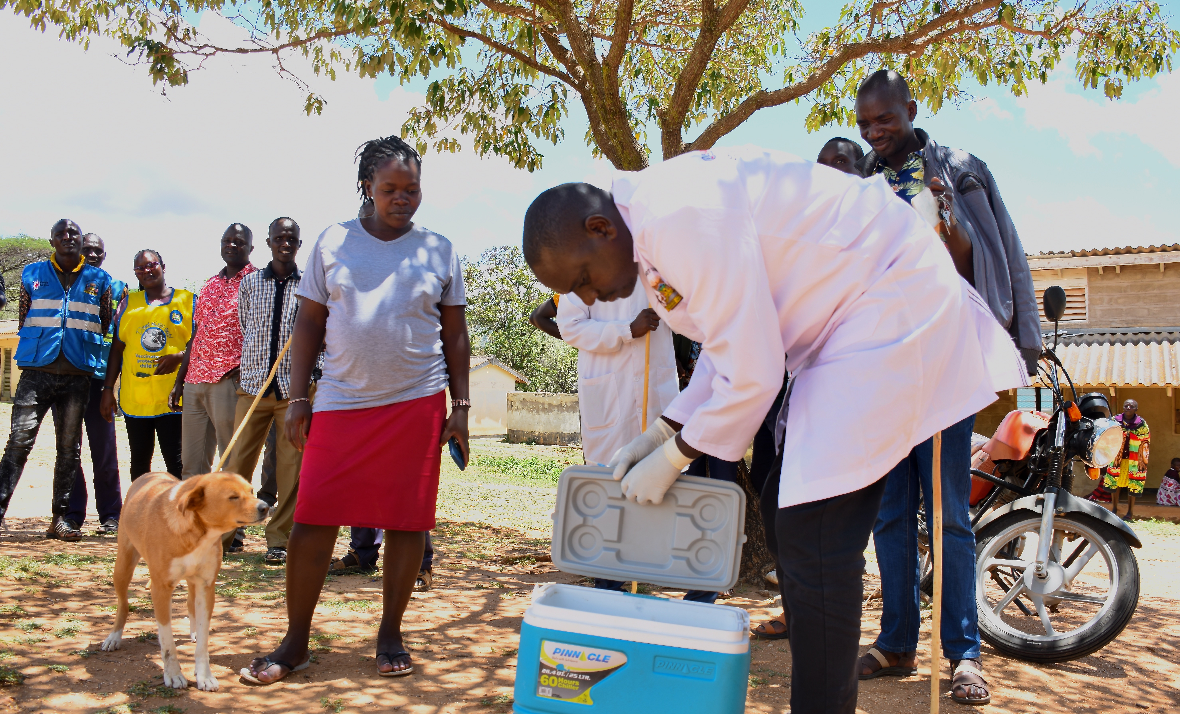
Key successes in outbreak preparedness and response:
Anthrax outbreak in Narok, May-June 2024
Claimed 6 heads of cattle.
4 of the carcasses properly disposed by burying.
70 people in 15 HHs affected after consuming meat from 2 carcasses. 13 people were hospitalized.
Animal ring vaccination was conducted by government reaching 2,909 cattle.
Notes:
Anthrax In Narok, May and June 2024.
Anthrax in the Sosiana unit (Transmara East). This outbreak resulted in the deaths of 5 cows that died within 5 days in May with 1 death of a cow reported in June.
70 people from 15 Households consumed the carcass from 2 carcasses in May. 13 people were hospitalized.
Disposal of 3 carcasses was done in May while 1 was done in June.
Ring vaccination was done where 2,909 cows were vaccinated against anthrax by Government.

Slide 10
Key achievements
Enhanced data readiness to support decision making, e.g. in animal vaccination campaign.
CBS data is being used to influence behavior change communication.
Strengthened one health partnership:
  VSF Germany has been supporting with rabies vaccines in Narok and Baringo counties.
  Partnering with Boehringer Ingelheim in Narok and Bomet in school health programming and in provision of rabies vaccines.
CBS data is being used to inform one health planning and financing:
  Narok county procured human rabies vaccine due to sustained advocacy by COHU.
  Bomet county procured animal rabies vaccines in financial year 2023/2024.
Notes:
COHU- county one health unit
The vaccine supplied has been increasing from 2020- 30 doses, 2021 - 20 doses, 2022-385 doses, 2023 -1335 Doses, 2024- 705 doses procured from Kemsa and Meds
Bomet county procured animal rabies vaccines in financial year 2023/2024(April 2023-12,000 vaccines and June 2023 – 24,160 anti-rabies doses)

Slide 11

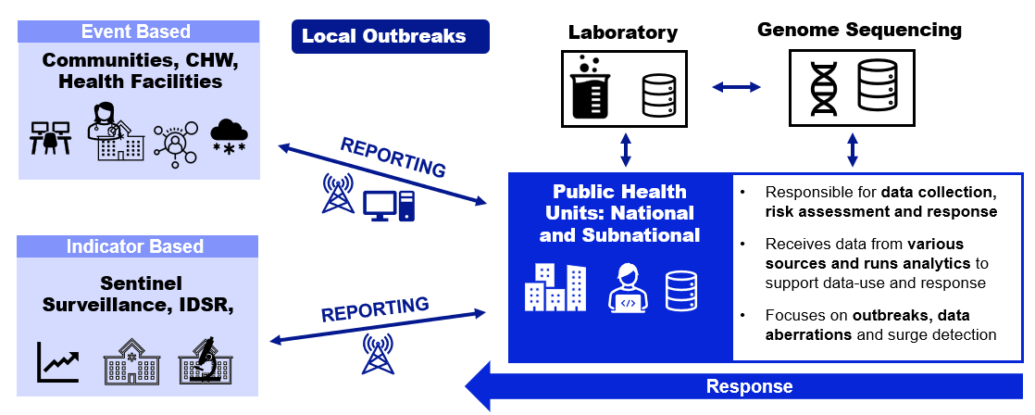
Illustration of early warning surveillance approach supported by The Global Fund
Investments in early warning surveillance including community based systems

Slide 12
Global Fund Investments are enhancing community based surveillance
Philippines – Epidemiological Bureau
Nigeria: 3 states
Sierra Leone: 4 districts
Cameroon; one region, all districts
Liberia
Central African Republic: 6 Districts+Mpox 14
Ghana: 28 districts representing 16 regions
Kenya – Dept. of Diseases Surveillance and Epidemic Response
Zambia
“NPHI”
Malawi: all 29 districts
Madagascar: 4 districts
Mozambique – National Surveillance Institute & National Public Health Department
Notes:
.

Slide 13






Key role of Community Health Volunteers in detecting
a plague outbreak in Madagascar*
18 days to detect/respond and notify
District receives reports of 2 deaths: CHVs, Regional, national level alerted. National RRT led outbreak investigation
Primary Health Unit weekly reporting. (Plague is immediately notifiable)
11 cases
5 deaths
Case fatality rate of 45.5%
12 Sept 2023
14 Sept 2023
14 Sept 2023
30 Sept 2023
2 Oct 2023
Onset date of first case in community.
Patient went to Primary Health Unit
District receives report of the first case as part of weekly aggregated data. No response initiated
Outbreak declared by MoH
WHO notified
Lessons learned from a plague outbreak in 2023 guide investments in event-based surveillance in Madagascar.
Manuela Christophere Andriamahatana Vololoniaina Nivoarisoa, Franck Chi Amabo, D.B. Ranoaritiana, F.A Raveloharivony,Fatim Louise Dia, Anthony Mounts, S. Arunmozhi Balajee. Plos Global Health (under review)

Slide 14

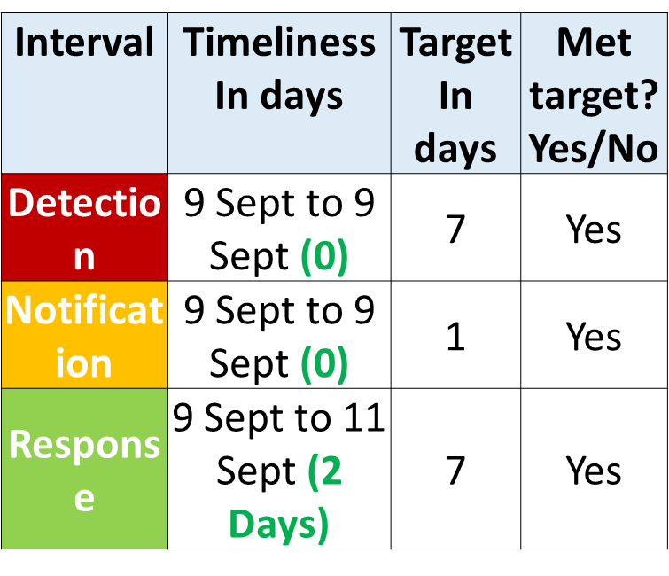
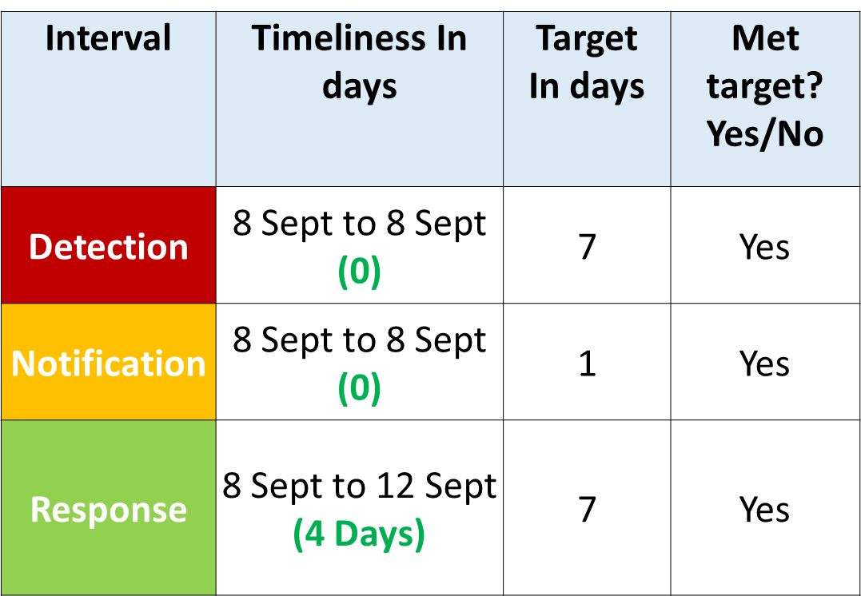
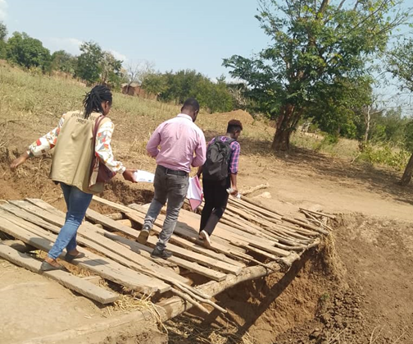
We are making progress improving capacities to detect, and notify local outbreaks early : Malawi
Measles Outbreak , Mangochi District
GF investments: guidance, training materials, upskilling of districts, community health workers, data reporting: improved ability in Mangochi, Chitipa to detect, report Measles, Cholera Outbreaks
CMLI on the ground reenforcing collection & measuring of data using global measurement framework 7-1-7
Cholera Outbreak, Chitipa district

Slide 15
One year of implementation of community-based surveillance* early lessons
1
Careful design of event-based surveillance important for utility and sustainability
  Signals need to be designed to balance sensitivity vs specificity
  Number of signals need to be negotiated
  Deliberate inclusion of communities/key focal points for event detection with community health workers (CHWs) as gatekeepers to public health system
  Mentoring/routine supervision in addition to trainings key
2
Optimal implementation requires capacity building of the entire public health eco-system
  Triage and verification
  Investigation
  Risk Assessment
  Response
3
Continued challenges in the sustainability of CHW
  CHW very busy with large workloads and routine functions sometime jeopardizing surveillance
  Siloed support of CHWs by donors
4
Need to implement to scale under the coordination of Ministries of Health
*CBS is the systematic detection and reporting of events of public health significance within a community by community members, A definition for community-based surveillance and a way forward: results of the WHO global technical meeting, France, 26 to 28 June 2018.

Slide 16
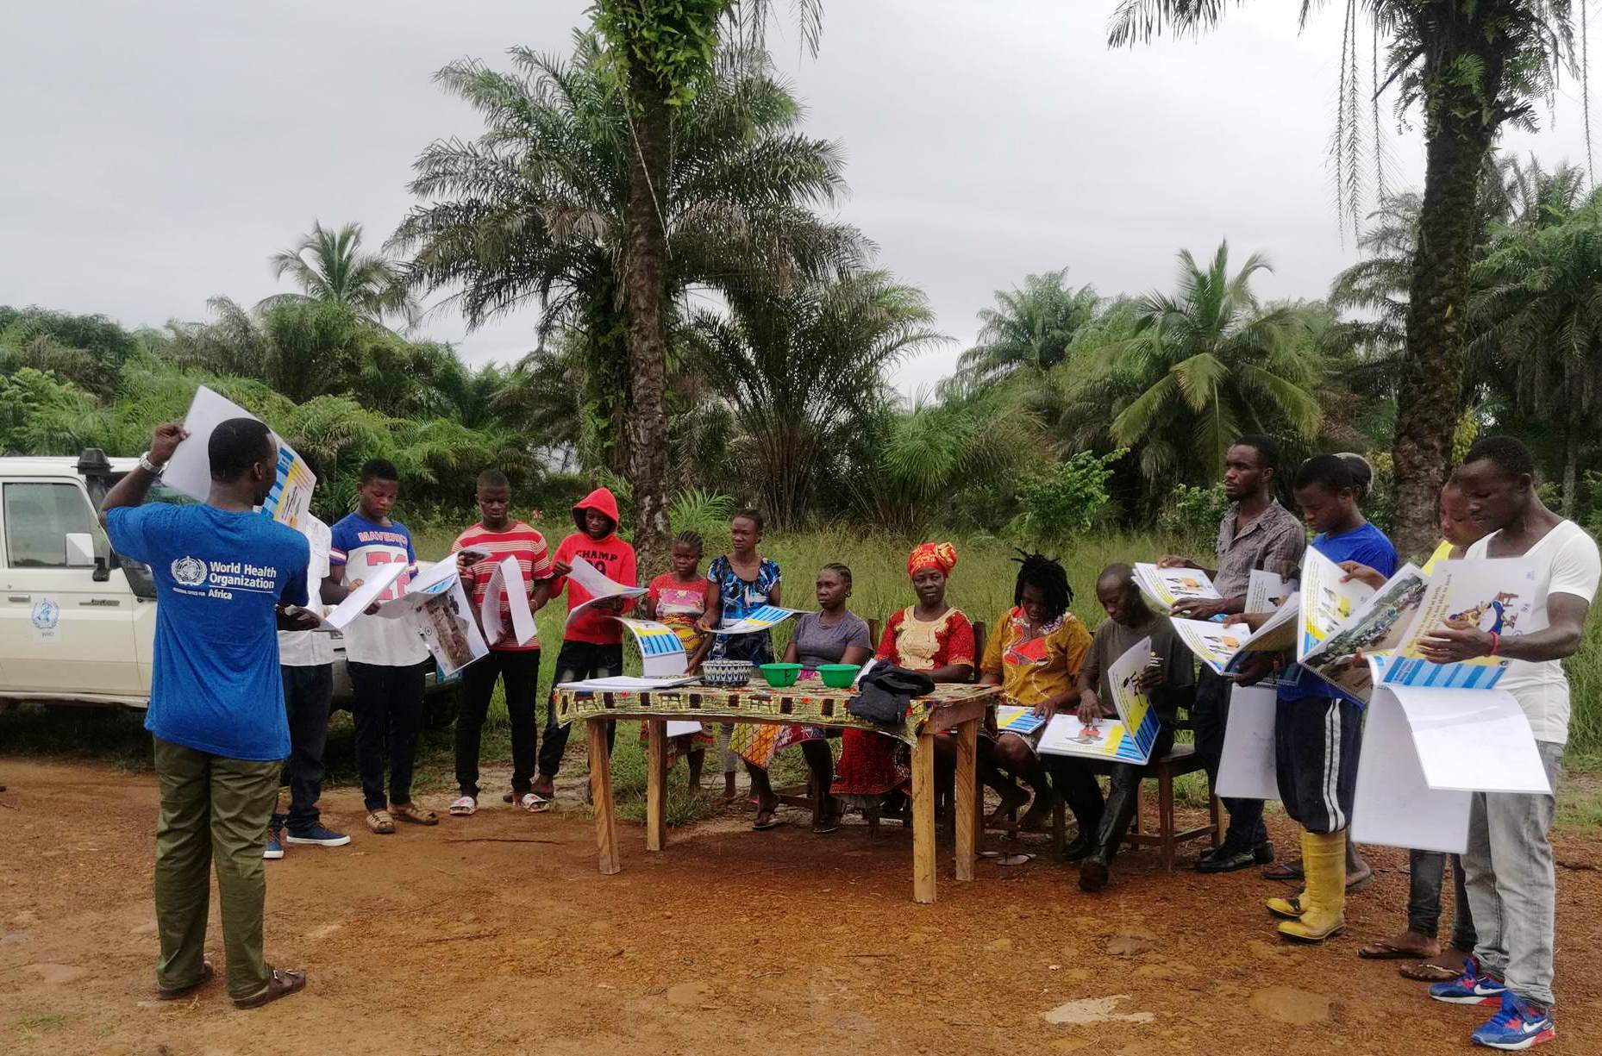
Way forward to strengthen community based early detection and response
Community Based Surveillance and Response as integral part of national surveillance and response system
Leveraging community structures and networks for systematic community engagement
Integration of community based interventions and services with primary health care
Capacity building of community health workforce
Enhanced global partnership and Investment for localized actions

Slide 17
Useful references
Technical Contributors to the June 2018 WHO Meeting (2019). A definition for community-based surveillance and a way forward: results of the WHO global technical meeting, France, 26 to 28 June 2018. Euro Surveillance January 2019.
Community-Based Surveillance – International Federation of Red Cross and Red Crescent Societies (IFRC)
Zinsstag J, Schelling E, Wyss K, Bechir M. Potential of cooperation between human and animal health to strengthen health systems. Lancet. 2005 2005;Sect. 2142-5.
Zinstag J, Kaiser-Grolimund A, Heitz-Tokpa K, et al (2023. Advancing One human-animal-environment Health for global health security: what does the evidence say?
UNCAHP (2018). First pre-draft of the Global Animal Law GAL Association. UN Convention on Animal Health and Protection.
G Paternoster, SB Martins, A Mattivi, et al. (2017). Economics of One Health: Costs and benefits of integrated West Nile virus surveillance in Emilia-Romagna.

Slide 18
EPI-WIN Webinar
View webinar “Engaging communities in early outbreak detection and response action through community-based surveillance”
Speakers:
  Dr Kai von Harbou, Community Readiness and Resilience, WHO Geneva
  Dr Petra Khoury, Director for Health and Care Department, International Federation of Red Cross and Red Crescent Societies
  Dr Rim Kwang-Il, Community Readiness and Resilience, WHO Geneva
  Dr Jakob Zinsstag-Klopfenstein, Swiss Tropical and Public Health Institute
  Biwott​ K. Hazael, Community Based Surveillance Officer, Kenya Red Cross Society
  Arun Balajee, PhD, Pandemic Surveillance Global Fund
  Rachel Goodermote, International Federation of Red Cross and Red Crescent Societies
  Dr Hilary Bower, UK-Public Health Rapid Support Team/ London School of Hygiene and Tropical Medicine (UK-PHRST/ LSHTM)
  Dr Philip Ngere, Division of Disease Surveillance and Response, Kenya Ministry of Health

