Slide 1
Treatment and medical support for patients with mpox, and their families
18 September 2024

Slide 2
The global mpox outbreak
The global mpox outbreak, which began in 2022, has resulted in over 100,000 confirmed cases reported to the WHO.
The rapid spread of the new Clade 1B strain, particularly in eastern DRC and neighbouring countries and its recent detection in Sweden and Thailand, underscores the growing threat.
This escalating situation led to the declaration of a Public Health Emergency of International Concern on 14 August 2024.
WHO in partnership with international and regional organisations is leading the global response by providing strategic leadership, including through providing clinical expertise to improve supportive care both in hospitals and at home.
WHO supports developing and updating response guidance for the control of Mpox that includes infection prevention control measures, how to screen, triage and isolate patients and how to manage mild and complicated Mpox including skin lesions, complications with eyes, pain, good nutrition and hydration.
The purpose of the webinar is to provide a rapid overview of the Mpox situation and to give practical guidance on treatment of mild and severe patients based on the WHO Interim guidelines developed in 2022.

Slide 3
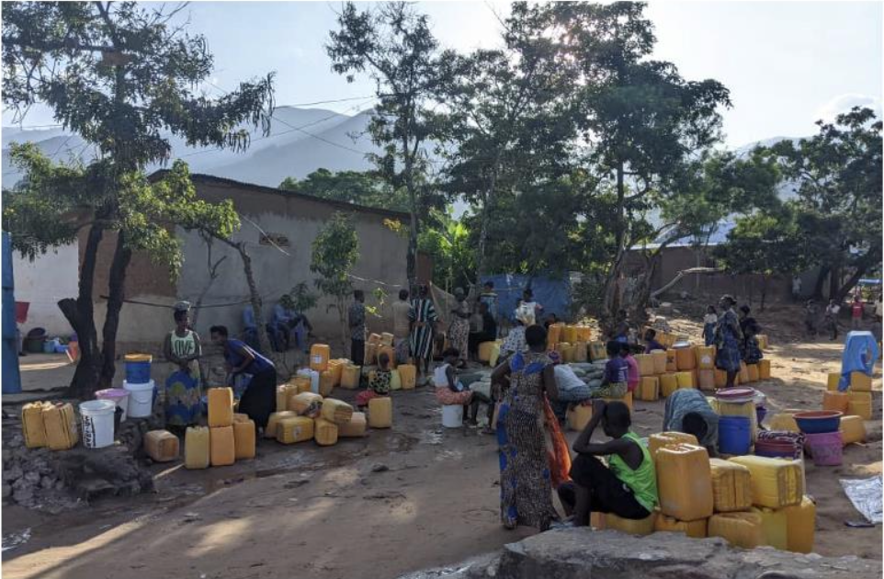
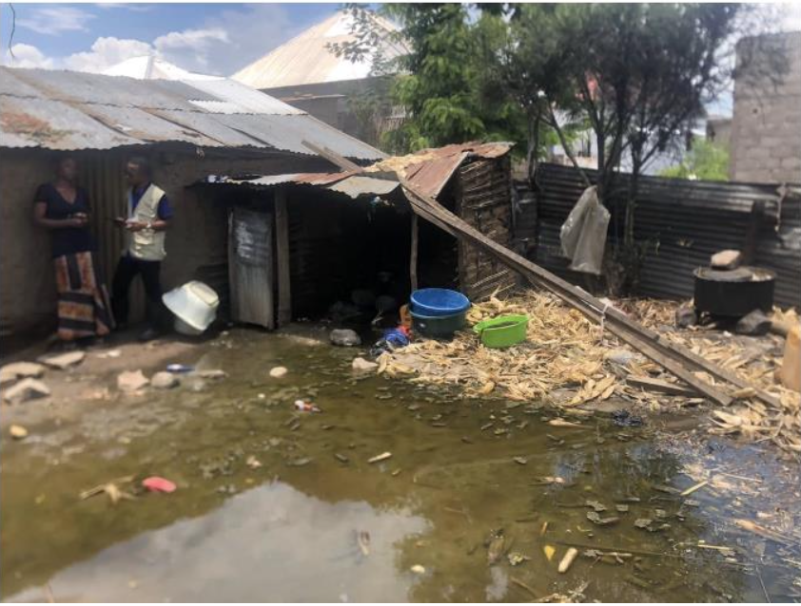
Democratic Republic of Congo (DRC)
The first official mpox case was diagnosed in 2 May 2024, in Uvira.
There is a high number of cases in Uvira, South Kivu, that shares border with Burundi.
In Uvira, there are slightly more cases in women than in men.
More than 50% of cases are children below 15 years.
There are also many cases of young babies who are breastfeeding but mothers do not have the disease. Transmission patterns are not yet clear.
Water, sanitation and hygiene could be an important factor leading to the spread of the disease.
Espoir Bwenge Malembaka, Center for Tropical Diseases and Global Health Université Catholique de Bukavu, South Kivu, DR Congo, and Johns Hopkins University

Slide 4
Democratic Republic of Congo (DRC)
Diagnostic challenges: No confirmation capacity onsite; frequent stockouts of supplies; long feedback for results; CD4 and viral load currently not measures.
Nutritional challenge: 45% of children under 5 in DRC have severe acute malnutrition.
Misuse of antibiotics is prevalent
Challenge in pain management because of limited treatment package
Social challenges: Poverty, WASH, population displacement and flooding in Uvira
Espoir Bwenge Malembaka, Center for Tropical Diseases and Global Health Université Catholique de Bukavu, South Kivu, DR Congo, and Johns Hopkins University

Slide 5
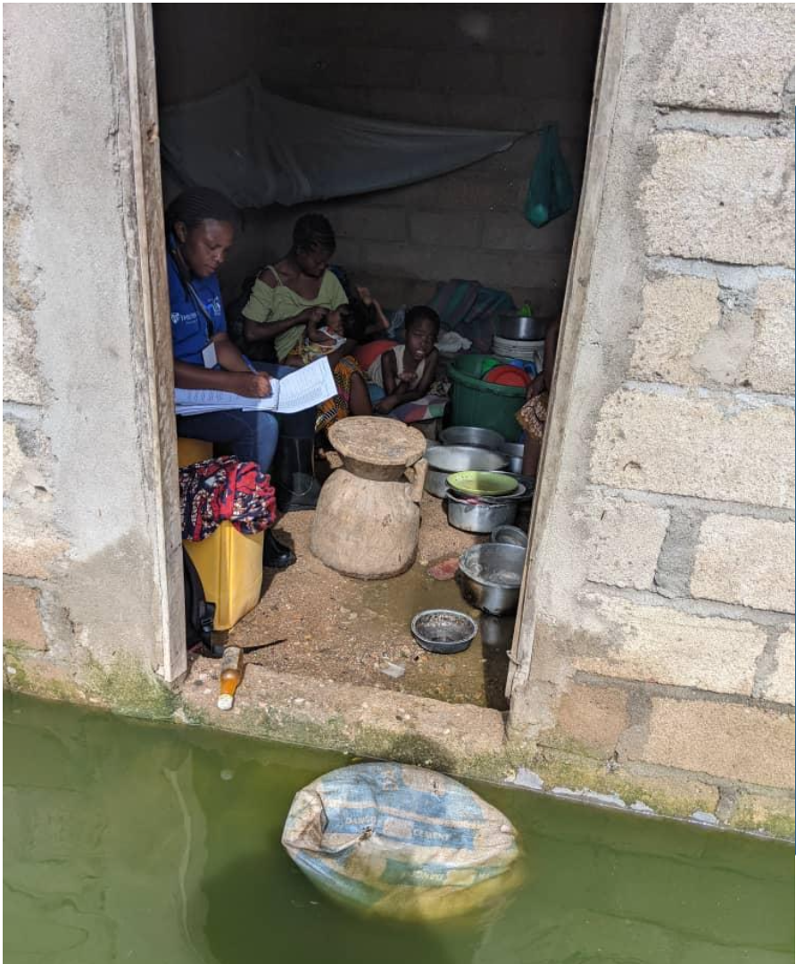
Summary of the situation in DRC
Mpox management is challenged by pre-existing health systems challenges.
Mpox confirmation capacity building is urgently needed onsite.
Diagnostic, management and monitoring of comorbidities should not be overlooked.
A community- and person-center approach to the management of the mpox crisis is needed.
Need to adopt global guidance to local context. Home isolation is not feasible in many settings
We need to to understand better the transmission patterns especially in children and persons in the same household, including the contribution of droplet transmission.
Essential to continue to promote hygiene, and handwashing with soap and water. Access to safe water is already a multidimensional problem.
Home isolation of mild cases is not feasible for most in Uvira because of high household number and limited number of rooms.
Espoir Bwenge Malembaka, Center for Tropical Diseases and Global Health Université Catholique de Bukavu, South Kivu, DR Congo, and Johns Hopkins University

Slide 6
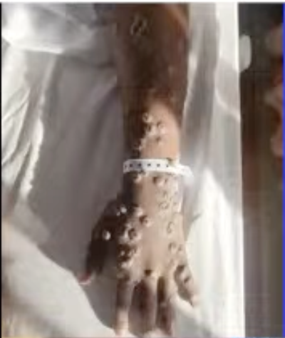
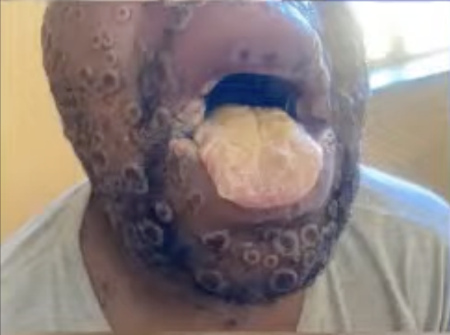
South Africa
South Africa outbreak has a different epidemiology, and the country has more resources.
From May 2024 to 18 September, there were 25 PCR+ cases, all male, most identify MSM and were HIV+. All clade Iib.
Severe disease related to undiagnosed or untreated HIV.
There is a challenge in diagnosis because of other diseases presenting with rash.
  Prof Lucille Blumberg, ID Consultant ,medical microbiologist, South Africa

Slide 7
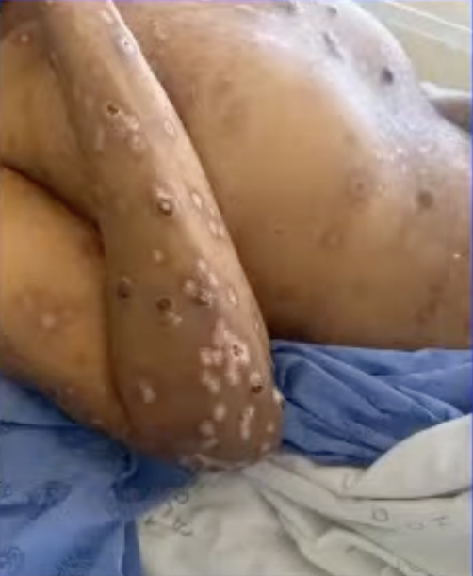
Management of mpox in South Africa
Package of care: Analgesia, nutritional support, fluids, treatment of secondary infections, skin care, home isolation
Link diagnosis, treatment and prevention to HIV programmes: Manage HIV-related opportunistic infections, STIs, ARVs, duration, IRIS
Psychosocial considerations: Stigma, contact tracing, sequelae
  Prof Lucille Blumberg, ID Consultant ,medical microbiologist, South Africa

Slide 8
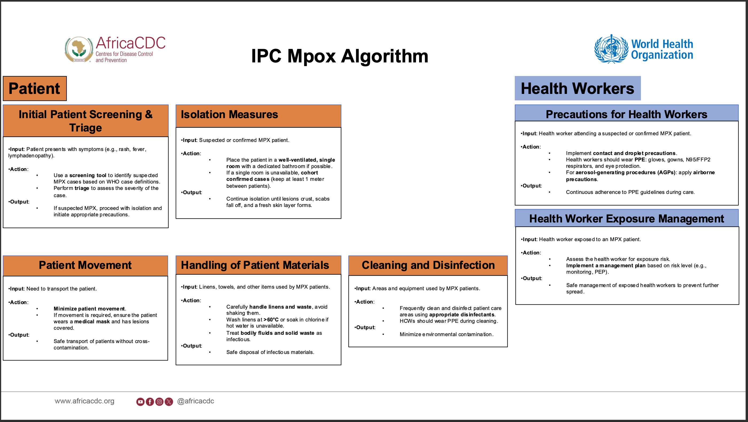
IPC Mpox algorithm at home (Africa CDC)
Andy Bulabula, CDC Ethiopia

Slide 9
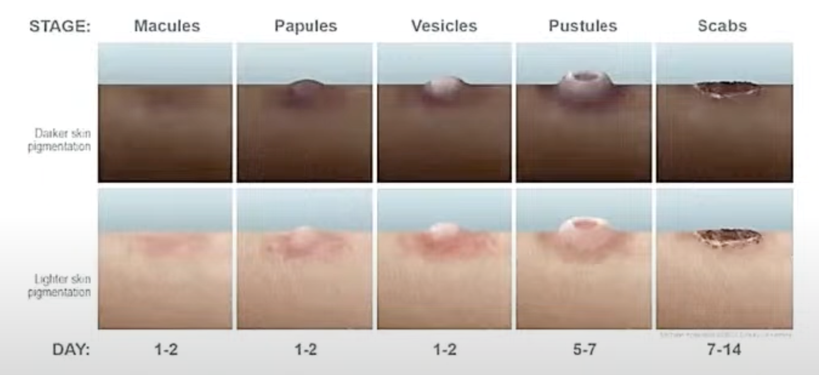
Characteristics of mpox typical rash
Lesions are firm, well demarcated, umbilicated
Range from 3mm to 15mm
Majority of patients have the same evolution
Face (95%), palms and soles (75%), mucous memberanes (70%), less commonly genitals
Range from few to thousands in number
Painful rather than itchy
Infectious unti all lesions are crusted over with complete re-epithelialization
Dr Nerissa Moodley, Dermatologist, South Africa

Slide 10
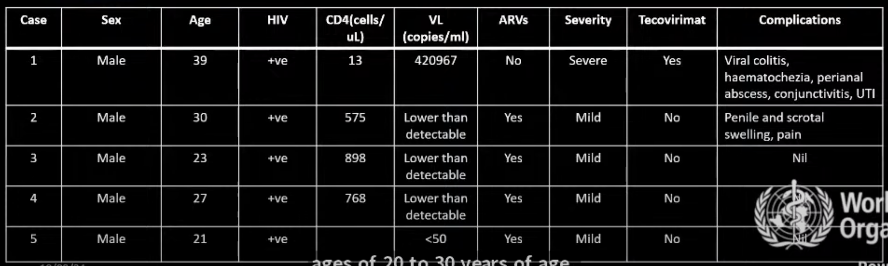
Range of cases among HIV+ patients may vary in severity, depending on viral load and ARV therapy
Dr Nerissa Moodley, Dermatologist, South Africa

Slide 11
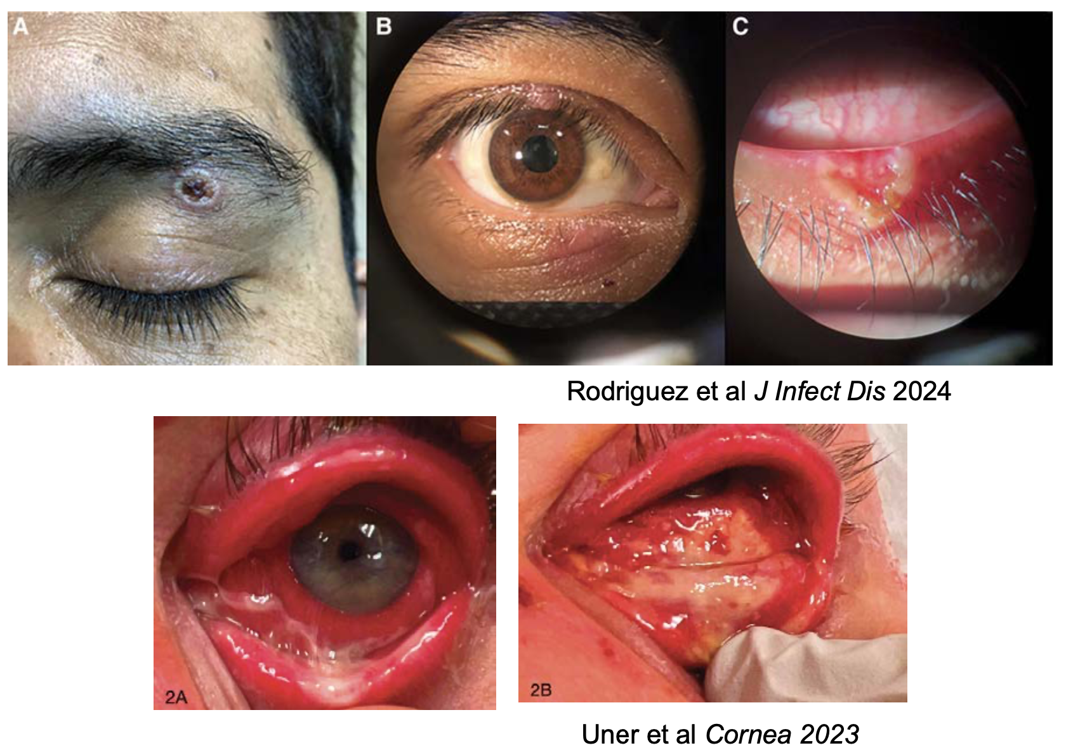
Severe cases and complications
Severe cases: CNS disease (encephalitis & myelitis), ophthalmic disease, neuropsychiatric (e.g. depression), internal infections and co-infections
Possible HIV Immune Reconstitution Inflammatory Syndrome (IRIS), an exaggerated inflammatory reaction to a disease-causing microorganism that sometimes occurs when the immune system begins to recover following treatment with antiretroviral (ARV). More evidence is still needed.
Ophthalmic features of mpox: periocular, umbilicated lesions; blepharitis; conjunctivitis; keratitis; uveitis
Therapies for these conditions are included in the presentations.
Dr Steve Yeh, Opthalmologist, UNMC, USA

Slide 12
Useful links
  Clinical management and infection prevention and control for monkeypox: interim rapid response guidance, 10 June 2022. Geneva: World Health Organization; 2022. https://iris.who.int/handle/10665/355798.
  Maal-Bared, R., Gerba, C., Bibby, K., Munakata, N., Mehrotra, A.S., Brisolara, K.F., Haas, C., Gary, L., Nayak, B., Swift, J. and Sherchan, S., 2022. The current multicountry monkeypox outbreak: what water professionals should know. ACS ES&T Water, 2(10), pp.1628-1638.
  Responding to the global mpox outbreak: ethics issues and considerations: a policy brief, 19 July 2023. Geneva: World Health Organization; 2023. https://iris.who.int/handle/10665/371405.
  Surveillance, case investigation and contact tracing for mpox (‎monkeypox)‎: interim guidance, 20 March 2024. Geneva: World Health Organization; 2024. https://iris.who.int/handle/10665/376306
  Risk communication and community engagement readiness and response toolkit: mpox. Geneva: World Health Organization; 2024. https://iris.who.int/handle/10665/376589.
  Strategic framework for enhancing prevention and control of mpox 2024-2027. World Health Organization; 2024. https://iris.who.int/handle/10665/376839.
  Public health advice on mpox and congregate settings: settings in which people live, stay or work in proximity. Geneva: World Health Organization; 2023. https://www.who.int/publications/m/item/public-health-advice-on-mpox-and-congregate-settings--settings-in-which-people-live--stay-or-work-in-proximity

Slide 13
EPI-WIN webinar
View “Treatment and medical support of patients with mpox”, 18 September 2024
Speakers
  Dr Maria D. Van Kerkhove, Director (a.i), Department of Epidemic and Pandemic Preparedness and Prevention, WHO
  Espoir Bwenge Malembaka, Center for Tropical Diseases and Global Health Université Catholique de Bukavu, South Kivu, DR Congo, and Johns Hopkins University
  Prof Lucille Blumberg, ID Consultant ,medical microbiologist, South Africa
  Andy Bulabula, CDC Ethiopia
  Dr Steve Woolley, Liverpool School of Tropical Medicine, UK
  Dr Nerissa Moodley, Dermatologist, South Africa
  Dr Steve Yeh, Opthalmologist, UNMC, USA
  The webinar was presented by Dr Supriya Bezbaruah EPI-WIN Lead in WHO

