Slide 1
Global Public Health Intelligence: WHO Operational Practices
31 October 2024

Slide 2
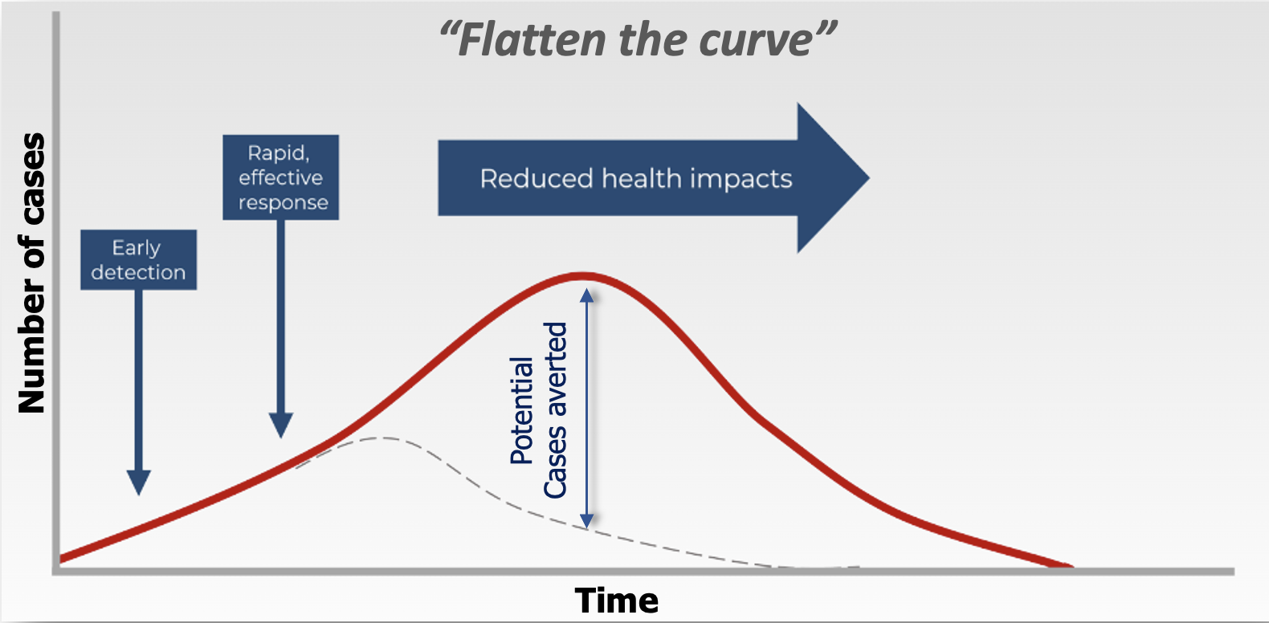
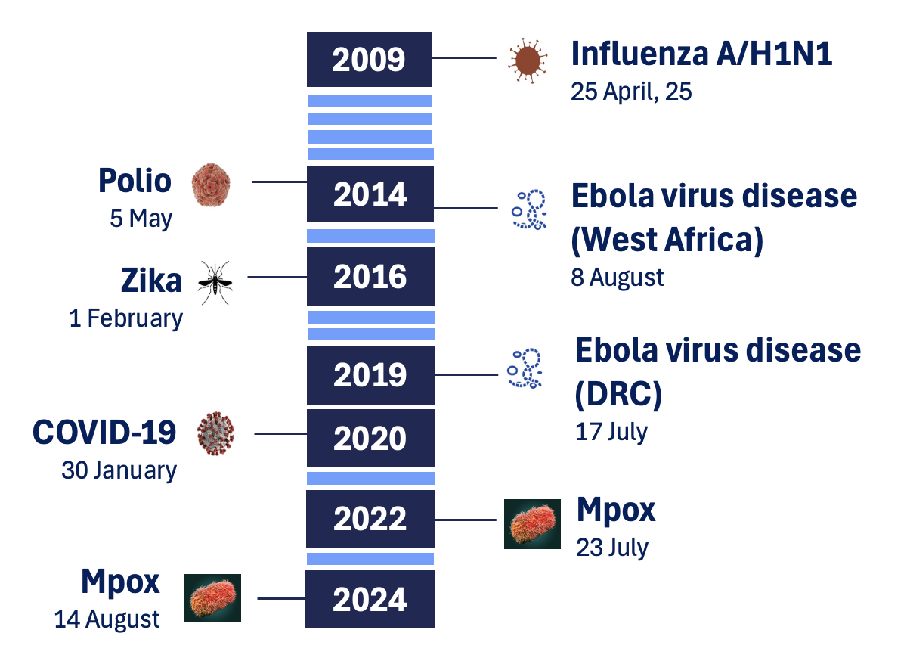
(Potential) Public Health Emergencies of International Concern
Early detection
Early warning
Early response
Saves lives
Public Health Intelligence: “…a core public health function responsible for identifying, collecting, connecting, synthesizing, analyzing, assessing, interpreting and generating a wide range of information for actionable insights and disseminating these for informed and effective decision-making to protect and improve the health of the population. ”
- UN Terms
Declared Public Health Emergencies of International Concern (PHEIC)

Slide 3
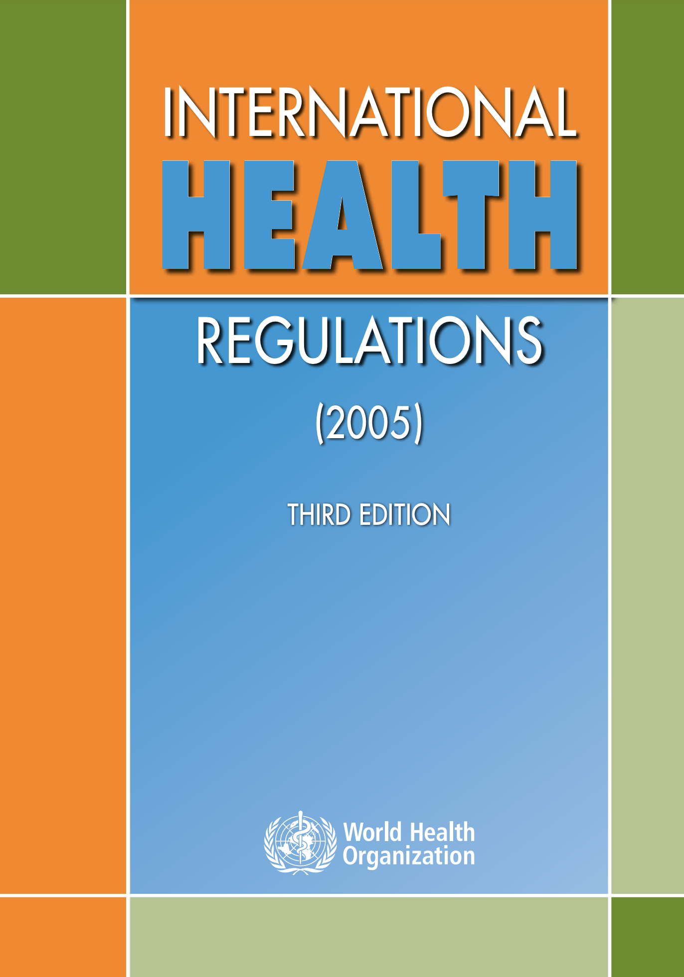
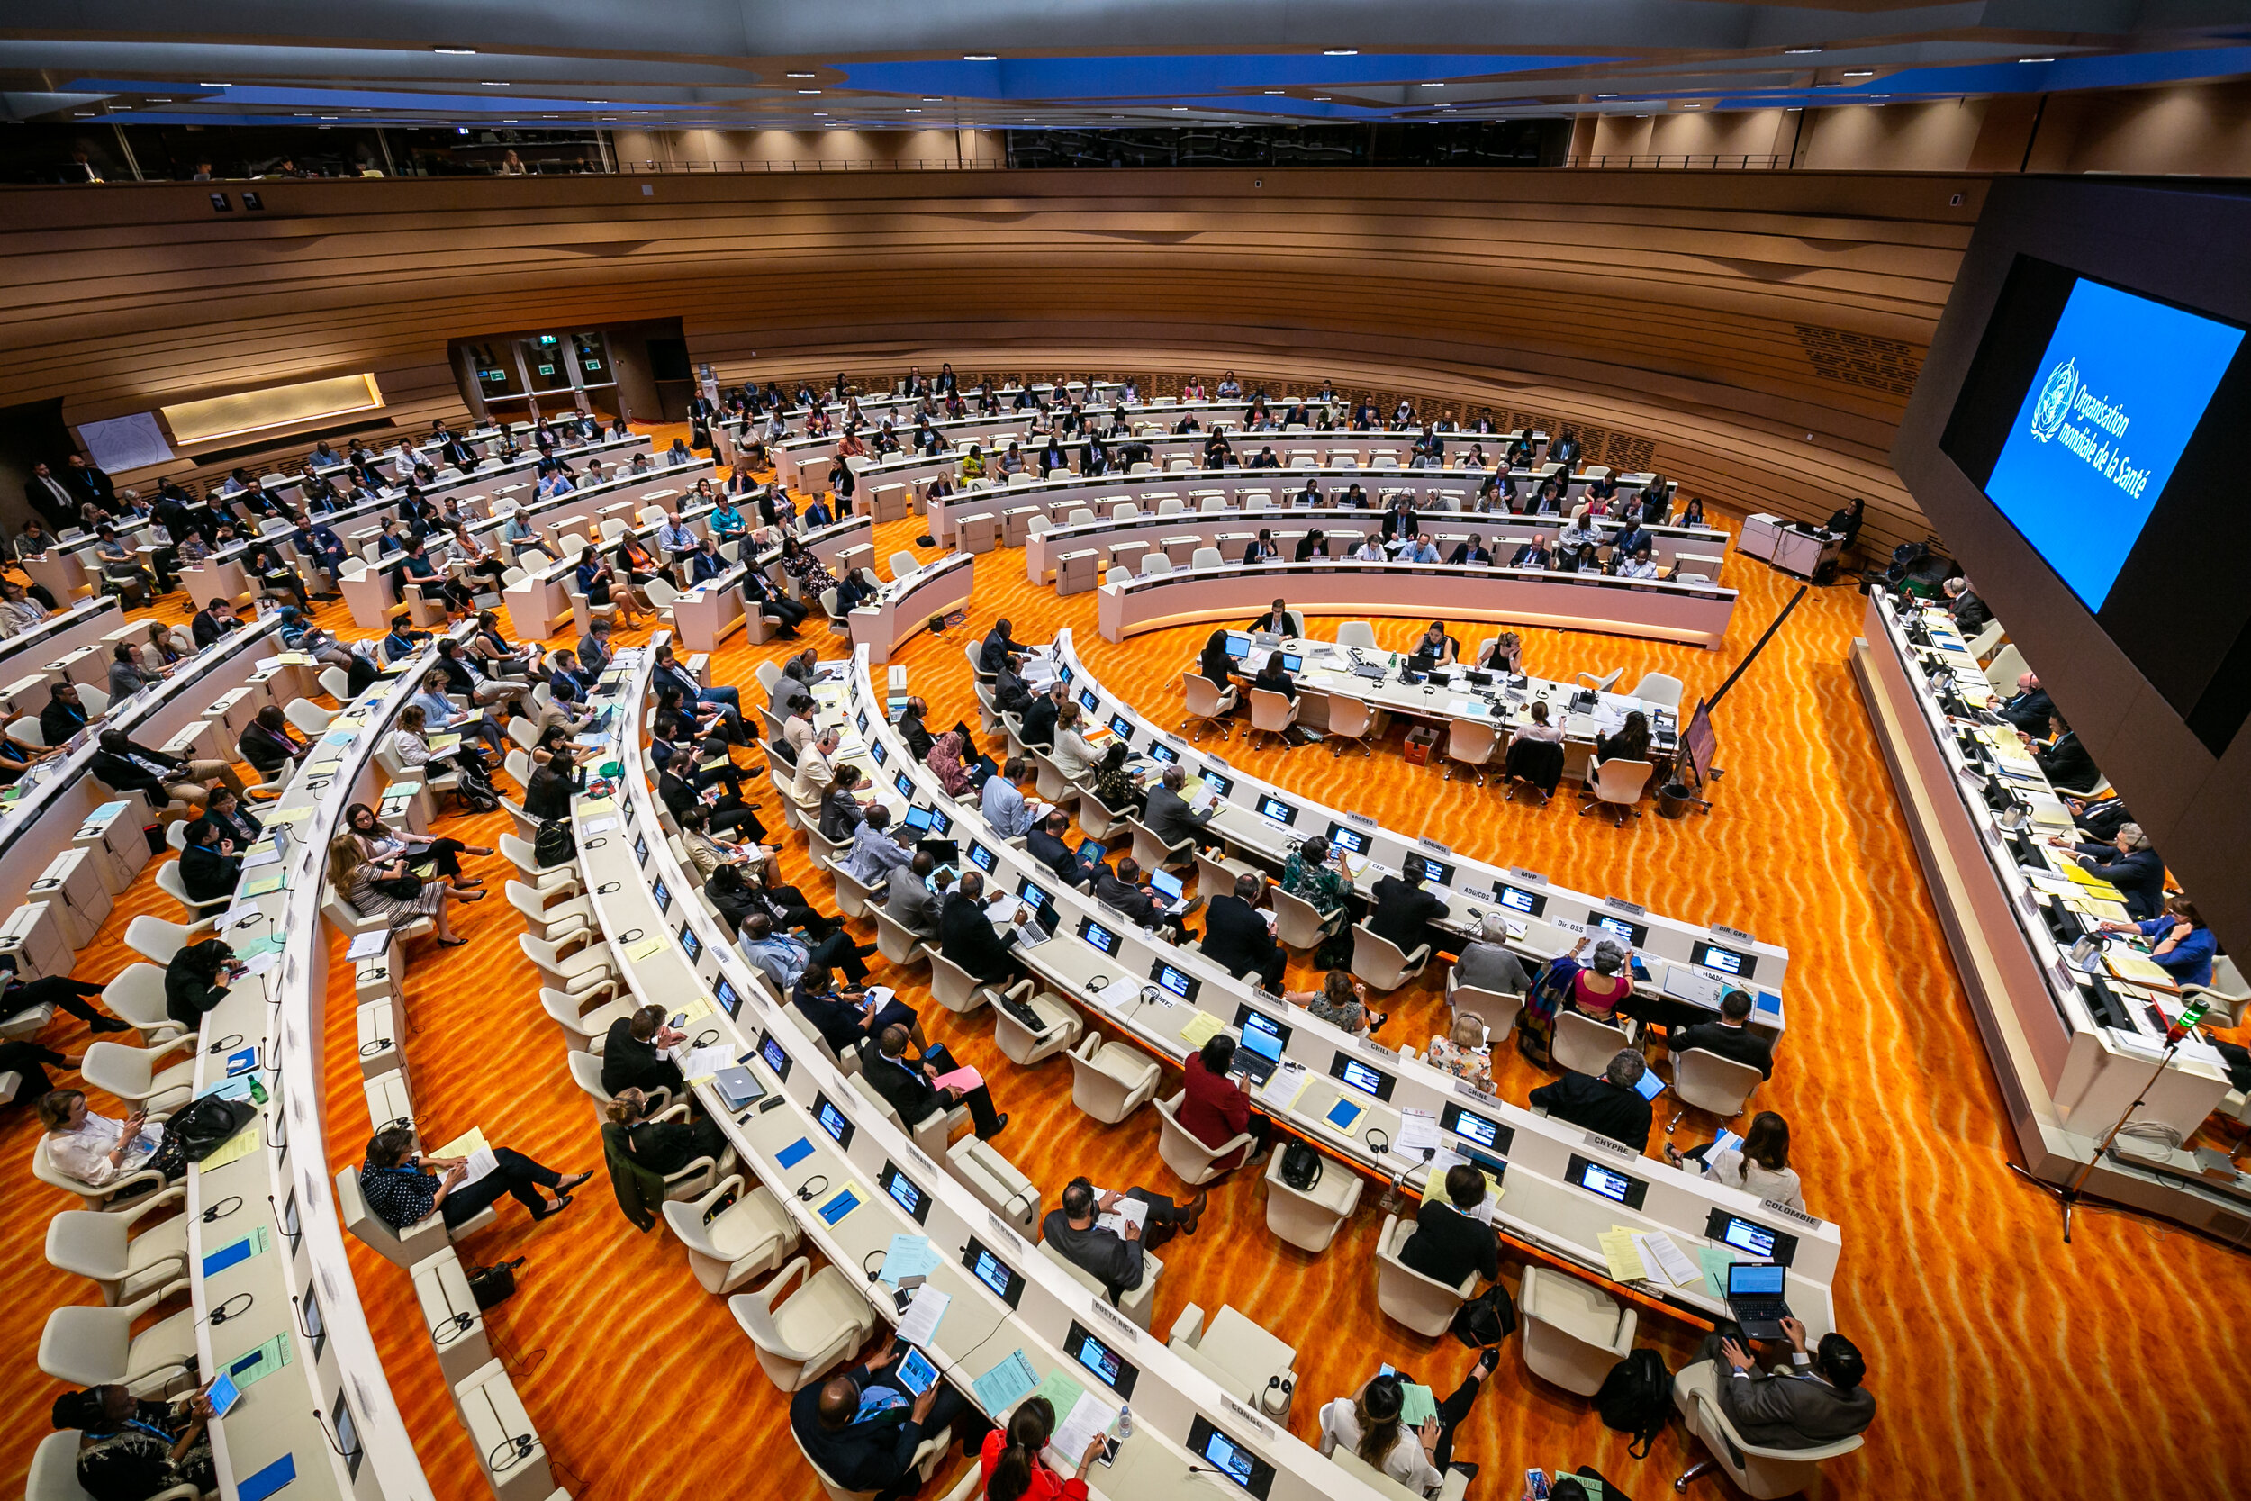
Public Health Intelligence under IHR (2005)– a Core WHO Activity
IHR article 5​ - Surveillance
WHO shall collect information regarding events through its surveillance activities and assess their potential to cause international disease spread and possible interference with international traffic. ​
IHR article 9 – Other reports
WHO may take into account reports from other sources other than notifications or consultations and shall assess these reported according to established epidemiological principles…WHO shall consult with and attempt to obtain verification from the State Party…[]
IHR article 11 – Provision of information by WHO
WHO shall send to all States Parties…[] such public health information…[]which is necessary to enable States Parties to respond to a public health risk. …[]
WHO may also make it available to the public …[] if there is a need for the dissemination of authoritative and independent information.
Other key articles for PHI operations
IHR article 6– Notification
IHR article 8– Consultation
IHR article 10– Verification

Slide 4
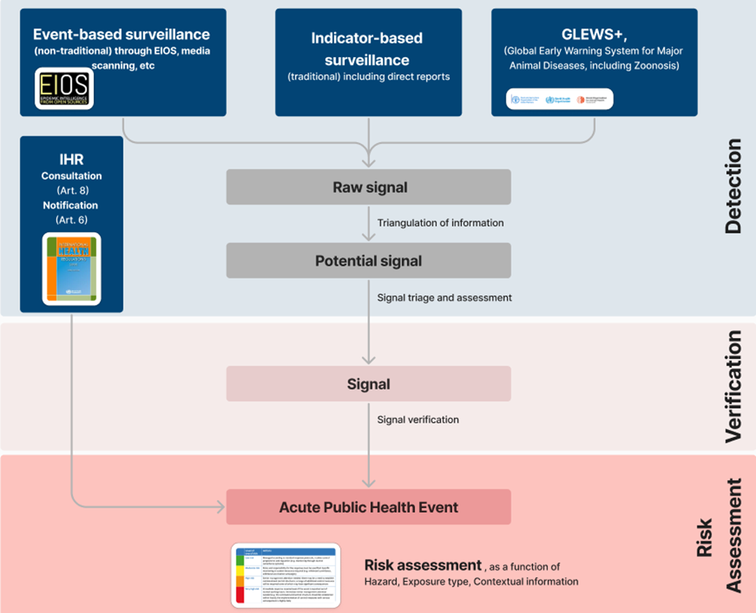


From Signal to Event
In 2023
~13,000,000
pieces of information
EIOS: Epidemic Intelligence from Open Sources
~1,300,000
raw signals
~1,500
signals
40 events
risk assessed

Slide 5
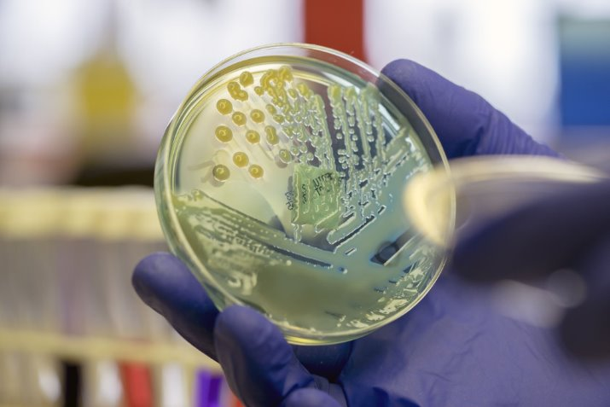
Signals considered ‘relevant’ for WHO?
Any public health concern with the potential to affect human health
Higher than expected mortality or morbidity
Among specific population groups (e.g., refugees, health care workers, marginalized populations)
Due to an undiagnosed or unknown illness or death in humans or unusual death animals
Concern for transmission/spread and global impacts:
Potential to cause an outbreak with substantial risk of spread, including food safety/security
Unusual/unexpected/unexplained morbidity or mortality related to international travel or mass gathering
Possible consequences for international trade or travel
From CBRN* and environmental hazards
Re-emergence of disease with pandemic potential or vaccine-preventable disease
Indirect effects on health including:
Undue level of concern/fear in the affected community
Potential reputational risk for WHO
*CBRN: Chemical, Biological, Radiological and Nuclear

Slide 6
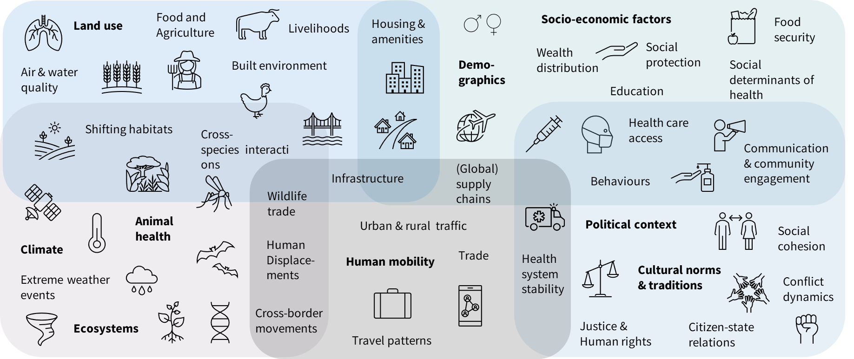
Signal Triangulation & Initial Risk Assessment
Do we already know as WHO?
  Review of internal systems
Respectable source?
  If yes, next question
  If not, check other sources
    Government websites
    Partner websites
    Expert teams
What is known?
  Person? Place? Time?
  Background rate?
  Unusual/unexpected?
What is the context?

Slide 7
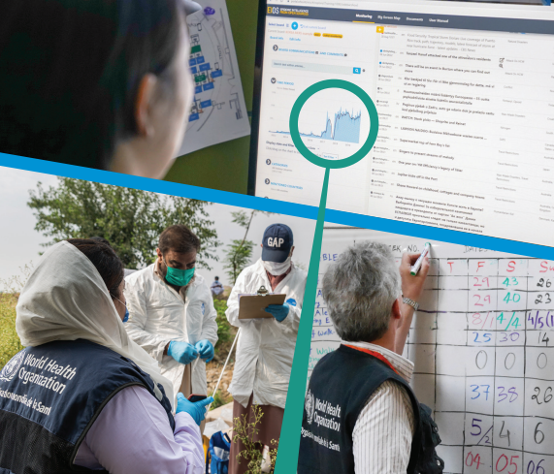
Daily Public Health Intelligence Review
Multi-disciplinary team with 24/7 coverage
Collaborative assessment, triage and categorization of signals/events
  Review of signals under monitoring
  Review new events reported by Member States
  Review of requests received from other teams
Review of outstanding alert actions (EIS*, RRA*, DON*, situation reports)
Identification of signals for daily reporting and presentation to WHO Director General and senior management for action
*EIS: Event Information Site report; RRA: Rapid Risk Assessment; DON: Disease Outbreak News report

Slide 8
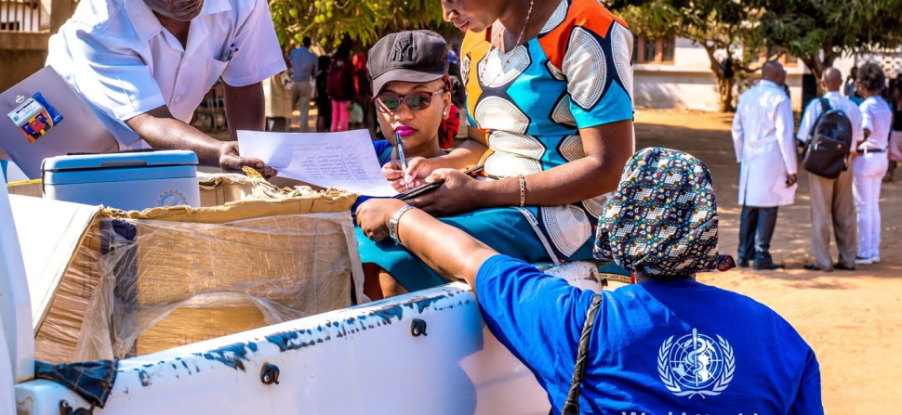
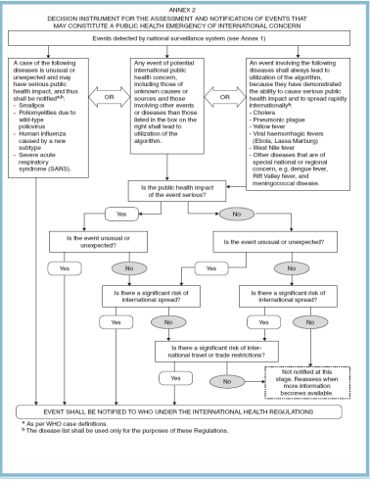
Signal Verification and IHR
Signal verification is a multistep process that involves collaboration with key stakeholders.
In 2023, 62% of responses to verification requests to Member States were received in <48hrs.
States Parties to the IHR* have obligation to notify within 24 hours any potential public health events of international concern.
Always notifiable
  Smallpox, SARS, Wild-type poliovirus, human influenza caused by new subtype
Any event of potential international public health concern that meet two of the criteria;
  Is the public health impact of the event serious?
  Is the event unusual or unexpected?
  Is there any significant risk of international spread?
  Is there any significant risk of international travel or trade restrictions?
*IHR: International Health Regulations

Slide 9

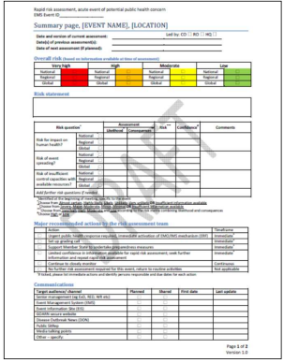
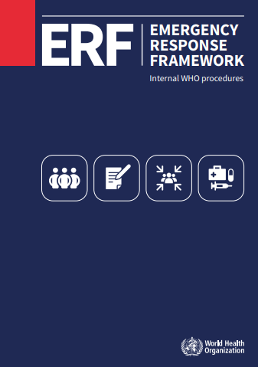
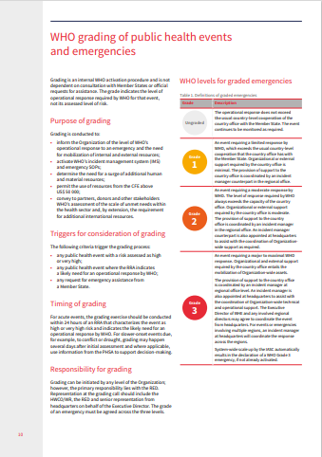
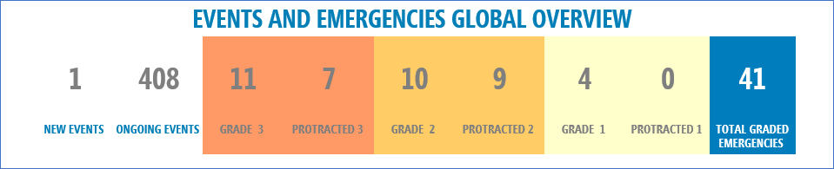
WHO’s Rapid Risk Assessment for Acute Public Health Events
Reflect WHO’s independent assessment including country’s capacities /vulnerabilities to control outbreak/event
Highlights urgent actions required including
  Refers event for review of IHR Emergency Committee for consideration as a PHEIC
  Activation of Emergency Response Framework mechanisms
  Recommend setting up a grading discussion
, as of 25 October 2024
IHR: International Health Regulations; PHEIC: Public Health Emergency of International Concern; ERF: Emergency Response Framework

Slide 10
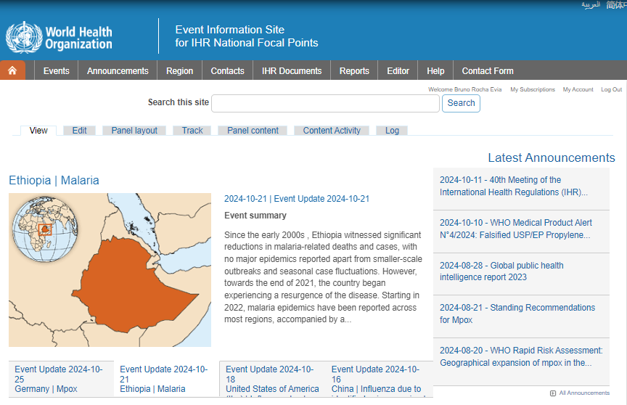
Alerting Member States: Event Information Site
EIS: secure website developed by WHO to facilitate communications with the National IHR Focal Points (NFPs) as part of the implementation of the IHR
Information is provided by WHO to NFPs in confidence as specified in Article 11.1 of the IHR
Information provided
  IHR criteria assessment
  Situation update
  Public Health Response
  WHO Risk Assessment
  WHO Advice/Recommendations
  Links for more information
Compiled by technical experts across 3 levels of WHO
Sent to NFP for consultation (an accuracy check)
IHR: International Health Regulations.

Slide 11
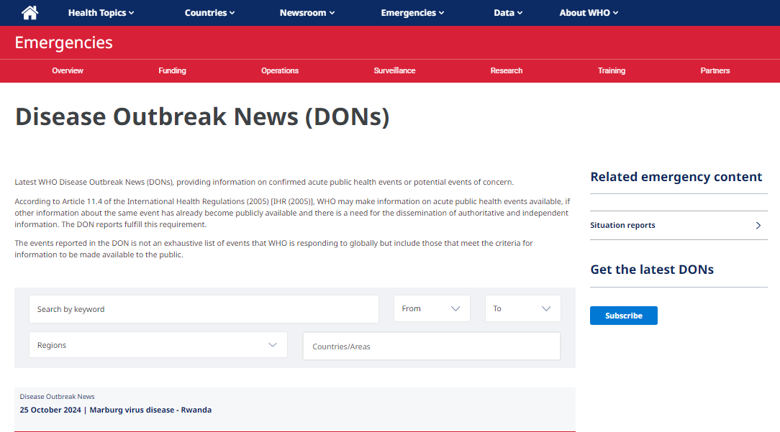
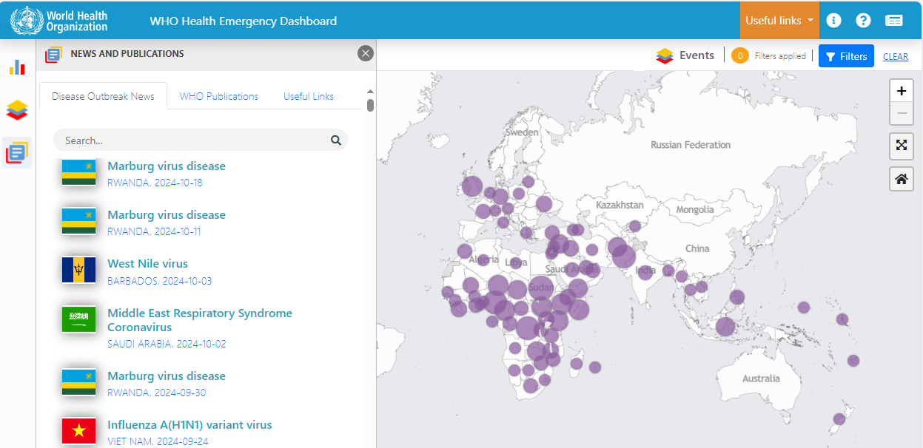
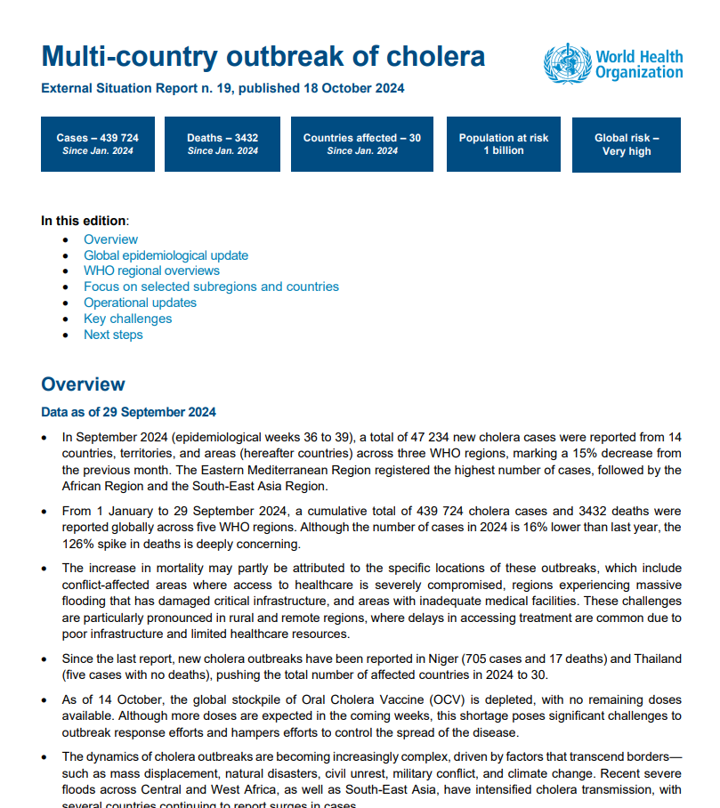
Alerting the Public: Disease Outbreak News, Situation Reports
WHO's main communications product for the public on acute public health events > 25 years
Translated and published in six UN official languages
Linked to the WHO Health Emergency Dashboard
Monthly summary in the Weekly Epidemiological Report
DONs: https://www.who.int/emergencies/disease-outbreak-news
Situation Reports: https://www.who.int/emergencies/situation-reports
Dashboard: https://extranet.who.int/publicemergency
WER: https://www.who.int/publications/journals/weekly-epidemiological-record
DON: Disease Outbreak News report; WER: Weekly Epidemiological Record

Slide 12
Working with countries,
How WHO EMRO collaborates with Member States
National IHR Focal Point
Means the national centre, designated by each State Party, which shall be accessible at all times for communications with WHO IHR Contact Points under these Regulations
WHO IHR Contact Point
Means the unit within WHO which shall be accessible at all times for communications with the National IHR Focal Point
Email:emroihr@who.int;
24/7 mobile phone: +201281263903
    IHR NFP Response:
    Within 24 hours, an initial reply to, or acknowledgement of the request from WHO;
    Within the next 24 hours, available public health information on the status of events requested by the WHO.
    Information to WHO in the context of an assessment under Article 6, including relevant information

Slide 13
Working with countries,
How WHO EMRO collaborates with Member States
Challenging scenarios
  No response after 48 hours or more
  Vague responses
  “Please wait responses”
How they are addressed
  Kind reminder, gentle reminder emails
  Phone calls or WhatsApp
  WHO country office involvement or senior management involvement
Friendly strategy: Offer of support or collaboration
  Laboratory support
  Updated WHO guidelines (clinical management, travel advisories)
  Field investigation, joint mission
  Risk assessment
  Collaboration with another MS
  Any other relevant expertise

Slide 14

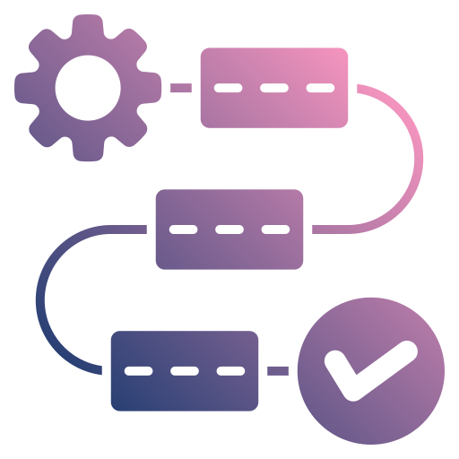

Reality check: challenges of the IHR-NFPs
Human Resource
Workflow
Legal structure/ framework
High staff turn-over
Lack of communication between IHR-NFP and other sectors
No legal support
Inadequate trainings (from 4-17 years ago)/no training at sub-national
No clear workflow between surveillance & IHR
Multi-channel approval
Inadequate access of IHR-NFP to decision makers
Limited human resource/competing priorities
No legal consequences for non-reporting
Political changes/division
Political sensitivities/fear of travel restrictions/national security

Slide 15

UNICEF – Signal/alert sources and triage
WHO Public Health Intelligence
EIOS, media scanning
Partners (MSF, HCR, IOM, CDC, ACDC)
Are children, newborns and pregnant women disproportionally affected?
Is it a vaccine-preventable disease event?
Unusual event, high mortality, undiagnosed disease that could disrupt wider determinants of health areas (e.g., education) and requires support across UNICEF sectors?
UNICEF Regional (RO) & country office (CO)
UNICEF signals
UNICEF collaborative work with WHO on signals

Slide 16
PHE Alert communication within UNICEF
 | Action | Headquarter
Within 24 hours | Notification | Alert/signals received and entered into the UNICEF signal tracker for monitoring Depending on source of alert, notify RO/CO, HQ relevant section, Emergency Programmes (EMOPS), UNICEF senior management, WHO or Global Outbreak Alert Response Network (GOARN) and request for additional information if available. UNICEF provides RO and CO with relevant technical guidance as required.
Within 24-48 hours | Assessment | As required, UNICEF Associate Director HEPR (Health Emergency Preparedness and Response) updates Office of Executive Director. Based on discussion with RO, HQ PHE Unit to propose a 3-level technical call (CO, RO, and HQ)
Within 7 days | If a response is warranted (Scale, Urgency, Complexity and Country Capacity) | The event is reviewed with the PHE extended team during weekly epi update. The level of UNICEF's engagement may also depend on the emergency level attributed by WHO. If the response requires enhanced HQ support: The Associate Director HEPR to identify a coordinator for the event at HQ for global coordination. Implement a surge based on needs, mobilize funding, preposition supplies As required, based on the assessed risk of the public health threat, the Associate Director of HEPR convenes an advisory group to determine the level of emergency for UNICEF.
If event is discarded |  | PHE unit to notify relevant colleagues and partners. Event is closed in the PHE signal tracker.

Slide 17
Useful references and links
International Health Regulation (2005) Third Edition (WHO, 2016)
Rapid Risk Assessment of Acute Public Health Events (WHO, 2012)
Emergency Response Framework Edition 2.1 (WHO, 2024)
Designation of National IHR Focal Points
DONs: https://www.who.int/emergencies/disease-outbreak-news
Situation Reports: https://www.who.int/emergencies/situation-reports
Dashboard: https://extranet.who.int/publicemergency
WER: https://www.who.int/publications/journals/weekly-epidemiological-record

Slide 18
EPI-WIN Webinar
View webinar “Global Public Health Intelligence: WHO Operational Practices”
Speakers
  Abdi Mahamud, Director, Alert & Response Coordination Department, WHO
  Esther Hamblion, Unit Head, Public Health Intelligence, WHO HQ
  Blanche Greene-Cramer, Team Lead, Alert and Verification, WHO HQ
  Aura Corpuz, Team Lead, Public Health Intelligence, WHO EMRO
  Tondri Noe Guinko, Public Health Emergencies, UNICEF

