Slide 1
Infection prevention and control & WASH: Keeping patients and health workers safe when caring for patients with mpox
14 October 2024

Slide 2
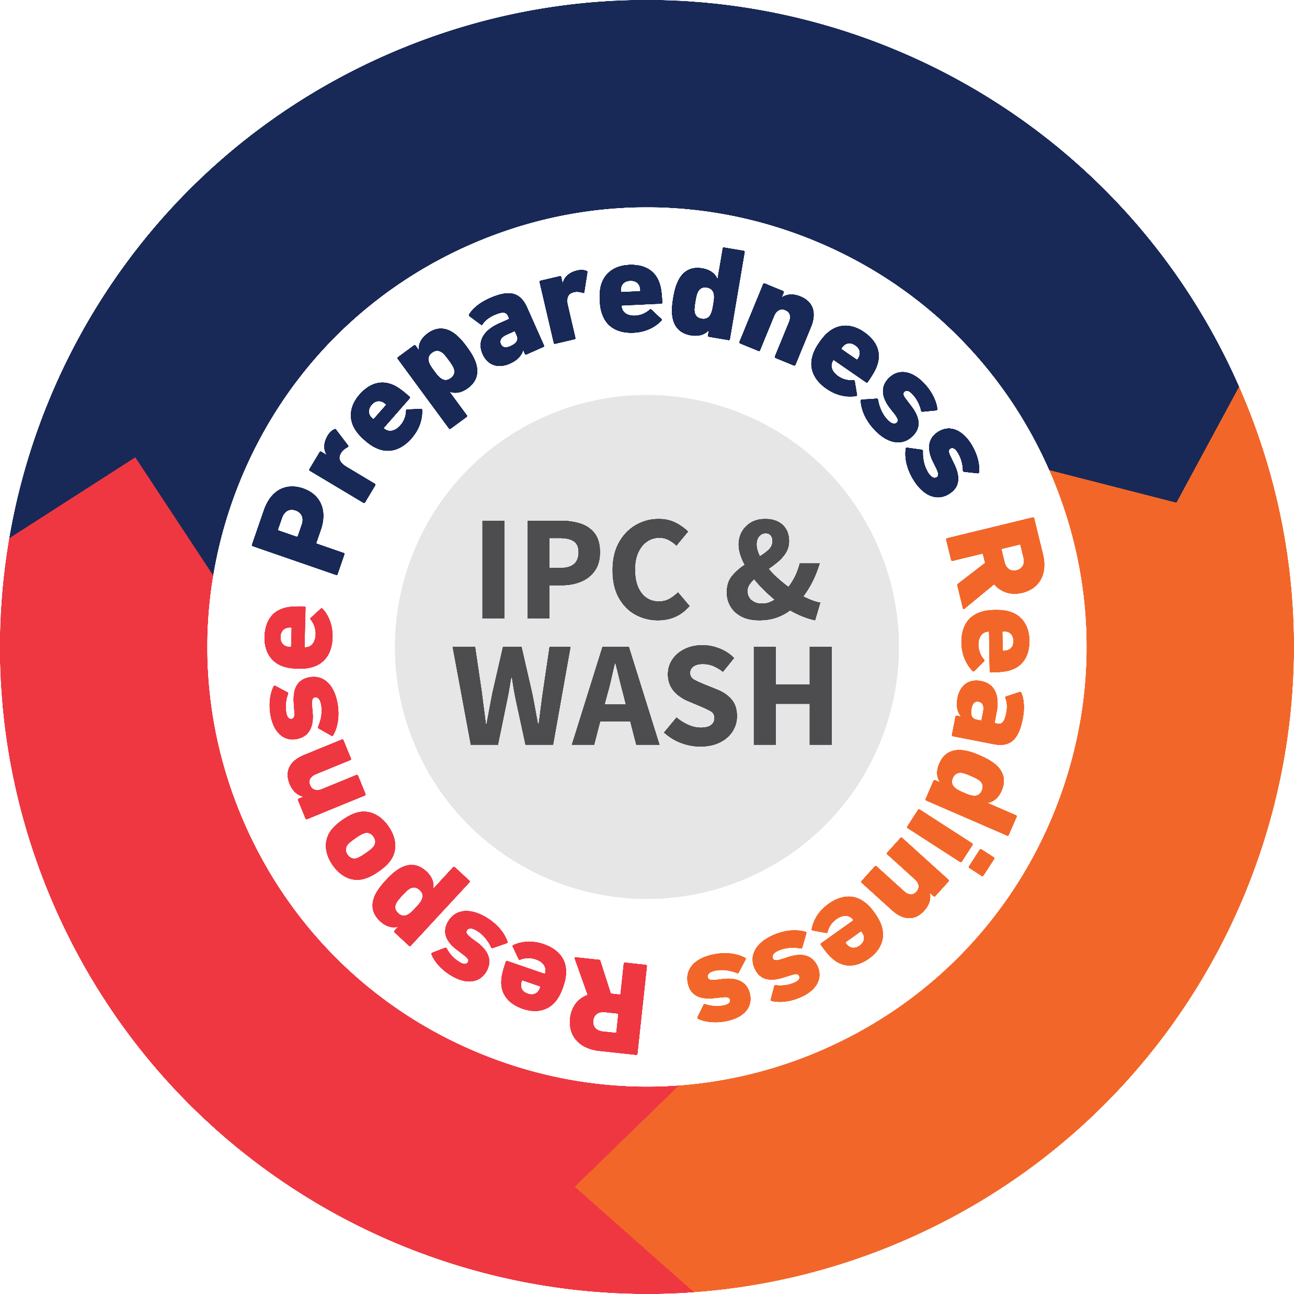
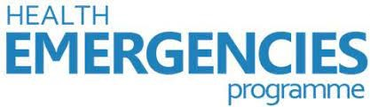
IPC & WASH: Keeping individuals with mpox and health and care workers that care for them safe
14 October 2024
Victoria Willet
WHO Health Emergencies Programme
IPC & WASH Team

Slide 3
Objectives
To emphasize the WHO infection prevention and control (IPC) and water, sanitation and hygiene (WASH) recommendations and available tools for healthcare settings where care for patients with suspected or confirmed mpox is provided.
To share practical experiences implementing IPC measures and strengthening WASH services in health facilities during the mpox response.

Slide 4
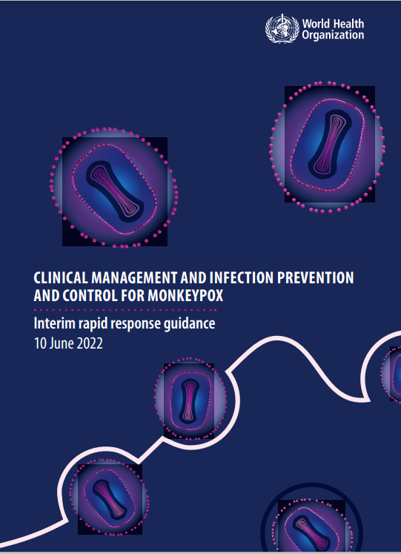
Clinical management and infection prevention and control for mpox: interim rapid response guidance
Health care settings
7 recommendations
Home and community settings
4 recommendations
Health and care workers exposures
Management of the deceased
1 recommendation
1 recommendation
Screening and triage
3 recommendations

Slide 5
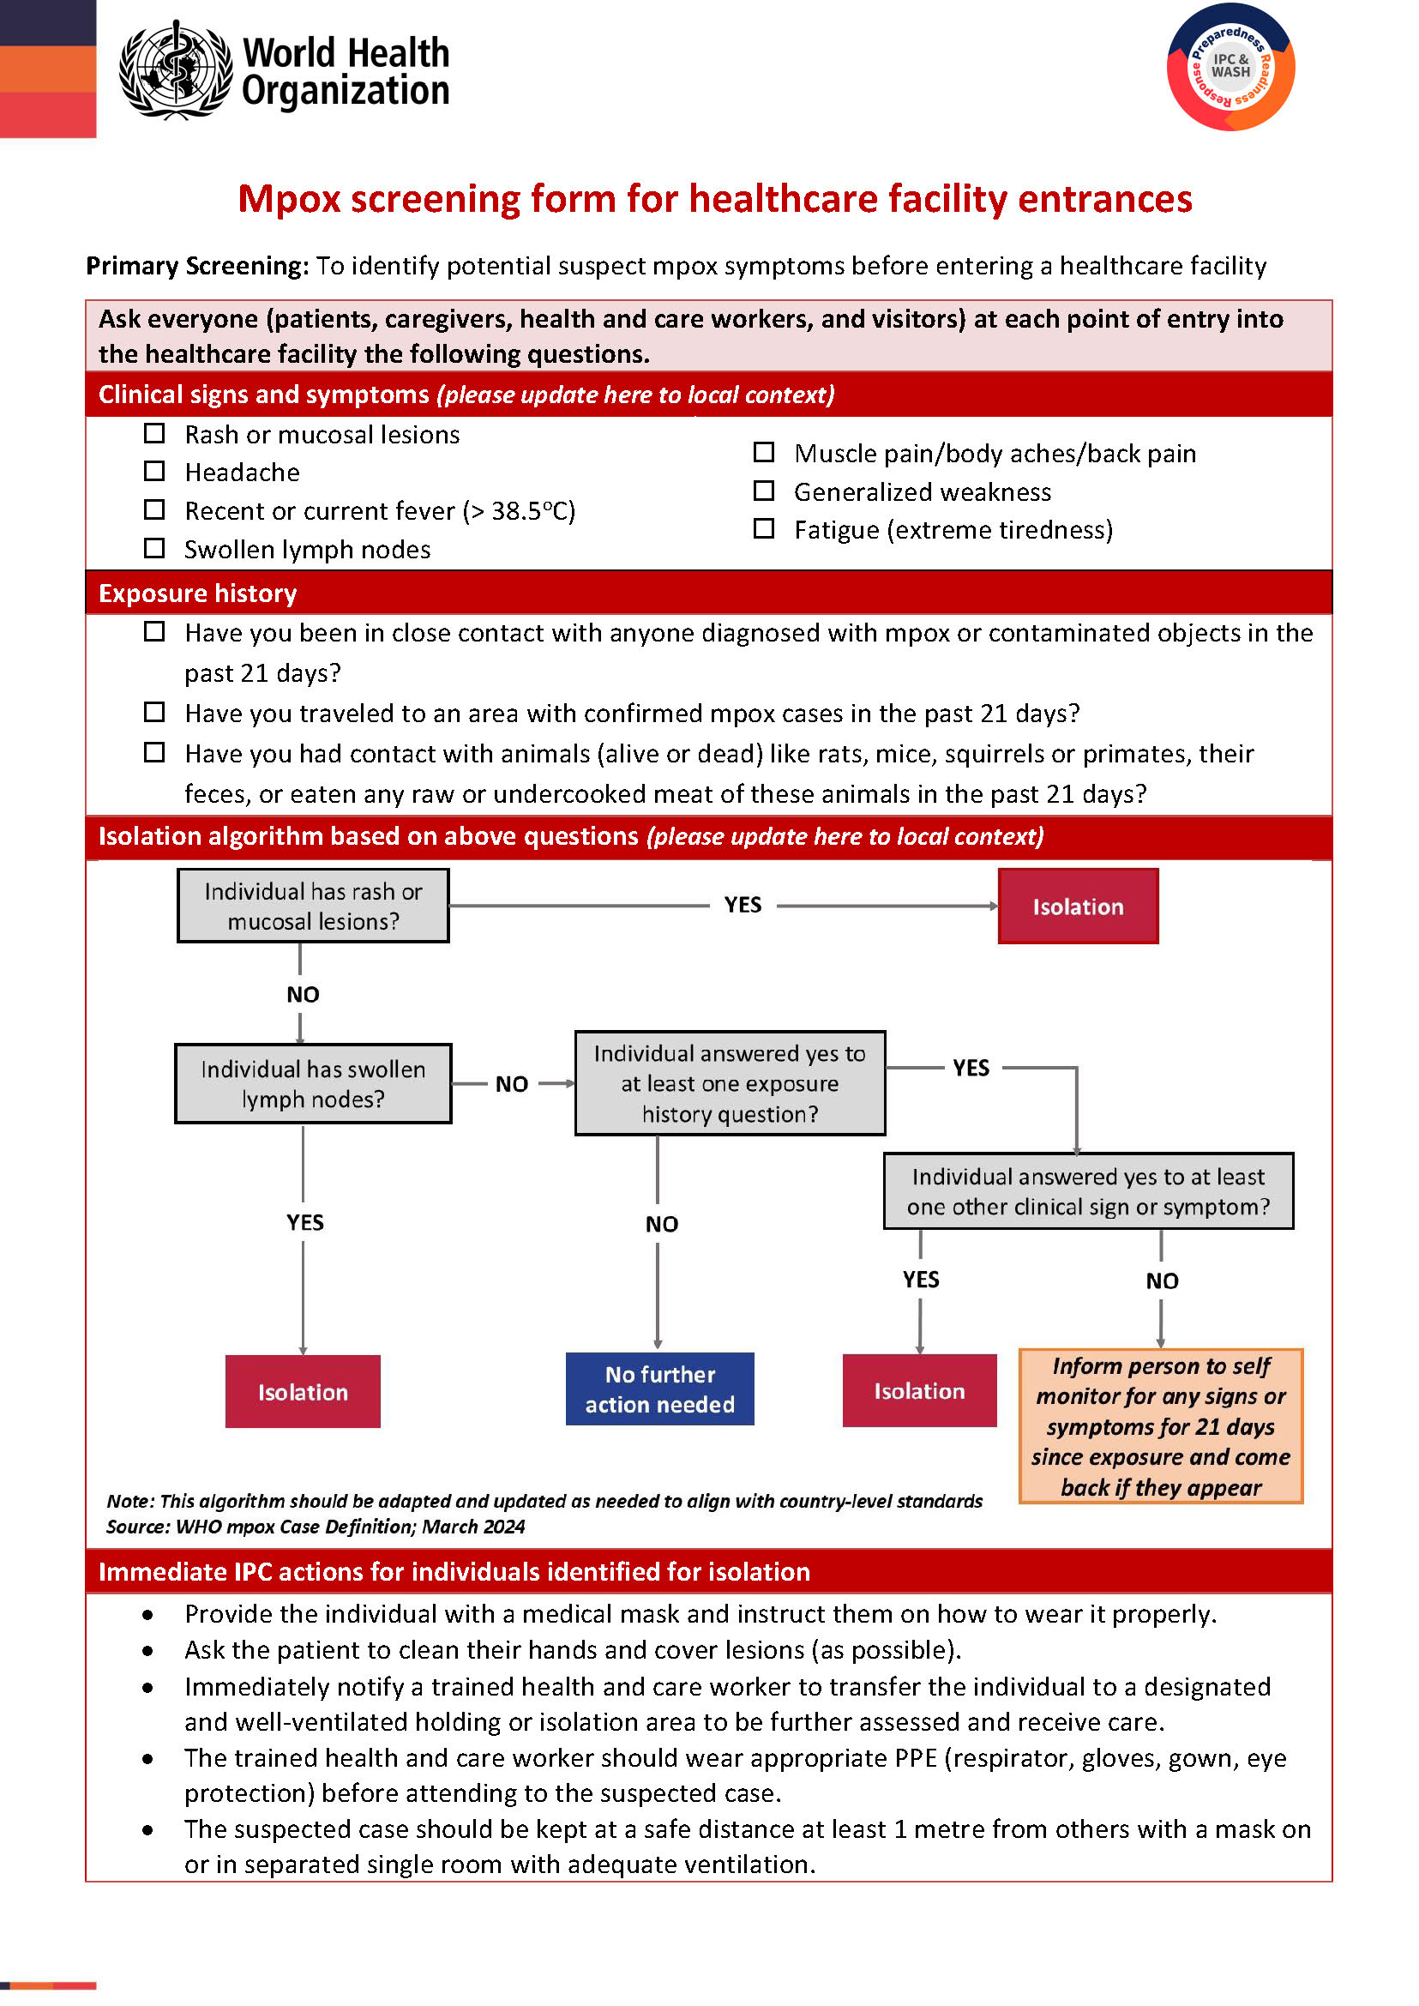
Key message: Screening
Prompt identification of mpox and swift implementation of IPC measures reduces transmission in health-care facilities. ​
Immediate actions include:​
Screening at the first point of contact​
Patient placement / isolation of patients where applicable​
Hand-hygiene best practices​
Appropriate selection and use of PPE​
Maintain a physical distance of at least 1 metre​
​

Slide 6
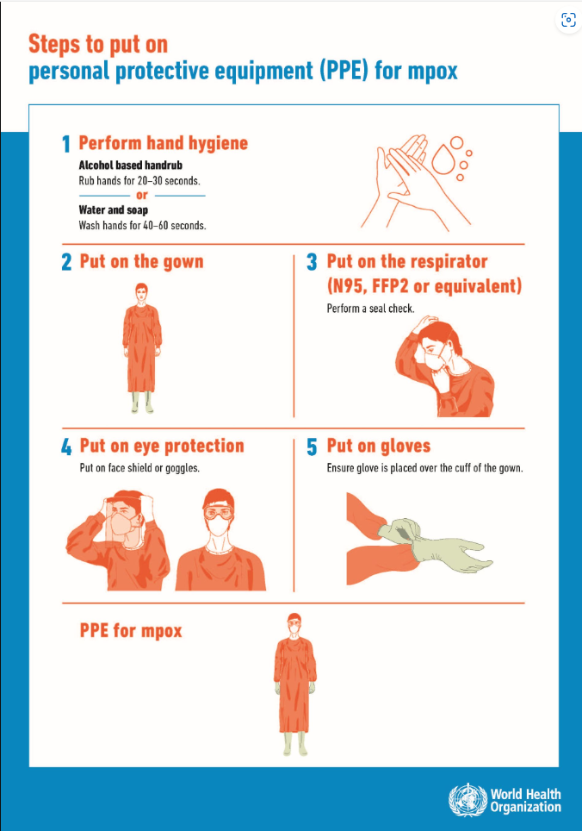
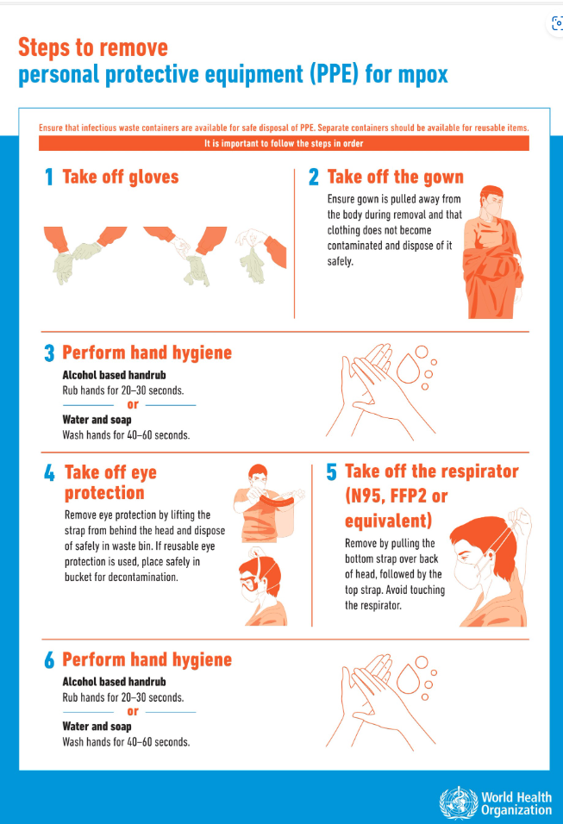
CARING FOR PATIENTS WITH SUSPECT MPOX
Contact and droplet precautions should be implemented for any suspected mpox patient.
  If differential is varicella zoster virus, implement airborne precautions until ruled out.
Airborne and contact precautions are recommended in circumstances and settings in with AGPs
Hand hygiene should be done any time the WHO “5 Moments” apply, and before PPE and after removing PPE

Slide 7
CARING FOR PATIENTS WITH CONFIRMED MPOX
Use contact and droplet precautions with a respirator
Required PPE: a respirator, eye protection (goggles or face shield), gown, and gloves
Airborne and contact precautions are recommended in circumstances and settings in which AGPs
Hand hygiene should be done any time the WHO “5 Moments” apply, and before PPE and after removing PPE

Slide 8
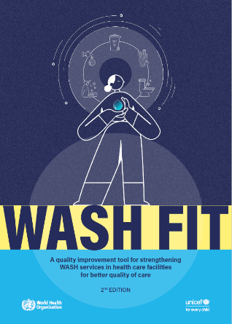
WASH and Waste management in health care facilities
Patient-care activities should be undertaken in a clean and hygienic environment that facilitates practices related to the prevention and control of health-care-associated infections (HAIs),
Provide Basic water, sanitation and hygiene infrastructure and services
For details on recommendations:
  WASH FIT: A practical guide for improving quality of care through water, sanitation and hygiene in health care facilities. Second edition

Slide 9
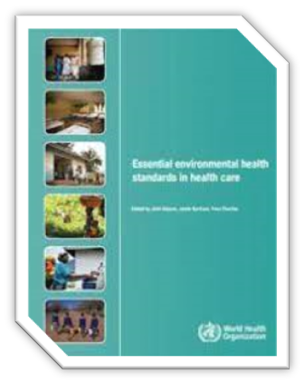
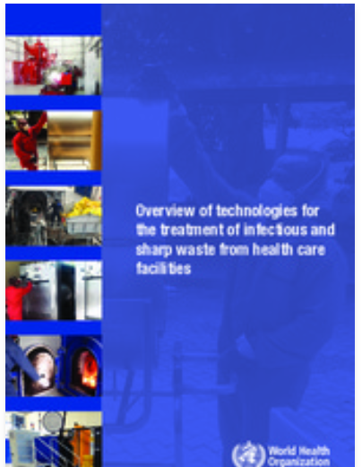
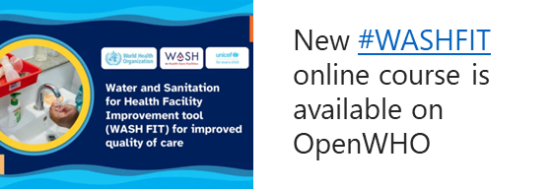
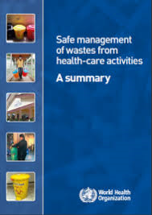
Technical Resources for Improvement of WASH and Waste in healthcare facilities
Essential environmental health standards in health care (who.int)
Overview of technologies for the treatment of infectious and sharp waste from health care facilities (who.int)
Safe management of wastes from health-care activities, 2nd ed. (who.int)
WASH FIT implementation Package; WASH FIT portal | WASH in Health Care Facilities (washinhcf.org)

Slide 10
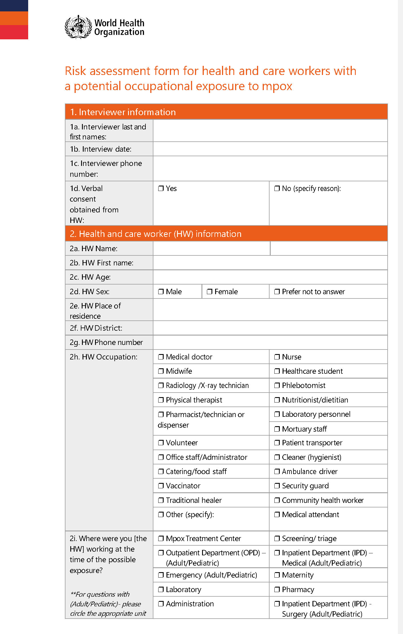
Future Tools
Health and care worker mpox exposure risk assessment
IPC measures for vaccination campaigns
Training materials for community health workers

Slide 11
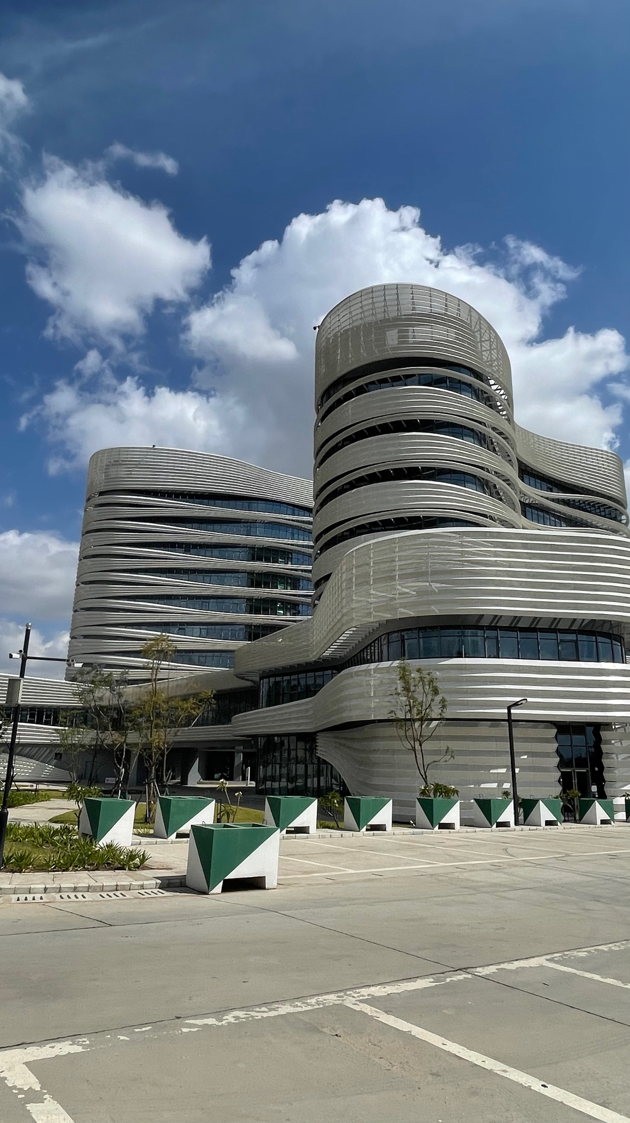

Highlight of IPC measures for health care workers
Safeguarding Africa’s health
Andy Bulabula, MD, MScClinEpi, PgDipIPC, PhD
Senior Technical Officer for IPC
Centre for Disease Control and Prevention
Africa CDC, HQ
14 October 2024

Slide 12
Africa CDC Recommendations
Introduction
General IPC Precautions for Monkeypox
Infection Prevention and Control (IPC) measures are critical for the prevention of Monkeypox transmission in healthcare settings.
Target audience: Health facility managers, clinicians, and IPC practitioners across various healthcare settings, including primary care clinics, emergency departments, infectious disease clinics, and more​.
Goal: Implement appropriate IPC measures for suspected and confirmed Monkeypox cases.
IPC is necessary for both suspected and confirmed Monkeypox patients.
Precautions include: Screening and triage at the first point of contact, isolation, use of Personal Protective Equipment (PPE) such as medical masks, gloves, gowns, and eye protection​.
Patient isolation: In a well-ventilated single room or cohort suspected patients away from confirmed patients​.

Slide 13
Africa CDC Recommendations
Africa’s Public health Intelligence Report
Contact and Droplet Precautions (Recommendation 1)
Enhanced Precautions for Confirmed Monkeypox Cases (Recommendation 2)
Recommendation 1: Contact and droplet precautions should be implemented for any suspected patient with MPX.
Airborne precautions should be added if varicella zoster virus (chickenpox) is suspected and until it is excluded​.
Key Actions: Use PPE (masks, gloves, gowns) and implement distancing measures to minimize exposure to respiratory droplets.
Recommendation 2: For confirmed MPX patients, contact and droplet precautions must continue.
Respirators should be used instead of medical masks​.
Objective: Limit exposure to airborne transmission when treating confirmed MPX patients.

Slide 14
Africa CDC Recommendations
Africa’s Public health Intelligence Report
Airborne Precautions for Aerosol-Generating Procedures (Recommendation 3)
Environmental Cleaning and Disinfection (Recommendation 4)
Recommendation 3: Airborne precautions must be implemented if aerosol-generating procedures (AGPs) are performed​.
Examples of AGPs: Intubation, bronchoscopy, or suctioning.
PPE required: N95 respirators, gowns, gloves, and eye protection.
Recommendation 4: Areas within the health facility frequently used by the patient or where patient care activities occur, as well as patient care equipment, should be cleaned and disinfected in accordance with national or facility guidelines​.
Key Action:
                Routine cleaning and disinfection of high-touch surfaces and shared equipment.
                During the cleaning process health workers must put on PPE (heavy duty gloves, gown, respirator [N95 or FFP2].

Slide 15
Africa CDC Recommendations
Africa’s Public health Intelligence Report
Safe Handling of Linens and Fabrics (Recommendation 5)
Waste Management Protocols (Recommendation 6)
Recommendation 5: Linens, hospital gowns, towels, and other fabric items should be handled and collected carefully to prevent dispersion of infectious particles​.
Key Actions: Use hot water (>60°C) for laundering, or chlorine for disinfection if hot water is unavailable. Avoid shaking linens.
Recommendation 6: All bodily fluids and solid waste from patients with MPX should be treated as infectious waste.
Key Actions: Proper disposal of PPE, contaminated medical supplies, and waste according to facility protocols to avoid environmental contamination.

Slide 16
Africa CDC Recommendations
Africa’s Public health Intelligence Report
Patient Interaction and Well-being (Recommendation 7)
Conclusion and Key Takeaways
Recommendation 7: Patients isolated with MPX should have measures in place to support interaction with family and visitors, promoting their well-being.
Key Actions: Allow controlled visitation or virtual visits, with visitors using appropriate PPE.
Summary: Infection Prevention and Control (IPC) measures are critical in health facilities to prevent the spread of Monkeypox.
Key Points: Strict adherence to contact, droplet, and airborne precautions, regular cleaning, waste management, and patient-centered care is essential​.

Slide 17


Brief overview of IPC-EHA activities in Healthcare Facilities
Mpox epidemic, Democratic Republic of Congo
Sharing experience in preparedness and response Infection Prevention and Control
DHSP, Democratic Republic of Congo

Slide 18
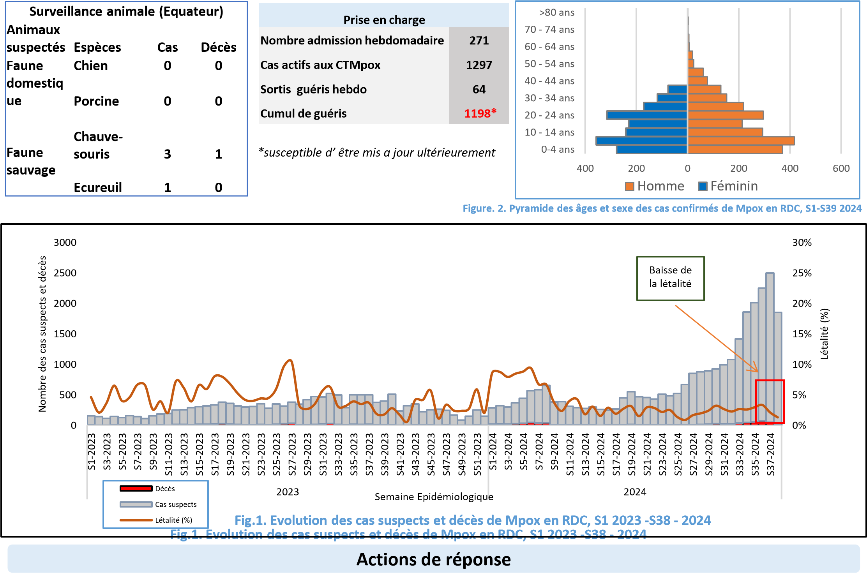
Epidemiological situation of Mpox in the country

Slide 19
Study: Evaluation of priority health care establishments in provinces at risk and implementation of the recovery plan for IPC-EHA interventions
Challenges | Recommendations
33.3% have screening capacity and 29.8% isolation. | Strengthen the capacities of the ESS for screening and the implementation of the triage and isolation system. Make the tools available: Triage sheet, thermo flash, register and the necessary inputs to facilitate the operation of the triage service in priority ESS.
40.2% Leadership in IPC, 45.8% hand hygiene and 29% availability of PPE | Strengthen the PCI-EHA capacities of PCI committees/Hygiene committees Make PPE available
44.4% Environmental cleaning and disinfection | Make PPE available for people carrying out this task and provide training on the recommended technique for this.
18.6% Identification and post-exposure care | Training with the PCI focal points of targeted healthcare establishments to better understand their responsibilities and discuss this activity
51% Patient location, 66%hygiene and sanitation | Supply of hand basins Promotion of hand hygiene in ESS Develop a recovery plan for allocations in structures to fill the gaps
17.4% Management of Mpox bodies | Provide training on EDS in the context of Mpox. Make available SOPs on the management of Mpox remains.

Slide 20
Challenges and constraints
Insufficient IPC-EHA inputs in the Provincial Health Divisions to support ESS including CT Mpox and PoE/PoC.
Insufficient support partners to support Provincial Health Department/ Essential Health Services
Insufficient triage and isolation units and difficulties in ensuring the continuity of their operation in the Essential Health Services following the lack of infrastructure and materials.
Difficulties of Isolation in IDP camps.

Slide 21
EPI-WIN Webinar
View webinar
Speakers
  Victoria Willet, WHO Health Emergencies Programme, IPC & WASH Team
  Andy Bulabula, MD, MScClinEpi, PgDipIPC, PhD, Senior Technical Officer for IPC, Centre for Disease Control and Prevention, Africa CDC, HQ
  Gertrude Nsambi, DHSP, DRC

