Slide 1
Safe at Home: IPC & WASH measures for home care and isolation in resource-limited settings
29 October 2024

Slide 2
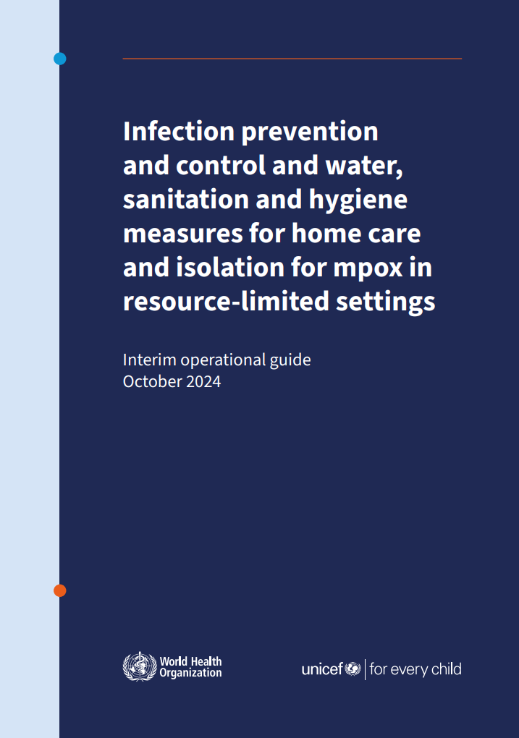
Infection prevention and control and water, sanitation and hygiene measures for home care and isolation for mpox in resource-limited settings
Determining if the person with mpox can be cared for and isolate at home
IPC measures for health and care workers, caregivers and persons with mpox during homecare and isolation
Linen management and environmental cleaning
Discontinuation of home isolation
Management of contacts of person with mpox
Water, sanitation and hygiene services during home care
Waste management during home care
Infection prevention and control and water, sanitation and hygiene measures for home care and isolation for mpox in resource-limited settings

Slide 3
IPC & WASH measures for home care and isolation in resource-limited settings
IPC measures for health and care workers during home care
IPC for the person with mpox
If supplies for hand hygiene, PPE not available - do not enter the households - consider conversing with the person with mpox or caregiver outside the home and maintain distance of at least 1 metre.
Cover lesions (can use own clothing) and wear a mask (medial or fabric) when around others
Separate from others- if no designated room in the house is available identify a space
Avoid touching the environment, furniture if outside of the isolation area-clean hands frequently
Do not share personal items including soap
Infection prevention and control and water, sanitation and hygiene measures for home care and isolation for mpox in resource-limited settings

Slide 4
IPC & WASH measures for home care and isolation in resource-limited settings
Linen and laundry
Cleaning the household
Launder items separately from the rest of the household
Do not shake linens, clothing
Variety of options for washing –mechanical or by hand:
  Preferable to use hot or warm water with detergent or chlorine (0.05%)
Use PPE when washing- disposable gloves, mask
Spraying or fogging is not recommended
Clean surfaces with soap and water then a disinfectant (e.g. 0.05% sodium hypochlorite) at least daily and once isolation is discontinued
Clean and disinfect items that must be shared
Use PPE or alternative barriers such as household gloves, fabric mask
Do not sweep- damp mop
Infection prevention and control and water, sanitation and hygiene measures for home care and isolation for mpox in resource-limited settings

Slide 5
IPC & WASH measures for home care and isolation in resource-limited settings
IPC for caregivers
Discontinuing isolation at home
Designated caregiver should be in good health, had previous MPXV infection or vaccination
When in contact with the person with mpox or the environment use PPE- options if “PPE” not available: fabric masks, dedicate own clothing, household rubber gloves
Clean hands
Persons with mpox who are cared for at home should remain in isolation and refrain from close contact with others until their skin lesions have crusted; the scabs have fallen off; and a fresh layer of skin has formed underneath.
Household members should be monitored, or should self-monitor, daily for the onset of signs or symptoms of a mpox infection for a period of 21 days from the last day they had contact with the person with mpox or with their potentially contaminated materials
Clean and disinfect the household and items such as bedding used by the person with mpox
Infection prevention and control and water, sanitation and hygiene measures for home care and isolation for mpox in resource-limited settings

Slide 6
IPC & WASH measures for home care and isolation in resource-limited settings
Water supply, quantity and quality
Sanitation and Hygiene
Basic ( 20 L/P/Day or 15 L/P/Day) safe water supply and storage facilities available at household level for drinking , hand washing, bathing, cooking, laundry , cleaning and disinfection
Access to improved sanitation facilities , dedicated toilet for infected patient
Shared toilet : perform cleaning and disinfection after each use by infected person or by caregiver wearing PPEs
Perform hand washing with soap and water or use waterless soap or ABHR
Community hand washing practices
Infection prevention and control and water, sanitation and hygiene measures for home care and isolation for mpox in resource-limited settings

Slide 7
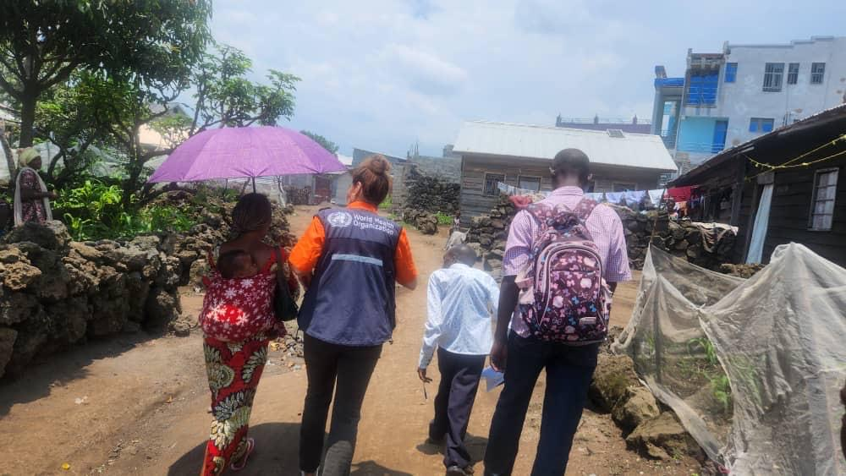
IPC & WASH measures for home care and isolation in resource-limited settings
Waste management
Waste (used PPEs, bandages) should be disposed of in sealed waste bag through centralized waste collection and disposal systems
Or burn and bury in protected pit
Keep the waste away from animals and humans
Wear appropriate PPEs while handling waste
Practice hand hygiene
Image source: A.Baller, WHO
Infection prevention and control and water, sanitation and hygiene measures for home care and isolation for mpox in resource-limited settings

Slide 8
Key Messages
Assess if the person with mpox is suitable for home care and isolation. Persons with mild, uncomplicated mpox may be isolated and receive care at home. Children under 5 years old should be cared for in a health facility as they are considered at higher risk for complications.
If a separate room is unavailable for isolating the person with mpox, designate a specific area within the shared space for this purpose.
Persons with mpox and their contacts should practice frequent hand hygiene and cleaning and disinfection of environment.
Health and care workers should have training and required supplies (PPE, alcohol-based handrub) prior to entering the households of persons with mpox. If these are not available health and care workers should avoid entering the houses and should maintain at least a 1 metre distance from the person with mpox.
Authorities should ensure access to safe water, sanitation, hygiene (soap and water) and waste disposal for persons with mpox and their family members during home isolation.
When resources are limited, consider strategies that do not exacerbate existing infrastructure issues. For example, an IPC strategy heavily focused on disposable PPE is not suitable if local safe waste disposal services are inadequate.
Infection prevention and control and water, sanitation and hygiene measures for home care and isolation for mpox in resource-limited settings

Slide 9
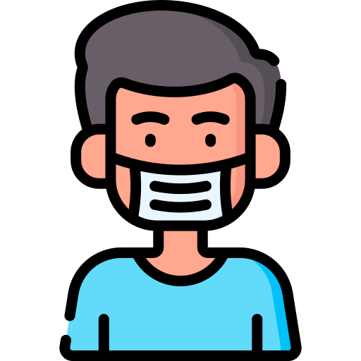
Reminders for CHW/ CV: How to protect yourself during an mpox outbreak
Stay informed about the risk of mpox in your community. Know the symptoms and check yourself regularly.
Refrain from close contact with individuals who have mpox. If close contact cannot be avoided, appropriate personal protective equipment should be worn.
Do not share items, such as bedding, clothing, utensils, cups or towels, with someone who is sick.
Seek health advice and monitor closely for signs and symptoms for 21 days if exposed: Get tested if you have signs or symptoms compatible with mpox.
If you do develop signs or symptoms of mpox, put on a mask, wash hands, and cover lesions then seek medical care. Isolate from others until symptoms are no longer present.
Follow the guidance of your health care provider or national public health authority when diagnosed with mpox.
For complete list, refer to: https://cdn.who.int/media/images/default-source/health-topics/monkeypox/mpox-what-we-know-infographic-thumb.jpg?sfvrsn=6849f684_5
Notes:
Included in Module 1, or include in Annex
https://cdn.who.int/media/images/default-source/health-topics/monkeypox/mpox-what-we-know-infographic-thumb.jpg?sfvrsn=6849f684_5

Slide 10
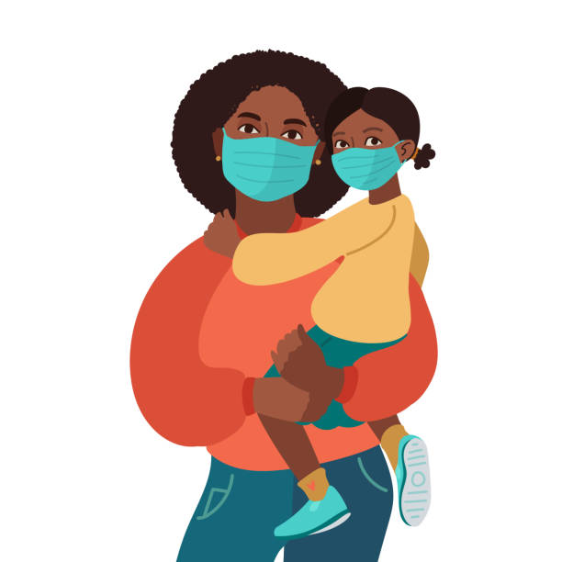
CHW role in home care and isolation
Always coordinate closely with local health authorities and staff in activities
Offer compassionate, respectful and people-centred care and counselling to people affected by mpox and their designated caregiver (when applicable).
Utilize community organizations as support in educating and raising awareness
Work with local health authorities to ensure available PPE to be used when needed.
Prepare and take with you supplies (e.g. PPE, alcohol-based handrub) for yourself and to leave with the household.
Always wear the appropriate PPE if you need to enter the isolation space of a person with mpox.
The ‘Infection prevention and control and water, sanitation and hygiene measures for home care and isolation for mpox in resource-limited settings’ provides a detailed overview of how home care and isolation can be safely done.
Notes:
Make language active, conversational, straightforward

Slide 11
CHW/CV roles to support mpox response
Community-based surveillance
  Understand community case definitions
  Detecting and notifying signals
  Contact tracing (if part of country protocol)
  Reporting cases through SMS or other methods
Home care and IPC
  Educating patients and their caregivers on handwashing, laundry, WASH, preparing disinfectant, waste management
  Support home monitoring (if part of country protocol)
RCCE-IM
  Delivering messages
  Support RCCE activities e.g. social listening, community feedback and community engagement
Community MHPSS
  Basic psychosocial support (BPS) and Psychological first aid (PFA)
Community-based health care and coordination
  Identifying warning signs
  Supporting other public health services
  Timely referral
  Support coordination with other community sectors
Community Detection and Response for Mpox: Training for Community Health Workers and Community Volunteers (WHO, 2024)

Slide 12
Safe at Home: IPC & WASH measures for home care and isolation in resource-limited settings
View EPI-WIN Webinar “Safe at home – IPC & WASH measures for home care and isolation in resource-limited settings”
Useful links:
  Infection prevention and control and water, sanitation and hygiene measures for home care and isolation for mpox in resource-limited settings (WHO, 2024)
Speakers
  Victoria Willet, WHO Health Emergencies Programme. IPC & WASH Team
  Lester Sam A Geroy, Consultant, Community Readiness and Resilience, WHO Geneva

