Slide 1
Making infodemic management operational in countries
1 August 2024

Slide 2
What is infodemic management?
An infodemic is too much information including false or misleading information in digital and physical environments during a disease outbreak.
  It causes confusion and risk-taking behaviours that can harm health. It also leads to mistrust in health authorities and undermines the public health response.
Infodemic management is the systematic use of risk- and evidence-based analysis and approaches to manage the infodemic and reduce its impact on health behaviours during health emergencies.
Building trust with communities is key to building trust.
Risk communication, community engagement and infodemic management are the core of community protection, one of the essential pillars of Health Emergency Preparedness and Response
The presentations are best practices in countries and Regions featuring a wide variety of frameworks, approaches and activities.

Slide 3
Infodemic management in WHO
Programmatic response

Slide 4
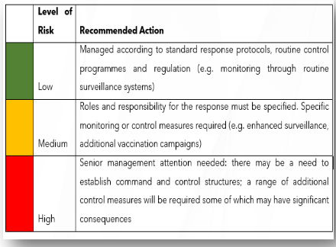

Qatar experience during Covid-19 and FIFA World Cup
Capturing of Signals | Management of Infodemics | Challenging Rumors
Data/Information from several sources are triaged, investigated and categorized into 3 levels. Use of technologies such as the EIOS enhanced social listening Early detection of signals and rumors that affects the public opinion. If there’s potential threat to Public Health, Immediate action is implemented. | MoPH releases public announcements through reliable social media channels, social influencers, or public health leaders, etc. Dedication of a spokesperson to respond to public rumors & misinformation MoPH monitoring of misleading Information | Advocacy for policies that regulate the spread of misinformation. Coordination and collaboration within MOPH and with external public & private institutions

Slide 5
Thailand experience: Procedures for responding to information about diseases and disaster

Slide 6
Thailand Emergency Risk Communication Model
Dr Sumanee Wacharasint, MD. Department of Disease Control, Ministry of Public Health Thailand.

Slide 7
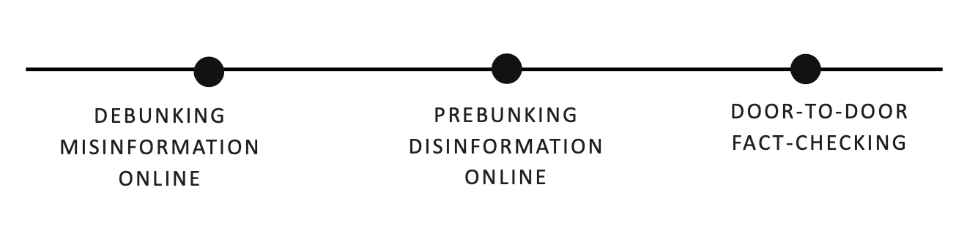

Georgia experience in partnerships
Partnerships in key activities
Partnership with MOH and NCDC
A WhatsApp Line to verify information (MoH & NCDC)
A weekly disinformation newsletter distributed to MoH & NCDC
Amplifying the content that was produced and published by NCDC

Slide 8
Capacity building in the Pacific Islands

Slide 9
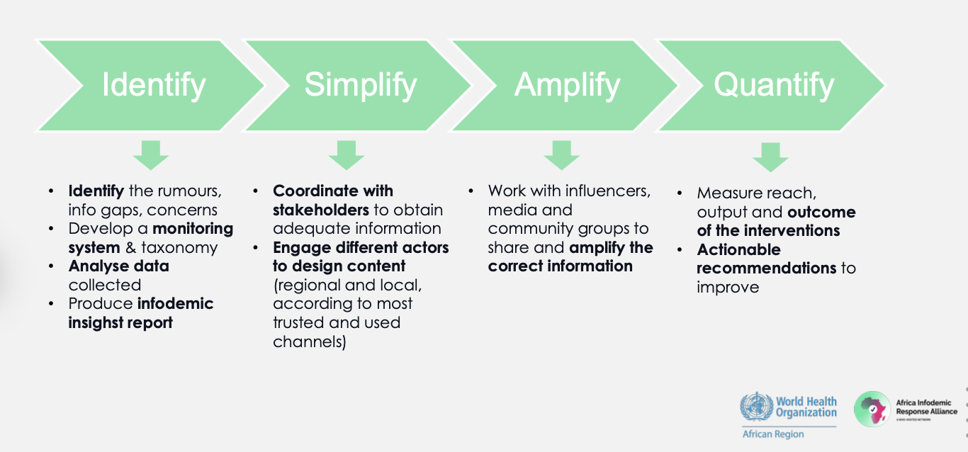
Approaches of the
Africa Infodemic Response Alliance (AIRA)
5 Pillars of Intervention
Strategic coordination
Social listening
Research
Content creation
Country support

Slide 11
Useful links
Infodemic management 101 course
Infodemic Management: Addressing health misinformation
Infodemic Management: Developing an infodemic insights report
Infodemic Management: Social marketing and message testing methods
Infodemic Management: Defining a taxonomy for social listening
Infodemic Management: Using human-centered design good practices
Infodemic Management: Working effectively as an infodemic manager in the field

Slide 12
https://bit.ly/flashsubscribe

Slide 13
EPI-WIN webinar
Listen to “Making infodemic management operational in countries”, 1 August 2024
Presentations:
  Dr Soha Albayat, MoPH, Qatar
  Dr Sumanee Wacharasint, MD., MoPH Thailand
  Mariam Tsitsikashvili, FactCheck Georgia
  Lenka Dojcanova, Division of Pacific Technical Support (DPS), WHO
  Rocio Lopez, Africa Infodemic Response Alliance (AIRA)

