Slide 1
WHO MERS-CoV Investigation Protocols: An Introduction
7 October 2024

Slide 2
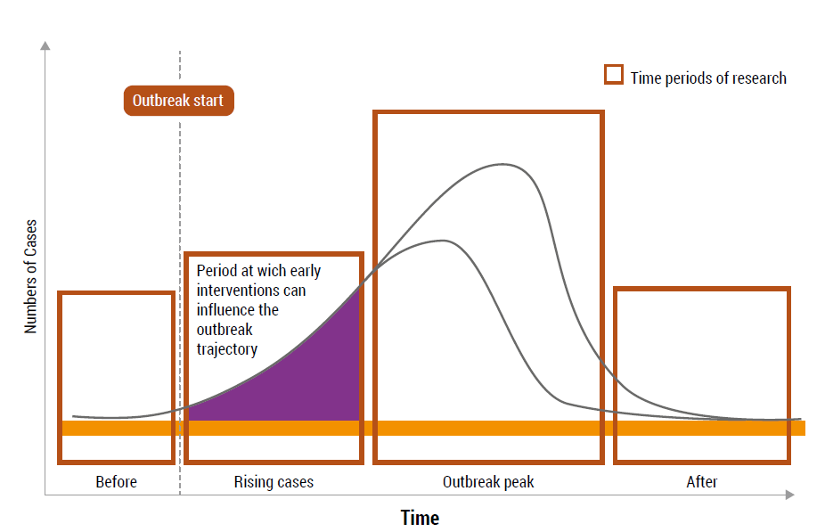
MERS-CoV Investigation Protocols
The MERS-CoV Protocols is one of the Respiratory Pathogen Template Protocols developed under “UNITY Studies” Respiratory Investigation Studies.
  These are ready “champion” approach that includes fast-track networks to rapidly implement investigation as part of pandemic preparedness and emergency response
  The templates include: key questions, key generic protocols, and key sites after, before and during the next pandemic.
  The other protocols are: Influenza template protocols and Covid-19 template protocols
  The UNITY protocols provided a standardized and timely international investigation framework during the Covid-19 pandemic.

Slide 3
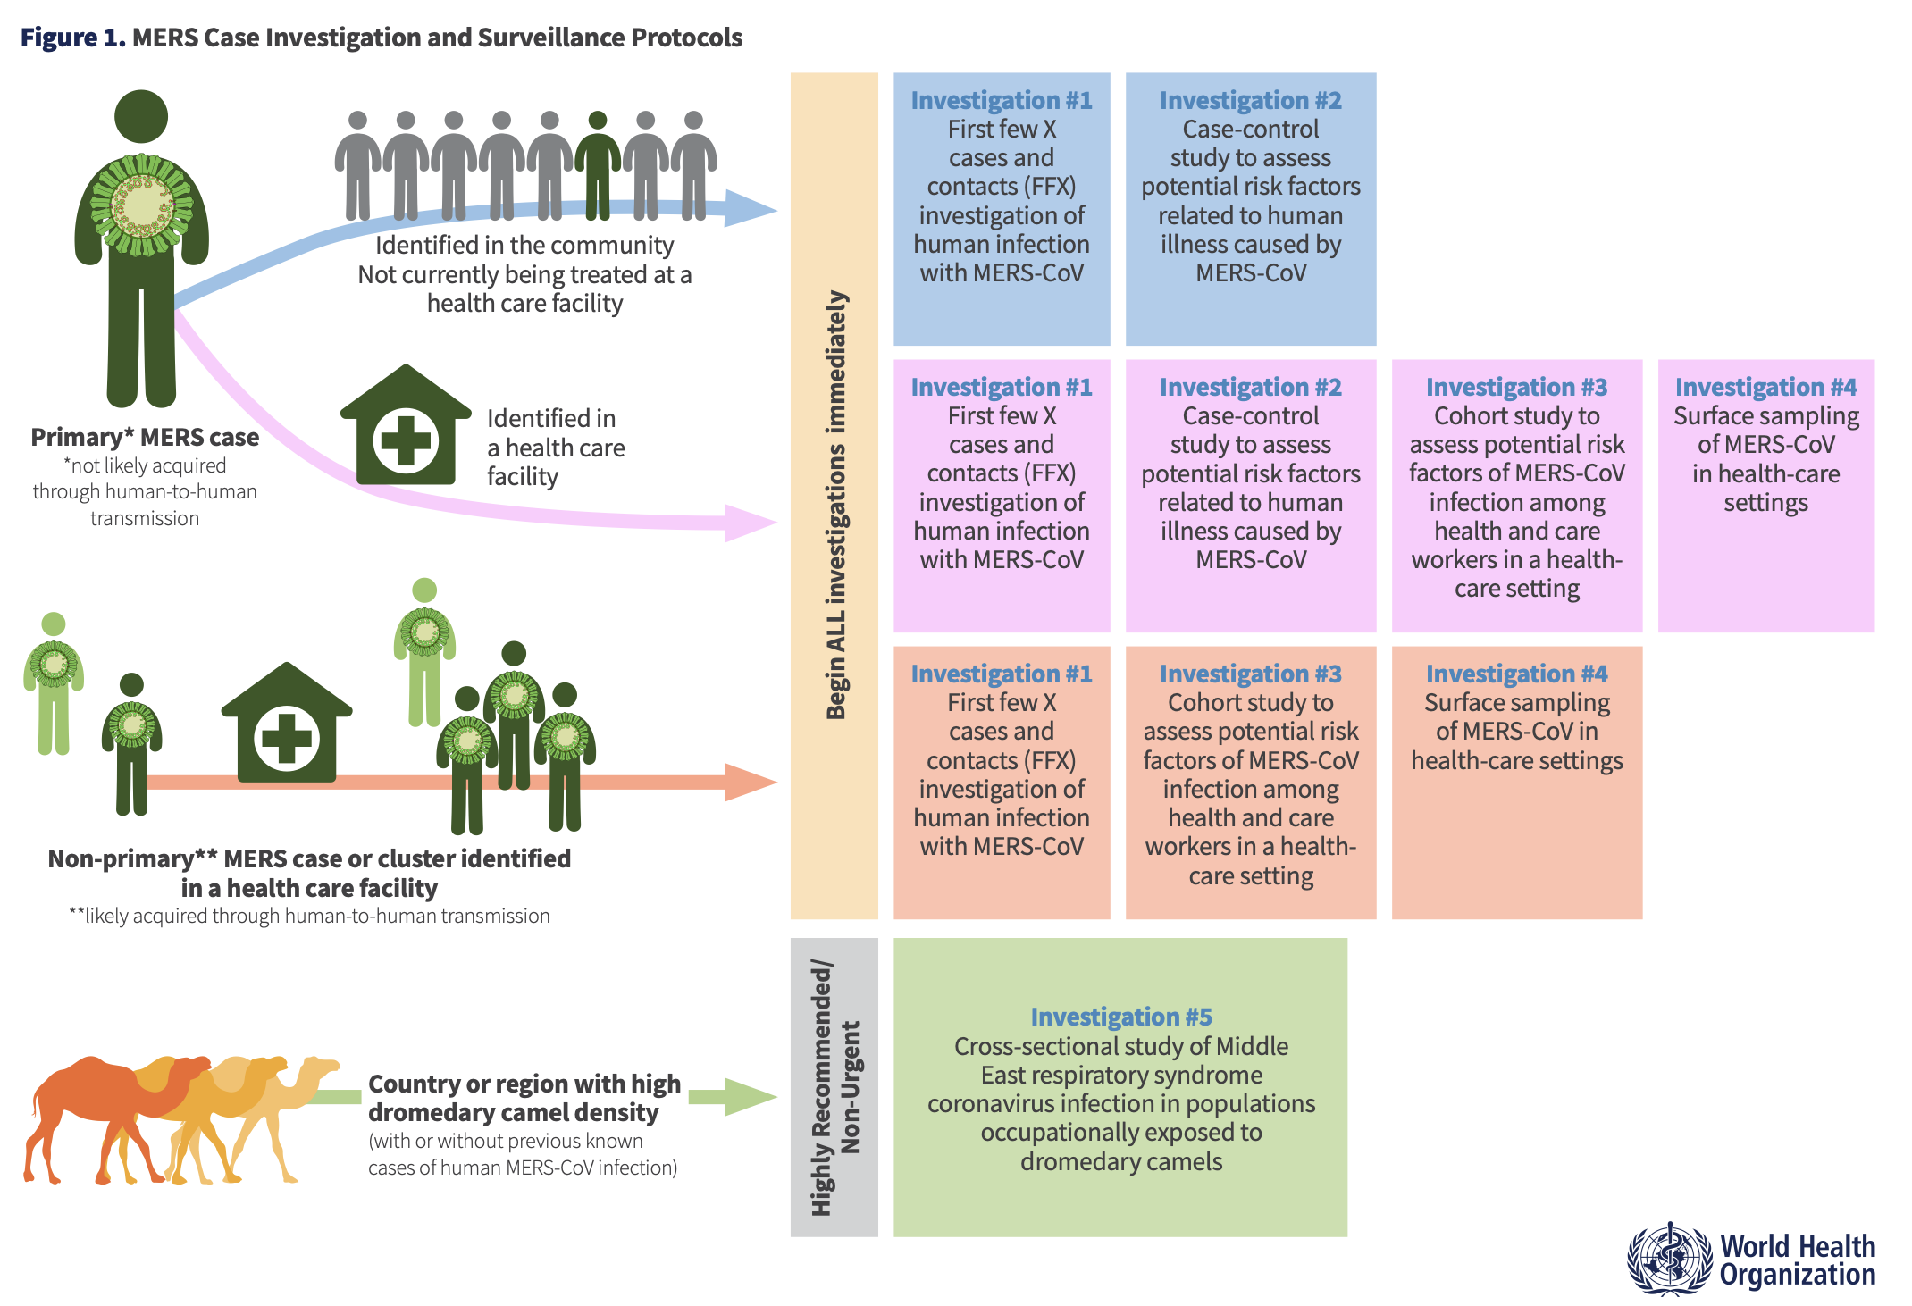
How to use the MERS-CoV Investigation Protocols
The first step is to identify and select the investigation you need.
The protocol includes case studies that investigators can use in selecting the appropriate methodology.
It is best that protocols are pre-approved for faster adaptation and implementation when needed.
Image found in “How to conduct surveillance and investigations of human infection with MERS-CoV using WHO’s Investigations and Studies (Unity Studies 2.0) protocols”

Slide 4
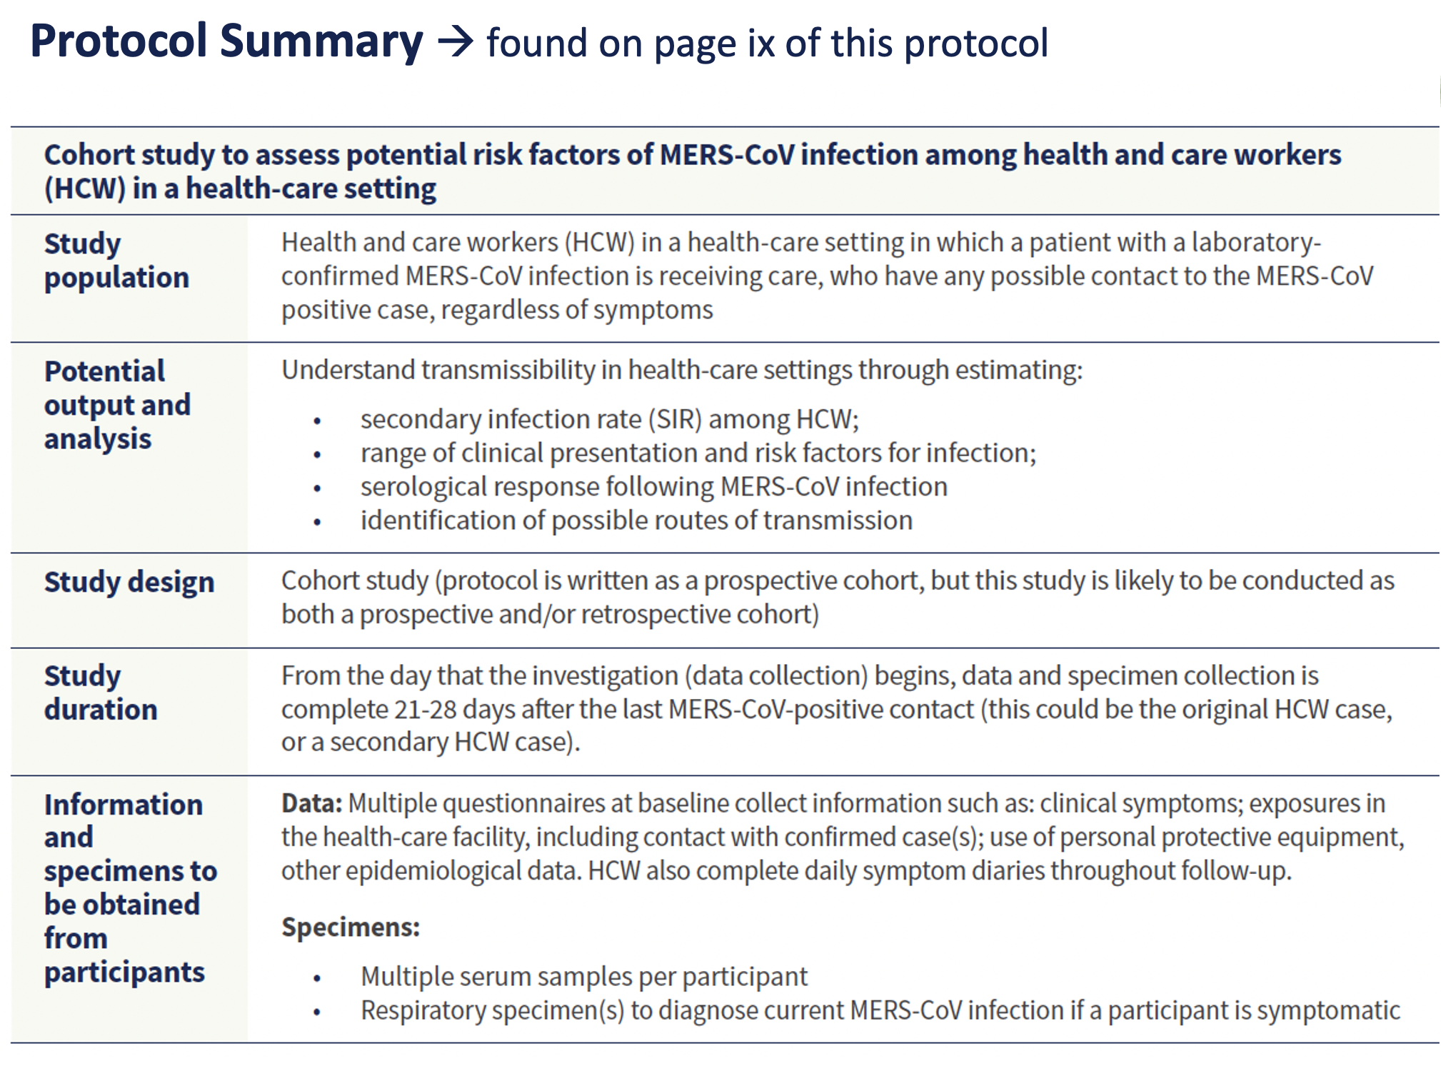
Once an investigation is selected, users can refer to protocol summaries
Implementation tips:
Modify language – reflect an operational protocol rather than a guidance
Adjust for your context
Remove irrelevant sections & add required sections or further methods of interest

Slide 5
Protocol structure and adaptation
Scientific background and rationale
  Is it up-to-date?
  Add current situation, regional details
  Objectives to add or remove?
Methods
  Specify actual setting, timing, population, estimated number of persons, laboratory tests being used, etcetera
  Adapt ‘ideal’ methods to situation (e.g. retrospective aspects)
Statistical analysis
  This section contains guidance. Use finalized study methods to create a detailed statistical analysis plan with a trained statistician and/or epidemiologist – prior to the study start!
Dissemination of results
  Use prompts and ideas in this section to create a dissemination plan
Composition of study team
  Based on finalized study plan, who else is needed on the team?
  Include collaborators (e.g. statisticians) from earliest stages
Annex 2: Questionnaires
Add and/or remove questions as per final study objectives (and feasibility, appropriateness)
Adapt response options to local context

Slide 6
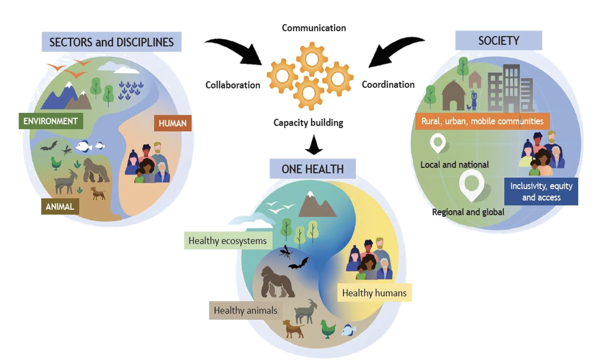
One Health Concept in MERS-CoV investigation protocols design and implementation
Goal
To assemble and unify the different methods, tools, and strategies driven by the various bodies of scientific knowledge using the One Health approach, to eventually standardize the investigations of MERS-CoV
Objectives
To obtain better (and as early as possible) understanding of the zoonotic spill over
To facilitate the understanding of the epidemiological characteristics of the outbreak
To recommend one heath ,evidence based prevention and control measures
1 The One Health definition developed by the OHHLEP states

Slide 7
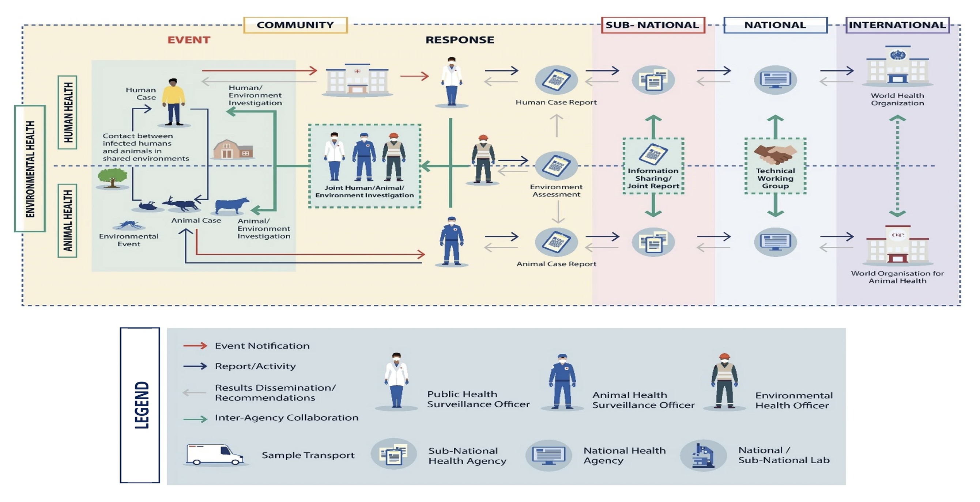
One Health Framework in the investigation of zoonotic diseases
Ghai, R.R., Wallace, R.M., Kile, J.C. et al. A generalizable one health framework for the control of zoonotic diseases. Sci Rep 12, 8588 (2022). https://doi.org/10.1038/s41598-022-12619-1

Slide 8
Requirements for efficient and effective One Health implementation of the protocol
Capital
Efficient multidisciplinary team structure
Support
Logistical
Operations
Joint and Timely investigation and analysis
Adequate resources
Governance , TORs ,Roles and Responsibilities
Global parternships
In advance Country Quadripartite agreement and endorsements
In advance ethical approval form both the human and Animal health
Political
Use of technology
Accessibility
Data sharing
One Bucket approach
Laboratory
Community engagement and participation
Collaborative approach to teamwork
Systematic approach to investigation
High quality and valid samples
Investigation Quality measures
Early notification to international agencies
Piloting ,training , top tabletop exercise , integration to RRT ,FETP

Slide 9
Kingdom of Saudi Arabia: Adapting Unity Study Questionnaires to local contexts
Camel Market Filed Pilot Study
Purpose of Pilot Study:
Pre-test of the questioner was conducted to enhance reliability and validity.
Place of The Study:
Taif is a city and one of the governorates of Makkah in Saudi Arabia. It is located at an elevation of 1,879 m (6,165 ft) in the slopes of the Hijaz Mountains, part of the Sarat Mountains. The city has a population of 563,282 people in 2022. It was chosen because it is known for its camel farms, camel markets, camel festivals, and camel auctions.
Methodology:
The three questionnaires had similar contents, so we created a table that includes suggested questions based on the questionnaire. Also, face-to-face questionnaires were conducted.
A trained Interviewer asked the questions in Arabic and in English. Participants were chosen based on their willingness (convenient sampling).
Number of participants were 23. These included: camel owner, camel farm worker, camel market worker, abbatoir worker and abbatoir owner.

Slide 10
Kingdom of Saudi Arabia: Factors influencing Responses to the Questionnaire
Cultural Context:
  KSA has a deep-rooted cultural relationship with camels, including their use in traditional practices, which may influence perceptions and knowledge about zoonotic diseases.
Familiarity with MERS-CoV:
  In KSA, MERS-CoV is more prominent due to its origins and prevalence in the region. Workers here may have a heightened awareness due to local outbreaks.
Healthcare Access:
  Availability and accessibility of healthcare services can affect attitudes toward disease prevention.
Regulatory Environment:
  Government policies, regulations regarding animal health, and public health campaigns may play a role in shaping responses.
Religious Beliefs:
  In KSA, the cultural and religious significance of camels might lead to differing practices and beliefs regarding health and disease, impacting how risk is perceived and managed compared to other cultures.
Personal Experiences:
  Individual experiences with MERS-CoV, whether through exposure, knowledge of outbreaks, or personal health experiences, could significantly influence how people respond to questionnaires in any context.

Slide 11
Kingdom of Saudi Arabia: Raising awareness among local investigators for the WHO MERS-CoV Unity Studies
Organizing workshops and training sessions
  For local investigators to educate them about the MERS-CoV Unity Study protocols, their significance, and proper implementation.
Collaborations with Key Stakeholders:
  Engaging with local health authorities, universities, and research institutions to promote the Unity Study.
  Can help leverage existing networks to disseminate information more widely.
Information Dissemination:
  Utilizing various communication channels, such as webinars, newsletters, and social media, to provide updates and information about the study protocols.
Incentivizing Participation:
  Offering incentives for local investigators to participate in the study, such as funding for research projects, access to data, or acknowledgment in published findings.
Continuous Engagement:
  Maintaining ongoing communication and support for local investigators throughout the study.
Building Research Capacity:
  Investing in building research capacity within local institutions through training and resources, enabling them to better understand and implement MERS-CoV study protocols.
Showcasing Success Stories:
  Highlighting successful collaborations or outcomes from the study to encourage further participation and demonstrate the value of the Unity Study for public health.

Slide 12
EPI-WIN webinar
View webinar “WHO MERS-CoV Investigation Protocols – An Introduction”
Speakers
  Sophie von Dobschuetz – WHO Technical Lead MERS-CoV and novel CoVs Unit Head, Emerging Diseases and Zoonoses
  Anna Funk - WHO Consultant, University of Calgary
  Dr Elmoubasher Farag – OHHLEP
  Dr Ezzuddin A Okmi – Director of Respiratory Infection Prevention at PHA, Kingdom of Saudi Arabia

