Slide 1
One Health Intelligence: Global Collaboration for Emerging Health Threat Detection
28 November 2024

Slide 2
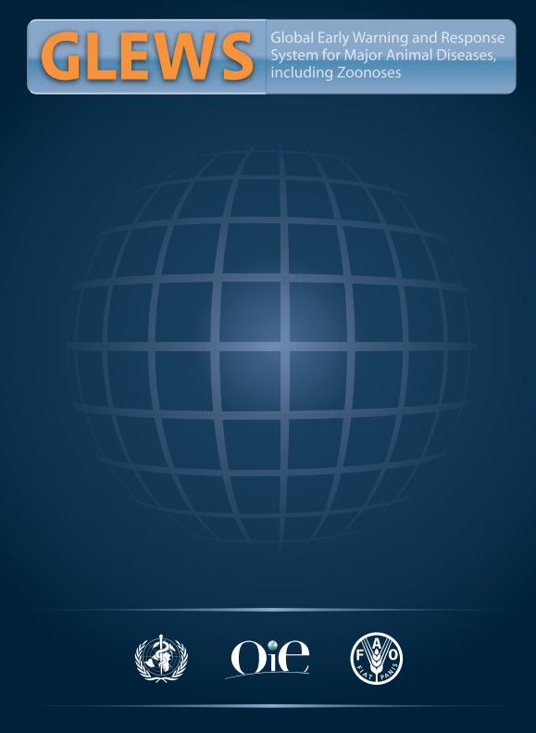
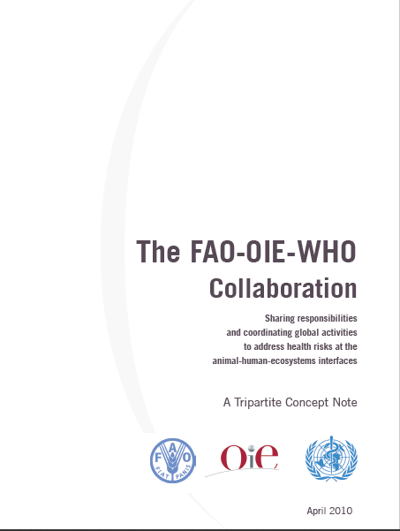
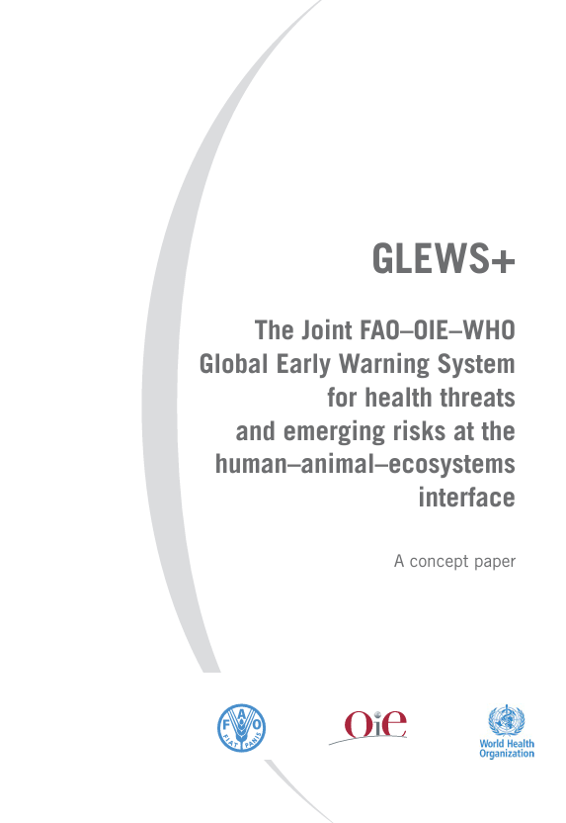
Tripartite FAO-WHO-WOAH collaboration in OHI
GLEWS, Global Early Warning and Response System for Major Animal Diseases, including Zoonoses, to consolidate, develop, and use cooperation and efficiency to address health threats
Concept note to prevent further pandemics of zoonoses and AMR through a strengthened "One Health approach“
GLEWS+, Global Early Warning System for health threats and emerging risks at the human-animal-ecosystem interface
GLEWS
February 2006
Tripartite Concept Note
April 2010
GLEWS+
June 2012

Slide 3
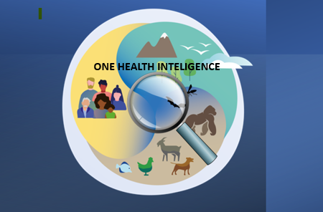
OBJECTIVE OF GLEWS+
The Joint FAO-WHO-WOAH Global Early Warning System (GLEWS+) for health threats and emerging risks at the human-animal-ecosystem interface
Enhance the detection of health threats at the human-animal-ecosystem interface
Monitor disease events to predict changes in endemic/ seasonal diseases, identify associated drivers and guide prevention
Conduct joint risk assessments for rapid action on acute health events of potential international concern
Ensure timely coordinated risk communication:
  within and across the three organizations,
  with Member countries, the public, and the international community.
GLEWS+
A GLEWS+ ‘event’ is a health event of potential international concern affecting domestic or wild animal populations, humans or the food chain.

Slide 4
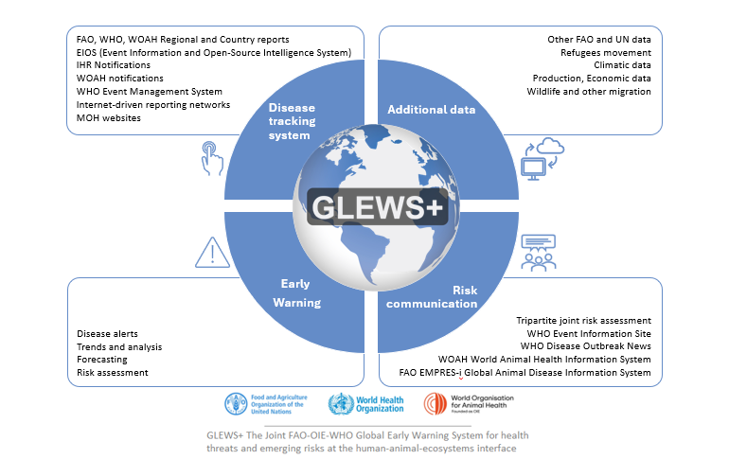
GLEWS+ work
A global disease early tracking and warning system that formally links One Heath Intelligence among human and animal public health
Global One Health Disease Intelligence under GLEWS+

Slide 5
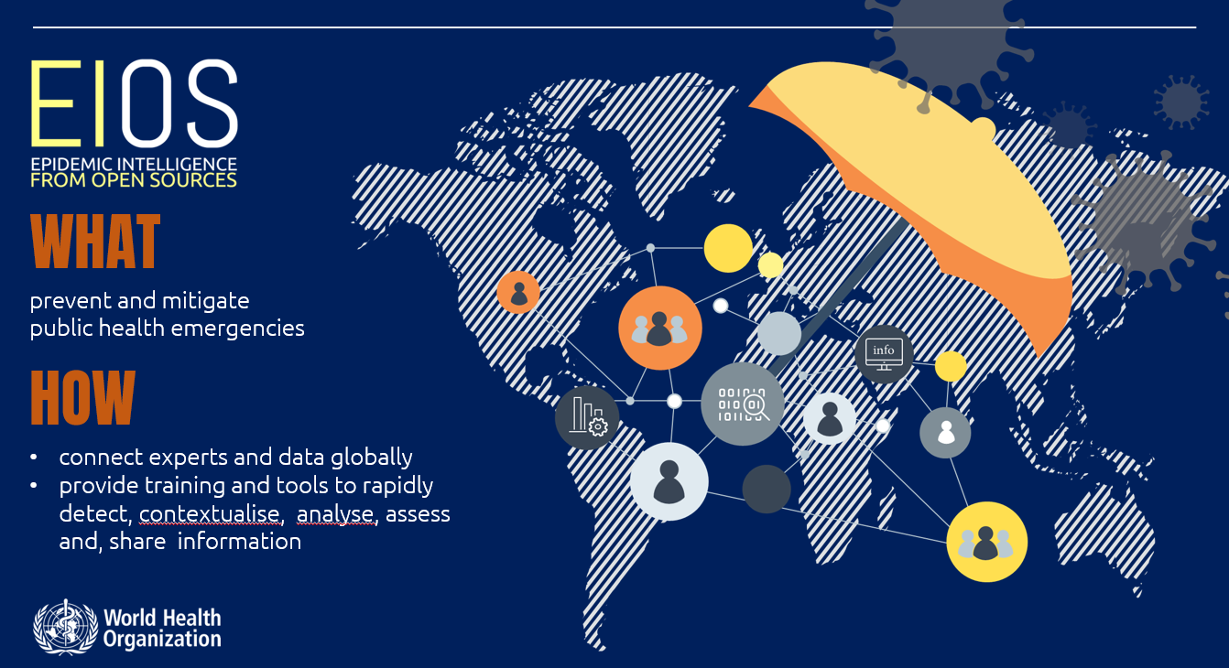
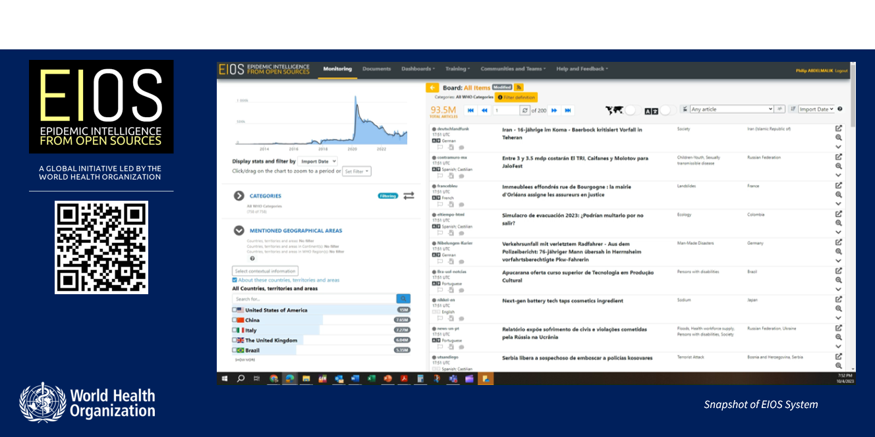
EIOS-Epidemic Intelligence from Open Source
Innovating and integrating Open-Source Public Health Intelligence thought community and technology
Detection-identification of health threat
Each organization has internal alert mechanisms to detect and verify potential health threats through their communication channels
Daily event-based surveillance (EBS) using the EIOS initiative.

Slide 6
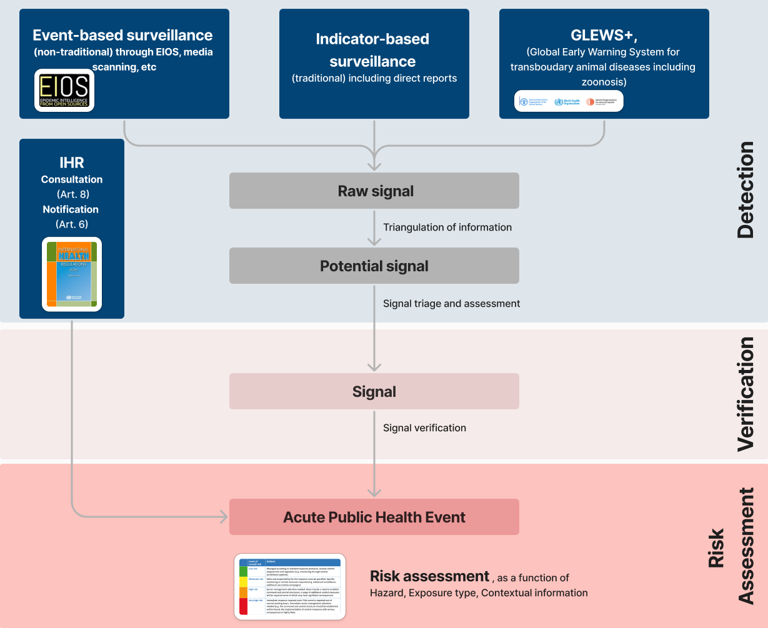
“GLEWS +” feeds WHO standard Public Health Intelligence practices
~13,000,000
pieces of information
~1,300,000
raw signals
~1,500
signals
40 events
risk assessed
https://www.who.int/news-room/events/detail/2024/10/31/default-calendar/who-epi-win-webinar-global-public-health-intelligence-who-operational-practices

Slide 7
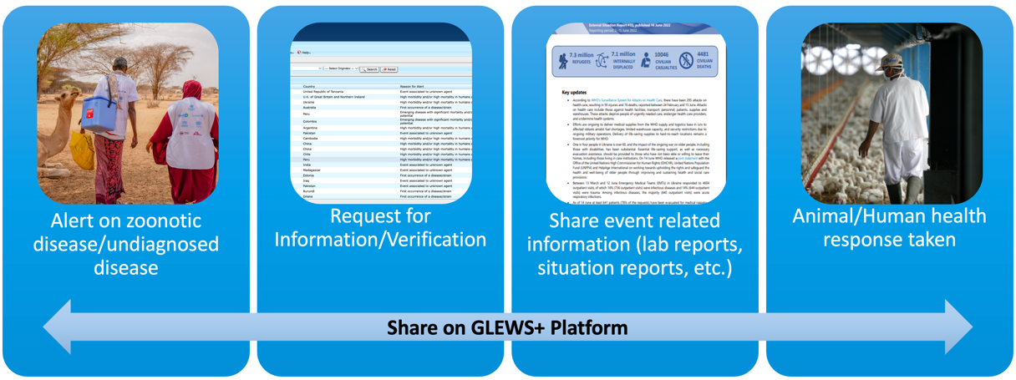
What triggers GLEWS+:
High morbidity and/or high mortality in humans and/or animals
Emerging disease with significant mortality and/or morbidity or zoonotic potential
Event associated with an unknown agent
First occurrence of a disease/strain
Reoccurrence of a disease/strain
From detection to early warning: GLEWS+ key functions
Information is shared securely through the GLEWS+ platform and remains confidential
Verification requests are sent to regional/national offices for reported events
Verified events are assessed and shared with technical teams
Tripartite Joint Risk Assessments (JRA) are conducted

Slide 8
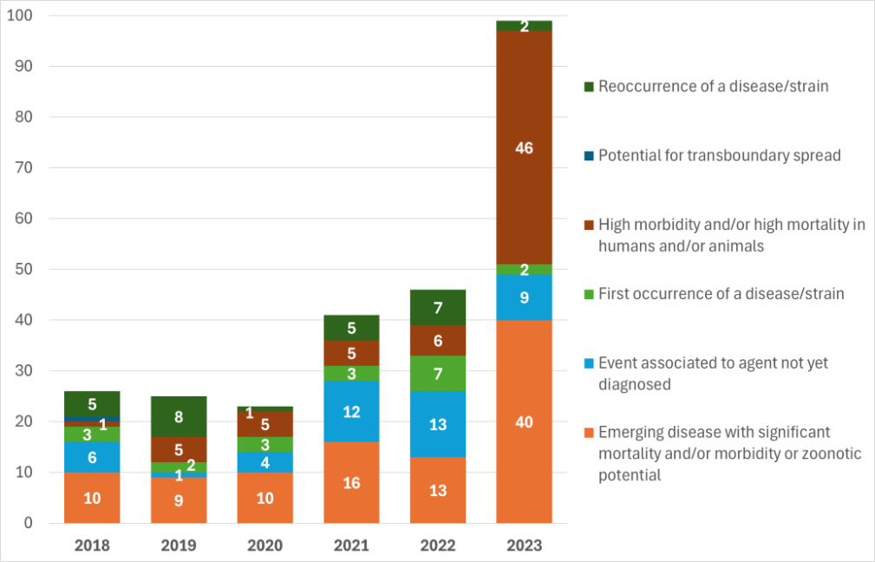
Reason for early warning 2018-2023
Emerging diseases with high mortality/morbidity or zoonotic potential, 38%. ​
High morbidity and/or high mortality in humans and/or animals, 27%.​
Event associated with the agent not yet diagnosed, 18%.​
Reoccurrence of a disease strain, 11%.​
First occurrence diseases/strain, 7%.
Distribution of disease related to different reasons on GLEWS+ platform

Slide 9
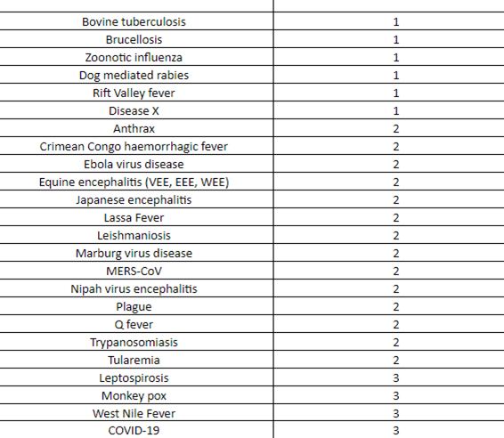
Diseases are grouped into three categories:
Priority GLEWS + zoonotic diseases
Category 1: diseases with a high impact on animal and/or human health
Category 2: diseases with a high impact on human health and a low impact on animal health
Category 3: diseases with a high impact on public health in an outbreak situation

Slide 10
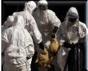
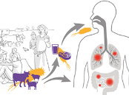
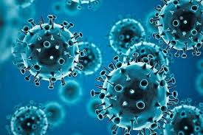
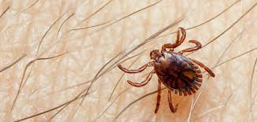
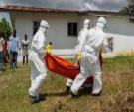
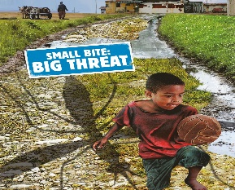
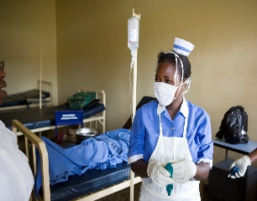
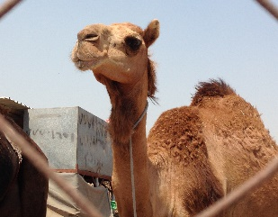
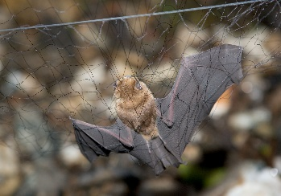
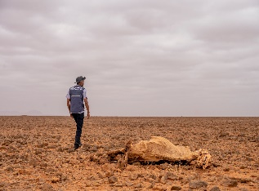
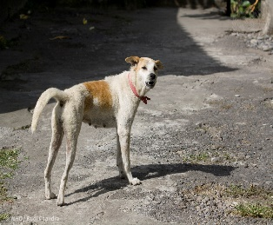
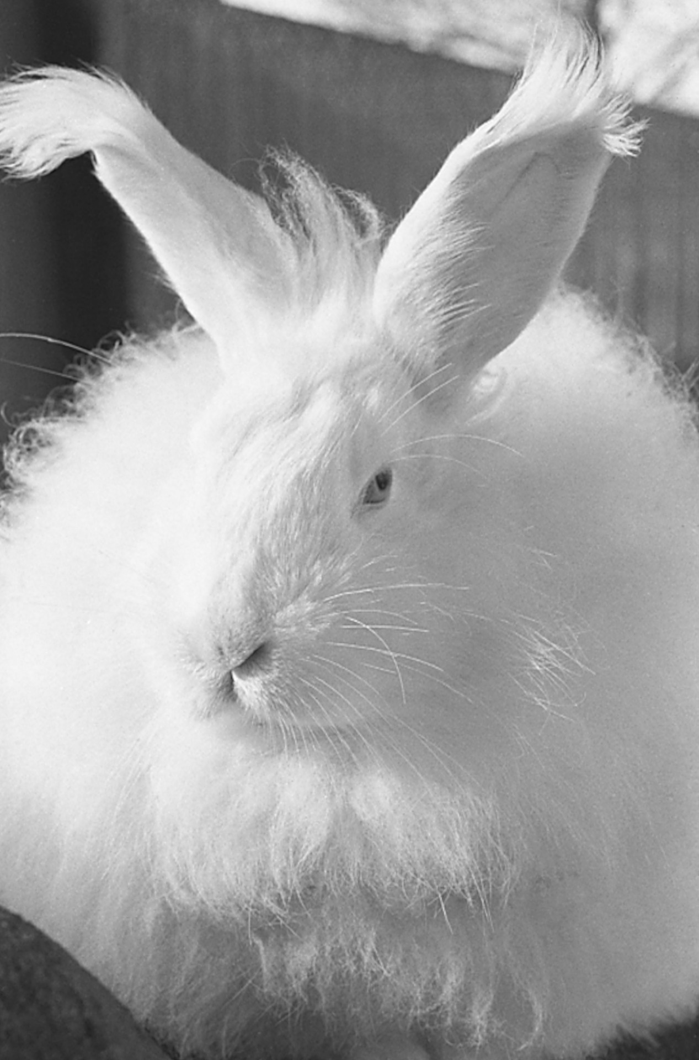
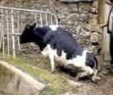
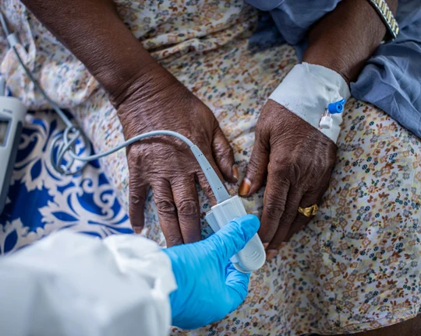
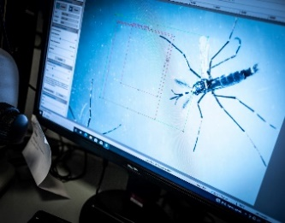
Events 2018-2023
- 243 Verification request
- 172 Confirmed events
- 71 False rumors
- Avian influenza mainly H5
- 62 events (26 %) reported as unknown etiology were later identified
GLEWS+ top 15 diseases identified
29%
Avian influenza
Anthrax
COVID-19
CCHF
Ebola
17%
Equine Encephalitis
Marburg
MERS
Nipah
RVF
26%
Rabies
Tularemia
Q Fever
Unknown cause
WNV
WHO Photo Library

Slide 11
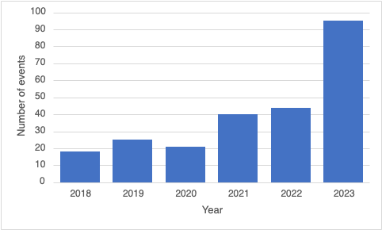
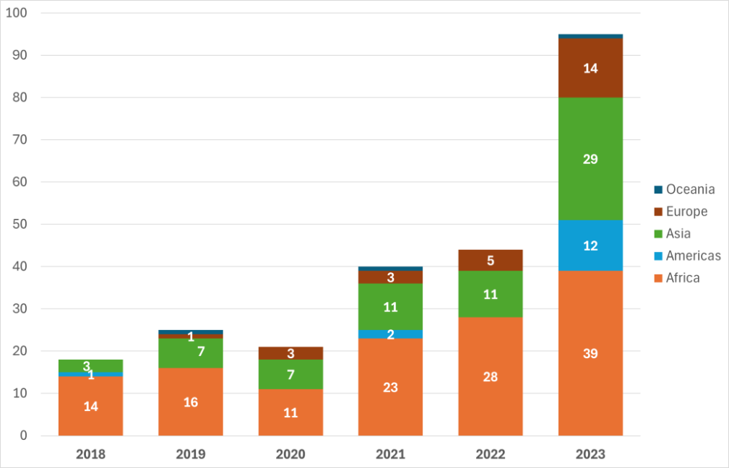
Annual trend in confirmed events
GLEWS+ recorded a significant increase in events
Confirmed events
Regional distribution of confirmed events
Majority, 54% of health threats in Africa​
Asia 28%
Europe 11%
Americas 6%
Oceania 1%

Slide 12
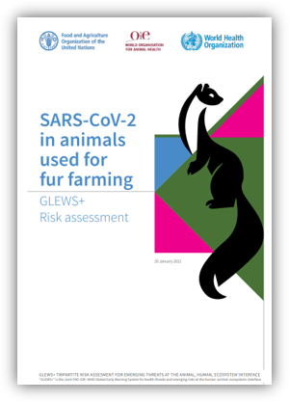
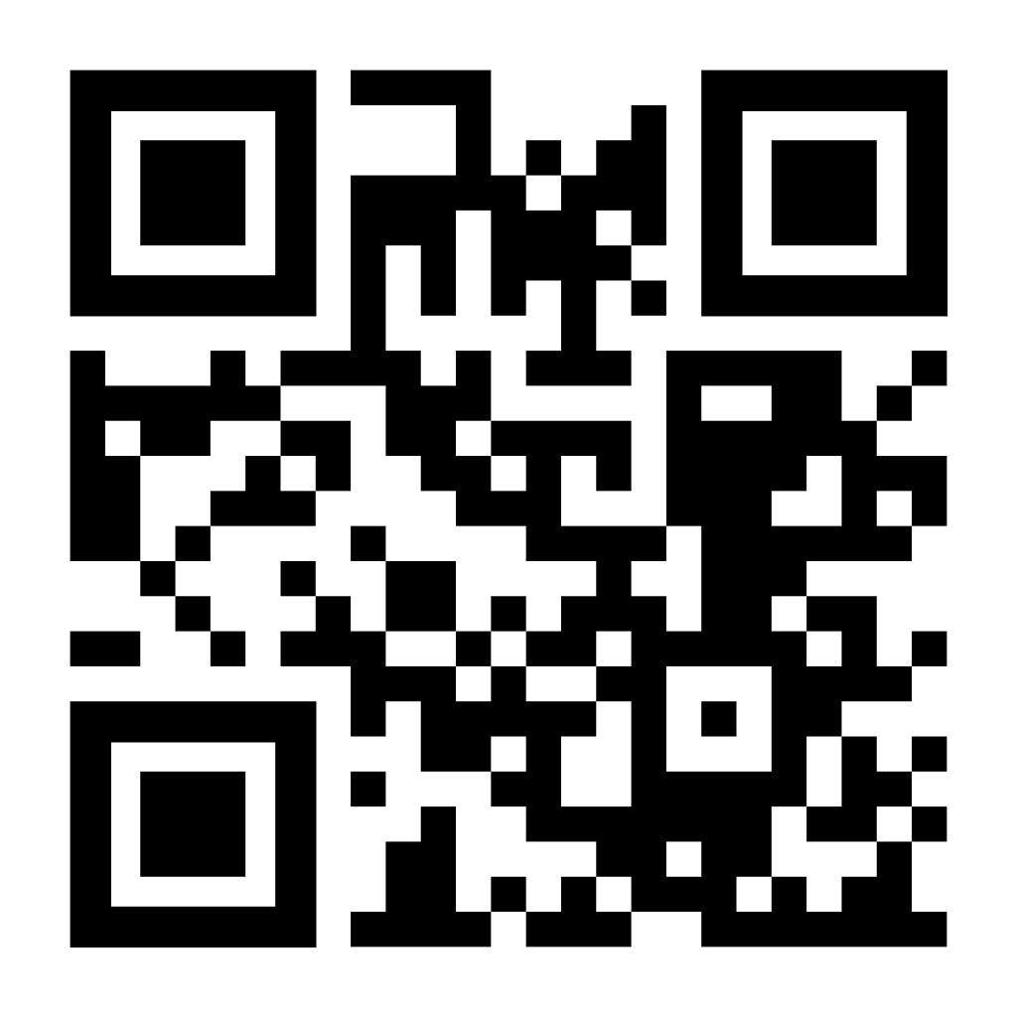
GLEWS+ Tripartite ​Joint Risk Assessments (TJRA)
Tripartite Joint Risk Assessments (TJRAs) offer a unique cross-sectoral approach for conducting comprehensive risk assessments on zoonotic events with endemic or pandemic potential ​
These assessments focus on developing risk management strategies across human, animal, and environmental health sectors under the One Health framework. ​
TJRAs enhance collective early warning and response capacities by integrating the alert and response mechanisms of FAO, WHO, and WOAH.
The majority are confidential, but some are public

Slide 13
EPI-WIN webinar
View webinar “One Health Intelligence: Global Collaboration for Emerging Health Threat Detection”
Speakers
  Dr. Maria Van Kerkhove, WHO
  Dr. Montserrat Arroyo, WOAH
  Dr. Dubravka-Dunja Selenic, WHO
  Dr. Ismaila Seck, FAO
  Dr. Itlala Gizo, WOAH
  Dr. Madhur Dhingra, FAO
For more information, please contact:
Dr Dubravka (Dunja) Selenic Minet, DVM, MSc, MPH
Team Lead (a.i), Risk assessment and EIS team
WHO GLEWS + Focal point
Public Health Intelligence (acute events)
Alert & Response Coordination, WHO HQ
selenicminetd@who.int

