Slide 1
New guidelines for Mpox: Clinical management and infection prevention and control
23 June 2025

Slide 2
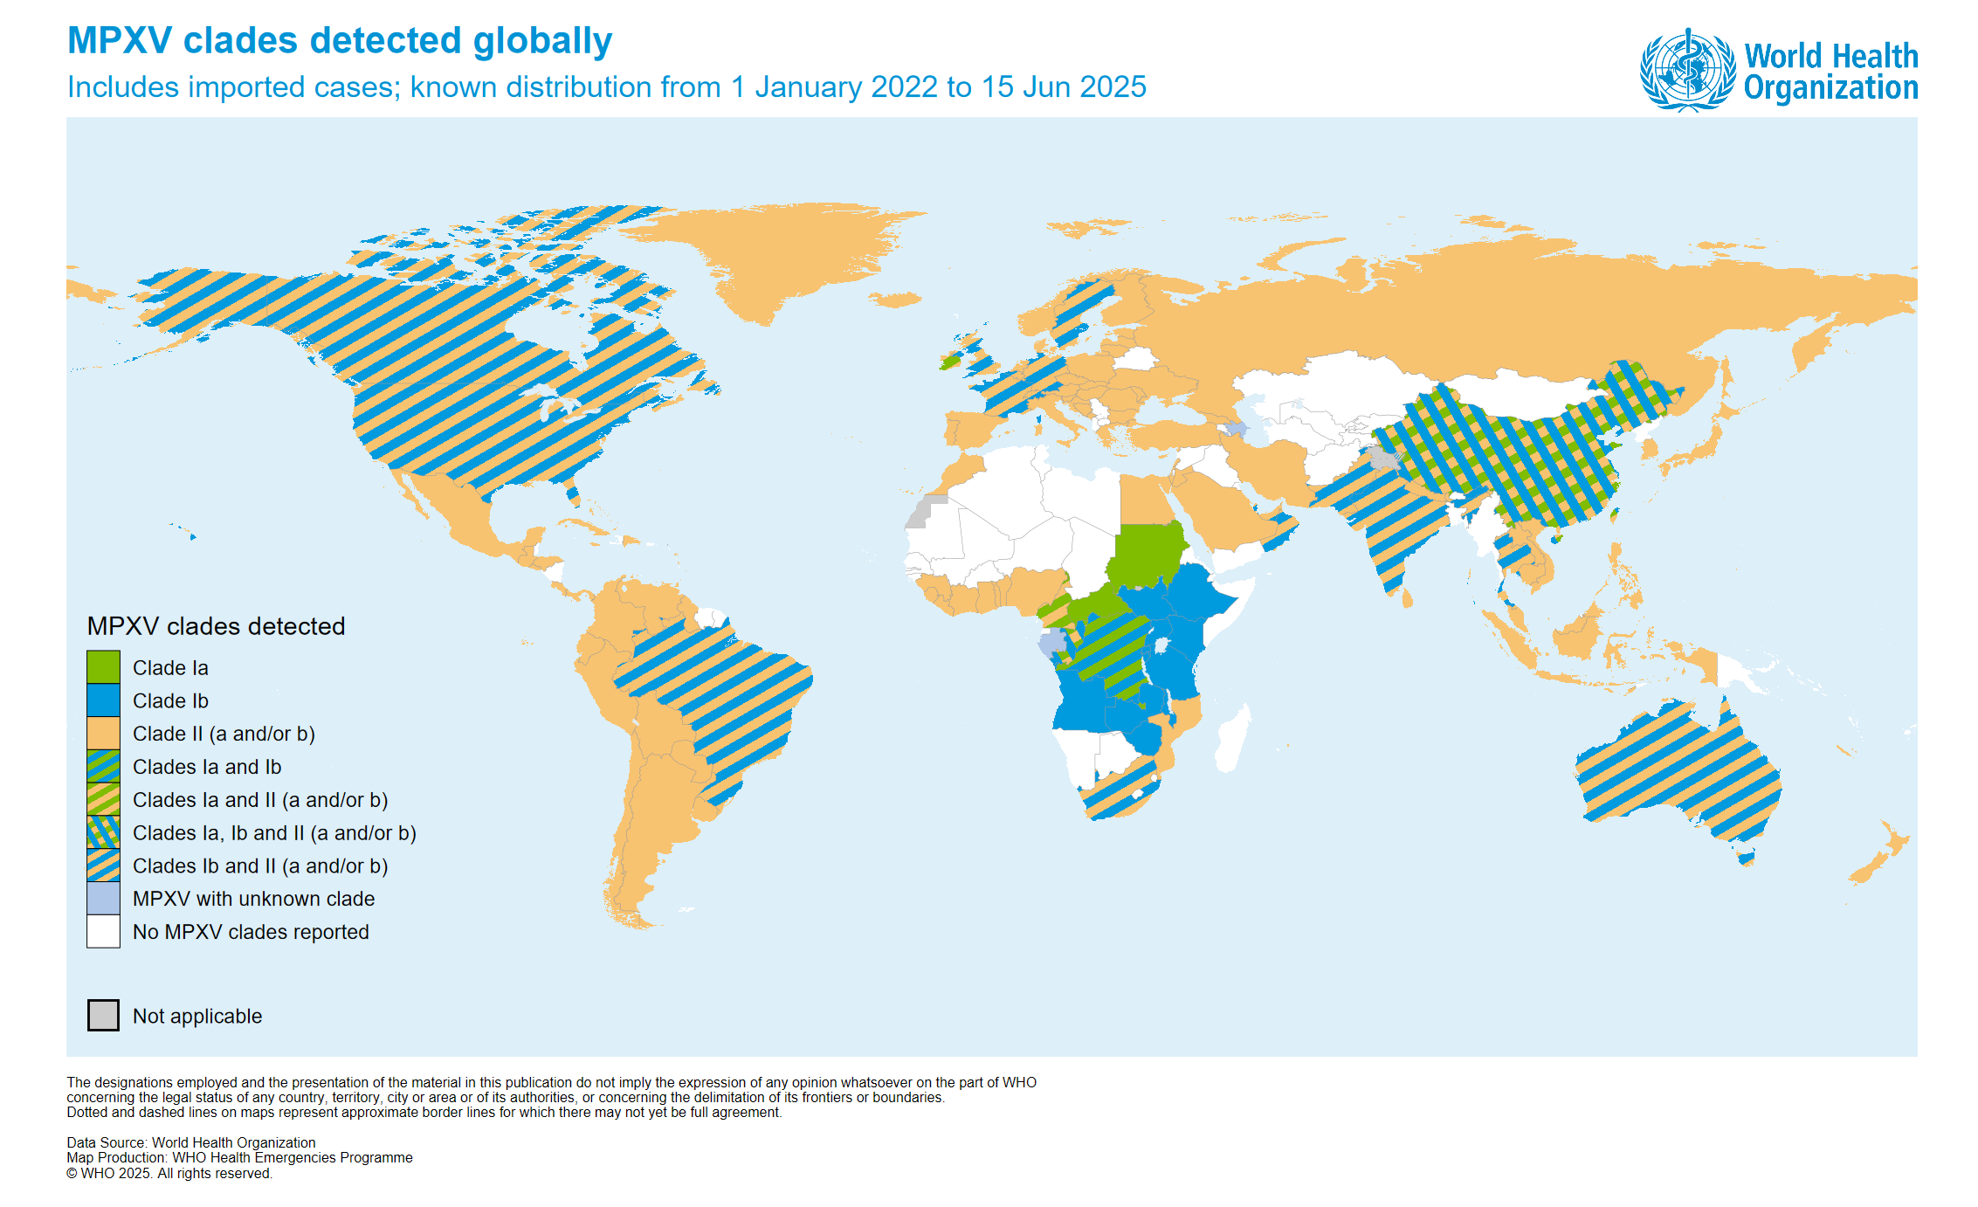
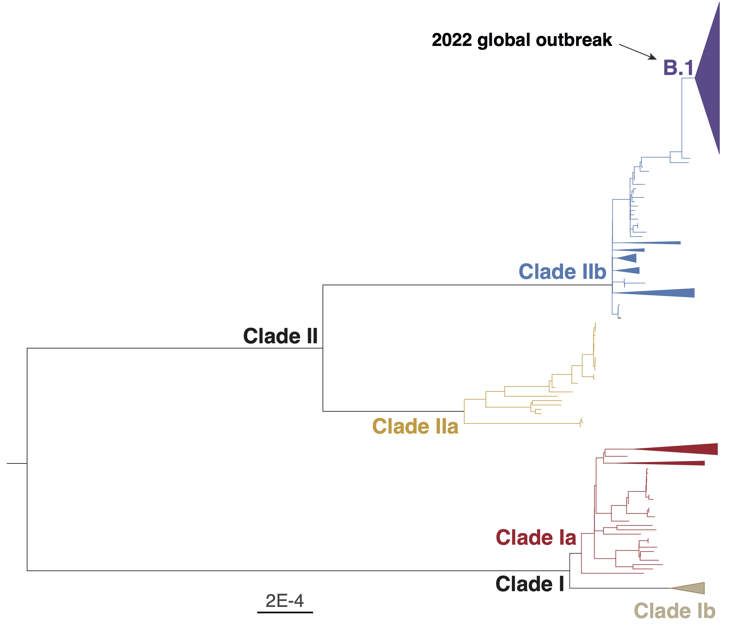
Monkeypox virus (MPXV) clades detected globally
The proportion of samples sequenced is still low and the information available might not be fully representative of the clade distribution

Slide 3
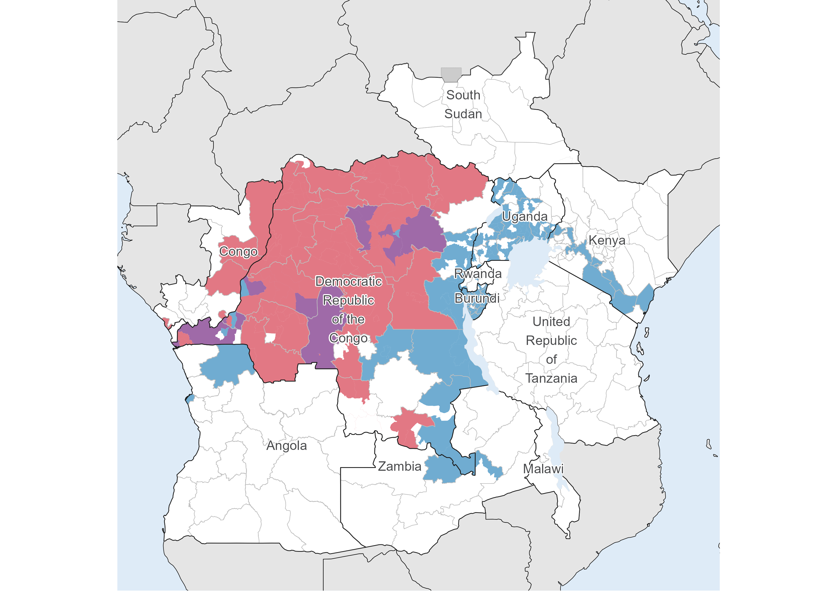
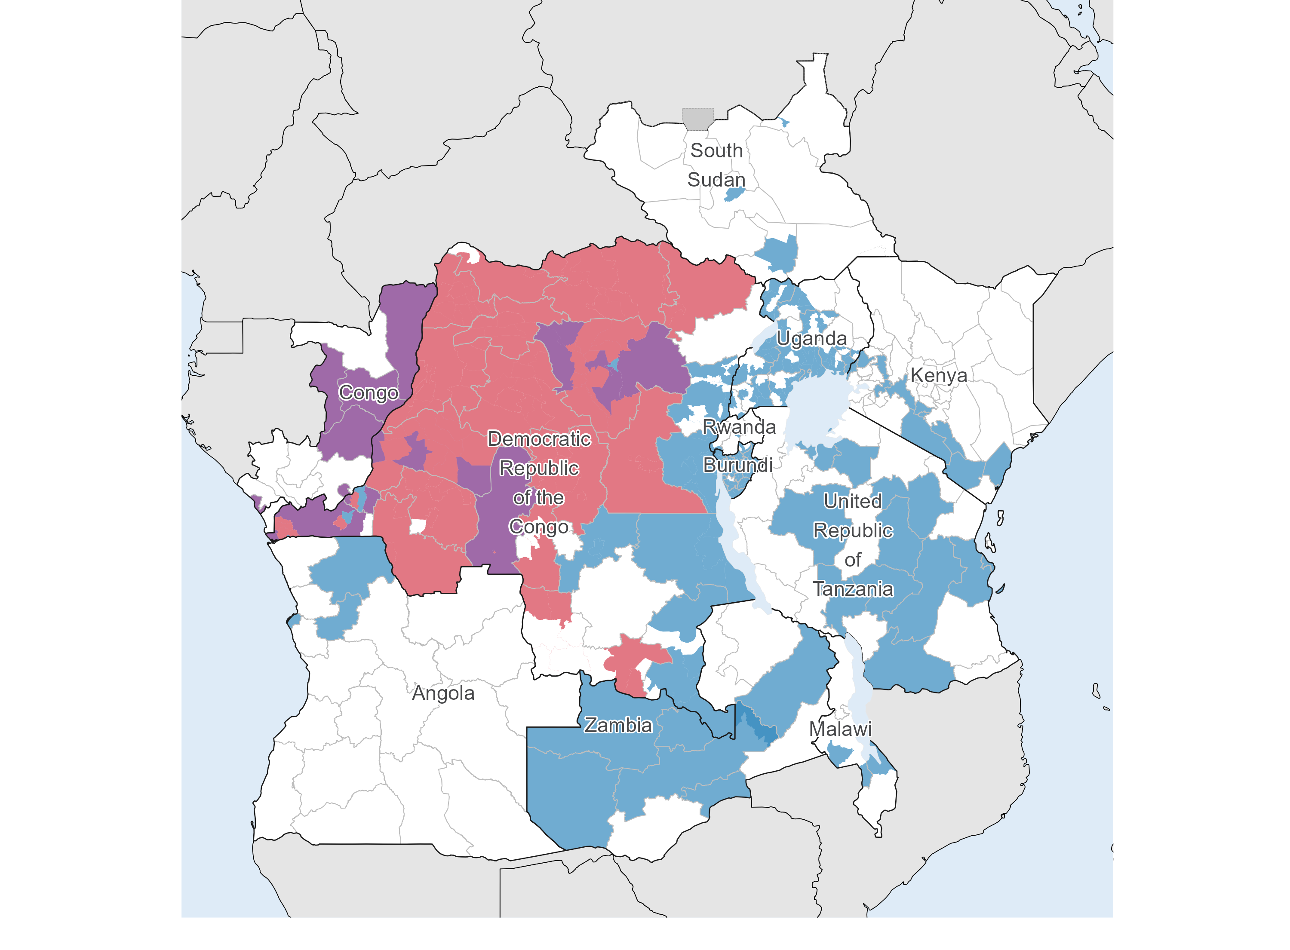
Evolution of mpox clades in Central and East Africa
January 2024 – February 2025
January 2024 – May 2025

Slide 4
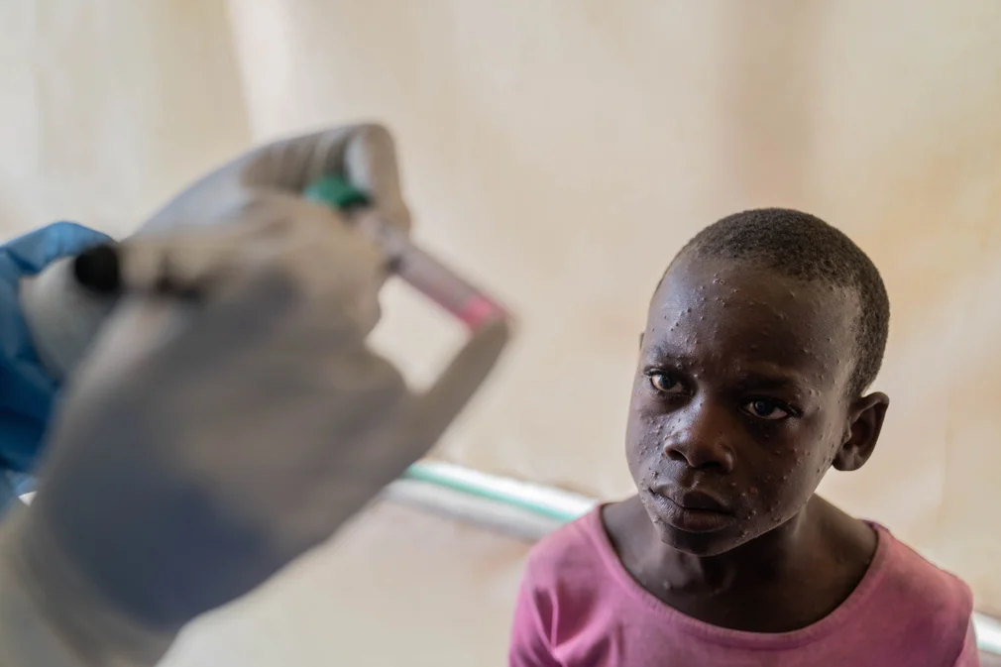
What triggered the need for new Mpox guidelines
WHO produced “interim” guidance in 2022.
Increased availability of clinical and epidemiological data and more case management experience.
Emergence of a new clade (Ib) and changing transmission patterns.
Improving quality of care can reduce mortality and morbidity, while ensuring health workers and other patients seeking care remain safe.
Espoir went to the health centre in the Democratic Republic of the Congo with Mpox and waits for treatment
Credit: Moses Sawasawa (used with permission)

Slide 5
Process of developing the WHO Living Guideline on Clinical Management and IPC for Mpox (May 2025)
WHO commissioned an updated systematic review on IPC measures to reduce mpox transmission, expanding on the publication by Kuehn et al.
    Key findings of updated review:
    >95% of transmission occurred via direct physical contact—both sexual and non-sexual—with skin lesions or lesion exudate.
    No confirmed cases of inhalation-based transmission were reported.
    Only one case of self-reported droplet exposure was identified.
    Health and care worker infections were rare and primarily due to needlestick injuries during specimen collection or clinical procedures.
        These findings informed the IPC recommendations
WHO convened a multidisciplinary mpox Guideline Development Group (GDG) composed of experts in infectious disease, IPC, clinical care, public health, HIV, pediatrics, and maternal health.
At GDG meetings Grading of Recommendations Assessment, Development and Evaluation (GRADE) Evidence to Decision (EtD) framework approach used: evidence obtained from the systematic reviews used to formulate statements (recommendations or good practice statements)

Slide 6
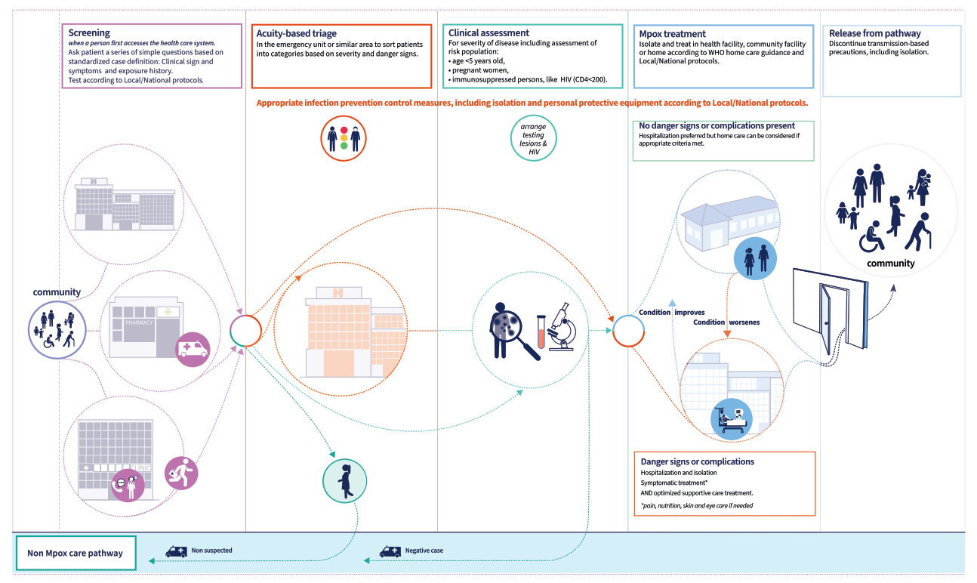
Highlights of the new Infection Prevention and Control recommendations
Mpox pathway – where the new recommendations apply

Slide 7
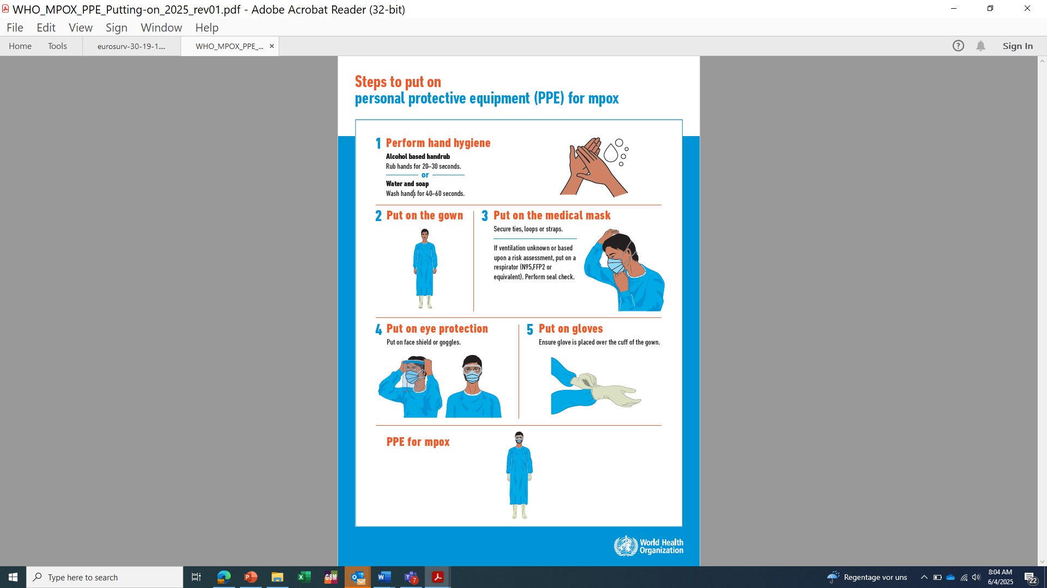
Mpox IPC guidelines: healthcare setting recommendation
In health care settings:
In patients with suspected or confirmed* mpox, WHO suggests that health and care workers use contact and droplet precautions. **
(Conditional recommendation for, low certainty evidence )
Consider using a respirator –a special mask to filter particles - when the ventilation is poor or unknown or based upon a risk assessment (e.g. immunocompromised status or presence of mucosal lesions).
Airborne precautions should be implemented if varicella zoster virus (i.e. chickenpox) or measles are suspected and until they are excluded.
Airborne precautions should be implemented when performing AGPs.
If single rooms are not available or in limited supply, cohort confirmed patients and prioritize single rooms for suspect and probable patients
* Confirmed mpox means via laboratory confirmation; probable meets clinical signs and symptoms with epidemiological link.
** Contact precautions include the following PPE: gloves, gown.
** Droplet precautions include the following PPE: a medical mask, consider eye protection based upon a risk assessment.
Clinical management and infection prevention and control for mpox: living guideline, May 2025

Slide 8
Mpox IPC guidelines: healthcare setting recommendation
Supporting patient interaction with visitors
WHO recommends that measures should be put in place to support patient interaction with family and visitors to promote well-being:
Visitors or caregivers should perform appropriate hand hygiene before and after entering/exiting the patient room, and be closely supervised on PPE use
Vulnerable and high-risk individuals should be counselled to make an informed decision on whether to visit the patient
Alternate modes of communication such as video conference to be offered
Clinical management and infection prevention and control for mpox: living guideline, May 2025

Slide 9
IPC measures in community settings and at home
Community settings | home-based care considerations
Hand Hygiene Dedicated personal items Linen and laundry handling Environmental cleaning and disinfection Waste management | Engage community health care workers and volunteers Ensure clear, accessible instructions for infection prevention at home Promote environmental cleaning and waste disposal systems Provide support to vulnerable groups Monitoring and follow-up through community health workers
Clinical management and infection prevention and control for mpox: living guideline, May 2025

Slide 10
Mpox IPC guideline: Home-based care recommendation
In community settings:
WHO suggests that persons with mild, uncomplicated mpox lesions cared for at home are not required to isolate*, provided their lesions are covered and they wear a well-fitting medical mask when in close proximity with others until all lesions are healed.
(Conditional recommendation for, low certainty evidence)
Persons with mpox who cannot cover lesions or wear a medical mask should isolate at home.
IPC measures to reduce environmental contamination at home should be implemented.
* Isolation: the separation of infected people with a contagious disease from people who are not infected.
Clinical management and infection prevention and control for mpox: living guideline, May 2025

Slide 11
Mpox IPC guidelines: home care implementation considerations
Mask & Lesion Covering
Always wear a medical mask near others (fabric if unavailable).
Cover lesions with clothing or bandages when around people.
Remote Follow-up
Use telemedicine or phone for check-ups—no in-person visits.
Hygiene & Environment
Clean and disinfect all personal spaces and frequently touched surfaces daily.
When leaving home
Wear a mask and cover all lesions.
Use private, well-ventilated transport.
Inform health facility in advance if seeking care.
Self-Care & Support
Person with mpox should manage their care or designate a healthy caregiver (preferably vaccinated or previously infected).
Caregiver keeps 1-meter distance
When closer contact is required (e.g., cleaning, laundry):
  Wear a medical mask + gloves
  Practice strict hand hygiene before and after glove use.
Clinical management and infection prevention and control for mpox: living guideline, May 2025

Slide 12
Challenges in current IPC practices
Challenges in current practice in healthcare settings | IPC challenges with health care isolation capacity: | IPC challenges with home-based care isolation:
Limited access to essential IPC supplies in healthcare settings (however medical masks are more accessible then respirators. Some health care workers may not like to wear a respirator and may prefer the use of a medical mask Use of respirators have been associated with reports of verbal and non-verbal communication barriers | During outbreaks and in resource-constrained settings, health facilities and treatment centers are overwhelmed (and may be overcrowded) resulting in limited health care facilities isolation capacity for mpox patients Inadequate WASH services in healthcare facilities Fear of being isolated can lead to concealment of symptoms, reducing early detection and public trust. The above make home-based care a sustainable and patient-centered option for mild, uncomplicated cases. | Isolation in the context of home-based care: Currently lack of evidence for its effectiveness May cause mental health challenges, including loneliness, anxiety, and depression Can amplify stigma towards infected individuals, leading to social isolation May result in economic hardship due to missed work or disruption of daily income-generating activities. All the above can lead to lack of compliance with home-based care isolation, making home-based care without isolation as an option
Refer to EPI-WIN webinar for other recommendations on: HIV and retrovirals, breastfeeding, etc.
Clinical management and infection prevention and control for mpox: living guideline, May 2025

Slide 13
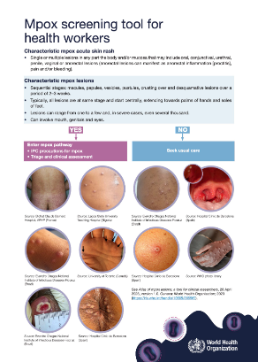
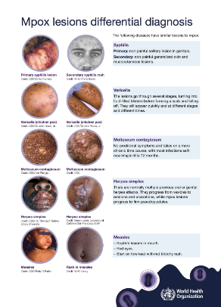
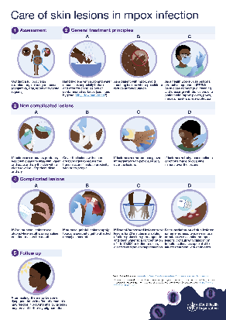
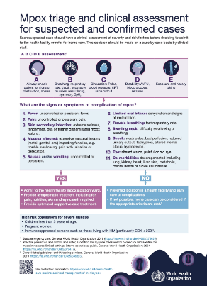
References and resources
WHO (2025). Clinical management and infection prevention and control for mpox: living guideline, May 2025.
Mpox screening tool for health workers
Mpox lesions differential diagnosis
Mpox triage and clinical assessment for suspected and confirmed cases
Care of skin lesions in mpox infection
Essential items supply estimator tool

Slide 14
Resources – other webinars
Project ECHO WHO-Africa CDC Mpox Case Management Webinar Series
Session 1:Topic: Overview of Mpox Case Management
https://www.youtube.com/watch?v=Ieq5doZfsl4 (English)
https://www.youtube.com/watch?v=rlC8bT5zRd0 (Portuguese)
https://www.youtube.com/watch?v=jmfaNCVeDkQ (French)
Session 2: Management of Skin Lesions and Hydration Status in Mpox Patients
https://www.youtube.com/watch?v=UX_-seJpRnE (English)
https://www.youtube.com/watch?v=kdpLALM87Fs (Portuguese)
https://www.youtube.com/watch?v=XK3_Jn1LEfM (French)
https://www.youtube.com/watch?v=TaoUo2aYXGA (Arabic)
Session 3: Management of Oral Lesions and Nutritional Care in Mpox
https://www.youtube.com/watch?v=vjOgxJ3X4Hw (English)
https://www.youtube.com/watch?v=AyaS2QNrAMk (Portuguese)
https://www.youtube.com/watch?v=qZNGQLu6UcQ (French)
Session 4: Mpox and the Eye; Clinical Presentation, complications and management(stand Mpox treatment centre design
https://www.youtube.com/watch?v=9H_DyKk1zI8 (English)
https://www.youtube.com/watch?v=9jAc0DDMlJE (Portuguese)
https://www.youtube.com/watch?v=2UNwXuOI4ag (French)
https://www.youtube.com/watch?v=h_jVWwqirHA (Arabic)
Session 5: Management of Co-infections in Mpox/HIV, measles, VZV and Syphilis
https://www.youtube.com/watch?v=UfOoscOAV2o (English)
https://www.youtube.com/watch?v=LbmM4FhgGCE (Portuguese)
https://www.youtube.com/watch?v=02qIU8yZ6lc (French)
https://www.youtube.com/watch?v=qrfoRw7xTL8 (Arabic)
Session 6: Home based care
https://youtu.be/q4XILr3iVL0 (English)
https://youtu.be/jVN3N1Tz1o0 (French)
https://youtu.be/OmCFPBJMX0w (Portuguese)
Session 7 : Planned for 8 April (Case Management in a Treatment Unit – including Unit Design, IPC/WASH, EPI, Screening and Triage aspects).
Session 8: May 20 " Improving Mpox Outcomes for patients: Your voice in setting WHO guideline priorities.

Slide 15
EPI-WIN webinar
View webinar “New guidelines for mpox clinical management and infection prevention and control”
Speakers
  Dr Nedret Emiroglu, Emergency Core Capabilities, WHO Geneva
  Dr Olivier le Polain, Epidemiology and Analytics for Response, WHO Geneva
  Dr April Baller, Safe and Scalable Care, WHO Geneva
  Dr Tochi Okwor, IPC guideline development group for Mpox
  Prof. Andy Bulabula, Africa CDC
  Dr Jamie Rylance, WHO Geneva
  Dr Valdiléa G. Veloso, Oswaldo Cruz Foundation (Fiocruz), Brazil
  Prof. Grace Ndeezi, Mpox GDG Member, Makerere University
  Dr Janet Diaz, Safe and Scalable Care, WHO Geneva

