Slide 1
The Utility of Pathogen Genomics: Spotlight TB
2 July 2025

Slide 2
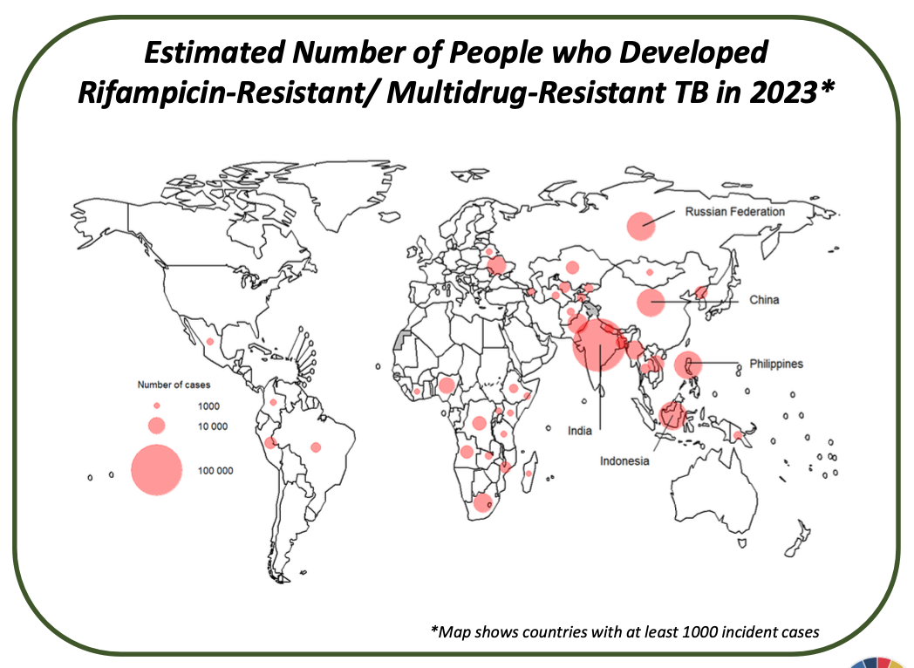
Background on drug-resistant tuberculosis
Tuberculosis (TB) remains a leading cause of infectious death globally, complicated by the rise of drug-resistant strains.
About a quarter of the world’s population is infected with TB, with 10.8 million new cases and 1.25 million deaths annually. (2024 WHO Global TB Report)
Drug-resistant TB (DR-TB) poses a significant challenge, with over 1.5 million cases, yet less than half are diagnosed or receive appropriate drug susceptibility testing (DST).
Advances in diagnostic technologies, especially genomic sequencing like targeted next-generation sequencing (tNGS), offer faster, comprehensive detection of drug resistance, improving treatment outcomes.
WHO has updated guidance and resources supporting expanded use of sequencing for DR-TB surveillance and clinical care, emphasizing the integration of new drugs, shorter treatment regimens, and cost-effective implementation strategies.
Figure modified from Pai, M., Behr, M., Dowdy, D. et al. Tuberculosis. Nat Rev Dis Primers 2, 16076 (2016).

Slide 3
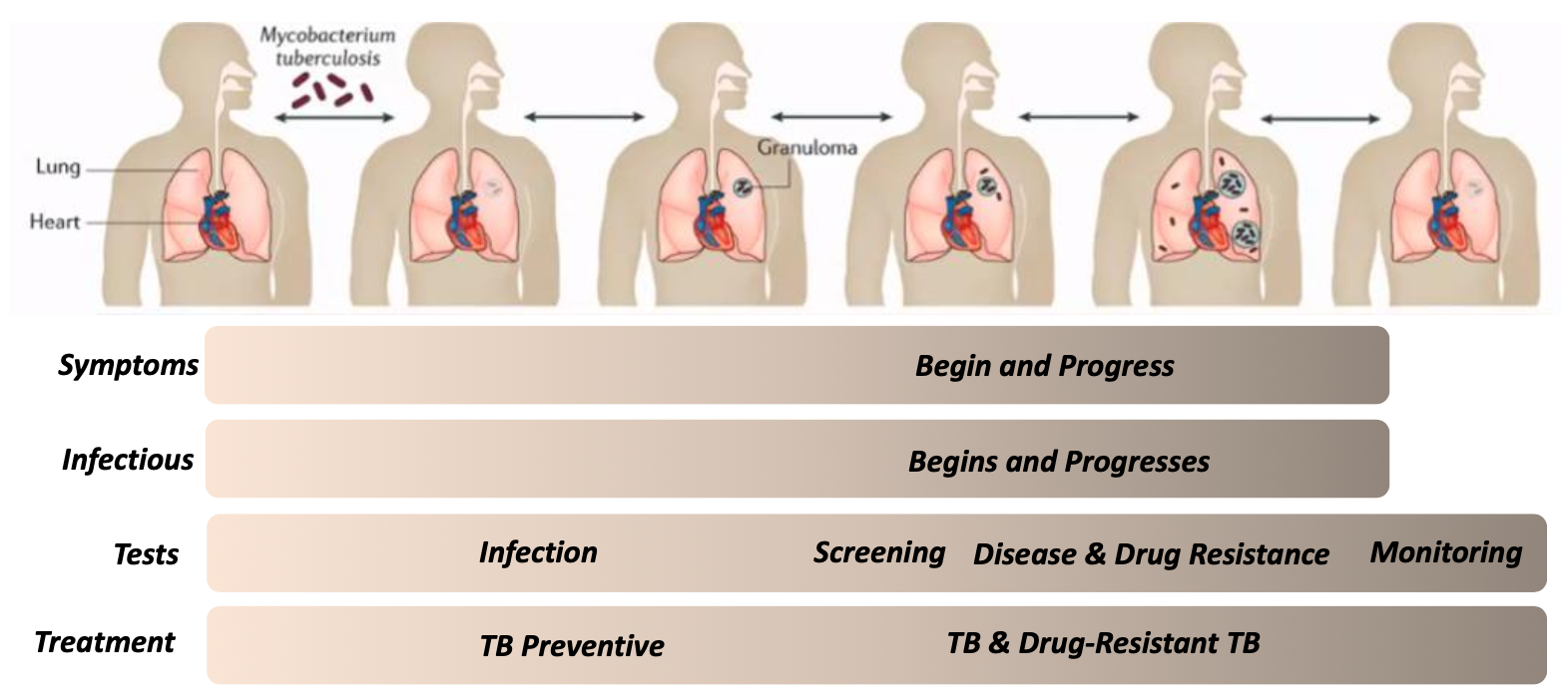
The spectrum of TB: An airborne bacterial disease
Figure modified from Pai, M., Behr, M., Dowdy, D. et al. Tuberculosis. Nat Rev Dis Primers 2, 16076 (2016).

Slide 4
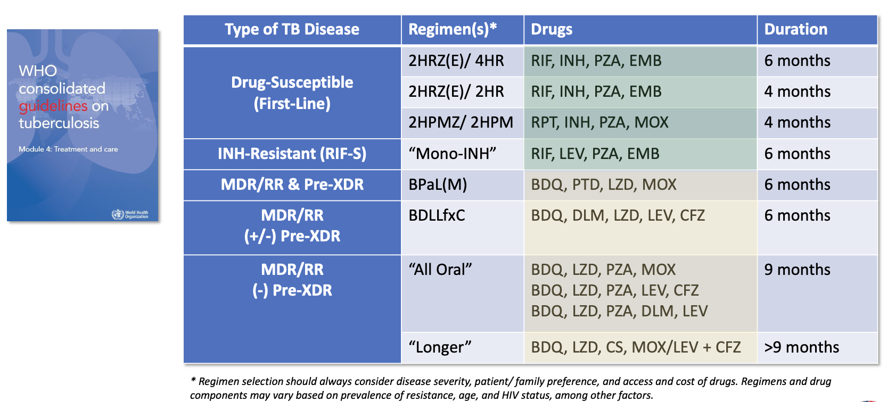
Advances in TB treatment
2025 WHO Consolidated guidelines on tuberculosis. Module 4: Treatment and care

Slide 5
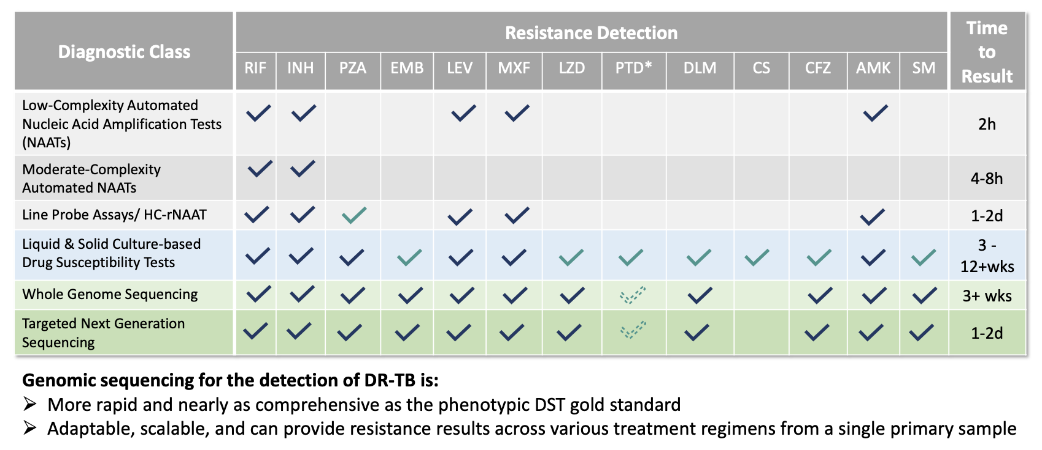
Expanding Landscape of WHO-recommended DR-TB diagnostics
2025 WHO Consolidated guidelines on tuberculosis. Module 4: Treatment and care

Slide 6

Seq&Treat: Genomics for drug-resistant TB diagnosis
The “Seq&Treat” initiative focuses on enhancing diagnostics for drug-resistant tuberculosis (DR-TB) through targeted next-generation sequencing (tNGS) technologies.
tNGS allows for rapid and accurate identification of drug resistance directly from clinical samples. This has potential for early detection and effective treatment to combat TB.
The clinical evaluation of tNGS workflows indicates high sensitivity and accuracy, demonstrating potential to replace conventional diagnostic methods.
The successful implementation of tNGS will require addressing technical challenges, including infrastructure, training, and data management.
The initiative emphasizes the importance of genotype-phenotype correlations and aims to generate evidence and capacity for global adoption of tNGS solutions.
Continuous updates to mutation catalogues are necessary to enhance the interpretation of genetic data, ensuring effective treatment decisions.
Challenges remain regarding implementation, including technical complexity and the need for standardized interpretation of genetic mutations related to drug resistance.

Slide 7
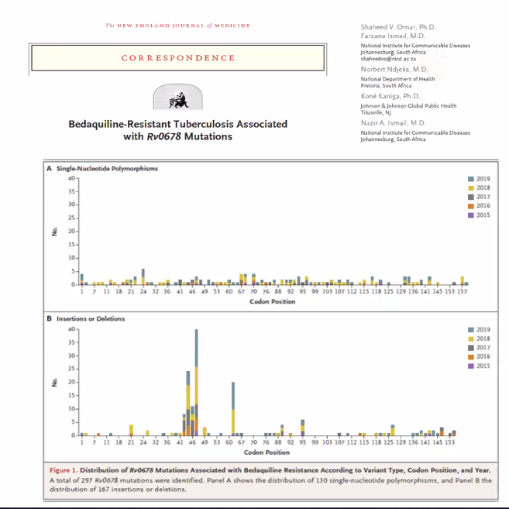
South Africa: Next-generation sequencing for drug-resistant TB surveillance
The introduction of next-generation sequencing (NGS) for drug-resistant tuberculosis (TB) surveillance has significantly enhanced the speed and accuracy of drug resistance detection in tuberculosis.
The National TB Reference Laboratory has enabled the country to contribute significantly to the World Health Organization’s mutation catalog and improve diagnostic evaluations for drug resistance.
South Africa’s TB diagnostic network has expanded to nearly 200 laboratories, improving access to diagnostic testing.
NGS enhances surveillance capabilities by providing quicker results for drug susceptibility and revealing transmission dynamics of drug-resistant TB.
Recent analyses indicate rising resistance rates, prompting national strategies to improve TB management and control.
The integration of genomic data with other surveillance data provides a comprehensive understanding of TB transmission dynamics and resistance patterns.
The findings have triggered a national response to address rising resistance rates and improve management strategies for drug-resistant TB.

Slide 8
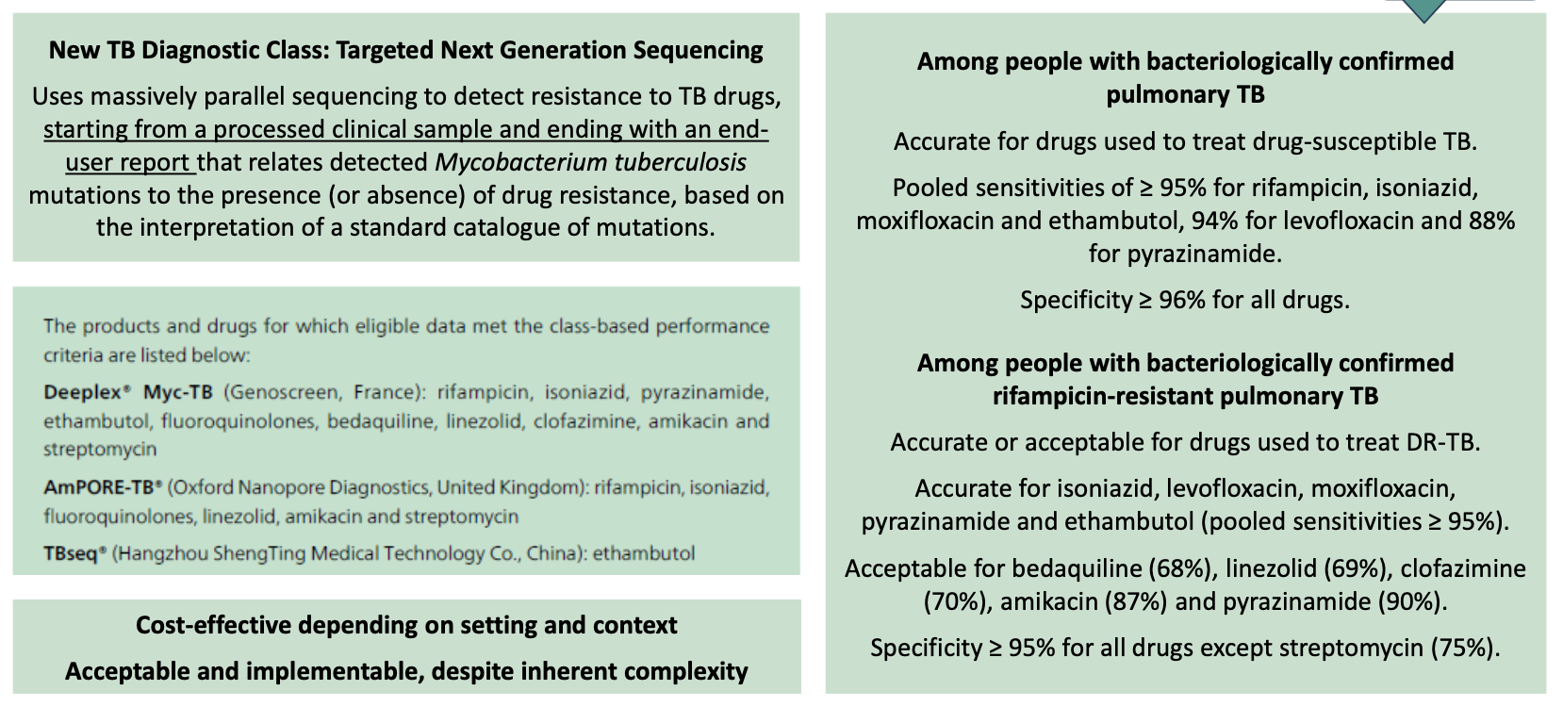
2023 Who Recommendations for Clinical Use of tNGS

Slide 9
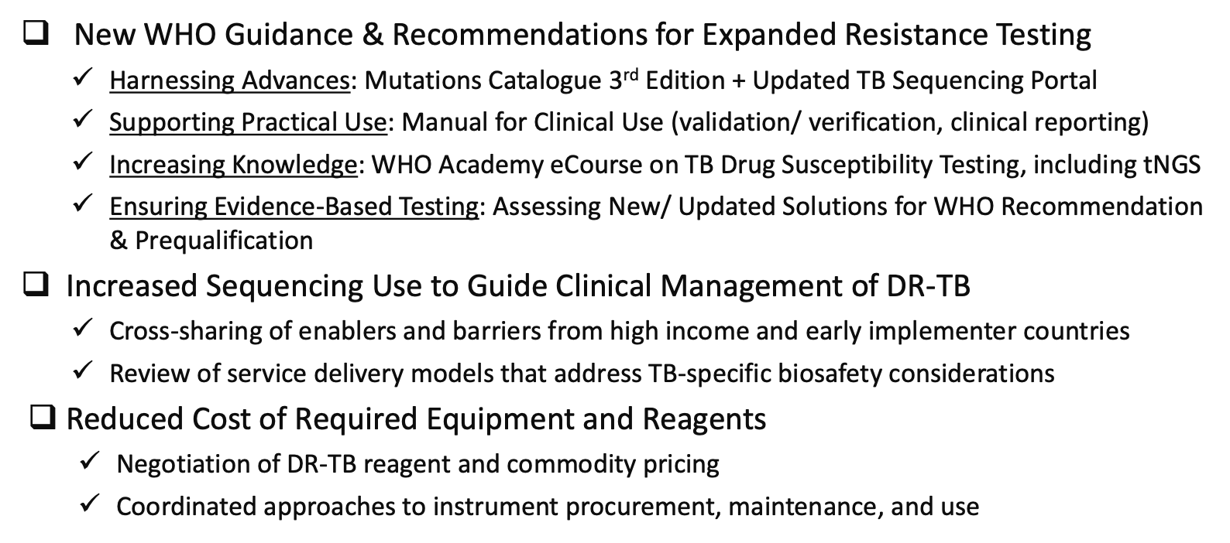
The Future for Genomic Sequencing of DR-TB

Slide 10
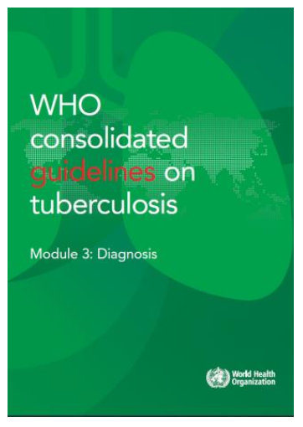
References
WHO (2023). Catalogue of mutations in Mycobacterium tuberculosis complex and their association with drug resistance. 2nd ed.
WHO and FIND (2018). The use of next-generation sequencing technologies for the detection of mutations associated with drug resistance in Mycobacterium tuberculosis complex: technical guide.
WHO (2021). Guidance for the surveillance of drug resistance in tuberculosis. 6th ed.
WHO and FIND (2023). The use of next-generation sequencing for the surveillance of drug-resistant tuberculosis: An implementation manual.
WHO (2025). WHO consolidated guidelines on tuberculosis. Module 3: Diagnosis.

Slide 11
EPI-WIN webinar
View webinar “The Utility of Pathogen Genomics: Spotlight TB”
Speakers
  Dr Timothy Dallman, Emerging Pathogen Intelligence Platforms, WHO Geneva
  Dr Patricia Hall-Edison, WHO Global Tuberculosis Programme, WHO Geneva
  Dr Anita Suresh, Genomics and Sequencing, FIND
  Dr Shaheed Vally Omar, Center for Tuberculosis, National Institute for Communicable Diseases/ NHLS, South Africa
  Greg Armstrong, Taskforce for Global Health
  Caxton Murira, Programme Lead for Clinical Trials and Research Community, Science for Africa Foundation
  Dr Josefina Campos, Emerging Pathogen Intelligence Platforms, WHO Geneva

