Slide 1
Update on influenza, COVID-19 and other respiratory viruses: focus on the winter season in the Northern Hemisphere
19 February 2025

Slide 2
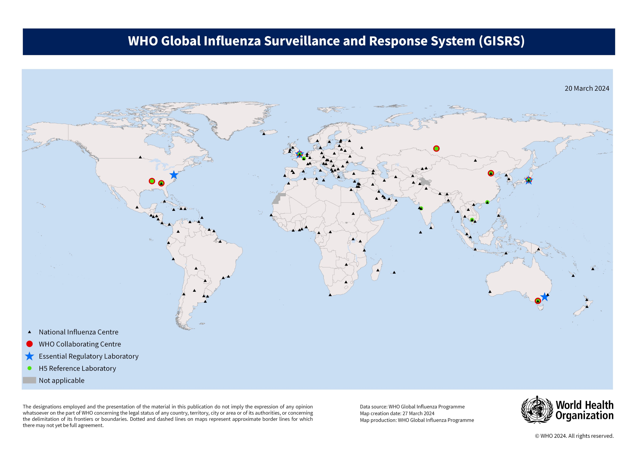
Surveillance at the global level
For over 70 years, the Global Influenza Surveillance and Response System (GISRS) has been the foundation for influenza surveillance, preparedness and response.
The succeeding slides provide recent surveillance data of selected respiratory viruses. Refer to the online recording and references for other surveillance data.
https://www.who.int/initiatives/global-influenza-surveillance-and-response-system

Slide 3


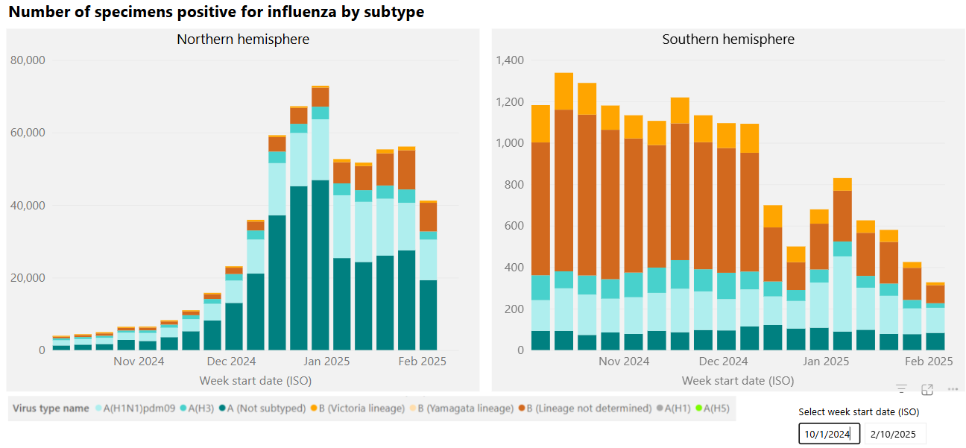
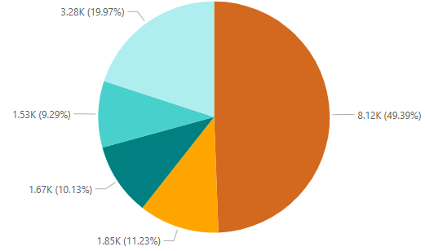
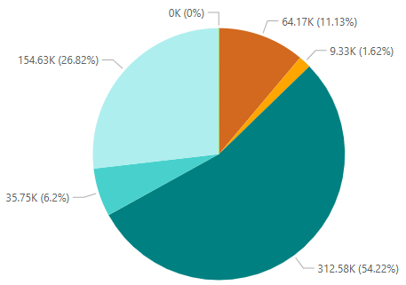
Influenza activity since Oct 2024
Notes:
Take a look at what is predominant this season over the past few months.
Of the subtyped influenza A viruses, most have been H1 viruses.

Slide 4
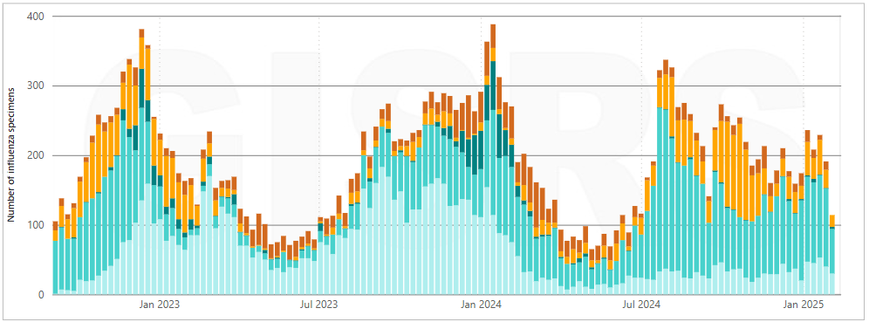
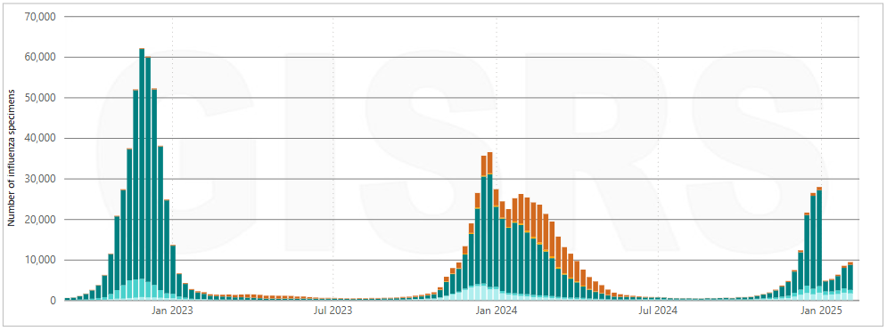
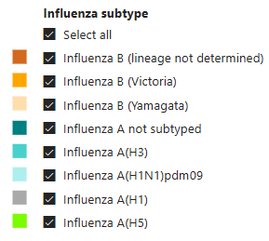
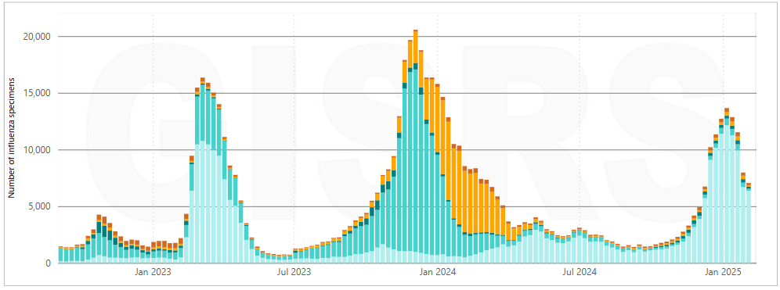
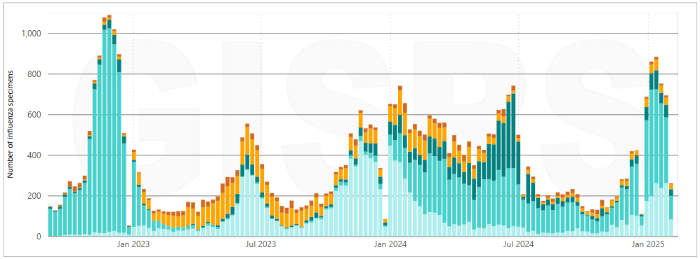
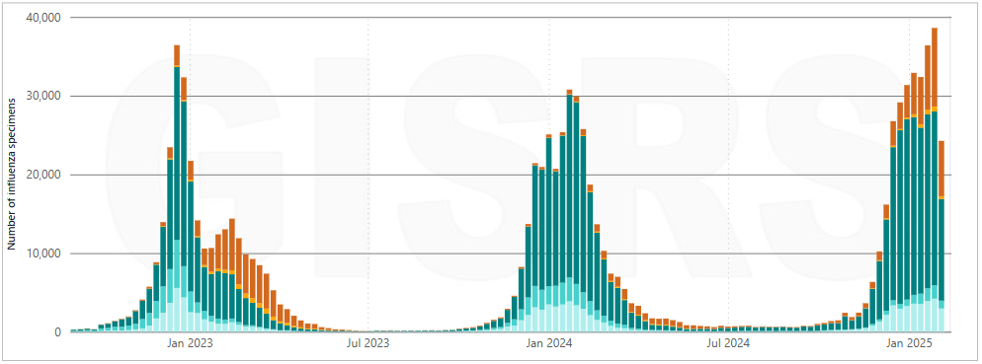
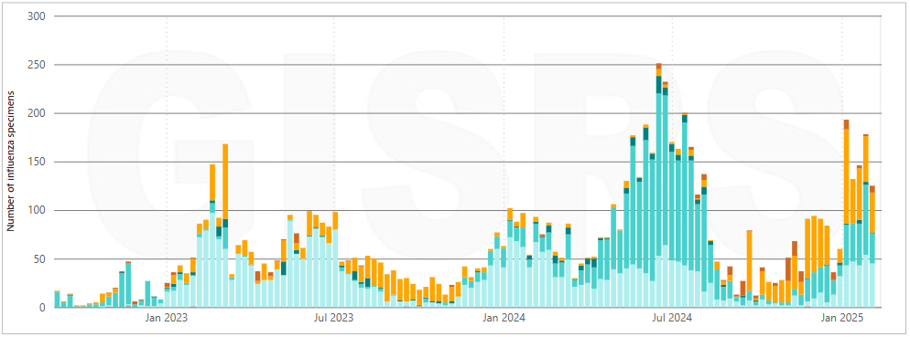
Influenza activity in the Northern Hemisphere since Oct 2022
Africa
North America
Asia
Central America and the Caribbean
Europe
Tropical South America
Source: Influenza surveillance outputs

Slide 5
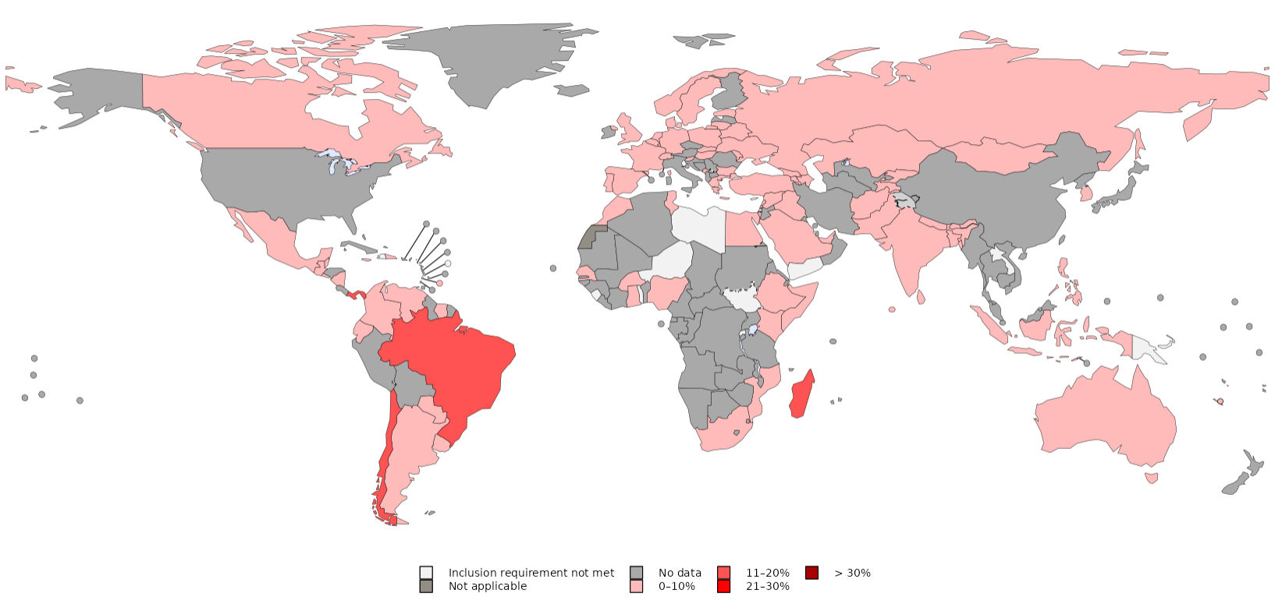
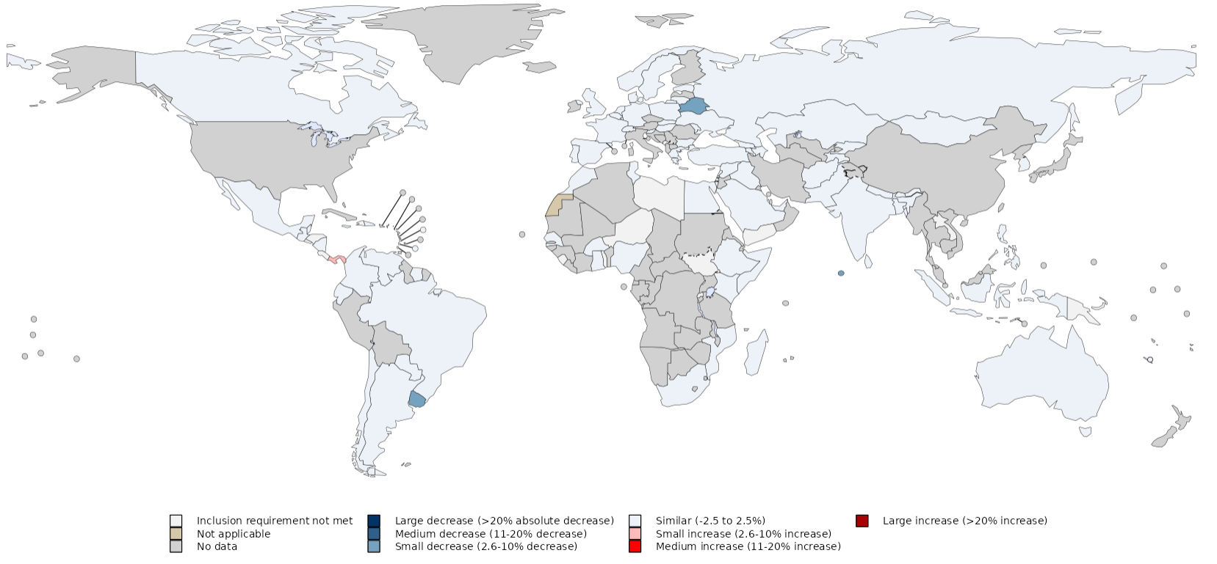
SARS-CoV-2 continuous to circulate with other respiratory viruses
Test Positivity Rate per country from sentinel and systematic virological surveillance,
Week ending on 9 February 2025
Change in proportion Test Positivity Rate per country from sentinel and systematic virological surveillance,
Week ending on 9 February 2025
Elevated activity in some countries from Central and South America, Southern Africa.
Low activity across reporting countries in the Northern America, Europe, Western Pacific and South East Asia .
All countries showed a stable or declining trend except one country in Central America.
Integrated Surveillance of SARS-CoV-2 within the Global Influenza Surveillance and Response System
Data source: FluNet (www.who.int/toolkits/flunet). Global Influenza Surveillance and Response System (GISRS).
Data as of 9 February 2025, generated on 17 February 2025

Slide 6
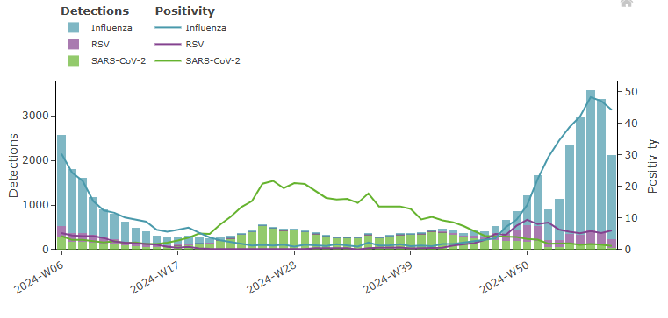
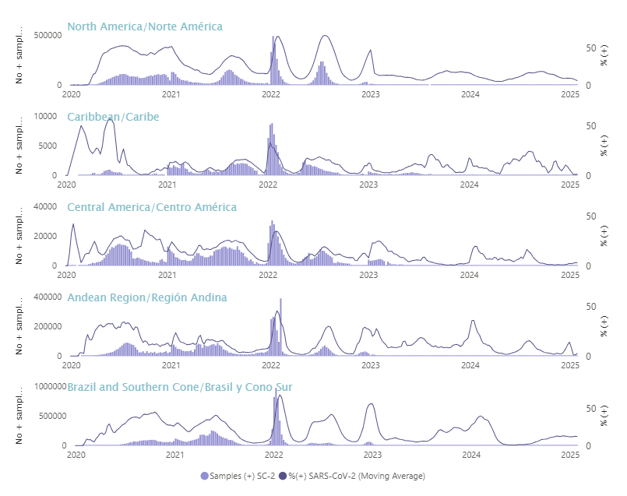
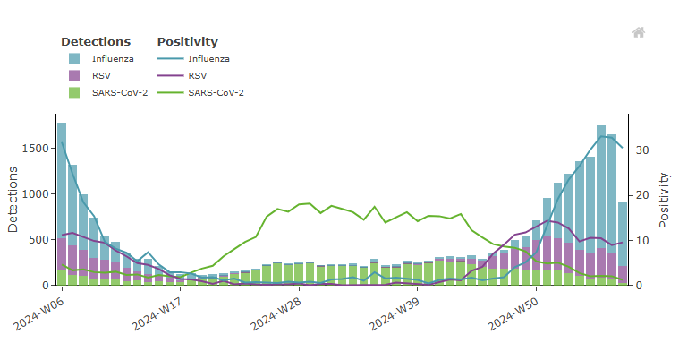
Prolonged elevated SARS-CoV-2 activity in summer months in countries from Europe and Americas observed in 2024
European Region
Region of Americas
Primary care sentinel sites
Secondary care sentinel sites
Data source: PAHO Regional Weekly Summary (https://www.paho.org/en/influenza-situation-report).
Data generated on 14 February 2024
Data source: Erviss (https://www.erviss.org/).
Data generated on 14 February 2025
Notes:
Key message: Both in Europe and Americas prolonged high-level activity during the summer. High level activity is defined as over 10% test positivity rate.
This is partly due to the some countries with prolonged high level activity for example Belgium had elevated SARS-CoV-2 activity 5 months non-stop from beg June to end October and partly timing of the peak, some countries had increases later than others..

Slide 7
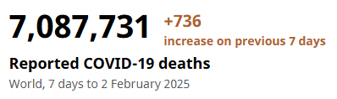
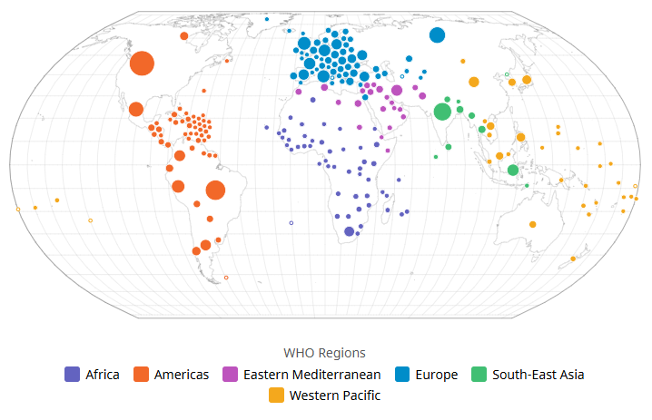
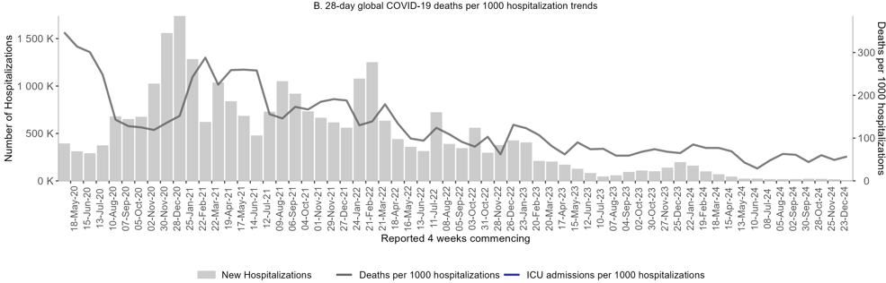
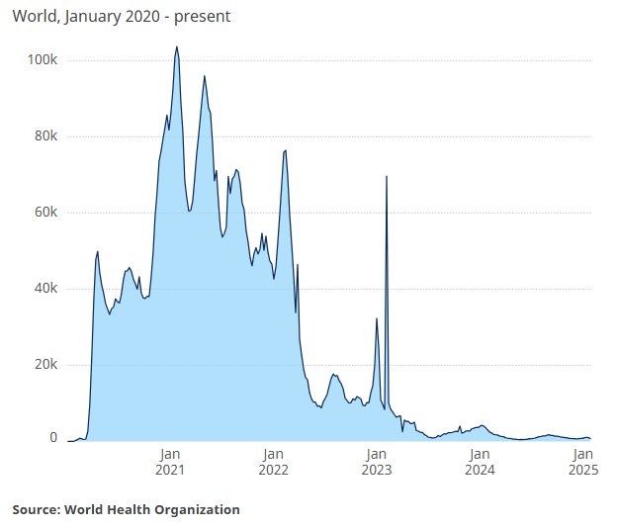
COVID-19 continue to cause deaths
by 11 countries
Deaths per 1000 hospitalizations:
169 in April 2022 to 78 as of early February 2025
data from 59 (25%) countries in 2024
Data must be interpreted with caution – rates of testing and data reporting have decreased substantially.
This report reflects the data officially reported to WHO, lack of reporting doesn’t mean absence of deaths in other countries.

Slide 8
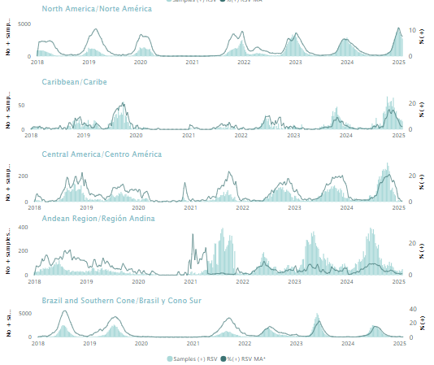
Respiratory syncytial virus (RSV) activity in the Americas
RSV activity reached levels comparable to previous seasonal peaks but has started to decline in North America and continues to decline or remain low in other subregions.
RSV epidemics are returning to pre-COVID-19 levels.
Source: Influenza, SARS-CoV-2, RSV - PAHO/WHO

Slide 9
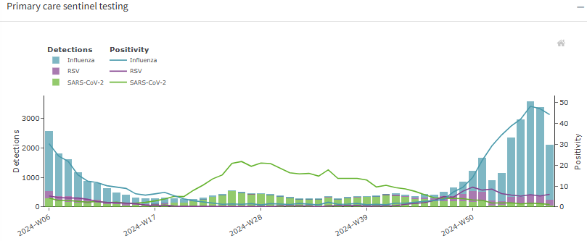
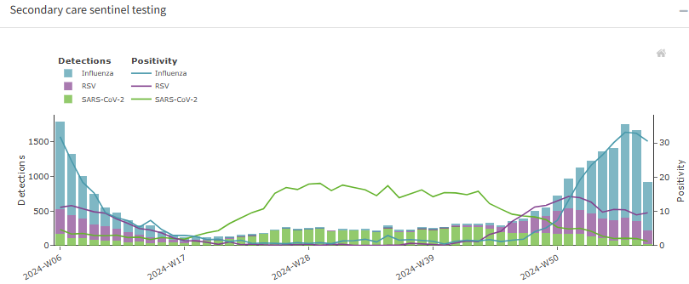
RSV activity in the WHO European Region
RSV positivity among primary care sentinel and SARI patients remains moderate but continues to plateau after peaking in late December.
The percentage of specimens from patients presenting to sentinel:
  ILI and ARI sites was at 6% compared to 5% the prior week.
  SARI sites was at 10% comparted to 9% in the prior week.
Children aged 0-4 years have the highest test positivity and comprise the highest number of cases for RSV.
Source: https://erviss.org/
Notes:
Update text

Slide 10
Applications
Wastewater surveillance
  Routine wastewater monitoring available from 30 countries in 5 WHO regions
Vaccination
  Vaccines are available for influenza, SARS-CoV-2, and for RSV, in some locations and in some age groups
  COVID-19 vaccine uptake has been exceedingly low so far in 2024; strengthened efforts are needed to turn vaccines into vaccinations
  Several countries have approved the use of RSV vaccines for older adults
Self-isolation continues to be recommended – “keep your cold to yourself”.
  Choosing to wear a mask when ill should also reduce the risk of onwards transmission in the community

Slide 11
Useful links and references
Implementing the integrated sentinel surveillance of influenza and other respiratory viruses of epidemic and pandemic potential by the Global Influenza Surveillance and Response System: standards and operational guidance
Manual for the laboratory diagnosis and virological surveillance of influenza
Influenza surveillance outputs
Influenza surveillance updates (updated weekly)
COVID-19 policy briefs
COVID-19 Global Risk Assessment
Tracking SARS-CoV-2 variants
COVID-19 deaths | WHO COVID-19 dashboard
Coronavirus Disease (COVID-19) Situation Reports

Slide 12
EPI-WIN webinar
View webinar “Update on influenza, COVID-19 and other respiratory viruses: focus on the winter season in the Northern Hemisphere”
Speakers
  Dr Maria van Kerkhove, Director, Epidemic and Pandemic Threat Management, WHO Geneva.
  Wenqing Zhang, Head, Global Influenza Programme (GIP), Epidemic and Pandemic Threat Management
  Aspen Hammond, WHO Global Influenza Programme (GIP) Team
  Ayse Acma, WHO Emerging Diseases and Zoonoses (EZD) Team
  Ben Cowling, School of Public Health, The University of Hong Kong
  Maria Zambon, UK Health Security Agency

