Slide 1
Safe sporting events, stronger public health: key considerations and country experiences for mass gatherings
12 February 2025

Slide 2
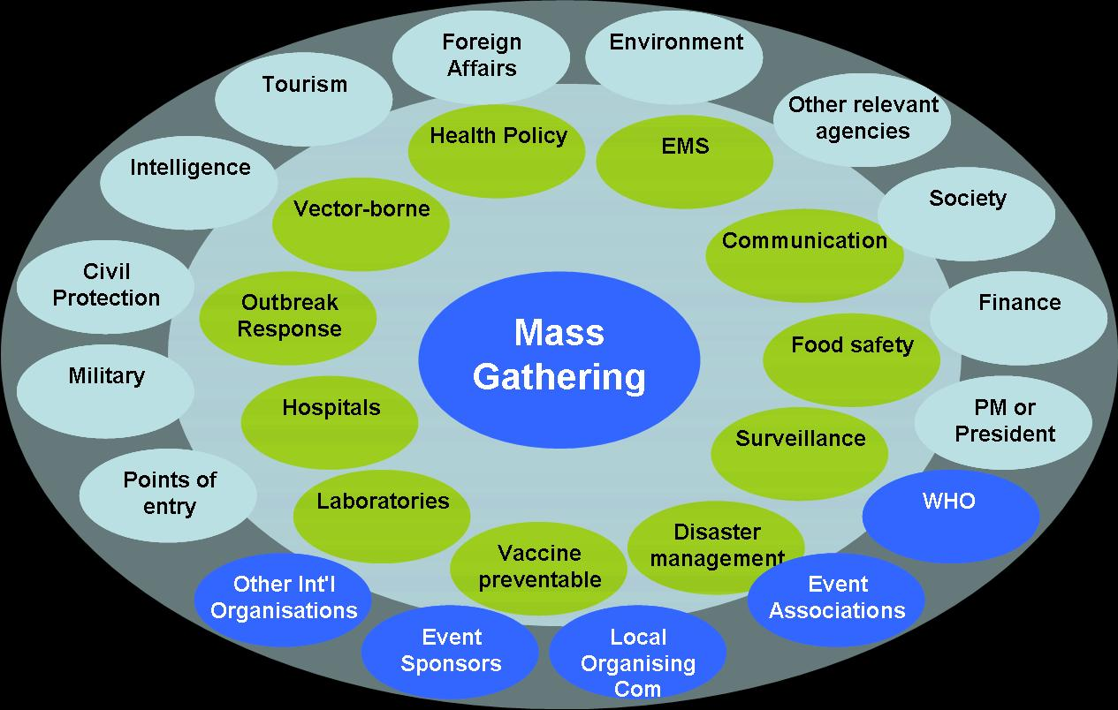
WHO Role on Mass Gatherings
WHO’s key role in provision of technical guidance and support to Member States and Event organizers on MG events
WHO does not have the mandate to enforce any action with regard to a mass gathering (modification, postponement, cancellation, etc.) or to authorize that it may proceed.
Strategic risk assessment throughout the cycle of event for planning and operations, including the identification of hazards, assessment of their likelihood of occurring, and their potential impact
Why mass gathering health matters

Slide 3
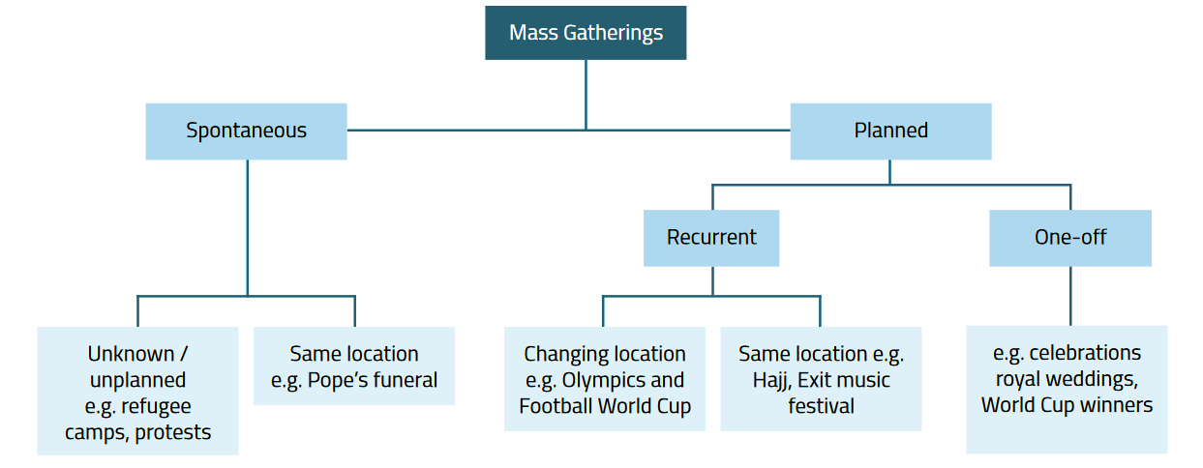
What Are Mass Gatherings?
Events characterized by large concentration of people for a defined period of time
Potential to strain the planning and response resources of the host nation or defined community
Potential health impact:
-- amplification of the transmission of
the disease
-- potentially disrupt the host country’s
response capacity
No universal threshold (in terms of the number of attendees) for mass gatherings
Notes:
What a mass gathering depends on:
Context in which the event takes place (e.g. the host country’s capacity to respond to health emergencies.)
Associated risks (e.g. existence of disease outbreak)

Slide 4
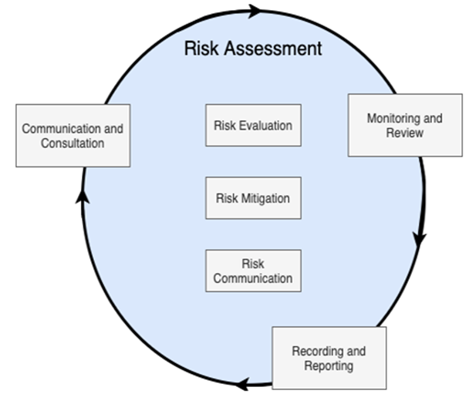



A risk-based approach for mass gathering health risk management
WHO Mass Gatherings All Hazards Risk Assessment Tool available from here:
https://partnersplatform.who.int/all-hazards-mass-gatherings-risk-assessment
Risk evaluation, which aims at identifying and quantifying the baseline risks associated with the gathering;
Risk mitigation, which proposes a series of precautionary measures aimed at decreasing the baseline risk of the gathering; and
Risk communication, which prompts the timely and proactive dissemination of information on the process, rationale, purpose and limits of the precautionary measures adopted, with the aim of enhancing adherence by event attendees.
Notes:
WHO propose an all-hazards, risk-based approach for mass gatherings, assessing whether to proceed, modify, or cancel based on potential risks.
This approach considers a broad range of threats and ensures health systems and other sectors are prepared to manage them effectively.
The risk-based approach should be tailored to the event's local context and characteristics and be reassessed regularly.

Slide 5
Mass gathering management: Before, During and After
Before
Conduct risk assessment using an all-hazard risk approach
During
Monitor and evaluate signals and data, subsequently disseminate reports
After
Document lessons learned and provide insights to improve future mass gathering planning, health infrastructure and capacities
Develop, test, and evaluate contingency planning
Enhance surveillance for domestic and international signal detection
Promote collaboration with relevant partners, institutions, and authorities
Build capacity through technical guides and training sessions
Respond to emergent alerts
Identify and document challenges for future improvement and successes
Evaluate health outcomes
Areas of WHO’s overarching support available for mass gatherings host countries and event organizers: BEFORE, DURING, AFTER the event

Slide 6
Strategies and lessons from different events
Cricket World Cup 2024
  Planning for mass gatherings requires extensive preparation for public health emergencies, with clear response mechanisms at the national, regional, and international levels.
  Planning needed to account for both event-related incidents and external emergencies like hurricanes/earthquakes etc. (Natural and man-made incidents).
  Critical components must include robust surveillance systems, early warning mechanisms, and cross-sector collaboration for rapid investigation and response.
Olympic and Paralympic Games 2024 Paris
  Identifying and managing health risks and threats
  Setting up response mechanisms to deal with an exceptional health situation(SSE)
  Organization of operational management of health alerts in the event phase - Operational management

Slide 7
Strategies and lessons from different events
FIFA World Cup 2022
  Governance: Medical Command Centre (MCC), National Health Care Incident Command Centre, Major Incident Preparedness & Resilience (MIPR), Event Review Group (ERG), Public Health Emergency Operations Center (PHEOC)
  Enhanced surveillance: Syndromic Surveillance, Event-Based Surveillance (EBS), CDC Email System, Notification Enhancements, Surveillance & Vaccine Electronic System (SAVES), MG EWARS Cell
  Health services response: Health services distributed among most visited locations like stadiums, fan zones, fan villages, hotels , Ambulance services, Sobering stations, Urgent care walk-in units, Sexual assault referral mechanism, FWC 2022 helpline
  Promoting health: Physical activity, Nutrition, Mental Health, Tobacco Control, Regular messaging to support health promotion areas

Slide 8
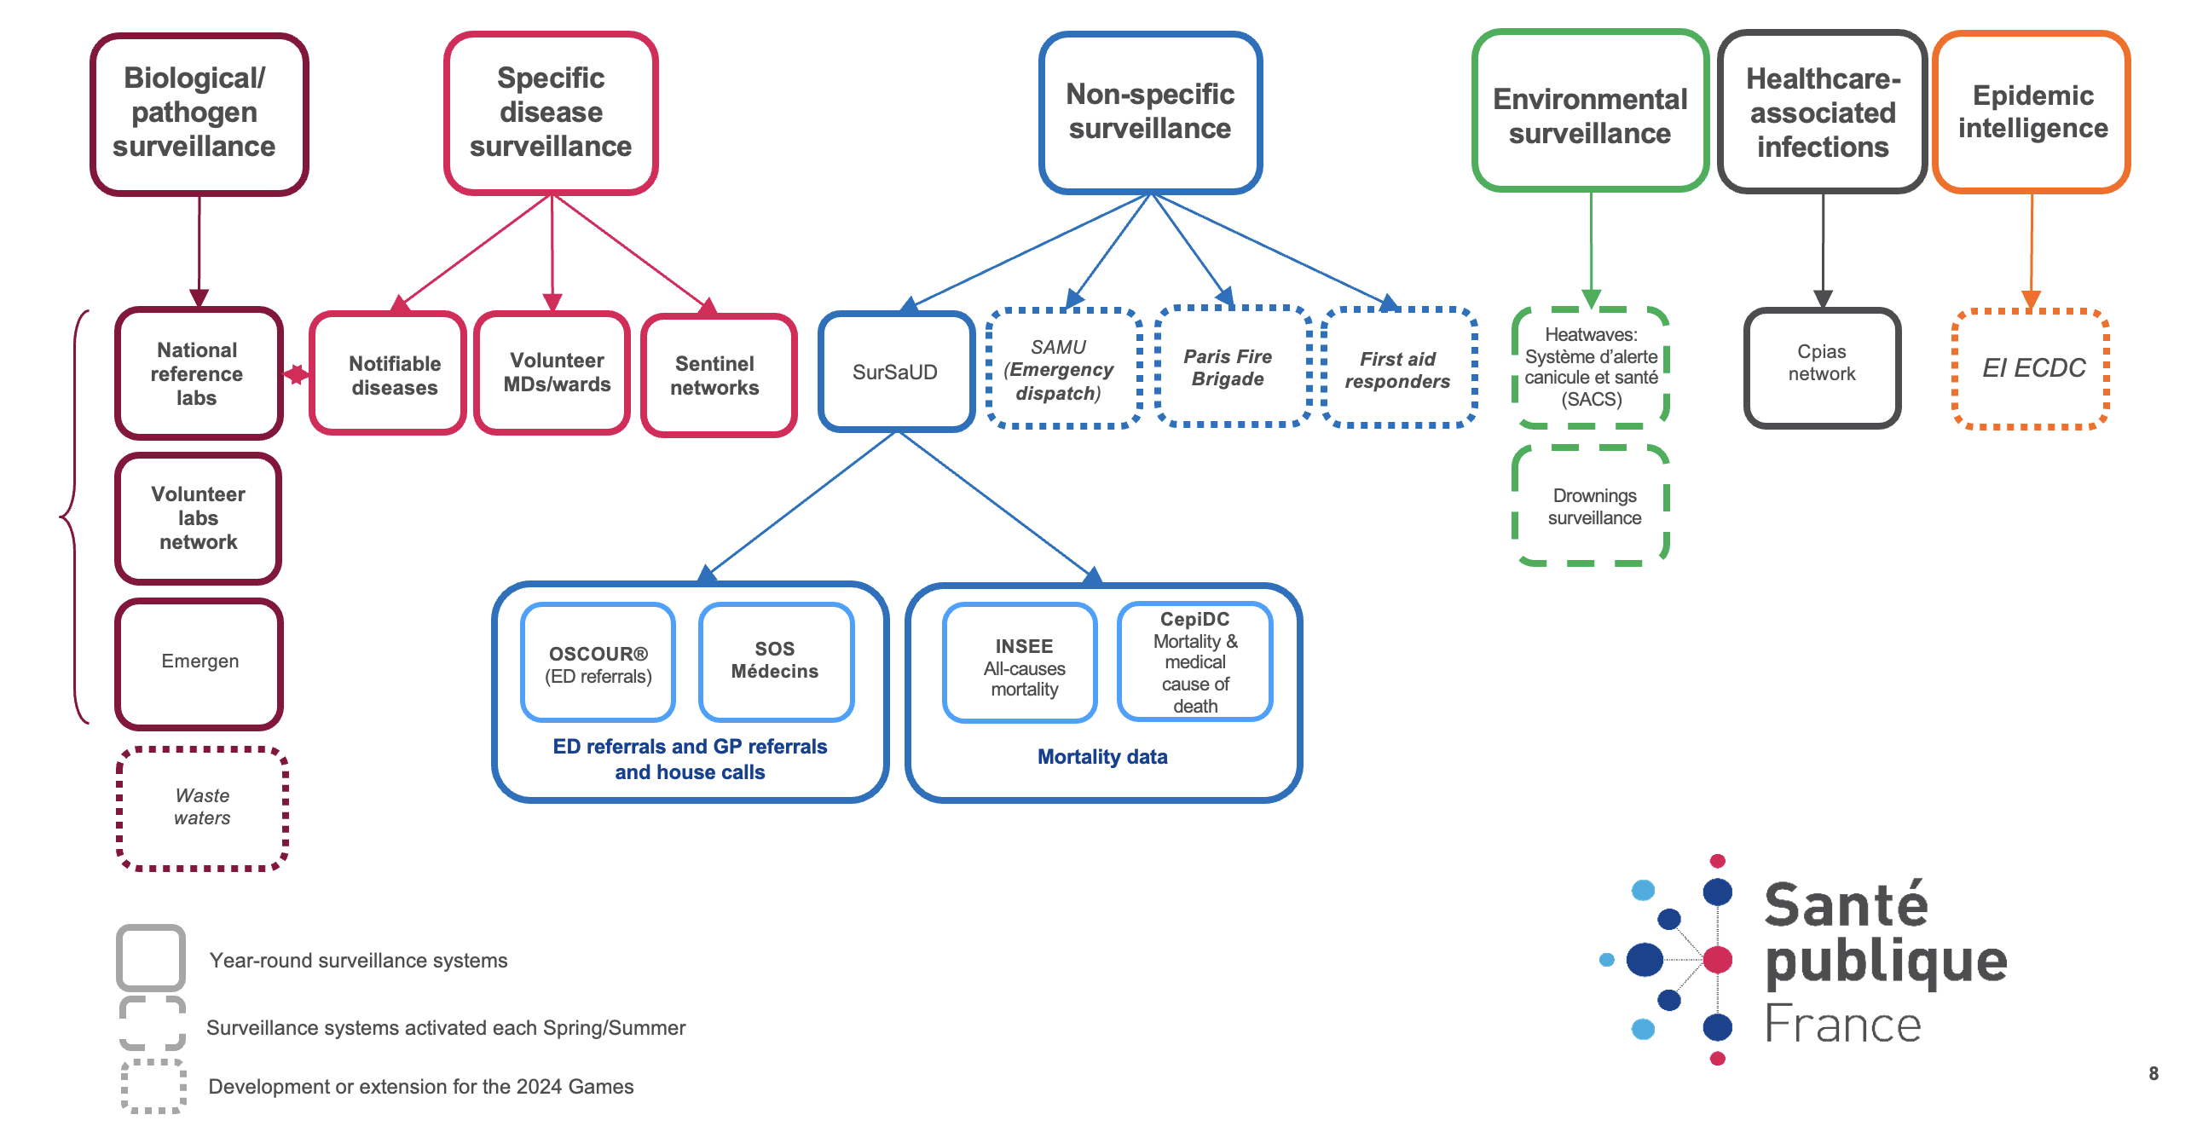
Example of surveillance system during a sporting event

Slide 9
EPI-WIN webinar
View webinar “Safe sporting events, stronger public health: key considerations and country experiences for mass gatherings”
Speakers
  Nedret Emiroglu, Director, Country Readiness and Strengthening Department, WHO headquarters
  Ninglan Wang, Unit Head, Border Health and Mass Gathering Unit
  Walter Alleyne, Ministry of Health and Wellness, Barbados
  Mathieu Letartre and Marie Hamsany, Ministry of Health and Santé Publique France
  Roberto Bertollini, Ministry of Public Health Qatar
  Manami Wanagawa
  Amaia Artazcoz Glaria

