Slide 1
Sudan Virus Disease: What do we know?
6 February 2025

Slide 2
Ebola Diseases
Ebola disease (EBOD) is a severe, often fatal illness caused by viruses belonging to the Orthoebolavirus genus. The case fatality rates is around 50%, ranging from 25%-90% in past outbreaks.
To date, 6 species of Orthoebolaviruses have been identified with 3 of them associated with large outbreaks:
  Bundibugyo virus (BDBV) causing Bundibugyo virus disease (BVD);
  Ebola virus (EBOV) causing Ebola virus disease (EVD); and
  Sudan virus (SUDV) causing Sudan virus disease.
EBOD is a zoonotic disease.
  The virus is transmitted to people through close contact with bodily fluids of infected animals found ill or dead and then spreads in the human population through human-to-human transmission.

Slide 3
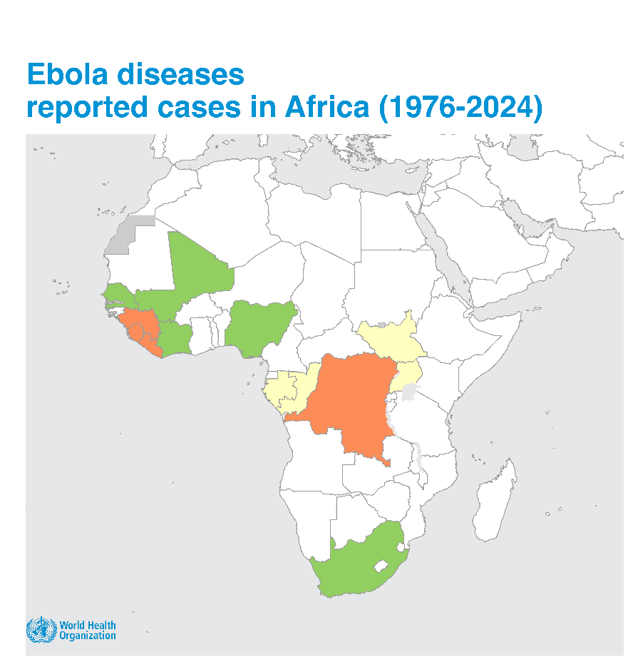
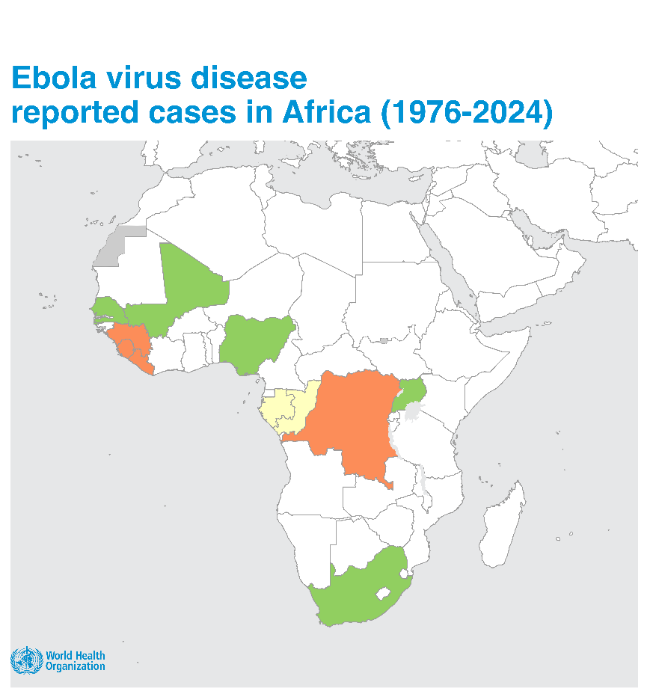
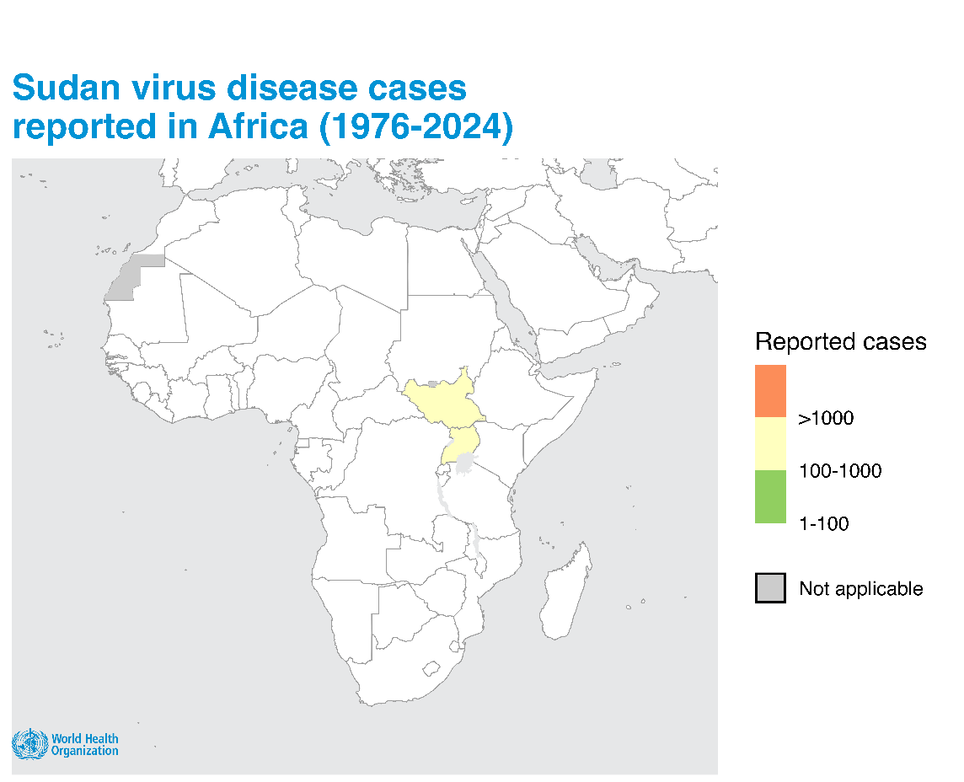
Geographic distribution of Ebola disease outbreaks
Ebola diseases were first identified in two simultaneous outbreaks in 1976, one SVD outbreak in South Sudan and one EVD outbreak in the Democratic Republic of the Congo.
To date, 41 outbreaks of Ebola disease have been reported including 31 of EVD (estimated 23,045 cases including 14,884 deaths, 8 of SVD (estimated 956 cases including 503 deaths) and 2 of BVD (estimated 206 cases including 66 deaths).
The designations employed and the presentation of the material in this publication do not imply the expression of any opinion whatsoever on the part of WHO concerning the legal status of any country, territory, city or area or of its authorities, or concerning the delimitation of its frontiers or boundaries. Dotted and dashed lines on maps represent approximate border lines for which there may not yet be full agreement.

Slide 4
Characteristics of EVD compared to SVD
Characteristics | Ebola virus disease (EVD) | Sudan virus disease (SVD)
N outbreaks (n country)
Estimated CFR (range)
Transmission route
Diagnostic (acute cases)
Approved vaccines
Approved therapeutics
31 (11 incl. 5 from imported cases)
8 (2)
65% (40-100%)
53% (41-71%)
Spillover from wildlife then human-to-human transmission. Resurgence linked to viral persistence in people who recovered documented.
Spillover from wildlife then human-to-human transmission.
Open PRC platform, semi-automated near patient PCR, Ag RDT (oral fluids from deceased individual)
Open PCR platform
No - candidate vaccines, for clinical trials
Yes - two vaccines
No - candidate therapeutics, for clinical trials
Yes - two monoclonal antibodies
Notes:
Ebola disease share a lot of commonalities but aslo have some differences. Because the terminology can be sometime confusing I’ll mention here what are the differences and will focus on the following slides on the commonalities they have.
Evd outbreak have been more commonly reported as mentioned in previous slide compared to SVD
CFR is similar though slightly lower for Sudan virus disease.
Transmission route is mostly similar, starting in most case by a spillover event from wildlife and then human-to-human transmission. However for EVD resurgence linked to viral persistence in people who recovered have been documented up to 7 years after recovery.
In terms of diagnostic tests for acute cases : more options are available for EVD (mostly thanks for the work done by many during the outbreak in West Africa) especially to support patient management with a semi-automated near patient RT-PCR tests and community deaths using an antigenic RDT. This facilitates the lab decentralization closer to outbreak epicenter. For Sudan virus, we only have availble open NAAT platform.
In terms of medical countermeasures, and this is where it’s critical to focus, while we have two approved vaccines againt Ebola virus we don’t have any for Sudan virus. Candidate vaccines have been developed and there is currently a trial happening in Uganda. But we do not know the safety and efficacy of these candidate vaccines. To be noted, the vaccines approved against Ebola virus ARE NOT effective against Sudan virus.
Similarly, there are two recommended monoclonal antibodies for patient with EVD while none are available against SVD. Candidate therapeutics have been developed for clinical trials
Now, let’s focus on all the rest that is similar across Ebola virus disease and Sudan virus disease.

Slide 5



Transmission of Orthoebolaviruses
1. Virus reservoir: fruit bats
5. Virus persistence
It is thought that the virus maintains itself in fruit bats of the Pteropodidea family.
Persistence of virus in body fluids (semen mostly) of people who recovered.
10% Health Care Workers
2. Epizootics in animals
3. Introduction in human population
4. Secondary human transmission
Infected fruit bats enter in direct or indirect contact with other animals and pass on the infection.
Large-scale epidemics in primates or mammals (e.g. forest antelopes) can happen.
Humans are infected either through:
handling infected dead or sick animals found in the forest (more frequent);
or through direct contact with infected bats (rare event).
Secondary human-to-human transmission occurs through direct contact with the blood, secretions, organs or other body fluids of infected persons.
High transmission risk when providing direct patient care or handling dead bodies (funerals).
Notes:
Starting with transmission of orthoebolavirus.
It is thought that the orthoebolavirus maintain themselves in fruit bats.
It can then be transmitted other animals such as chimpanzees, gorillas, monkeys, forest antelope or porcupines Epizooties in non-human primate have been documented.
Introduction of the virus in the human population is generally through through close contact with the blood, secretions, organs or other bodily fluids of infected animals.
Once the spillover happened, it spreads between persons via :
direct contact with body fluids (stool, vomit, blood, urine, saliva, semen, breast milk) of a sick person with EBOD
direct contact with an EBOD deceased person’s body (body handling, funeral involving touching of the body and body fluids)
contact with surfaces or equipment contaminated by the body fluids of a sick person with EBOD, and especially through unsafe injection practices.
Viral persistence in some body fluids of some people who recovered has been documented, mostly in semen. Transmission via exposure to infected semen have been documented although it remains rare events. Relapse event, via persistence of the virus in the brain has also been documented for Ebola virus.

Slide 6
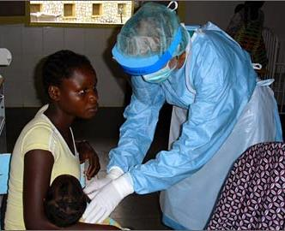
At-risk population
People with contact with animals sick or dead in rainforest
People in close contact such as family members or care givers with sick people exhibiting symptoms.
Healthcare workers and medical personnel caring for EBOD patients.
Laboratory workers handling specimens from EBOD patients.
People handling bodies of people who died of EBOD.
Traditional healers caring for EBOD patients.

Slide 7
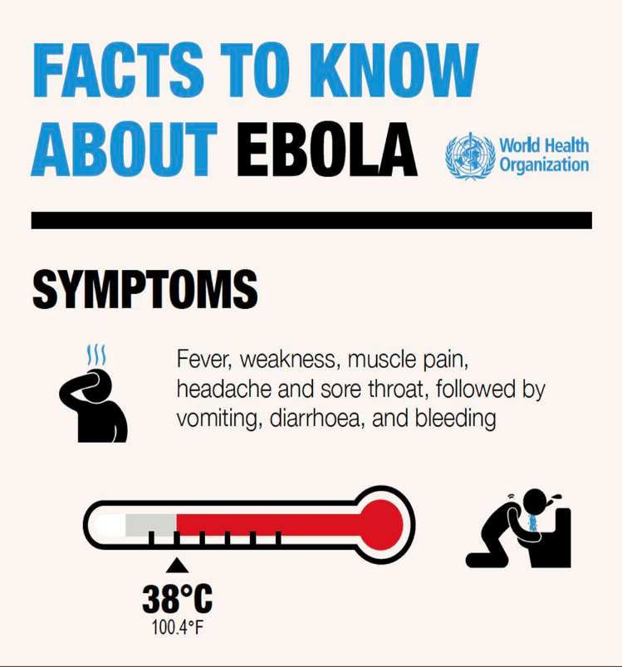
Clinical features of Ebola disease
The incubation period is 2 - 21 days.
Human are NOT infectious until they develop symptoms.
Initial symptoms can include sudden onset of fever and fatigue, muscle pain, headache and sore throat.
Usually followed by vomiting, diarrhoea, rash, impaired kidney and liver function, spontaneous bleeding internally and externally (in some patients).

Slide 8
Identifying cases
Symptoms are non-specific; clinical diagnosis may be difficult.
Differential diagnosis includes other viral haemorrhagic fevers, yellow fever, malaria, typhoid fever, shigellosis, and other viral and bacterial diseases.
Patient history is essential and should include:
  Contact with a dead or sick animal;
  Contact with a suspected, probable or confirmed Ebola disease patient
Definitive diagnosis requires testing:
  reverse transcriptase polymerase chain reaction (RT-PCR) assay
  IgG and IgM antibodies enzyme-linked immunosorbent assay (ELISA)
  antigen detection tests
  virus isolation by cell cultureHandling and processing specimen requires suitably equipped laboratories under maximum biological containment conditions and staff collecting samples should be trained.

Slide 9
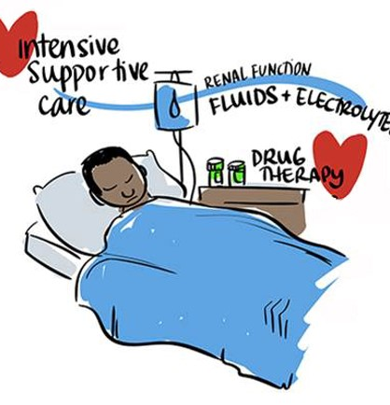
Caring for patients with Ebola
Chances of survival can be improved through:
  Early intensive care support such as monitoring fluids and electrolytes balance and vital signs, and careful rehydration.
  Supportive drug therapy including painkillers, antiemetic for vomiting, anxiolytic for agitation, +/-antibiotics and/or antimalarial drugs.
  Psycho-social support and services are also critical.
For Ebola virus disease, WHO made strong recommendations for treatment with mAb114 (ansuvimabTM) or REGN-EB3 (InmazebTM).
There are no approved specific therapeutics for other Ebola diseases, though candidate therapeutics are under development and be rolled out through clinical trials.

Slide 10
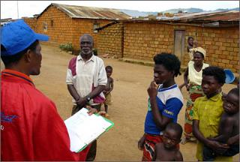
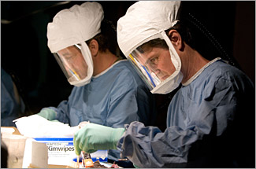
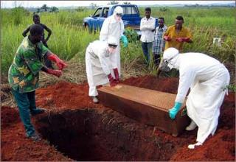
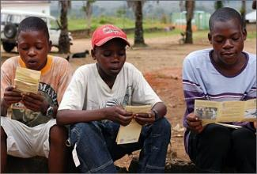
Ebola Disease Outbreak Control
Ebola Disease Outbreak Control
Strong community engagement to empower communities in defining and adhering to outbreak control interventions
Surveillance and contact tracing
Laboratory support for confirmation and patient management
Case management
Infection prevention and control in health facilities
Safe and dignified burials

Slide 11
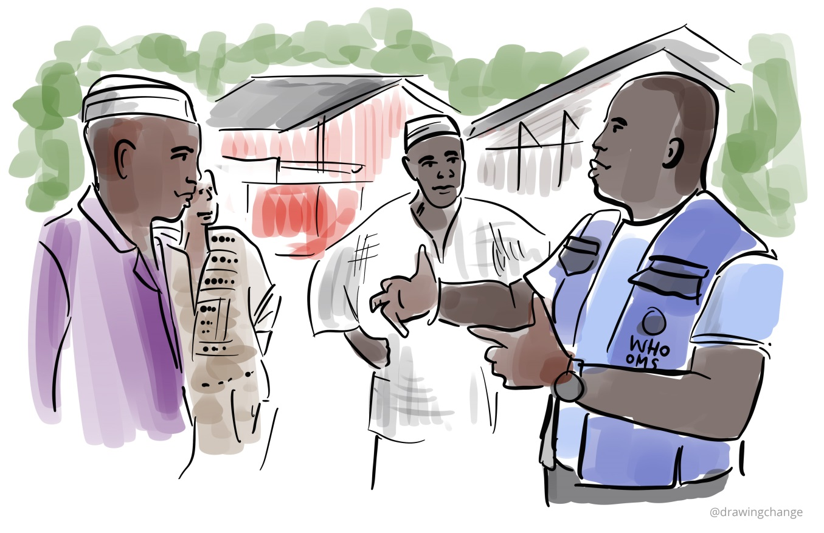
Important control measures
Community Engagement and awareness
  Trust from communities has to be gained and respect shown to everyone affected by an outbreak.
  Engage with communities to promote desired health practices and behaviours, particularly on caring for sick and/or deceased persons.
  Provide accurate and timely health advice and information on the disease.
Reducing wildlife-to-human transmission
  Animals should be handled with gloves and other appropriate protective clothing.
  Animal products (blood and meat) should be thoroughly cooked before consumption.
Reducing human-to-human transmission
  Avoid close contact with EBOD patients and their body fluids and refer early patient to an adequately equipped health facility.
  Patients suspected or confirmed for EBOD should be isolated in a designated treatment center for early care and to avoid transmission at home.
  Safe and dignified burial practices should be facilitated for suspected or confirmed EBOD patients who died.

Slide 12
Ongoing Response - Uganda
Coordination
High level WHO leadership and commitment, with the in-country presence of the Dr. Mike Ryan, the Deputy Director General and Executive Director for WHO Health emergencies
EOC was activated at MOH which is, leading and coordinating the heightened surveillance and response efforts.
Setting up coordination structures with partner involvement activated at national and subnational levels
Integration of PRSEAH into response activities
Public Health Measures (at the epicenters)
Institutional quarantine established for high risk and hard-to-manage contacts
Mandatory safe and dignified burial for confirmed and probable cases
Surveillance, PoE
Case investigation teams, rapid response teams and contact tracing teams operational in all affected districts
Ongoing In-depth investigation into the chains of transmission and linkages
Exit screening is ongoing at Entebbe International Airport and six Points of Entry (PoEs) to mitigate cross-border transmission with the support of WHO.
Laboratory
144 samples tested for SVD by PCR
Genomic sequencing – outbreak results from a zoonotic spillover event and is closely related to the 2012 Luwero outbreak.(not linked to 2022 outbreak)
Case Management
  03 Treatment units set up: Mulago, Mbale and Matuga
  Strengthening of treatment unit and supportive care
  Use of Remdesivir on compassionate use for confirmed cases
  Ongoing MPHSS support to all patients admitted in isolation unit and quarantine
Infection Prevention and Control
  Training of HCW managing patients and SDB teams in KMA, Mbale activated
  Ongoing assessment and improvement of IPC in both private and public facilities
Research
  Launch of the Tokomeza clinical trial on Monday 3 Feb 2025 at Mulago with support from WHO(within 4 days of outbreak declaration)
  Therapeutics: Clinical trial of MBP134 to start soon
OSL
  WHO provided essential supplies Ongoing assessment of needed supplies and stock levels
RCCE
  Review , translation and dissemination of messages
  Ongoing sensitization and awareness creation in communities

Slide 13
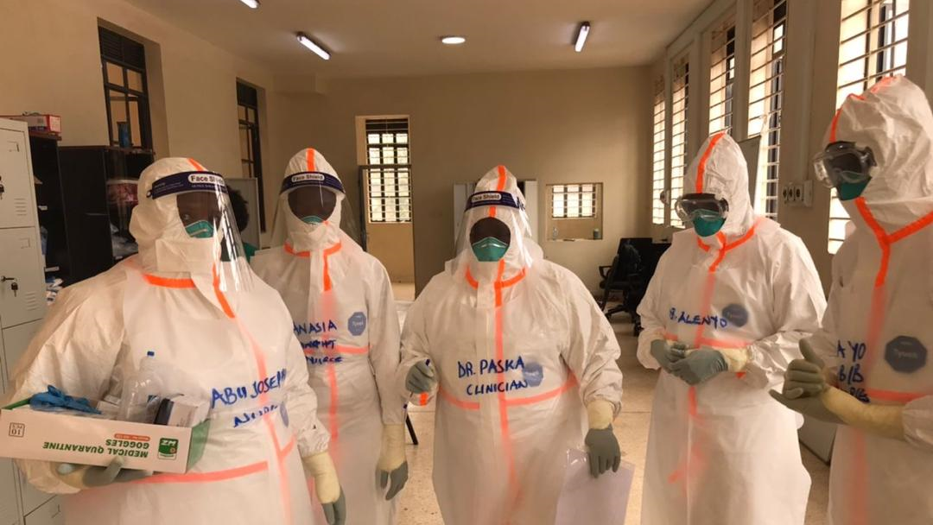
Lessons and recommendations in Uganda
Lessons
Investments during previous outbreaks: Strengthening national capacities leading to progressive improvement in coordination, field epidemiology, laboratory testing including genomic sequencing
Integrating research in preparedness and response: Early engagement with regulatory entities and having ready trial protocols facilitated rapid implementation of RCT.
Rapid and comprehensive response( rapid identification of contacts , follow-up, clinical care, IPC and other public health measures)
Recommendations
Resource mobilization to meet the response needs
Strengthening response across all pillars
Integration of response to the multiple ongoing outbreaks including mpox, Crimean-Congo Hemorrhagic Fever (CCHF), cholera, measles and yellow fever.
Scaling up operational readiness in neighboring countries.
Continued investment in R&D of counter measures against VHFs

Slide 14
Ebola disease resources
Fact sheet and coordination
Ebola disease - Fact Sheet (link)
Ebola and Marburg disease epidemics: preparedness, alert, control, and evaluation (link)
Ebola disease – Questions and answers (link)
Surveillance and contact tracing
Case definition recommendations for Ebola or Marburg virus diseases (link)
Implementation and management of contact tracing for Ebola virus disease (link)
Ebola disease outbreak toolbox (link)
Risk communication and community engagement
Communication for behavioural impact (COMBI) (link)
WHO outbreak communication planning guide (link)
Safe and dignified burials
How to conduct safe and dignified burial of a patient who has died from suspected or confirmed Ebola disease (link)
Travel and Points of Entry
Considerations for border health and points of entry for filovirus disease outbreaks (link)
Exit screening at airports, ports and land crossings: Interim guidance for Ebola disease (link)
Laboratory
Diagnostic testing for Ebola and Marburg diseases: interim guidance (link)
How to safely collect blood samples by phlebotomy from patients suspected to be infected with filovirus (link)
How to safely collect oral swabs (saliva) from deceased patients suspected to be infected with filovirus (link)
How to safely ship human blood samples from suspected EBOD cases within a country by road, rail and sea (link)
Clinical care
Optimized supportive care for Ebola disease: clinical management standard operating procedures (link)
Guidelines for the management of pregnant and breastfeeding women in the context of Ebola disease (link)
Clinical care for survivors of Ebola disease: interim guidance (link)
Ebola and Marburg treatment centres: facility design and construction standards for preparing for and responding to outbreaks (link)
Essential Items Estimator Tool for health facilities in Ebola disease context (link)
Medical countermeasures for Ebola virus disease
Therapeutics for Ebola virus disease (link)
International Coordinating Group on vaccine provision – Ebola virus disease (link)
SAGE recommendations on Ebola virus disease vaccine (link)
Infection Prevention and control
Infection prevention and control guideline for Ebola and Marburg disease (link
Steps to put on (link) and remove (link) personal protective equipment for Ebola/Marburg disease: Coverall
Steps to put on (link) and remove (link) personal protective equipment (PPE) for Ebola/Marburg disease: Gown and headcover
Countermeasures R&D for Ebola diseases
A WHO-Strategic Research Agenda for Filovirus Research and Monitoring (WHO-AFIRM) (link)
CORE trial protocol for candidate therapeutics against Ebola disease (link)
CORE trial protocol for candidate vaccines against Ebola disease (link)
Filoviridae - Landscape of vaccines and therapeutics licensed or under development (link)
Trainings
FiloTREAT - clinical management to filovirus disease (link)
Design of screening and treatment centers for Ebola and Marburg (link)
IPC measures in health-care settings for Ebola or Marburg disease outbreaks (link)
International Coordinating Group on vaccine provision (link)

Slide 15
EPI-WIN webinar
Listen to “EPI-WIN Sudan Virus Disease Outbreak: What do we know?”
Speakers
  Anaïs Legand, Viral Haemorrhagic Fevers team, Health Emergency Programme,WHO Geneva
  Dr Otim Patrick Ramadan, Regional Incident Manager (Filoviruses IMST), WHO Regional Office for Africa

