Slide 1
Community Protection for Cholera: Risk Communication and Community Engagement (RCCE)
10 September 2025

Slide 2
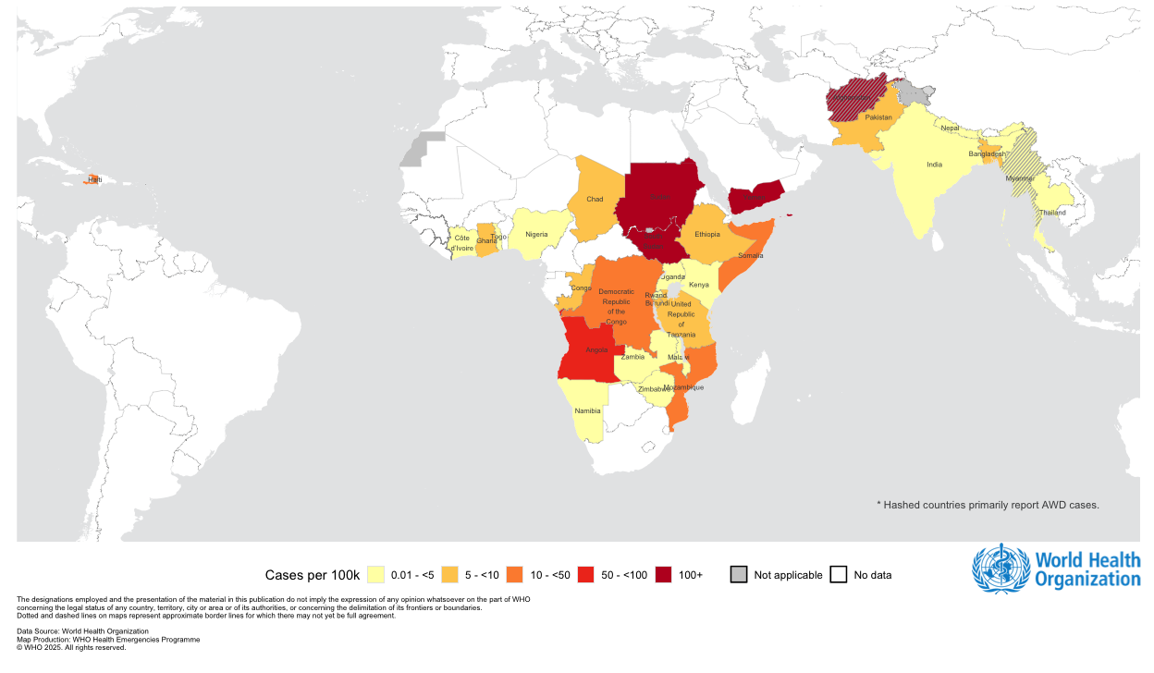
Global Cholera and AWD Situation
1 January to 31 August 2025 (W35)
435 006 | Cases reported in 2025
5 007 | Deaths reported in 2025
31 | Countries officially reporting cases in 2025
5 | Countries currently in “Acute Crisis” Chad, Democratic Republic of Congo, Republic of Congo, South Sudan, Sudan
Global cholera / AWD attack rate per 100 000 population since Jan 2025
a 17.9% decline in reported cases compared with the same period in 2024
a 51.1% increase in reported cases compared with the same period in 2024
Cholera is….

Slide 3
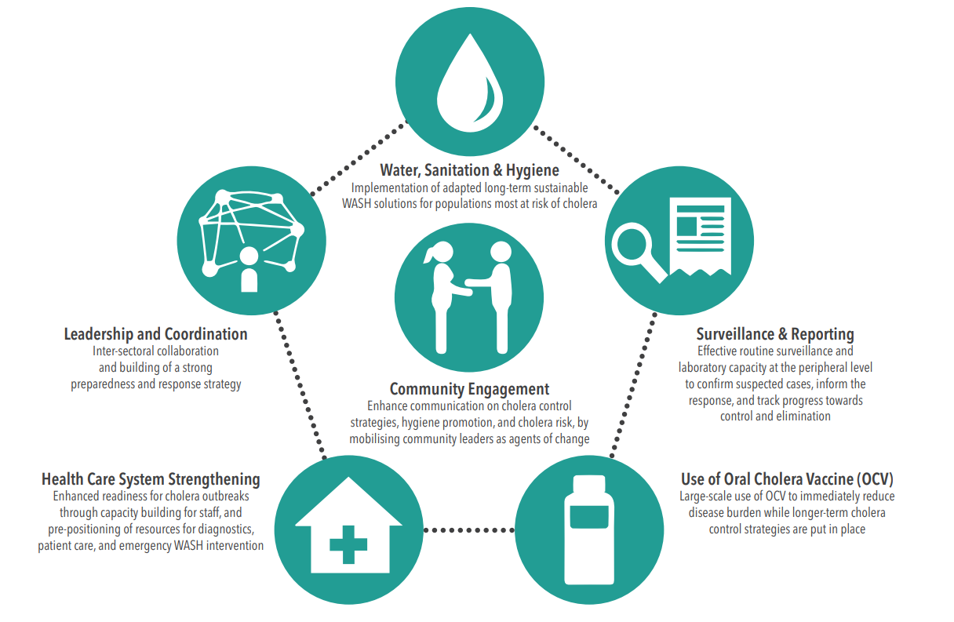
A package of measures to control cholera
The GTFCC encourages countries to develop National Cholera Control Plans to plan for and monitor the implementation of cholera control measures

Slide 4
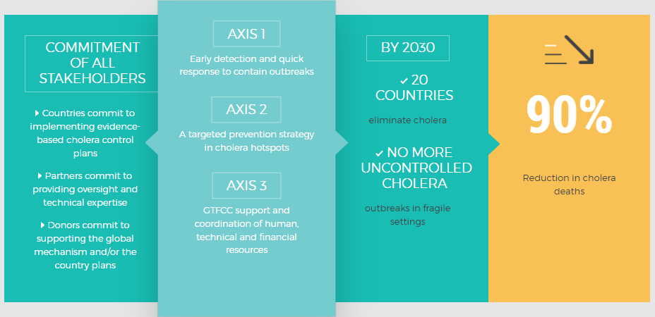

Ending cholera: A Global Roadmap to 2030

Slide 5
« Theory of change »
Long-term WASH -
Sustainable solution, required for elimination
Change reactive approach, adopt an approach to prepare for and prevent outbreaks
Target and coordinate multisectoral interventions, leaning on:
  Strong surveillance to target interventions
  A clear coordination mechanism
  Country commitment
  An engaged community
Vaccination -
Protect the population and “buy time”
Case management, Emergency WASH –
Save lives, halt transmission
From emergencies to development
Community engagement
Surveillance

Slide 6
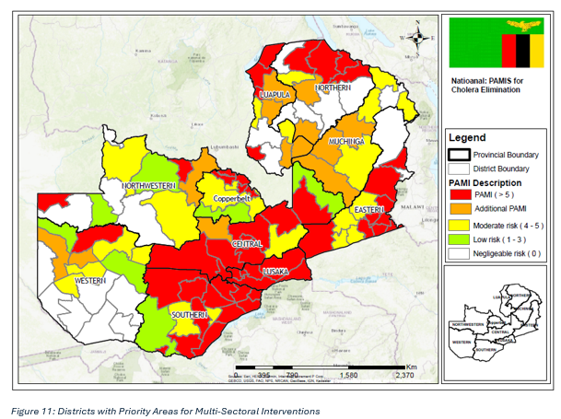
The Role of Community data in the 2024 Zambia Cholera response and application in Zambia
Cholera has been endemic in Zambia since 1977
2024 saw one of the worst Cholera outbreak with over 23,000 cases.
In 2024, nearly half of Zambia’s districts(54 out of 116 districts) were mapped as Priority Areas for Multi-Sectoral Cholera Interventions(PAMIs)
5 million people at risk of cholera in PAMI districts
Since then, the country has had 4 outbreaks (Muchinga, Copperbelt, Central and currently Northern provinces of Zambia.
Community data through RCCE activities such as RQAs and CFMs continue to play a critical role in Cholera emergency response.

Slide 7
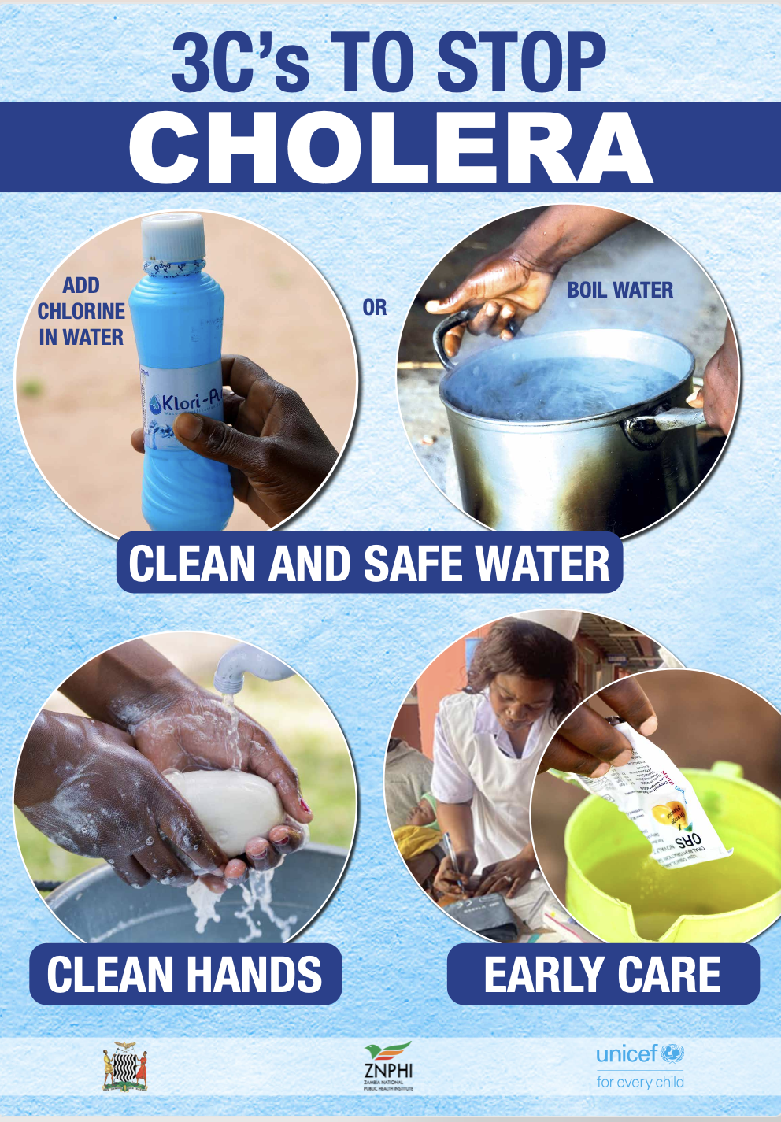
Applications of community data during the cholera outbreak response in Zambia
Community feedback were gathered through RCCE partners (MOH CBVs and frontline health care, Zambia Red Cross, CBOs, FBOs), from call centres (e.g Childline Zambia, ZNPHI, DMMU) and live radio program discussions.
An Interagency Interactive community feedback mechanism dashboard was developed
How community data was used in the cholera outbreak:
1. Informed tailored risk communication messaging
2. Targeted Engagements for at risk populations
3. Informed multisectoral response activities across various pillars
4. Addressed socio-economic barriers to care
5. Improved mental health and psychosocial support
6. Informed policy

Slide 8
Community-Led Cholera Response in Sudan
Integrating RCCE Approaches into Cholera Prevention and Control
Cholera Response Framework in Sudan
Sudan, with a population of approximately 48 million, has faced severe challenges since the onset of armed conflict in April 2023, leading to widespread displacement, health system collapse, and a nationwide cholera outbreak by August 2025.
The crisis has resulted in over 48,000 suspected cholera cases and more than 1,000 deaths, affecting nearly all states and overwhelming already fragile health infrastructure.
🤝 Community Ownership
Youth, women, IDPs, drama groups, and local leaders as trusted messengers
Household feedback used to adapt strategies
🧭National Coordination
Federal & State MoH, HAC, UNICEF, WHO, NGOs
Health Cluster coordination
🩺Surveillance & Case Management
Early detection (EWARN, health facilities)
ORS / IV treatment centers
💧WASH Interventions
Water chlorination & safe storage
Emergency latrines & waste management
📢RCCE & Community Engagement
📦 Logistics & Supplies
ORS, chlorine, soap distribution Pre-positioned supplies in high-risk areas
📢RCCE & Community Engagement
Vols training, community engagement, radio messaging, interactive community theatre

Slide 9
Community-Led Cholera Response in Sudan
Integrating RCCE Approaches into Cholera Prevention and Control
Integration of Social & Behavioral Data
- Household surveys
- Community feedback
- Behavior monitoring
- Adaptive messaging
Radio Drama & integrative
Household visits
Community vols
Community engagement sessions
RCCE Committee
Federal MoH (Chair)
Health Promotion Dept. (Rapporteur)
UN Agencies: UNICEF, WHO, UNFPA
National NGOs & Sudanese Red Crescent
Ministry of Religious Affairs & Endowment
State Health Depts. & National Experts
Using data collected from household surveys, messages focused on very practical behaviors: washing hands with soap, treating drinking water, and using latrines consistently. Communities themselves began organizing cleaning campaigns, and in several sites people even dug new latrines to reduce open defecation.
Comprised of partners from UN agencies, NGOs, government bodies, and media, RCCE committees are mandated to ensure a unified, timely and coordinated response to public health emergencies.

Slide 11
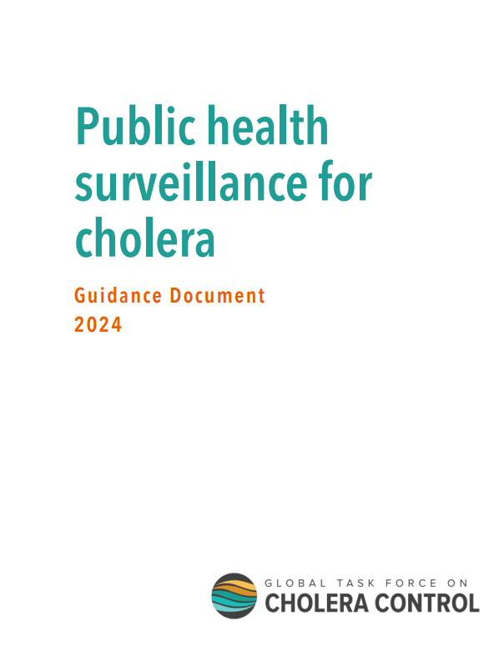
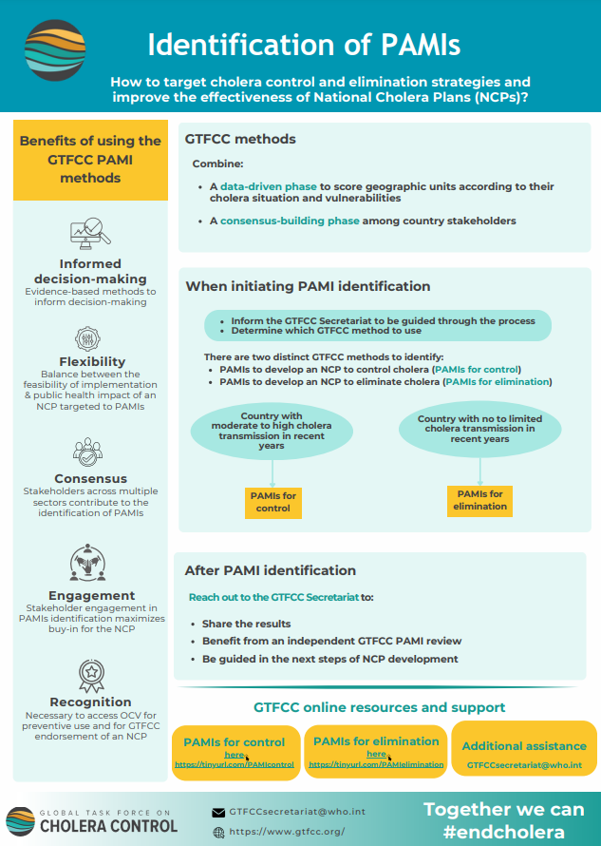
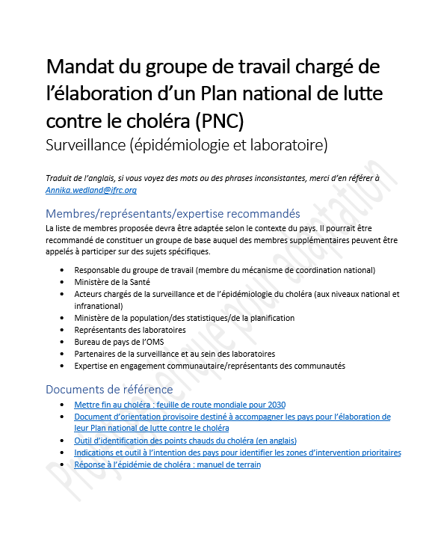
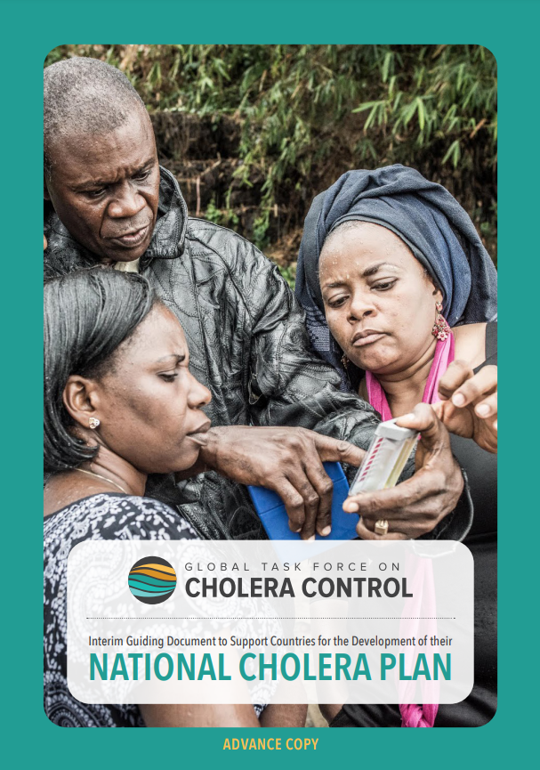
Tools to support National Cholera Plan Development
  NCP Interim Guiding Document
  Template for National Cholera Plans
  Terms of reference for working groups what to consider when developing the country specific NCP
  Priority Areas for Multisectoral Interventions (PAMIs) – Global Task Force on Cholera Control, Technical guidance Identification of Priority Areas for Multisectoral Interventions (PAMIs) for cholera control – Global Task Force on Cholera Control / elimination
  Specific set of guidance and tools per pillar available on the GTFCC website in the Resources section (use the filter to access the different areas of intervention)
  Tools to support countries in developing the situational analysis or SWOT analysis are under development.

Slide 12
EPI-WIN webinar
View webinar “Community Protection for Cholera: Risk Communication and Community Engagement (RCCE)”
Speakers
  Stella Chungong, Director, WHO Geneva
  Kai von Harbou, Unit Head, WHO Geneva
  Dana le Roy, Policy Officer Nutrition and Health, WHO
  Marlon Martinez Valiente, Technical Officer, WHO
  Kathryn Alberti, Technical Officer, WHO
  Tikulirekuti Banda, SBC and RCCE Officer, UNICEF Zambia
  Ibrahim Abdelkhier, NIDAA, Sudanese Development Call Organization
  Dana McLaughlin

