Slide 1
Respiratory syncytial virus (RSV) Genomic Surveillance: How and why
13 August 2025

Slide 2
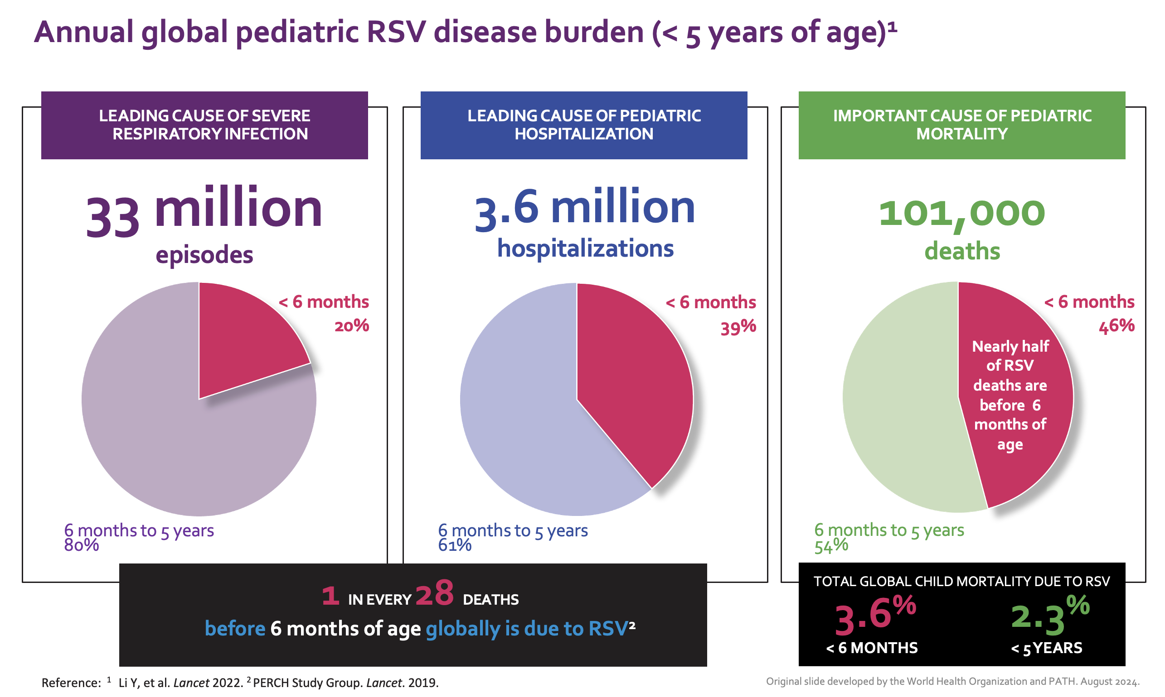
Respiratory Syncytial Virus
Human Respiratory Syncytial Virus (RSV) is a globally prevalent cause of lower respiratory tract infection in all age groups.
  In infants and young children, the first infection may cause severe bronchiolitis that can sometimes be fatal.
  In older children and adults without comorbidities, repeated upper respiratory tract infections are common and range from subclinical infection to symptomatic upper respiratory tract disease.
RSV genomic surveillance helps understand the phylogenetic diversity of RSV in communities. It serves to inform development of RSV prevention products and track virus evolution following introduction of RSV vaccines and monoclonal antibodies in communities.
The RSV genomic surveillance guidance is critically important for WHO because it operationalizes a core pillar of the Global Genomic Surveillance Strategy for Pathogens with Pandemic and Epidemic Potential (2022–2032).

Slide 3
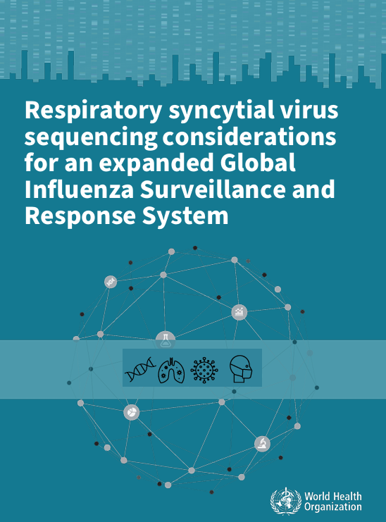
RSV sequencing programme
Genomic sequencing - part of integrated surveillance strategies to understand challenges to the effectiveness of newly introduced interventions
There is rapid progress in development of new RSV interventions e.g. vaccination
RSV immunization is now recommended for infants, pregnant persons and older adults globally
Goal of the sequencing programme:
  Understand current global genetic diversity of RSV
  Understand the spread of lineages globally
  Support the use of molecular diagnostics
  Inform the development and introduction of interventions

Slide 4
Objectives of the sequencing recommendations
Outline standards for RSV specimen collection and diagnostic testing for high quality sequencing
Improve access to tools for RSV sequence data generation, analysis and interpretation
Ensure timely sharing of RSV sequence data
Strengthen capacity within participating laboratories and ensure the sustainability of integrated respiratory virus surveillance
Adopt and repurpose existing sequencing technologies to maximise the use of existing laboratory infrastructure, which can then be applied to other pathogens or emergencies

Slide 5
Sample types, timing, and patient groups
Surveillance and sequencing strategies differ between countries
  Use country’s existing surveillance system criteria
Aim for representativeness with sampling:
  Age groups that are likely to be targeted by interventions
    0 - 11 months [maternal vaccines / infant monoclonal antibodies]
    12 - 23 months [pediatric vaccines / monoclonal antibodies in high risk]
    ≥60 years, if a country is introducing vaccination in this older age group
    Other age groups, dependent on resources and future interventions
  Different geographic locations across the country
  Different time points (early, middle, late season and out of season)
  Ranges of disease severity (milder community cases, hospitalised)
Clinically significant cases, such as fatal cases and breakthrough infections

Slide 6
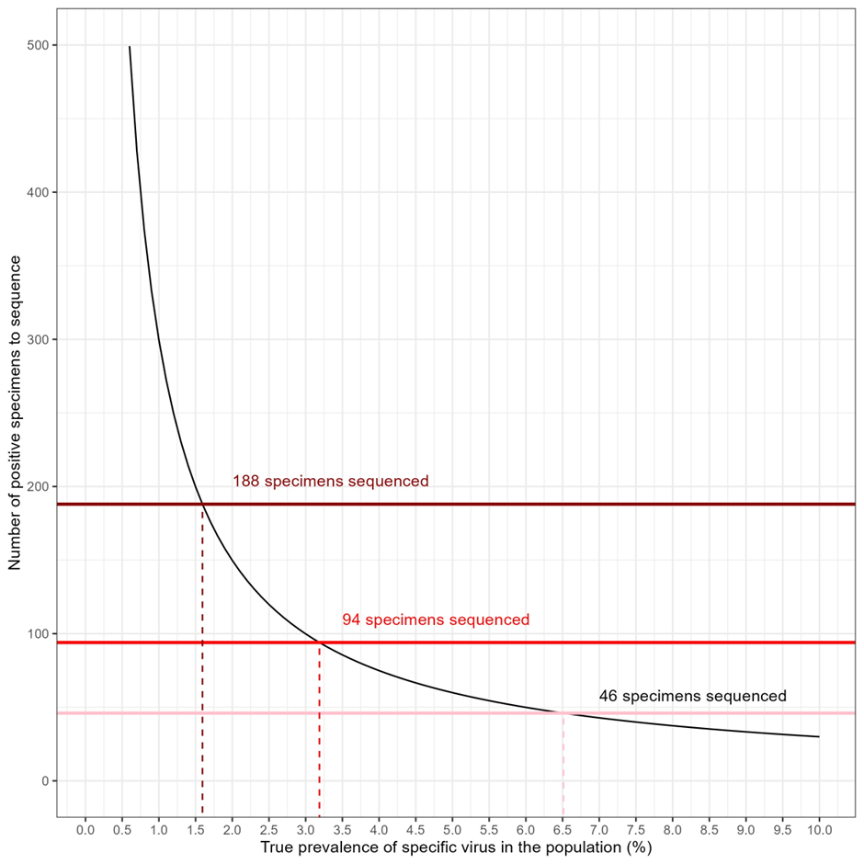
Sample size
Identify main lineages circulating within a country at high prevalence, and minor lineages circulating globally at low prevalence
Recommend 46 sequences per country per year
  Identify lineages circulating at a prevalence of 10% (95% CI 4.2-22.0%)
  Permit identification of a lineage circulating to a prevalence of 6.6% nationally, and 0.27% globally
Choose proportion of RSV-A to RSV-B samples based on the circulating distribution

Slide 7
Storage, transport, and handling to preserve RNA quality
Same type of specimens collected for SARS-CoV-2 and influenza testing
Recommended: nasal aspirates, nasal swabs, throat (OP) swabs, nasopharyngeal swabs, nasopharyngeal aspirates, combined NP/OP
Viral/Universal transport medium (VTM/UTM)
Stored and transported at 2-8°C, and RNA extracted within 72 hours
Alternatively, freeze in -70°C freezer
Freeze-thaw cycles should be minimized
rRT-PCR testing – CDC IRR / commercial kits

Slide 8
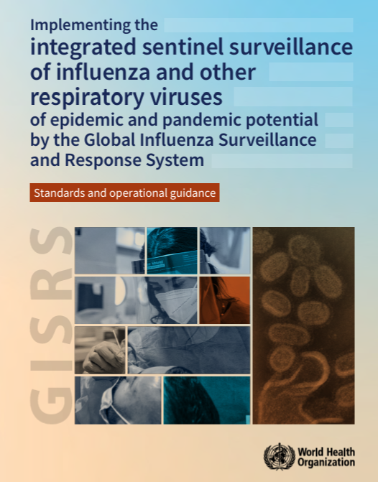
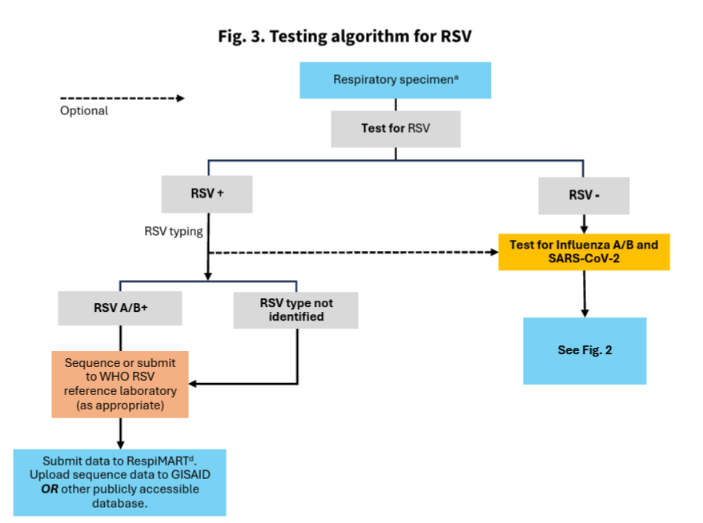
Integration with Influenza and SARS-CoV-2 specimen workflows

Slide 9
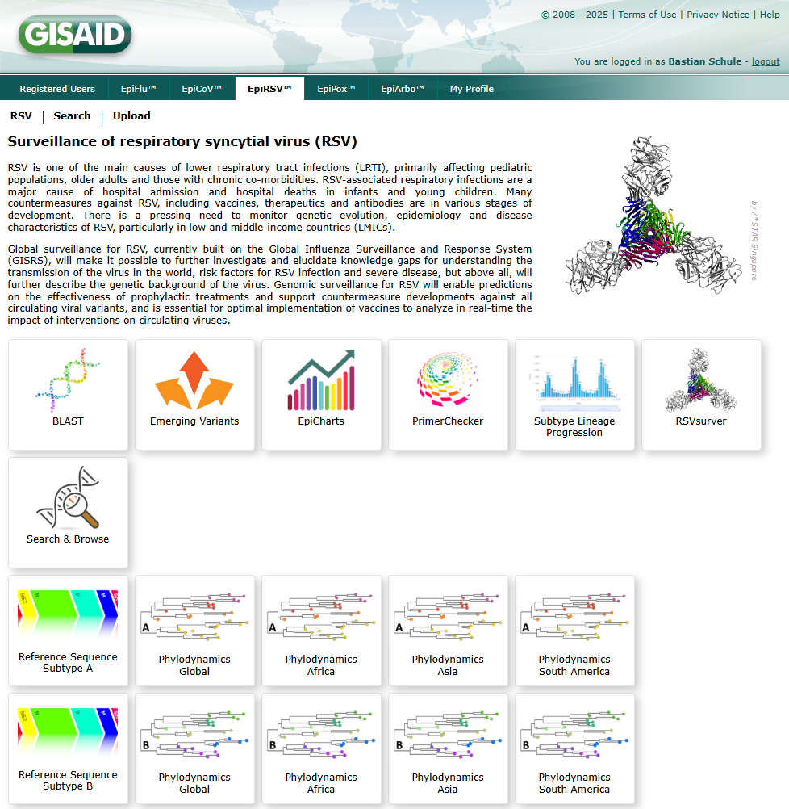
EpiRSV & other tools for RSV surveillance
Global surveillance for RSV is currently built on the Global Influenza Surveillance and Response System (GISRS). The system allows further investigation better understanding of virus transmission, the risk factors for infection and severe disease and better understanding of viral genomics.
EpiRSV was launched in late 2020. With data from more than 99 countries, it provides access to >80K sequences. Its tools have been updated for a variety of analysis.
The webinar runs through the EpiRSV and other tools and how these can be used by researchers and organizations for RSV surveillance.

Slide 10
EPI-WIN webinar
View webinar “Respiratory syncytial virus (RSV) Genomic Surveillance: How and why”
Speakers
  Dr Wenqing Zhang, WHO
  Dr Siddhi Hirve, WHO
  Dr Thomas William, University of Edinburgh, UK
  Dr Sebastian Maurer-Stroh, GISAID Data Science Initiative
  Dr Obadia Mfuh Kenji, WHO

