Slide 1
Seasonal Influenza Vaccination: Protecting the vulnerable
1 October 2025

Slide 2
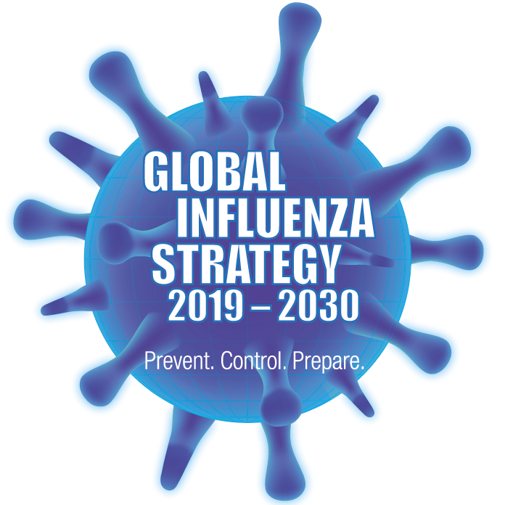
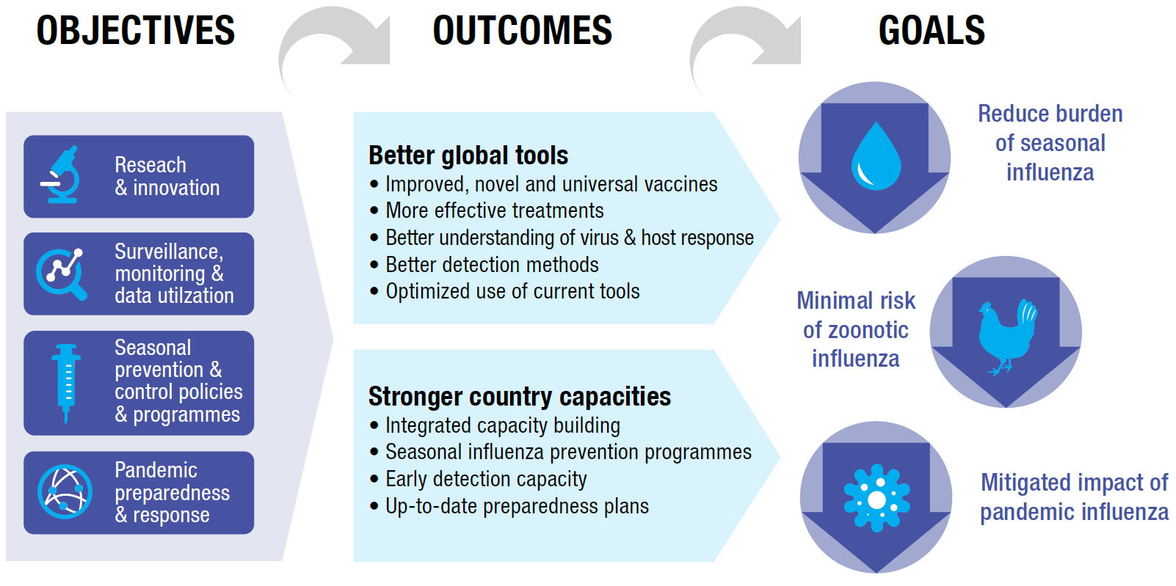
Global Influenza Strategy 2019-2030:
Influenza prevention and control is a global priority
Vision for 2030
Attainment of the highest possible influenza prevention, control and preparedness to safeguard the health of all people
Notes:
WHO launched the Global Influenza Strategy for 2019-2030 in March 2019. The vision for 2030 is “attainment of the highest possible influenza prevention, control and preparedness to safeguard the health of all people.” The strategy has two high-level outcomes (better global tools and stronger country capacities) supported by 4 strategic objectives.
The strategy aligns with WHO’s 13th general programme of work and the Sustainable Development Goals for 2030.

Slide 3
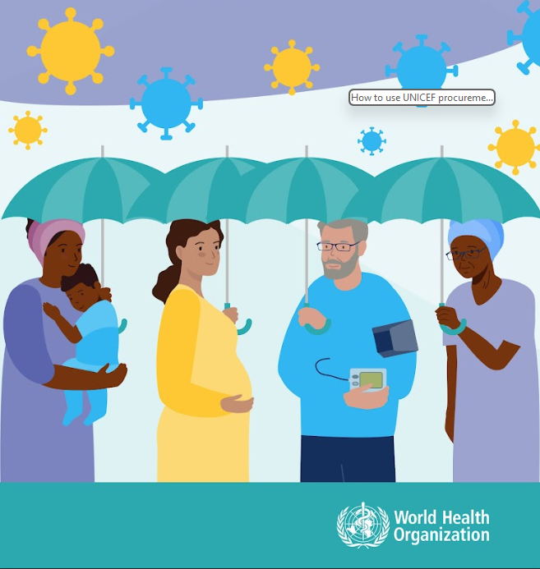
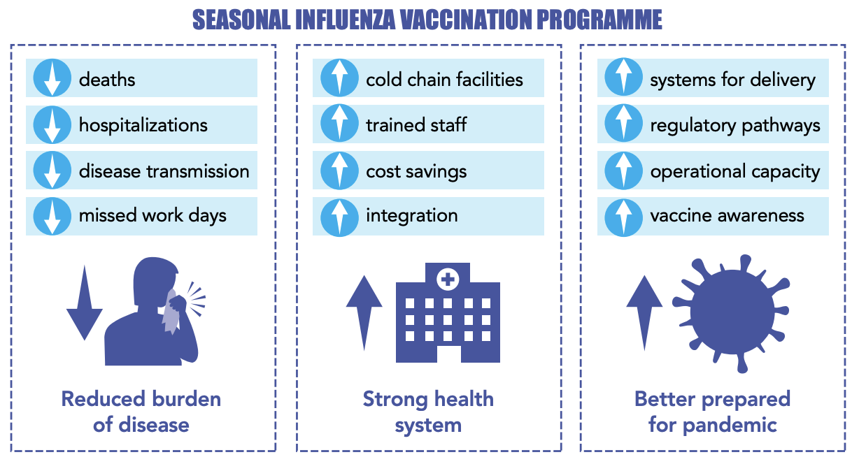
Importance of seasonal influenza vaccination
  WHO recommends all countries consider introducing or expanding their seasonal influenza vaccination programme.
Benefits of seasonal influenza vaccination
  Target group selection should be driven by national disease burden, priorities, resources, programmatic feasibility

Slide 4
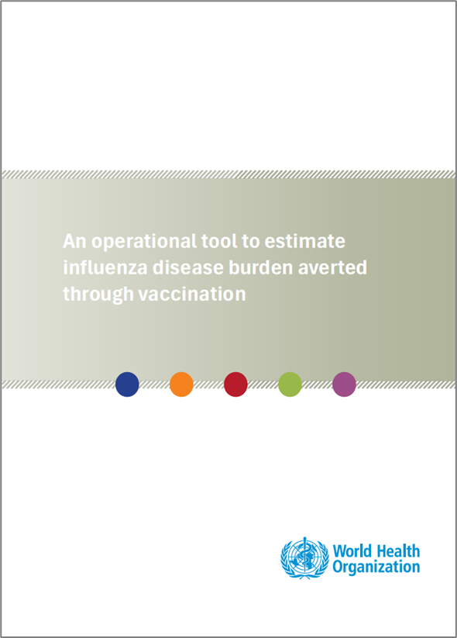
Identifying the impact of influenza vaccination
Influenza vaccination impact is assessed by:
  Quantifying averted deaths, hospitalizations, and medical visits.
  Estimating the impact of existing vaccination campaigns and the potential impact of introducing vaccines in new settings.
  Comparing vaccine types and formulations to optimize public health outcomes.
These data support:
  Advocacy efforts for vaccination programs.
  Risk communication to populations.
  Economic evaluations of vaccination benefits.
https://www.who.int/publications/i/item/B09385

Slide 5
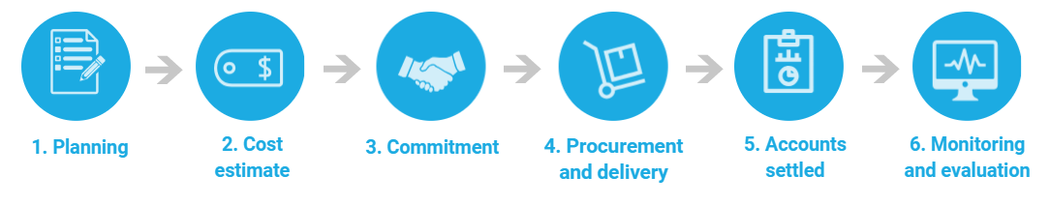
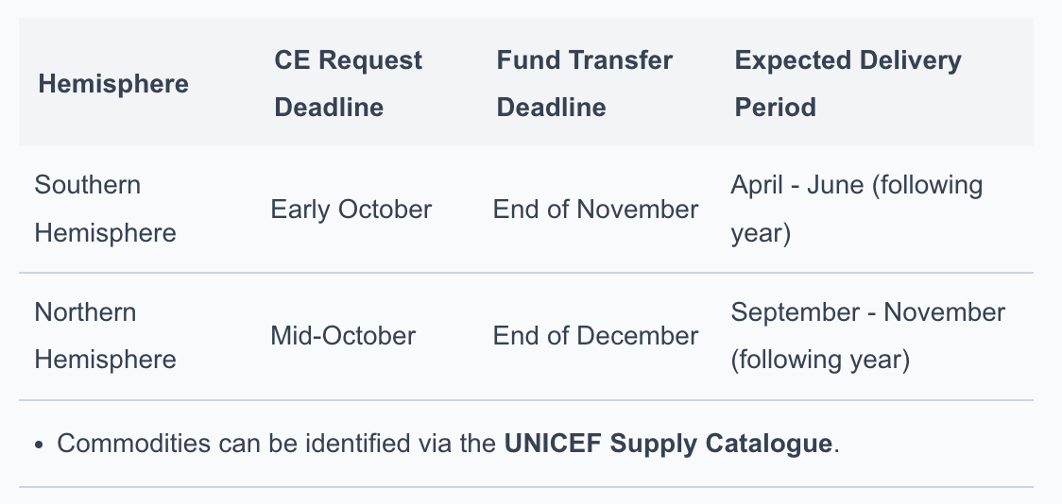
How can countries access influenza vaccines through UNICEF Supply Division?
Countries and partners can access influenza vaccines through UNICEF’s procurement services.
The process involves:
  Submitting a Procurement Service Request Form with necessary details.
  Review and preparation of a Cost Estimate (CE).
  Signing a Memorandum of Understanding (MOU) upon CE acceptance.
  Procurement activities initiated upon receipt of funds.

Slide 6
Country experiences
Behavioral and Social Drivers of Influenza Vaccination: Case Study from Jordan
The study used a mixed-methods approach to identify barriers and drivers affecting influenza vaccine uptake:
  Qualitative Phase involved focus groups with vaccine recipients, vaccinators, and influencers in two governorates to explore perceptions and barriers.
  Quantitative Phase surveyed 1,500 participants including healthcare workers (HCWs), pregnant women, and elderly individuals using the BeSD (Behavioral and Social Drivers) Arabic tool.
Key Drivers of Vaccination:
  Recommendations by healthcare workers.
  Trust in healthcare providers.
  Family and community support.
  Community engagement initiatives.
Expanding Access Through Pharmacy-Based Vaccination (Ukraine Example)
The Ministry of Health of Ukraine highlighted efforts to increase access to seasonal influenza vaccination by enabling pharmacy-based vaccination services.
This approach aimed to broaden vaccination coverage by leveraging pharmacies as accessible vaccination points.
Implementation was supported through: Amendments to health legislation of Ukraine; Training pharmacists and coordinating suppliers; Public awareness campaigns; and Collaboration with partners and stakeholders. PIP PC support.
The project resulted to wider access and convenience, especially in underserved areas; and higher vaccination coverage supports community immunity.

Slide 7
EPI-WIN webinar
View webinar “Seasonal Influenza Vaccination: Protecting the vulnerable”
Speakers
  Ioana Ghiga , Lead , planning for access, allocation and deployment of pandemic influenza medical countermeasures and WHO BioHub System, WHO
  Shoshanna Goldin, Technical Officer, WHO
  Wenqing Zhang, Unit Head, Global Influenza Programme, WHO
  Chesco Nogareda, Special Program Comprehensive Immunization, PAHO
  Yasmin Vargas, UNICEF Supply Division
  Nizar Maswadeh, Jordan Ministry of Health
  Svitlana Aleksenko, Ukraine Ministry of Health

