Slide 1
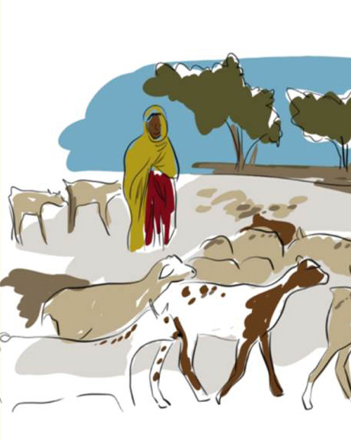
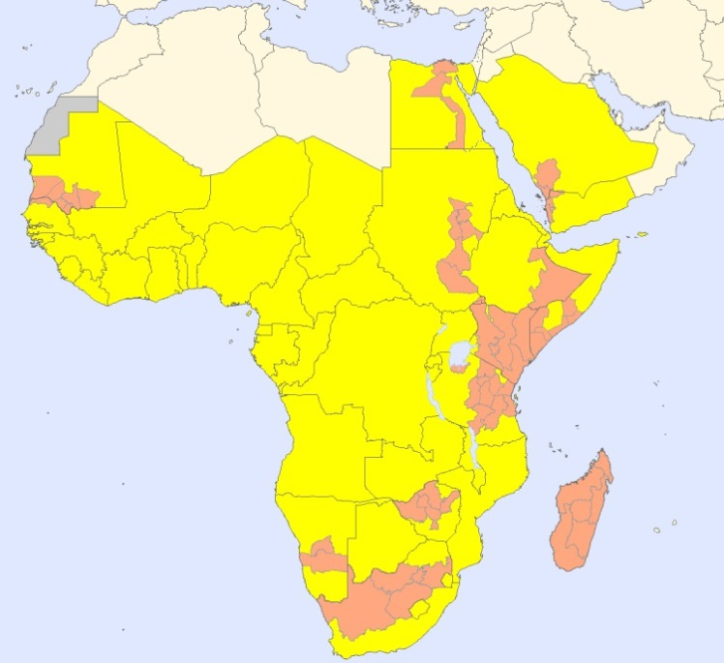
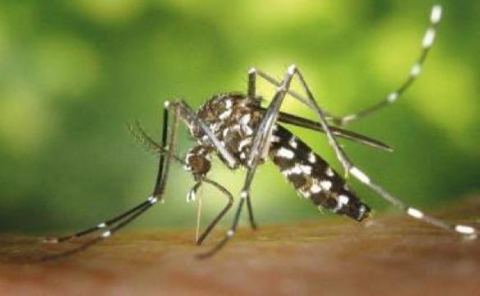
Introduction to
Rift Valley Fever
Viral Haemorrhagic Fevers team
Country at risk for RVF
Region or province with large RVF outbreaks

Slide 2
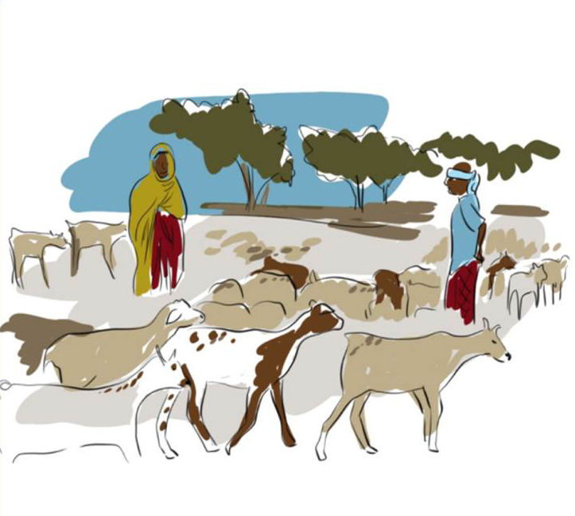
Learning objectives
Describe signs, symptoms, and transmission routes of Rift Valley fever (RVF)
List main prevention and control measures
Describe areas where Rift Valley fever is a public health concern.

Slide 3
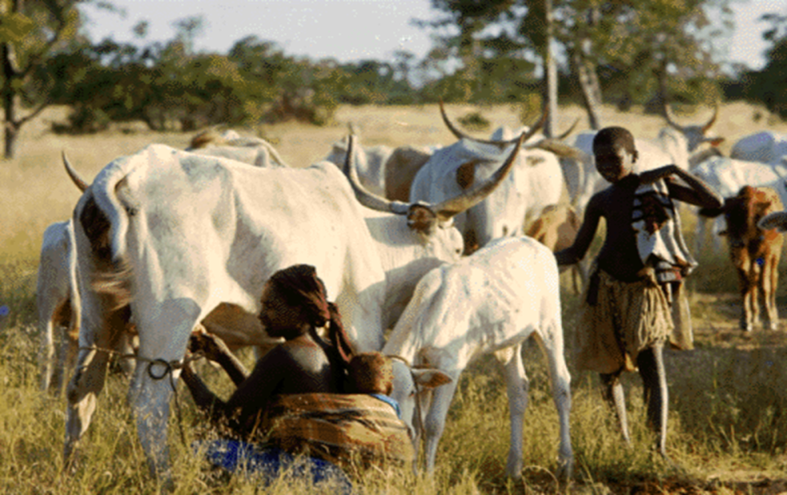
Rift Valley fever disease
Rift Valley fever (RVF) is a viral zoonosis that primarily affects animals but can also infect humans
Most human infections result from contact with the blood or organs of infected animals.
Human infections may result to a lesser extent from bites of infected mosquitoes that feed on infected livestock.
98% of infected people will have subclinical symptoms, only 2 in 100 people will develop a severe disease.
To date, no human-to-human transmission of RVF virus has been documented

Slide 4
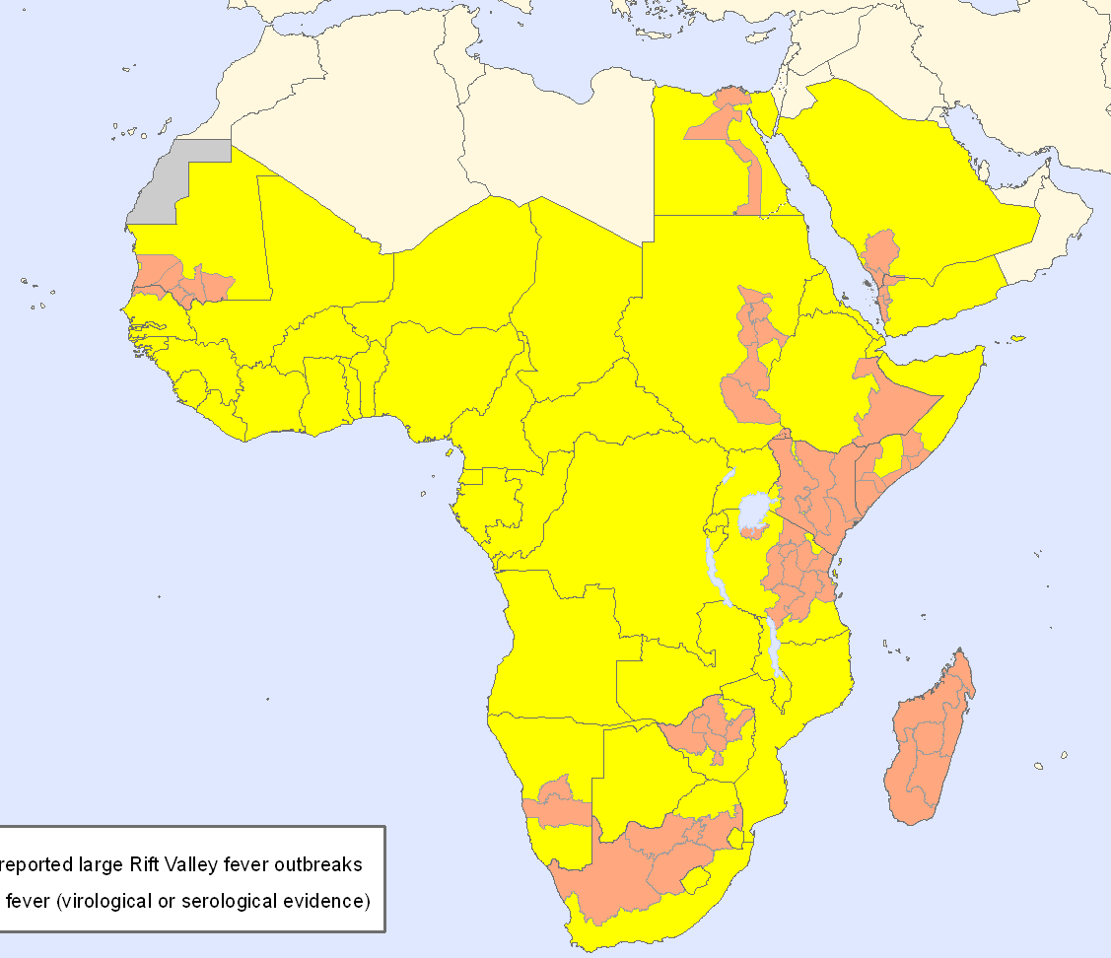

Geographic distribution of Rift Valley fever
RVF outbreaks have been reported in sub-Saharan Africa and Egypt.
Sporadic cases are reported every year in sub-Saharan Africa.
Major outbreaks have been reported in Eastern and Western Africa.
In 2000 cases were confirmed in Saudi Arabia and Yemen following exportation of infected livestock.
Areas that reported large RVF outbreaks
Countries at risk for RVF (virological or serological evidence)

Slide 5
Burden of Rift Valley fever
Huge economic impact on countries animal trade and agricultural sector
1 billion people at risk (estimates)
Sub-Saharan
Africa
Explosive outbreaks of severe disease in livestock and humans throughout Africa with potential to spread to Middle East, Asia and Europe

Slide 6
Rift Valley fever transmission
Aedes mosquitoes
Mosquitoes
No
Reservoir Aedes mosquitoes
Human infections
No secondary human infections
In nature, RVF virus maintains itself in Aedes mosquitoes eggs and in a cycle involving mosquitoes and livestock.
RVF virus is responsible of explosive outbreaks of severe disease in domestic animals.
Humans are infected through:
direct or indirect contact with blood or organs of infected animals during slaughtering or butchering, assisting with animal births, or from disposal of carcasses or fetuses.
bites of infected mosquitoes (several species)
No human-to-human transmission of RVF virus has been documented.

Slide 7
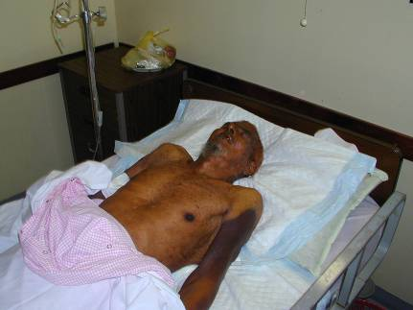
Clinical features of RVF disease in human
The incubation period (the interval from infection to onset of symptoms) for RVF varies from 2 to 6 days.
98 % cases are asymptomatic or unnoticed or develop a mild disease
Photo from Madani et al. CID, KSA, 2003.
Only 2% of cases are severe, with 3 different complications: ocular (eye) disease, meningoencephalitis or haemorrhagic fever

Slide 8
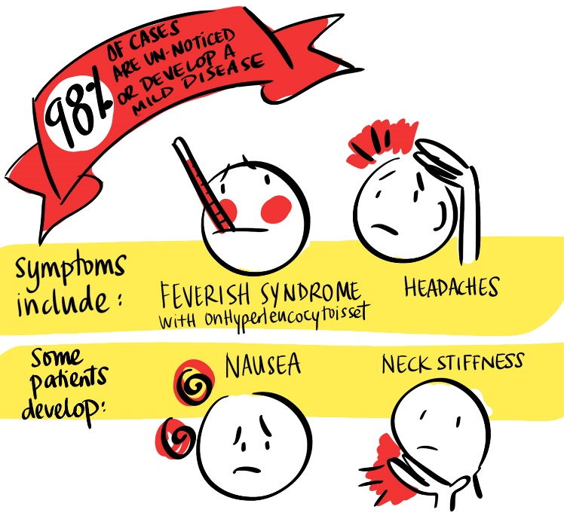
Clinical features of RVF disease - mild forms
A feverish syndrome with sudden onset of flu-like fever, muscle pain, joint pain and headache.
Some patients develop neck stiffness, sensitivity to light, loss of appetite and vomiting; in these patients the disease, in its early stages, may be mistaken for meningitis
The symptoms of RVF usually last from 4 to 7 days, after which time antibodies become detectable and the virus disappears from the blood.

Slide 9
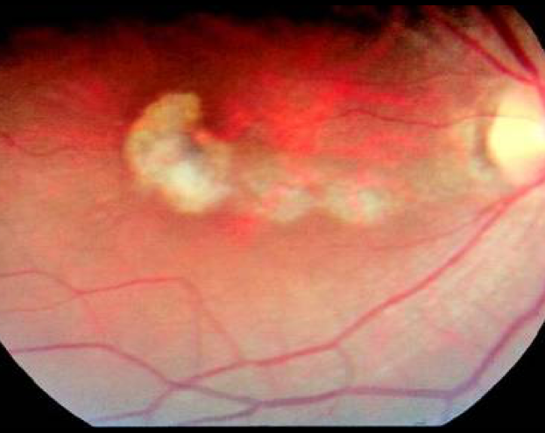
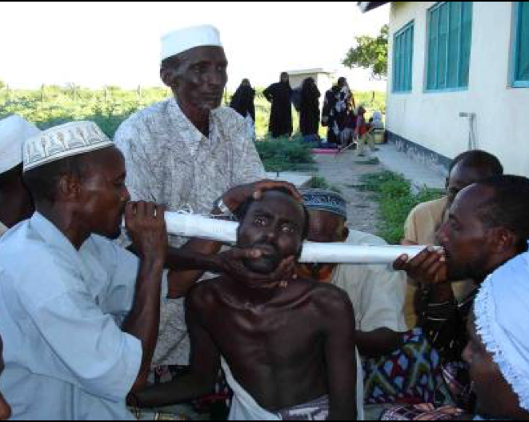
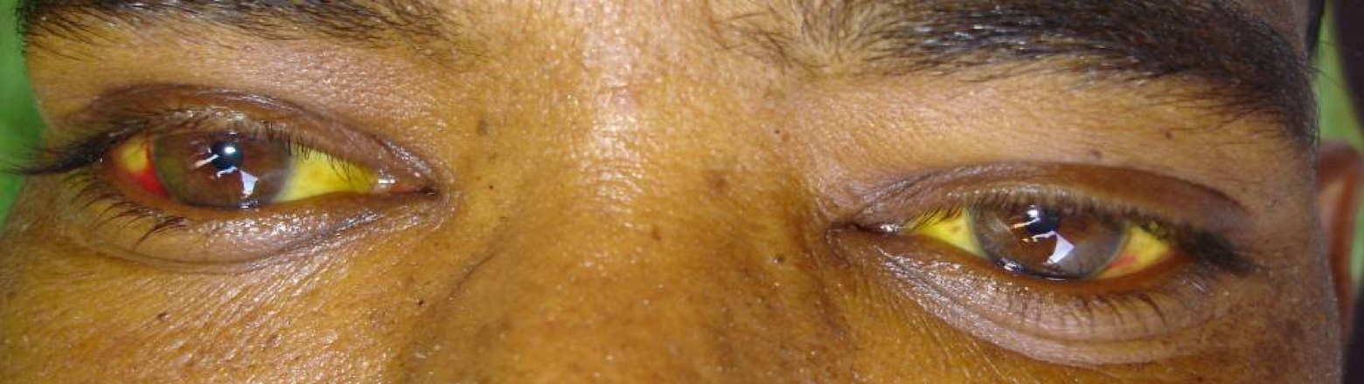
Clinical features of RVF disease - severe forms
Photo from Madani et al. CID, 2003.
Photo by P. Formenty WHO, 2007.
Photo by P. Formenty WHO, 2007.
Ocular form: lesions, blurred or decreased vision in the eyes occurring 1 to 3 weeks after first symptoms.
Meningoencephalitic form: intense headache, loss of memory, vertigo, hallucinations, confusion, coma convulsions, occurring 1 to 4 weeks after the first symptoms.
Haemorrhagic fever form: Initially evidence of severe liver impairment, such as jaundice; then signs of hemorrhage appear occurring 2 to 4 days after the onset of illness.
Notes:
Ocular form: The disease may resolve itself with no lasting effects within 10 to 12 weeks. However, when the lesions occur in the macula, 50% of patients will experience a permanent loss of vision. Death in patients with only the ocular form of the disease is uncommon.
Meningoencephalitis: Clinical features include intense headache, loss of memory, hallucinations, confusion, disorientation, vertigo, convulsions, lethargy and coma. Neurological complications can appear later (after more than 60 days). The death rate in patients who experience only this form of the disease is low, although residual neurological deficit, which may be severe, is common.
Haemorrhagic form: Subsequently signs of haemorrhage then appear such as vomiting blood, passing blood in the faeces, a purpuric rash or ecchymoses (caused by bleeding in the skin), bleeding from the nose or gums, menorrhagia and bleeding from venepuncture sites. The case-fatality ratio for patients developing the haemorrhagic form of the disease is high at approximately 50%. Death usually occurs 3 to 6 days after the onset of symptoms.

Slide 10
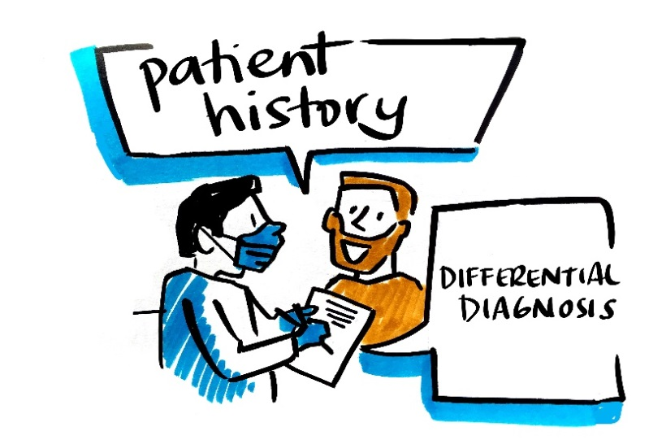
Rift Valley fever - diagnosis
Symptoms are non-specific; clinical diagnosis may be difficult.
Differential diagnosis includes other viral haemorrhagic fevers, malaria, leptospirosis, rickettsiosis, relapsing fever, shigellosis, cholera, meningitis, yellow fever, and other viral and bacterial diseases.
Patient history is essential and should include:
  exposure to sick animals during slaughtering or butchering, assisting with animal births or disposal of carcasses or fetuses.
  conducting veterinary procedures.
  or exposure to area/village where RVF outbreak is reported

Slide 11
Laboratory diagnosis of Rift Valley fever
Definitive diagnosis requires testing:
  Reverse transcriptase polymerase chain reaction (RT-PCR) assay
  IgG and IgM antibodies enzyme-linked immunosorbent assay (ELISA)
  antigen detection tests
  virus isolation by cell culture.
Handling and processing specimen requires suitably equipped laboratories under maximum biological containment conditions and staff collecting samples should be trained.

Slide 12
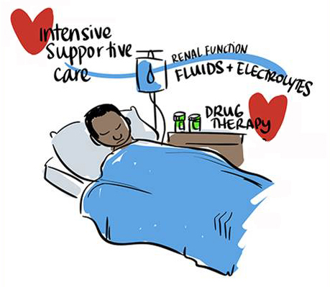
Rift Valley fever – intensive supportive care
Early, intensive care support: monitor fluid and electrolyte balance and renal function, blood pressure, oxygenation, careful rehydration.
Support of coagulation system with blood component therapy.
Supportive drug therapy, including: painkillers, antiemetic for vomiting, anxiolytic for agitation, +/- antibiotics and/or antimalarial drugs.
Not recommended: antiviral drug ribavirin active in vitro but treated patients who survived acute illness died later from encephalitis.
Rift Valley fever severe forms

Slide 13
Key components of RVF outbreak control
Control RVF outbreak in domestic animals
Care for sick people
National leadership
Reduce the risk of transmission from infected animals to humans in animal husbandry, veterinary, and slaughtering practices at home or in facilities

Slide 14
General strategy to control RVF outbreaks
Conduct social and cultural assessments
Engage with key influencers: women and/or youth associations, traditional healers, local authorities, religious & opinion leaders
Formal and informal communication
Address community concerns
Standard infection prevention and control measures
Triage of mild and severe patients
Treatment of severe presentations
Clinical trials
Ethics committee
Behavioural and social interventions
Psycho-social
support
Patient care
Ethical aspects
Media
Coordination
Supplies
Lodging, food
Social and epidemiological mobile teams
Finances, salaries
Transport vehicles
Epidemiological investigation,
surveillance
and laboratory
Active case-finding
Specimen collection
Laboratory testing
Database analysis
Coordinate with veterinary services in areas where RVF animal outbreaks are reported
Logistics
Coordinate with Veterinary Services
Control of Vectors

Slide 15
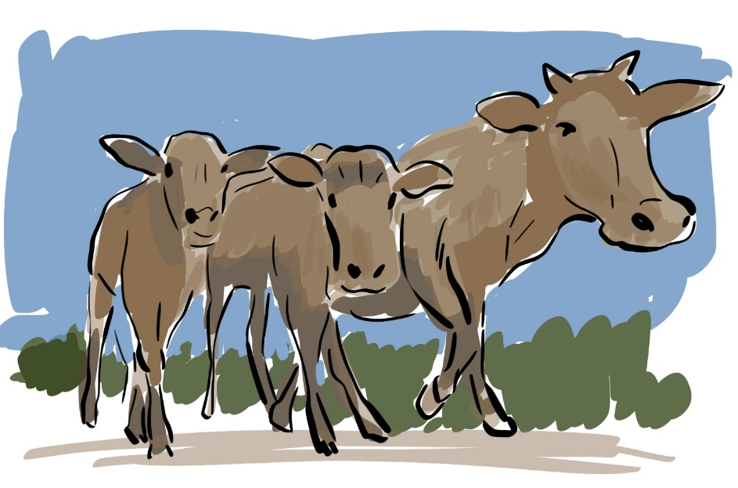
Community engagement and awareness
Engage with communities to promote desired health practices and behaviours, including reduction of exposure to infected animals and safe meat preparation.
Provide accurate and timely health advice and information on the disease.
Notes:
Comment accepted

Slide 16
Reducing risk of animal-to-human transmission
Activities related to infected animal husbandry and slaughter practices
  Avoid or minimize contact with blood and organs from sick animals or dead: do not kill or manipulate without protections carcasses or fetuses of infected animals.
  Hand hygiene: wash your hands with SOAP immediately after every contact with any body fluid from an infected animal.
  Use of personal protective equipment (PPE): particularly important for veterinarians (care, autopsies).
  Wear PPE in slaughterhouses or during slaughtering animal at home in the affected areas.
Consumption of products of animal origin
  All products and tissues of animal origin as the blood, the organs (liver, kidneys, lungs) meat and milk should be thoroughly cooked before eating.
  http://www.who.int/foodsafety/areas_work/food-hygiene/5keys/
  In times of outbreak, in affected areas, sick animals should not be eaten.
Notes:
When data from these studies is available, the following recommendations can be made in the context of the particular disease outbreak
For example: there are the general items shown earlier , avoid sick animals,
but messages can be targeted to those in affected areas and those that may be affected in the future
Likewise, distribute bednets, repellants, etc to the affected population
Implement effective vector control programs
movement of animals - from where to where
conduct vaccination campaigns safely in appropriate l

Slide 17
Reducing risk of mosquito-to-human transmission
Reduce the risk of transmission from mosquito to human individually and in the community :
  Through the use of Insecticide-treated bed nets (ITNs).
  Through the use of repellents if available.
  By the use of clothing in light colors (pants and long-sleeve shirts).
  By avoiding outdoor activities during the height of mosquito activity periods.
Implement appropriate vector control program based on the results of entomological investigations.
Notes:
When data from these studies is available, the following recommendations can be made in the context of the particular disease outbreak
For example: there are the general items shown earlier , avoid sick animals,
but messages can be targeted to those in affected areas and those that may be affected in the future
Likewise, distribute bednets, repellants, etc to the affected population
Implement effective vector control programs
movement of animals - from where to where
conduct vaccination campaigns safely in appropriate l

Slide 18
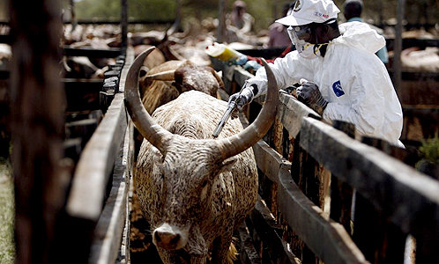
Control RVF outbreak in domestic animals
Outbreaks of RVF in animals can be avoided if there is an ongoing mass vaccination program in place.
Animal vaccination must be applied before the beginning of a foci to prevent an outbreak.
If an RVF animal outbreak is suspected
  Quarantine local animals;
  Limit and/or prohibit movements of animals from affected areas to disease-free areas;
  Establish a system of active animal surveillance to serve as an early warning for veterinary and human health authorities,
  DO NOT vaccinate during the epizootic due to the high risk of intensifying the outbreak (animal health workers may, inadvertently, transmit the virus through the use of multi-dose vials and the re-use of needles and syringes).
Notes:
During mass animal vaccination campaigns, animal health workers may, inadvertently, transmit the virus through the use of multi-dose vials and the re-use of needles and syringes.

Slide 19
Controlling infection in health-care settings
No person-to-person transmission of RVF virus has been documented to date.
Implement Standard Precautions with all patients – regardless of their diagnosis – in all work practices at all times including safe injection practices. http://www.who.int/csr/resources/publications/standardprecautions/en/index.html
Laboratory workers are also at risk. Samples taken from suspected human RVF cases for diagnosis should be handled by trained staff and processed in suitably equipped laboratories.

Slide 20
Key Public Health challenges
Difficult to diagnose and to treat severe cases.
98% cases are asymptomatic.
Multiple mosquito vectors may be involved.
Large economic impact on countries animal trade may not encourage prompt reporting.
Increased (animal) trade means increased risk of outbreak.

Slide 21
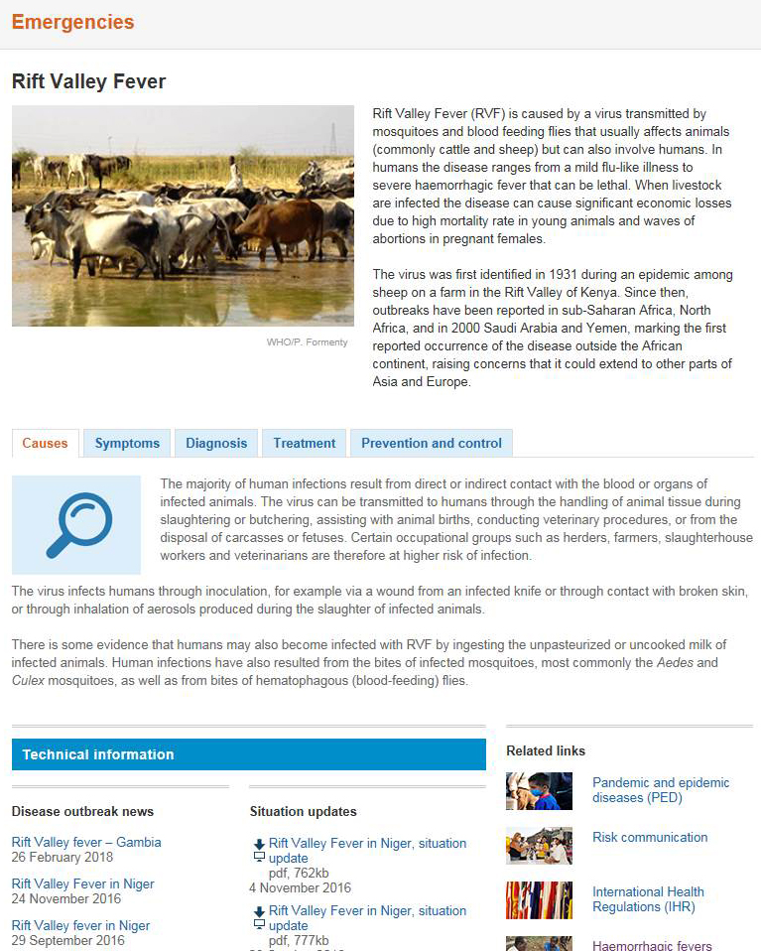
WHO information on Rift Valley fever
中文 English Français Русский Español عربي
Rift Valley fever
Technical information
Fact Sheet
Disease outbreak news
Rift valley fever map
Related links

Slide 22
Other resources on Rift Valley fever
World Organization for Animal health
Information on Rift Valley fever
Manual of Diagnostic Tests and Vaccines for Terrestrial Animals
Applying the One Health principles: a trans-sectoral coordination framework for preventing and responding to Rift Valley fever outbreaks.
Food and Agriculture Organization
Rift Valley fever action framework
Rift Valley fever surveillance manual
What you need to know about Rift Valley fever
Rift Valley fever (RVF) Early Warning Decision Support Tool (RVF DST)
Notes:
When data from these studies is available, the following recommendations can be made in the context of the particular disease outbreak
For example: there are the general items shown earlier , avoid sick animals,
but messages can be targeted to those in affected areas and those that may be affected in the future
Likewise, distribute bednets, repellants, etc to the affected population
Implement effective vector control programs
movement of animals - from where to where
conduct vaccination campaigns safely in appropriate l

Slide 23
Key contact
Anaïs Legand
  -----------------------------------------
  Viral Haemorrhagic Fevers team
  Health Emergencies Programme
  WHO Geneva
  leganda@who.int

