Slide 1

Overview of the Rift Valley fever (RVF) situation in Senegal and Mauritania
Data as of 9 November 2025 – Epi Week 45*
*Trend analyses performed on complete data through W44 (2 November 2025). More recent figures are provided when possible.
Sources : Ministry of Health, Senegal, Ministry of Agriculture, Senegal, Ministry of Health Mauritania, WHO Senegal Country Office Sitreps

Slide 2
IMST_RVF_EPI_Updates
Epidemiological situation in Senegal

Slide 3
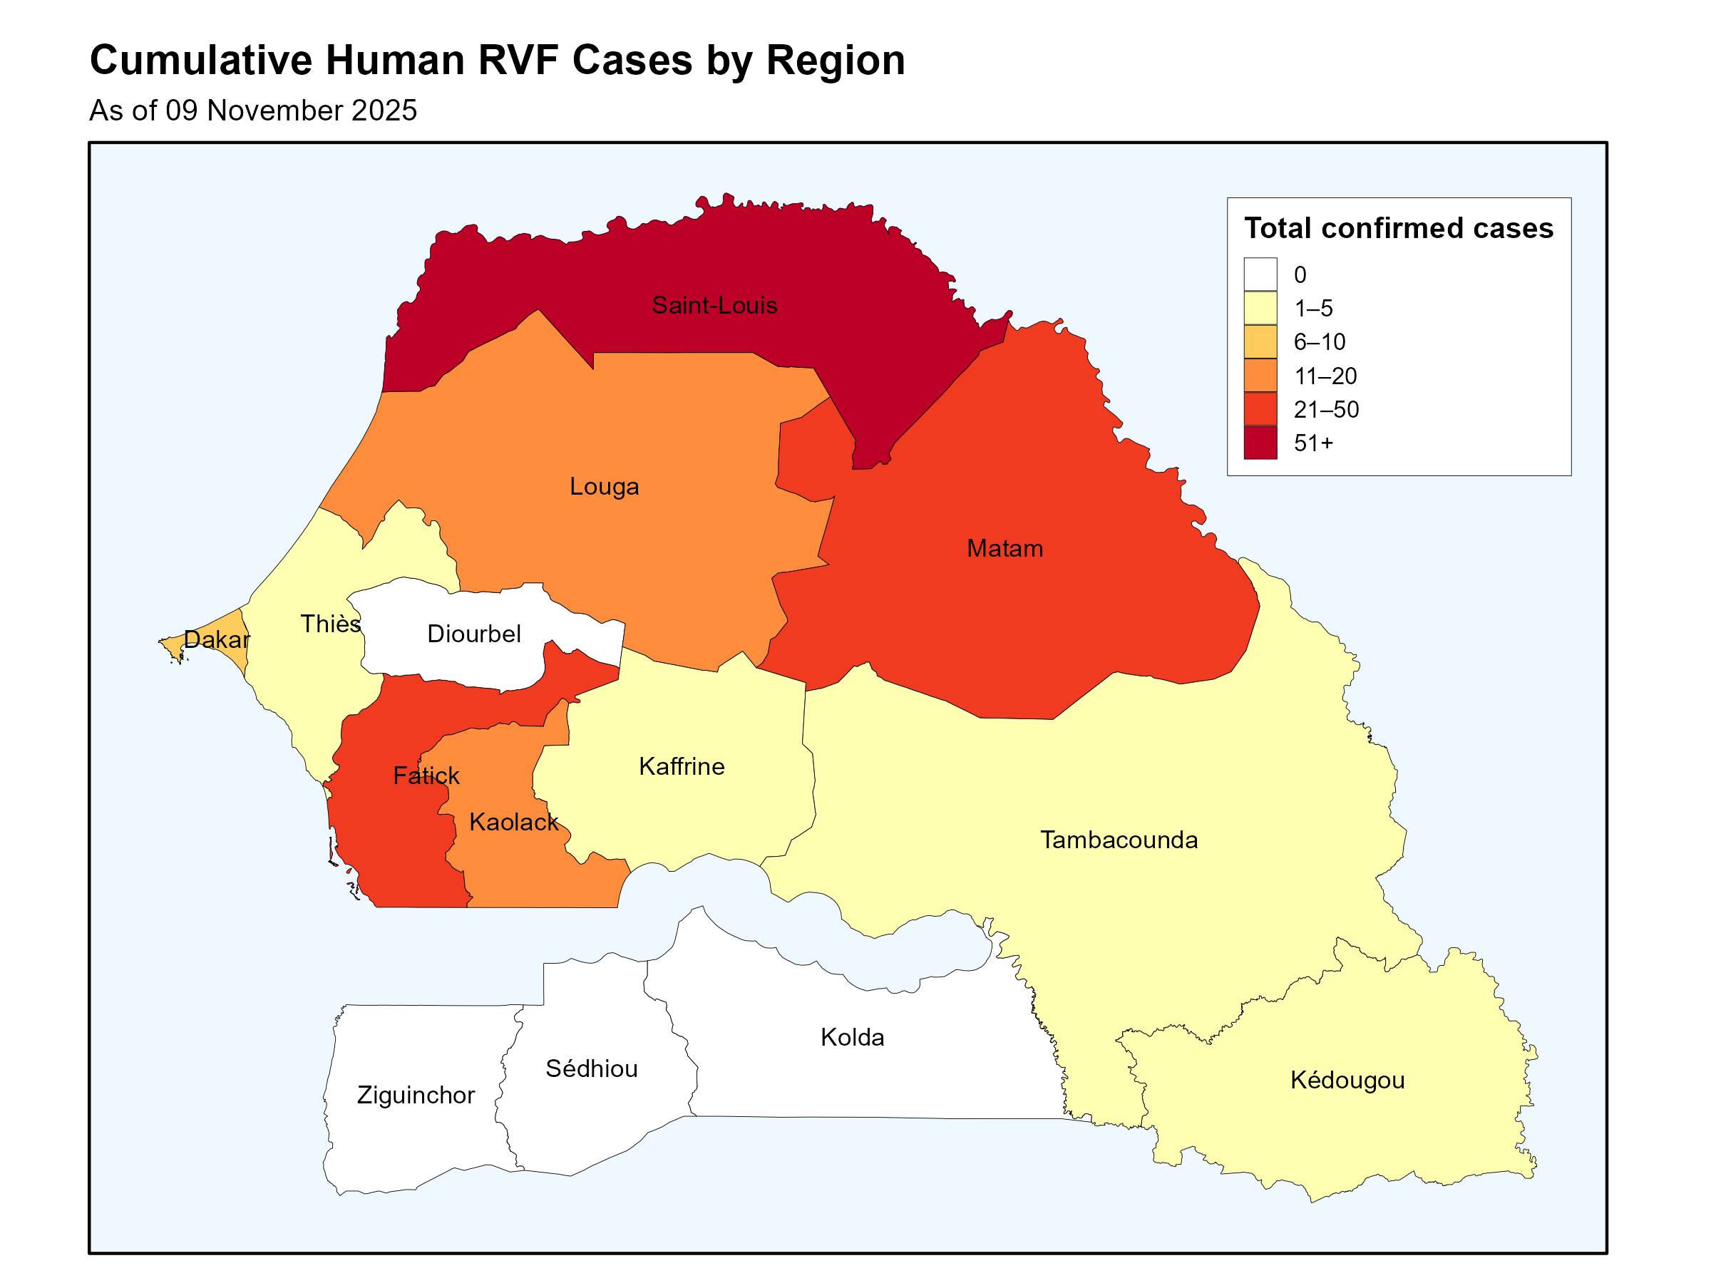
Geographical distribution of confirmed RVF human cases by affected Regions
(as of 09 November 2025)
A total of 424 human confirmed cases have been reported since early September in 32 departments in 10 regions.
The most affected region is St-Louis, where 322 human cases were confirmed (75.9% of total cases).
A total of 30 deaths reported, CFR 7.1%.
Most affected groups are adult males.
Breeders and housewives are most affected (housewives refer to women who take care of small ruminants at home).
Notes:
Among the confirmed cases, 76.2%(n=250) were reported in rural areas, while 23.8% (n=78) were reported in urban areas.

Slide 4
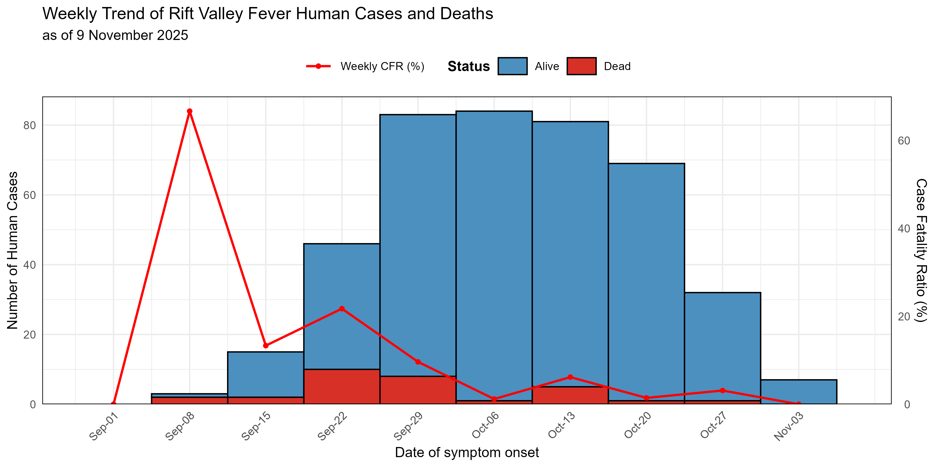
Weekly Epicurve of Confirmed RVF Human Cases in Senegal
(as of 9 November 2025)
First human cases had symptom onset in early September.
Appears to be a continually decreasing trend in cases starting in W42, but data is not yet complete for recent epi weeks.
CFR has been decreasing over time, which could be explained by:
  Increased surveillance and early detection
  Improved case management

Slide 5
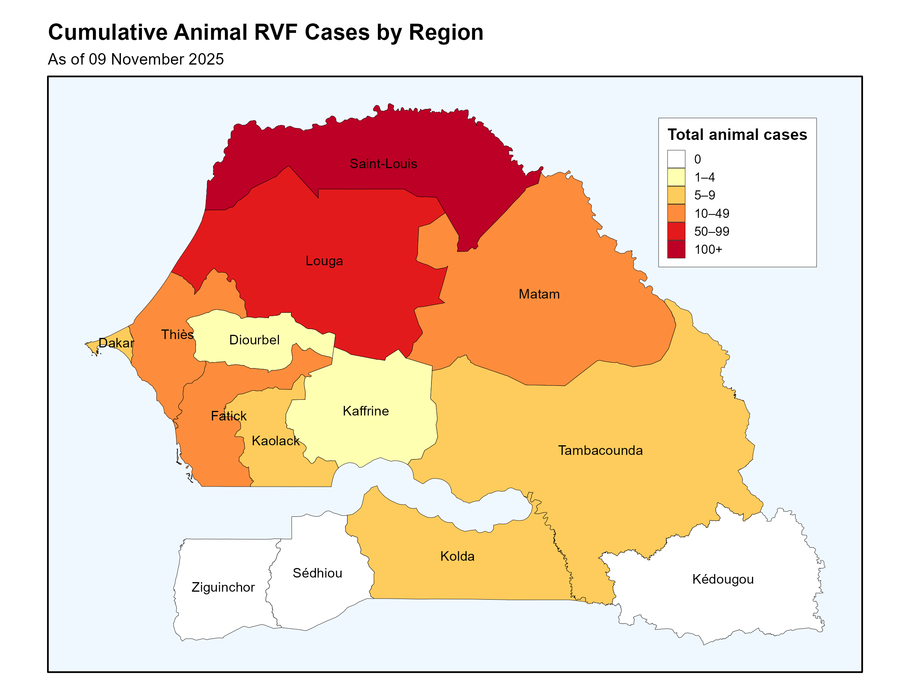
Distribution of RVF cases and deaths in animals
(as of 09 November 2025)
As of 09 November 2025:
(Data from Week 38 to Week 45)
Cumulatively, 302 confirmed RVF cases were reported among animals:
  Sheep (51%)
  Goats (41%)
  Cattle (8%)
1,935 abortions notified
11 regions have reported cases in animals​
Of note: only the region of Kedougou has reported human cases but no cases in animals

Slide 6
IMST_RVF_EPI_Updates
Epidemiological situation in Mauritania

Slide 7
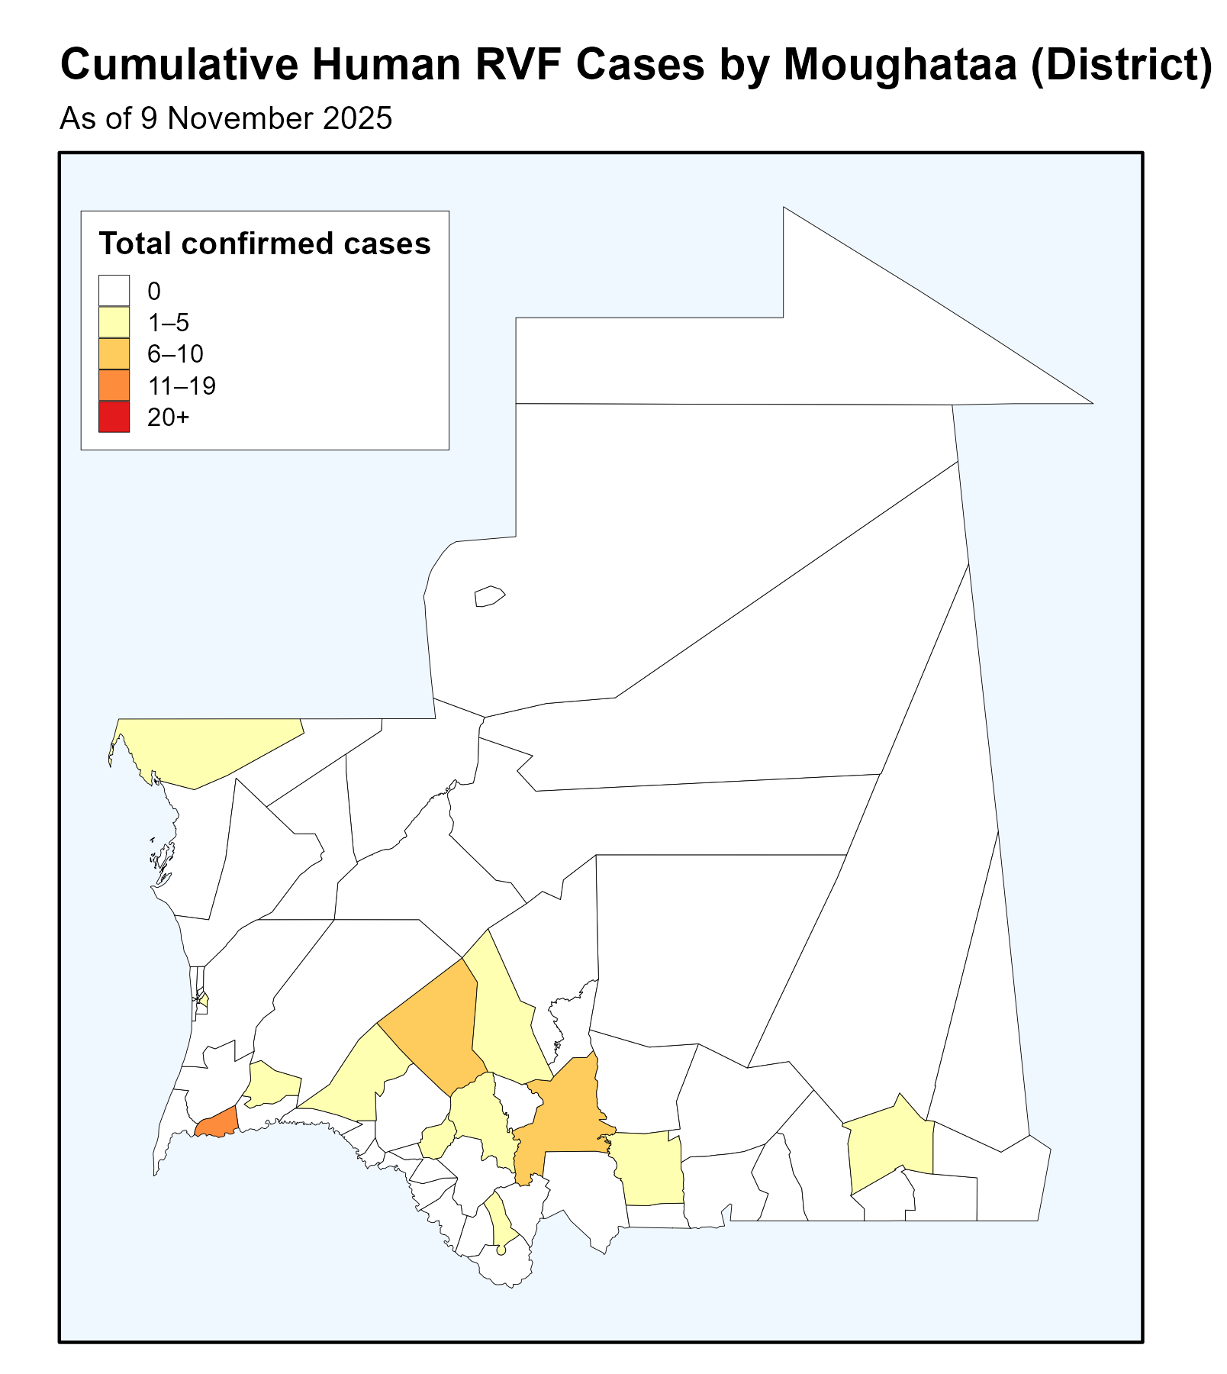
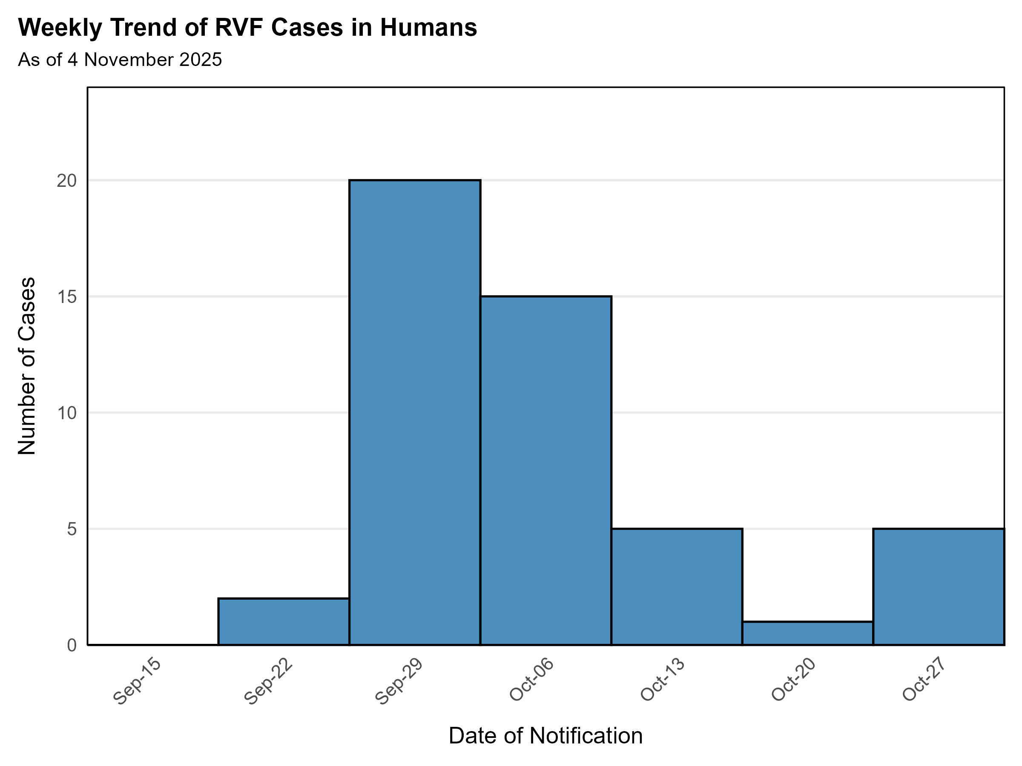
Geographical distribution of RVF human cases in Mauritania
(as of 9 November 2025)
A total of 52 confirmed cases have been reported in Mauritania in 13 districts were affected across 11 provinces and 15 deaths (apparent CFR 28.8%).
78% of cases are males; 73% of cases are adults
237 samples tested to date, 20.3% positivity rate. Only PCR testing available so far.
Other outbreaks
  A total of 49 dengue cases were detected, 2 with co-infection with RVF.
  A total of 258 confirmed cases of diphtheria in 2025 with a marked increase since epi-week 36.

Slide 8
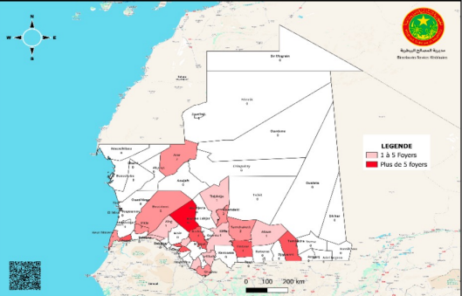
RVF cases in animals in Mauritania
(as of 4 November 2025)
63 animal outbreaks recorded in across 25 districts in 11 provinces; most affected species are goats and camels
Of the 975 animal samples analyzed, 225 were positive, representing a positivity rate of 23%.
The geographical distribution of animal outbreaks shows a marked concentration in the southern and central provinces (Brakna, Assaba, Hodh El Gharbi, and Trarza), corresponding to areas with high pastoral density and intense cross-border livestock trade, factors likely to promote the spread of the virus.
RVF cases in animals as of 4 November 2025

Slide 9
IMST_RVF_EPI_Updates
Public health interventions

Slide 10
Public Health Actions - Senegal
Coordination
PHEOC activated and national and regional IMSTs established
Update of the national response plan
Meeting of the One Health TWG of the national High Health Security Council
Surveillance
Active case search and investigations are ongoing in the affected regions
Deployment of SURGE teams in Saint Louis, Louga and Matam regions with WHO support.
Deployment of national entomologists in Tambacounda, Kaffrine and Diourbel regions;
Briefing of surveillance FPs on the RVF DHIS 2 tracker module
Laboratory
Deployment of mobile laboratories from the National Laboratory Directorate, IPD, IRESSEF
Clinical care
Clinical management of severe cases in hospitals
Home-based care for mild cases
Vector control activities
Spraying of animals and treatment of watering ponds by regional livestock brigades
Distribution of mosquito nets
RCCE
Community sensitization (households, markets)
Broadcast of sensitization messages through local radios
Logistics
Procurement of medical equipment and supplies (mosquito nets, drugs, etc) with WHO support
Animal health
Surveillance and testing of herds
Peri-focal vaccination of animal to limit spread to unaffected herds.

Slide 11
Public Health Actions - Mauritania
Coordination
Coordination meetings held with the participation of the Ministries of Health , Ministry of Livestock, and partners.
Regular meetings of the One Health national committee and One Health committees in affected regions and moughataas, coordinated by administrative authorities.
Response plan developped. .
Mobilisation of partners (CDC, FAO).
Surveillance
Enhanced epidemiological surveillance in high-risk areas (active case search, investigations)
2-day field deployment of 4 joint teams to support in-depth investigations of RVF and diphtheria outbreaks
Laboratory
Laboratory confirmation of cases by PCR at the National Institute of Public Health Reserach (INRSP)
Case management
Isolation and clinical management of severe cases in regional hospitals
Ongoing deployment of 3 EMT members
RCCE
Community sensitization ongoing in the affected districts
Animal health
Issue of vigilance circulars for private veterinarians and meat inspectors
Distribution of batches of pharmaceutical products, vector control products and personal protective equipment in affected regions
Distribution of communication materials (posters, leaflets) at regional level to support local awareness-raising efforts.

Slide 12
Public Health Actions – WHO support
In both countries the Incident Management System activated, supported by a joint WHO HQ and AFRO IMST. Event graded Grade 2 on 13 October, and a CFE request approved on 20 October. In both country, focus on :
  Support surveillance activities and expand diagnostic capacities at district level (including trainings) in human and animal health sectors.
  Scale up RCCE efforts significantly to focus on meaningful engagement with the most affected groups (e.g. herders, slaughterhouse workers) to raise awareness of transmission risks, preventive measures, care pathways, and access to trustworthy information.
  Organize targeted training for healthcare worker, community health care workers and community-based animal health workers on RVF awareness and preventive measures, zoonotic and vector risks, case recognition and management as well as community engagement best practices.
  Improve capacities for clinical care for severe patients through training, provision of supplies, and surge capacity as required.
  Procure and distribute medical, IPC and laboratory supplies based on country needs.
  Continue supporting investigation of transmission patterns, including examination of malaria circulation as well dual mapping of the human and animal outbreaks.
  Scale up vector-control activities, for RVF but also importantly against malaria and dengue.
  Continue partner coordination efforts with FAO, WOAH and other key operational partners and sectors.

Slide 13
Thank you
Your feedback is most welcomed!
Thank you!

