Slide 1
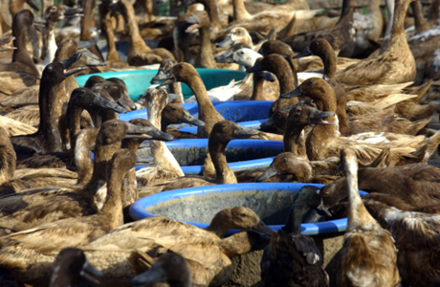
Joint outbreak investigation during avian influenza outbreaks
EPIWIN webinar
19 November 2025
Aspen Hammond
Global Influenza Programme
Notes:
Epi, viruses, ra, PH actions and resources

Slide 2
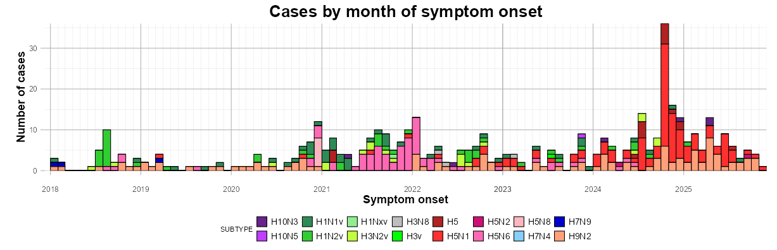
Epicurve of human cases of zoonotic influenza
2018 to 18 Nov 2025
*This may include detections in persons without symptoms that could represent contamination and not infection.
Sporadic with direct or indirect exposure to infected animals or contaminated environments.
Infections can be severe and even fatal.
No sustained human-to-human transmission.
Prompt & thorough investigations are critical; alert for person-to-person transmission

Slide 3
Why is early detection important for zoonotic influenza?
Human infections can be severe and appropriate clinical management should be provided.
Need to understand the epidemiology: who is at risk for infection and severe disease and why?
Need to understand the virology: how similar is the virus to that infecting local animals or are there changes that might indicate increased transmission or adaptation to humans?
To understand transmission: is the virus spreading from person to person?
To respond and control outbreaks: prevent further spread among animals and humans.
Pandemic potential
Photo credits: WHO / Julio Takayama

Slide 4
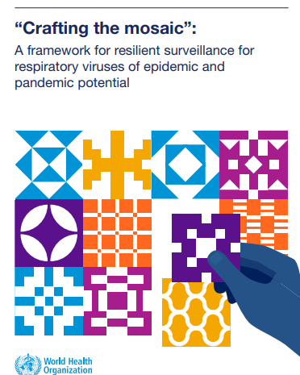
Early detection and surveillance for zoonotic influenza
Objectives
Rapidly detect zoonotic influenza virus infections or outbreaks
Assess transmissibility, risk factors for transmission, and extent of infection from zoonotic influenza virus
Describe clinical presentation and risk factors for severe outcomes associated with zoonotic influenza infections
The timely detection of a virus that could emerge, spread and cause illness in humans requires multiple event-based and indicator-based systems to work together.
https://www.who.int/publications/i/item/9789240070288

Slide 5
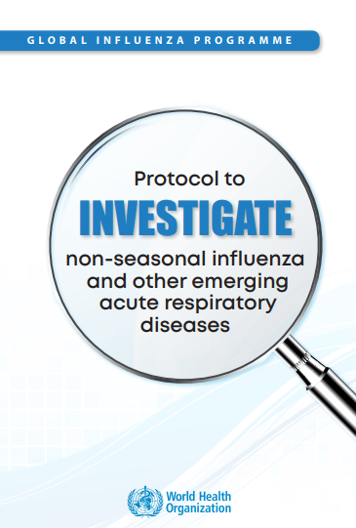
Investigations
Know the triggers for investigating zoonotic influenza cases.
Thoroughly investigate and monitor closely all suspected and confirmed cases and implement immediate public health actions:
  provide appropriate treatment,
  include testing for animal influenza viruses in investigation and laboratory protocols,
  assess exposure to animals and travel history,
  contact tracing and active searching for other cases,
  and the early identification of any unusual respiratory events that could signal person-to-person transmission of the virus.
Public health and animal health authorities should work together and share information during investigations of human cases of zoonotic influenza,
  assessing the role of local animals as sources of exposure,
  understanding if any illnesses / deaths have occurred in local animals,
  and whether animal influenza viruses are circulating in local animals.
          Risk assessment is done throughout the investigation
https://www.who.int/publications/i/item/WHO-WHE-IHM-GIP-2018.2

Slide 6
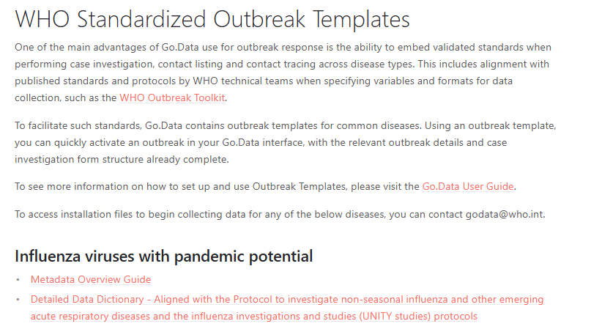
Investigation-WHO standardized outbreak templates (go.data)
Just published
https://worldhealthorganization.github.io/godata/outbreak-templates/

Slide 7
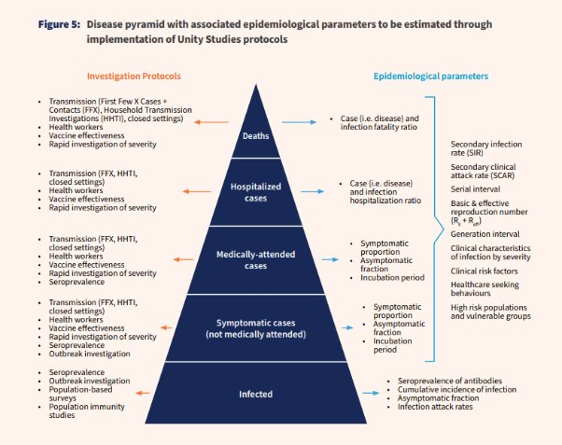
Investigations
  Discrete studies and early investigations focus on certain objectives not efficiently met by existing standard surveillance systems.
https://www.who.int/initiatives/respiratory-pathogens-investigations-and-studies-unity-studies

Slide 8
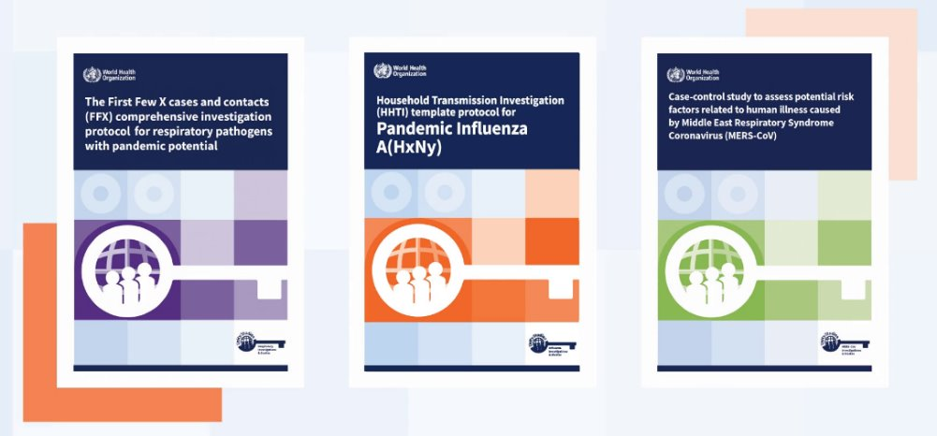
Respiratory investigations and studies (Unity Studies)
6 template protocols published:
  The First Few X cases and contacts (FFX) investigation
  Household transmission (HHTI) investigation
  Closed settings transmission investigation
  Population-based seroprevalence investigation
  The First Few X cases and contacts diagnostic test evaluation
Protocols in production:
  Rapidly assessing clinical severity
  The First Few X (FFX) Case Series investigation
Separate protocols for influenza and respiratory pathogens with pandemic potential/pathogen X

Slide 9
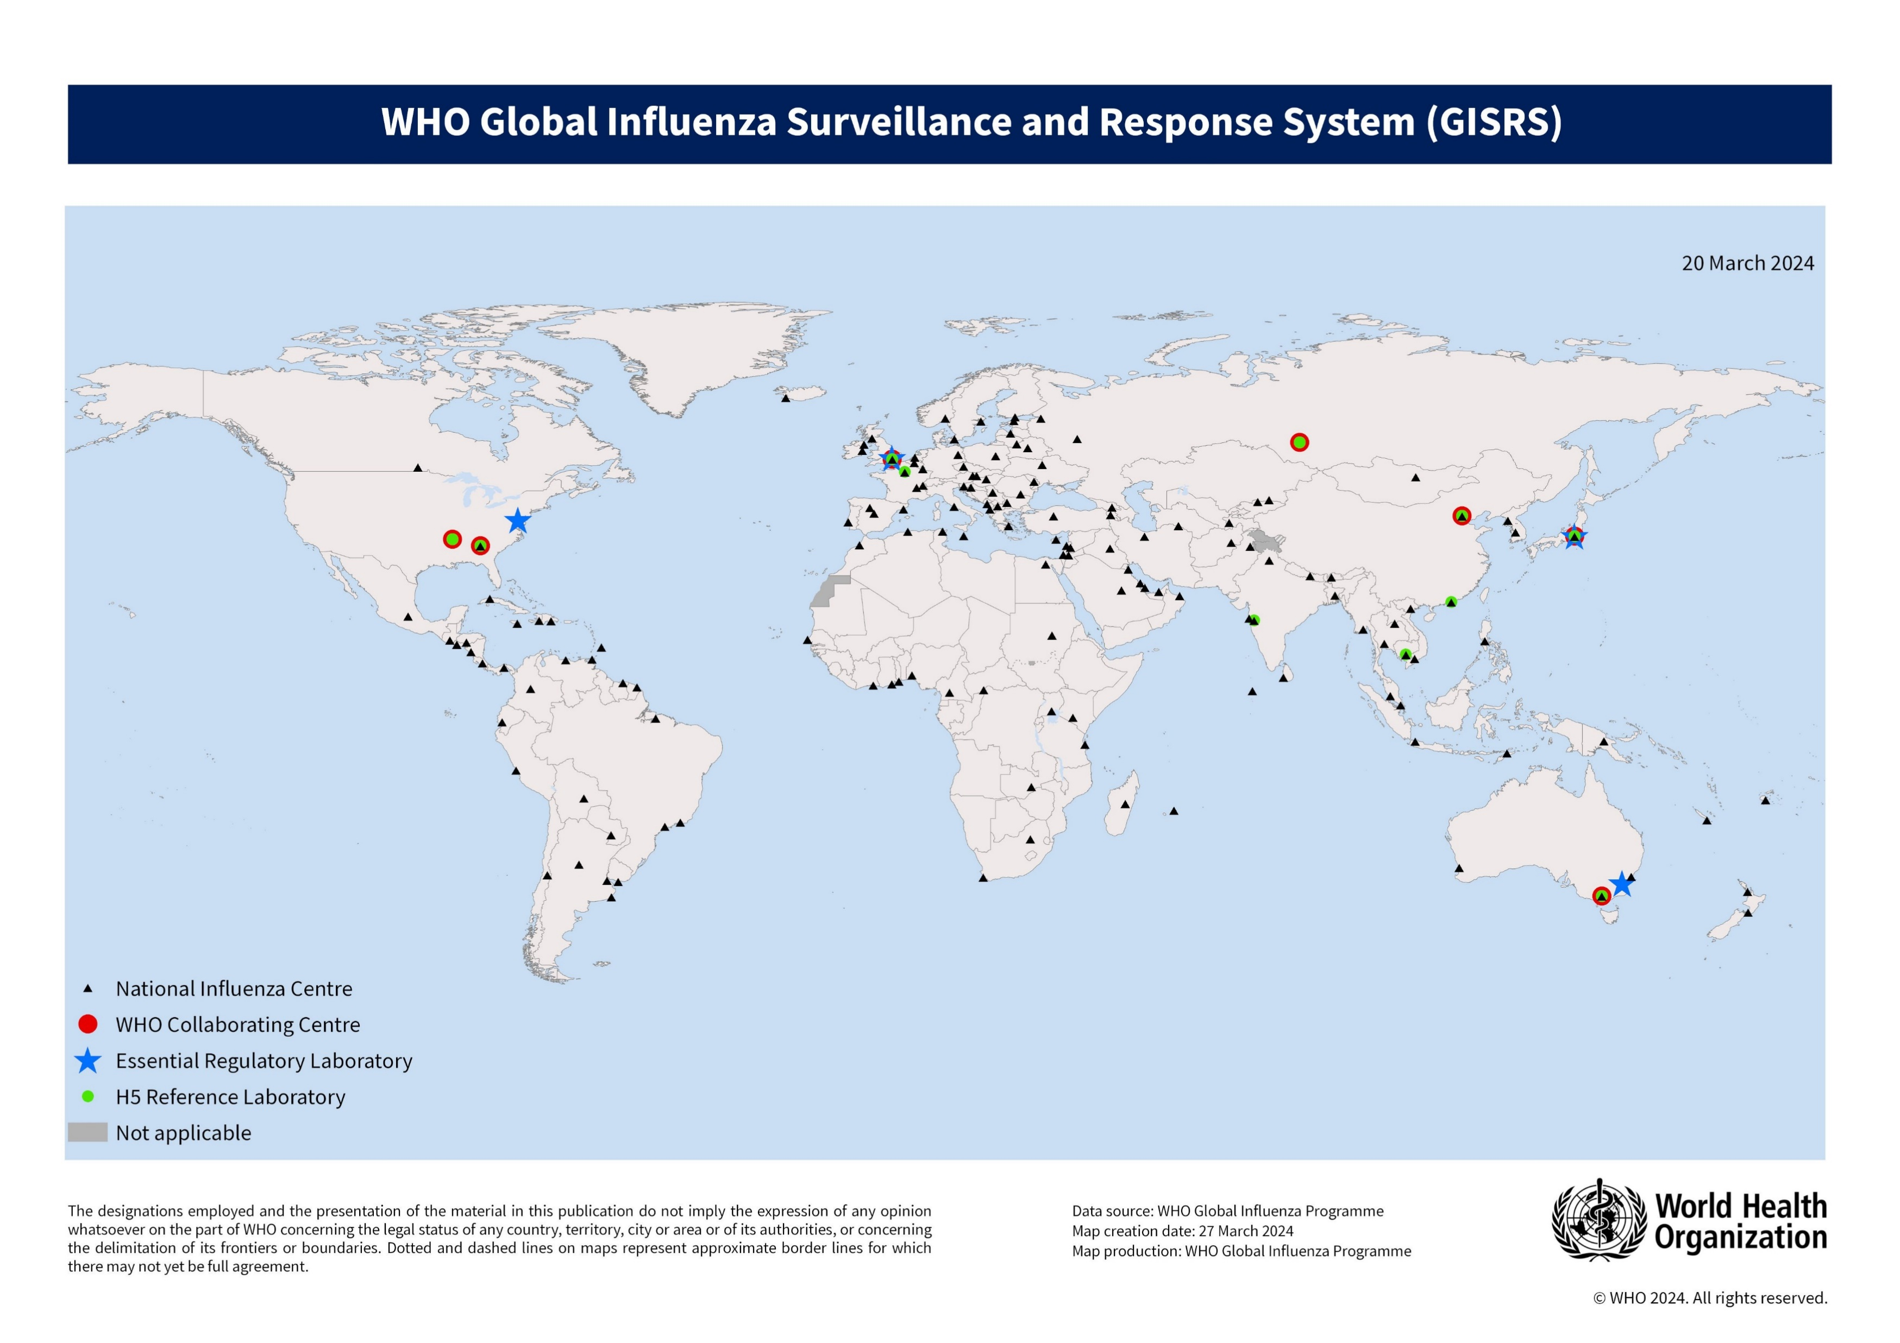


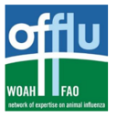

Surveillance and monitoring of influenza including zoonotic influenza
Global Influenza Surveillance and Response System (GISRS), since 1952
Continuous complementary operations of systems and partners
Signal detection
Investigation
Confirmation by GISRS laboratories
Risk assessment
Joint response in One Health approach
Virus detection capability, Rapid, Sharing
Timeliness & Representativeness
Enormous commitment from Member States
Enormous support from international agencies & partners
Notes:
The GISRS network is the cornerstone for influenza surveillance and monitoring including H5 and other zoonotic influenza and other respiratory viruses.
The GISRS network comprises more than 160 institutions globally, including NICs, WHO H5RL, WHO CCs and ERLs. With virus detection capabilities, sharing representative viruses and timely sharing of zoonotic viruses. In addition to, continuous complementary operations and collaboration with partner organizations like FAO, WOAH and other global networks like OFFLU and CEIR for risk assessment and joint response under One Health Approach.

Slide 10

Thank you

Slide 11
Resources
Global Influenza Programme | https://www.who.int/teams/global-influenza-programme
Global Influenza Programme Surveillance and monitoring | https://www.who.int/teams/global-influenza-programme/surveillance-and-monitoring
Global Influenza Programme Human-Animal Interface | https://www.who.int/teams/global-influenza-programme/avian-influenza
Public health resource pack for countries experiencing outbreaks of influenza in animals: revised guidance | https://www.who.int/publications/i/item/9789240076884
Protocol to investigate non-seasonal influenza and other emerging acute respiratory diseases | https://apps.who.int/iris/handle/10665/275657
WHO Disease Outbreak News | https://www.who.int/emergencies/disease-outbreak-news
Zoonotic influenza outbreak toolkit | https://www.who.int/emergencies/outbreak-toolkit/disease-outbreak-toolboxes/zoonotic-influenza-a-virus-outbreak-toolbox
Manual for the laboratory diagnosis and virological surveillance of influenza | https://apps.who.int/iris/rest/bitstreams/52982/retrieve
Laboratory biosafety manual, 4th edition | https://apps.who.int/iris/rest/bitstreams/1323419/retrieve
Operational Guidance on Sharing Influenza Viruses with Human Pandemic Potential (IVPP) under the Pandemic Influenza Preparedness (PIP) Framework | https://apps.who.int/iris/rest/bitstreams/1091180/retrieve
“Crafting the mosaic”: a framework for resilient surveillance for respiratory viruses of epidemic and pandemic potential | https://www.who.int/publications/i/item/9789240070288
Implementing the integrated sentinel surveillance of influenza and other respiratory viruses of epidemic and pandemic potential by the Global Influenza Surveillance and Response System: standards and operational guidance | https://iris.who.int/handle/10665/379678

Slide 12
Essential immediate public health actions following detection of a human case of zoonotic influenza
Public health response: initiate surveillance, case investigation, contact tracing to assess risk and implement response and control measures
Enhance surveillance temporarily: in the community and health facilities to better understand the outbreak characteristics
  collect more information and different types of specimens from each case,
  increase the number of patients subject to specimen or data collection
  retrospective assessments: targeted investigation of unusual respiratory cases or clusters, review of clinical records for similar illnesses, interviews with local health care providers, or targeted testing of available or stored specimens (either respiratory or serum specimens)
Zoonotic surveillance
Case management
International reporting
Timely virus sharing
Photo credits: WHO / Julio Takayama
Notes:
If there is a suspected or confirmed case, there are immediate public health actions that should follow. I list some here, but it is not an exhaustive list. This includes … I will in the next few slides, I will share some potentially useful resources that you could refer to later.
: If the influenza virus is also infecting animals, countries should have an approach in place for assessing and monitoring the health of individuals at risk of potential exposure to infected, or presumed to be infected, animals

