Slide 1
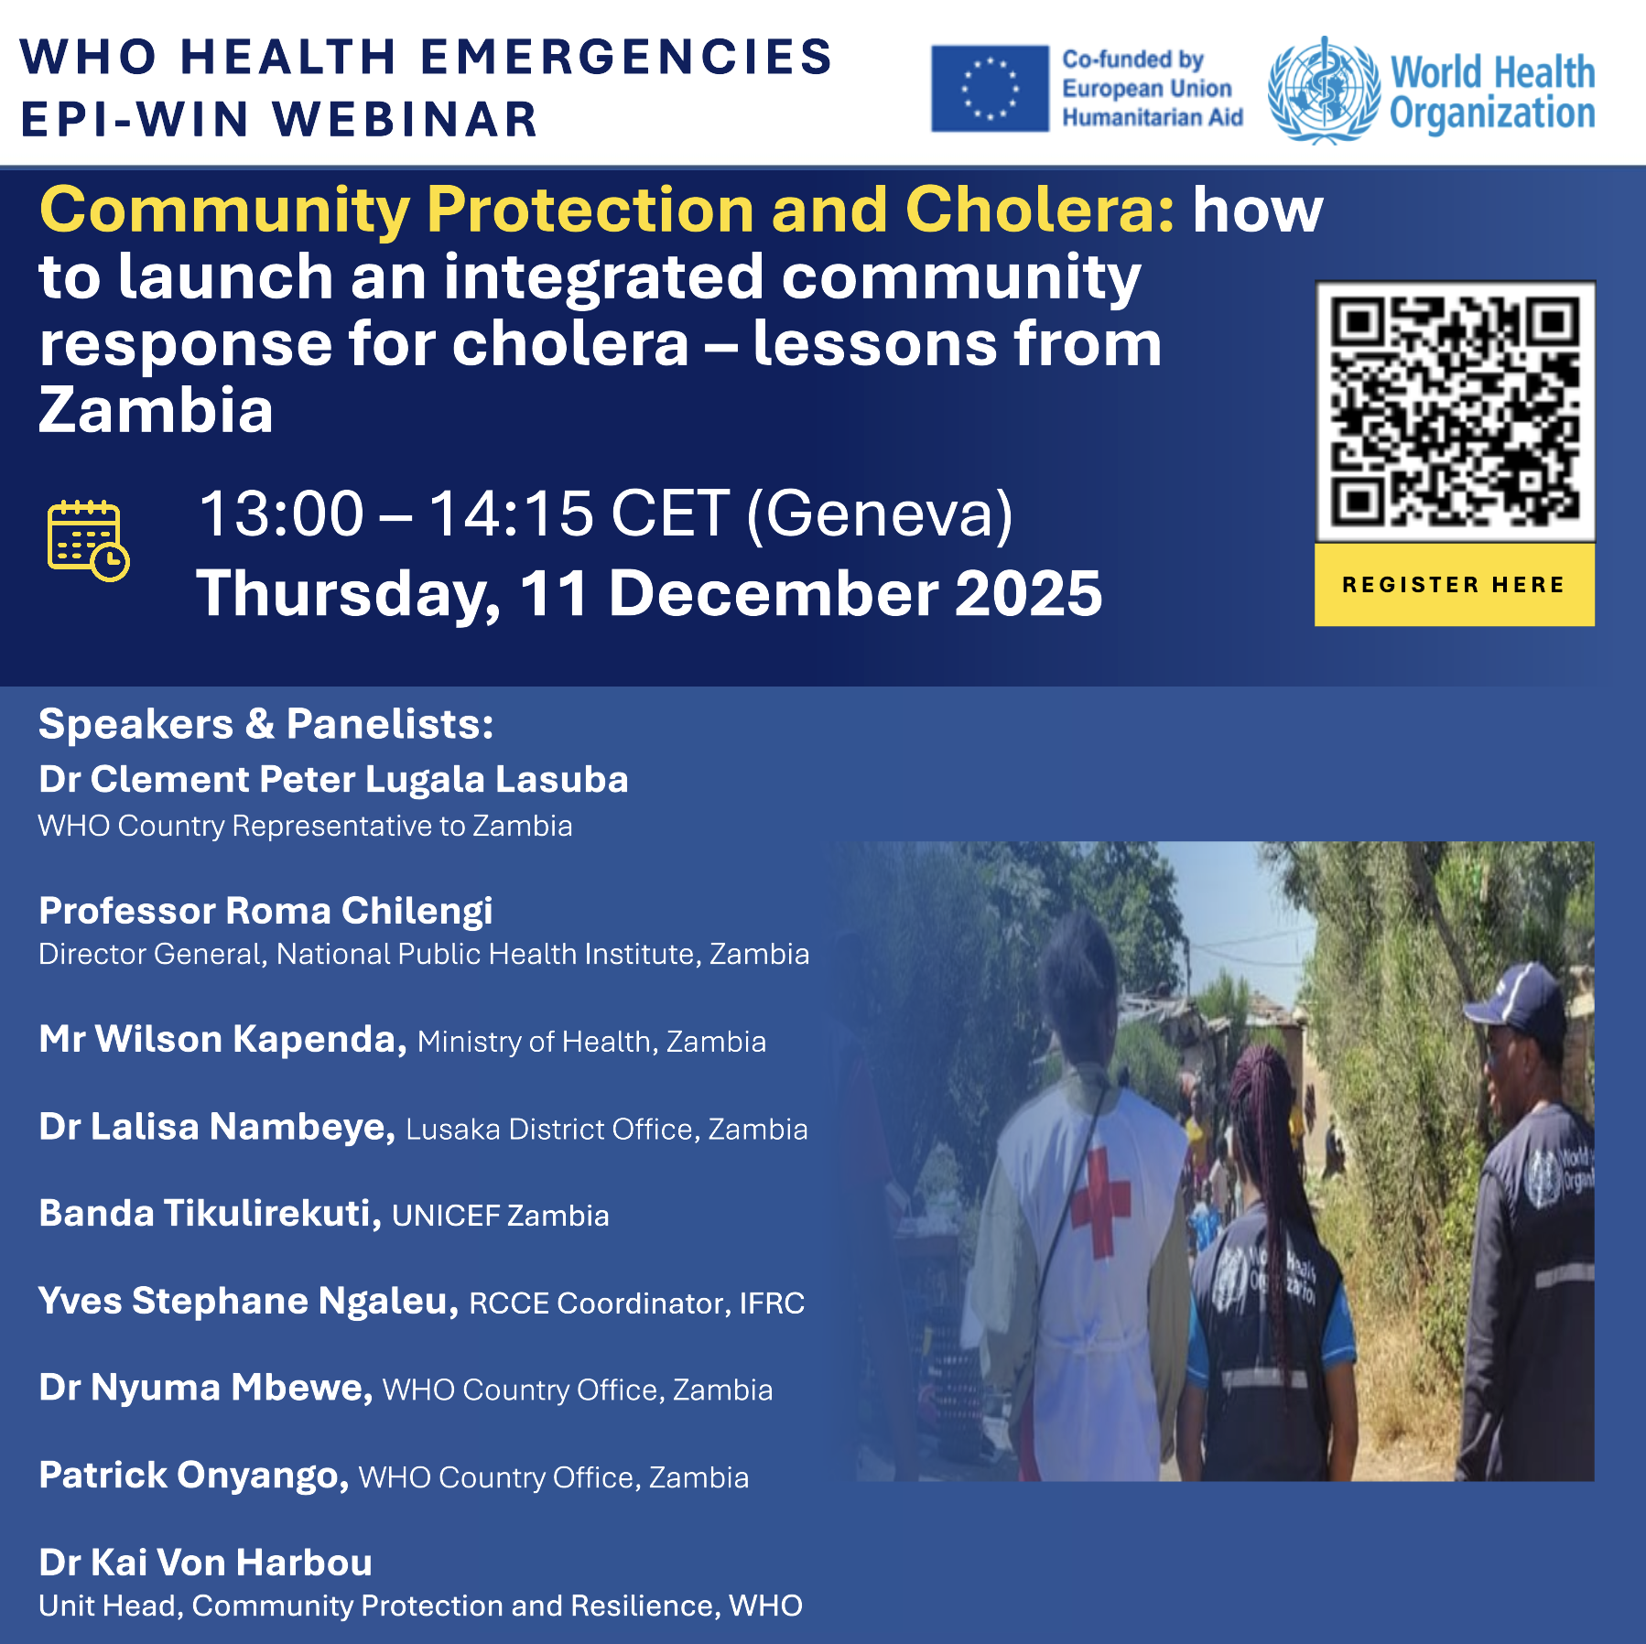

Slide 2

WHO Information Network for Epidemics (EPI-WIN) Webinar
Community Protection and Cholera: how to launch an integrated community response for cholera – lessons from Zambia
Time (CET) | Topic | Speaker
13.00 - 13.03 | Introduction of EPI-WIN, housekeeping | Lester Sam Geroy, EPI-WIN Science and Knowledge Translation, WHO
13.03 - 13.05 | Introduction to topic and speakers | Kai Von Harbou, Unit Head, Community Protection and Resilience, WHO
13:05 – 13:15 | Welcome Remarks | Clement Peter Lugala Lasuba, WHO Country Representative to Zambia Roma Chilengi, Director General, National Public Health Institute, Zambia
13:15 – 13:25 | Zambia’s Integrated Community Strategy for Cholera Control | Wilson Kapenda, Ministry of Health, Zambia
13:25 – 13:35 | Frontline perspectives | Lalisa Nambeya, Lusaka District Office, Zambia
13:35 – 13:40 | Experience sharing from Zambia partners | Banda Tikulirekuti, UNICEF Zambia Yves Stephane Ngaleu, RCCE Coordinator, IFRC
13:40 – 13:50 | Lessons learnt and way forward to community pandemic preparedness | Nyuma Mbewe, WHO Country Office, Zambia
13:50 – 14:00 | Q&A | All Speakers
14:00 – 14:05 | Technical closing: The Zambia experience learnings as a model for cholera management | Patrick Onyango, ECHO
14:05 - 14.10 | Closing | Supriya Bezbaruah, EPI-WIN Science and Knowledge Translation, WHO

