Slide 1
The Role of CSOs in the Universal Health and Preparedness Review (UHPR)
Civil Society Organizations (CSO)
Ludy Suryantoro
Head of Unit, Multisectoral Engagement for Preparedness

Slide 2
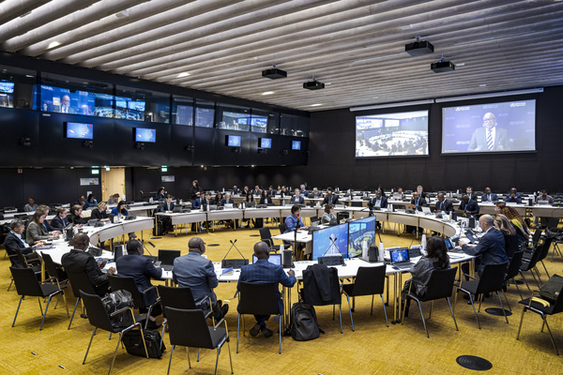
Outline
Overview of the Universal Health and Preparedness Review (UHPR)
CSOs Engagement within the UHPR
CSO engagement in the Sierra Leone UHPR
4. Next steps

Slide 3

Background
No country was prepared for a health emergency of the scale and severity of Covid-19 pandemic
Leadership challenges
Fragmentation in response strategies
Lack of platform for sharing of experiences and peer-to-peer learning between countries
Insufficient international cooperation and solidarity

Slide 4





UHPR Overview
1. Preparing for the UHPR Process
Country internal High-level Discussion for Official Engagement
4. National Follow-up
Fund Raising
Priorities Implementation
Monitoring & Evaluation
2. National Review
Country Development Profile
High-level engagement, Multisectoral & whole-of-society participation
High-Level Mission &
National Report
Maximum
6
Months
3. Global Peer Review (GPR)
High-level regional and Global dialogue among MS
under the auspices of WHO
Notes:
The Universal Health and Preparedness Review (UHPR) is a voluntary, Member State-led, and high-level process. It was launched by the WHO Director-General in 2020 as a strategic response to the lessons of the COVID‑19 pandemic. It is designed to strengthen national health security capacities through inclusive national dialogue, and regional and global peer review.
The UHPR does not duplicate these tools but synthesizes their findings and elevates them to the highest political level — engaging Heads of State, government leaders, and decision-makers. This approach fosters whole-of-government and whole-of-society dialogue, ensuring that health emergency preparedness remains a priority on political and development agendas.
The UHPR cycle consists of four phases.
Phase 1 – Preparing for the process: The process begins with national consultations to establish a strong foundation for formal engagement. This phase is driven by national leadership and aims to align stakeholders around a common vision and purpose for the review.
Phase 2 – National Review: This phase culminates in an in country high-level mission during which the WHO Director-General and Regional Director are invited to engage with country leadership, decision-makers, and partners to review the country’s key priorities and proposed strategies. The outcomes are captured in a National Report, which is formally endorsed by the Head of State and shared with the WHO for publication.
Phase 3 – Regionalization & Global Peer Review (GPR): The National Report is presented and discussed with peer Member States, partners, and donors, initially at the regional level and subsequently at the global level.
Phase 4 – National Follow-up: The priorities identified through the process are translated into concrete actions through targeted implementation, sustainable financing strategies, and continuous monitoring, ensuring long-term impact and institutionalization of health emergency preparedness across sectors.

Slide 5
CSOs’ engagement in the UHPR
Significance of CSOs engagement in the UHPR
Operational steps for MS to engage CSOs in different phases of the UHPR process
  National review phase (Phase 2)
  Global peer review (Phase 3)
  National follow-up phase (phase 4)
Notes:
Engaging CSOs in the UHPR process can achieve the following objectives:
•Enhancing transparency and accountability in preparedness efforts
•Building trust and policy adherence and strengthening preparedness
•Improving responsiveness and effectiveness of health emergency interventions
•Reducing health inequities in health emergencies
Member states could engage CSOs from phase two to phase four of the UHPR process.
During the national review phase (Phase 2), member states state engaging CSOs by creating enabling environment and selecting CSO representatives and appropriate types of engagement. Then member states could develop plans for engagement, build capacities for the selected CSOs and ensure their consistent participation, particularly in the process of drafting national report.
In the global peer review (GPR) phase (Phase 3), the UHPR national report is shared with CSOs, who are given a chance to provide written feedback, which helps ensure that community perspectives are considered in the peer review process. Following the submission of feedback, the questions and comments raised by CSOs are shared with the concerned Member States, allowing them to prepare responses and address these issues during the peer dialogue. This approach ensures that the voices of the CSOs are heard.
In the national follow-up phase (phase 4), CSOs could support the national follow-up process in several sways: contribute to the drafting of national health and development plans, mobilize resources by leveraging their own networks, and support the design and roll-out of monitoring tools that track progress.

Slide 6
CSO engagement in the Sierra Leone UHPR
Sierra Leone completed UHPR National phase in May 2023
CSOs engaged in the focus group discussions during the national phase and the national follow-up phase
Outcomes of the CSOs discussions during the UHPR
    Enhance collaboration between CSOs and Government.
    Ensure early involvement of CSOs in future health response.
Experience gained from CSO engagement during UHPR
    Benefits gained from CSO Engagement during UHPR
    Challenges gained from CSO Engagement during UHPR
Notes:
During UHPR of Sierra Leone, CSOs engaged in focus group discussions to identify key strengths, best practices, and challenges regarding emergency preparedness, input into the national report. After the UHPR, CSOs engaged in such activities as monitoring, resource mobilization, assessment of risk and vulnerabilities of specific groups during health emergencies, advocacy around UHC commitments, follow-up with Government and partners on recommendations of UHPR, as well as community education and awareness.
Outcomes of the CSOs discussions during the UHPR include:
Enhance collaboration between CSOs and Government before, during, and after an emergency/public health event.
Ensure early involvement of CSOs in future health response - from planning to implementation.
Improve strategies to prevent future epidemics more effectively.
Depoliticize emergency response processes to ensure unbiased and efficient interventions.
Improve access and equity to underserved populations, esp. those suffering from mental health issues.
Advocate for increased government allocation to health preparedness and response capacities.
Establish mechanisms to monitor and track the progress of UHPR implementation on a quarterly basis.
Benefits and challenges gained from CSO Engagement during UHPR,
Benefits of UHPR
Collaboration and coordination with high-level political leadership, community participation, gender inclusion, equity, and capacity building can build a sustainable and resilient health system.
Exposure to IHR global policy
Whole-of-government and whole-of-society approach in mitigating and responding to emergencies
Inclusion and consultation on emergency preparedness and response processes
Exposure and participation to high-level intersectoral meetings
Challenges
CSO’s in the districts were not included/consulted during the UHPR process
A nationwide sensitization on the UHPR pilot was not conducted before the pilot
High-level mission coincided with major political activities in the country (General elections)

Slide 7
Next steps
Continue exploring the most suitable modalities for CSO engagement in UHPR in different country contexts through further pilots.
Publish a guide on engaging CSOs, communities and people in the UHPR
Engage stakeholders in piloting the CSO guide to ensure its relevance and refine its content.
Collaborate with WHO teams and other partners to strengthen CSO engagement
Notes:
To support Member States in engaging civil society and communities throughout the UHPR process, our unit has drafted Social Participation in the UHPR: A Guide for Engaging Civil Society, Communities, and People. This guide is also intended to serve as a resource for civil society and community actors, helping them better understand the objectives, roles, and contributions involved in the UHPR process. We have already consolidated inputs from colleagues working on UHC and sent to each unit of out department for comments. We are planning to publish this guide this year.
We are also looking forward to collaborating with WHO teams and other partners to strengthen CSO engagement in UHPR and health emergency preparedness.

Slide 8
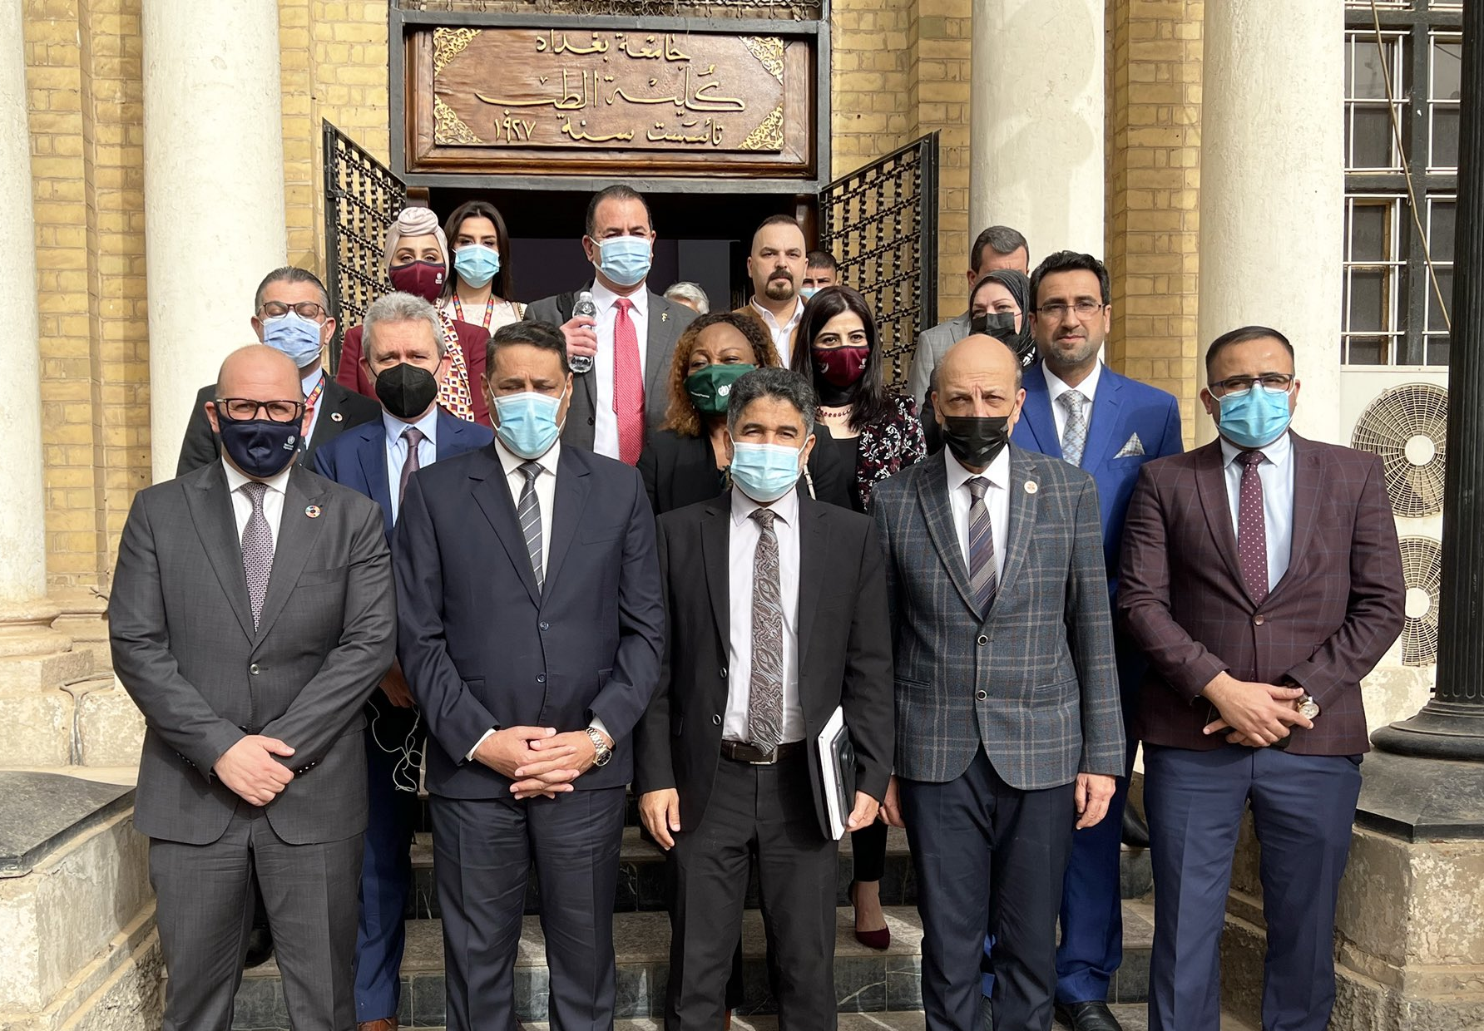
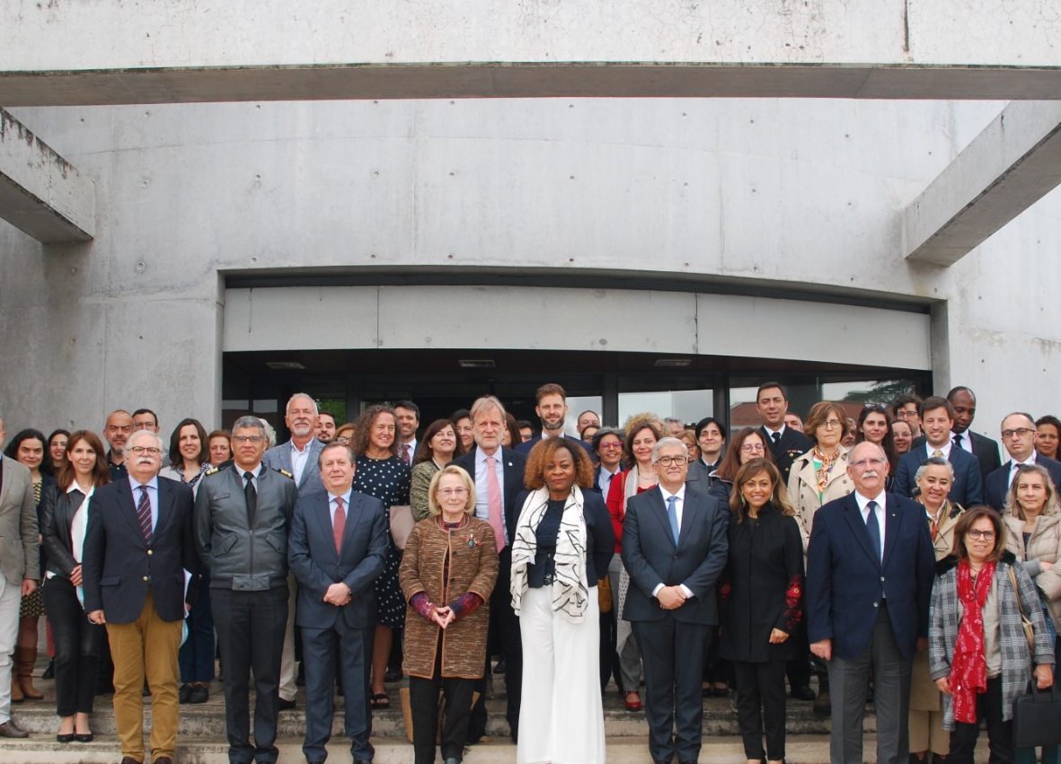
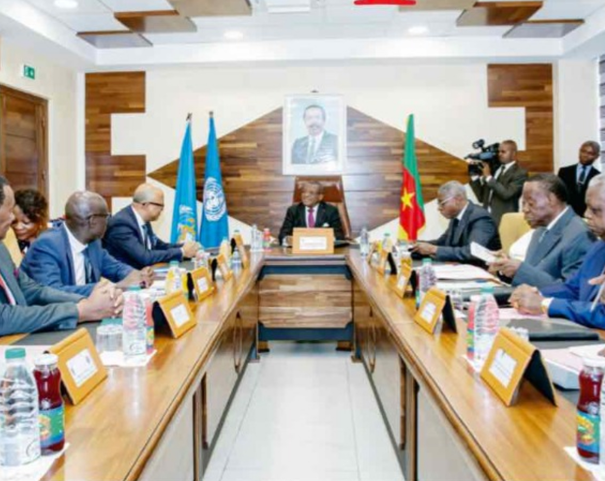
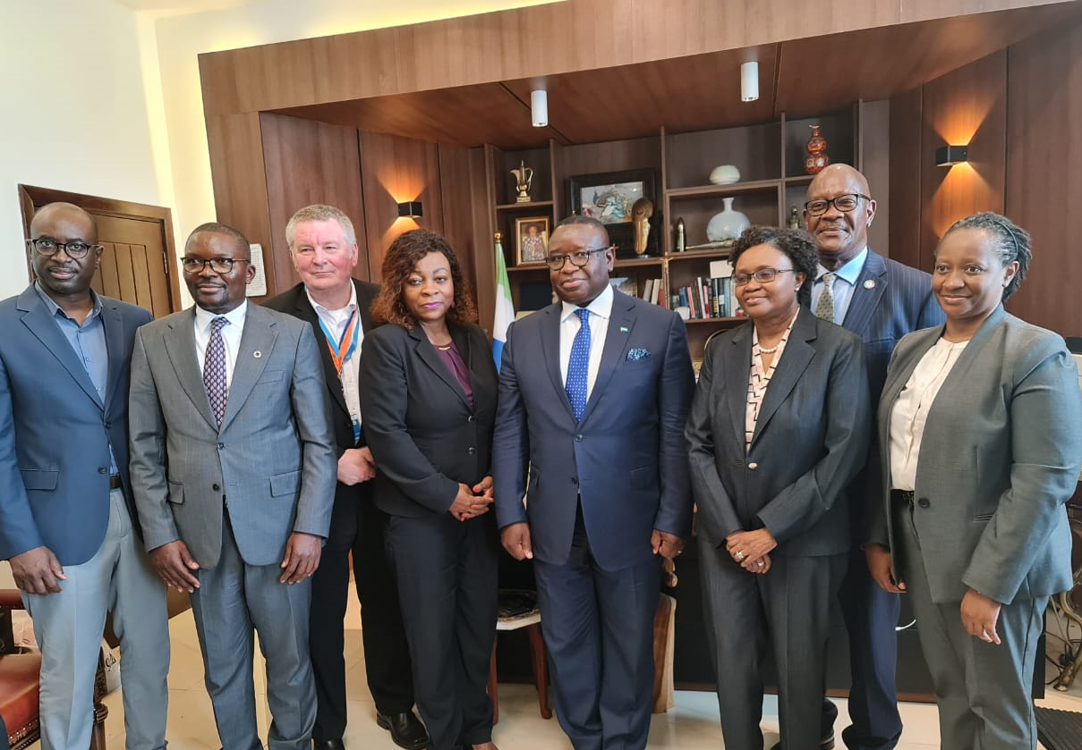
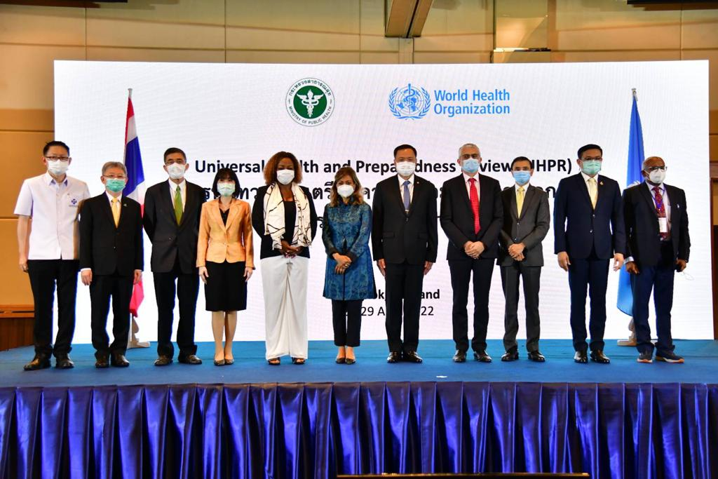
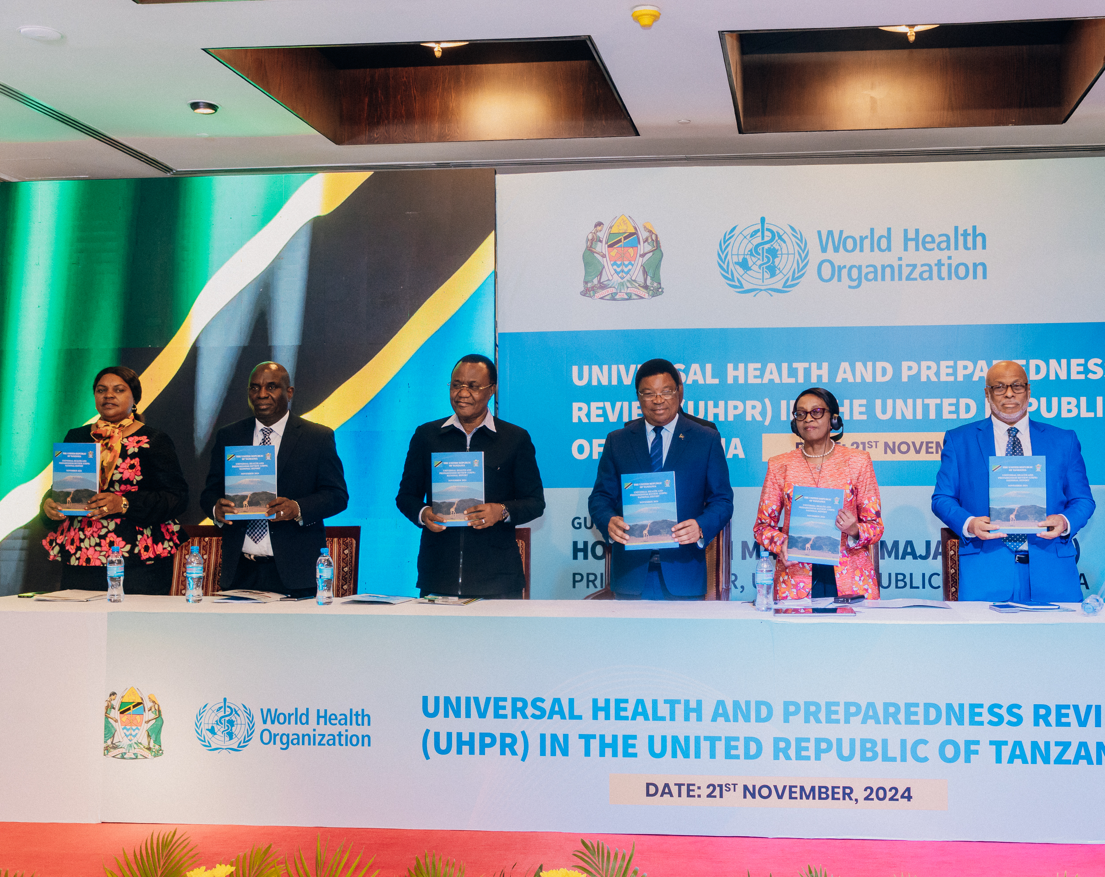
UHPR High-level Mission Iraq, Portugal, Cameroon, Sierra Leone, Thailand and Tanzania

Slide 9

Contact uhpr@who.int
Website
https://www.who.int/emergencies/operations/universal-health---preparedness-review

