Slide 1
DIGITAL VIOLENCE IN EMERGENCIES: PUBLIC HEALTH INTERVENTIONS FROM THE FIELD
Dr Millie Mayiziveyi Phiri
Journalist, Researcher, Author
Insights from the Book: Gender-Based Violence and Digital Media in South Africa

Slide 2


Why Digital Violence is a Public Health Issue
  Cyberbulling, doxing, sexual harassment, hate speech, stalking
  Targets: journalists, politicians, human rights defenders, LGBTQ+
  Public Health Impact: Trauma, impaired mental health, silencing voices, weakened emergency communication

Slide 3
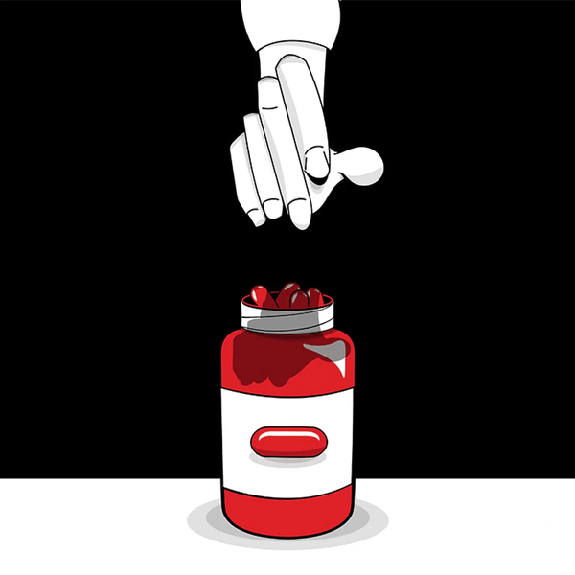
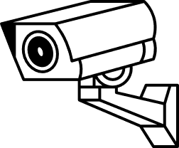
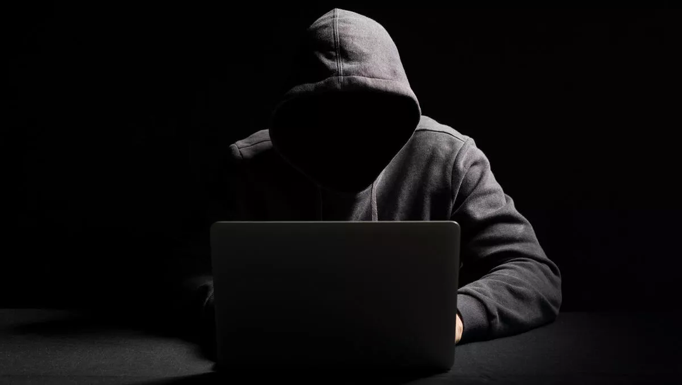
Field Realities - Epidemic Levels of Digital Trauma
Online misogyny in spaces similar to Reddits ‘’Red Pill’’ normalizes violence
Surveillance of female journalists, human rights defenders ⟶ self censorship, withdrawl, exile after threats escalated into physical violence
Fear of stalking online ⟶ withdrawl from public life

Slide 4



Survivor - Centered Interventions
  Trauma- informed helplines with privacy safeguards, trained staff, discreet referals
  Female journalists ‘ advocacy: legal reforms, strict penalties, platform accountability, mental health support, cybersecurity training
  Online solidarity spaces offering debates) as digital public spheres for coping and resilience

Slide 5

Institutional & Legal Recommendations
  Embed digital safety in emergency preparedness protocols
  Survivor- friendly reporting enviroments to rebuild trust
  Enforce platform accountability and protective laws

Slide 6

Feminist Public Health Principles
  Visibility and voice: online spaces like Hashtag campaigns amplify survivor voices
  Intersectionality: women are not homogenous; anonymity/ disguise highlight diverse risks
  Representation: media coverage and online debates are inventions themselves
  Structural change: patriarchy embedded across race/class ⟶ need systematic transformation ( education, empowerment, representation)

Slide 7
Call to Action
Recognize digital violence as a public health emergency
Elevate survivor voices in global frameworks
UNiTE for safe, inclusive, resilient digital futures
Safety is not a privilege - it is a right

Slide 8
Thank you
phirimillie@yahoo.co.uk

