Slide 1
WHO competency framework, risk communication and community engagement
For stronger and more inclusive health emergency programmes
Tom Moran
Community Protection and Resilience
Health Security Preparedness
WHO Health Emergencies Program
Oct 2025, Geneva

Slide 2
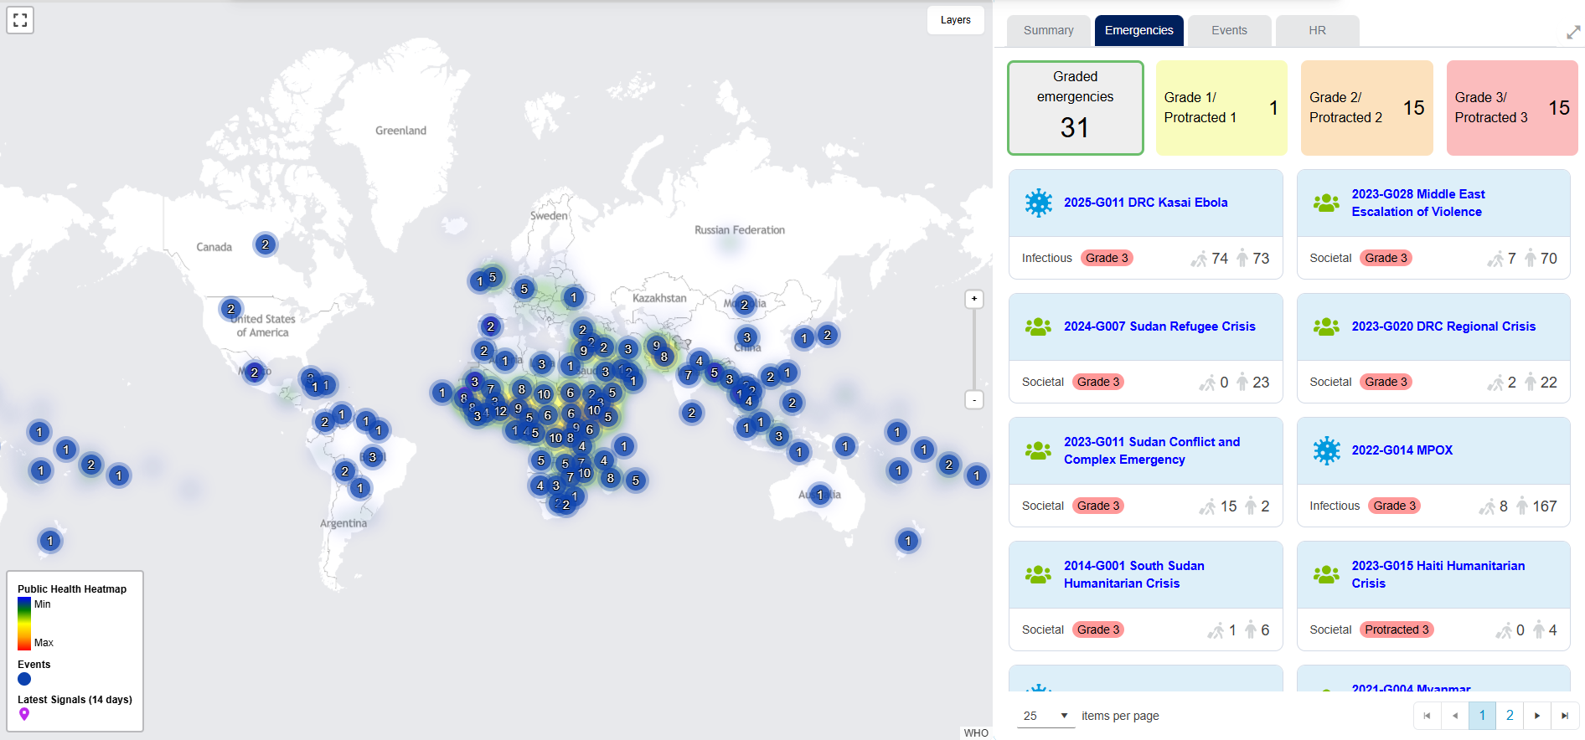
The global context
Increasing frequency of public health emergencies and complex crises
Increasing recognition of risk communication and community engagement as essential for equitable and effective emergency programmes
Screenshot from WHO health emergency dashboard – 31 graded emergencies.

Slide 3
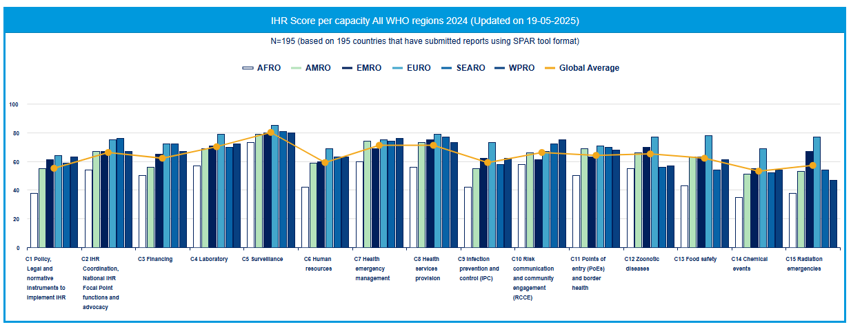
Why is a global RCCE competency framework needed?
Capacity gaps - Despite increased recognition and recommendations to strengthen RCCE systems, persistent capacity gaps remain globally – even though RCCE is a core capacity under the International Health Regulations (2005, 2024 amendments).
Different Interpretations: There are varied understandings and definitions of what RCCE encompasses across regions and sectors.
Fragmented approaches - Differing priorities have led to uneven investment and implementation.
Need for agreed standards – A common framework ensures consistent RCCE capacity and a shared understanding of core behavioural competencies and applied action.

Slide 4
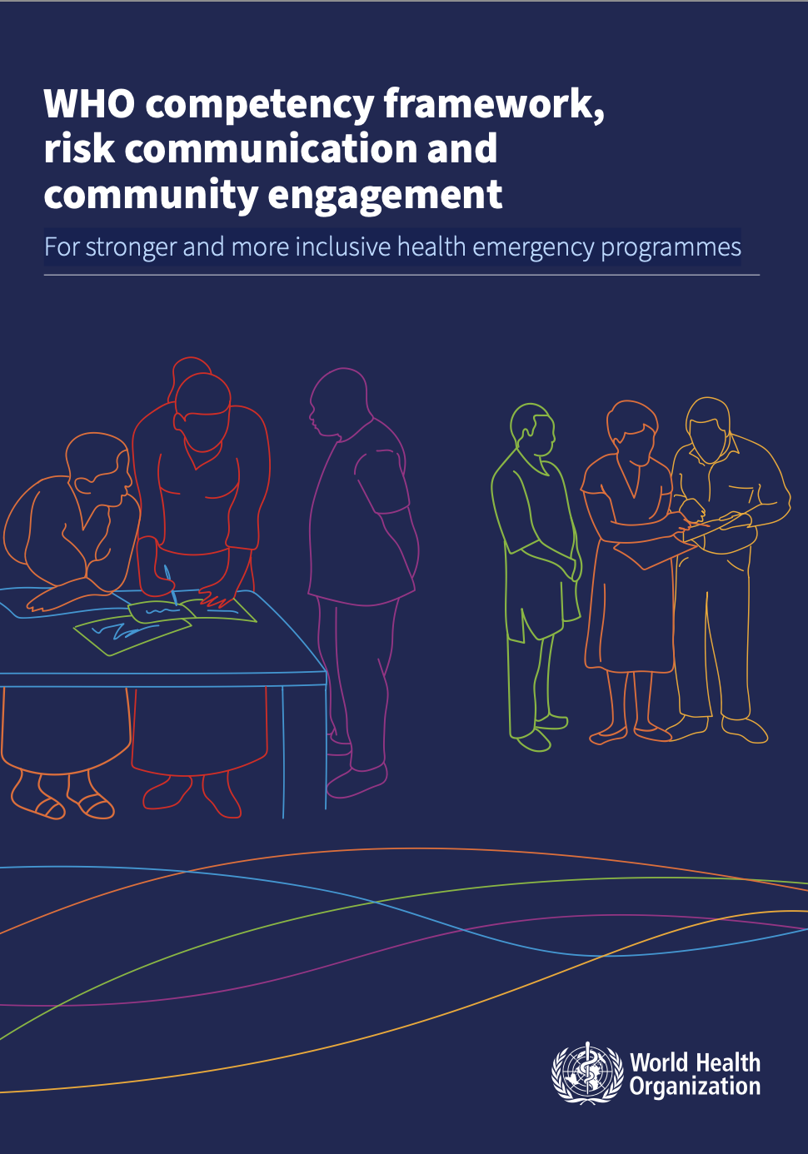
What does this framework do?
This framework provides a standardized, evidence-based foundation to strengthen RCCE capacity across WHO, Member States, and partners.
It defines the core knowledge, skills, and behaviours needed to:
Communicate risks clearly and effectively
Manage and counter misinformation
Engage and empower communities
It establishes a shared global standard to:
Build and sustain competencies and workforce capacity
Enhance coordination across regions
Improve accountability and performance, ensuring actions align with best practice and ethical standards
Integrate RCCE into national systems
Ultimately, it ensures WHO and partners are better equipped to engage communities, build trust, and communicate risks effectively.
https://www.who.int/publications/i/item/9789240035287

Slide 5
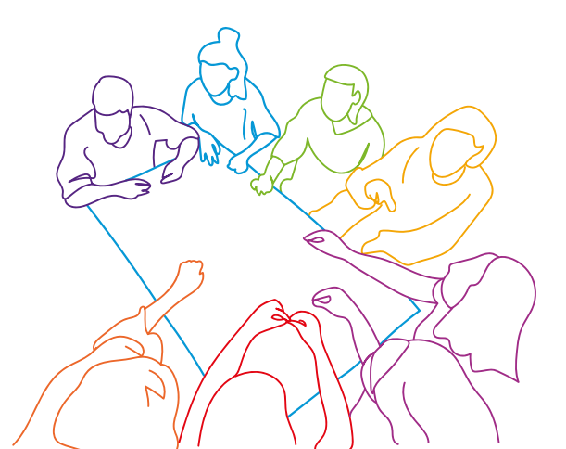
How can it be applied?
Workforce development: as a standardised reference for developing team competencies
Needs assessment: to guide tools to identify gaps and areas for improvement
Professional development: creation of learning pathways
Recruitment: as a reference source for ToR and job descriptions.
Performance assessment: as a reference source to develop performance indicators
Programme development: for learning and training curricula development

Slide 6
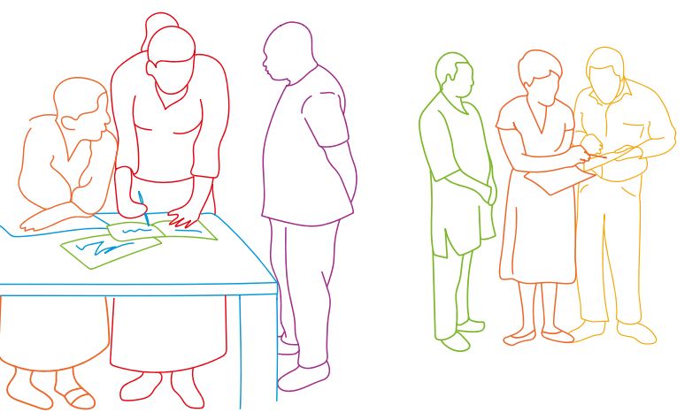
Who is it for?
RCCE teams who design, implement & evaluate RCCE strategies and plans
Academic institutions and capacity building experts
Emergency response teams
Policymakers and administrators
Community-based organizations
Health and development partners
Public health workforce

Slide 7
How was the RCCE framework developed?
01
02
03
04
Foundational Work
Proposal of initial competencies
Structuring competencies
Consolidation
Desk review
Establishment of working group
Development of representative personas
Stakeholder engagement: consultations and focus group discussions
Formulation of initial competencies
Feedback on competencies
Aligning competencies with foundational models
Integration with existing frameworks
Consideration of reporting requirements
Final review the competency framework
Ensuring alignment with WHO SOPs and guidance for CFs

Slide 8
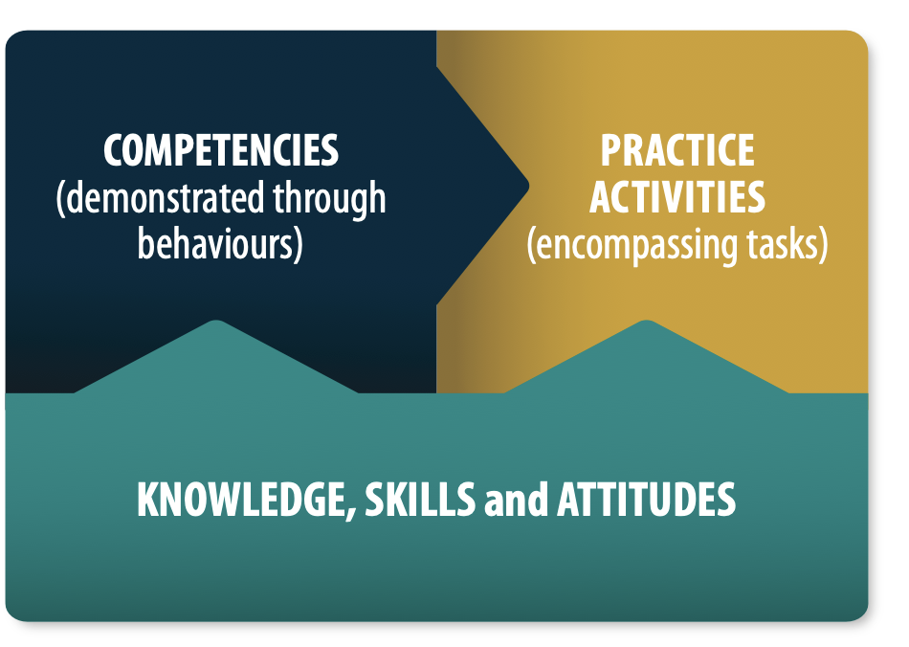
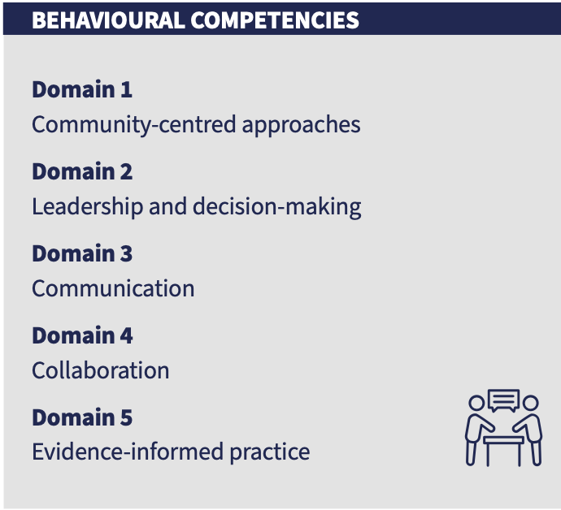
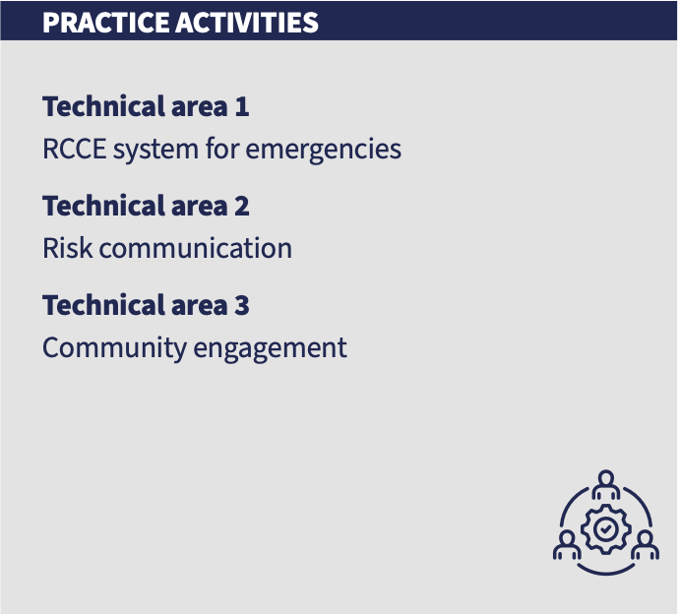
Structure of the framework
Foundational model
Behavioural competencies
Practice activities
Ref. 2022 WHO Global Competency and Outcomes Framework for Universal Health Coverage

Slide 9
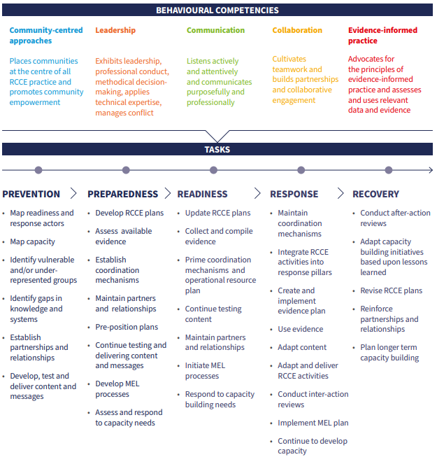
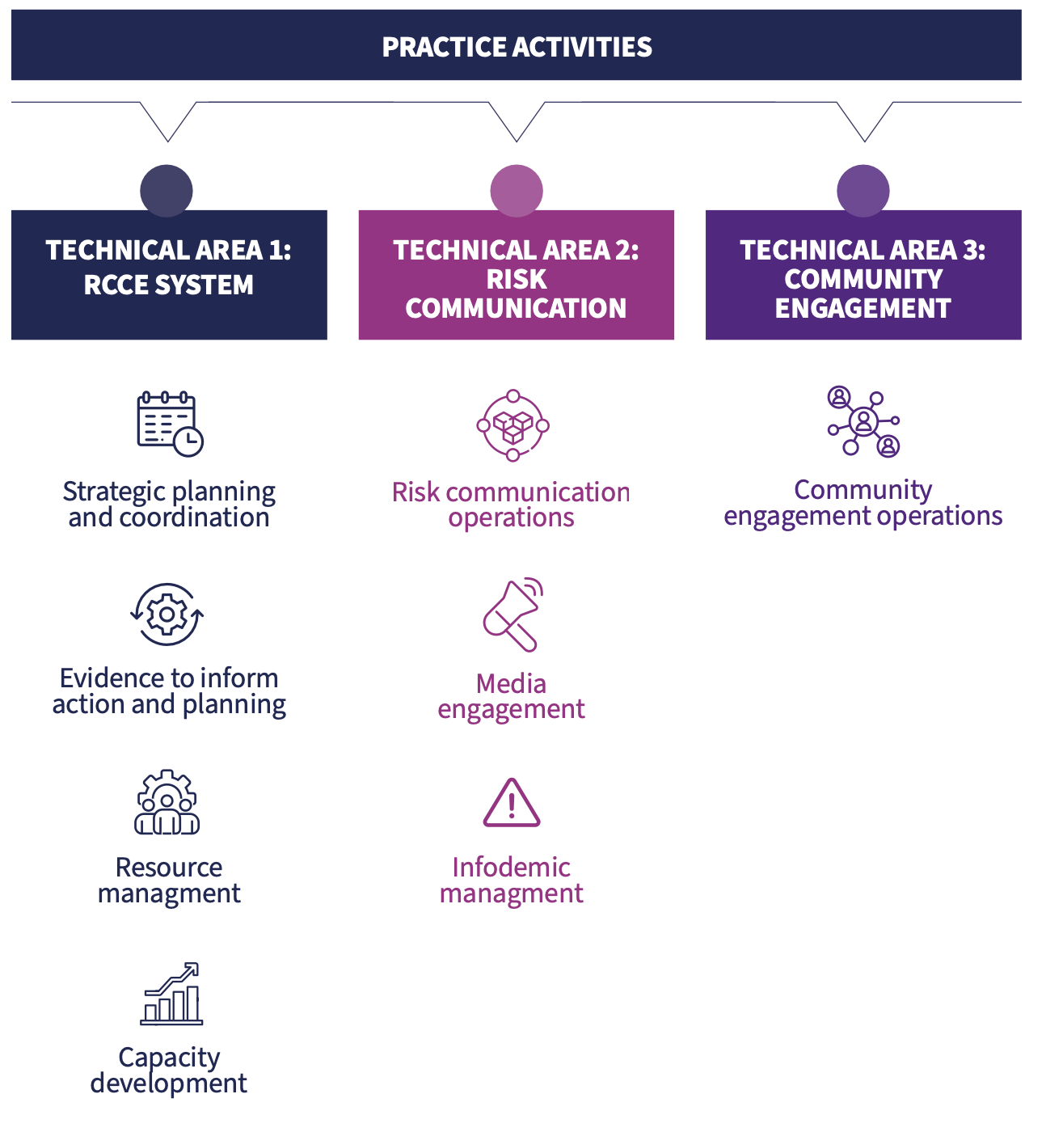
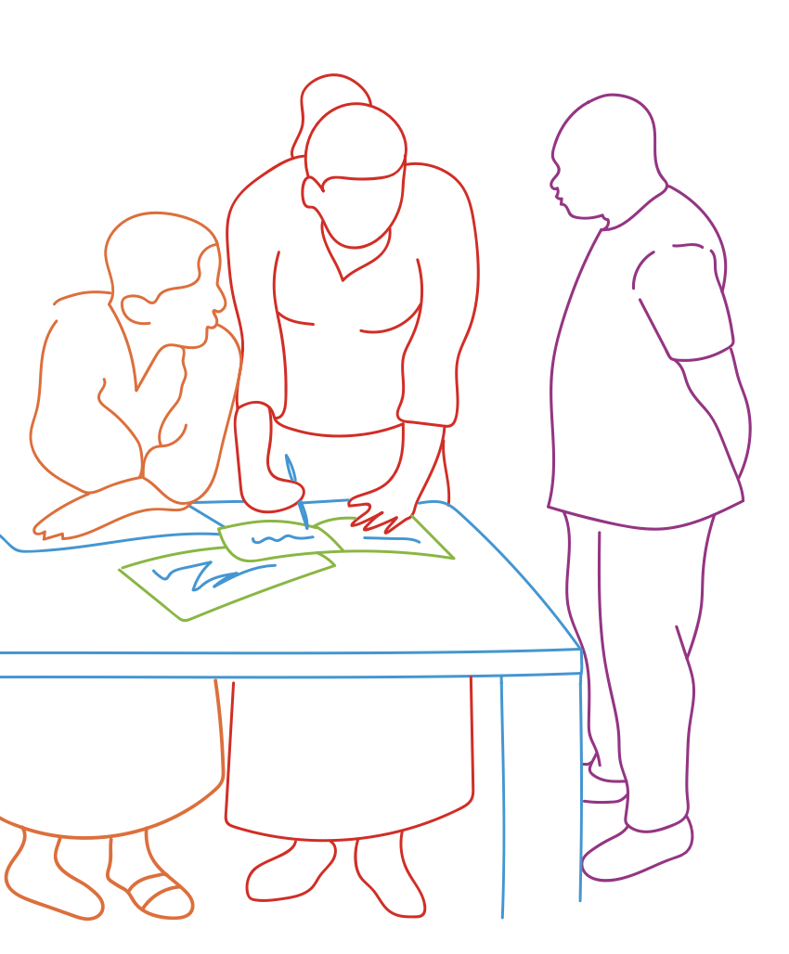
Key behaviours, practice activities and tasks across emergency cycle

Slide 10
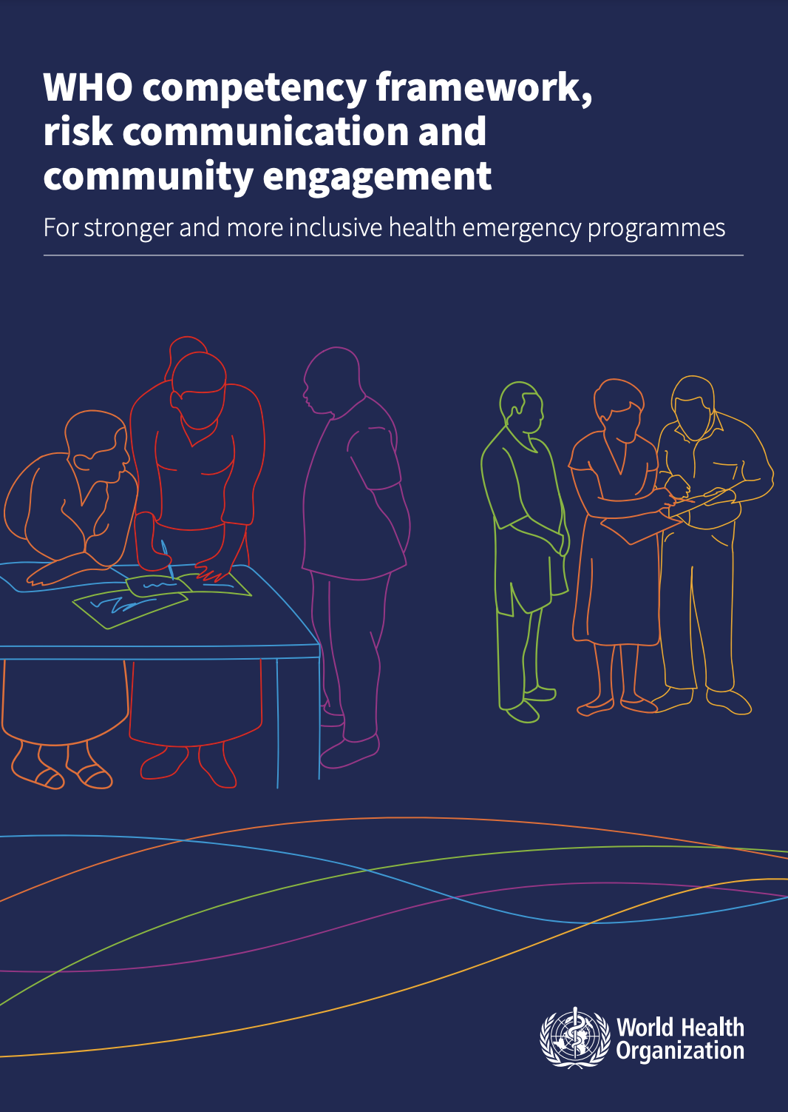
Future adaptations and next steps
The framework is flexible and adaptable, designed to be contextualized to national and local needs.
Countries can select and prioritize competencies most relevant to their RCCE context and capacities.
It will be periodically reviewed and updated to reflect:
  Revisions to IHR benchmarks and reporting tools
  Feedback from implementation and user experience
  Emerging RCCE trends, technologies, and methods
  New research and evidence on effective RCCE practices
  Ongoing monitoring of learning and performance outcomes
https://www.who.int/publications/i/item/9789240035287

