Slide 1
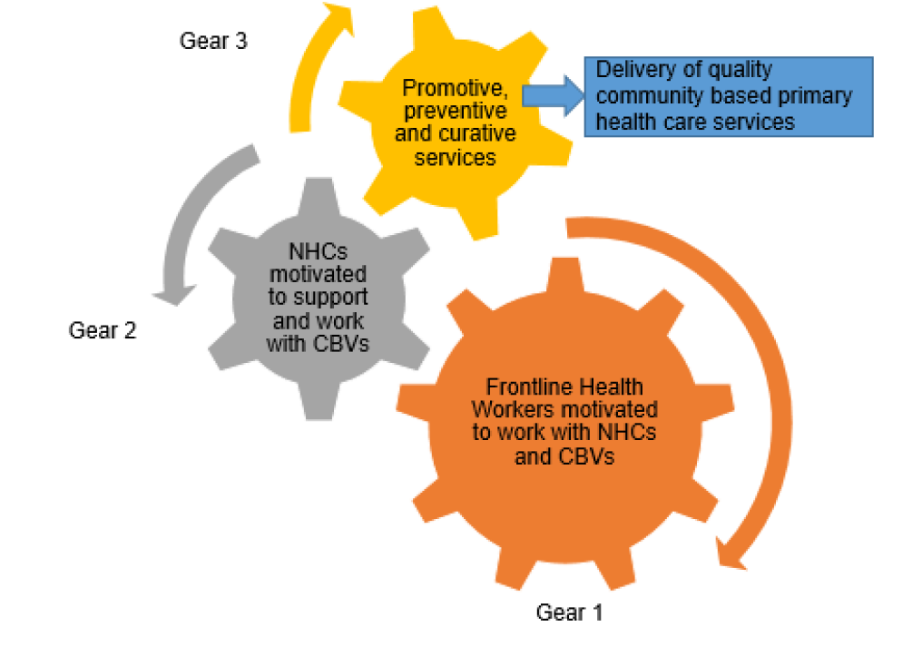
Implementation of Zambia’s Integrated Community Strategy for Cholera Control
Wilson Kapenda
WHO EPI WIN Webinar
December 11th 2025
Community Health Engine
Notes:
Source od image – Ministry of Health NHC Strategy 2024

Slide 2

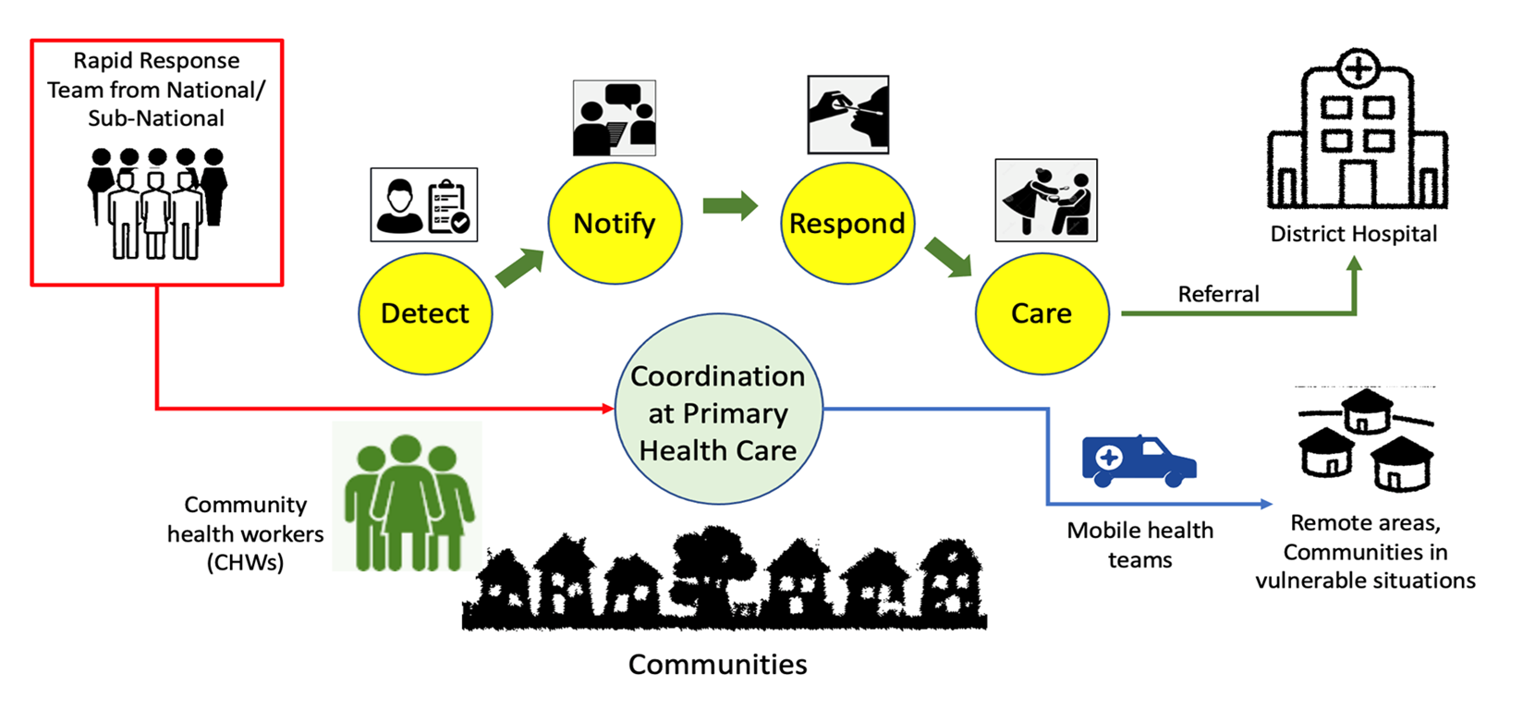
Public Health and Health Service Delivery Functions between Health Facilities and Communities
Core content
Notes:
This slide shows the roles of community health workers in terms of detecting, reporting and responding to the outbreak i.e. by immediate referral to health facilities. CHWs also form an important link with PHC health workers and Rapid Response Teams. They may also be requested to support key activities e.g. outreach health programmes and mobile health teams to communities.
Can you already picture your role in the community? Which of these activities have you done before? Have you accompanied a person to the health facility? Have you joined contact tracing or active case finding before?

Slide 3
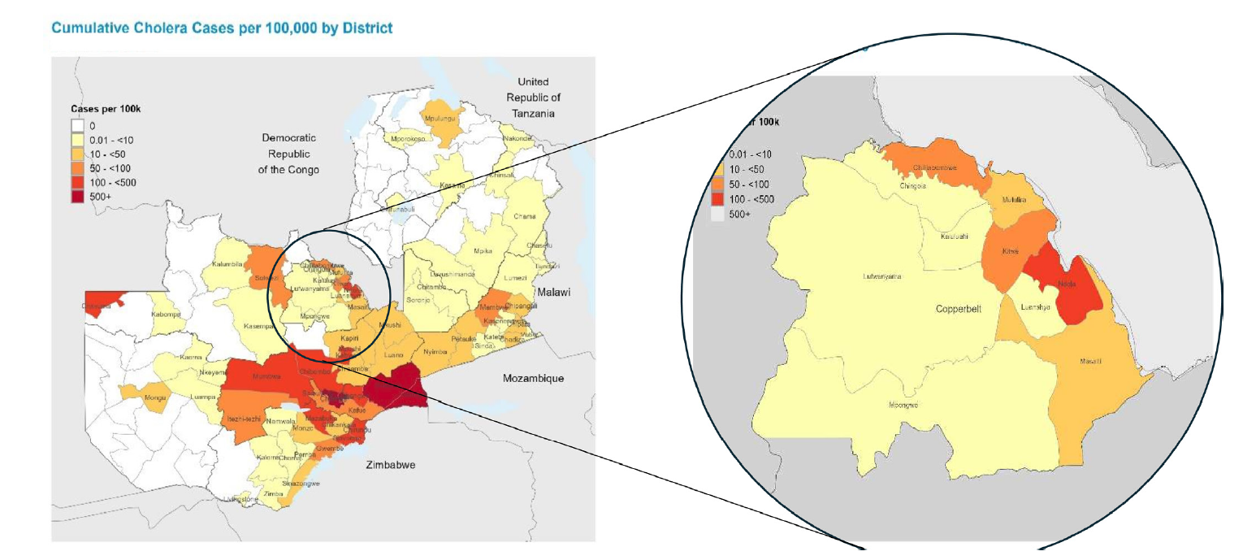
Geographic Impact of the 2024 Outbreak
Hotspots were identified during the outbreak – Copperbelt and Lusaka
Focus of pilot was Ndola, Kitwe and Chililabombwe
Map highlighting highest cases

Slide 4
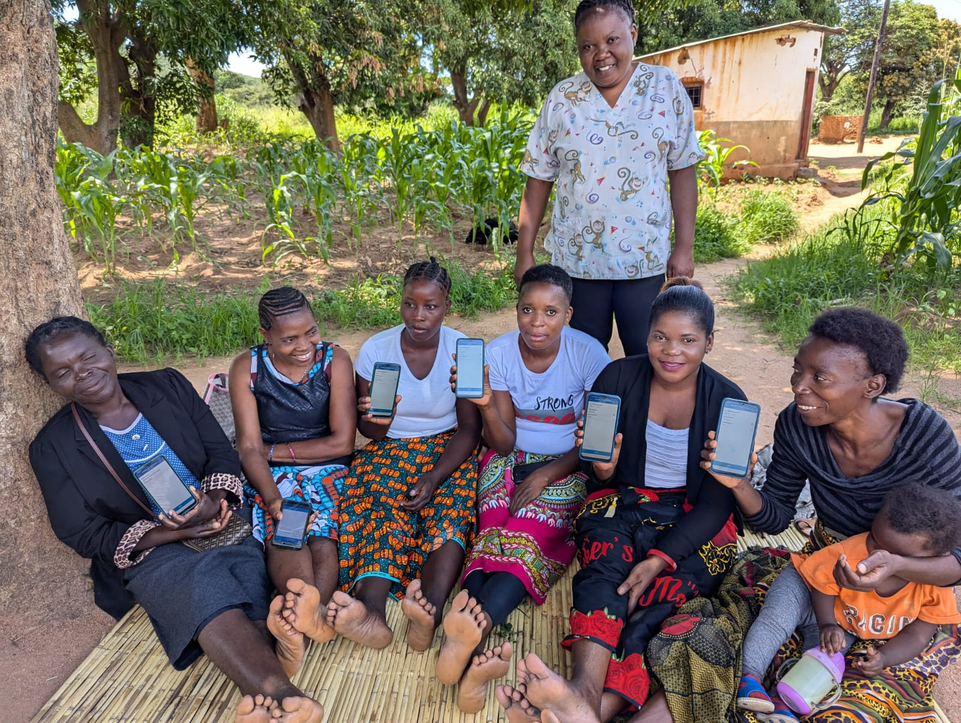
Zambia’s Integrated Community Strategy for Cholera Control
Multidisciplinary Teams – technical teams were deployed to Ndola, Kitwe, Chililabombwe
Capacity Building
  80 community-based volunteers (CBVs) trained
  85 Health care workers trained
Tools and logistics: Teams were equipped with digital reporting tools, cholera test kits and transportation support to reach hotspots rapidly
Notes:
Image from MOH website,
Package of interventions as defined in the ICSCC publication, including CATI and ORPs which were tailored during the response

Slide 5
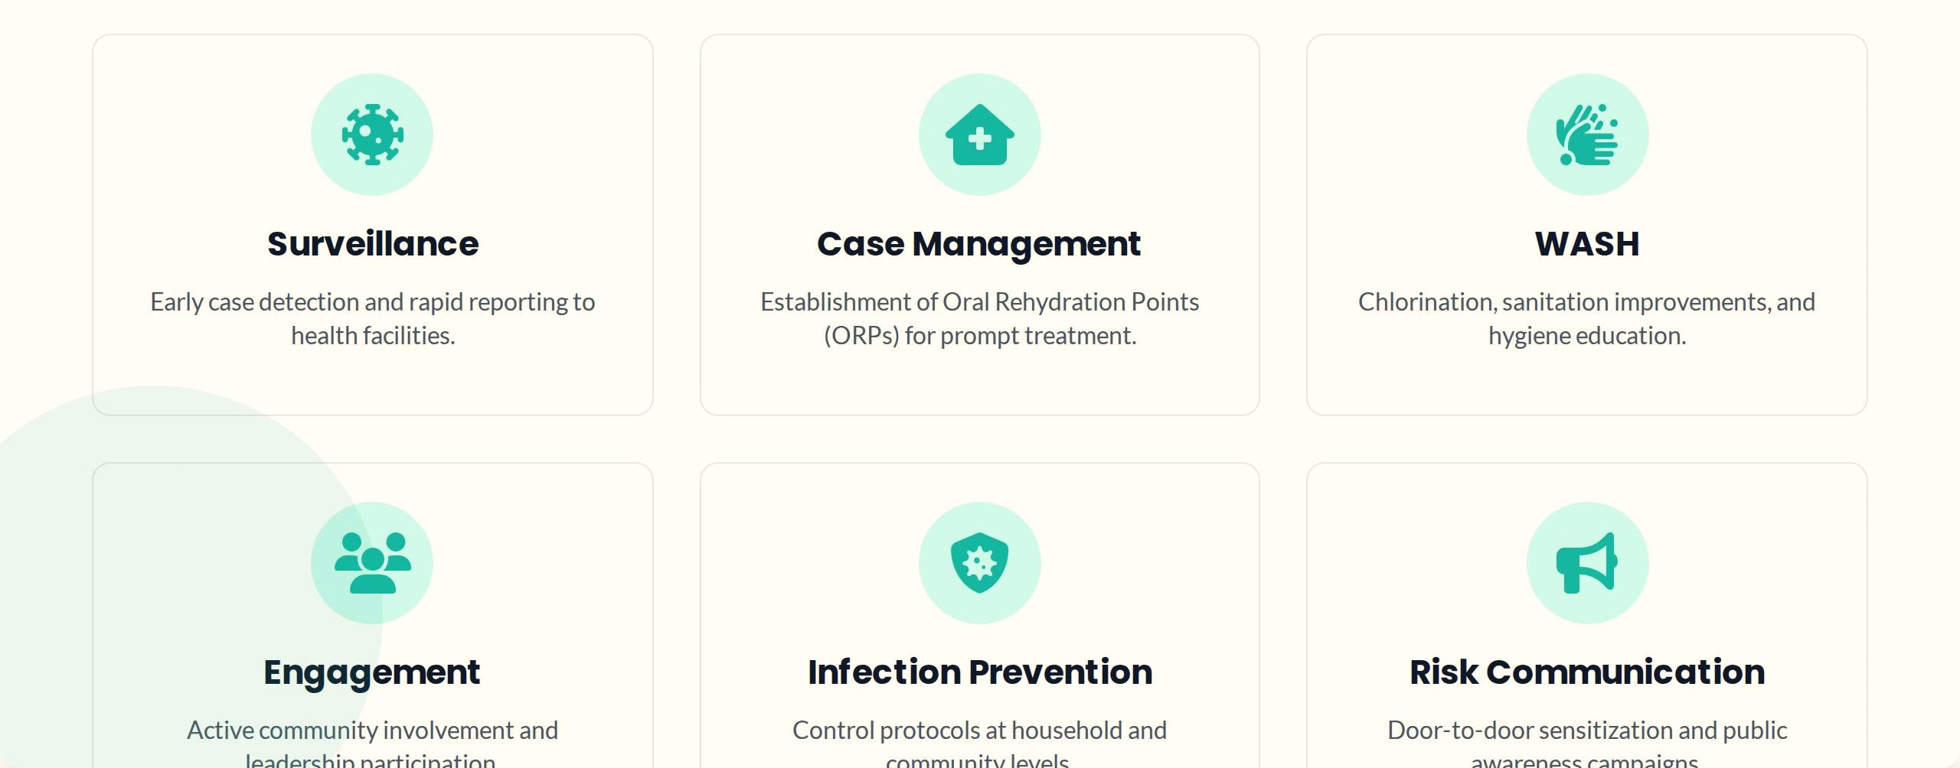
Components of the Integrated Strategy
  CHWs were strengthened during the largest outbreak, delivering a combined package of services tailored to reduce mortality and limit spread.

Slide 6

WASH as the First Line of Defense
Targeted Actions
Water Treatment: Distribution of liquid and granular chlorine to households for point of use disinfection
Hygiene Promotion: Intense campaigns promoting handwashing with soap at critical times
Sanitation: Liming of latrines and distribution of sanitation items to high-risk areas
Outcomes: Visible improvement in household water treatment and reduced transmission in pilot zones

Slide 7
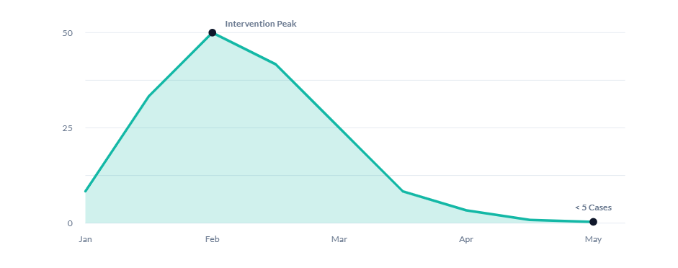
Impact of ICCSS on Daily Cases
Following implementation of the integrated strategy on the Copperbelt, daily cases dropped significantly, stabilizing to zero
Notes:
Clearly evident how the community strategy has helped to reduce cases, “flatten the curve” but more so reduced community deaths. Has been now used and refined in subsequent outbreaks.

Slide 8
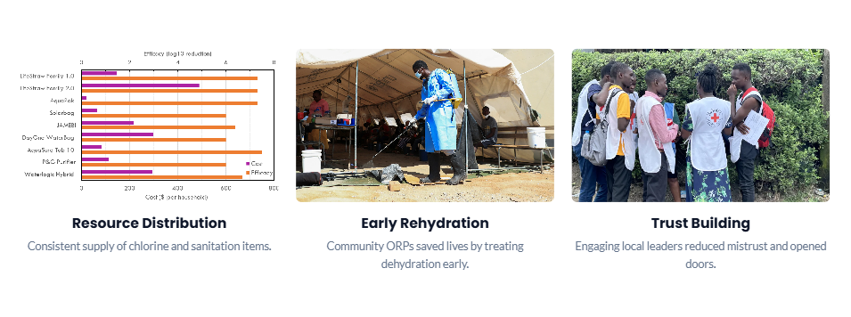
Key Drivers of Success
Community resilience depends on trust built between the health systems and the community
Early engagement with local leadership in emergency preparedness can help prevent deaths
Resource distribution such as ORS and hygiene kits ensured early rehydration
Trust Building
Engaging local leaders reduced mistrust and opened doors

Slide 9
Challenges and Lessons Learned
Key Challenges
  Resource constraints – shortages of ORS, chlorine, lab reagents
  Community mistrust- initial resistance and lack of access to households
  Data gaps – manual data collection caused delays in response times
Lessons learned
  Coordination is critical – multisectoral approach works better than isolated health interventions
  Early engagement of community leaders before deployment builds necessary trust
  Strategies must be adaptable and tailored to local socio-cultural dynamics

Slide 10
Conclusion
The ISCC offers a scalable model for regions facing similar public health challenges, underscoring the potential of integrated community-based approaches in building long term resilience
Moving forward, Zambia aims to institutionalize these community structures through the polyvalent CBVs, integrating WASH and Emergency preparedness into long term response strategies

Slide 11

Full article available at https://gh.bmj.com/content/bmjgh/10/1/e017055.full.pdf
Notes:
Mwale M, Chipimo PJ, Kalubula P, Hibusu L, Mulima SMC, Kapema K, Mwangilwa K, Mbewe N, Kapaya F. Building resilience against cholera: lessons from the implementation of integrated community strategy for cholera control in Zambia. BMJ Glob Health. 2025 Jan 22;10(1):e017055. doi: 10.1136/bmjgh-2024-017055. PMID: 39848640; PMCID: PMC11758682.

