Slide 1

A Framework for Civil Society Organization engagement in Health Emergencies
Dr Supriya Bezbaruah
Technical Officer, Community Protection and Resilience
WHO Information Network for Epidemics (EPI-WIN)

Slide 2


Enable, Empower, Engage (3Es): engaging CSOs during the COVID-19 pandemic (2020-21)
WHO provided direct financial and technical support to 54 grassroots civil society organizations (CSO),
Covered 40 countries
Served over 80 million vulnerable people including
  migrants, refugees, IDPs
  persons with disabilities,
  older persons, youth groups, women and children in distress,
  hard-to-reach indigenous communities, hidden social and ethnic minorities,
  informal workers and front-line care providers.
Highlighted need for systematic inclusion of CSOs in health emergencies, beyond participation, in decision making, planning, implementation and shared accountability
https://knowledge-action-portal.com/en/content/community-assets-and-civil-society-outreach-critical-times-initiative-engage-civil-society

Slide 3


A Framework for CSO engagement in Health Emergencies in 10 steps
Aims at enhancing inclusive community-centred decision-making, planning and implementation along with shared, all-partner accountability for health emergency resilience at the community level.
What: Practical steps to support a harmonized, multistakeholder approach to strengthening community resilience to emergencies.
Audience: WHO staff at all three levels, partners and national counterparts
Aligned with: WHO localization strategy, empowering local actors to take ownership of health emergency management
https://www.who.int/publications/i/item/9789240109520

Slide 4
The 10 Steps
Step 1: Mapping CSOs
Step 2: Defining roles and responsibilities to ensure shared accountability
2
Step 3: Establishing communication, feedback, and information sharing channels
3
Step 4: Organizing joint needs assessment for preparedness and response – the importance of inclusivity
4
Step 5: CSO Planning in alignment with the national and local strategies, monitoring and evaluation
5
Step 6: Engaging CSOs in coordination and reporting mechanisms for health emergencies
6
Step 7: Collecting data – the importance of data analysis and visualization
7
Step 8: Enhancing and strengthening capacities – collaborative construction of knowledge
8
Step 9: Advocacy and resource mobilization
9
Step 10: Piloting new approaches for good practice, dissemination / influencing policies

Slide 5
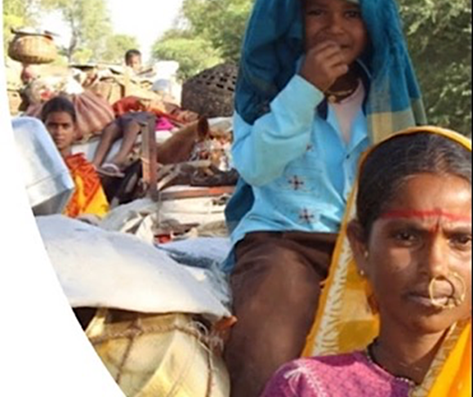
Mapping CSOs
Identify key stakeholders to support mapping:
Define objectives and target populations/ communities
Review laws and regulations defining the scope of CSO participation in emergencies along with their action in non-emergency periods
Compile a list of CSOs
Categorize CSOs and obtain more information
Create a database or roster
Validate data:
Assess CSO capacities and resources
Define priorities and match needs
Select CSOs for specific actions
Collaborate and coordinate
Collect and disseminate best practice experiences
Photo Credit: Disha

Slide 6
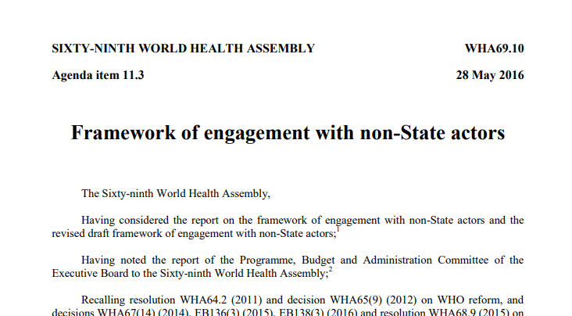
Defining Roles and responsibilities and shared accountability
Roles could be identified in the process of mapping,
includes reviewing the CSOs’ best practice experiences, challenges and lessons learned in previous and ongoing emergencies, and case studies.
facilitates the effective alignment of CSO strengths to address community-level capacity needs.
WHO engagements with a CSO or a group of CSOs are typically formalized in a memorandum of understanding (MoU) or by a letter of agreement, both of which are directed by the Framework of Agreement with Non-state Actors (FENSA) , as well as the WHO policies on Prevention and Response to Sexual Exploitation, Abuse and Harassment
It is also important to conduct due diligence and background checks for each potential influencer.
It is also important that the CSO is aware of its duty to report any conflict with the ethics and values stated in WHO policies, and to train staff on these issues.

Slide 7

Establishing communication, feedback, and information sharing channels
Regular consultative and stakeholder meetings
It could also be a digital platform (email lists, WhatsApp/Signal/ Telegram groups, and other collaboration tools, including informal knowledge sharing platforms such as WHO’s HIVE)
Emphasize CSOs representation in health councils

Slide 8
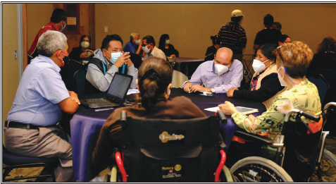
Engaging CSOs in coordination and reporting mechanisms for health emergencies
CSOs with pertinent roles and community outreach should be included in formal emergency coordination mechanisms that bring together government agencies, humanitarian organizations, and other stakeholders.
This requires an environment that enables CSO participation, including national legislation and resource allocation along with mechanisms for sharing resources, expertise, and knowledge.

Slide 9

CSO Planning in alignment with the national & local strategies, monitoring and evaluation
Health is not always central for many CSOs , and especially during humanitarian emergencies. Building health awareness is key for CSOs’ involvement.
Inclusive planning, with the CSOs’ informed and empowered voice at the decision making table, ensures resources are distributed equitably and aligned with community needs and national plans.

Slide 10
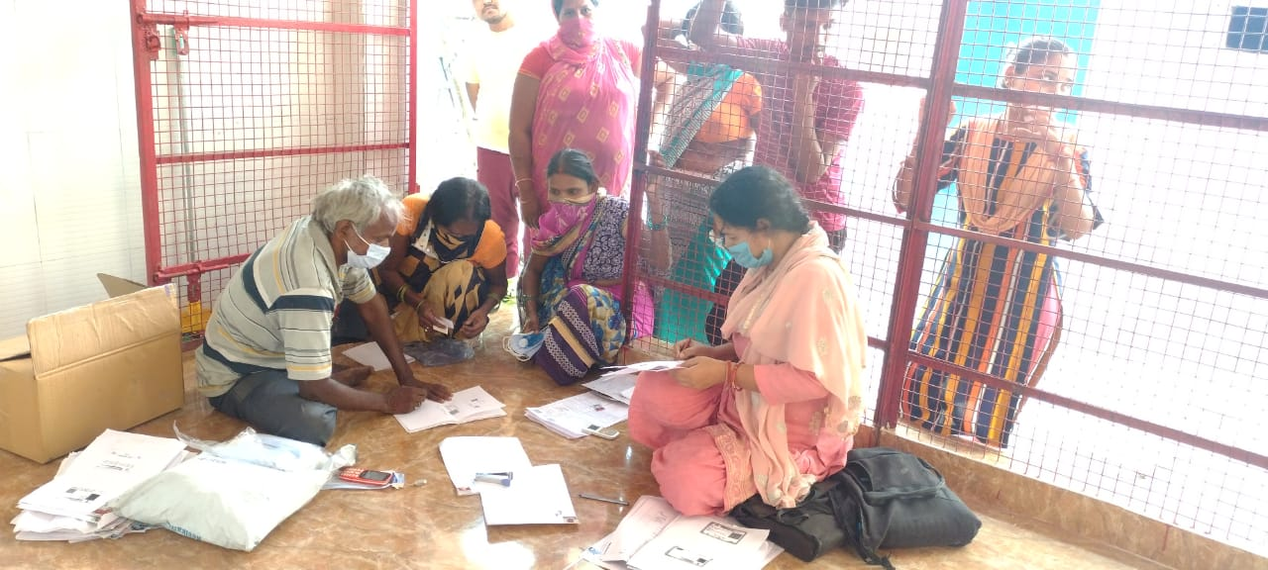
Collecting data – the importance of data analysis and visualization
CSOs contribute by collecting, analyzing and sharing actionable data in various critical areas for emergency preparedness and response. These include
  community based surveillance,
  mortality surveillance,
  population movements,
  health service utilization,
  barriers to access of specific services, and others.
Mechanisms for CSOs to formally and informally offer a wealth of data that should inform efficient decision making for emergency prevention, preparedness, readiness, response, and recovery.
Photo credit: DISHA

Slide 11
Thank you!
European Union Civil Protection and Humanitarian Aid (ECHO)
Nellie Kartoglu for initiating this work
Everyone who has contributed and reviewed this document

Slide 12
{Team}
Community Protection and Resilience Unit (CPR)
Department of Health Emergency Core Capabilities (ECC)
Health Emergency Preparedness & Response Programme
World Health Organization, Geneva HQ, Switzerland
communities@who.int
https://www.who.int/activities/strengthening-community-readiness-for-health-emergencies

