Slide 1
Seasonal Influenza Vaccination
EPI WIN

Slide 2
Agenda
Introduction
Setting the Scene
Seasonal influenza vaccination – who should be vaccinated and why
How global seasonal influenza vaccination data is used to provide recommendations on vaccine composition
Panel
Q&A
Close

Slide 3
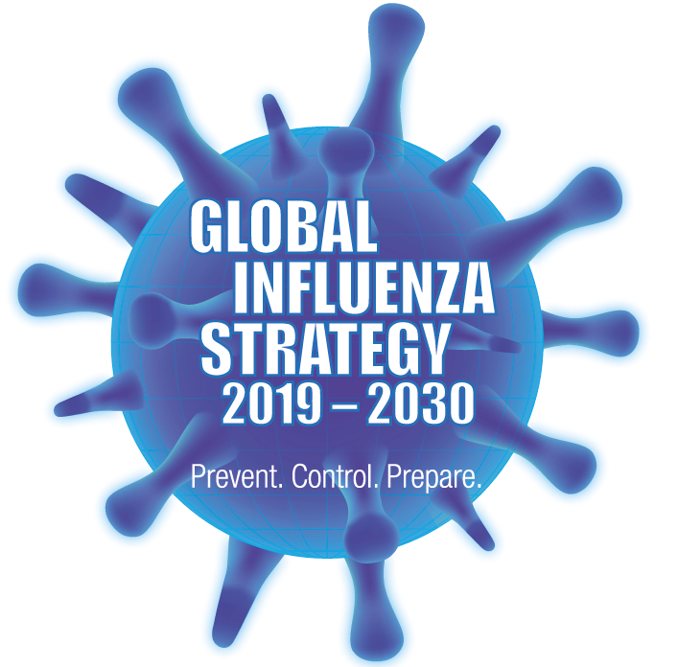
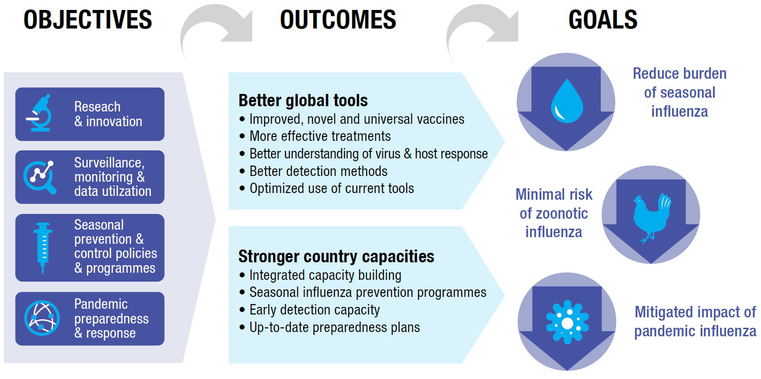
Global Influenza Strategy 2019-2030:
Influenza prevention and control is a global priority
Vision for 2030
Attainment of the highest possible influenza prevention, control and preparedness to safeguard the health of all people
Notes:
WHO launched the Global Influenza Strategy for 2019-2030 in March 2019. The vision for 2030 is “attainment of the highest possible influenza prevention, control and preparedness to safeguard the health of all people.” The strategy has two high-level outcomes (better global tools and stronger country capacities) supported by 4 strategic objectives.
The strategy aligns with WHO’s 13th general programme of work and the Sustainable Development Goals for 2030.

Slide 4
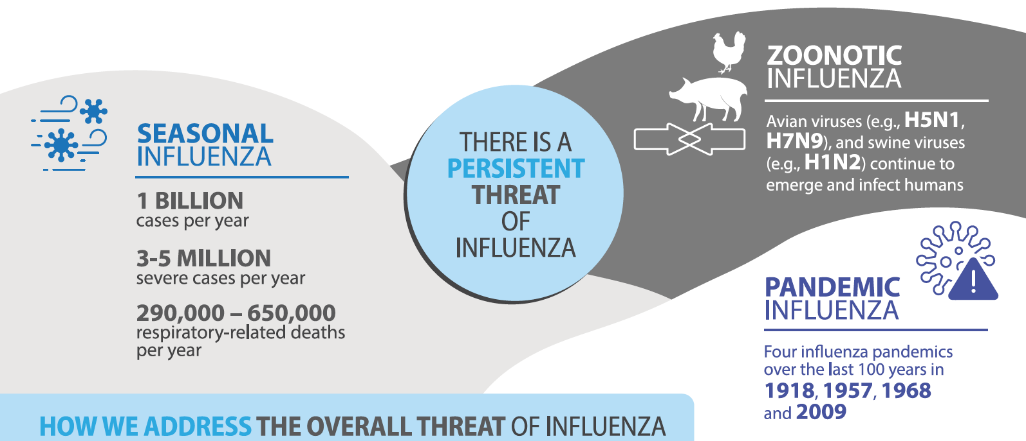
Global Burden of Disease
Importance of influenza prevention, control, & preparedness

Slide 5



Do not edit
How to change the design
What actions can you take to protect yourself and others from seasonal influenza?
The Slido app must be installed on every computer you’re presenting from

Slide 6
Do not edit
How to change the design
Who does WHO recommend get vaccinated against seasonal influenza?
The Slido app must be installed on every computer you’re presenting from

Slide 7
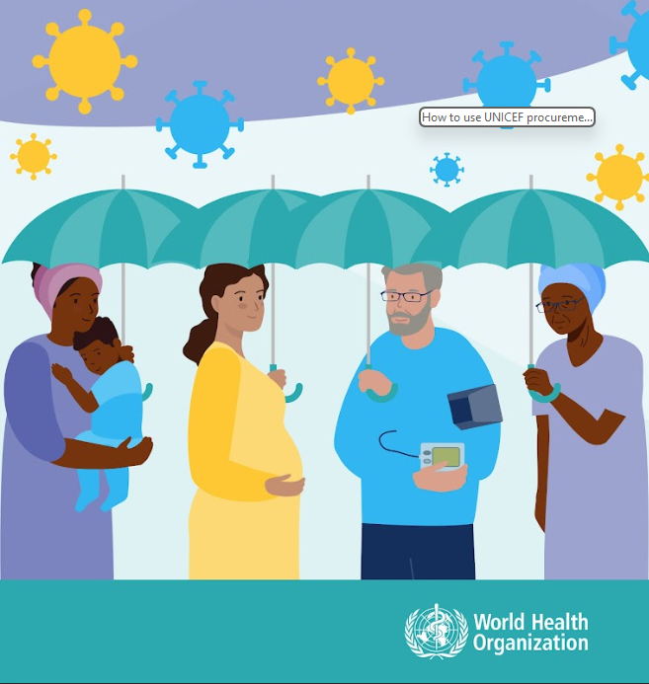
Recommended Target Groups
  WHO recommends all countries consider introducing or expanding their seasonal influenza vaccination programme.
  Priority target groups: health workers, individuals with comorbidities/underlying conditions, older adults, and pregnant women
  Additional groups to consider: children, individuals living in congregate-living settings (e.g., prisons, refugee camps), disadvantaged populations, indigenous populations
  Target group selection should be driven by national disease burden, priorities, resources, programmatic feasibility
https://www.who.int/publications/i/item/who-wer9719

Slide 8

Do not edit
How to change the design
Why do people need to be vaccinated against seasonal influenza each year?
The Slido app must be installed on every computer you’re presenting from

Slide 9
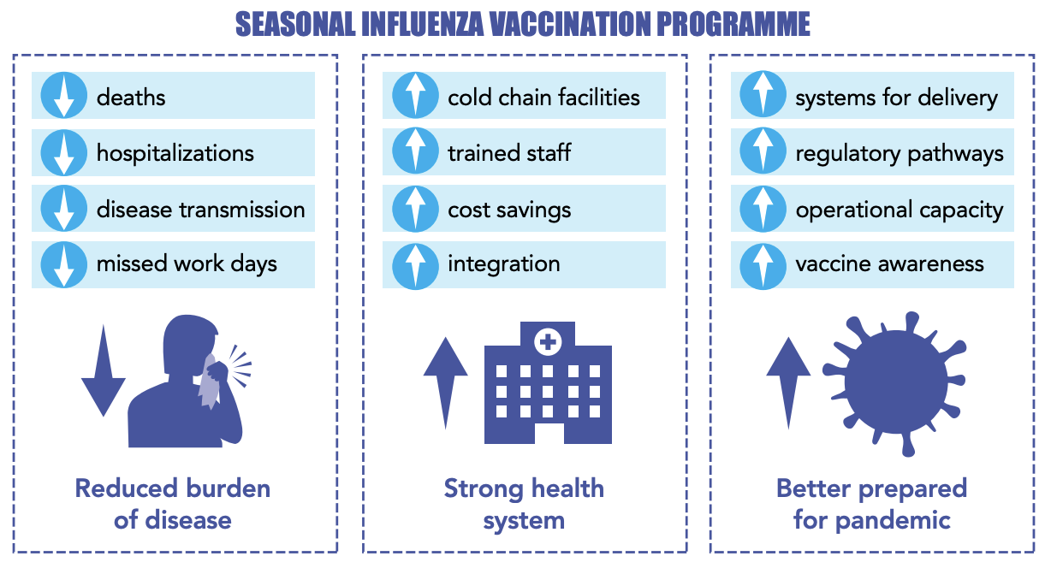
Benefits of seasonal influenza vaccination

Slide 10
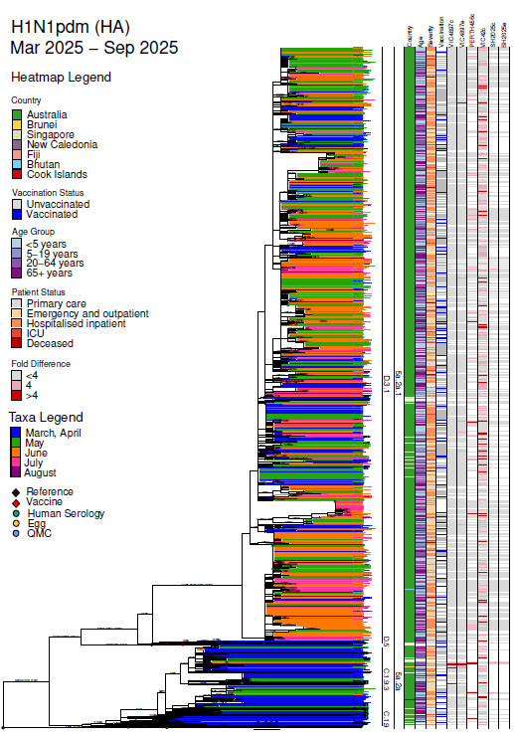
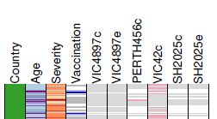
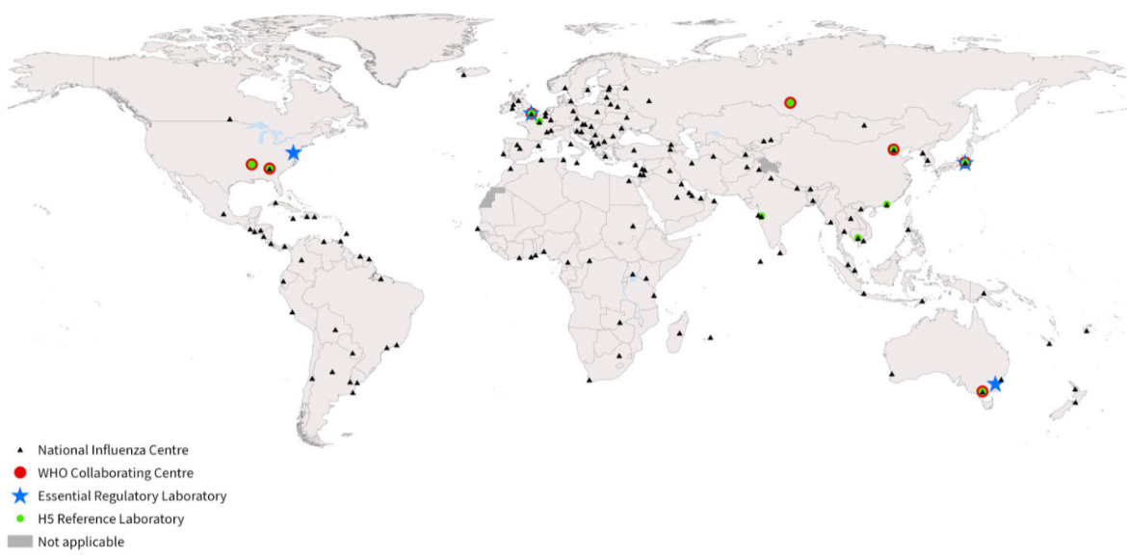

Influenza vaccine compositions updated every year
Based on year around surveillance conducted by GISRS
  WHOCCs, NICs, WHO ERLs, WHO H5 Reference Laboratories
  Supported by hosting countries,
  public & private partners, and collaborators
Global Influenza Surveillance and Response System

Slide 11
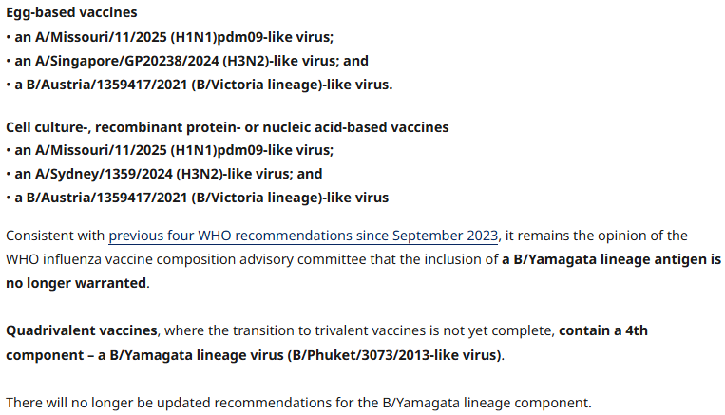
From data to vaccine viruses & potency reagents
Data and information from the GISRS network and other sources evaluated
  Surveillance data
  Antigenic characterization of viruses
  Human serology studies with influenza virus vaccines
  Genetic characterization of viruses
  Virus fitness forecasting
  Antiviral resistance
  Vaccine effectiveness
  Availability of CVVs
WHO advisory committee makes recommendations
WHO updated recommendation last week for southern hemisphere 2026:
Candidate vaccine viruses (CVVs) and Potency reagents from GISRS
https://www.who.int/teams/global-influenza-programme/vaccines/who-recommendations

Slide 12
Panel
Impact of influenza vaccination – Francisco Nogareda, PAHO/WHO
Accessing influenza vaccines – Yasmin Vargas, UNICEF Supply Division
Understanding behavioural and social drivers of influenza vaccination – Nizar Maswadeh, Jordan Ministry of Health
Increasing access to seasonal influenza vaccines – Svitlana Aleksenko, Ukraine Ministry of Health

Slide 13
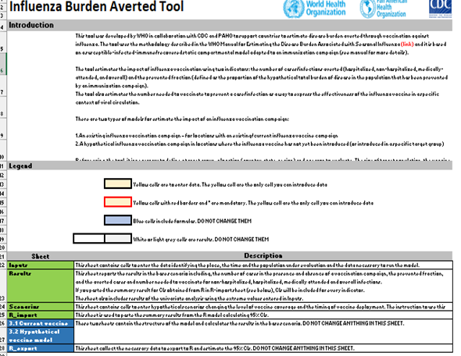
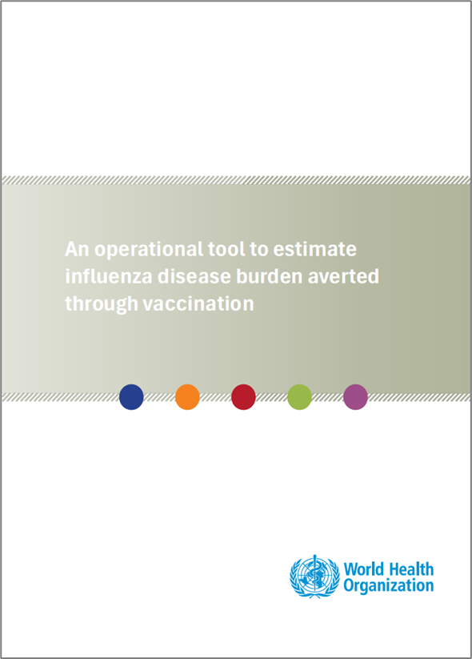
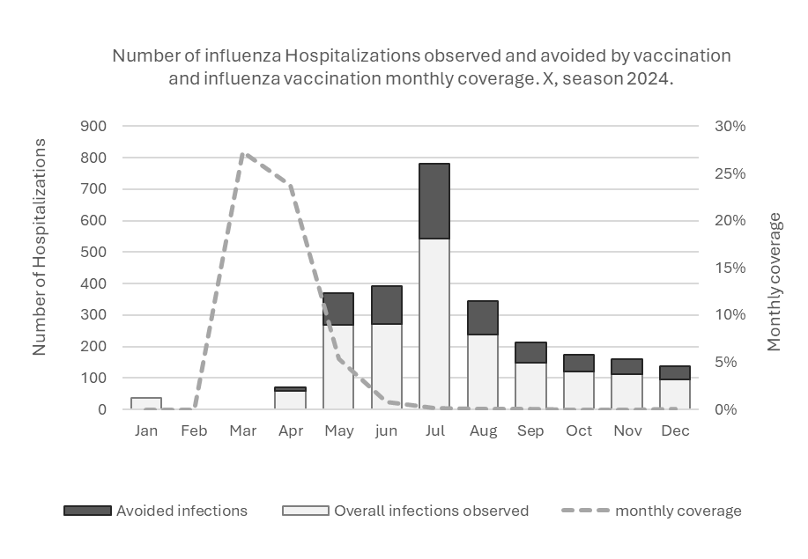
Identifying the impact of influenza vaccination
Quantify the influenza-associated burden averted by vaccination (deaths, hospitalizations and medical visits)
Estimate the averted burden in an existing influenza vaccine campaign
Determine the potential impact of introducing the influenza vaccine
Improve the timing of an influenza vaccine campaign
Compare impact for vaccine type and formulation
Provide information about the benefits of vaccination
  To stakeholders à advocacy
  To the population à risk communication
Contribute to economic evaluations
https://www.who.int/publications/i/item/B09385

Slide 14
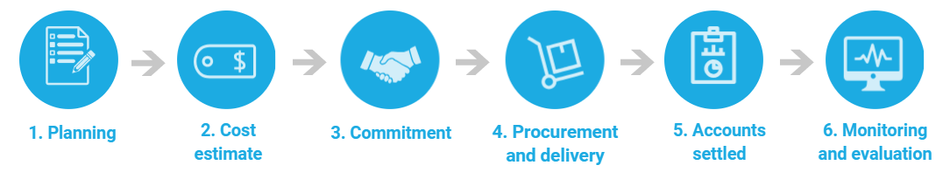
How can countries access influenza vaccines through UNICEF Supply Division?
To start the process, Partner must submit the Procurement Service Request Form to CPHHQ-SD-Procurement Services ID (psid@unicef.org), with the material number and relevant details Request for PS 2021.xlsx - Google Sheets Commodities are identified via the online UNICEF Supply Catalogue Home page (unicef.org)
The Request Form is reviewed, and if meets all of the necessary criteria, a draft Cost Estimate (CE) is prepared by SD
In parallel or upon Partner’s acceptance of the CE a Memorandum of Understanding (MOU) is signed.
Upon receipt of funds SD will initiate the procurement activities.
TIMELINE
Southern Hemisphere: CE should be requested by early October annually and funds must be reached to SD by the end of November / Delivery during April - June the following year
Northern Hemisphere: CE should be requested by mid-October annually and funds must be reached to SD by the end of December / Delivery during September – November the following year

Slide 15
Behavioural and social drivers of influenza vaccination (Jordan)
🔎 Step 1 – Qualitative Phase**
2 governorates:
👥 Recipients, 👨‍⚕️ vaccinators, and 🗣️ influencers
Explored perceptions & barriers
📊 Step 2 – Quantitative Phase**
1,500 surveyed (HCWs, pregnant, and elderly)
BeSD Arabic tool | Face-to-face survey
Measured awareness, uptake & misconceptions
✅ Step 3 – Insights & Way Forward
Practical Barriers
- 💉 Availability & supply gaps
- 🚪 Access & distance/transport
- 💰 Affordability & unclear subsidy
- 📜 Eligibility criteria
Information / Perception Barriers
- ❌ Concerns about efficacy/safety
- ℹ️ Misconceptions about the vaccine
- 💤 Low risk perception of influenza severity
- 😷 Post-COVID-19 “vaccine fatigue”
Drivers of vaccination:
HCW recommendation, trust & family support, and community engagement

Slide 16
Expanding access to seasonal influenza vaccines through pharmacy-based vaccination
MINISTRY OF HEALTH OF UKRAINE
Objectives | Implementation | Impact
•Increase influenza vaccine accessibility for all citizens •Provide an alternative to hospital-based vaccination sites which align with Ukrainian law. •Reduce the burden on healthcare facilities and family doctors. •Reach more people through widespread pharmacy networks. | •Amendments to health legislation of Ukraine. •Training pharmacists and coordinating suppliers. (Input on Medical University Curricula for graduating pharmacists) •Public awareness campaigns. •Collaboration with partners and stakeholders. PIP PC support. | •Wider access and convenience, especially in underserved areas •Higher vaccination coverage supports community immunity. •Strengthening the healthcare system reduces the burden on hospitals and clinics. •Enhanced public trust in vaccines and pharmacy-based healthcare services. •Ukraine is aligning itself with EU and US practices by becoming a model for future preventive initiatives.

Slide 17
Questions and Answers
Please use the Q&A feature to ask questions to the speakers and panelists.

Slide 18
Thank you!

