Slide 1
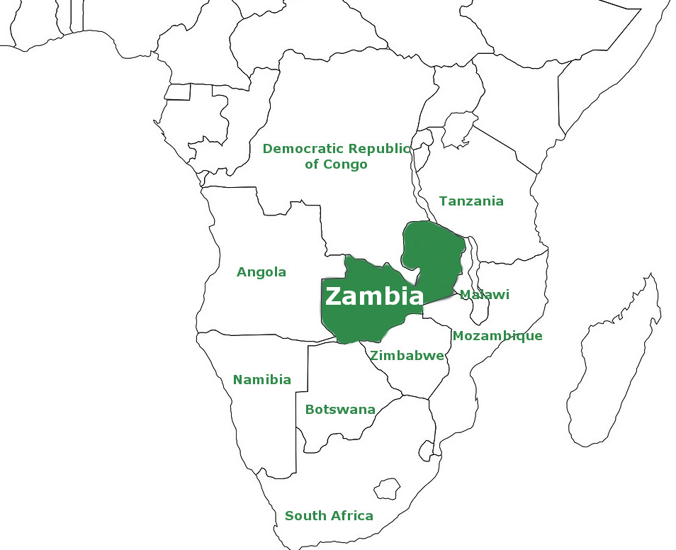
Community Protection and Cholera
Strategic Lessons and Future Directions
WHO EPI Win Session
Dr. Nyuma Mbewe
Emergency Preparedness and Response Technical Officer
WHO Zambia Country Office
11th December 2025

Slide 2
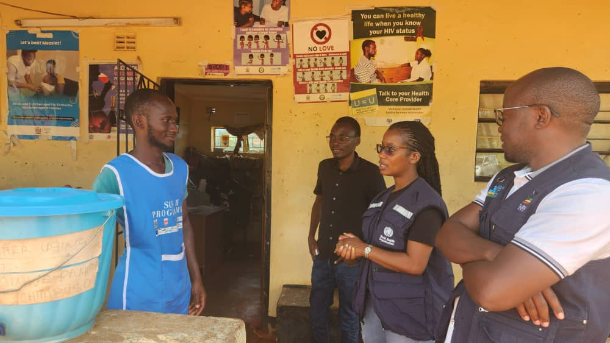
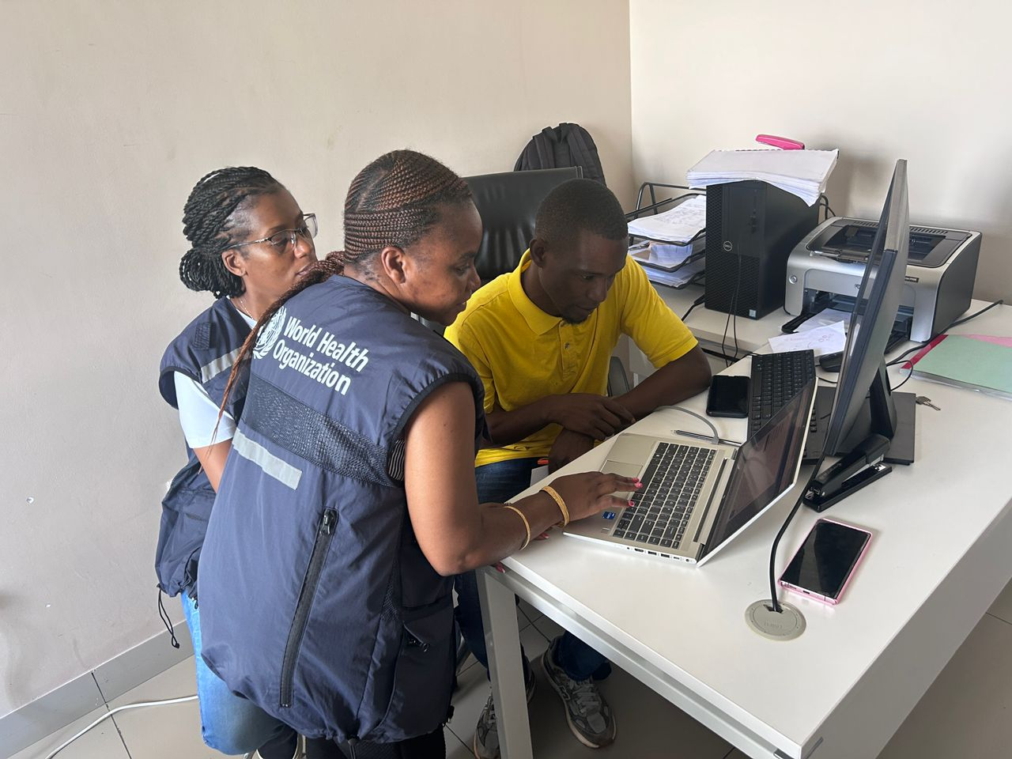
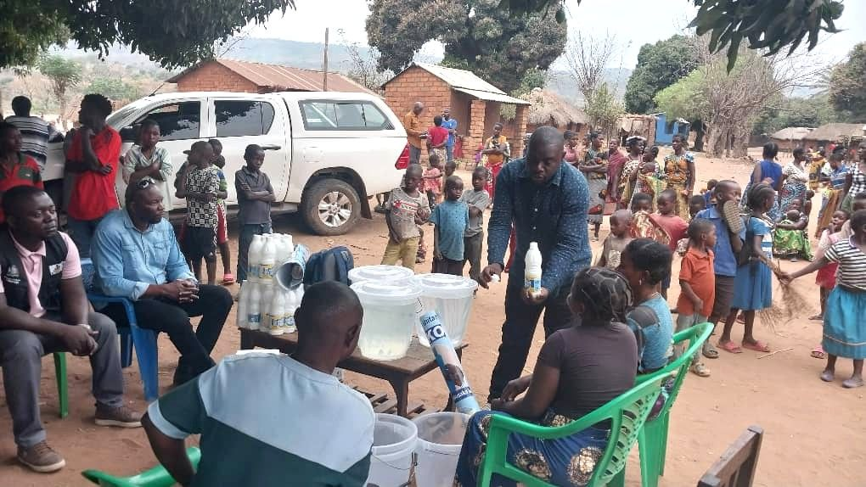
Lessons learnt
Hyper-local risk communication led to behaviour change during peak transmission
Embedding WASH, Surveillance and case management into RCCE
Rapid detection and referral improved through proximity and community trust
Stronger coordination between district teams, CHWs and technical partners enabled continuity even in highly mobile populations

Slide 3
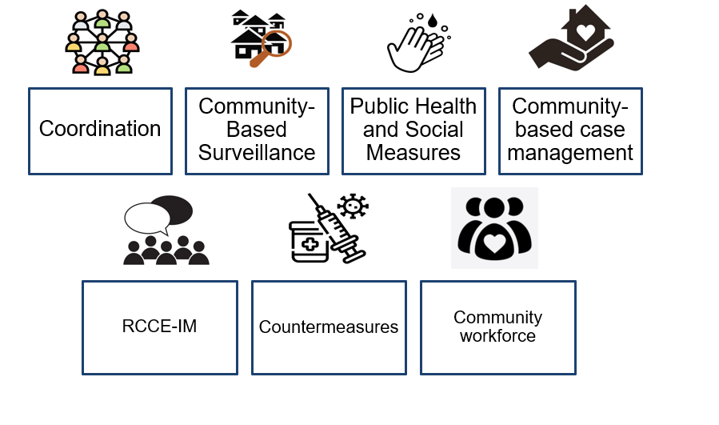
Strategic takeaways from the community response:
Local leadership involvement directly influenced uptake of WASH interventions.
Community-based surveillance (CBS) is decisive in urban cholera contexts.
Integrated WASH–RCCE–surveillance teams helped break transmission faster.
Community action platforms compensate for infrastructure gaps in PAMis
Community engagement is the anchor that connects case management, surveillance, WASH and resilience

Slide 4
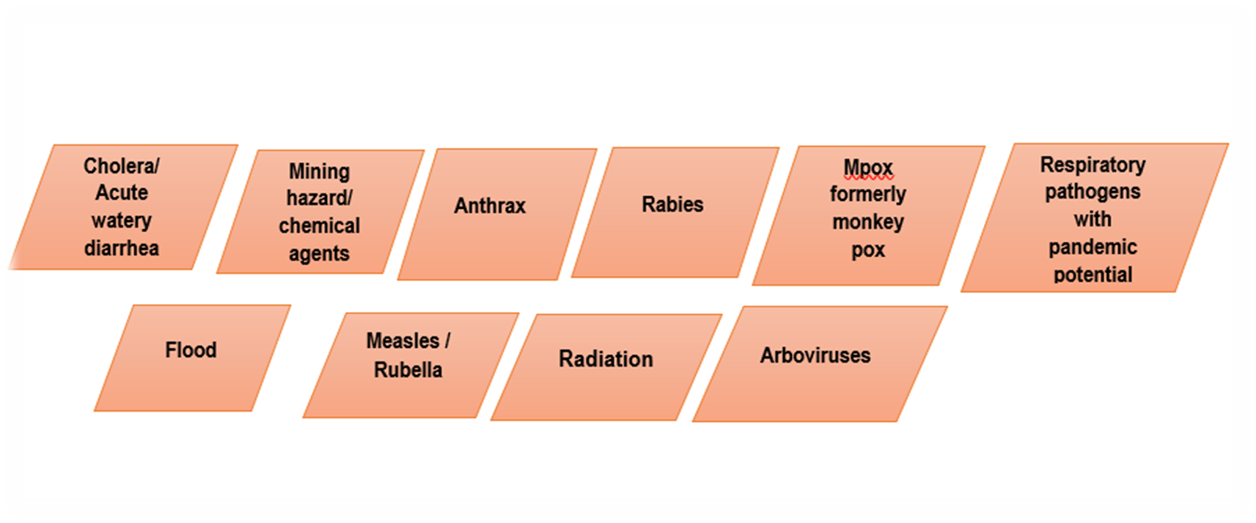
Linking to broader health security
Zambia updated STAR 2025, and NAPHS, and community protection being prioritized with training planned for CBVs

Slide 5
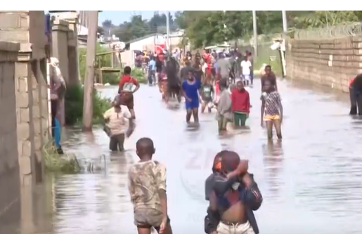
Structural Challenges Still Affecting Community Resilience
Mobility and overcrowding in hotspot peri-urban zones.
Inconsistent WASH infrastructure and slow waste management improvements.
Volunteer fatigue and high turnover within community networks.
Limited predictable financing to sustain community-level cholera work.
Climate-driven shifts increasing exposure in already vulnerable communities.
Notes:
Photo courtesy of ZNBC

Slide 6
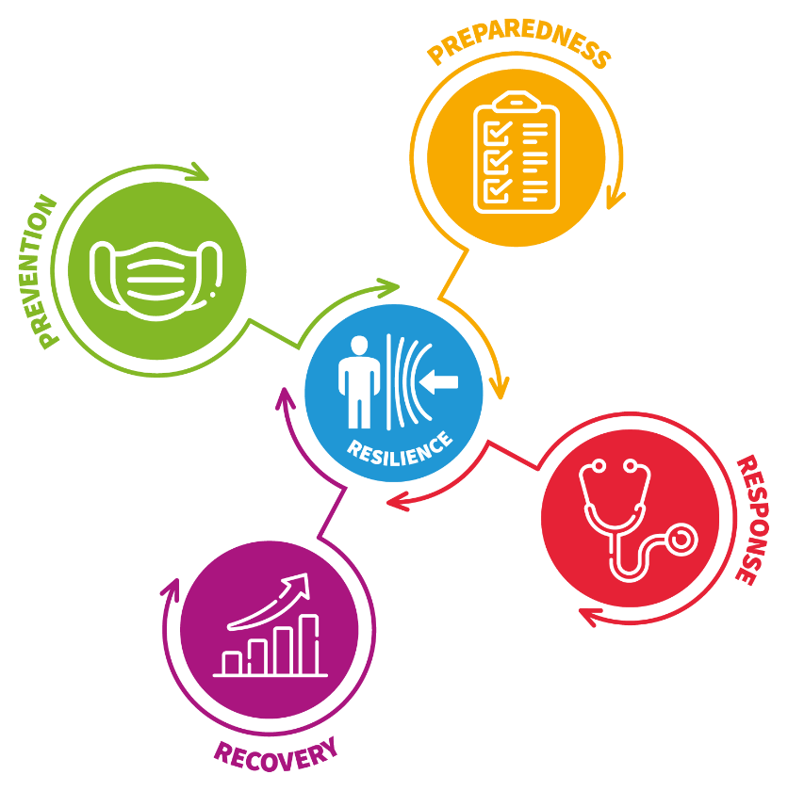
The Path forward and Priorities for 2026 and beyond
Institutionalize CBS and community protection units in all hotspot districts
Expand integrated community WASH–RCCE teams ahead of rainy seasons
Strengthen district–community digital referral and alert systems
Link community EPR interventions with broader climate and urban health programmes
Maintain annual simulation exercises and cross-sector preparedness reviews

Slide 7

Thank You

