Slide 1
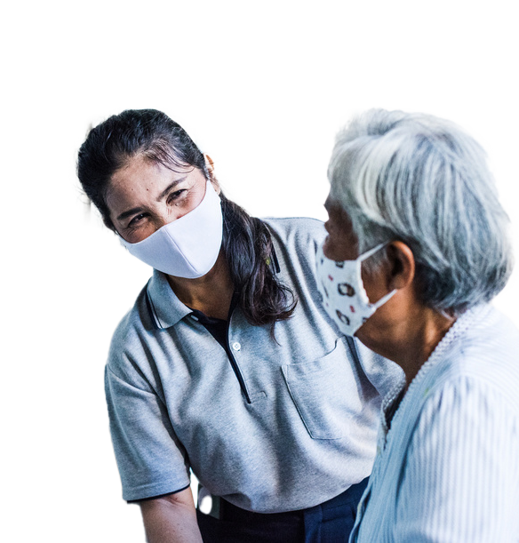
RCCE-IM Tools:
- Assessing capacity
- Creating a Plan
An overview of new tools developed by
WHO Europe’s RCCE-IM technical team
15 October 2025

Slide 2
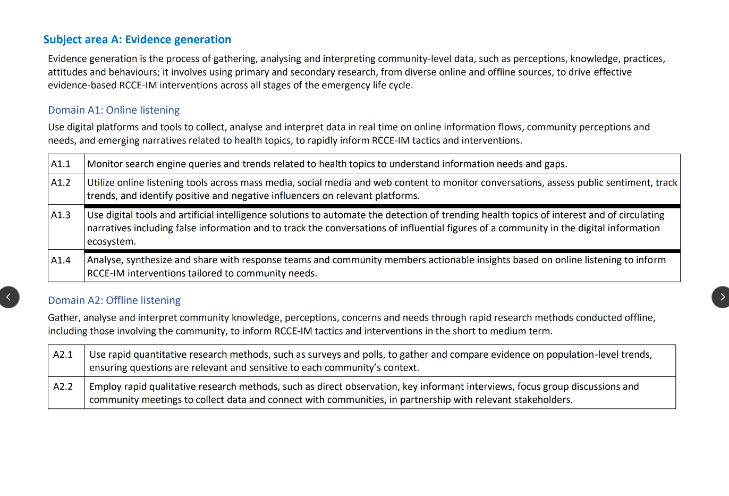
RCCE-IM Expanded Capacities
WHO Europe expanded the competencies to include Infodemic Management – misinformation, disinformation, malinformation and offline and online social listening.
These capacities form the basis of the cope and range of knowledge, skills and behaviours of Risk Communication, Community engagement, and Infodemic management.
A copy of the full list of capacities is available in the chatbox as well as within the tools we will show you today.

Slide 3

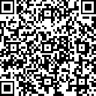
We measure and monitor all the capacity-building work we do.
Be counted!
Take our brief survey. No personal details required.
Notes:
https://extranet.who.int/dataformv6/index.php/723136?lang=en

Slide 4

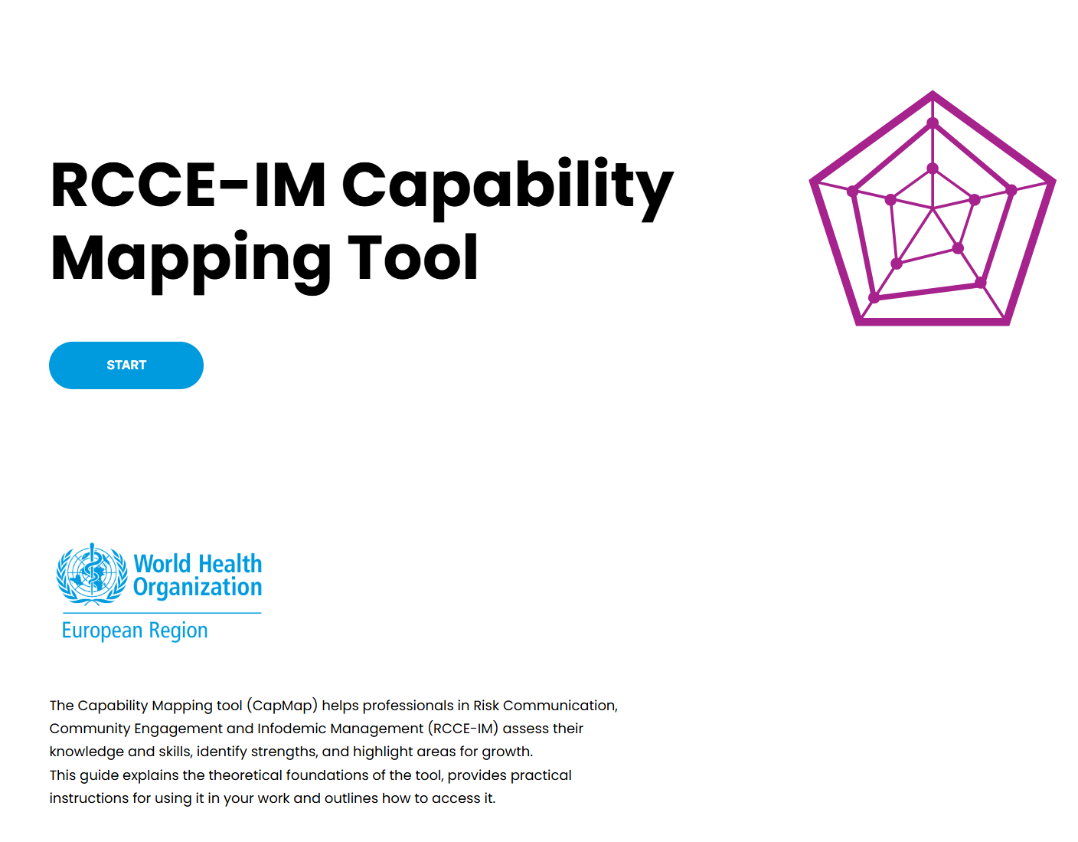
Let’s take a look at the tools…
Individuals / Team members start by assessing capacity using the CapMap tool.
Notes:
https://rise.articulate.com/share/WfispZElq27fQhfyU-gHqbbRBYQgM143

Slide 5
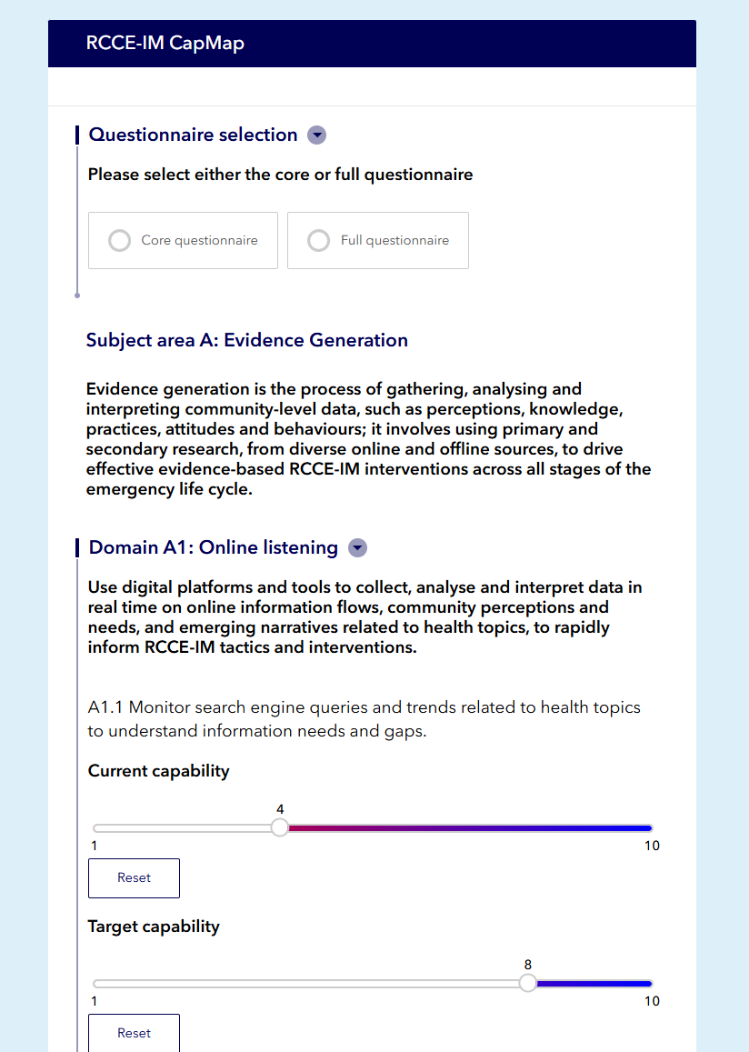
After reading about the tool, take the actual assessment…
Take the short-form questionnaire (20 questions) or the long-form questionnaire (77 questions). The long form gives more insight into the specific knowledge and skills of RCCE-IM and is useful for teams embarking on national plans.
The CapMap is currently available in English and Russian.
Take the assessment and then…
Notes:
https://survey123.arcgis.com/share/b226a133a99a48a0b909624e2ee307b6

Slide 6
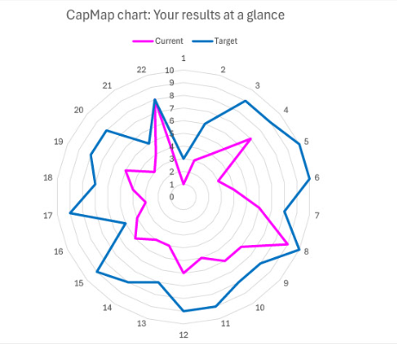
Receive your result…
The result is emailed to your email address. WHO also receives a copy.
The CapMap assessment result is used to identify priority areas, gaps in capacity and strengths across teams.
As a trainer, we review results to the assessment from participants to build trainings that are tailored to specific needs, strengths and gaps.

Slide 7
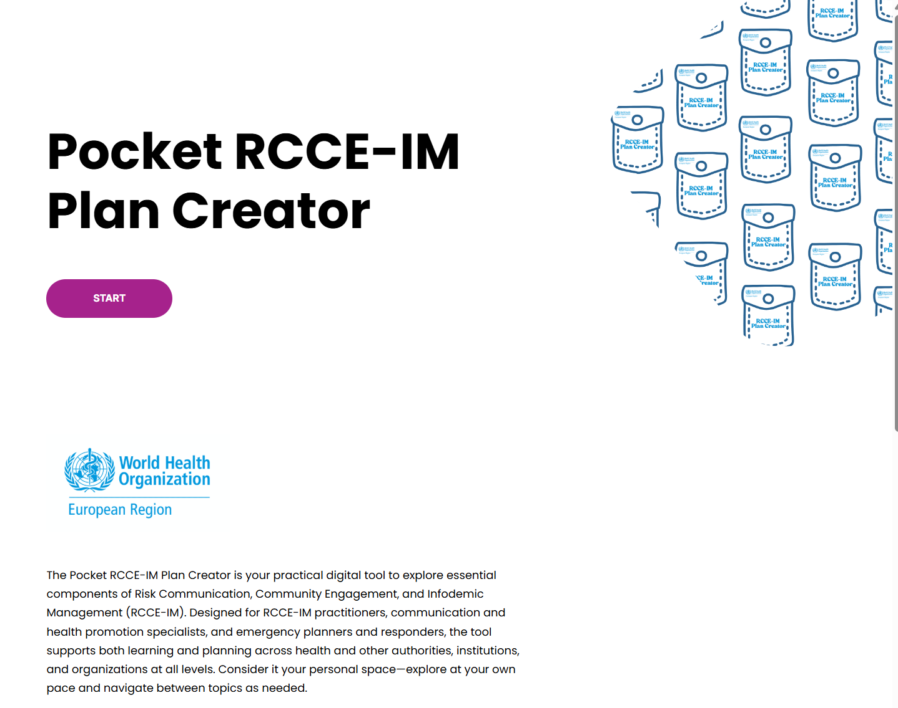
Now it’s time to work out how to make a plan…
Teams dig into the RCCE-IM Plan Creator tool to learn how to make a plan and access templates and tools.
Notes:
https://rise.articulate.com/share/WfispZElq27fQhfyU-gHqbbRBYQgM143

Slide 8

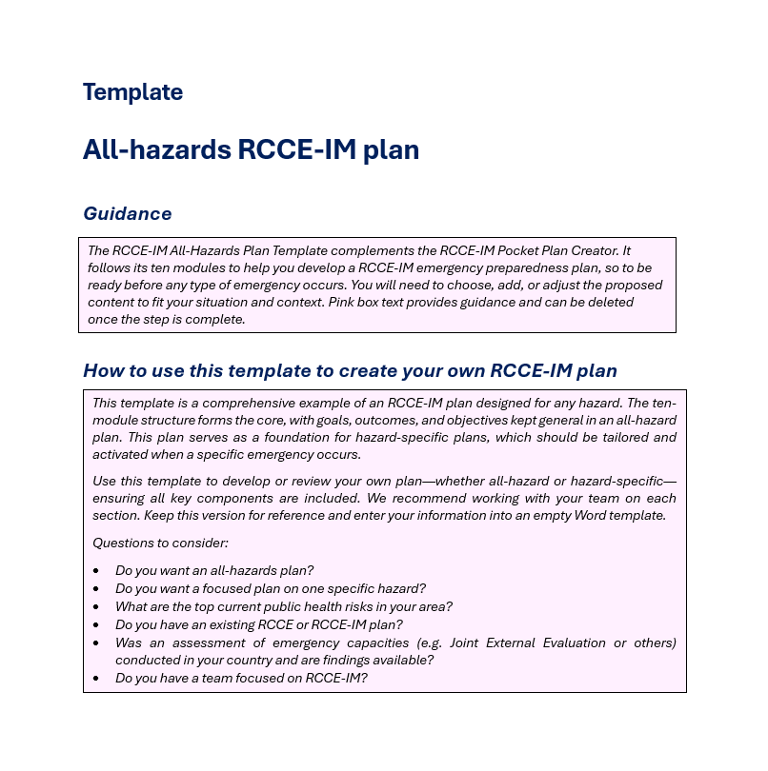



And then teams work together to make a plan…
Teams upload the RCCE-IM plan templates into the collaborative platform (SharePoint, Box, Dropbox, etc.) that they already use to make a plan and access templates and tools.
Notes:
https://rise.articulate.com/share/WfispZElq27fQhfyU-gHqbbRBYQgM143

Slide 9
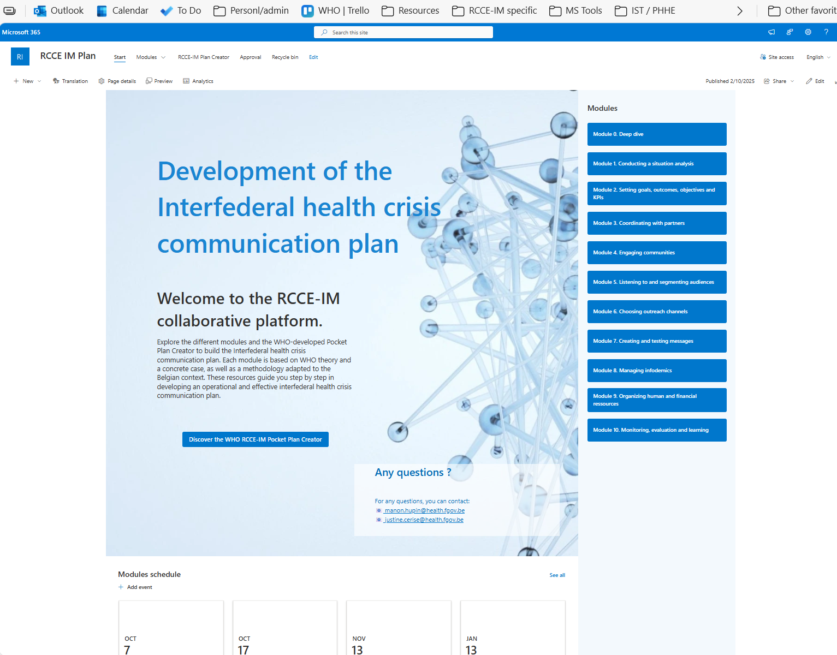

Does your Ministry team want to localize the materials for your site?
The tools we present here were developed in English.
The intention is to translate tools using crowdsourcing through Ministry teams.
Belgium and Germany are currently in process to translate the tools into French, Dutch and German.
WHO Europe retains a copy of the translated file for use on our site. We provide you the source files to host the tools on your webpage.
Do you want to work with us to localize the tool for your Ministry?
Go to: https://forms.office.com/e/3p8WJHuDUR
Notes:
https://forms.office.com/e/3p8WJHuDUR

Slide 10
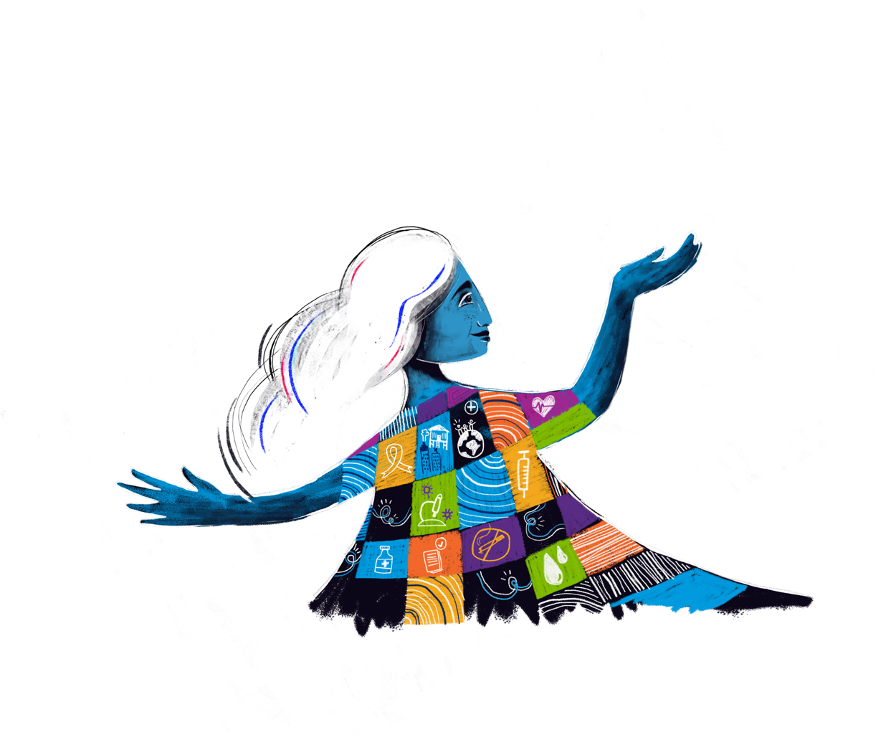
Thank you!
This presentation has been designed to be accessible, for a positive and inclusive user experience for all.
For more information, please contact:
Nancy Claxton Hanna Radysh
RCCE-IM capacity-building officer MEL consultant
claxtonn@who.int radyshg@who.int

