Slide 1
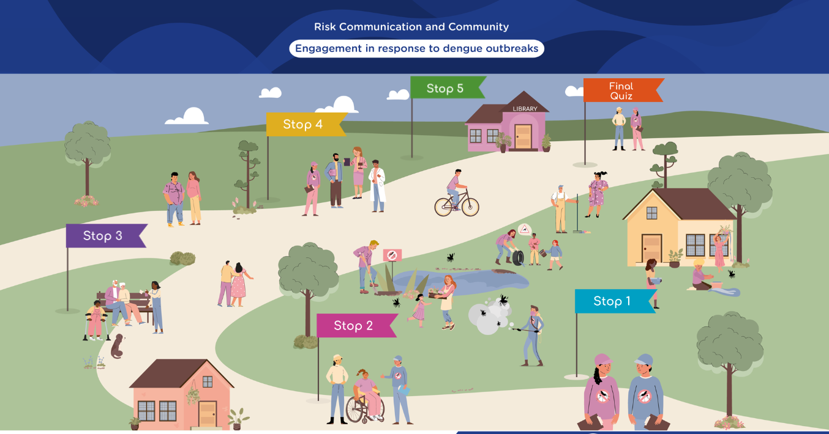



Slide 2
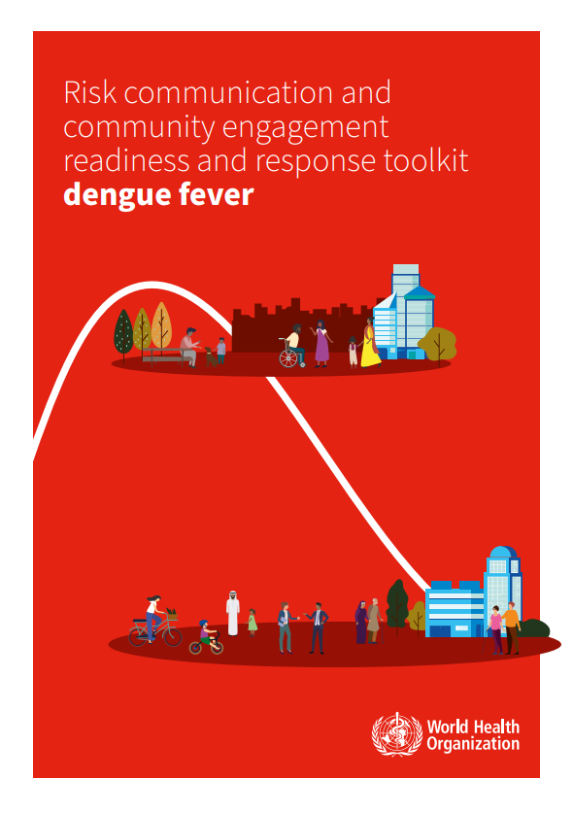

Based on WHO’s RCCE R&R toolkit
Developed between two PAHO Departments: Communicable Diseases and Health Emergencies
3 to 3.5 hours self-instruction. Available on PAHO’s VC website and App.
Spanish and English languages
https://bit.ly/PAHORCCEdengue

Slide 3
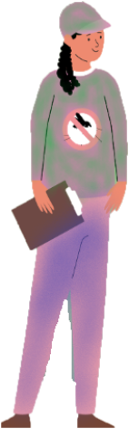
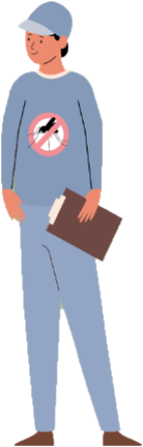

The Story
Brisa is a health promoter, and Benjamin is a health communications expert.
They work in Aldrelia’s local health office.
They have been notified of an unprecedented rise in patients admitted to emergencies in the local health center with dengue fever symptoms.

Slide 4
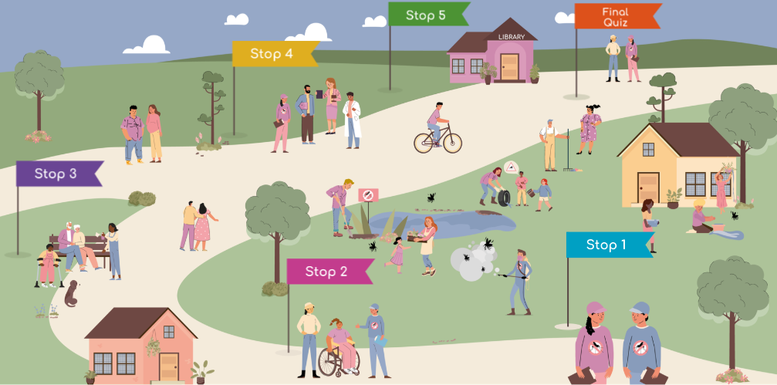




Slide 5
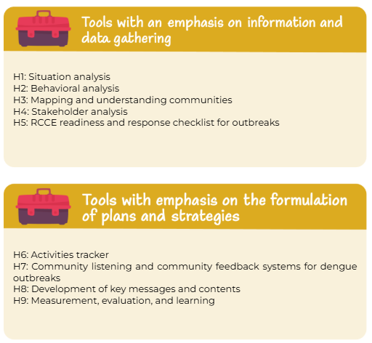



Slide 6
Main learnings
Shorter courses – more enrollments:10K+ enrollments in 6 months.
Student engagement is greater through practical examples
Applied RCCE to different thematics.
Telling a story through academic content.
Financial sustainability of hosting and adaptations over time.

