Slide 1

SMART Guidelines: Advancing Guideline Use in the Digital Age
February 2021
Notes:
The WHO envisions a future where everyone in the world benefits fully and immediately from life-saving health interventions and universal public health practices. The introduction of the Smart Guidelines, which we’re here to discuss today, will help make this vision a reality. The entire World Health Organization, as well as its partners in public health like PEPFAR and the US CDC and global technology corporations like Google are joining forces to bring the Smart Guidelines to life.
I am thrilled to share with you more about what this initiative is about, how it unfolds, and most importantly the impact it will have.
----------------------------
SMART: Standards-based, Machine-readable, Adaptive, Requirements-based, and Testable

Slide 2
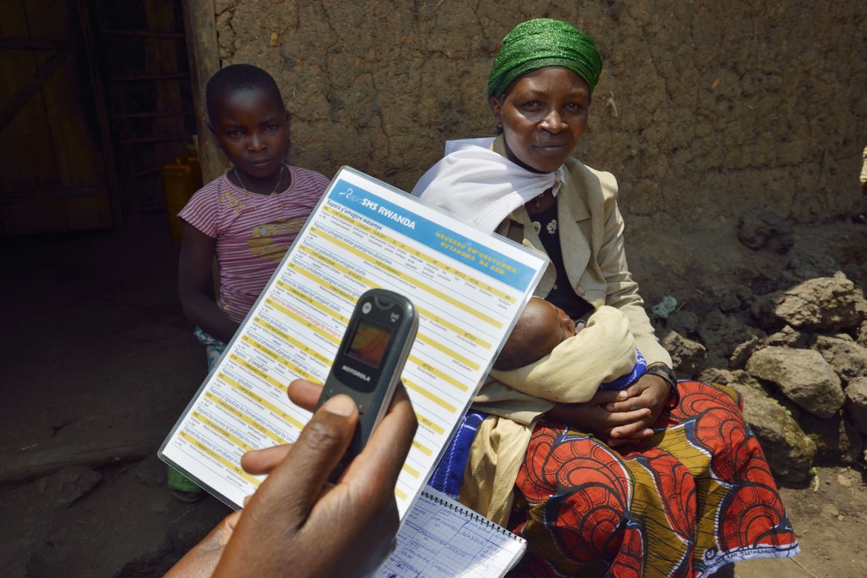
WHO guidelines influence the health of billions around the world
The World Health Organization (WHO) delivers guidelines for clinical care and public health services in the country setting.
WHO Guidelines are a critical resource for the majority of the world
Hundreds of guidelines exist
These guidelines shape behaviors across country health systems
Guidelines comprise proven life-saving interventions
Notes:
Not everybody outside of the WHO understands that guidelines are such a crucial part of what the WHO does. So let’s start with a common understanding of WHO guidelines as they are today. Hundreds of guidelines exist to shape the processes of health systems and the behavior of health care workers around the world. They serve as a starting point as well as a guiding star for countries seeking to design high-impact health programs, and are especially critical for countries that lack their own evidence base to draw upon. It’s helpful to remember that the guidelines developed and disseminated by the WHO are really a suite of proven life-saving interventions that influence the health of billions of people globally.

Slide 3
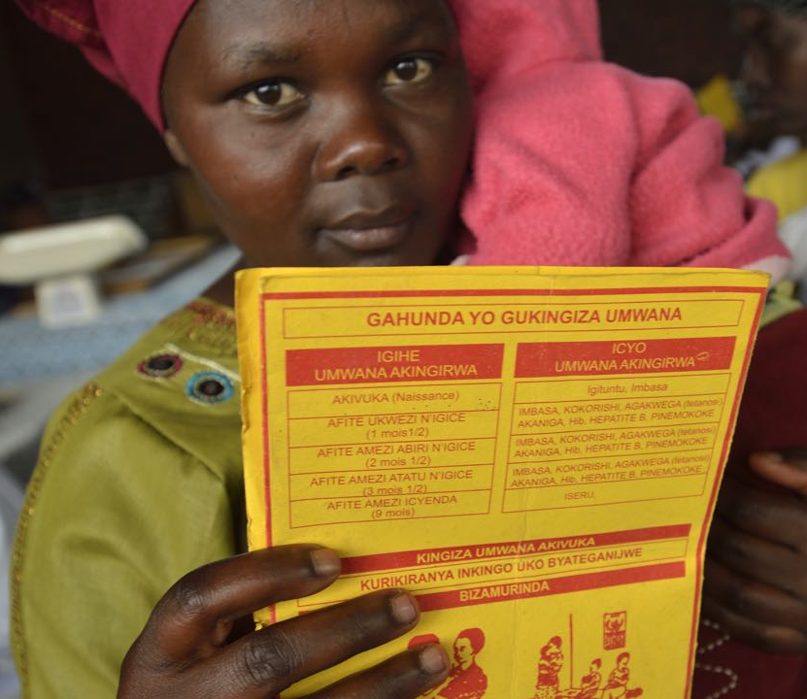
When applied consistently, the recommendations within guidelines save lives
For example, WHO guidelines:
Protect millions of children from potentially life-threatening diseases as a result of recommended immunization schedules
Reduce incidence and mortality within HIV programs due to increased eligibility accelerating ART scale-up and coverage
Reduce maternal and perinatal mortality and morbidity when ANC routine care and management of complications during pregnancy and childbirth recommendations are applied
Notes:
As you all know firsthand, the guidelines articulate and endorse rigorously tested recommendations for health interventions to be adopted within country programs.
The examples listed here, related to immunization, HIV, and Antenatal Care guidelines, are just some of the specific examples of impact the interventions within WHO guidelines have had.
Immunization schedules recommended by WHO are globally adopted, protecting millions of children from potentially life-threatening diseases
HIV-related guidelines expanding the target population to universal eligibility have accelerated ART scale-up and coverage, leading to documented improvements in clinical outcomes (e.g., VL suppression, CD4 cell counts) and impact (e.g., mortality, incidence)
WHO recommendations related to routine care and management of complications during pregnancy and childbirth reduce maternal and perinatal mortality and morbidity
To put it succinctly, when applied consistently, the recommendations within the WHO guidelines save lives.

Slide 4




However, the potential benefits of guidelines are diluted and delayed…
Current State
Implications
Time delays
Patients are denied access
Diminished accuracy
Health services are compromised
Limited ability to evaluate and adapt
Delayed improvements to health practices
Passive dissemination mechanism
Lack of impact at scale
Notes:
However, the potential benefits of guidelines are currently diluted and delayed, potentially resulting in significant consequences for global health. Why is that? Until recently, the only viable and consistent mechanism available to you all at the WHO for disseminating guidelines has been through written documents.
However in their narrative format, it can take well over a decade for recommendations to be developed, adapted by countries and institutionalized within health care processes, resulting in individuals being denied access to effective interventions for years after the interventions are first identified
And that process of adapting guidelines for use in country can compromise guideline accuracy (or fidelity) and consistency, which can lead to health care professionals providing care that doesn’t follow the guidelines.
Additionally, there is little about the current format or dissemination processes of the narrative guidelines that supports those of you within the WHO in tracking guideline adoption and use across different country contexts. This inhibits evaluation of clinical and data practices, and leaves you unable to confirm guideline impact or make critical updates and enhancements to improve guidelines over time.
Where limited survey studies have allowed for evaluation of guideline adoption, they have shown that passive dissemination of narrative guidelines is unlikely to result in systemic changes in health service delivery or desired health outcomes. This indicates that guidelines, which are made up of life-saving measures, are lacking a dissemination mechanism to realize their full impact at scale.
--
References:
-“The lag between the discovery of more efficacious forms of treatment and their incorporation into routine patient care is unnecessarily long, in the range of about 15 to 20 years (Balas and Boren, 2000). Even then, adherence of clinical practice to the evidence is highly uneven.” (https://www.ncbi.nlm.nih.gov/books/NBK222272/)
-“Results of studies in the USA and the Netherlands suggest that about 30–40% of patients do not receive care according to present scientific evidence, and about 20–25% of care provided is not needed or is potentially harmful.” (https://www.thelancet.com/journals/lancet/article/PIIS0140673603145461/fulltext#secd11100565e585)
- “WHO guidelines generally favour passive techniques such as dissemination of the guideline in print or electronic form: this approach alone is unlikely to result in changes in health professional practice or the desired health outcomes [9].” (https://implementationscience.biomedcentral.com/articles/10.1186/s13012-016-0440-4)
-"The WHO guidelines (n = 123) analysed mentioned implementation techniques 800 times, although most mentioned implementation techniques very briefly, if at all. Passive strategies (21 %, 167/800) and general policy strategies (62 %, 496/800) occurred most often. Evidence-based active implementation methods were generally neglected with no guideline mentioning reminders (computerised or paper) and only one mentioning a multifaceted approach. Many guidelines contained implementation sections that were identical to those used in older guidelines produced by the same WHO technical unit." (https://implementationscience.biomedcentral.com/articles/10.1186/s13012-016-0440-4)

Slide 5
Health system digitization stands to either help or further hinder guideline implementation
Countries are investing heavily in digital health systems. They directly impact the behavior of actors across healthcare delivery. However, without clear processes and tools, there is a risk these systems will not consistently guide users to the best healthcare practices. With appropriate support, digital health systems can save lives.
Notes:
So we have the life-saving interventions communicated through narrative guidelines that countries are challenged to implement efficiently and effectively. Alongside these challenges, countries are investing in the development of national digital health systems that interface with and influence the behavior of actors at all levels of the health system. This impact of health system digitization or digital health stands to either help or further hinder guideline implementation.
Currently, there are no consistent processes or tools for applying the narrative guidelines in digital systems. This presents a risk that systems will not consistently guide users to the healthcare practices recommended in the guidelines. However, with appropriate support, digital health systems can accelerate guideline implementation and improve their fidelity, thereby saving lives.
In other words, the Smart Guidelines initiative is an opportunity to dramatically streamline and accelerate adoption of guidelines through digital health systems. If we ignore this opportunity, we also stand to make guideline adoption that much more difficult. In other words, digital health investments can either support or interfere with the delivery of life-saving interventions, depending on how well the systems being built manifest the guidelines.

Slide 6

Introducing SMART Guidelines…
SMART Guidelines are a new approach to using clinical, public health, and data recommendations in the digital age. At their heart, SMART Guidelines are a comprehensive set of documentation, reusable digital health components (e.g., interoperability standards, code libraries, recommended datasets, algorithms, technical and operational specifications) and procedures to steer guideline localization and translation into effective and interoperable digital systems, which preserves fidelity and accelerates uptake of recommendations within evolving digital health systems.
Notes:
So let’s spend some time talking about what the Smart Guidelines actually are. (Read the slide verbatim)

Slide 7
SMART Guidelines provide a pathway to advance the adoption of best clinical and data practices, even if a country is not yet fully digital
SMART GUIDELINE LAYER
L5
L5
L4
L4
L3
L3
L2
L2
L1
L1
Progressive Digital Pathway
Paper-based and legacy systems
Intelligent digital systems
Notes:
Smart Guidelines provide an evolutionary pathway, allowing countries to apply tools to support operationalizing and implementing the health interventions recommended by WHO guidelines, no matter their digital health maturity. This initiative establishes 5 Smart Guideline Layers that progressively build from traditional paper-based systems towards intelligent digital systems as illustrated here.

Slide 8

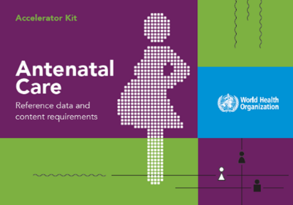
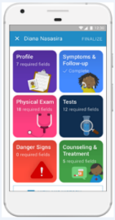
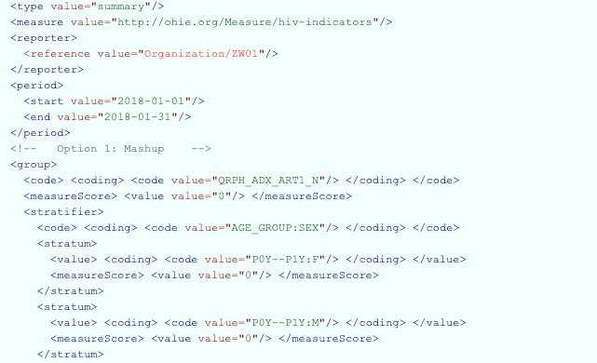

When applied in the context of country health systems, the components within each layer can contribute to improved health services
L1
L2
L3
L4
L5
WHO ANC Recommendations
ANC Digital Adaptation Kit
FHIR standards built into WHO digital ANC module
WHO digital ANC module: generic version 1.0
In progress
Narrative Guidelines
Digital Adaptation Kits
Machine-readable Recommendations
Reference Software
Precision Health Models
WHO ANC SMART guidelines – https://www.srhr.org/antenatalcare/#Tools
Notes:
All together, the components provided by each layer of the Smart Guidelines can contribute to improved country health services. Starting with the analogue (or non-digital) components in L1 and L2 (these are called narrative guidelines and digital adaption kits) and then progressing to the digital components of L3 and L4 (also called Machine-readable Recommendations and Reference Software), these each support countries wherever they may be in terms of digital ecosystem maturity. And they all lead to the final layer, L5, which is currently conceptual in nature and will ultimately seek to utilize AI and Machine Learning to bring precision health models to bear for stronger evidenced-based health systems in the long-term.
To better illustrate how the guidelines are represented in each layer, let’s take a look at a specific recommendation from Antenatal care (ANC) guidelines so we can provide an example of one recommendation’s “journey” from L1 – L4.

Slide 9

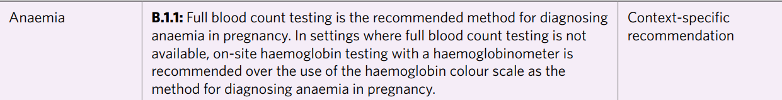
SMART Guidelines in practice for antenatal care (ANC)
L1: Traditional guidelines enhanced with unique identifiers to track recommendation updates
L1
WHO ANC recommendations
L1: Text from guideline
Notes:
Starting with L1, you’ll see here a very specific recommendation from the WHO guideline on ANC, related to diagnosing anemia in pregnant women. This guideline states that where full blood count testing is not available, on-site hemoglobin testing with a specific tool (a hemoglobinometer) is recommended over the use of another tool (a hemoglobin color scale). In this scenario, a healthcare provider either must have this recommendation memorized or they are referring to this guideline during a patient encounter.

Slide 10

SMART Guidelines in practice for antenatal care (ANC)
L2: Translates narrative guidelines into structured components for operationalizing within country programs
L1
L2
L2: Structured logic from Digital Adaptation Kit
WHO ANC recommendations
ANC Digital Adaptation Kit
Components of a Digital Adaptation Kit
1. Health Interventions & Recommendations
2. Generic Personas
3. User Scenarios
4. Business Processes & Workflows
5. Core Data Elements
6. Decision Support Logic
7. Indicators & Monitoring
8. Functional & Non- functional Requirements
Notes:
As the recommendation moves to L2, the guideline narrative is translated into structured components to support operationalizing the recommendations within the context of country programs. This provides uniformity in the application of the intervention so that there are more consistent and predictive outcomes across countries.
So for the ANC guideline, the anemia recommendation is now in the form of a decision table, in which can be translated easily into an application, which the health worker then utilizes during a patient encounter. This guides the health worker to the specific recommendation to use the hemoglobinometer when testing for anemia.

Slide 11
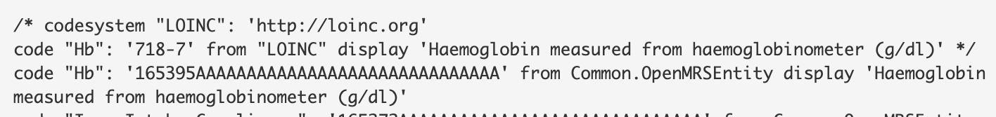
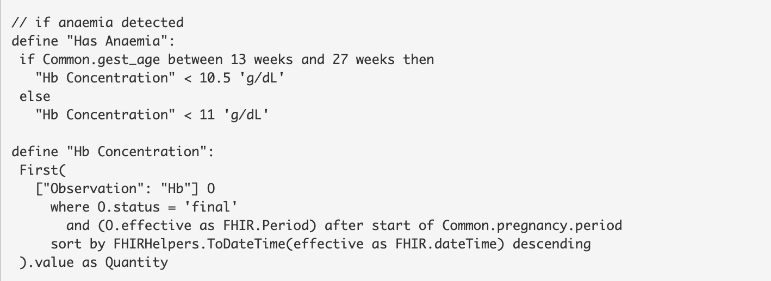

SMART Guidelines in practice for antenatal care (ANC)
L3: Transforms L2 components into standards-based software code that accurately reflects guideline decision logic and data requirements
L1
L2
L3: Guideline in software code
WHO ANC recommendations
ANC Digital Adaptation Kit
L3
FHIR standards built into WHO digital ANC module
Notes:
In layer 3, the anemia recommendation is transformed into a digital format for the first time: it is now in a standards-based software code that preserves the decision logic and data standards necessary to ensure the fidelity of guidelines is maintained and can be accurately implemented through digital tools. This screenshot shows that the software code is written to state that hemoglobin is measured from a hemoglobinometer, and if this software were to be integrated into a digital tool, that recommendation would be preserved.
--
-Image Source: http://build.fhir.org/ig/who-int/anc-cds/Library-anc-recommendation-a2.html

Slide 12
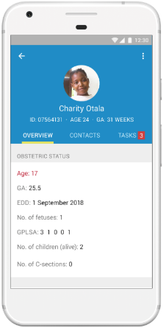
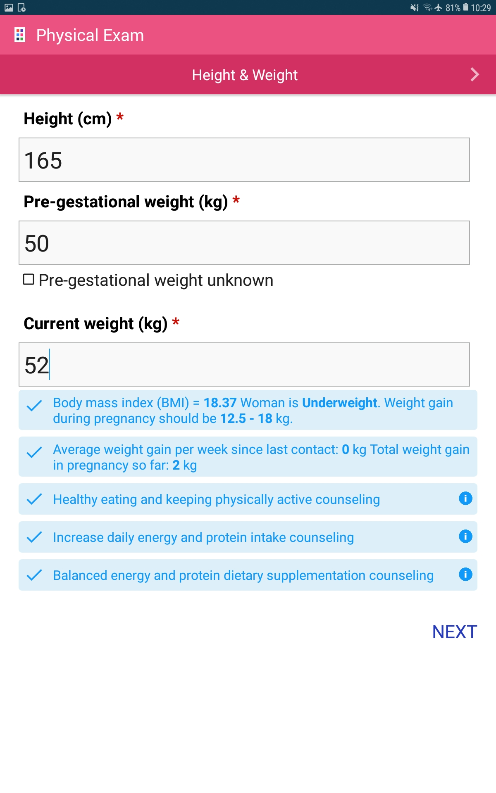

SMART Guidelines in practice for antenatal care (ANC)
L4: Manifests guidelines in software applications that are ready to be deployed in the field
L1
L2
L4: WHO digital ANC module
WHO ANC recommendations
ANC Digital Adaptation Kit
L3
L4
FHIR standards built into WHO digital ANC module
WHO digital ANC module: generic version 1.0
Notes:
And then we arrive at Layer 4: here, the guidelines have been fully incorporated into a software application that can be integrated with a country’s digital health system. This screenshot is from the ANC L4 reference software, and as you can see has fields for data capture during a patient’s physical exam. This software is based on the decision logic, data standards and definitions -- defined in Layer 2 and expressed in code in Layer 3 - but adds the digital functionality and user interface necessary so that the software is ready to be localized and deployed for use by health program actors in country.
ANC is not the only health program area where Smart Guidelines are already being implemented.
Smart Guidelines are drafted or in progress for 10 other health domains (e.g., HIV, Family Planning)
WHO has also partnered with Google to support country capacity building and establishment of an open-source technology stack and libraries (SDK) to facilitate adoption of WHO smart guidelines packages

Slide 13
The SMART Guidelines Layers
L1
L2
L3
L4
L5
Digital Adaptation Kits
Machine-Readable Recommendations
Reference Software
Precision Models
Enhanced Guidelines
Traditional guidelines enhanced with unique identifiers to track recommendation updates
Translates narrative guidelines into structured components (e.g., decision trees, flow diagrams) for operationalizing within country programs
Transforms L2 components into standards-based software code that accurately reflects guideline decision logic and data requirements
Manifests guidelines in software applications that are ready to be deployed in the field
Provides advanced analytics to support continuous improvement of health services
Notes:
When looking at the full arc of guideline transformation across the lat, the team at WHO has standardized this progression from paper and legacy systems to intelligent digital systems while providing components at each layer that can support the operationalization of guidelines regardless of the maturity of a country’s digital health ecosystem.
Layer 1 continues to provide the guidelines in narrative format but with a unique identifier for each recommendation, to easily track and integrate updates and changes to guidelines as they are published.
Layer 2 translates the narrative guidelines into structured components - such as illustrated workflows, decision-support documentation, and data dictionaries, packaged as Digital Adaptation Kits - so that guidelines can be operationalized within country health programs and consistently applied.
Layer 3 transforms the L2 components (e.g., decision-support processes) into digital format through standards-based software code that developers can integrate into digital systems, avoiding inadvertent errors in guideline translation and allowing for interoperability at scale. L3 focuses on the L2 components that are most essential for guideline fidelity.
Layer 4 turns L3 guideline code into fully functional software applications that can be customized and integrated into any country digital system.
The vision of Layer 5 is to eventually provide advanced analytics and Artificial Intelligence to support continuous improvement of recommendations (and associated software code) for precision patient care and data use. Layer 5 will ultimately offer the ability of countries and the WHO to learn from how recommendations are used and what issues come up, all contributing to improved health services.

Slide 14
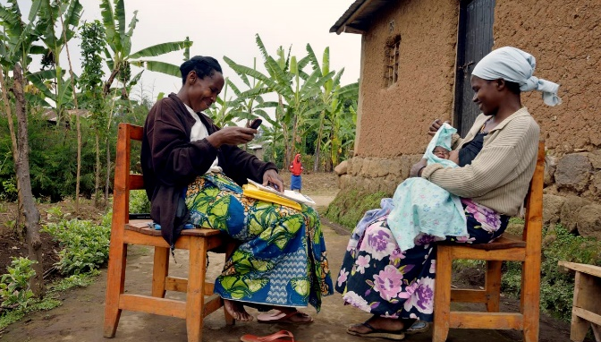
The SMART Guidelines support a paradigm shift: they systematize and accelerate the consistent application of life-saving interventions globally
Notes:
When we take a step back from the details and specific components of the layers, we see that at the initiative level, the Smart Guidelines support a paradigm shift: they systematize and accelerate the consistent application of life-saving interventions globally.
---------------------------
(Optional additional statement) There are two levels to this paradigm shift: 1) it brings evidence-based medicine to health care in countries, and 2) supports global public health, in that all interventions are represented consistently and accurately in digital systems.

Slide 15
SMART Guidelines transform the way WHO’s evidence base is applied for health service delivery globally. They…
Accelerate guideline use
Accelerate the adoption of clinical, public health, and data interventions in member states by leveraging evolving digital technologies
Ensure guideline fidelity
Systematically encourage the consistent and accurate interpretation of guidelines as digitization takes place
Improve analytics and M&E
Strengthen data quality, metrics, and reporting - across geographies and different levels of digital system maturity – to accurately monitor, course correct, and attribute health gains
Strengthen the evidence base
Create feedback loops to continuously track how guidelines are used, enriching and speeding up the evidence base, and enabling more rigorous evaluation of guideline impact
…for better clinical care & stronger health systems
Notes:
So the opportunity of the Smart Guidelines is to transform the way the evidence base is used in health service delivery globally, for greater health system efficiency, sustainability, and impact.
They accelerate guideline use by addressing three key delays that have impeded adoption. 1) They help countries adopt guidelines to begin with; 2) they support guideline localization; and 3) they help get guidelines reflected in fast-evolving digital systems
They ensure guideline fidelity as they are adapted and implemented in country digital systems, helping to ensure interventions are applied in accordance with the latest guidelines
They improve analytics and M&E by collecting the right data to accurately monitor, course correct, and attribute health gains
They support continuous strengthening of the evidence base that is used to update and improve guidelines overtime, though feedback loops that will enrich and speed up the evidence base in support of evidence-based medicine, as well as provide the WHO more clarity on guideline usage and impact.

Slide 16
Call to Action: opportunities for engagement for actors at all levels
Donor Community
Support the development and maintenance of Smart Guidelines, invest in products that adopt Smart Guidelines, and require use of Smart Guidelines in country implementations
Program Managers
Request digital products that implement Smart Guidelines
Technologists
Adopt Smart Guidelines as the primary mechanism to improve the functionality and interoperability of tools
Health System Actors
Advocate for the adoption of Smart Guideline tools in the context of health service delivery
Guideline Developers
Engage with business analysts and other experts to ensure guidance is accurately translated to digital tools
Notes:
Actors throughout the ecosystem, including the donor community, have an important opportunity to advance the development and uptake of Smart Guidelines:
Guideline Developers within the WHO can engage with business analysts and other experts to ensure guidelines are accurately translated to digital tools
Program Managers and other MOH actors within countries can request digital products that implement Smart Guidelines
Technologies can adopt Smart Guidelines as the primary mechanism to improve the functionality and interoperability of tools
And Health System Actors can advocate for the adoption of Smart Guideline tools in the context of health service delivery
To get to the next level of thinking on how these different actors will be involved and contribute will be to design a comprehensive operationalization plan.

Slide 17

Thank you!
For more information:
Dr Garrett Mehl, mehlg@who.int
Department of Digital Health and Innovations, Science Division, WHO
https://www.who.int/teams/digital-health-and-innovation/smart-guidelines/
For more information on WHO ANC SMART Guideline:
www.srhr.org/antenatalcare

Slide 18
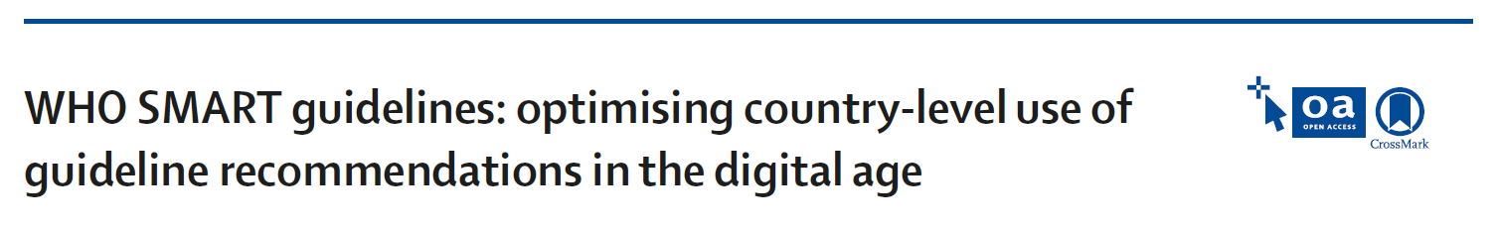
SMART Guidelines
SMART Guidelines are an operationalization of this vision for a new WHO-supported approach to facilitate rapid, effective, global implementation of WHO guideline recommendations in the digital age
S = Standards-based
M = Machine-readible
A = Adaptive
R = Requirements-based
T = Testable
Notes:
SMART Guidelines are an operationalization of this vision for a new WHO-supported approach to facilitate rapid, effective, global implementation of WHO guideline recommendations in the digital age.

