Slide 1


Slide 2
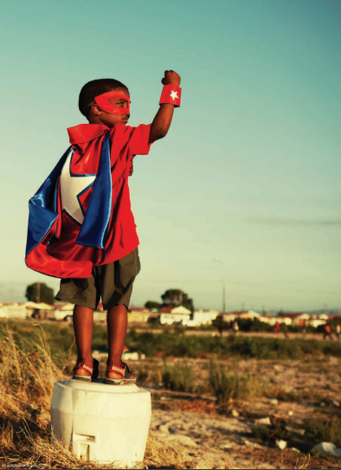
Aims of the report
Describe the state of the problem
Document what countries are doing
Identify gaps and actions to address them

Slide 3

Violence & the Sustainable Development Goals
Target 16.2: end all forms of violence against children
Target 4a: ensure non-violent learning environments for all
Target 5.2: eliminate all forms of violence against women & girls
Target 16.1: significantly reduce all forms of violence & related deaths everywhere

Slide 4

INSPIRE technical package
Implementation/enforcement of laws
Norms & values
Safe environments
Parent & caregiver support
Income & economic strengthening
Response & support services
Education & life skills

Slide 5
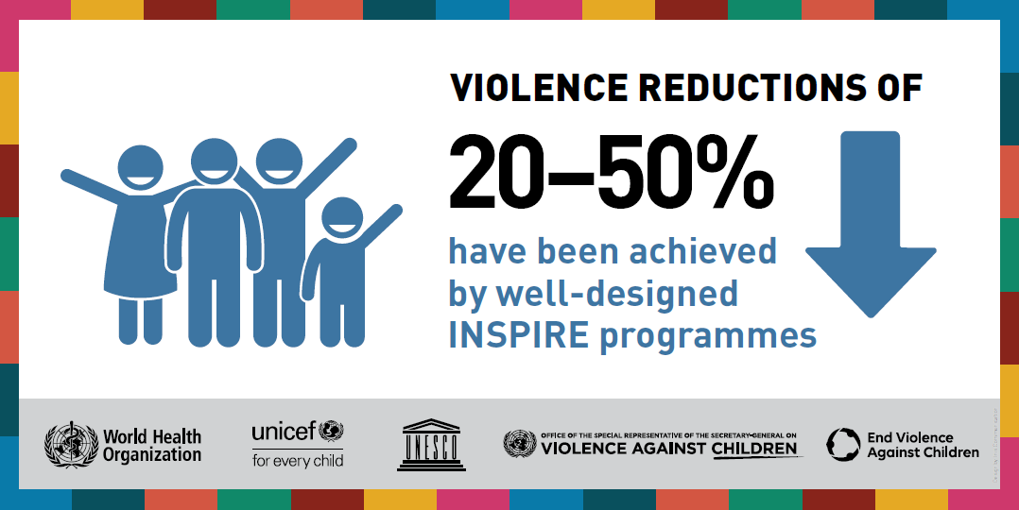

Slide 6
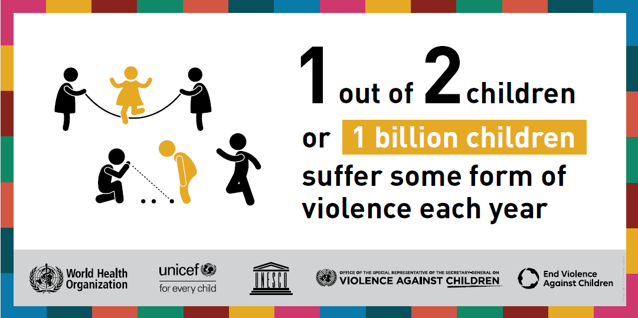
  Magnitude

Slide 7
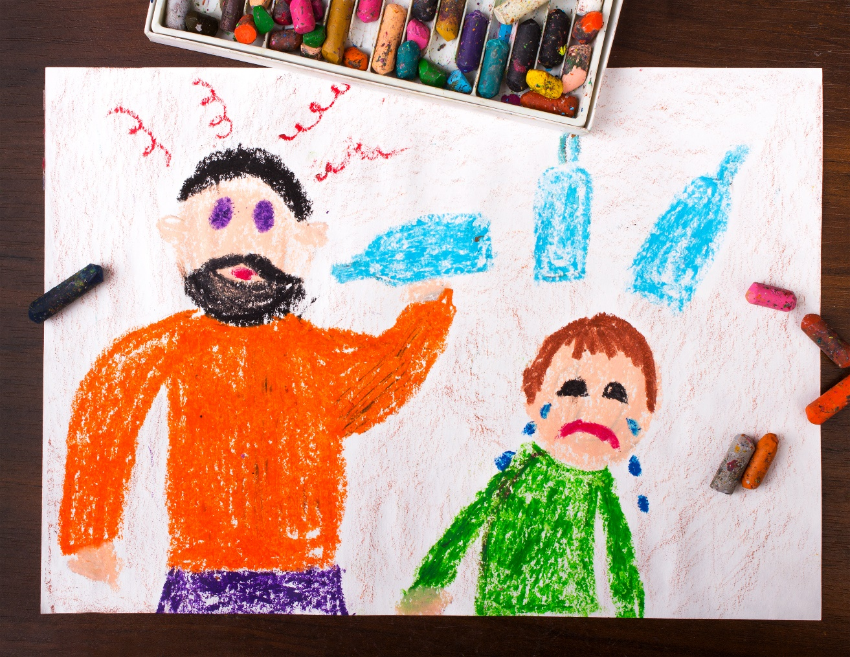
3 in 4 children aged 2-4 years suffer parental violence in past year
1 in 3 students aged 11–15 years bullied in past month
120 million girls & young women aged 0-20 years suffered forced sexual contact in lifetime

Slide 8
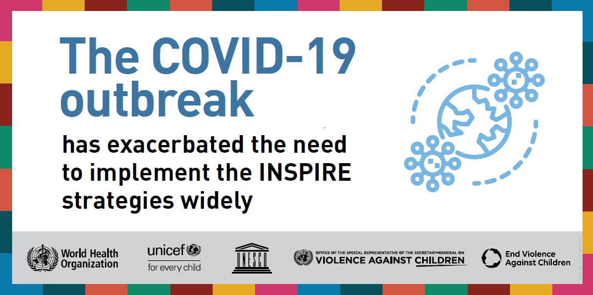

Slide 9
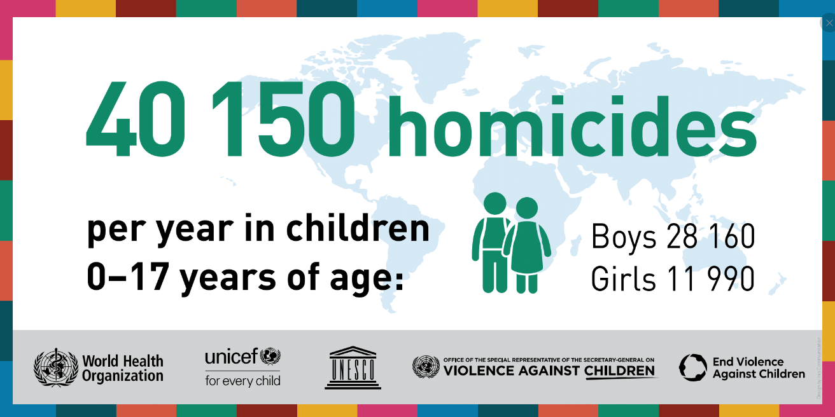
  Consequences

Slide 10
Health consequences of violence against children
Non-communicable
disease and risk behaviours
Injury
Head Injury
Stroke
Cancer
Fractures
Internal Injury
Heart
Disease
Chronic Lung
Disease
Burns
Diabetes
Obesity
Depression and Anxiety
Violence
Alcohol
Mental health
PTSD
Physical
Inactivity
Smoking
Suicide
Assault
Alcohol
And Drugs
Fetal
Death
Unsafe
Sexual Practices
STDs
Unintended
and Adolescent
Pregnancy
Multiple Partners
Pregnancy
Complications
HIV
Maternal and
child health
Communicable disease
and risk behaviours
Direct effect
Indirect effect due to adoption of high-risk behaviour

Slide 11
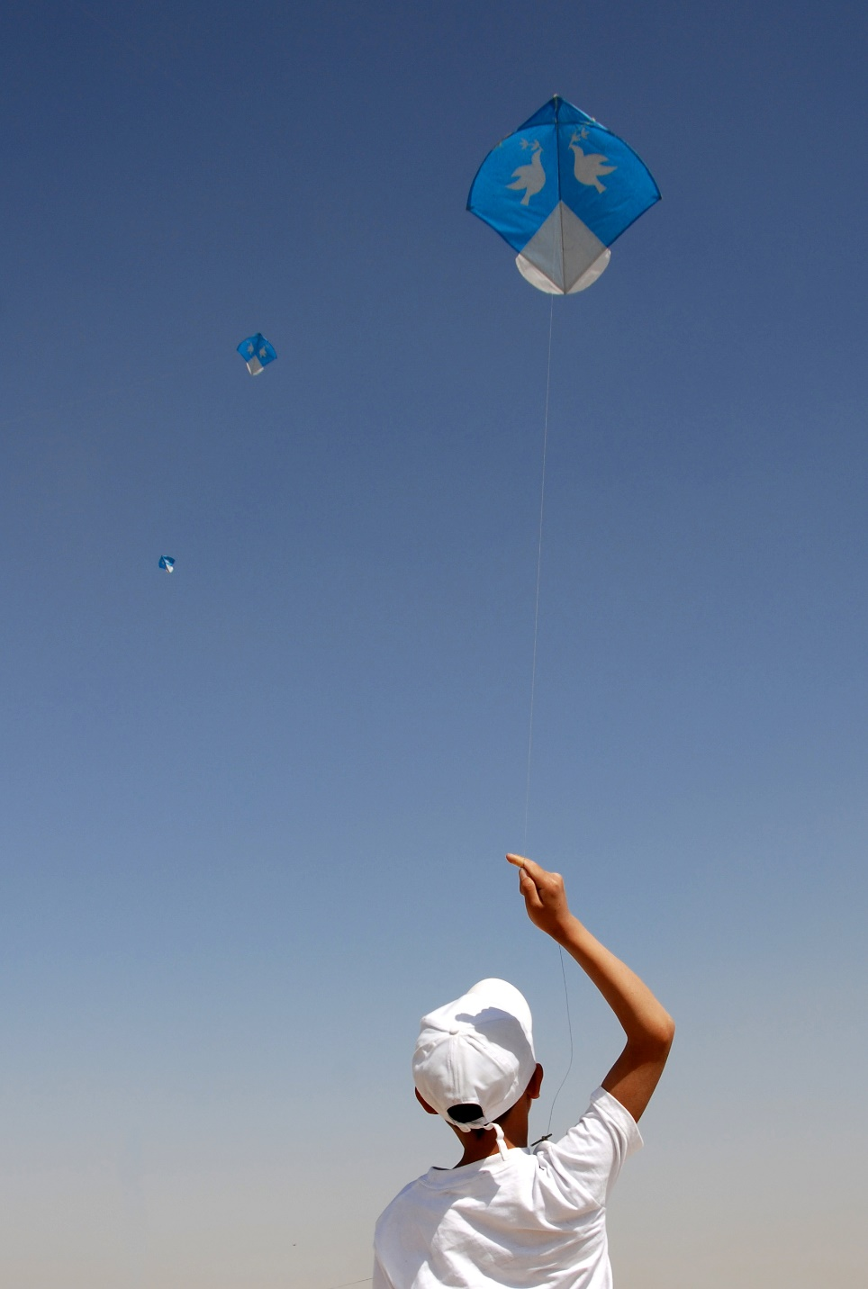
< 10% of low-income countries report having fully funded national actions plans compared to half of high-income countries
Only one fifth of countries have national action plans that include specified indicators on the prevalence of violence against children

Slide 12
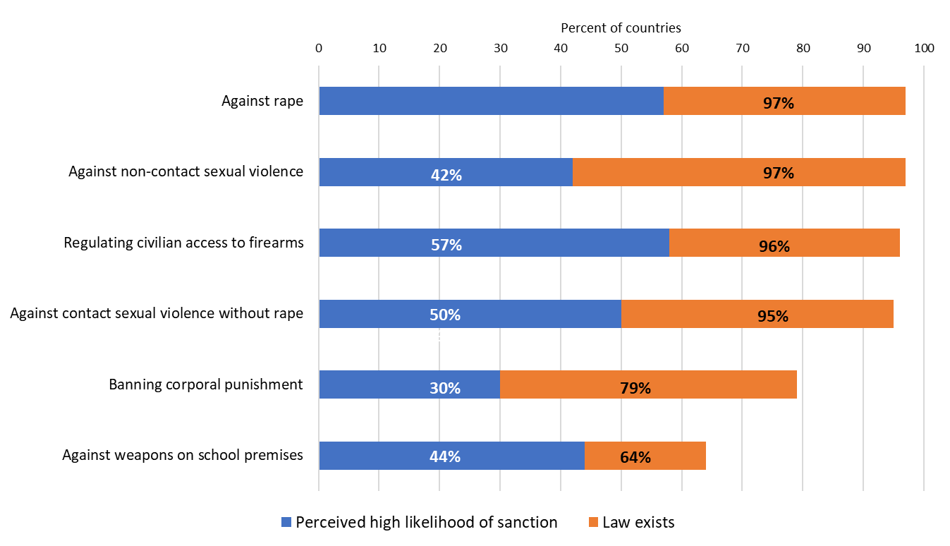
Laws to prevent violence against children are widely enacted,
but not adequately enforced
58%
58%
Percentage of countries with national laws and extent to which enforcement was considered sufficient (N=155 reporting countries)

Slide 13
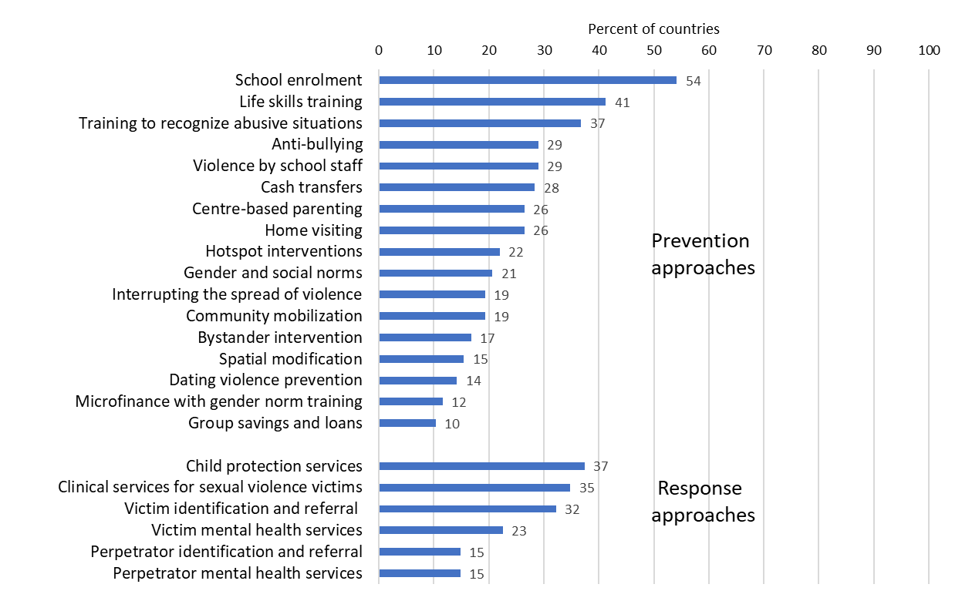
Government support for most INSPIRE approaches exists in many countries, but far more is needed to ensure they reach all who need them
Percentage of prevention and response approaches where support was considered adequate to reach all in need (N=155 reporting countries)

Slide 14
Only 1 in 4 countries report that prevention programmes & response services are reaching all who need them
Percentage of prevention and response approaches considered to be reaching all in need by country income level (N=155 reporting countries)

Slide 15
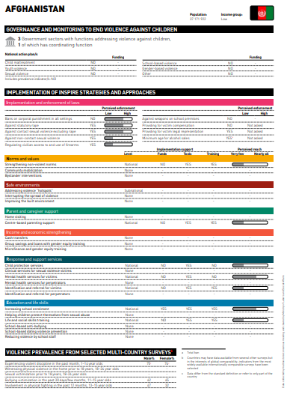
Country profile pages
Governance and monitoring mechanisms
Implementation ratings for all INSPIRE approaches
Prevalence of violence against children

Slide 16
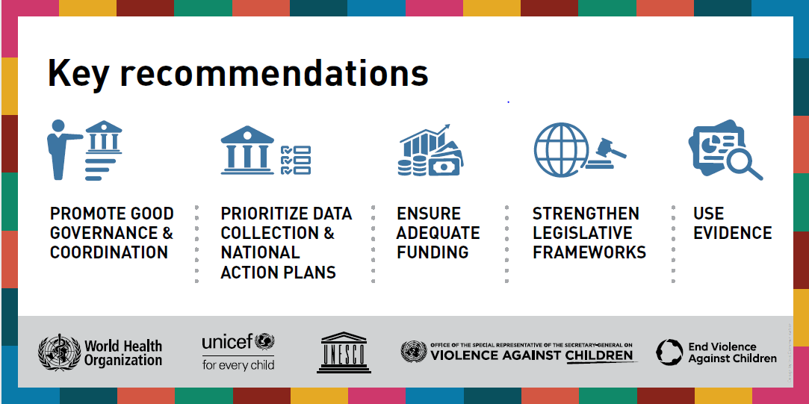

Slide 17
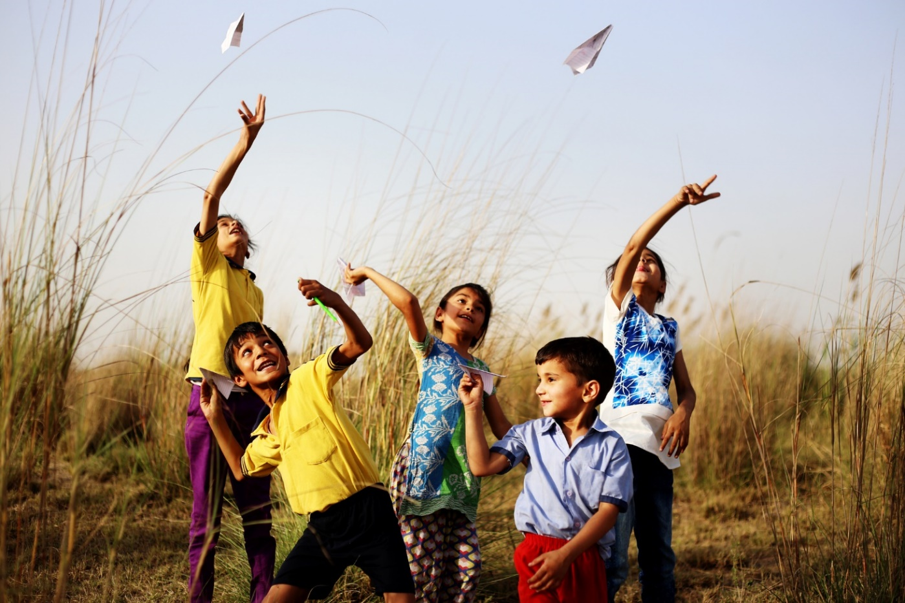
Acknowledgements
National Data Coordinators & participating Member States
WHO colleagues involved in preparing the report, the launch & follow up
Fondation Botnar
US Centers for Disease Control and Prevention

Slide 18

www.who.int/global-status-report-on-violence-against-children-2020

