Slide 1


Global Challenges and Health Dynamics
2
MODULE 2 PART 1
21st Century Health Dynamics and Inequality
Notes:
Title slide

Slide 2


2
Learning Objectives
1
Describe some of the major global challenges impacting health
Notes:
Briefly summarize the key objectives for this lecture.
This lecture will explore the relationships between the social determinants of health, which was discussed in the previous lecture and contemporary global challenges. The purpose of dealing with these issues together is to highlight their complex interaction and communicate why a HiAP approach is increasingly relevant.

Slide 3

2
Global Challenges for Health
The 21st century brings many complex
and interacting challenges.
Some of the major global challenges directly
and indirectly impacting health include:
1
Globalization
2
Urbanization
3
Poverty
4
Socioeconomic inequality
5
Food insecurity
6
Environmental degradation
7
Demographic transition
Notes:
With globalization of the last few decades, we have begun to think of health as truly global. Health is increasingly recognized as something requiring collaboration and solidarity across traditional boundaries. We live in an interdependent world where health and well-being are shaped by circumstances, decisions, and events occurring in sometimes distant places. For example, food supply lines are globally integrated and environmental health risks like climate change defy national borders. Successfully addressing these challenges requires new knowledge and cross sectoral learning, social innovations for how we govern our global society, and new ways of financing health interventions. There is a need to break down the artificial sectoral barriers and promote global and regional collective action on the social determinants of health, whilst maintaining local endeavours.
Additional consideration: Given the differences in social, political and environmental challenges and health inequalities, it is recommended that you adapt and supplement these teaching notes with information and examples relevant to the country or region where the HiAP course/workshop is being held.

Slide 4
2
Globalization: trade, migration and industrialization
1
The world is more and more economically
interconnected. Trade between countries
is one indication of this.
  Between 1960 and 2017, the value of trade in goods and services
  as a share of global GDP increased from 12% to 37%.¹
The number of people travelling
and migrating is increasing.
1 World Bank, World Development Indicators. Accessed https://data.worldbank.org/indicator/NE.EXP.GNFS.ZS
Notes:
Economic globalization has been the fundamental driving force behind the overall process of globalization over the last four decades. It has been characterized both by a dramatic growth in the volume of cross-border flows and by major changes in their nature. For example, international trade flows have grown at an accelerating rate.
Migration is a global reality. International migration has increased to 258 million, and the numbers of refugees and people displaced by conflict, natural disasters, and climate change are at their highest levels.* Indeed, migration is one of the most pressing issues of the 21st century. Discrimination, gender inequalities, and exclusion from health and social services repeatedly emerge as negative health influences for migrants. Promoting health in global mobility is paramount.
* The ULC-Lancet Commission on Migration and Health: the health of a world on the move. (2018). The Lancet, 392: 2606-54.

Slide 5
2
Globalization: trade, migration and industrialization
1
Many low- and middle-income economies
have industrialized and grown significantly.
  Consequences for rural to urban migration, urbanization
  and socioeconomic change.
This globalization is impacting health in multiple ways:
  Increases risks of global epidemics such as severe acute
  respiratory syndrome (SARs) and the spread of health hazards
  including contaminated foods and products;
  Rapid economic growth places pressure on the labour force,
  infrastructure and environment.
Notes:
Over the last several decades, many low- and middle-income economies have industrialized and grown significantly. The direct consequences of rapid economic growth on health are likely to be negative because of the profoundly disruptive nature of this change. The disruption is simultaneously multi-dimensional: social and familial relations, moral codes, the physical and built environments, forms of government, and the law itself are all thrown into flux when a society experiences industrialization and the consequent population movements that occur.
Industrialization leads to migration of people from rural areas to urban regions leading to overpopulation and overcrowding, which often results in poor health practices due to congestion and the development of slums. Individuals are more susceptible to contracting diseases as a result of overcrowding and poor housing conditions, for example tuberculosis. Industrialization also creates and exacerbates the unfair distribution of resources and leads to socioeconomic change. Furthermore, rapid economic growth can result in more occupational accidents, poor construction and planning that impacts urbanization, as well as more pollution and over-exploitation of natural resources.
These issues and other globalization processes affect health through their impacts on the social, economic, commercial and political determinants of health and on health systems. There are multiple direct and indirect linkages between globalization and the determinants of health.
The challenges continue to evolve. In light of increasing pressure, there is a need for the creation of more effective models of global governance for health, and ongoing discussion platforms to influence the complex and compelling interplay between globalization and health.

Slide 6
2
Urbanization
2
Urbanization is the process of the population
moving from rural areas to urban areas,
which leads to many changes in economic,
social and physical environments.
The world is rapidly becoming more urban.
  Between 2010 and 2050, the percentage of
  the world’s population living in urban areas
  is predicted to increase from 50% to 70%.
  At present, nearly 1 billion people or 33%
  of the urban population live in slums.
Notes:
Urbanization is inevitable as a country’s production moves away from agriculture and towards industry. People begin to move to the cities for better access to employment and resources. In developing countries, employment opportunities often open rapidly through the process of industrialization. Cities and towns become hubs of trade and culture, and more people start moving out of rural areas to gain access to some of these social and financial benefits.
If too many people start moving from rural areas to urban areas, the cities and towns begin to experience overcrowding. Jobs become scarce as more people move into urban centres and as result people become unemployed or underemployed. Affordable housing becomes an issue, and slums begin to develop. Education and social services can become strained, and poverty rises. As people struggle to feed themselves, crime can start to increase. Pollution becomes a significant issue when a large number of people live in a small geographic area. Overcrowded cities quickly become unhealthy for their residents.

Slide 7
2
Urbanization
2
As with rapid economic growth, urbanization can place strain on infrastructure resulting in poor living conditions and an inability to properly access social services like education and medical care.
Rapid, unplanned urbanization creates congestion and pollution, and has impacts on health-promoting behaviours and risk factors for non-communicable diseases (NCDs).
Notes:
Urbanization can have several positive effects on society, however, if not well planned much of it is detrimental. Rapid and often unplanned urban growth is often associated with poverty, environmental degradation, and population demands that outstrip service capacity. These conditions place human health at risk.
A range of urban health hazards and associated health risks as a result of urbanization are well documented: substandard housing, crowding, air pollution, insufficient or contaminated drinking water, inadequate sanitation and solid waste disposal services, vector-borne diseases, industrial waste, increased motor vehicle traffic, stress associated with poverty and unemployment, among others.
Furthermore, studies have demonstrated the links between the built environment and health-related behaviour. For example, the built environment is important to promote physical activity. Cities and neighbourhoods with greater amounts of green space are associated with weekly walking and moderate-to-vigorous physical activity. Efficient public transport also encourages active travel. Urbanization done well has an important role for reducing the burden of non-communicable diseases (NCDs).
Globally, a quarter of all preventable illnesses are the result of the environmental conditions in which people live. Local governments need to be mindful of their city planning so their populations can thrive for the foreseeable future and ensure urbanization is sustainable.

Slide 8
2
Economic growth, poverty
and governance
3
Economic growth is the most powerful instrument
for reducing poverty and improving quality of life.
In 2015, 736 million people lived on less than $1.90
a day, down from 1.85 billion in 1990.² While poverty rates have declined in all regions, progress has been uneven. Increasingly, the majority of the world’s poor live in middle-income countries.
2 The World Bank, Understanding Poverty, accessed (page updated Apr 03, 2019):
https://www.worldbank.org/en/topic/poverty/overview
Notes:
Despite considerable economic growth over the past half century, a large percentage of the world’s population still lives in poverty. It is becoming even more difficult to reach those remaining in extreme poverty, who often live in fragile countries and remote areas. Access to good schools, health care, electricity, safe water, and other critical services remains elusive for many people, often determined by socioeconomic status, gender, ethnicity, and geography. The multidimensional view of poverty – whereby other aspects such as education, access to basic utilities, health care, and security are included – reveals a world in which poverty is a much broader, more entrenched problem.
The share of poor according to a multidimensional definition that includes consumption, education, and access to basic utilities is approximately 50 percent higher than when relying solely on monetary poverty. Furthermore, for those who have been able to move out of poverty, progress is often temporary: economic shocks, food insecurity, and climate change threaten the gains made and potentially force people back into poverty.

Slide 9
2
Economic growth, poverty
and governance
3
Health is traditionally viewed as an end product
of the growth process. However, in the other direction, a healthy population is also a driver
for economic growth.
In many countries, the past several decades of economic growth have been accompanied
by a shift in the discourse of public policy
and governance towards neoliberalism.
Notes:
Health has traditionally been seen as an end product of the growth process. However, the relationship is two-way. Whilst wealth undoubtedly leads to health – people with higher incomes have a greater command over the goods and services that promote health, such as better nutrition, access to safe water, sanitation, and good quality health services – health also enhances economic growth. Health is a form of human capital and therefore an input into the growth process, as well as an output.
Better health enhances growth by improving productivity, and higher growth allows better human capital formation. Countries with educated, healthy populations are in a better position to prosper and lift people out of poverty, especially in a favourable policy environment. However, inclusive growth is needed to reach the remaining poor and the target of ending extreme poverty by 2030 (refer to the United Nations Sustainable Development Goals).
In many countries, the past several decades of economic growth have also been accompanied by a shift in the discourse of public policy and governance towards neoliberalism. The policies that neoliberalism tends to favour includes: strict fiscal discipline, tax reform to benefit corporations and higher income individuals, market-determined exchange rates and interest rates; free trade and free capital flows, as well as state privatization and deregulation. In the health sector, this has led to less public health spending, fewer health care services and higher out-of-pocket expenses, which subsequently impact health outcomes.

Slide 10
2
Socioeconomic inequality
4
Interrelated to poverty, there is also socioeconomic inequality. Socioeconomic inequality relates to disparities in both economic and social resources.
Large inequalities exist not only across countries, but also between population groups within
each country.
Notes:
This slide provides an introductory summary of inequality. The concept of inequality will be discussed in more detail in the next lecture.
Socioeconomic inequality relates to disparities in both economic and social resources, linked to social class and includes earnings, income, education and health that contribute to a sense of well-being. Measures incorporate such indicators as income, education, occupation, or health status. Large inequalities exist not only across countries, but also between population groups within each country.
Today, almost half of the world’s wealth is owned by just 1% of the population. The top 1% richest individuals in the world captured twice as much growth as the bottom 50% individuals since 1980.

Slide 11
2
Socioeconomic inequality
4
Growth in many countries has disproportionally benefited higher income groups while lower income households have been left behind.
Income and wealth inequalities are fundamental causes of health inequalities. They influence other factors such as housing, alcohol use and smoking.
Notes:
Income and wealth inequalities are fundamental causes of health inequalities. They influence other factors such as housing, alcohol use and smoking. Reducing poverty and inequalities in income and wealth is important in reducing health inequalities. Income is considered to be the most important social determinant of health.
Initiatives and policies for inclusive growth help to combat socioeconomic inequalities. Inclusive growth is economic growth that is distributed fairly across society and creates opportunities for all. Work on inclusive growth shows that there does not have to be a trade-off between growth and equality.

Slide 12
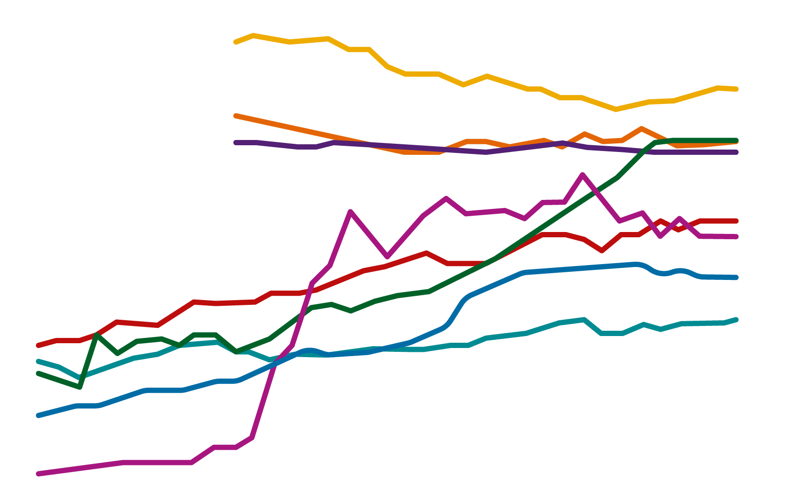
2
Socioeconomic inequality
Inequalities are on the rise and halting this trend has
become a priority for policy-makers in many countries.
Global Income Inequality
Inequality is Rising or Staying Extremely High Nearly Everywhere
Top 10% income shares across the world, 1980-2016
Africa
60
Brazil
China
Europe
50
India
Middle-East
Russia
Share of National Income (%)
US-Canada
40
30
20
1980
1985
1990
1995
2000
2005
2010
2015
Source: World Inequality Lab, World Inequality Report, 2018
Notes:
Use a graph or diagram to introduce participants to the concept of inequality. The graph depicted above is provided as an example only and can be adapted to the contextual needs depending on the location of the training course.
Explanation for above graph:
Socioeconomic inequalities have been on the rise across the world for several decades. Income equality varies greatly across world regions. It is lowest in Europe and highest in the Middle East. In recent decades, income inequality has increased in nearly all countries, but at different speeds, suggesting that institutions and policies matter in shaping inequality. Since 1980, income inequality has increased rapidly in North America, China, India, and Russia, and more moderately in Europe.ª
World Inequality Lab researchers note that this period coincides with the rollback in these countries and regions of various post-World War II policies aimed at narrowing economic divides. By contrast, they point out, countries and regions that did not experience a post-war egalitarian regime, such as the Middle East, sub-Saharan Africa, and Brazil, have had relatively stable, but extremely high levels of inequality.
a World Inequality Lab, World Inequality Report (2018). Accessed: http://wir2018.wid.world

Slide 13
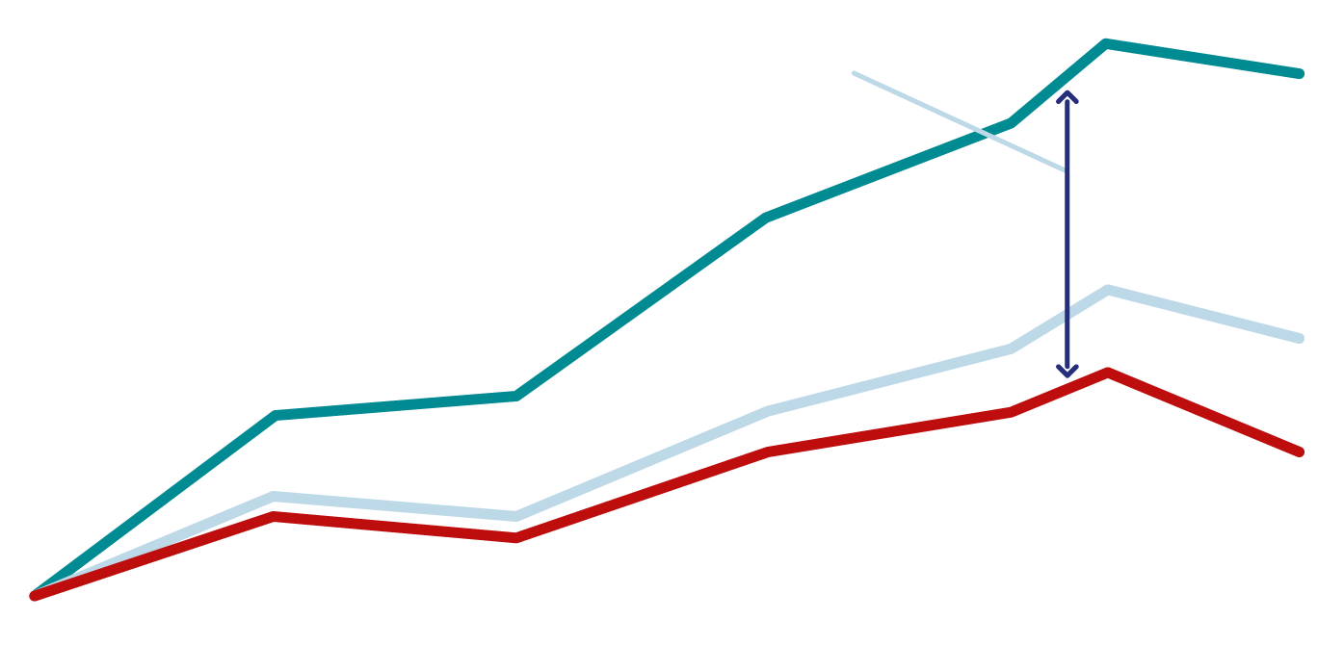
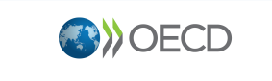
2
Socioeconomic inequality
Rising income inequality
Change in real household income, OECD average
The gap between
low income and high
income earners keeps on increasing over the years
Top 10%
40%
Bottom 40%
20%
Bottom 10%
0%
1980
1985
1990
1995
2000
2005
2010
Source: In It Together - Why Less Inequality Benefits All (2015)
Notes:
Graph depicted is provided as an example only and can be adapted to the contextual needs depending on the location of the training course.
Explanation for above graph:
In many OECD countries, inequalities are at their highest levels in 30 years and are widening. The top 10% of income earners take home over ten times more pay than the bottom 10%.

Slide 14
2
FOOD INSECURITY
5
Food security exists when all people at all times have physical, social and economic access to sufficient, safe and nutritious food to meet dietary needs and food preferences for an active and healthy life.
New shocks related to climate change, conflict, pests
(such as locusts) and infectious diseases are hurting food production, disrupting supply chains and stressing
people’s ability to access nutritious and affordable food.
Notes:
Food insecurity refers to a lack of consistent access to food, which diminishes dietary quality, disrupts normal eating patterns, and can have negative consequences for nutrition, health and well-being.
It is estimated that over 2 billion people do not have regular access to safe, nutritious and sufficient food.
Ongoing fragility and conflict, civil insecurity, large-scale displacement, climate-change and natural resource degradation - which are linked in complex ways - continue to intensify food insecurity for millions of people.

Slide 15
2
FOOD INSECURITY
5
The widespread incidence of microbiological, chemical or other food safety hazards in food also continues to be a serious issue for the food system.
Recent world economic reports have highlighted economic slowdowns and downturns in several economies, impacting global food security and nutrition trends.
Notes:
The widespread incidence of microbiological, chemical or other food safety hazards in food also continues to be a serious issue for the food system. There are some 600 million cases of foodborne illness globally each year – and children and poor people bear the brunt of this burden.
Unsafe food not only represents a serious public health concern, but it also negatively impacts the incomes of farmers, the livelihoods of food vendors and the continuity of business and trade.
In addition, the impact of economic slowdowns and downturns on food security and nutrition cannot be separated from the root causes of hunger and malnutrition: poverty, inequality and marginalization.
Recent world economic reports highlight that slowdowns, stagnation and outright recessions are evident in several economies and already leading to increased unemployment and declines in income. Economic slowdowns and downturns often lead to a rise in unemployment and decline in wages and incomes, challenging access to food and essential social services for the poor. People’s access to high-quality, nutritious food can be affected, as can access to basic services such as health care.
While economic shocks are rarely the primary drivers of food crises, in many instances, they worsen the severity of acute food insecurity, as well as prolonging the duration of the crisis.
To safeguard food security and nutrition, it is critical to have in place economic and social policies to counteract the effects of adverse economic cycles when they arrive, while avoiding cuts in essential services.

Slide 16
2
Environmental degradation
6
Conserving the earth’s ecosystem on which human society depends is a precondition for economic and social development, including good health.
Although human health has improved dramatically since 1950, this gain has been accompanied by unprecedented environmental degradation from human activities that now threaten both human
health and life-support systems.
Notes:
Growing evidence suggests that humanity is undermining the stable state of the earth’s ecosystem. The planet is increasingly becoming unhealthy and the global south is the most affected, especially by air pollution.
The major health problems resulting from environmental degradation include air pollution and the overuse, misuse and contamination of water, land and forests in an intertwining of natural resource use (or abuse) with market-driven features of the built environment, jeopardizing the spaces and places where people work, play and live.
Sustainable development initiatives and policies by countries should address key environmental issues such as climate change, clean energy, urbanization and transport.

Slide 17
2
Environmental degradation
6
Environmental factors – polluted air, built environment hazards, agricultural practices, occupational hazards, radiation, climate change, chemical exposures and inadequate water and sanitation – were associated with 12.6 million deaths (23% of deaths worldwide) in 2012.³
3 Prüss-Ustün, A, Wolf, J, Corvalán, C, Bos, R & Neira, M 2016, Preventing disease through healthy environments:
a global assessment of the burden of disease from environmental risks, WHO, Geneva.

Slide 18
2
Environmental degradation
Global impacts on health of the planet
and human health, 2018 – 50.
Air
Household or urban pollution and greenhouse gases
Greatest cause of death and sickness; causes displacement globally globally.
Land
Desertification, deforestation, and chemical pollution
Impact on access to land, number of jobs
Socioecological systems
Pollution (including antibiotics or nano), extraction greater than recharge
Interconnectedness of Earth system
Freshwater
Impact on water security, health and jobs
Fish population declines, plastic pollution, coral bleaching, polar ice melting
Oceans
Loss of cheap protein and jobs
Pollinators decline; extinction of genes, species, or ecosystems
Biodiversity
Food security decrease, potential zoonoses increase
Planetary Impact
Good
Stable
Reversible
Irreversible
Human Health
Impact
Low
Source: Gupta, J et al. (2019). Communicating the health of the planet and its links to human health.
The Lancet, Planetary Health, DOI:https://doi.org/10.1016/S2542-5196(19)30040-3.
Notes:
Length of bars indicates severity of the impact on the planet or humans: the worse the impact, the longer the bar. Dotted lines reflect the cumulative nature of the locally occurring problem and its effects on the most vulnerable, showing that these effects might be more serious in some areas than others shown by the solid bar.
The diagram shows that biodiversity is the worst affected component, followed by air, oceans, freshwater, and land. The irreversibility of biodiversity loss (from genes to ecosystems, including, for example, pollinators) at all levels reflects an ongoing major extinction event. ^{b}
b Ceballos G, Ehrlich PR, Dirzo R. Biological annihilation via the ongoing sixth mass extinction signalled by vertebrate population losses and declines. Proc Natl Acad Sci USA 2017; 114:E6089-96.

Slide 19
2
Demographic transition
7
Demographic transition is the transition from high birth and death rates to lower birth and death rates as
a country or region develops from an agricultural society to an industrialized economic system.
Population growth: according to the United Nations, the global population is predicted to increase from 6.8 billion to 9.1 billion between 2010 and 2050.
Notes:
Most countries and regions are experiencing unprecedentedly rapid demographic change. The most obvious example of this change is the huge expansion of human numbers: four billion have been added since 1950. Projections for the next half century expect a highly divergent world, with stagnation or potential decline in parts of the developed world and continued rapid growth in the least developed regions.

Slide 20
2
Demographic transition
7
Other demographic processes undergoing change include women’s fertility and increasingly older populations in the developed world.
This demographic transition places strain on the health care system as more people need care, especially for chronic illnesses such as NCDs.
Notes:
Other demographic processes are also undergoing extraordinary change: women's fertility has dropped rapidly and life expectancy has risen to new highs. Past trends in fertility and mortality have led to very young populations in high fertility countries in the developing world and to increasingly older populations in the developed world. Contemporary societies are now at very different stages of their demographic transitions.
These demographic transitions place strain on the health care system as more people need care, especially for chronic illnesses such as NCDs, and in some areas there is a relatively smaller workforce to support the economy.

Slide 21
End of
Module 2 Part 1
Please continue to Module 2 Part 2

