Slide 1


Complex social issues
4
MODULE 4 PART 1
The policy-making process
Notes:
Title slide

Slide 2


4
LEARNING OBJECTIVES
1
Recognize that complex problems require complex solutions
2
Have been able to successfully
apply Health in All Policies thinking
to the problem of obesity
Notes:
Briefly summarize the key objectives for this lecture.
This lecture explores the nature of complexities behind many social issues, which sets the scene for the next lecture which describes the policy-making process, including considerations of important characteristics for policy change.

Slide 3
Wicked problems
4
Complex social issues: causes are not always clear, the solutions are not straightforward and there are many actors involved.
These issues are described as “messy”, “fuzzy” or “wicked”.
For example: health inequality and NCDs such as cancer, cardiovascular disease and mental illness.
Notes:
Complex social issues cannot be treated with traditional linear, siloed approaches because they are often ‘wicked problems’ and can have unintended consequences if dealt with in isolation of the system within which they exist. Wicked problems are chaotic and have also been called ‘social messes’.
Such policy problems cannot be definitively described. Indeed, wicked problems are ill-defined (their causes are not always clear), ambiguous and often associated with strong moral and political issues and vested interests. Since they are strongly stakeholder dependent, there is often little consensus about what the problem is, let alone how to deal with it. The number of stakeholders involved in wicked problems means that there is a constant balancing and compromising process.
Stakeholders are: competing and cooperating, vying for position, willing to reflect, and to change their positions on the basis of this self-reflection. This is why such problems do not have stable problem formulations and do not have pre-defined solution concepts. Wicked problems are dynamic – they are sets of complex, interacting issues evolving in constantly changing social contexts. They are also long-term in nature.
It is important to work towards all stakeholders understanding each other’s position well enough that they can engage in meaningful discussion about the problem. Collaboration becomes the new imperative to solve wicked problems.
To summarise, wicked problems are complex and multi-causal, requiring system wide responses from health and outside of health sectors.

Slide 4
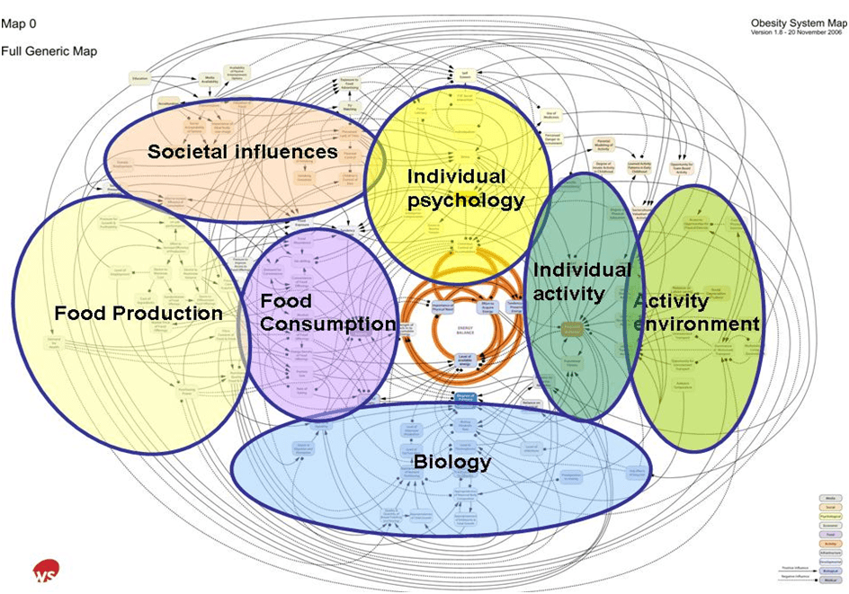
The example of obesity
4
The complex combination of factors behind obesity – the ‘obesity system’ map
Source: Butland B et al. (2007) Tackling Obesities: Future Choices. London, Government Office for Science, p. 90.
Notes:
Obesity is a wicked problem. This slide illustrates that obesity is caused by a complex combination of factors: societal influences, food production, food consumption, the environment and an individual’s psychology, biology, and physical activity. It also highlights the important role that systems and structures not usually associated with health and well-being have in the creation of and maintenance of obesogenic environments.
For complex problems, such as obesity, it is clear that a single government sector (i.e. the health sector specializing in the management of care delivery), will not have all the tools, knowledge, capacity, let alone budget, to address this complexity. Often health organizations lack knowledge of the political processes and the political culture making it even more difficult to tackle these problems. Ministries of health are not equipped to deal with the “causes of the causes” such as the social determinants of health.

Slide 5
Problem types
4
COMPLEX
Cause and effect may be identifiable in retrospect, but may be unlikely to conform with prior expectations of how things work. Interventions must be flexible as outcomes may be unforeseen.
COMPLICATED
Cause and effect may be unclear at the time, but can be inferred using data, analysis and expert knowledge. Once understood, rules for intervention can be defined and followed.
DISORDER
CHAOTIC
Cause and effect relationships may be speculated in retrospect, but cannot be validated. Interventions must be approached as a learning exercise: act, sense, then revise if necessary.
SIMPLE
Cause and effect is predictable and the appropriate response to definable situations can be codified in standard Operating Procedures which then drive interventions.
Notes:
This slide compares simple, complicated and complex problems.
A “simple” problem (e.g. one person with a bout of gastroenteritis) would require a standard, simple solution (oral rehydration and possibly a course of antibiotics when warranted). A “complicated” problem (e.g. a salmonella outbreak in a care home for the elderly) would require investigation, data collection and analysis, and a more astute intervention (food preparation monitoring, isolation, disease management and clinical intervention).
“Complex” and “chaotic” problems as encountered in health in the 21st century, require flexibility, adaptation, collaboration and a much more strategic intervention.

Slide 6
Addressing wicked problems using public policy
4
Strategic, collaborative approach to policy-making.
Mind-set that increasingly public health problems are
not suited to easy solutions – there are no quick fixes.
Wicked problems require:
  – A range of trade-offs;
  – A tolerance for ambiguity and for uncertainty;
  – An opportunities driven approach; and
  – A good contextual analysis.
Notes:
Health in All Policies is premised on this kind of strategic, collaborative approach to policy-making. The mechanisms required to address wicked problems using public policy are grounded in collaboration. They require cross-sectoral work. Understanding the complexity and messiness of wicked problems provides some insight into the need for a multifaceted and intersectoral approach to addressing them. In addition, approaches to addressing wicked problems through public policy require a mind-set that recognises that increasingly public health problems are not suited to easy solutions – there are no quick fixes.
Building a shared understanding of the problem is a key step towards developing solutions. It is important that there is a space that accounts for all the stakeholders’ perspectives/understandings of the problem and likely solutions, even though they are likely to be different.
It is important to consider and be aware that in addressing wicked problems using public policy there is a requirement for:
A range of trade-offs;
A tolerance for ambiguity and for uncertainty;
An opportunities driven approach; and
A good contextual analysis – here it is helpful to differentiate between:
- The contextual environment: factors in the external world which impact the issue but cannot be influenced by the organization;
- The transactional environment: factors that are external to the organization but can be influenced by that organization; and
- The policy or strategy space: the internal world of an organization or system which can be controlled.
We will now turn our attention to the policy-making process in relation to HiAP in more detail (refer to next lecture: Policy-making and HiAP – Module 4, Part 2).

Slide 7
End of
Module 4 Part 1
Please continue to Module 4 Part 2

