Slide 1


Stakeholder engagement
7
MODULE 7 PART 1
The role of non-governmental stakeholders in HiAP/Whole-of-society approaches
Notes:
Title slide

Slide 2


7
LEARNING OBJECTIVES
1
Define a stakeholder and provide examples
2
Explain the benefits and challenges of non-government stakeholder engagement
3
List principles for effective and
accountable stakeholder consultation
4
Recognize strategies used by actors
to counteract efforts to improve
health and inequity
Notes:
Briefly summarize the key objectives for this lecture. This lecture is about the role of non-government stakeholders in HiAP; the benefits and costs of consulting widely, and the principles of effective stakeholder engagement. This lecture explores the merits and process of multi-stakeholder engagement in HiAP.

Slide 3

Whole-of-Government vs Whole-of-Society approaches
7
Intersectoral action refers to the coordinated efforts of two or more sectors within government to improve health outcomes. This can include working across different levels of government such as district, provincial and national jurisdictions.
The term intergovernmental is sometimes used to refer to these horizontal and vertical linkages between levels of government within a country. Whole-of-government, joined-up government and healthy public policies are similar terms used in the HiAP literature.
A whole-of-society approach, in contrast, refers to coordinated efforts to improve health by multiple stakeholders within and outside government that may also be from several sectors.
Notes:
This slide reiterates the distinction between whole-of-government and whole-of-society approaches discussed in Module 5, which highlights the continuity between Modules 5 and 7.
Governments are responsible for the health of their peoples and have a critical leadership and stewardship role in the organized effort by society to promote health and well-being. However, the social determinants of health imply that many non-government stakeholders have an interest or concern in health. Whereas labour unions have an interest in ensuring safe working conditions, the activities of certain private companies can cause considerable harm to human health. Governments, thus, have a crucial role to play in the HiAP approach by engaging stakeholders within and beyond government.
Module 5 focused on intersectoral collaboration or internal government stakeholder engagement. This is also referred to as a whole-of-government approach.
This lecture (Module 7) looks at external non-government stakeholder engagement. This is also referred to as a whole-of-society approach. This is where government involves a range of actors in the development, implementation and monitoring of health and equity issues using a HiAP approach.
Non-governmental stakeholders usually play critical roles in the policy formation and development stages of the policy cycle, however, the engagement of non-government stakeholders can play a role at all stages of the policy cycle.

Slide 4
Defining a stakeholder
7
A primary stakeholder is one who, without continuing participation, the policy or issue could not succeed or be addressed. For example, schools might be a primary stakeholder when dealing with the issue of healthy
foods for children.
A secondary stakeholder is one who has some influence or is affected by the policy or issue. However, their engagement is not essential to address the issue or to take policy action. For example, car manufacturers might be a secondary stakeholder when addressing road safety and drink driving.
Notes:
Stakeholder consultation has become a requirement in the successful development of public policy and service. Stakeholder consultation involves the development of constructive, productive relationships over the long term. It results in a relationship of mutual benefit.
Not all stakeholders have the same importance and necessary involvement in the formation, development and evaluation of health policies.
An initial distinction can be made between:
A primary stakeholder is one who, without continuing participation, the policy or issue could not succeed or be addressed. For example, schools might be a primary stakeholder when dealing with the issue of healthy foods for children.
A secondary stakeholder is one who has some influence or is affected by the policy or issue. However, their engagement is not essential to address the issue or to take policy action. For example, car manufacturers might be a secondary stakeholder when addressing road safety and drink driving.

Slide 5

Why is stakeholder consultation important?
7
Increases accountability and is an
indicator of good governance.
Practical policy benefits:
  Assessing support and opposition to a policy
  Giving government activities visibility and legitimacy
  Empowering the marginalized
  Increasing collaboration and the more efficient use of resources
  Ensuring the sustainability of interventions.
Notes:
In principal, a government’s engagement with external stakeholders increases accountability to its citizens and is an indicator of good governance. There are also practical policy benefits, such as:
Assessing support and opposition to a policy;
Giving government activities visibility and legitimacy;
Empowering the marginalized;
Increasing collaboration and the more efficient use of resources; and
Ensuring the sustainability of interventions.
Overall, decision-making throughout the policy cycle will be more informed and in tune with those who the actions will affect. Through the engagement process, differing viewpoints will have been taken into account and so there should be an understanding of differing perspectives and that there may be a need for compromise.
As the WHO Bangkok Charter for Health Promotion in a Globalized World states,
“An integrated policy approach within government and international organizations, as well as a commitment to working with civil society and the private sector and across settings, are essential if progress is to be made in addressing the determinants of health.”¹
1WHO (2005) Bangkok Charter for Health Promotion in a Globalized World.

Slide 6
7
Other benefits of stakeholder consultation
Can help accumulate evidence and public support for radical measures to improve population health and inequity.
Harness ‘windows of opportunity’ as a collective.
Best practice – demonstrates desire to engage in meaningful two-way/multi-directional communication, and recognizes the important contribution stakeholders at all levels can make to future policy changes.
Notes:
Engaging with supportive external stakeholders such as research institutions and non-government health organizations can also help accumulate evidence and public support for radical measures to improve population health and inequity. This can be especially important for health ministries with limited political influence and resources. In addition, particular external stakeholders, such as health and community services NGOs, often have public trust, which makes them a critical partner for addressing societal concerns.
Engaging in meaningful stakeholder consultation can also help to harness ‘windows of opportunity’ and to facilitate policy change. Having established partnerships already in existence can mean that when a policy window does open, the ‘key players’ are already at the table, thus supporting policy entrepreneurs to act rapidly before the policy window closes.
Finally, consulting with stakeholders in the policy cycle is best practice. It represents good governance and transparency, demonstrates a desire to engage in meaningful two-way or multi-directional communication, and recognizes the important contribution stakeholders at all levels can make to future policy changes, which will directly or indirectly affect them.

Slide 7
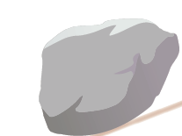
7
The triangle that moves mountains
Relevant knowledge
Social
movement
Political
leadership
Source: based on Wasi P (2000) Triangle that moves the mountain and health systems reform movement in Thailand.
Human Resources for Health Development Journal, Vol. 4, No. 2, pp. 106–110 (http://www.who. int/hrh/en/HRDJ_4_2_06.pdf).
Notes:
The combination of knowledge, social pressure and government leadership has been called the “triangle that moves mountains”. The Triangle aims to illustrate the power of evidence, civil movement and political leadership.
The Mountain means a big and very difficult problem, usually unmovable. The Triangle, as illustrated in this slide consists of: Creation of relevant knowledge through research, social movement or social learning and political involvement. Knowledge derived from research must be translated into forms and languages that can empower the public.
The “Triangle that Moves the Mountain” is a conceptualized strategy initiated as a social tool for solving difficult social problems, by simultaneously strengthening capacity in three interrelated areas: (1) creation of knowledge; (2) social movement; and (3) political involvement. The concept has been claimed as the basis of many successes in various Thai policy arenas.
The core principle that the triangle is underpinned by is to bring together the three areas (or groups) represented by the triangle corners to combine top-down and bottom-up approaches to achieve progress and reform. The triangular process aims to create synergy through the constant interaction and exposure between the three different areas (or groups) within a structured environment.
The power of various stakeholder groups coming together to complement each other is a huge strength in working collaboratively to co-design policy and its delivery strategies.

Slide 8
7
Challenges of stakeholder engagement
Some of the challenges or risks of
stakeholder engagement can include:
Prolonging policy-making
Increasing costs of intervention
Polarizing interest groups
Creating unmanageable expectations
Notes:
Parallel to the above-mentioned benefits, there are also challenges.
A comprehensive multi-stakeholder process can give high legitimacy to an initiative, but it also entails significant transaction costs. The more stakeholders at the table, the more difficult and time-consuming the process can be to reach a common understanding and position.
Some of the challenges or risks of stakeholder engagement can include:
Prolonging policy-making;
Increasing costs of intervention;
Polarizing interest groups; and
Creating unmanageable expectations.

Slide 9
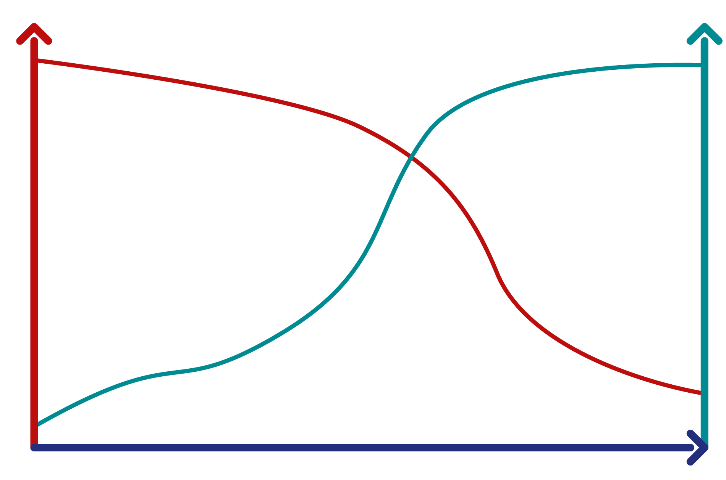
Finding the balance in stakeholder engagement
7
Speed
Legitimacy
Quality of stakeholder participation
Source: Vallejo N and Hauselmann P (2004) Governance and Multi-stakeholder Processes.
International Institute for Sustainable Development, p. 6.
Notes:
One of the balances to find in consulting with external actors is between speed and legitimacy; fewer actors make policy formulation and implementation faster but stakeholders may be reluctant to accept or support a policy in which they had no say or influence. This slide illustrates this point.

Slide 10
Principles of stakeholder engagement
7
Empowerment
Accountability
Transparency
Cost-effectiveness
Resources
Notes:
As we have discussed, stakeholder engagement is important for both value-based and instrumental reasons.
Given the potential value of stakeholder engagement and the reputational risks and possibly long-term problems if done incorrectly, it is sensible to consider the following principles:
Empowerment: Stakeholders should share the responsibility for making decisions and accountability for the impacts of such decisions. Engaging stakeholders is morally essential to respect the fundamental rights and dignity of affected groups. You should aim to promote an inclusive and diverse stakeholder engagement with a tailored approach by stakeholder. A participatory inclusive approach should underpin the engagement process, giving stakeholders formal roles in governance structures, where feasible and applicable. Stakeholder engagement engenders a sense of shared ownership.
Accountability: Stakeholder engagement leads to more ownership over the issues, thus improving the quality of policy recommendations and increased stakeholders’ interest in the policy-making process. It also promotes rigour and a quality-base to the relevant stages of the policy cycle. Furthermore, good governance is required to provide clarity about stakeholder engagement roles and responsibilities and what is expected of people involved in the policy-making process.
Transparency: Promote open and honest engagement and set clear expectations. Ensure communication with stakeholders is clear and tailored to their specific needs. Communicate information to stakeholders early in the decision-making process, in ways that are meaningful and accessible. There should always exist the opportunity for every stakeholder to express their opinions and provide inputs. Be clear about the outcomes you are hoping to achieve and the steps on the way. Transparency also builds trust.
Cost-effectiveness: Engaging early can lead to savings of both time and money in the long-term.
Resources: Stakeholder engagement promotes the efficient use of resources (shared resources). In addition, a wide range of knowledge and skills can contribute to the policy agenda.

Slide 11
Government involvement with other actors: Civil society
7
Civil society (whole-of-society approach to HiAP) can encompass many actors including:
  Non-government organizations
  Faith-based groups
  Labour unions
  Philanthropic foundations
  Professional associations
  Cooperatives and research institutions.
These actors are not-for-profit.
Notes:
Looking at the contribution of civil society to HiAP, or the whole-of-society approach, it is important to reiterate that civil society is a broad term that can encompass many actors including non-government organizations, faith-based groups, philanthropic foundations, labour unions, professional associations, cooperatives and research institutes. The single characteristic that these actors share is that they are not-for-profit.

Slide 12
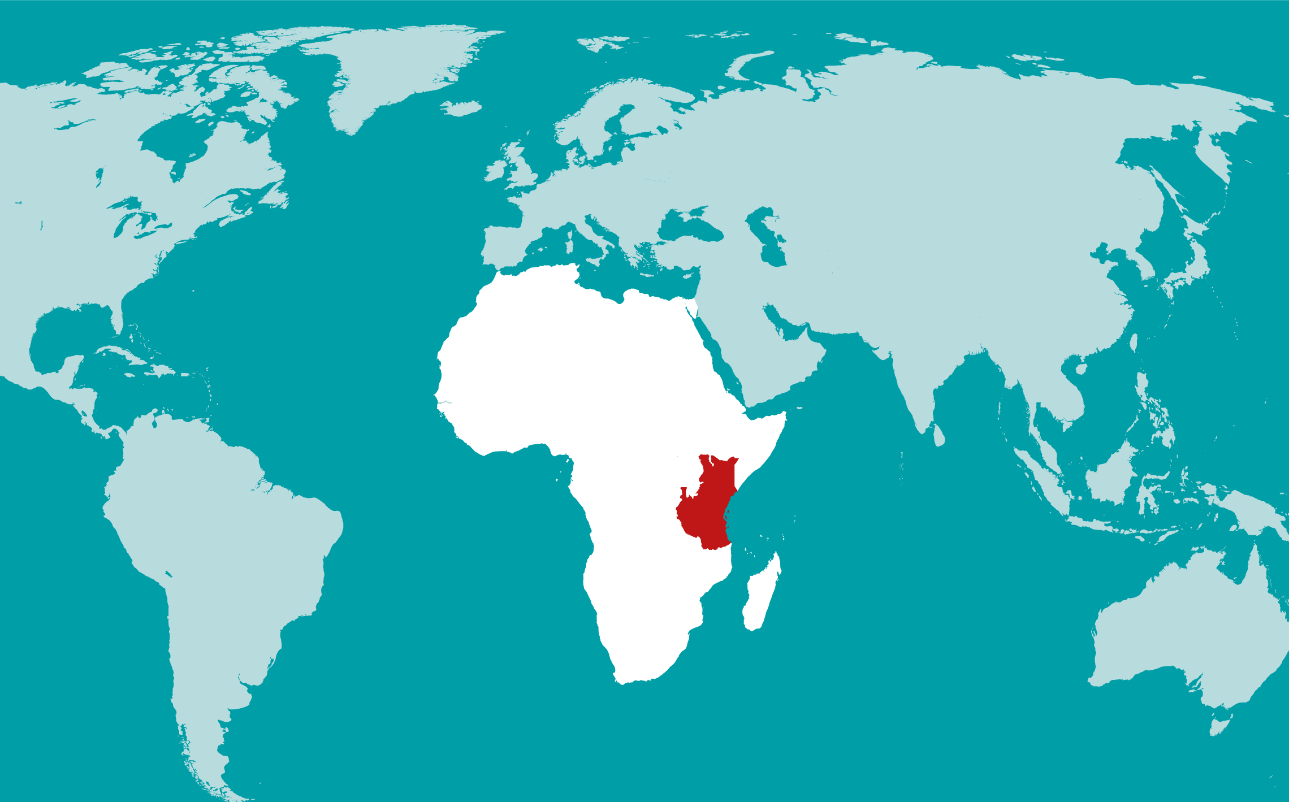

Example: Contribution of civil society to HiAP
7
Fish Farming Project in South Imenti
Constituency in Meru County, Kenya
Notes:
Globally, the fisheries industry plays an important role in economic, social and health development. In Kenya, this industry contributes to local incomes, subsistence and nutrition, which are all important determinants of health. The intersectoral Economic Stimulus Programme (ESP) was launched to address food insecurity and mitigate the effects of the 2007 post-elections violence and the global economic and financial crisis. The ESP was allocated KES 22 billion, which were committed to numerous projects per constituency, in order to bring benefits to other sectors. Among the numerous intersectoral programmes introduced was fish farming or aquaculture. The focus of fish farming was to improve food and nutrition and create over 120 000 employment and income opportunities.
The overall ESP was implemented with an aim of tackling underlying determinants of health and members of the public had a responsibility to monitor public development projects to evaluate how well public resources were being used and how to improve performance. In particular, the ESP ensured maximum intersectoral stakeholder and community participation to ensure transparent identification and implementation of the projects, that funds were managed accountably, and projects were completed and governed effectively to benefit the targeted communities. Thus, the Kenyan Government’s ESP was a comprehensive, mutually-supportive policy, designed to achieve agreed goals through an intersectoral approach and stakeholder participation. The fisheries project adopted a strategy to expedite commercial fish farming growth through a collaborative and participatory approach, involving both public and private sectors and civil society. The multi-stakeholder team with direct oversight of the ESP consisted of a Member of Parliament as the patron, the District Commissioner, District Development Officer, District Public Works Officer, Community Development Fund Committee (CDFC) Chairperson, Secretary and Treasurer, District Accountant, heads of all government departments, non-governmental and religious organizations representatives, two men and women representatives from the constituency, two youth representatives, the CDFC Fund Account Manager and Constituency Projects Technical Committee, and the Kenya Private Sector Alliance. To ensure effective implementation and monitoring of the ESP programme, intersectoral and stakeholders’ meetings were held twice a month at the national (coordination and monitoring) and constituency (implementation) level.
Intersectoral and stakeholder participation in the project’s identification and implementation allowed prioritization of social development needs and the design of home-grown interventions to address their respective challenges, many related to health determinants. The case study demonstrates that increased political willingness, as evident by the intersectoral ESP, contributed to the successful implementation of the fish farming project thus benefiting the participants in terms of increased food production and improved source of protein and essential micronutrients, which are all important for preventing many human diseases. In addition, the collaborative and participatory approach with a range of different actors enabled both positive outcomes for the health sector and other sectors involved in the project.
Excerpt from: Intersectoral case study: Addressing determinants of health through intersectoral collaboration: fish farming project in South Imenti constituency in Meru County, Kenya. World Health Organization. Regional Office for Africa. https://www.afro.who.int/sites/default/files/2018-02/19%20Dec%202013_Fish%20farming%20project%20in%20South%20Imenti%20constituency%20in%20Meru%20County%2C%20Keny%20case%20study.pdf

Slide 13
Government involvement with other actors: Private sector
7
Unlike civil society, the characteristic that the private sector ultimately shares is the pursuit of profit.
There has always been critical public health analysis of the power of the private sector – especially in the field of tobacco – and attention has turned to other areas in recent years:
  E.g. work on unhealthy commodities (commercial determinants of health).
This suggests scepticism and caution.
Notes:
The next few slides explore engagement with the private sector, particularly in regards to the commercial determinants of health. The private sector can include multinational companies, micro, small and medium enterprises, individual entrepreneurs and financial intermediaries.
Unlike civil society, the characteristic that the private sector ultimately shares is the pursuit of profit. This creates a complicated, often conflictual relationship with the public health sector given the principles of health as a matter of social justice and a public good as discussed in Module 1.
While on the one hand, the private sector might have considerable resources, expertise and technology to potentially direct towards public health, there are numerous issues such as neglected diseases and the commercial determinants of health that should suggest scepticism and caution.

Slide 14
Government involvement with other actors
7
:
The private sector and the economic determinants and commercial/corporate interests and influence
Economic/corporate interests have an important role in shaping population health and health equity e.g. through trade and globalization.
Private sector influence has risen exponentially with an increase in large private foundations and public-private partnerships as a result of economic globalization and trade liberalization.
Notes:
Economic/corporate interests have an important role in shaping population health and health equity, for example through trade and globalization.
Private sector influence has risen exponentially with an increase in large private foundations and public–private partnerships. Particularly, in relation to the commercial determinants of health, changes in global business and consumption landscapes have boosted the power of large companies, with economic globalization and trade liberalization spurring the rapid expansion and corporate influence of these companies around the world. This perpetuates concerns about the role, effect and lack of accountability of private foundations when thinking about the private sector as a stakeholder in the policy-making process.

Slide 15
Government involvement with other actors (cont.)
7
:
The private sector and the economic determinants and commercial/corporate interests and influence
Fit-for-purpose regulatory regimes are needed to constrain negative corporate influences on health and encourage ethical business practices beneficial for population health.
Encourage positive economic determinants of health.
Notes:
Evidence suggests that fit-for-purpose regulatory regimes are needed to constrain negative corporate influences on health and to encourage ethical business practices beneficial for population health.
There is a need to encourage positive economic determinants of health.

Slide 16
Commercial determinants of health
7
Commercial determinants of health: strategies and approaches used by the private sector to promote products and choices that are detrimental to health.
Kickbusch I, Allen L & Franz C (2016). The commercial determinants of health. The Lancet Global Health; 4(12), PE895-E896.
Transnational food companies powerfully shape the supply, demand, and consumption of food and beverage products → increasing consumption of ultra-processed foods and sugary beverages linked to rising levels of obesity.
Notes:
We will now explore the issue of government stakeholder engagement with the private sector in relation to the commercial determinants of health.
We define the commercial determinants of health as “strategies and approaches used by the private sector to promote products and choices that are detrimental to health”.²
Transnational food companies powerfully shape the supply, demand, and consumption of food and beverage products. These companies are one of the main drivers of the increasing consumption of ultra-processed foods and sugary beverages, which are cheap, highly palatable, and sold in large portion sizes, but which are also high in energy and fat, salt and/or sugar. Furthermore, transnational companies are moving quickly into markets in developing countries, where regulation may be less stringent, and aggressive marketing strategies can be deployed. This has led to a ‘nutrition transition’ in many developing countries, i.e. a move away from healthier traditional diets, to ‘westernized’ diets higher in fat, salt and sugar. Increasing consumption of products such as fast food and sugar –sweetened beverages is in turn linked to rising levels of obesity and diabetes.
² Kickbusch I, Allen L & Franz C (2016). The commercial determinants of health. The Lancet Global Health; 4(12), PE895-E896.

Slide 17
Commercial determinants of health (cont.)
7
Global food industry also has a significant influence on policy and regulation that aims to improve nutrition and diet-related health –
Increasingly engages in collaborative initiatives with government that have obesity prevention objectives e.g. Australia’s ‘Health Star’ food labelling system.
Notes:
The global food industry also has a significant influence on policy and regulation that aims to improve nutrition and diet-related health. The food industry often plays a key role in international and national policy-making, including through processes of consultation with government. It increasingly engages in collaborative initiatives with government (and non-government) actors that have obesity prevention objectives, as with Australia’s ‘Health Star’ interpretive food labelling system.
However, the industry also lobbies against global and national initiatives that it sees as compromising its economic interests, raising a possibility of detrimental effects on laws and policies aimed at improving diet-related health. Accordingly, whether to engage the food industry in obesity prevention efforts and on the commercial determinants of health (and how to do so effectively) is a matter of considerable debate (and research) within the public health community.

Slide 18
The public-private mix in the policy dialogue
7
Public interest vs Private interest – often a critical barrier that has to be tackled in developing policy change focusing on the public/private mix.
Government needs to manage the less desirable features that the private sector may bring to policy development.
Interactions between government(s) and the private sector need to be guided by public interest and transparency.
Notes:
It is not sufficient to ignore the private sector, or to give it inappropriate roles in policy development. Engagement with private-sector agents is necessary, especially when addressing the wider determinants of health.
In practice, real or perceived differences in understanding and motivation between reform leaders in government, on the one hand, and private-sector interests, on the other, are often a critical barrier that has to be tackled in developing policy change focusing on the public/private mix. Government is often stereotyped as being explicitly and exclusively concerned with the public interest, in contrast to private agents who are seen as only self-interested and profit hungry. That perceived divide might encourage reform leaders and policy-makers simply to ignore the private sector, or to give it inappropriate roles in policy development.
The degree to which interests converge or overlap is, therefore, a foundation for further action. It will fundamentally shape the type of public/private interaction on health policy issues. Building up a careful understanding of the range of interests of the private sector will be an important basis for strategic action. To do this, it must not only be understood that private-sector interests are often heterogeneous, but that in some cases one actor may hold multiple objectives. We will delve further into this discussion when we look at Module 8 – Negotiating for Health.
In addressing public/private mix issues, it will be particularly important to see what private-sector actors can bring to the policy development process – whether it be information and technical skills to help make decisions, or power or resources to allow for smooth implementation of policy. At the same time, the government clearly needs to manage the less desirable features that the private sector may bring to policy development. Chief among these, especially in the for-profit sector, is divergent interests.
Interactions between government(s) and the private sector need to be guided by public interest and transparency.
We will now discuss the concept of public-private partnerships and their role in building healthy public policy, giving an example of how private interests have been managed successfully.

Slide 19
Public-Private Partnerships (PPPs)
7
A PPP is defined by Reich¹ as:
The collaborations should involve at least one public organization and one
private profit-making organization. The public organization could include
national government bodies and international agencies such as the WHO,
World Bank or a United Nations agency. The “private sector” normally
would extend to any type of profit-making corporation.
1
2
The partners will have certain common goals for a particular health problem.
3
The different partners will divide the workload and mutually receive benefits.
1Reich M (ed.) (2002) Public-Private Partnerships for Public Health, Harvard Series on Population
and International Health. Cambridge, MA, Harvard University Press.
Notes:
A PPP is defined by Reich (see reference above) as:
1. The collaborations should involve at least one public organization and one private profit-making organization. The public organization could include national government bodies and international agencies such as the WHO, World Bank or a United Nations agency. The “private sector” normally would extend to any type of profit-making corporation.
2. The partners will have certain common goals for a particular health problem.
3. The different partners will divide the workload and mutually receive benefits.

Slide 20


Example: Private sector involvement in HiAP - Public-Private Partnership
7
Successful sodium regulation
in South Africa
Notes:
High salt intake in the form of sodium has been shown to explain the high prevalence of hypertension worldwide. Therefore, hypertension is neither unique nor novel to South Africa (SA), but the legislative actions undertaken by the South African government reflect a new approach to addressing this growing burden. Research has shown that a significant portion of hypertension is linked to sodium consumption, and a major proportion of sodium consumption in SA comes from bread – part of the staple diet. Aware of the burden of hypertension and the high levels of sodium in processed foods, the then Minister of Health and the National Department of Health (NDOH) spearheaded legislative action to regulate sodium in food products at the manufacturing level in 2013. Based on the mixed results of voluntary regulation in other countries, the NDOH decided to initiate mandatory regulation to effectively curb sodium consumption.
Answers to a questionnaire distributed to the food industry members showed that about half of the groups who answered preferred to have regulated rather than voluntary sodium, because they believed this could even the playing field. The government devoted a significant amount of time and effort to understanding the industry’s concerns, many of which were considered in negotiations. Years of South African research and intersectoral interactions between government, academia, and industry culminated in successfully signed regulations.
Excerpt from: Hofman, Karen J. & Lee, Richard. (‎2013)‎. Intersectoral case study: Successful sodium regulation in South Africa. World Health Organization. Regional Office for Africa. https://apps.who.int/iris/handle/10665/205179

Slide 21
CONSIDERATION OF CORPORATE INTERESTS IN THE POLICY DIALOGUE
7
Corporate interests can permeate the policy
dialogue and undermine government actions by:
Casting doubt on scientific evidence and misleading the public
Promoting ineffective policy solutions
Lobbying
Participating as an actor in the policy arena
Notes:
This slide outlines some of the ways in which corporate interests can be powerful in permeating the policy dialogue and undermine government actions. This slide prepares participants for the next lecture (Module 8) – Negotiating for Health. It is, therefore, useful to ask participants to start to think about the different interests and strategies that may come into play during the negotiating process. Many of these tactics will come up again as common negotiation strategies, for example, avoidance, which is often used by actors seeking to stop or reduce the impact of state regulation.
Corporate interests can undermine government actions in the policy process by:
Casting doubt on scientific evidence and misleading the public by denying negative health effects.
Promoting ineffective policy solutions. For example, the alcohol industry has promoted corporate social responsibility, a policy intervention that has been proven to be ineffective as the incentives favour irresponsibility rather than responsibility.
Permeating and, at times, infiltrating other sectors or decision-making levels by lobbying policy-makers and politicians or recruiting former civil servants with credibility among their peers. Tobacco lobbyists might also reach other sectors (e.g. trying to persuade policy-makers of benefits for tobacco growers’ livelihoods or of potential revenue losses following a tax increase) and ultimately permeate their political discourse.
Participating as an actor in the policy arena. Engagement can be negative and, even where positive, is often limited or superficial.
Additional consideration:
Should countries or regions want to expand on this section, it would be valuable to critically assess the effectiveness of some of the voluntary agreements that the private sector has signed up to as part of government efforts to address some certain NCDs.

Slide 22
CONSIDERATION OF CORPORATE INTERESTS IN THE POLICY DIALOGUE
7
Corporate interests can permeate the policy
dialogue and undermine government actions by:
Using litigation to challenge policy decisions
Creating alliances with other business sectors
Moving to countries with least resistance
Notes:
This slide outlines some of the ways in which corporate interests can be powerful in permeating the policy dialogue and undermine government actions. This slide prepares participants for the next lecture (Module 8) – Negotiating for Health. It is, therefore, useful to ask participants to start to think about the different interests and strategies that may come into play during the negotiating process. Many of these tactics will come up again as common negotiation strategies, for example, avoidance, which is often used by actors seeking to stop or reduce the impact of state regulation.
Corporate interests can undermine government actions in the policy process by:
Using litigation at national and international levels to challenge policy decisions.
Creating alliances with other business sectors for example, hospitality, gambling, retail and advertising in the case of the tobacco industry.
Moving to countries with least resistance. Markets are dynamic so regulatory efforts in one country can lead to expanding markets in others. Actors can accept decreases in one region as long as overall consumption of harmful products increases. For example, reductions in North American or some European markets may be compensated for by aggressive marketing elsewhere.
Additional consideration:
Should countries or regions want to expand on this section, it would be valuable to critically assess the effectiveness of some of the voluntary agreements that the private sector has signed up to as part of government efforts to address some certain NCDs.

Slide 23
INTERACTIONS WITH THE PRIVATE SECTOR
7
Support the creation of positive conditions
for health in the private sector:
Produce balanced sectoral reports that consider actions
to promote a responsible private sector
Conduct and provide evidence and tools for health equity impact assessments of trade, investment, fiscal and monetary policies
Define models for ethical investment that increase health equity
Mobilise resources and capacities for health equity impact assessments of trade/fiscal/economic policies through building-up a community of practice across academia and NGOs
Improve policy coherence across all sectors.
Notes:
To support the creation of positive economic/commercial determinants for health and health equity, the following should be considered:
Produce balanced sectoral reports that consider actions to promote a responsible private sector
Conduct and provide evidence and tools for health equity impact assessments of trade, investment, fiscal and monetary policies
Define models for ethical investment that increase health equity
Mobilise resources and capacities for health equity impact assessments of trade/fiscal/economic policies through building-up a community of practice across academia and NGOs
Improve policy coherence across all sectors.

Slide 24
CATALYZING MULTISECTORAL ACTION ON NCDs: WHOLE-OF-SOCIETY APPROACH
7
Engaging beyond the health sector: developing NCD responses will require action across all government departments, as well as the engagement of civil society and the private sector.
Bridging the governance gap: strong governance and regulatory frameworks are a prerequisite for:
  Protecting the development of NCD policies from undue influence by any real, perceived or potential conflict of interest, including between the tobacco industry and public health; and
  Mobilizing adequate and sustained resources to implement NCD responses from public resources, private business and finance, and international development cooperation, including voluntary innovative financing mechanisms.
Notes:
Developing NCD responses will require action across all government departments, as well the engagement of civil society and the private sector. Implementing a Health in All Policies, whole-of-government and whole-of-society approach for addressing NCDs is particularly necessary to achieving the NCD-related targets in the Sustainable Development Goals (SDGs).
Strong governance and regulatory frameworks to support multisectoral action on NCDs are a prerequisite for:
Protecting the development of NCD policies from undue influence by any real, perceived or potential conflict of interest, including between the tobacco industry and public health; and
Mobilizing adequate and sustained resources to implement NCD responses from public resources, private business and finance, and international development cooperation, including voluntary innovative financing mechanisms.

Slide 25
End of
Module 7 Part 1
Please continue to Module 7 Part 2

